Slide 1
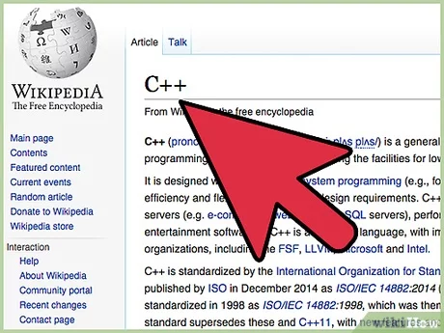
Introduction

Slide 2

Why C++?
-> C++ is an enormous language which is very powerful because it is a high-level language that offers low-level features,
-> C++ is particularly good at interacting directly with computer hardware, making execution very fast.
-> C++ is still one of the top listed in job advertisements.
-> … infinite reasons
-> C++ is fast, it is the language of choice of many 2D and 3D game engines as well as Virtual Reality.

Slide 3
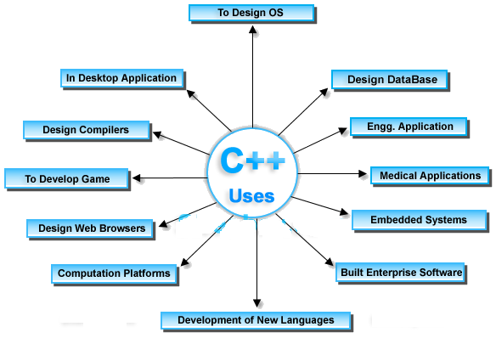

Slide 4
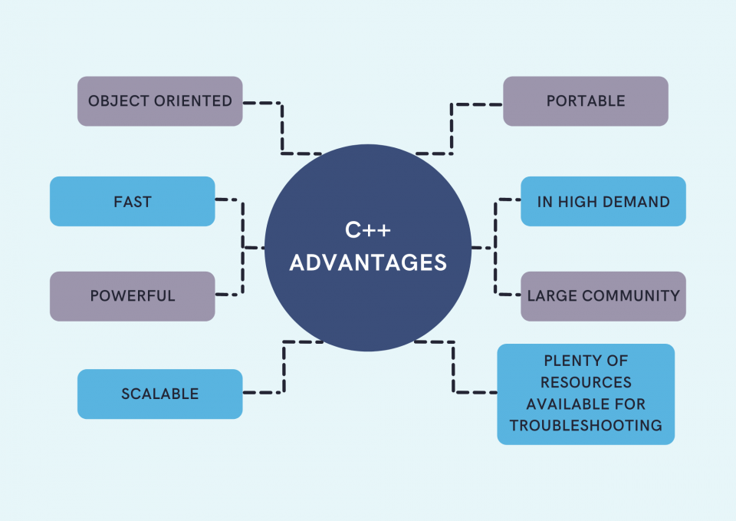

Slide 5
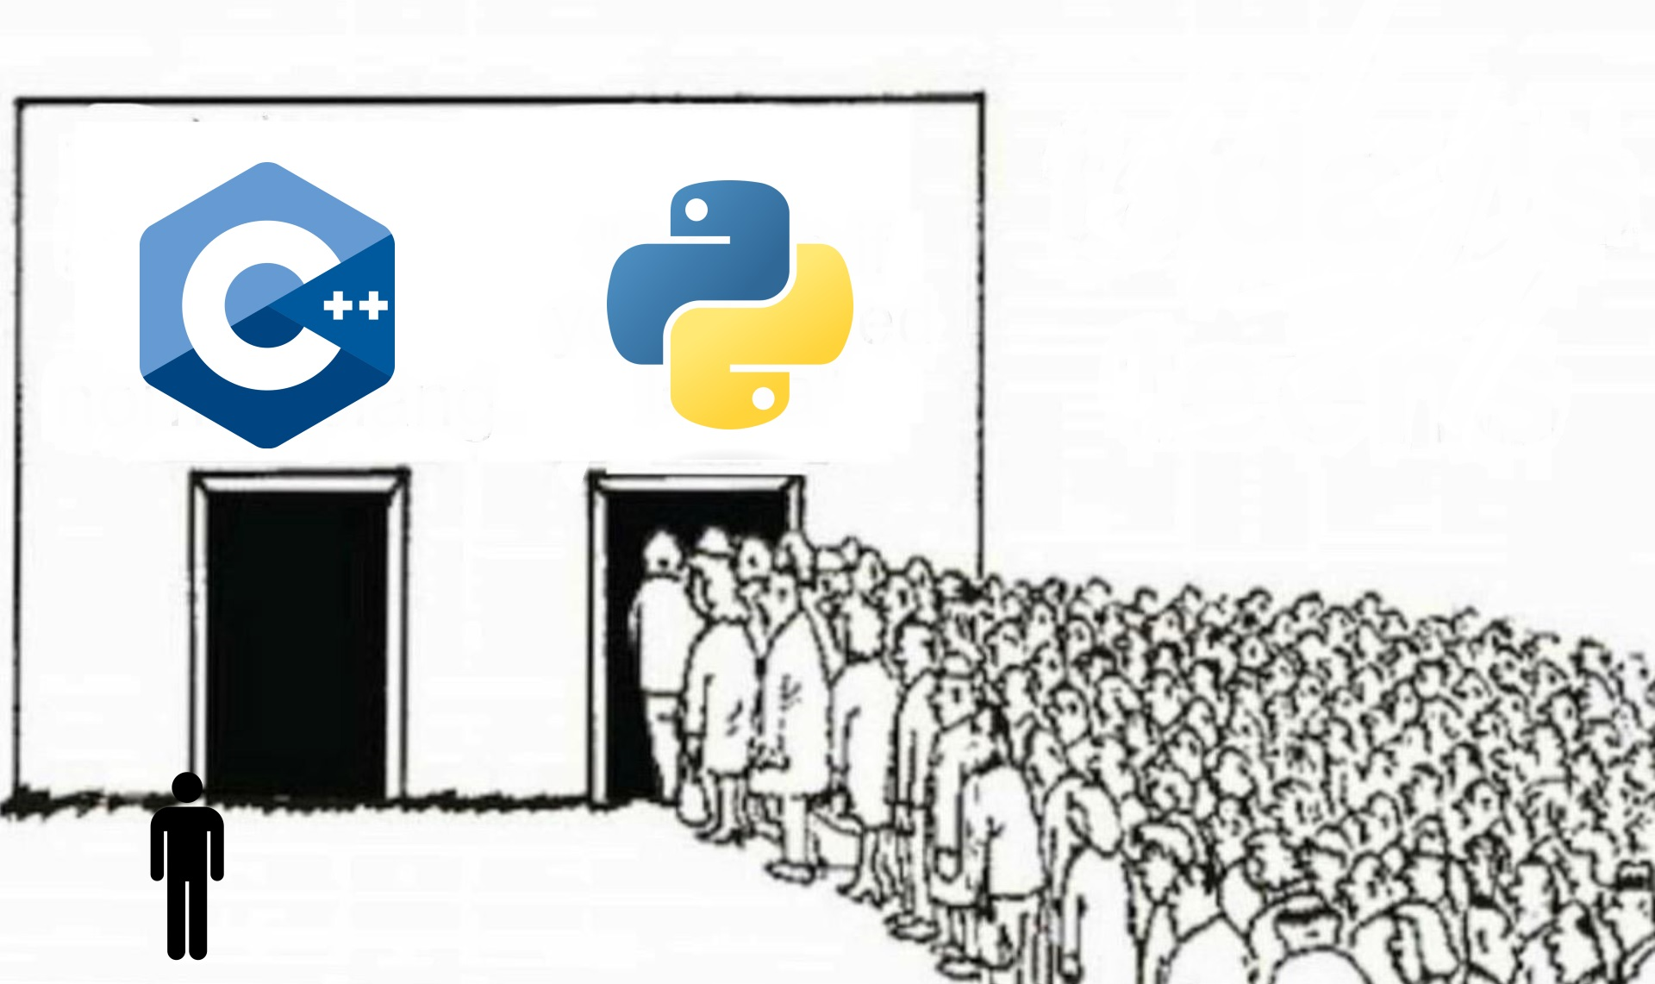
Disadvantages:
No Disadvantages, it is the best language.

Slide 6
Disadvantages
Complexity: Extensive feature set leading to a steep learning curve.
Manual Memory Management: Potential memory leaks and issues without proper handling.
Lack of Garbage Collection: Manual deallocation of memory required.
Complex Syntax: Time-consuming code reading and writing compared to other languages.
others…

Slide 7

Installation with dev c++
Download only for windows users

Slide 8
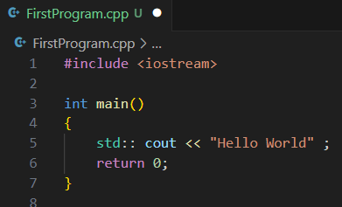
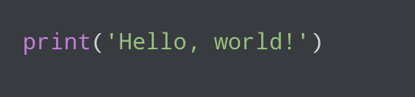
Line 1: #include <iostream> is a header file library that lets us work with input and output objects, such as cout
Line 3: Another thing that always appear in a C++ program is int main(). This is called a function. Any code inside its curly brackets {} will be executed.
Line 5: cout is an object in C++ that represents the standard output stream, usually the console. It is part of the std namespace
cout (pronounced "see-out") is used together with the insertion operator (<<) to output/print text.

Slide 9
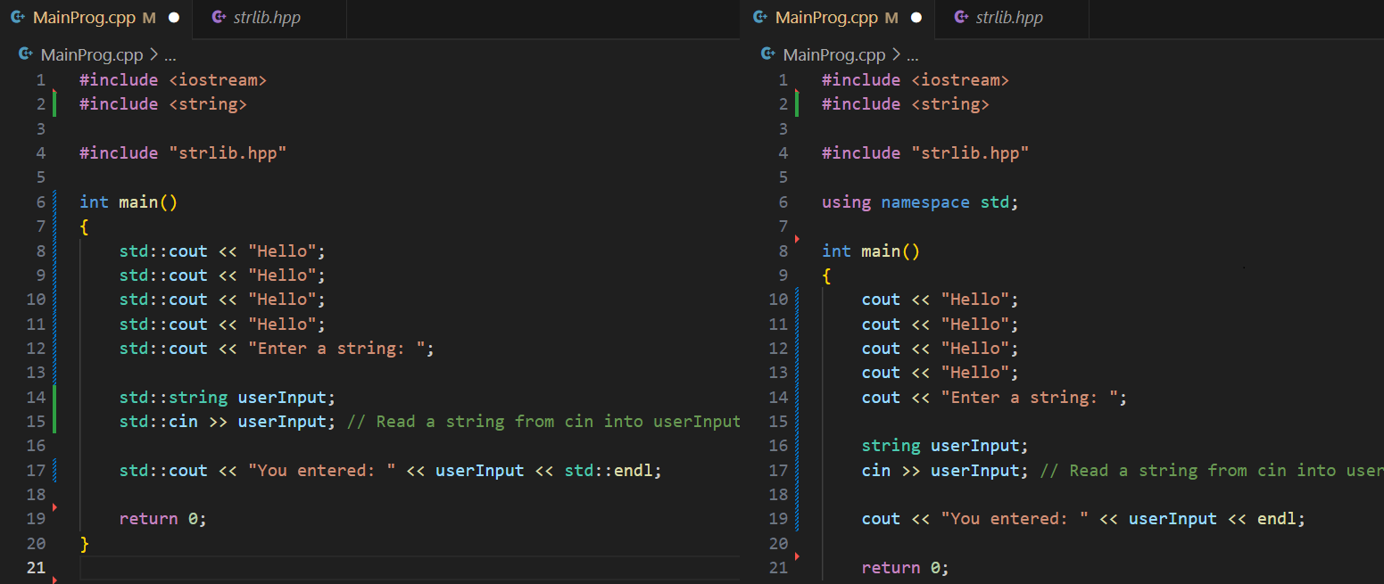

Slide 10
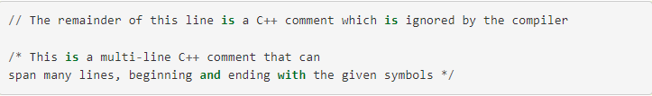
Comments in C++

Slide 11
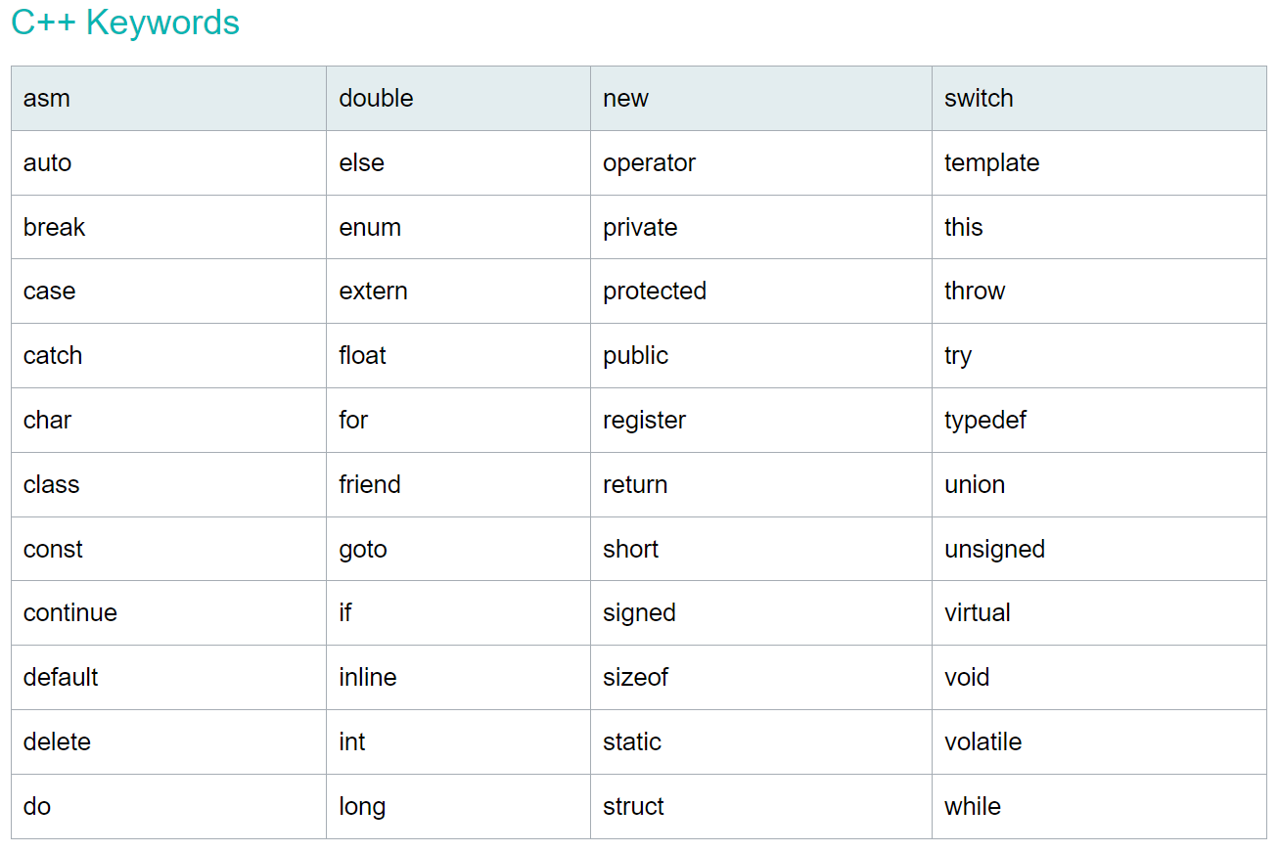

Slide 12
Data type in C++
Primitive Derived User-Defined
-> Class
-> Structure
-> Union -> Enumeration
-> TypeDef
-> int
-> float
-> double -> bool -> char
-> Array
-> Vector
-> Pointer -> Reference -> String

Slide 13
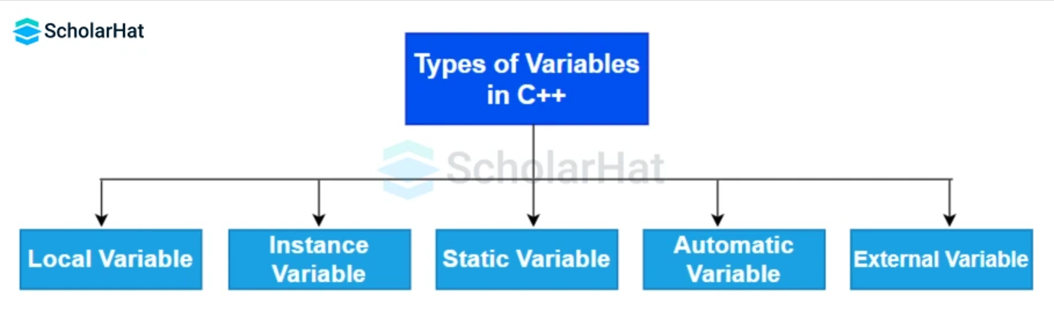

Slide 14
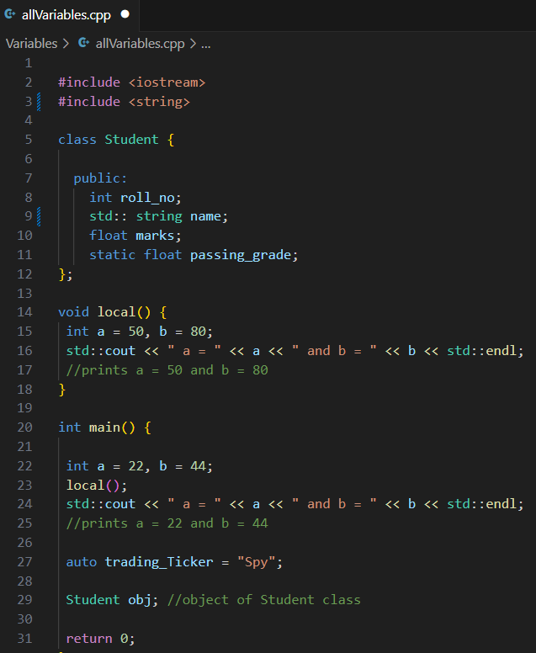
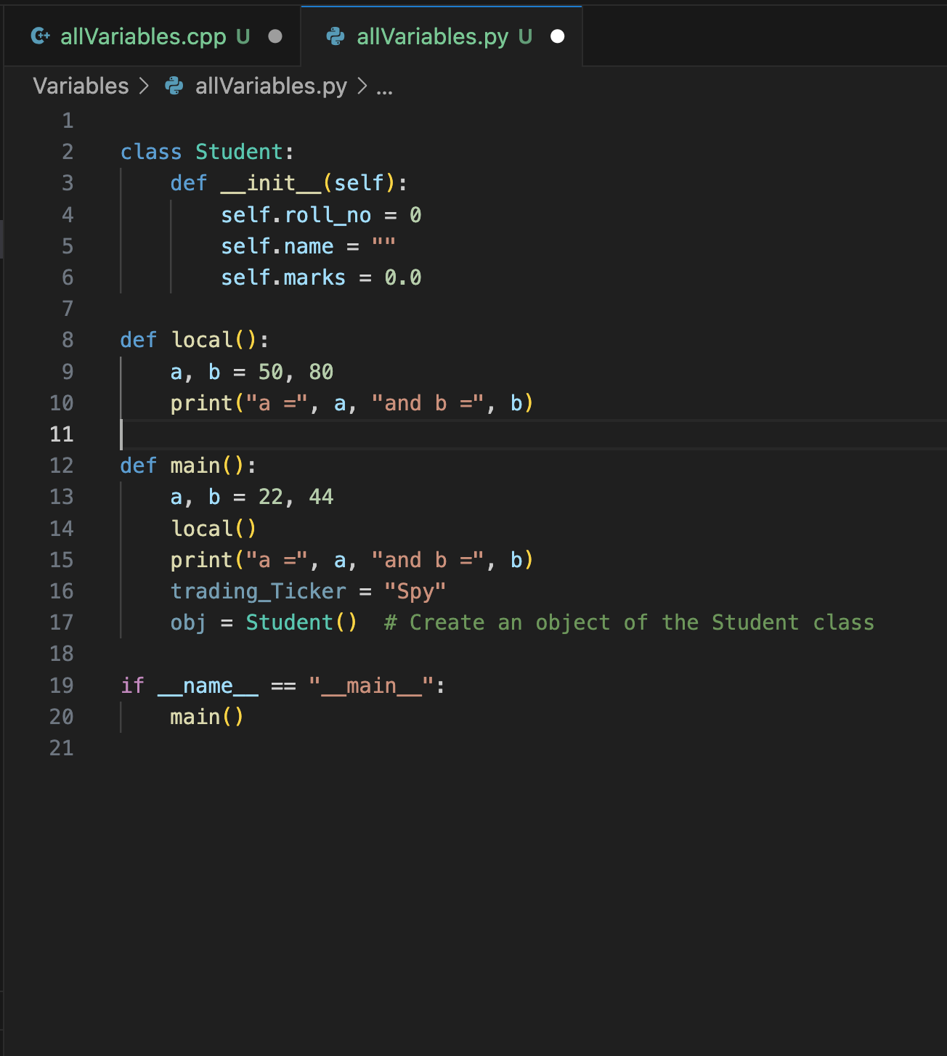
static
local
auto
instance
C++ Python

Slide 15
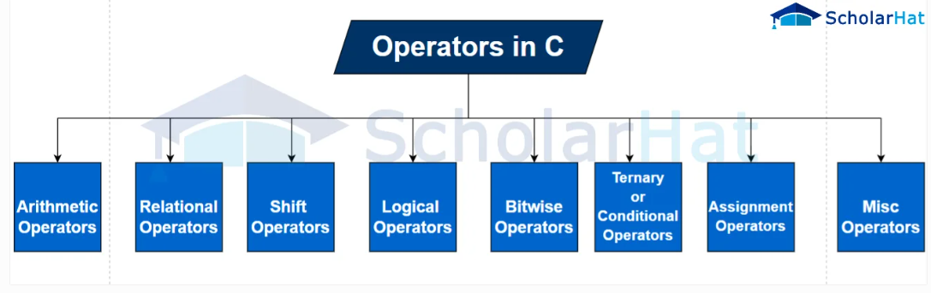

Slide 16
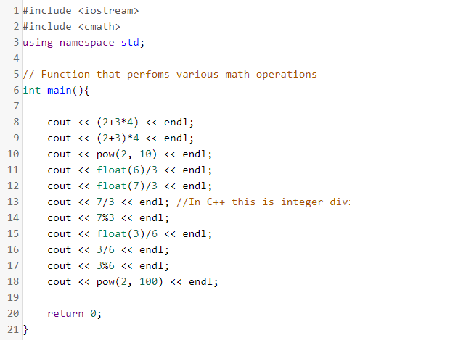
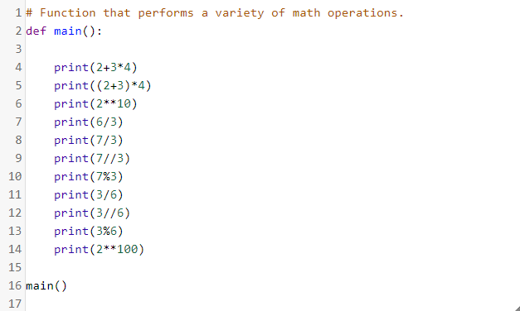
Opera tors
C++ Python

Slide 17
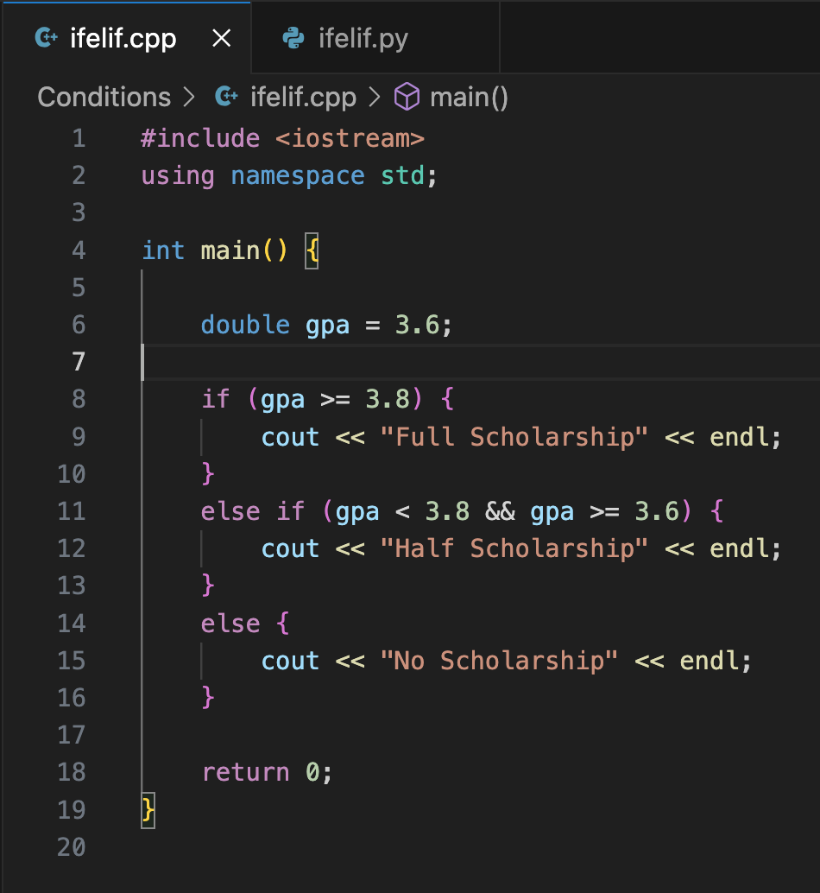
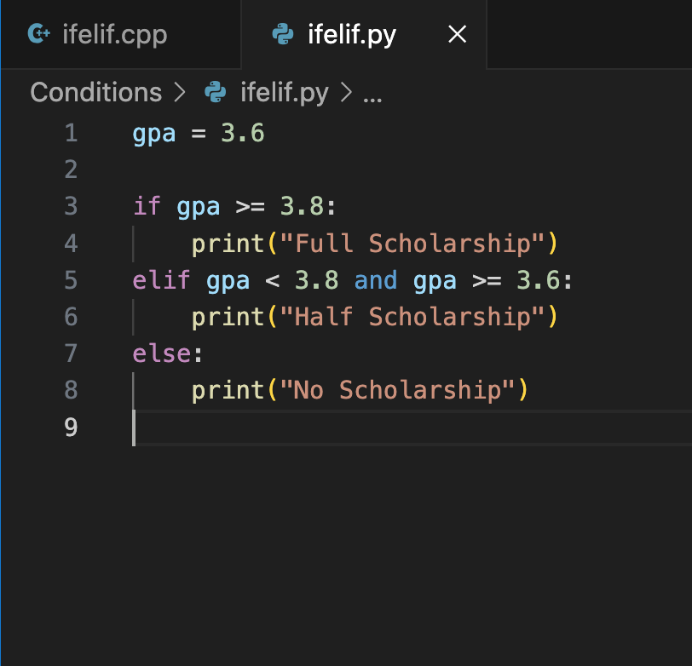
Conditional Statement, if/else
C++ Python

Slide 18
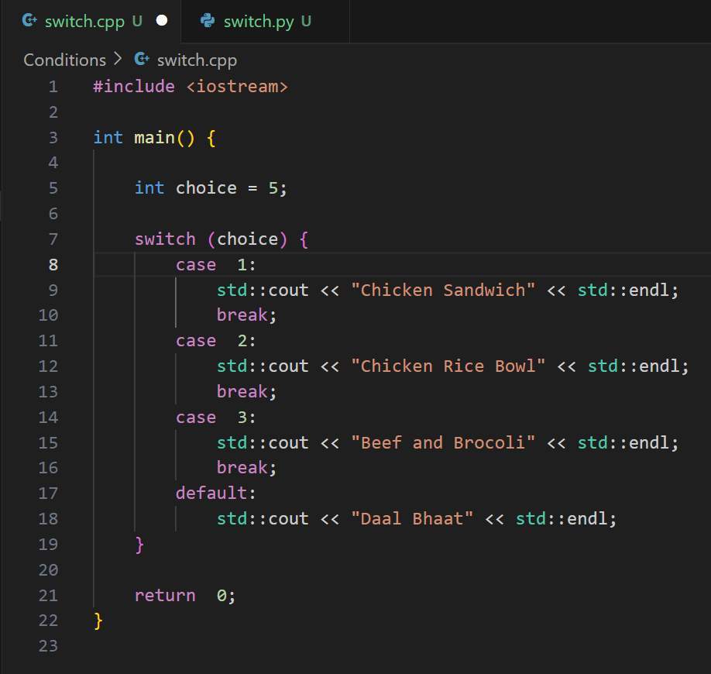
Switch Statement

Slide 19
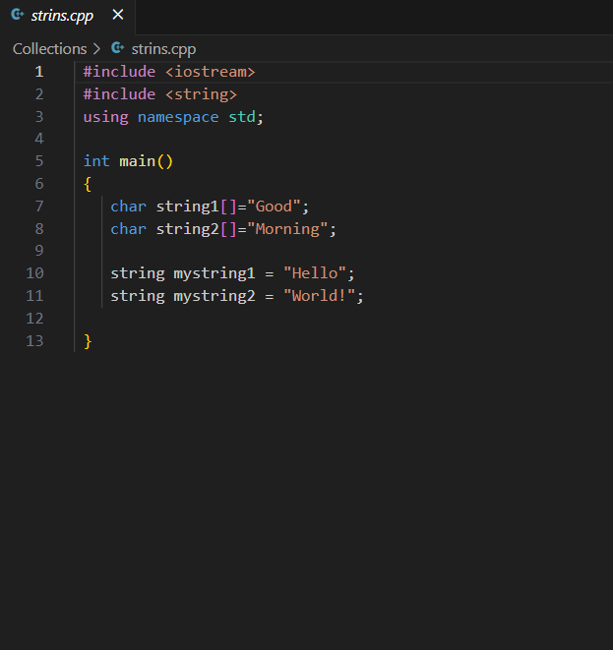
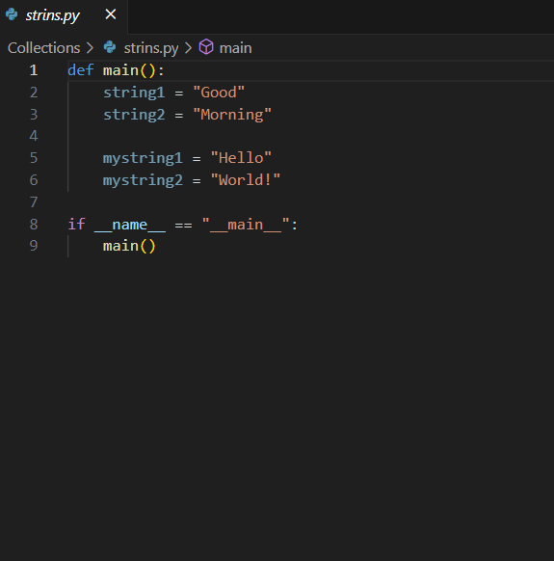
Strings
C++ Python

Slide 20
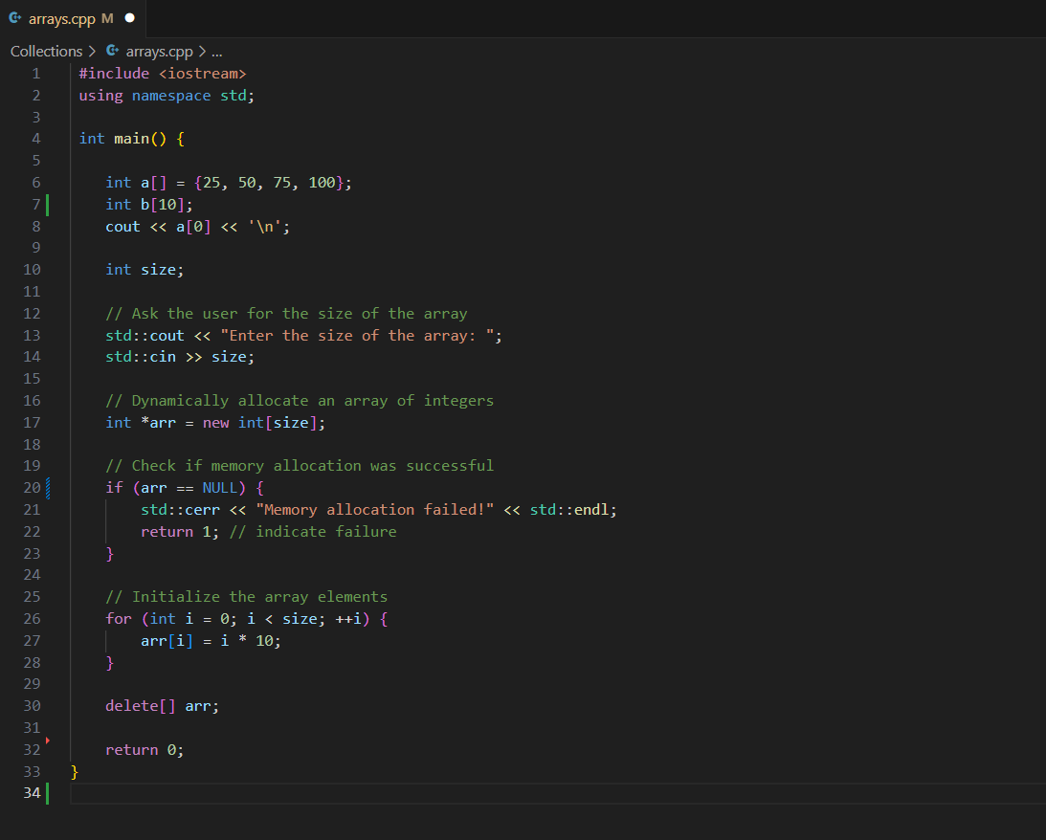
Arrays

Slide 21
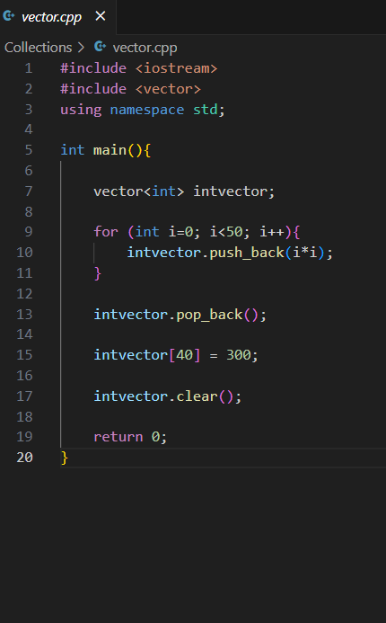
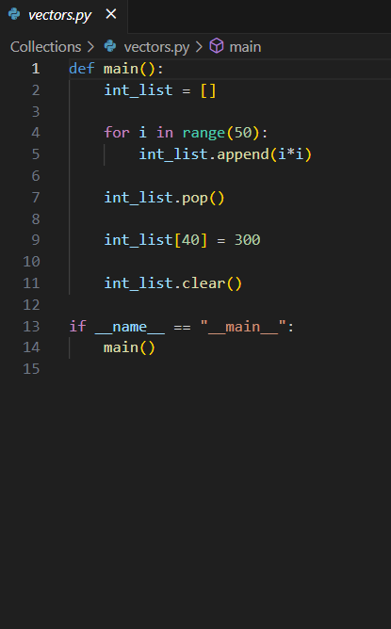
Vectors
C++ Python

Slide 22
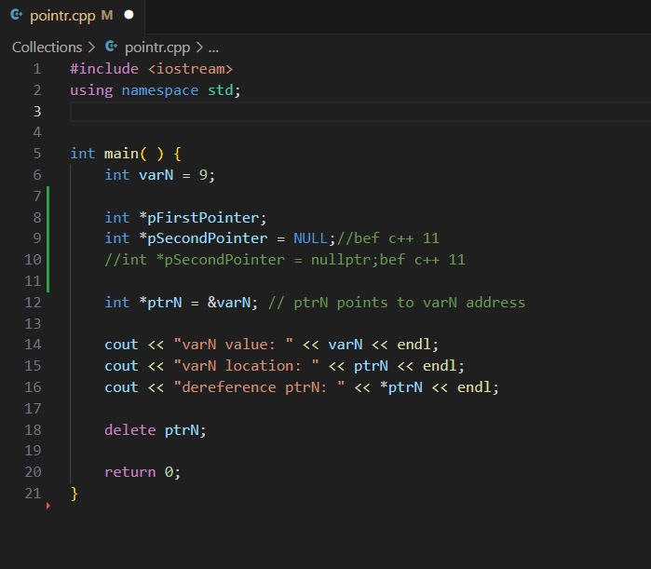
Pointer

Slide 23
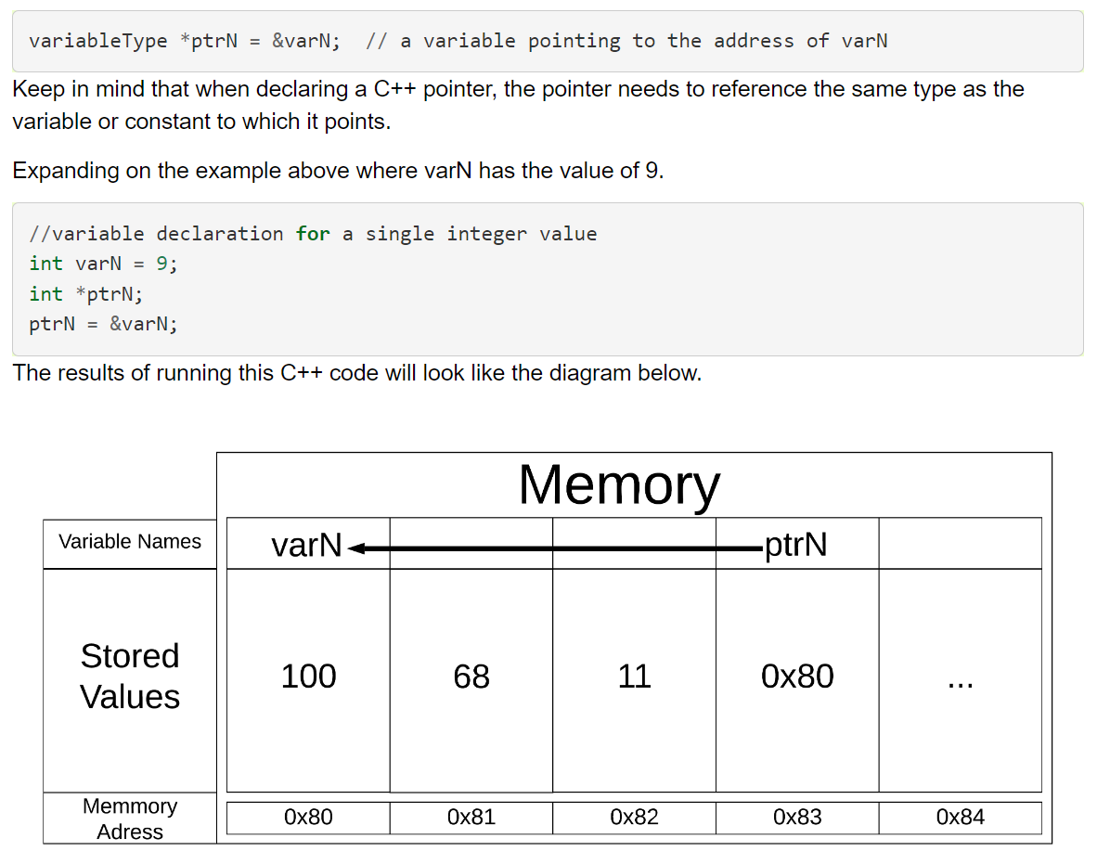
Pointer

Slide 24
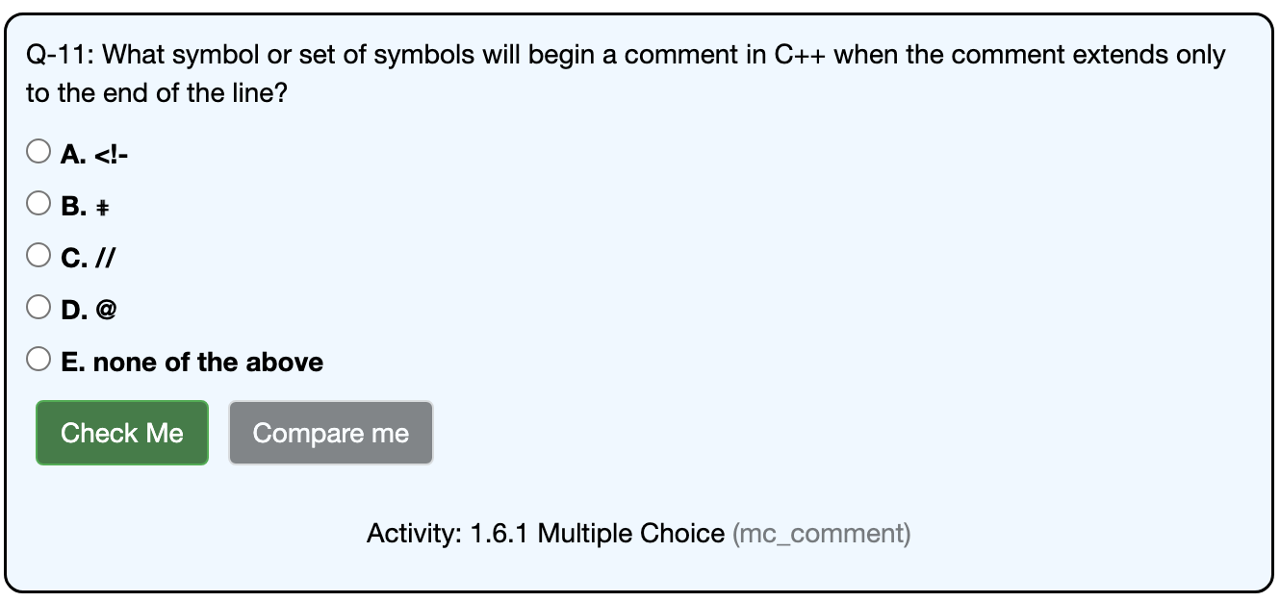

Slide 25
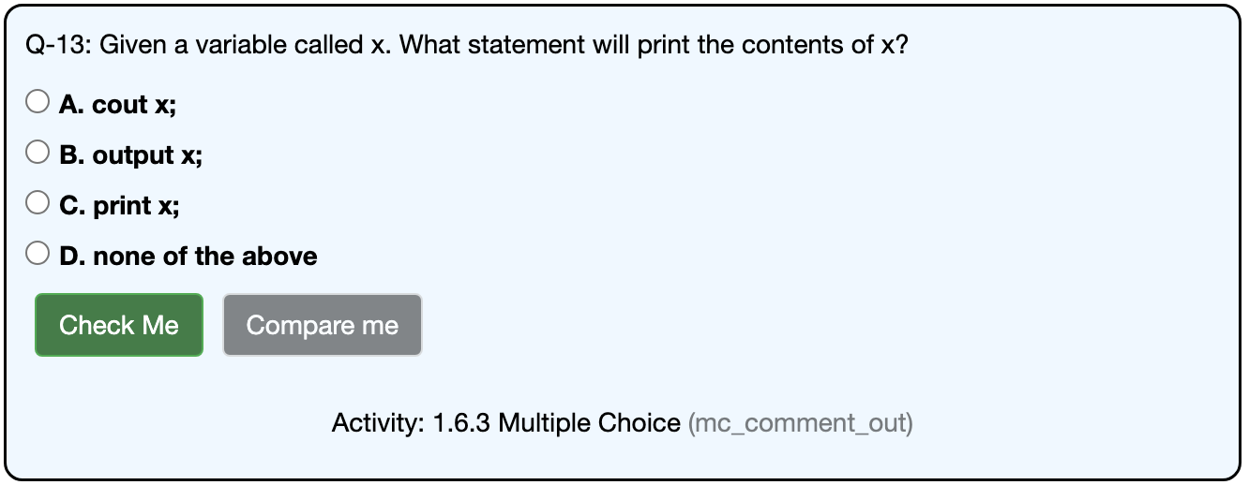

Slide 26
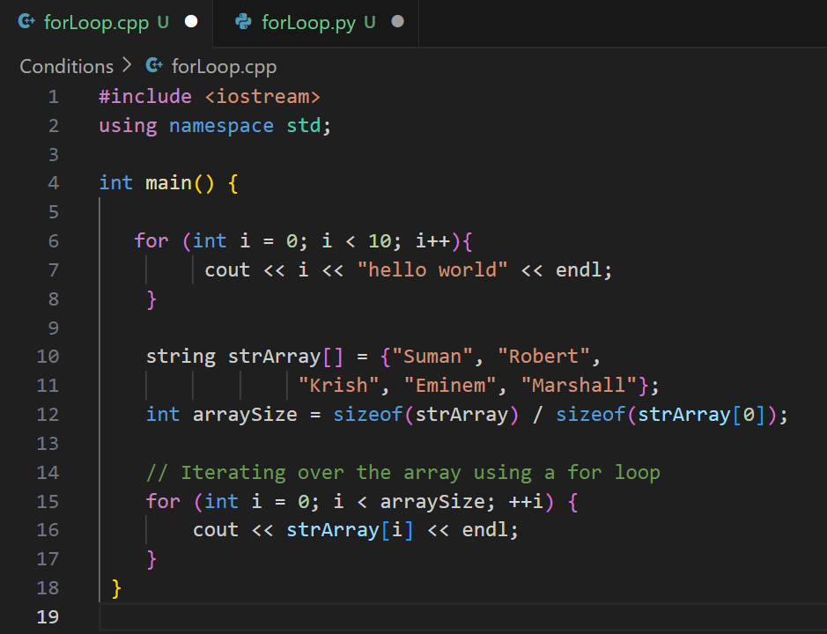
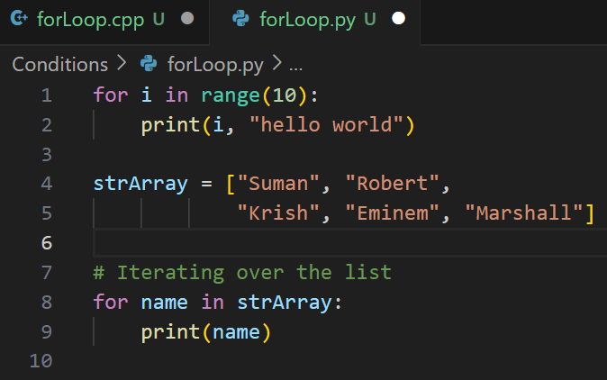
For Loop in C++
C++ Python

Slide 27
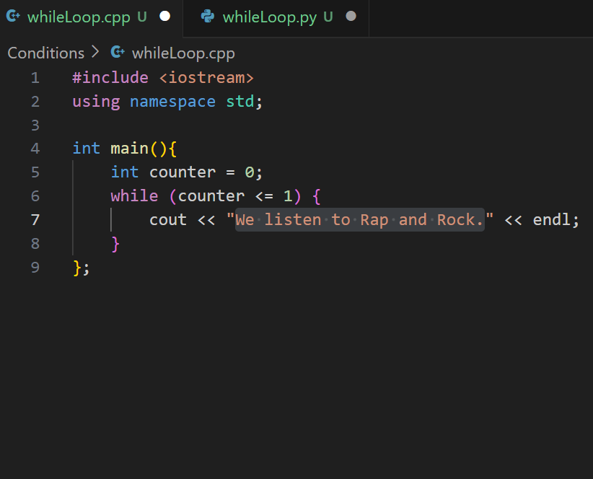
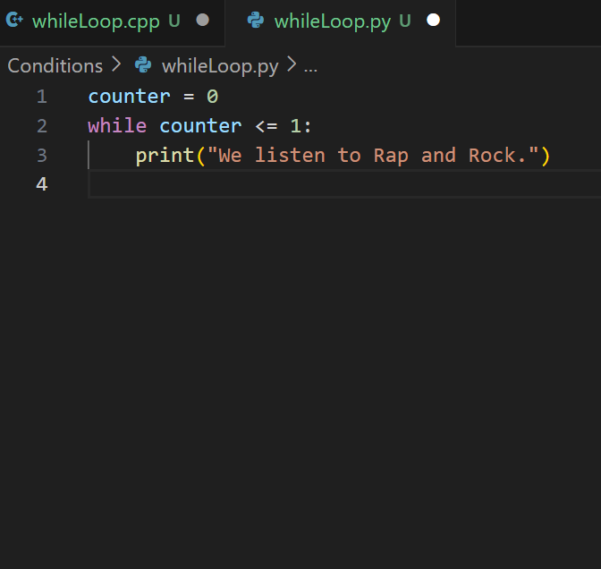
While Loop in C++
C++ Python

Slide 28
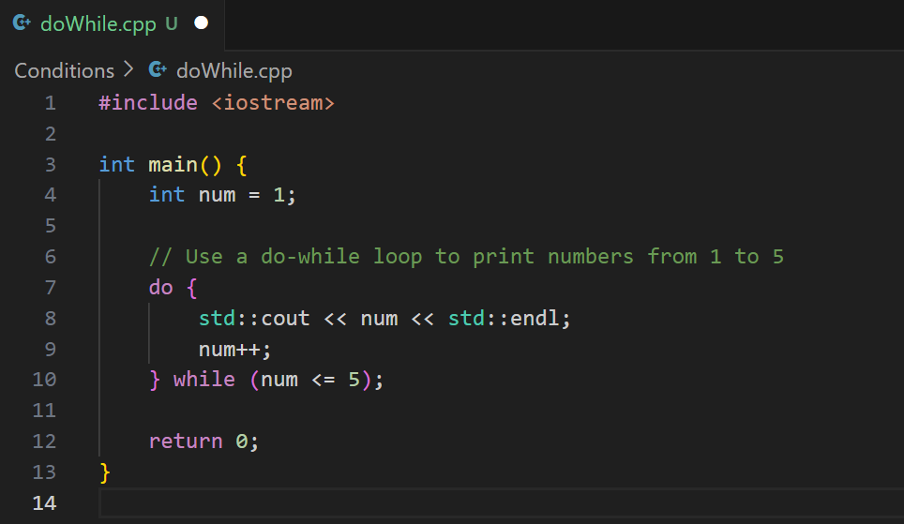
Do While Loop in C++

Slide 29
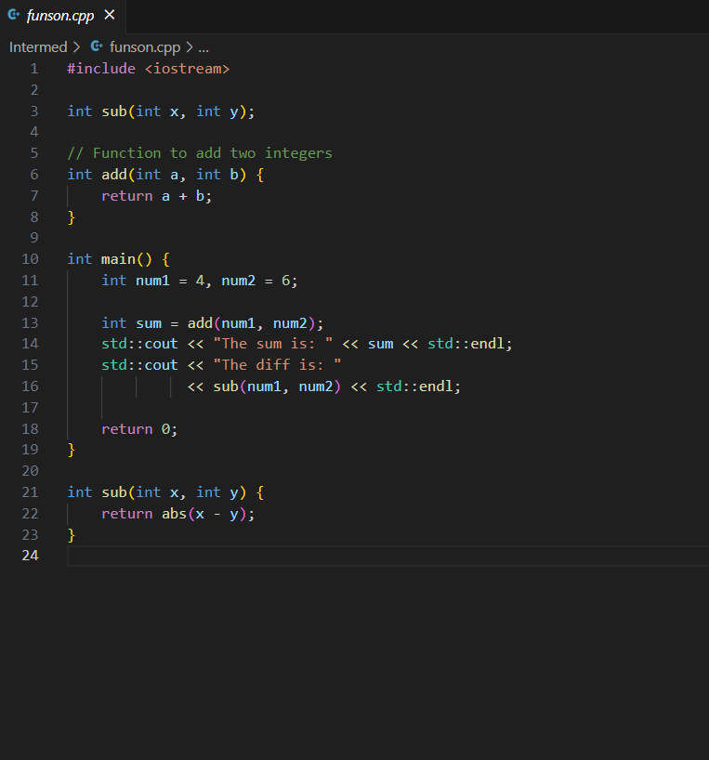
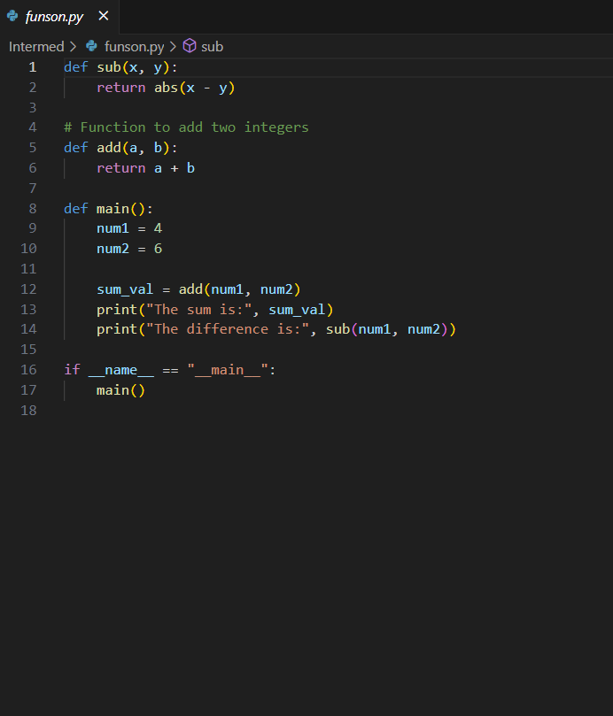
Functions

Slide 30
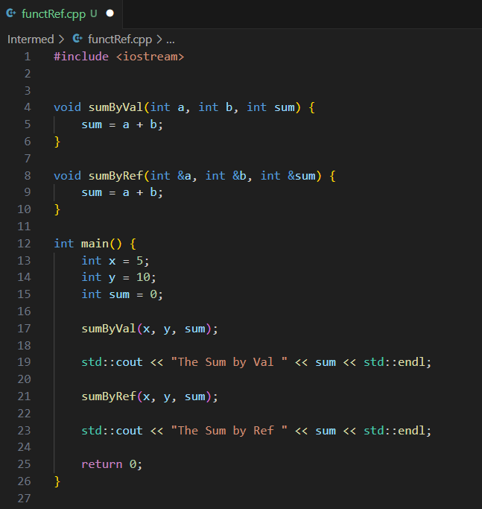
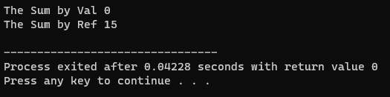
Pass By Val Pass By Ref

Slide 31
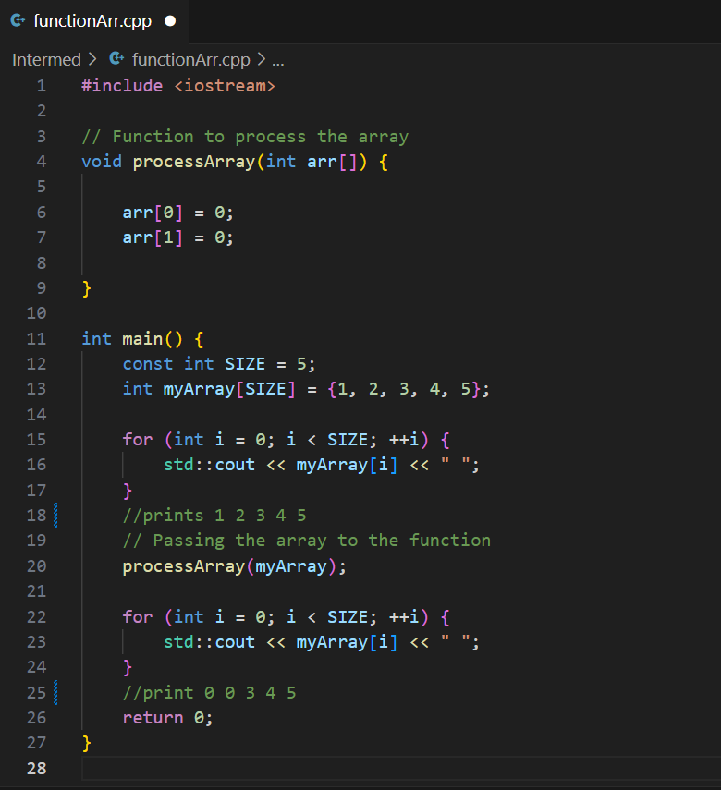
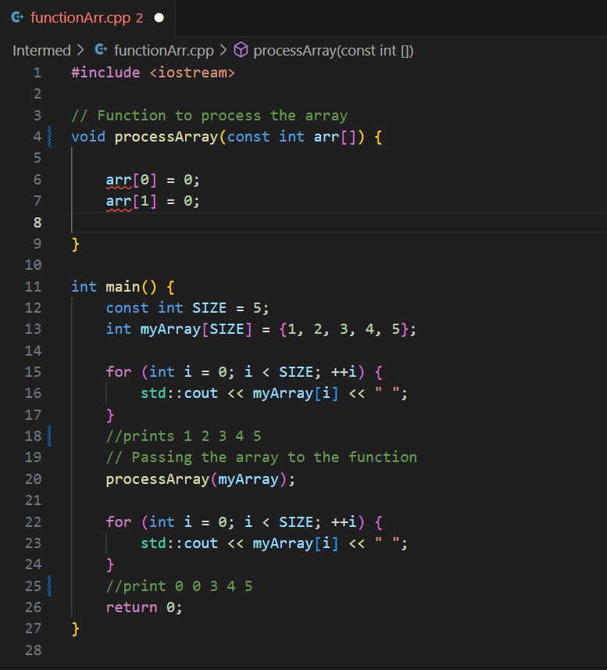

Slide 32
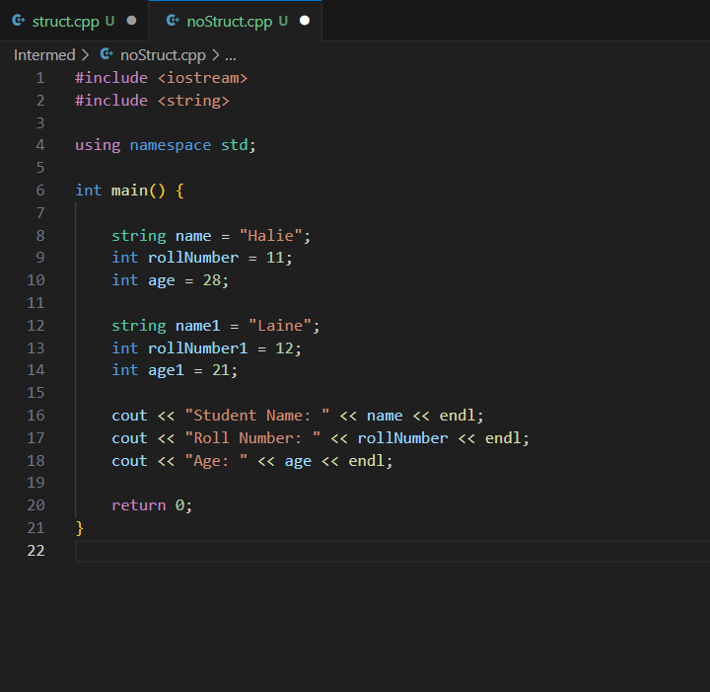
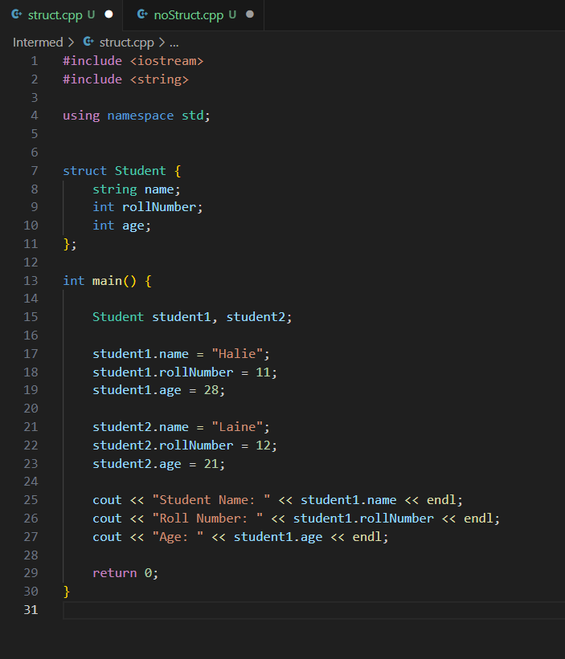
Without struct With struct

Slide 33
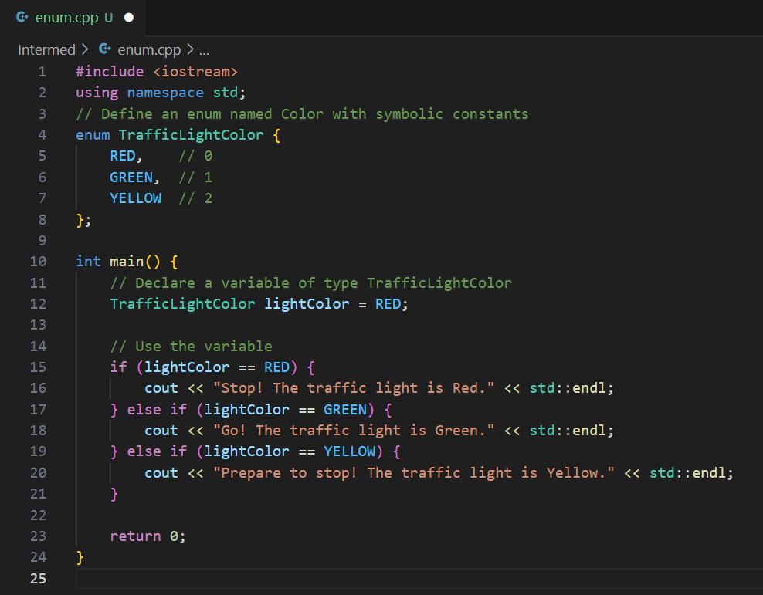
Enum

Slide 34
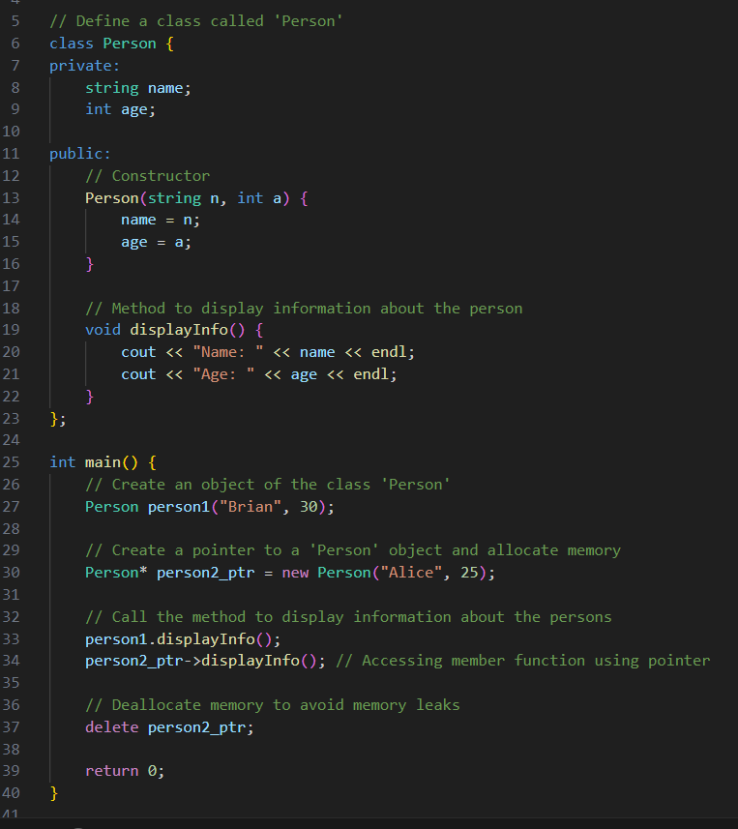
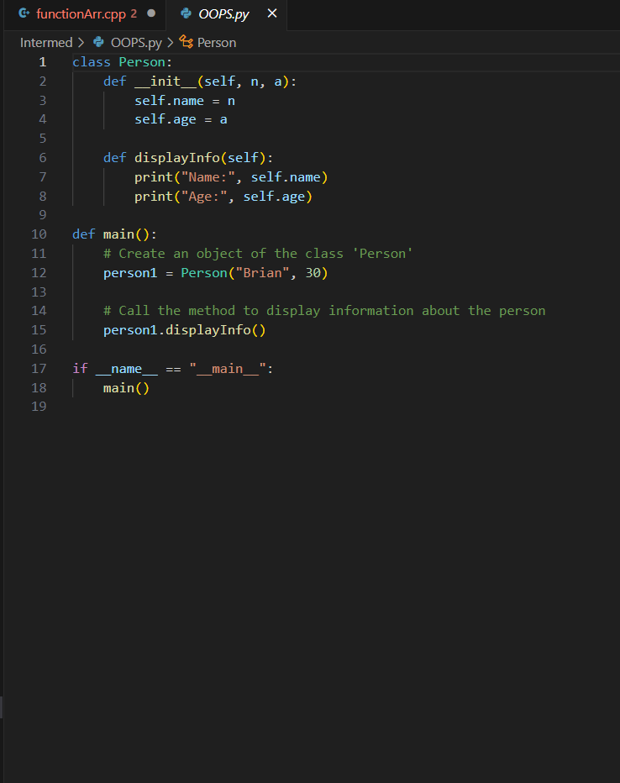
Class

Slide 35
Assignment on next slide
Convert the Python code to C++.
You are free to work in a group of two if you want, just write both of your name as a multiple line comment on the top. But, if you work in a group, then you must write comment on your code
Do not ask AI (chatgpt, gemini, copilot, grok or other) to convert your code. Although, you may ask for some smaller task like how to do this.
Slides are always the most powerful source for you to do assignment.

Slide 36
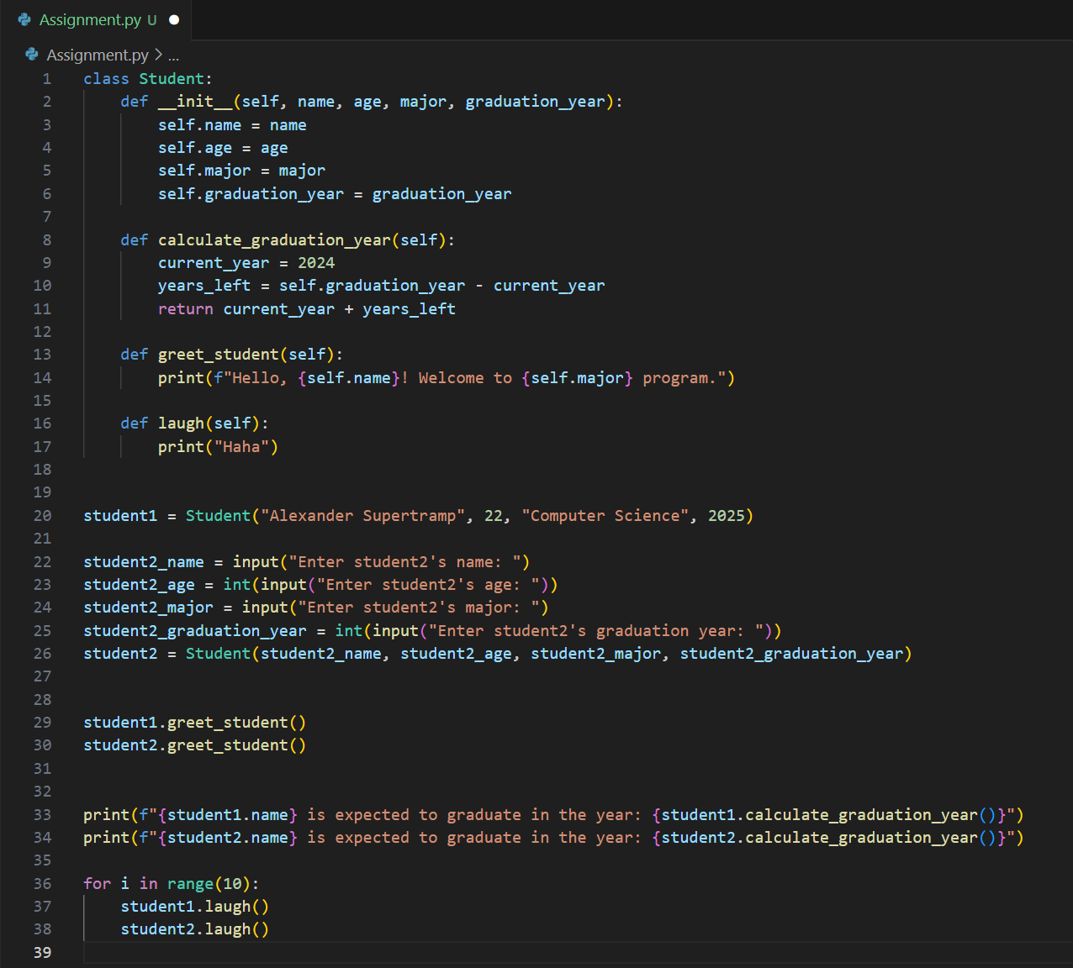
C++ - OneCompiler - Write, run and share C++ code online
Control + click (win) Command + click (mac) After you complete, Try running it and Click triple dot next to Run button and download
Url to code: https://github.com/Khagendra01/Cpp_In_One_Hour/blob/main/Assignment.py

Slide 37
Thank You!
K-Gen
https://www.linkedin.com/in/khagendrakhatri/
https://github.com/khagendra01/
Khagendra Khatri

