Slide 1
Final Project Defense
Fusemachine AI Fellowship 2023, DL Module
Crops Disease Identification
Presented By
Khageshor Giri
Pawan Sapkota Sharma
Rojes Shrestha
Sushil Dyopala

Slide 2
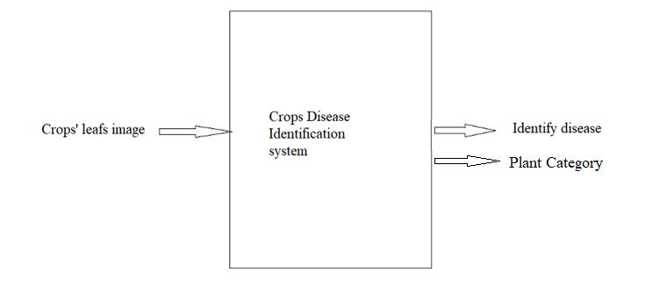
Problem Statement
This project aims to develop a system which can identify diseases on plant leaves and suggest the closest possible solutions.

Slide 3
Final Goal
The final aim of our team for this project was creating a End to End Flask web App. This web app should be able to identify disease and plant type by Using Deep CNN model.
For Frontend we use Html, CSS, Bootstrap and JS and Flask was used to support backend.
A User can upload their photo to web and request for prediction. After that the model process the image and return prediction for disease.

Slide 4
Dataset
For this project we use PlantVillage Dataset. We pick data for Kaggle.
This dataset consists of about 87k RGB healthy and diseased crop leaves of 256x256 which are categorized into 38 different classes.
This dataset consist total of 14 types of plant’s leaves.
The total dataset is divided into an 80/20 ratio of training and validation set preserving the directory structure.

Slide 5
Possible Approaches
To address this problem, we are going with a supervised learning approach.
We are using deep convolutional neural networks for the classification problem described above.
We are going through the following steps to solve this problem
Problem Formulation and Business Goal
Data Collection
EDA and Data Preprocessing
Model Building and Performance Evaluation
Model tuning and
Draw Conclusion
Flask Web Application

Slide 6
Model Building
We consider following 2 approaches while we building model
2 Models for 2 Prediction
Single Model Multiple Prediction
In first approach we build 2 different with same parameters.
In second approach we build multiple models with different parameters.

Slide 7
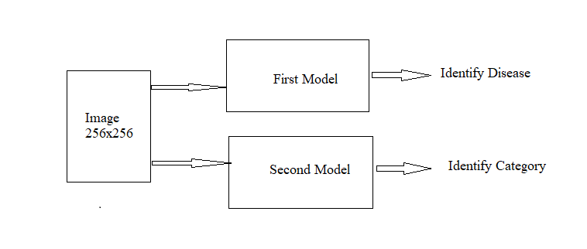
2 Models for 2 Prediction
For this approach we build two different models by following same architecture. In this approach we pass 256x256 RGB image as input in both model at same time. First model detect disease and second model identify the category of plant.
For building this model we use following
Type = CNN
Kernel = 3x3, padding = 1
MaxPooling = 4
Activation Function = ReLU
Normalization = BatchNormalization
Optimizer = Adam
Cost Function= Categorical Cross Entropy
Epochs= 5
Batch Size= 64
Learning rate= 0.001

Slide 8
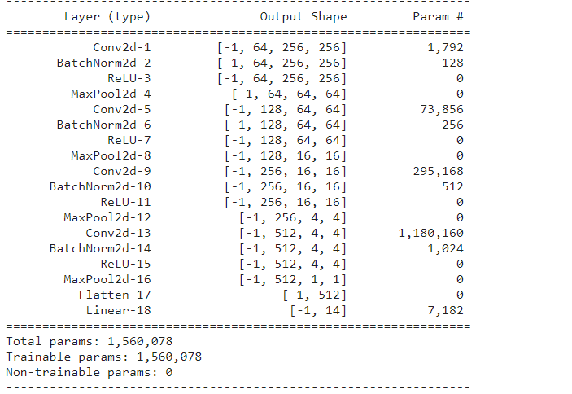
Architecture For First Approach
We train our model for 5 epochs and the accuracy is only 48.9%

Slide 9
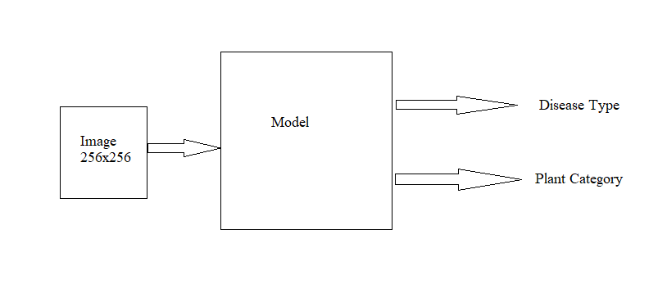
Single Models Multiple Prediction
For this approach we build single models. In this approach we pass 256x256 RGB image as input in model. This model detect disease and identify the category of plant at a same time.
We experiment with couples of architectures while building models and select best performing model.
For building this model we use following
Type= CNN
Kernel = 3x3, padding = 1
MaxPooling = 4
Activation Function= ReLU
Normalization= BatchNormalization
Optimizer = Adam
Cost Function= Categorical Cross Entropy
Epochs= 3
Batch Size= 64
Learning rate= 0.001

Slide 10
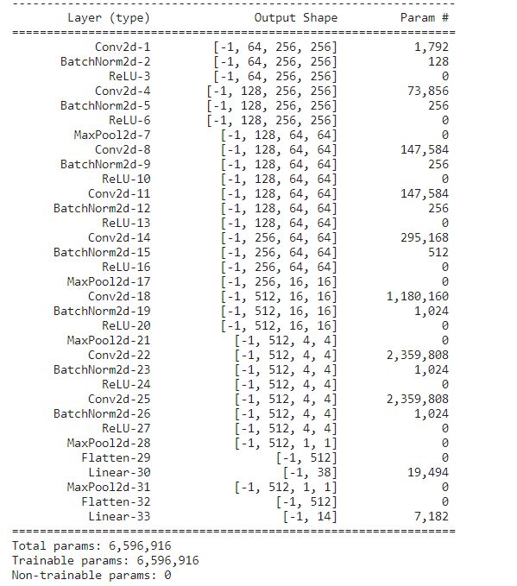
Architecture For Second Approach
We train our model for 3 epochs and the accuracy is 96.05%

Slide 11
Challenges
While doing this project we face couples of challenges. They are given below
Limited Resource
Huge Dataset
Training
Parameter tuning
Group Communication

Slide 12
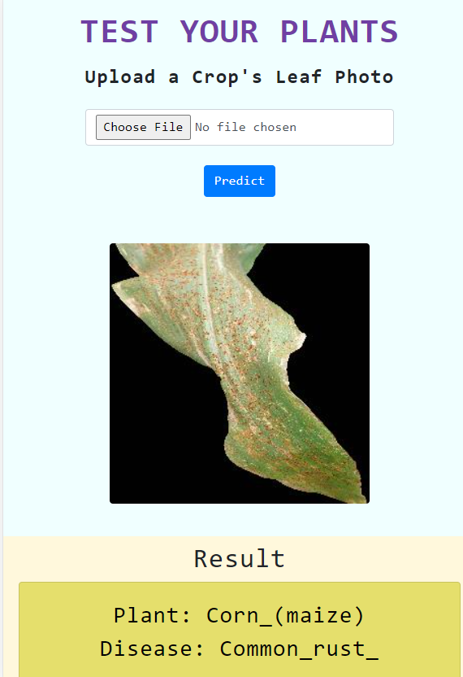
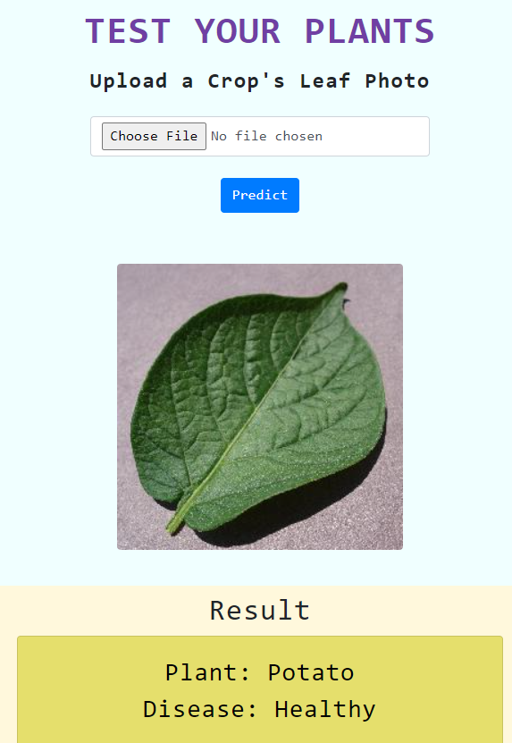
Outcomes

Slide 13
Thank You

