Slide 1
Final Project Defense
Fusemachine AI Fellowship 2023, CV and NLP Module
Resume Parser
Presented By
Khageshor Giri

Slide 2
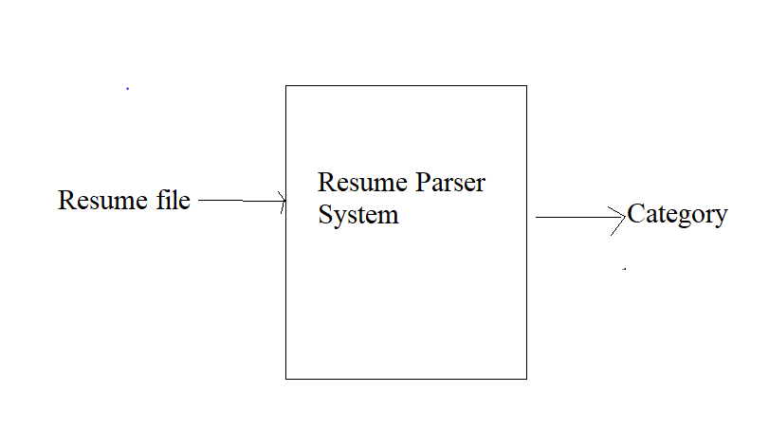
Problem Statement
This project aims to develop a system which can identify the category of resume.

Slide 3
Final Goal
The final aim of our team for this project was creating a End to End Flask web App. This web app should be able to identify resume category by Using KNN and OnevsRest model.
For Frontend we use Html, CSS, Bootstrap and JS and Flask was used to support backend.
A User can upload their resume file like pdf, txt and docks to web and request for classification. After that the model process the file and return result for category.

Slide 4
Dataset
For this project we use Resume Dataset. We pick data for Kaggle.
This dataset consists of about 1000 resume of 25 different types.
The total dataset is divided into an 80/20 ratio of training and validation set preserving the directory structure.

Slide 5
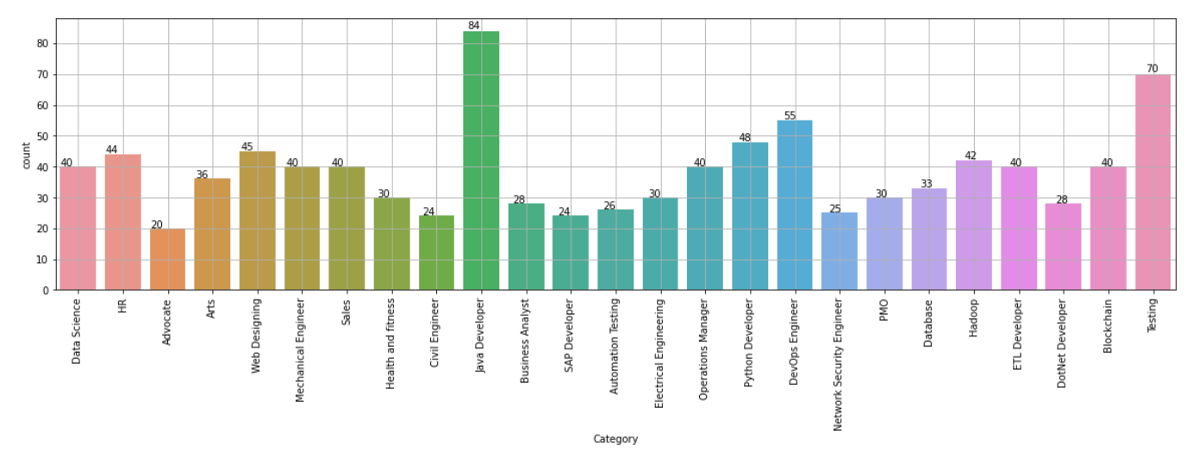
Dataset

Slide 6
Possible Approaches
To address this problem, we are going with a supervised learning approach.
We are going through the following steps to solve this problem
Problem Formulation and Business Goal
Data Collection
EDA and Data Preprocessing
Model Building and Performance Evaluation
Model tuning and
Draw Conclusion
Flask Web Application

Slide 7
Data Preprocessing
Converting pdf, txt or docx file into raw text.
Removing unnecessary symbols, urls, characters, white spaces, and new line
Using TF-IDF converting raw text into matrix
Dividing that data into training and test set.

Slide 8
Model Building
Here I use different machine learning algorithms to train our model. From which I select best performing model.
For this project I used following algorithms.
KNeighbors Classifier
RandomForest Classifier
Logistic Regression
GradientBoosting Classifier
I used OneVsRest Classifier algorithm for multiclass classification
Among all of these Kneighbors and RandomForest did best so I select the for further process.

Slide 9
Models Performance
For the Kneighbors Classifer
training accuracy: 0.9805
testing accuracy: 0.9668
For the Random Forest Classifier
training accuracy: 1.0
testing accuracy: 9.8
After applying k (10) fold cross validation I got
0.958 for Kneighbors classifier
0.996 for Random forest classifier
SO I select Random Forest Classifier to build my final model.

Slide 10
Working flow of application
User upload there resume(pdf, txt, docx)
Convert into raw text
Clean raw text for vectorization
Using TF-IDF for vectorization
Use Model to get prediction
Show Predicted category in web application

Slide 11
Outcomes
A End to End Web application that can takes resume files as input and classify them according their category

Slide 12
Challenges
While doing this project we face couples of challenges. They are given below
Limited Resource
Small Dataset
Training
Parameter tuning

Slide 13
Thank You

