Slide 1
Final Project Defense
Fusemachine AI Fellowship 2023, CV and NLP Module
Resume Parser
Presented By
Khageshor Giri

Slide 2
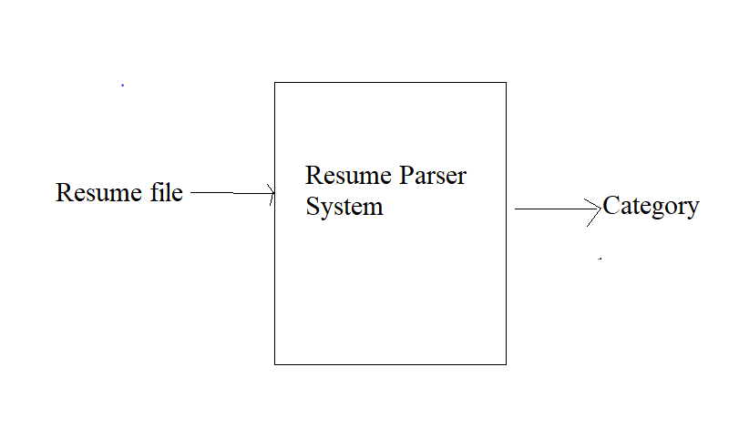
Problem Statement
This project aims to develop a system which can identify the category of resume.

Slide 3
Final Goal
The final aim of our team for this project was creating a End to End Flask web App. This web app should be able to identify resume category by Using KNN and OnevsRest model.
For Frontend we use Html, CSS, Bootstrap and JS and Flask was used to support backend.
A User can upload their resume file like pdf, txt and docks to web and request for classification. After that the model process the file and return result for category.

Slide 4
Dataset
For this project we use Resume Dataset. We pick data for Kaggle.
This dataset consists of about 1000 resume of 25 different types.
The total dataset is divided into an 80/20 ratio of training and validation set preserving the directory structure.

Slide 5
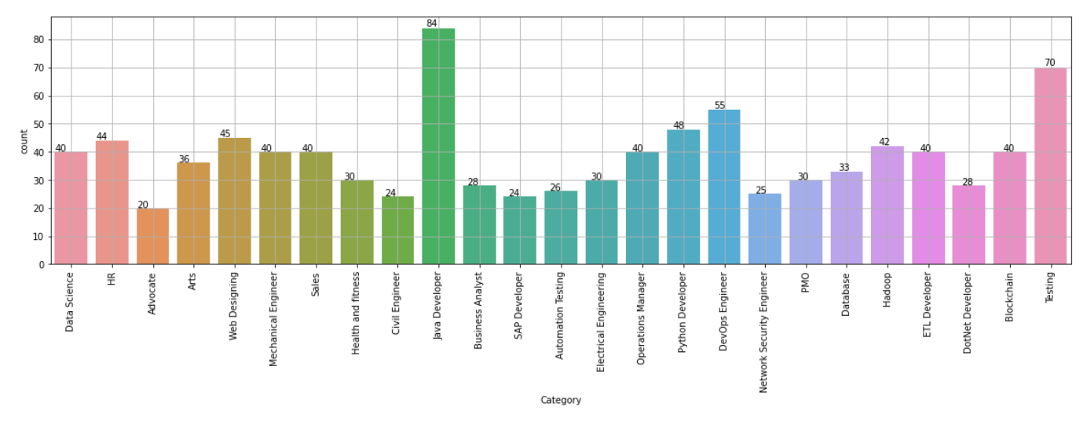
Dataset

Slide 6
Possible Approaches
To address this problem, we are going with a supervised learning approach.
We are going through the following steps to solve this problem
Problem Formulation and Business Goal
Data Collection
EDA and Data Preprocessing
Model Building and Performance Evaluation
Model tuning and
Draw Conclusion
Flask Web Application

Slide 7
Model Building

Slide 8
2 Models for 2 Prediction

Slide 9
Architecture For First Approach

Slide 10
Challenges
While doing this project we face couples of challenges. They are given below
Limited Resource
Small Dataset
Training
Parameter tuning

Slide 11
Outcomes

Slide 12
Thank You

