Slide 1



SOFTWARE ENGINEERING
Teacher:Pham Thai Ky Trung

Slide 2




Menmber
FINAL Project
Minh khai GROUP 6
Tuan kiet GROUP 7
SUPPLEMENT FACTS
PRODUCTS

Slide 3

For winform, accountants need to have the following tasks:
+ create goods received
+ create goods delivery
+ update status of order
+ update payment status of agent
+ view best-selling products
+ view contracted goods
+ view Manufacturer
+ vevenue report monthly
+ view warehouse
+ view Order
+ view import
1. DETERMINED WHAT WINFORM AND WEBFORM NEED TO DO

Slide 4
For webform MVC, agents need to have the following tasks:
+ create Order
+ View status of orders
+ Place an order of items
+ Choose a payment method(cash,momo)
+ Register
1. DETERMINED WHAT WINFORM AND WEBFORM NEED TO DO

Slide 5
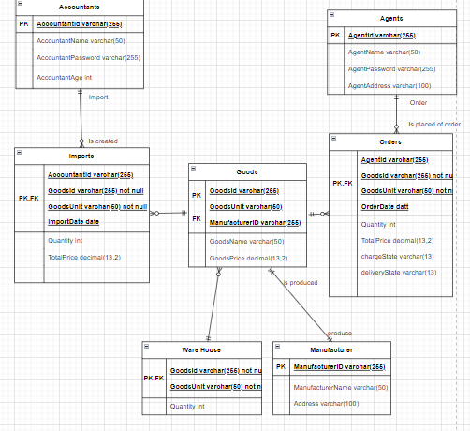
2.RELETIONSHIP IN DATABASE

Slide 6
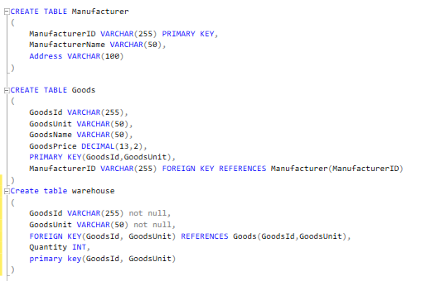

2.CREATE DATABASE

Slide 7
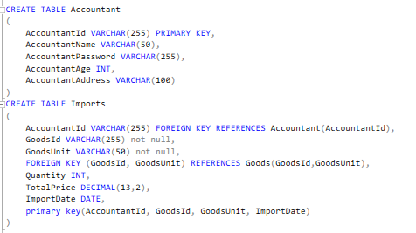
2.CREATE DATABASE

Slide 8
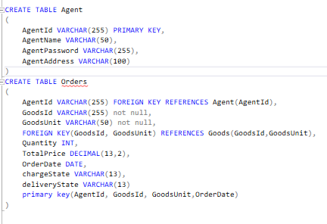
2.CREATE DATABASE

Slide 9
Thank for listening

