Slide 1

Automation Framework
Matthew Hoang
Khai Tran

Slide 2
Agenda
1 – Project Overview
2 – Selected Solution: WebdriverIO
3 – Why WebdriverIO
4 – Project Structure
5 – Test Execution & Commands
6 – Demo
7 – Q&A

Slide 3
1 – Requirements
Requirements: Design an automation test framework which
  Can tested on
    Multi-browsers (desktop & mobile browsers)
    Multi-devices (Android & iOS devices)
    APIs
    Combine Web & Mobile & API in a testcases
  Have ability
    Parallel execution
  Can integrated to
    Allure reports
    CI/CD
  Easy and quick development

Slide 4
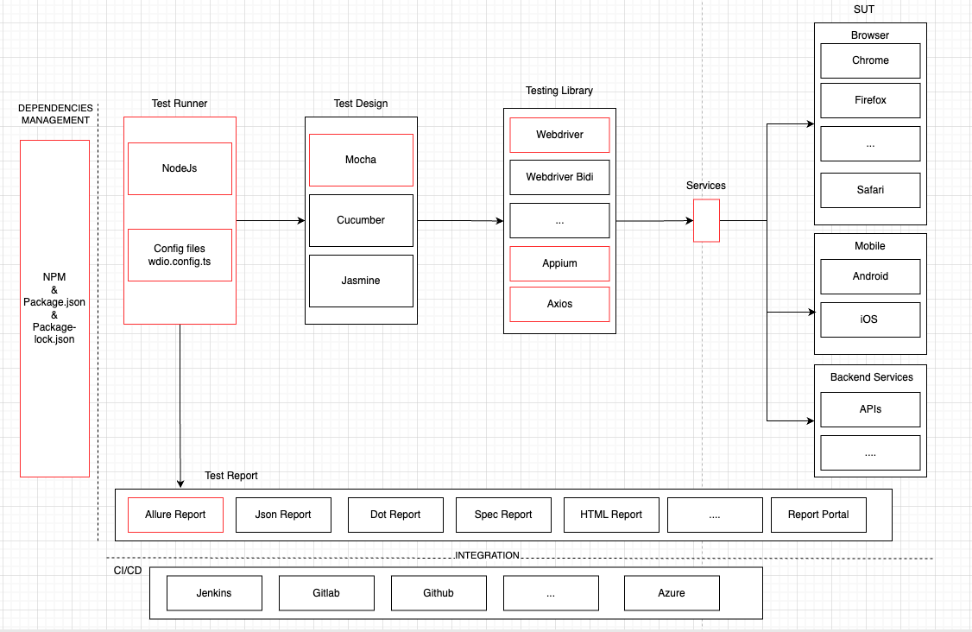
2 – Selected Solution: WebdriverIO framework

Slide 5
3 – Why WebdriverIO
Why WebdriverIO
Feature | Benefit
🧩 Web + Mobile + API test | One framework for all platforms: web, mobile, APIs and easy for extended usage
⚙️ Easy to learn | Simple and Modern Syntax because native program language (JS, TS) Good Documentation and Community Support Fast Setup and Easy Maintenance
⚡ Live debug on execution | Framework support pause and debug on test execution
🚀 Parallel execution | Framework configuration support
📊 Allure reporting | Clear html reports on various metric
🌍 Strong open-source | Reliable documentation
🔄 CI/CD friendly | Works with Jenkins/GitHub/…

Slide 6
4 – Project Structure
project-root/
├── config/
│ ├── wdio.shared.conf.ts, wdio.api.conf.ts, wdio.browser.conf.ts, wdio.ios.app.conf.ts, …
├── test/
│ ├── UI_test
│ │ ├── helpers
│ │ ├── specs/ (web, ios, combine test)
│ │ ├── pageobjects/
│ │ └── screenobjects/
│ ├── API_test
│ │ ├── helpers
│ │ ├── specs/ (APIs test)
│ │ ├── services/
│ │ └── test_data/
└── allure-report/

Slide 7
5 – Test Execution & Commands
Test type | Command
🖥️ Web Test | npm run browser -- --spec=test/specs/web.sample.e2e.ts
📱 iOS App Test | npm run ios.app -- --spec=test/specs/ios.sample.e2e.ts
🔄 Combined UI Test | npm run combine -- --spec=test/specs/combine.sample.e2e.ts
⚙️ API test | npm run api
🔄 Combined UI + API Test | npm run combine -- --spec=test/specs/combine3.sample.e2e.ts
📊 Generate Report | npm run allure-report

Slide 8
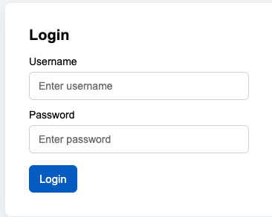
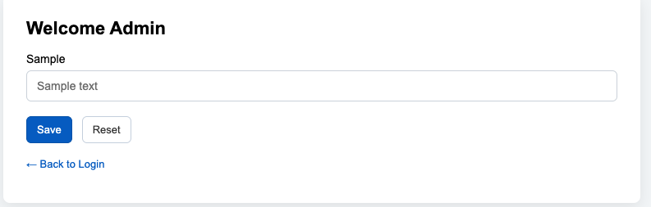
6 – Demo – Web test
Scenario 1: Login web successfully by correct username and password
  Steps for manual test:
    Access https://khaigft.github.io/web_html/login.htm
    Input username = autoQAGFT and password = admin, then click Login
    Validate the home page after login successfully by “Welcome Admin” text.
  Automation execution command:
    npm run browser -- --spec=test/specs/web.sample.e2e.ts
  Generate allure report
    npm run allure-report

Slide 9
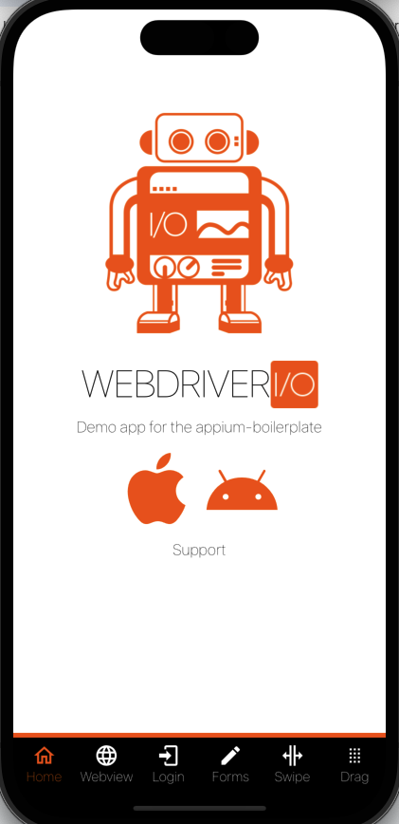
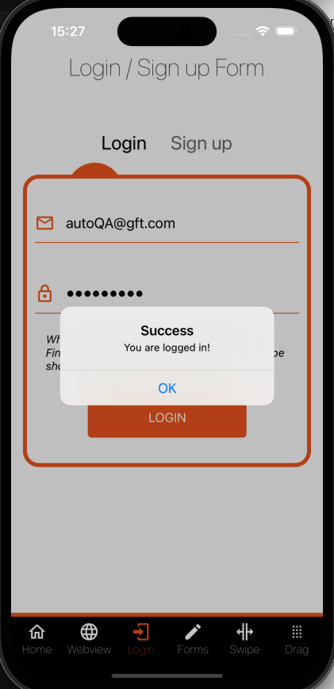
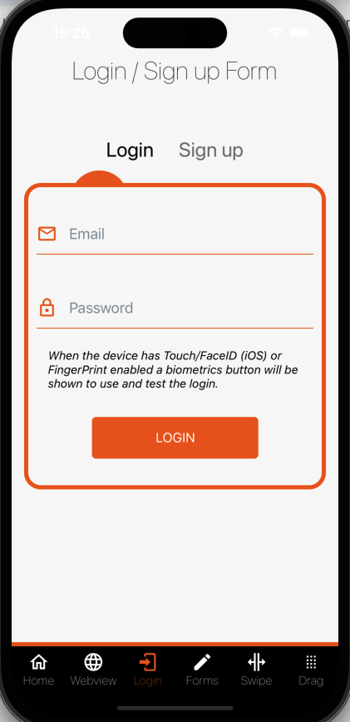
6 – Demo – iOS test
Scenario 2: Login web successfully by correct username and password
  Steps for manual test:
    Install & Launch application on iOS device
    On Home screen, navigate to Login screen by the Navigation menu
    Input username = autoQA@gft.com & password = Test1234!, then click Login button
    Validate “Login successful” popup & click OK to close this popup
  Automation execution command:
    npm run ios.app -- --spec=test/specs/ios.sample.e2e.ts
  Generate allure report
    npm run allure-report

Slide 10
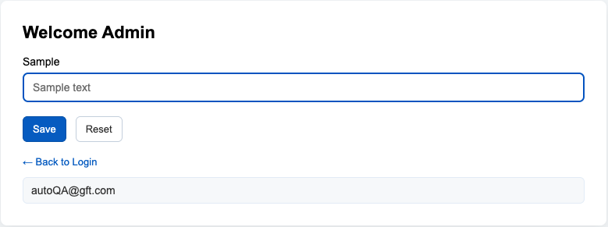
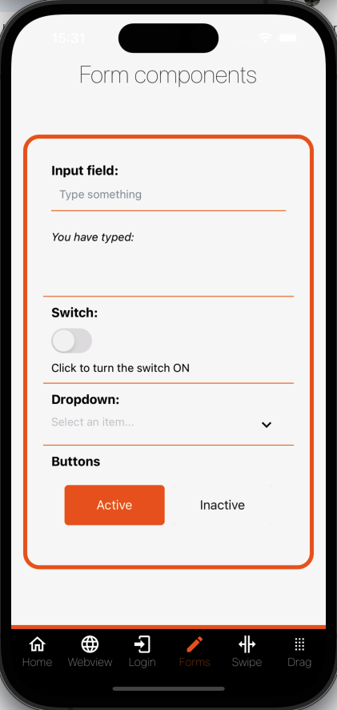
6 – Demo – combined web + mobile test
Scenario 3: Login test on web → Login test on app -> input field test on web -> input field test on app
  Steps for manual test:
    Scenario 1 - Login web successfully
    Scenario 2 - Login iOS application successfully
    Scenario 1a – Input and validate inputted text on sample textbox of Home screen
      On Web - Home screen, input text on sample textbox, then enter and validate it
    Scenario 2a – Validate input text on Form screen of iOS application
      On iOS device – Login screen, navigate to Form screen
      On iOS device – Form screen, input text on Input field of Form screen and validate it
  Automation execution command:
    npm run combine -- --spec=test/specs/combine.sample.e2e.ts
  Generate allure report
    npm run allure-report

Slide 11
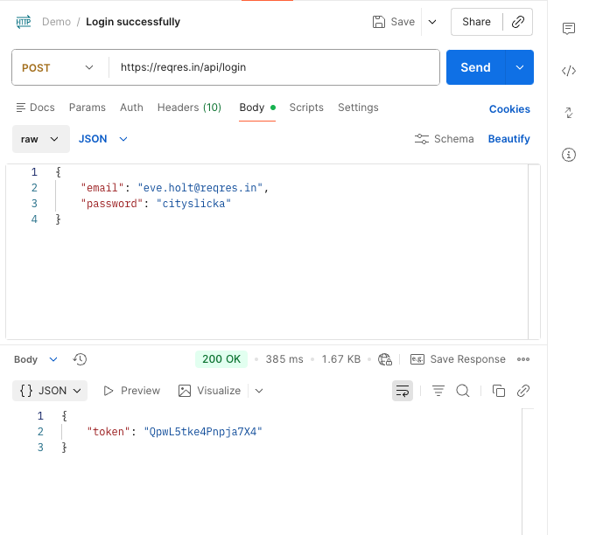
6 – Demo – API test
Scenario 4: Login successfully through Login API by correct email and correct password
  Steps for manual test:
    Call POST https://reqres.in/api/login with correct username and correct password
    Validate API response for successfully login (response code = 200, response body has token)
  Automation execution command:
    npm run api -- --mochaOpts.grep "@loginSuccess”
  Generate allure report
    npm run allure-report

Slide 12
6 – Demo – combined web + API + mobile test
Scenario 5: Login test on web → get User API test-> Login test on app -> update user API test -> input field test on web -> input field test on app
  Steps for manual test:
    Scenario 1 - Login web successfully
    Scenario 4a - Get user information and validate schema through get user API
      Call GET https://reqres.in/api/user/2
      Validate API response (response code = 200, response body has corrected schema)
    Scenario 2 - Login iOS application successfully
    Scenario 4b – Update user information through update user API
      Call PUT https://reqres.in/api/user/2
      Validate API response (response code = 200, response body has updated information)
    Scenario 1a – Input and validate inputted text on sample textbox of Home screen
    Scenario 2a – Validate input text on Form screen of iOS application
  Automation execution command:
    npm run combine -- --spec=test/specs/combine3.sample.e2e.ts
  Generate allure report
    npm run allure-report

Slide 13

Thank you!

