Slide 1
CIS 5525: Neural Computation
Week II: Feedforward Neural Networks
Instructor: Kai Zhang
CIS @ Temple University, Spring 2020

Slide 2
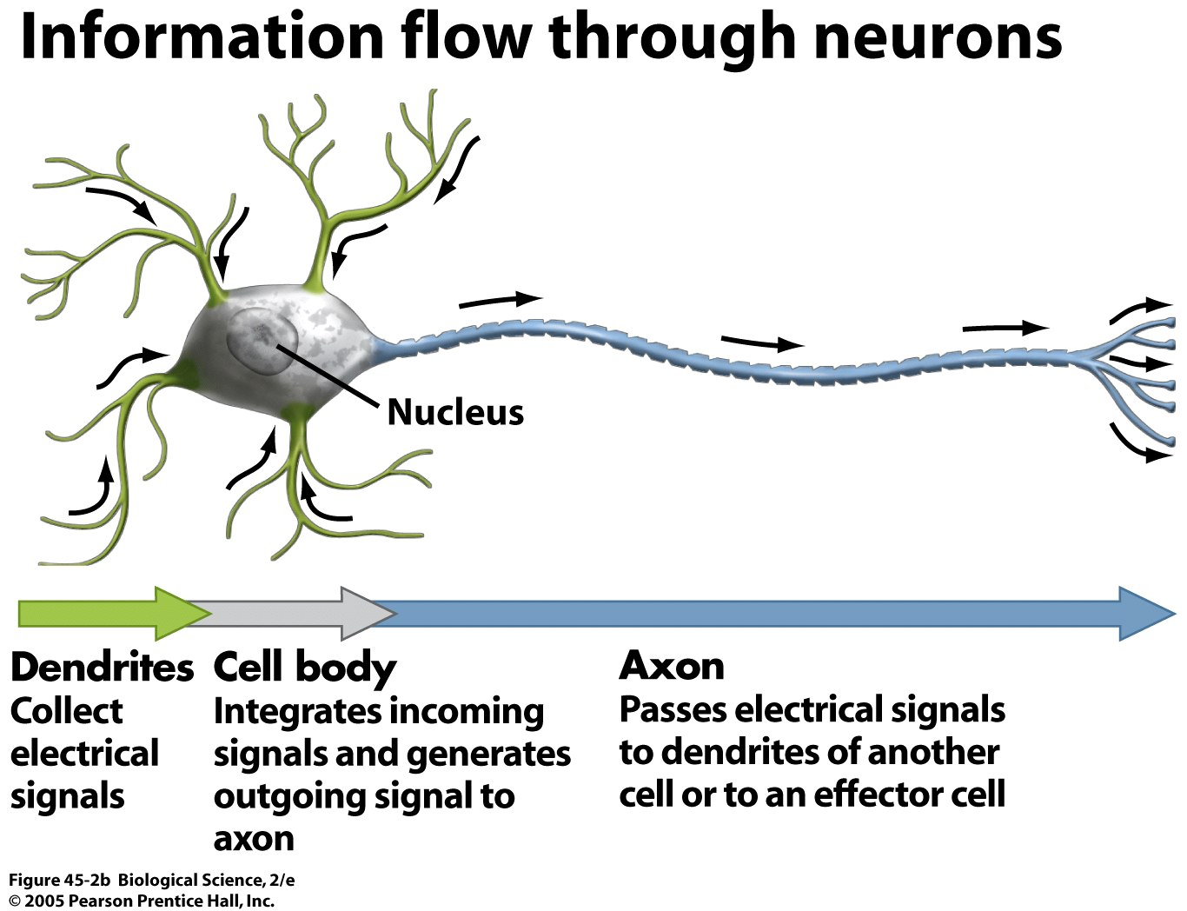
Information Flow in Neurons

Slide 3
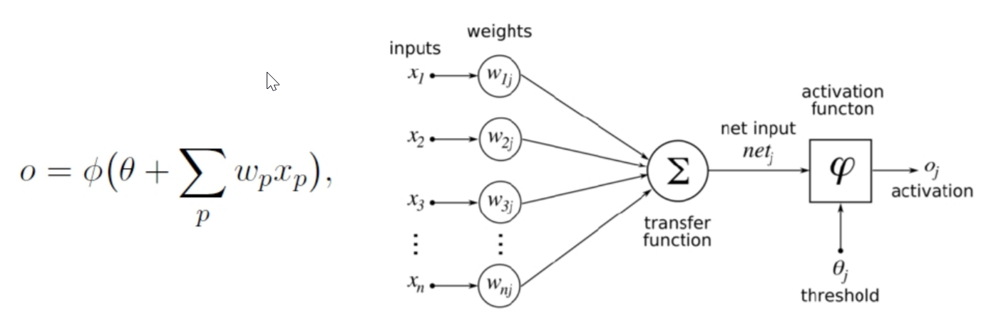

Perceptron
Basic model for the perception learning algorithm (PLA,1950’s)
Assumes data are linearly separable
Sign function as the activation, decision function $O=sign(W^{′}x+θ)$
adder
The perceptron: a probabilistic model for information storage and organization in the brain, Frank Rosenblatt, Psychological Review, 1958

Slide 4
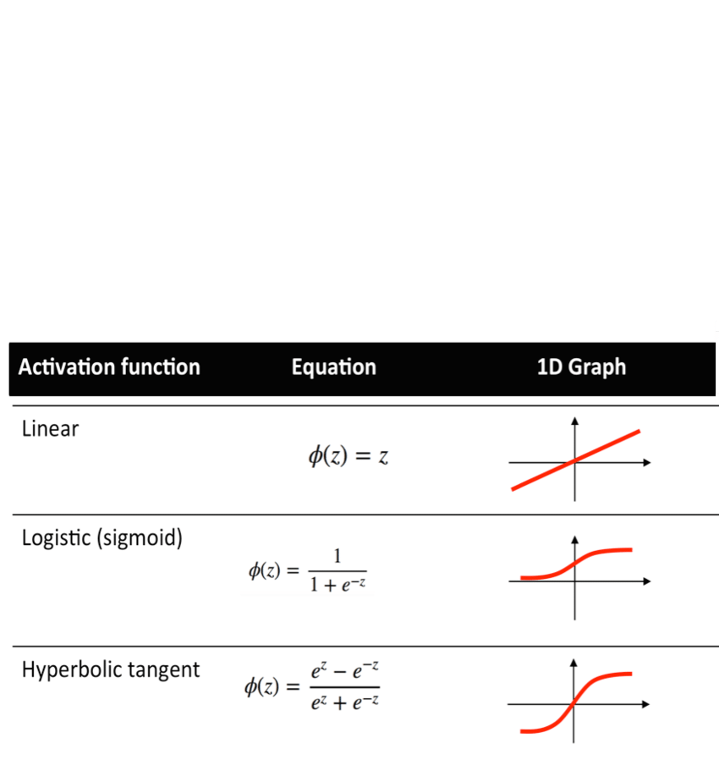
Activation Functions
Threshold (step), sigmoid, tanh, softplus, rectifier, RELU, etc.

Slide 5
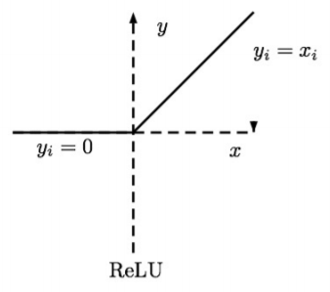
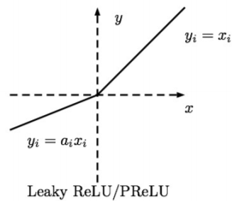
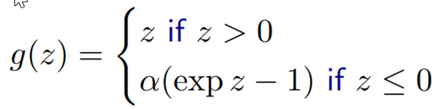
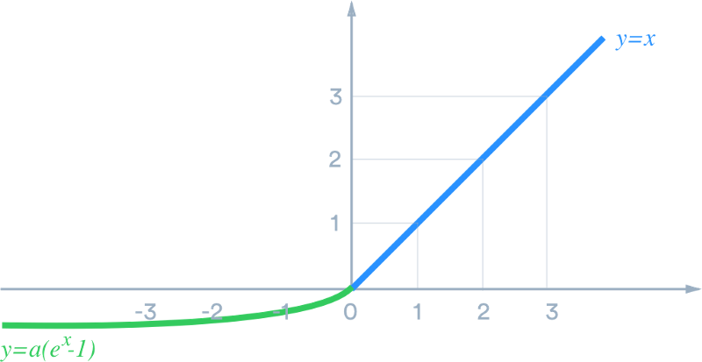
More activation function in deep learning
Leaky RELU
(Maas et al., 2013) Fix ai to a small value
Parametric ReLU:
(He et al., 2015) Learn alpha_i
ELU (exponential linear unit)
Clevert et al. ”Fast and Accurate Deep Network Learning
by Exponential Linear Units (ELUs)”

Slide 6

Decision Boundary of a Perceptron
x₂
x₂
x₃
w₁x₁ + w₂x₂ + w₃x₃ + w₀ = 0
w₁x₁ + w₂x₂ + w₀ = 0
x₁
x₁
Weights are the coefficients of hyperplane
w^{T}x is the (signed) distance of point x to hyperplane w
Example: http://mathinsight.org/distance_point_plane

Slide 7
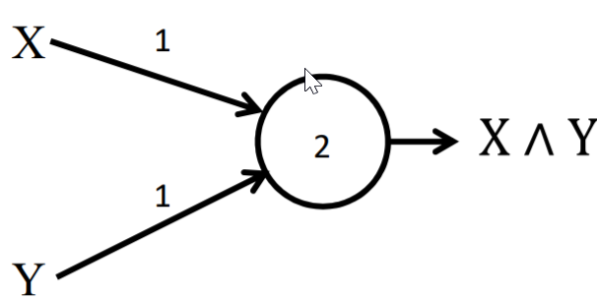
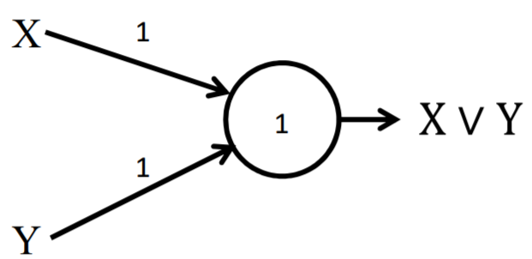


Simple Boolean Unit
AND gate
OR gate
$$O= step\left(X∗1+Y∗1−2\right)$$
$$O= step\left(X∗1+Y∗1−1\right)$$

Slide 8
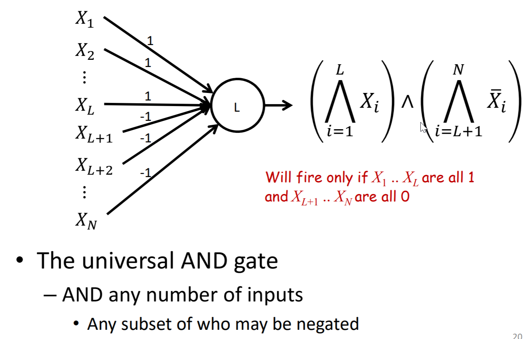
Combined Boolean Units

Slide 9
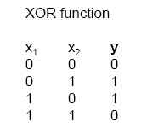
Limitation of single-layer perceptron
What a perceptron can do
mimic any Boolean function
What it cannot

Slide 10
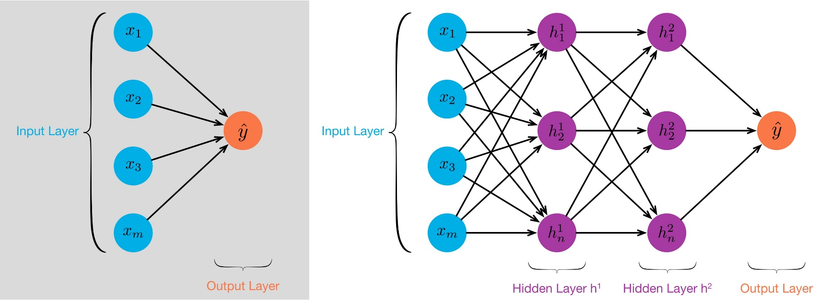
Multiple layer perceptron (MLP)
The MLP is a Universal Approximator for the entire class of functions (maps) it represents
Theoretical result [Cybenko, 1989]: 2-layer net with linear output can approximate any continuous function over compact domain to arbitrary accuracy (given enough hidden units!)

Slide 11
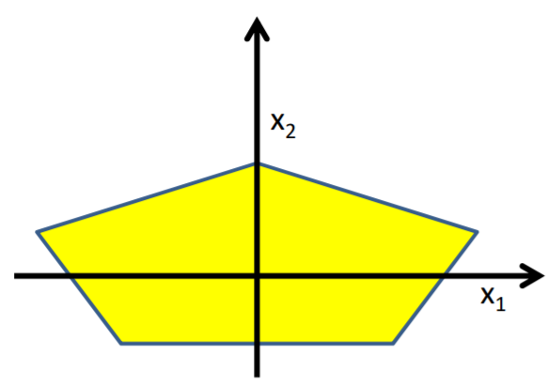
Complicated decision boundaries by MLP
Build a network of units with a single output that fires if the input is in the coloured area

Slide 12
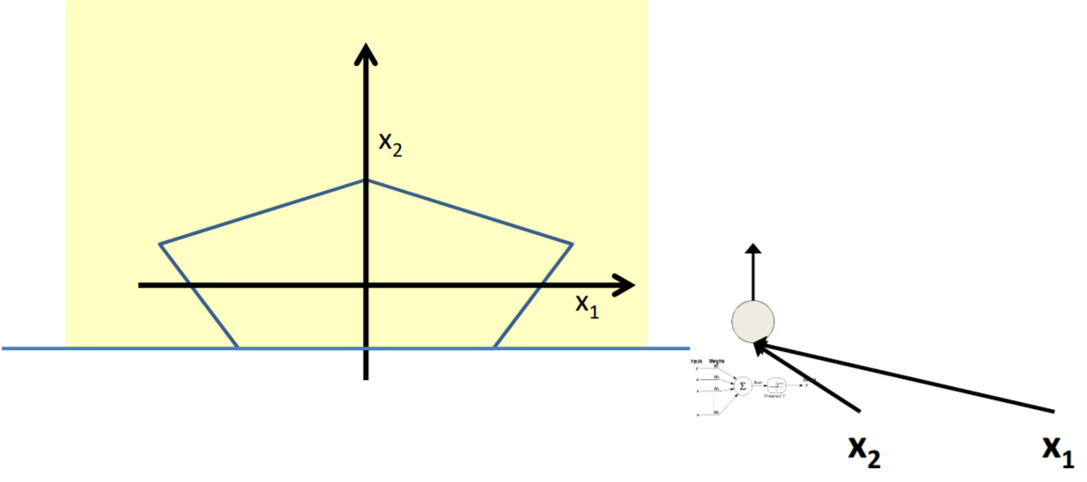
Complicated decision boundaries by MLP

Slide 13
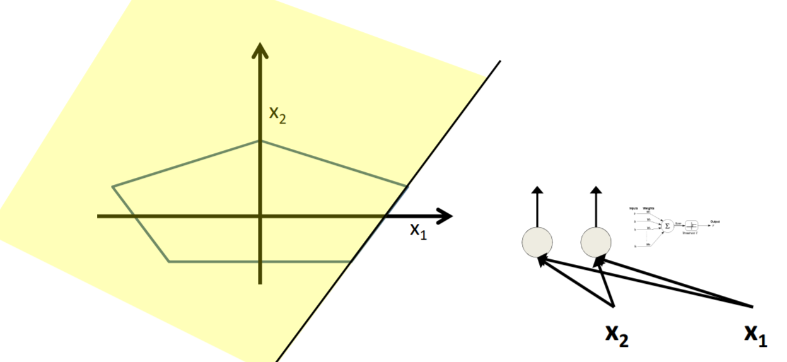
Complicated decision boundaries by MLP

Slide 14
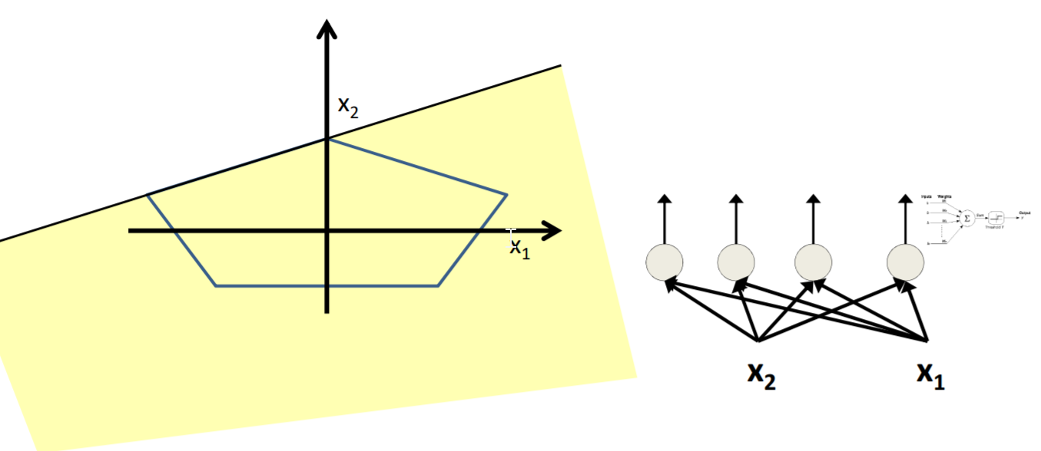
Complicated decision boundaries by MLP

Slide 15
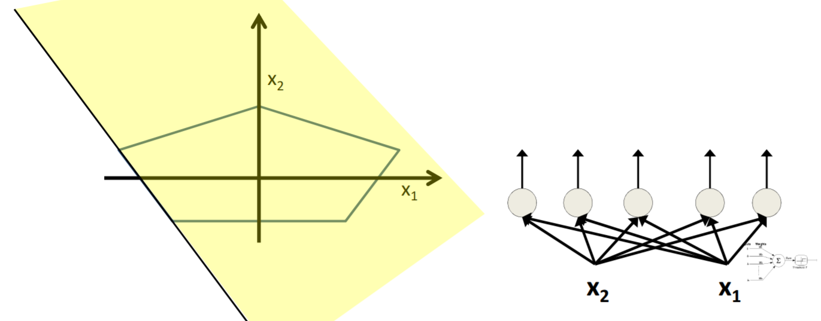
Complicated decision boundaries by MLP

Slide 16
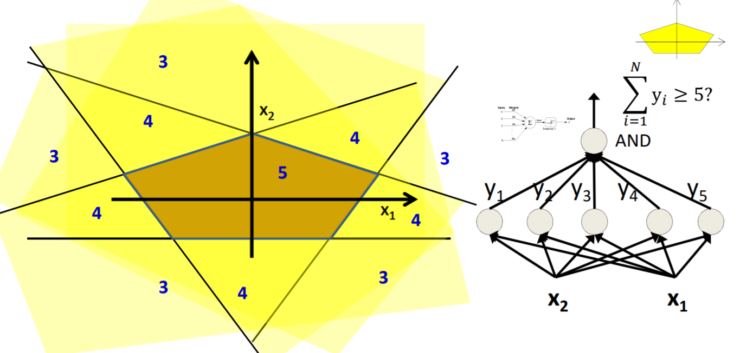
Complicated decision boundaries by MLP

Slide 17
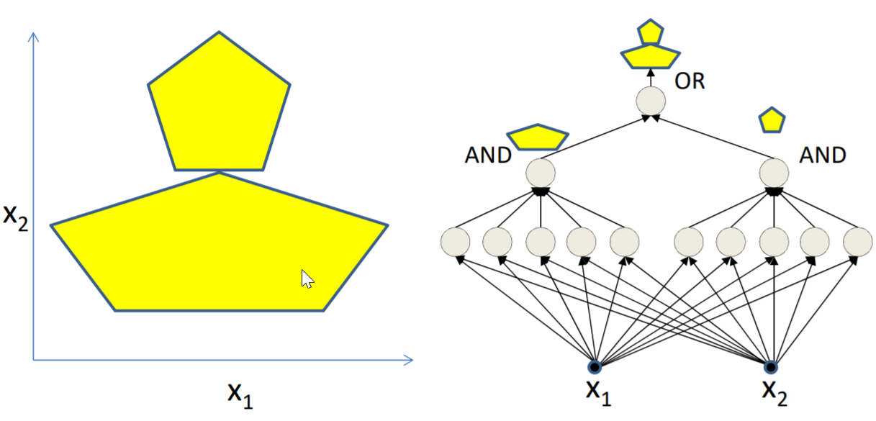
Complicated decision boundaries by MLP

Slide 18
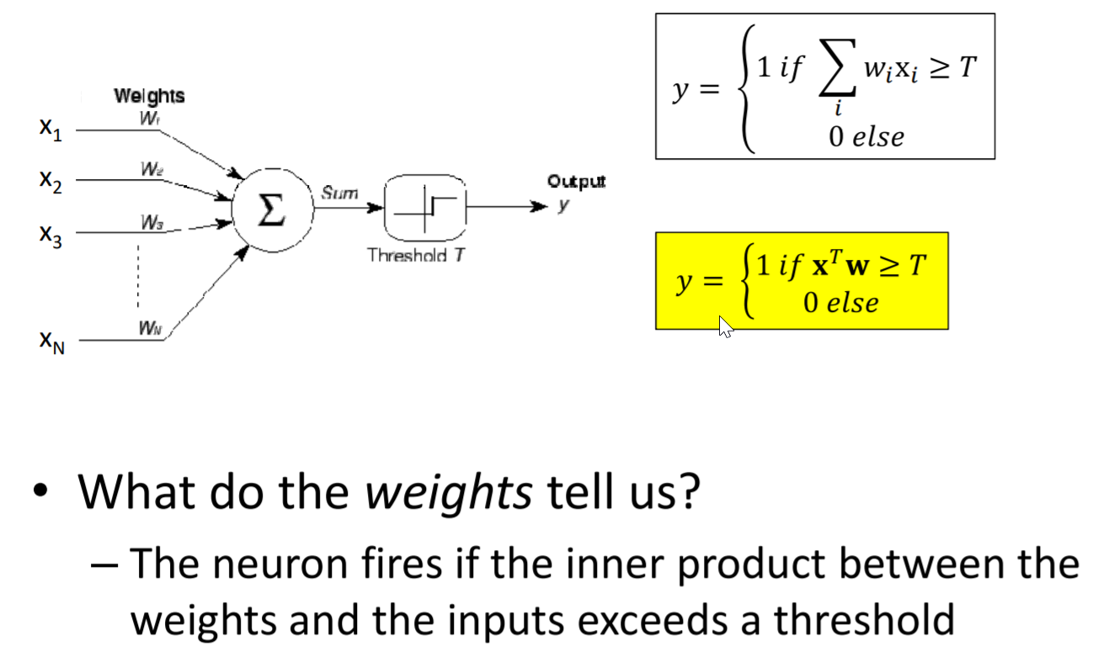
Continuous Input Scenarios

Slide 19
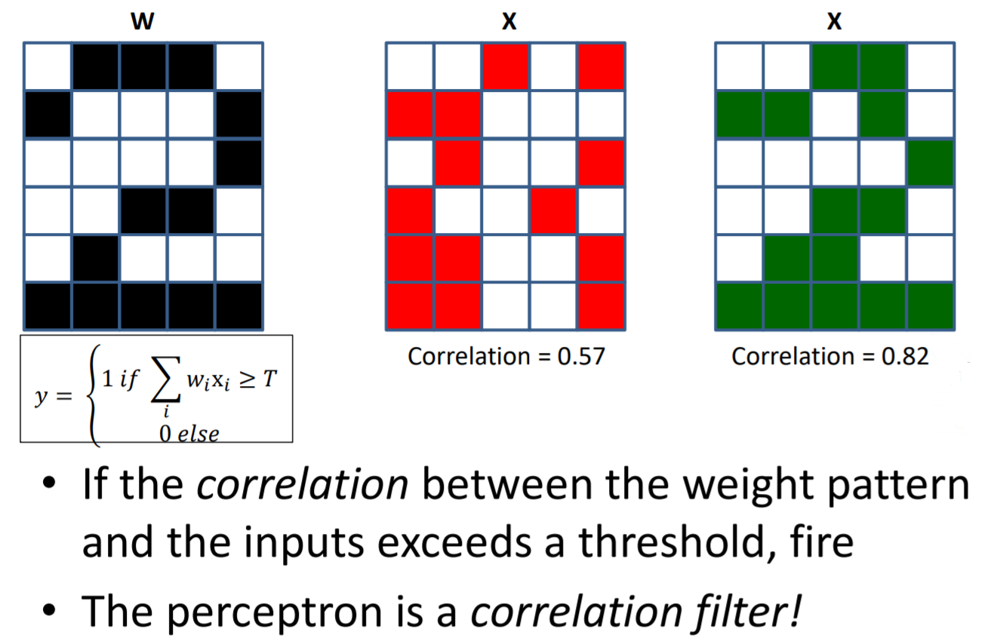
Weights as templates

Slide 20
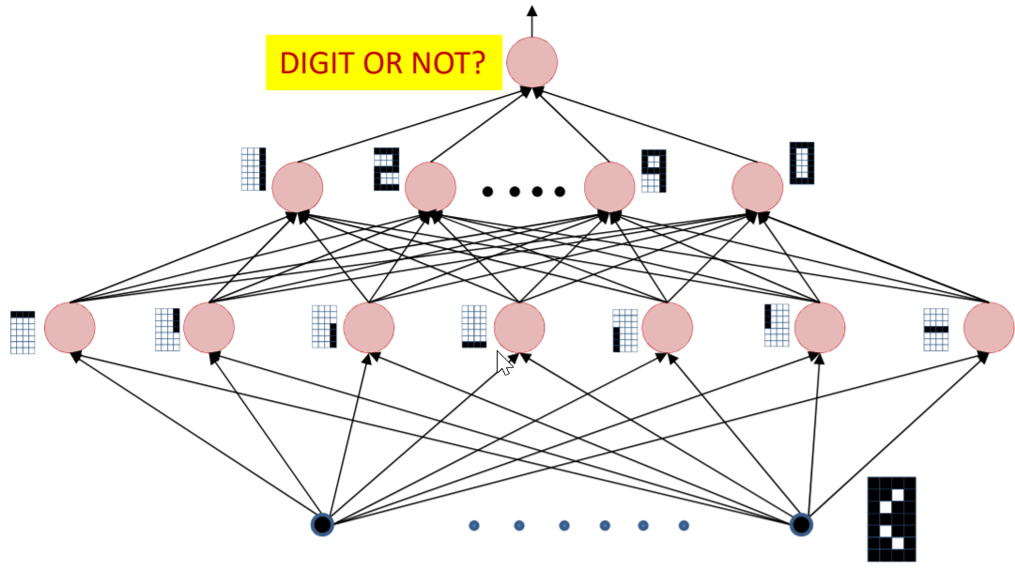
Cascaded Feature Detectors
The input layer comprises “feature detectors”
Detect if certain patterns have occurred in the input
The network is a Boolean function over the feature detectors
The network is a Boolean function over the feature detectors

Slide 21

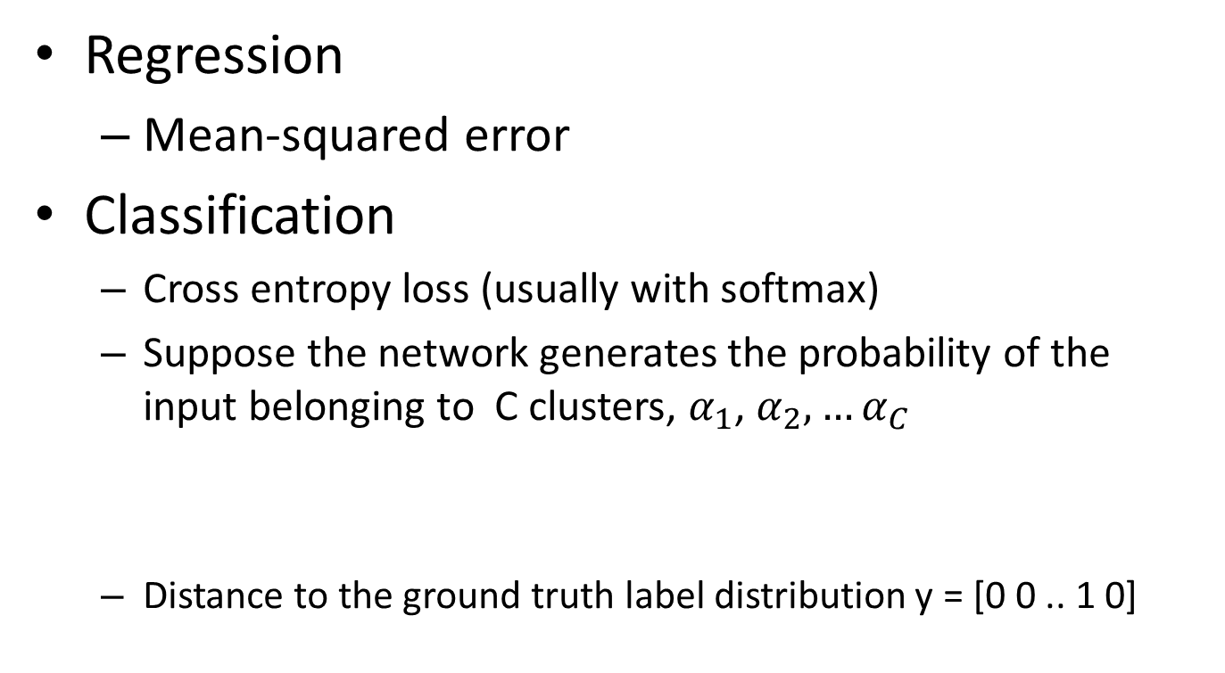

Error functions
Regression
Mean-squared error
Classification
Cross entropy loss (usually with softmax)
Suppose the network generates the probability of the input belonging to C clusters, $α_{1}$, $α_{2},…α_{C}$
Distance to the ground truth label distribution y = [0 0 .. 1 0]
$$cross entropy=y_{i}log⁡(p_{i})$$

Slide 22
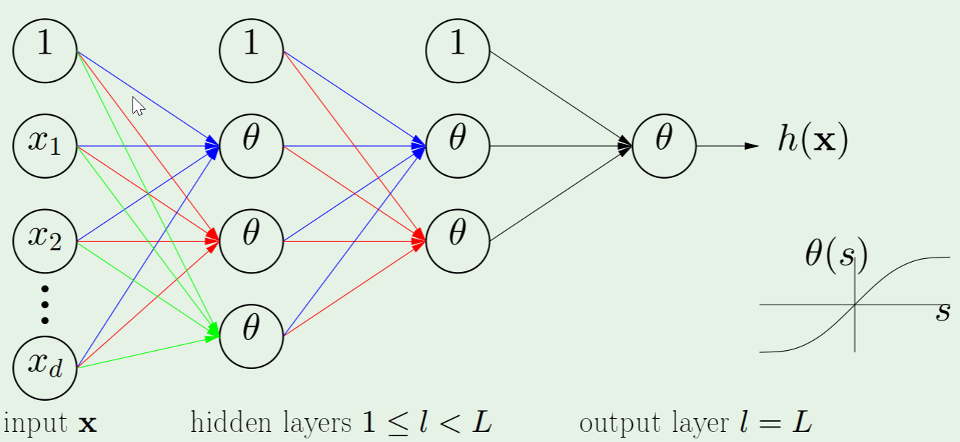
Backpropagation

Slide 23
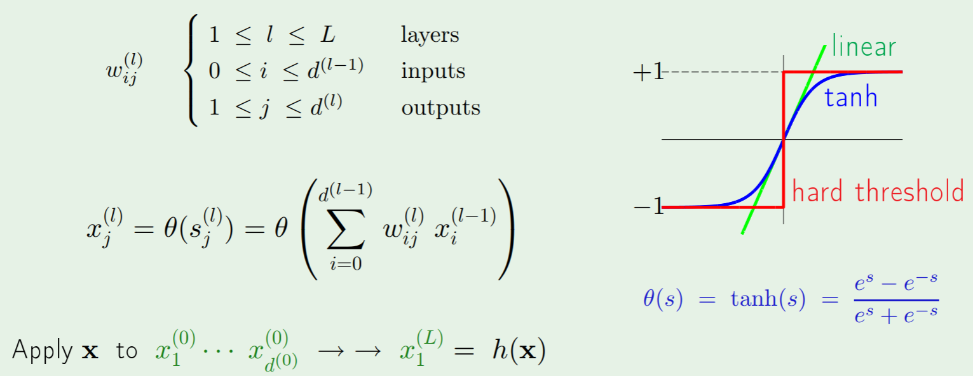
Backpropagation

Slide 24
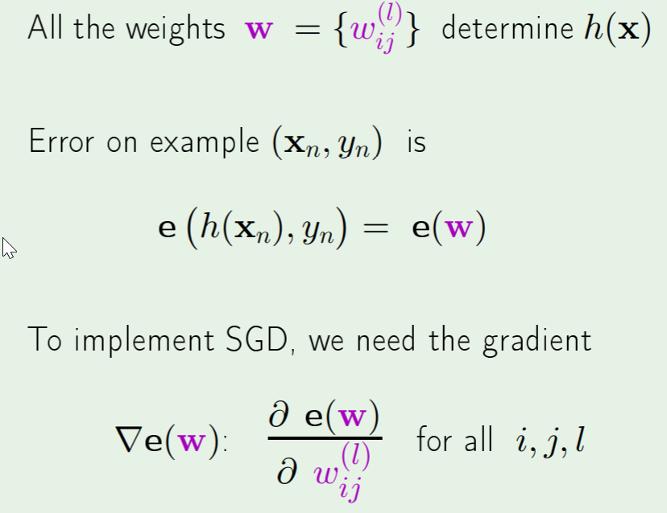
Backpropagation
Apply gradient descent (or SGD)

Slide 25
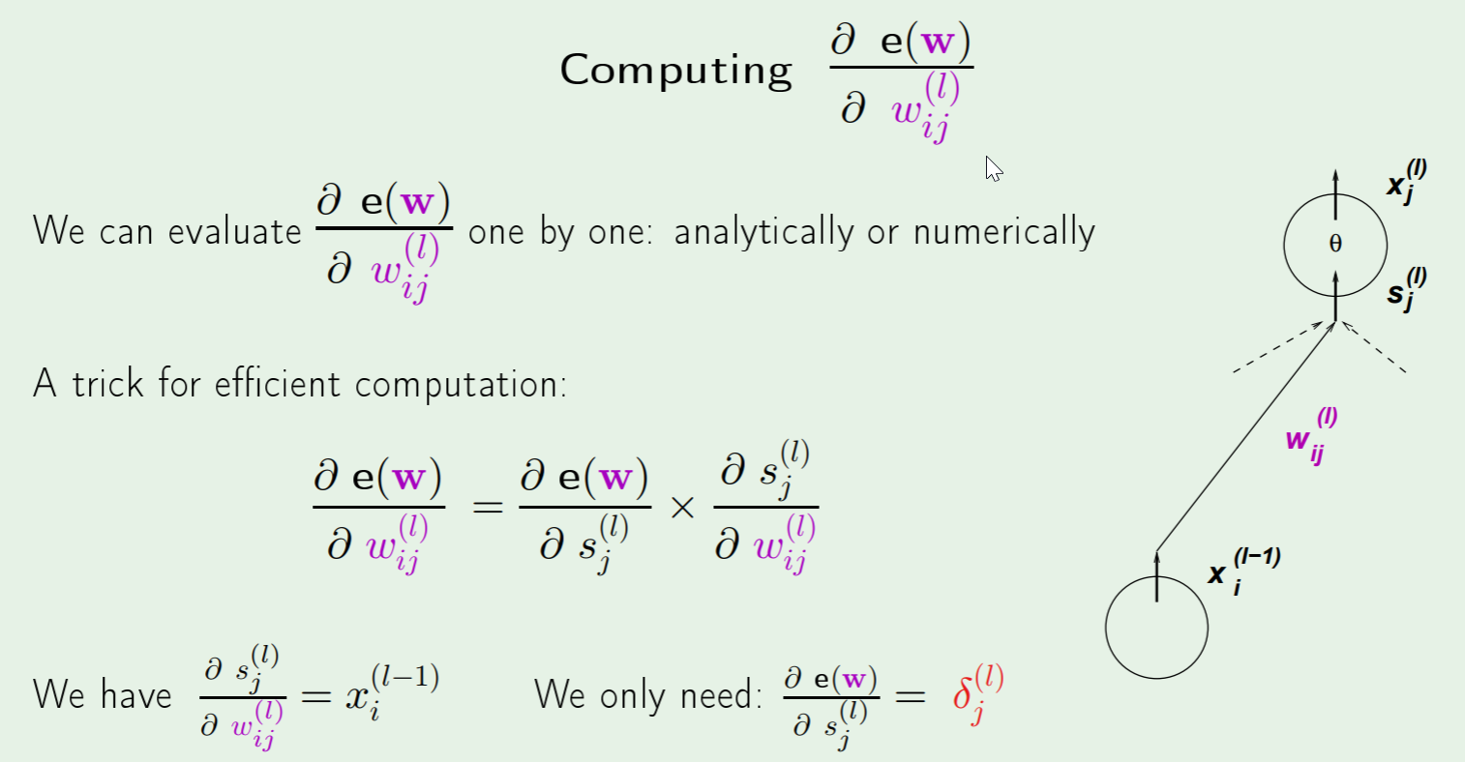
Backpropagation

Slide 26
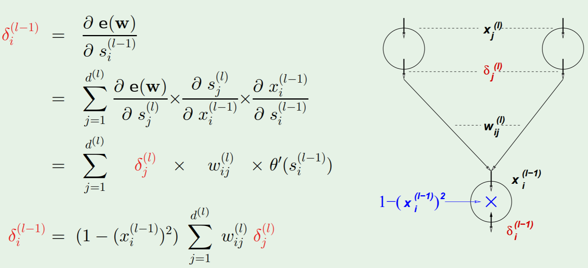
Backpropagation

Slide 27
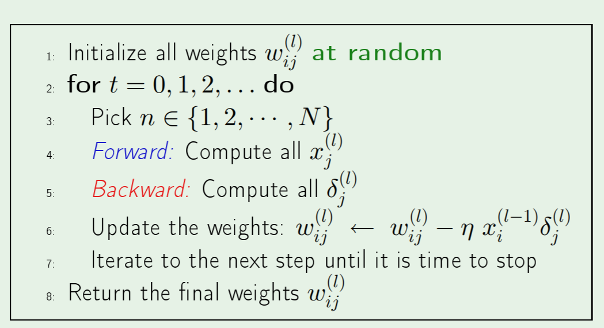
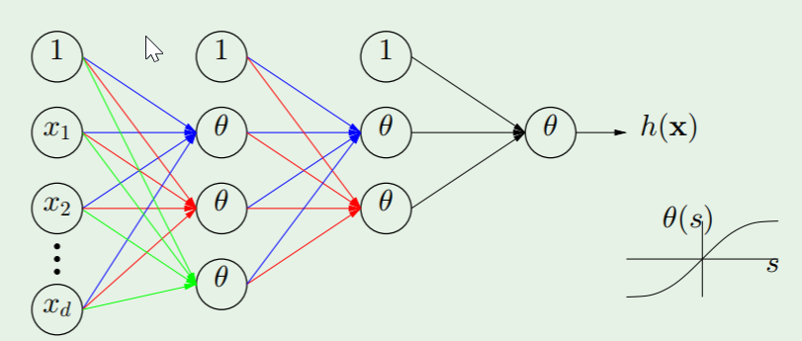
Backpropagation

