Slide 1
Bayesian Learning (cont’d)
Slides adapted from David Kauchak

Slide 2
Basic steps for probabilistic modeling
Probabilistic models
Step 1: pick a model
Step 2: figure out how to estimate the probabilities for the model
Step 3 (optional): deal with overfitting
Which model do we use, i.e. how do we calculate p(feature, label)?
How do train the model, i.e. how to we we estimate the probabilities for the model?
How do we deal with overfitting?

Slide 3
Training revisited
What we’re really doing during training is selecting the Θ that maximizes:
After Bayes’ Rule, this leaves us with:
That is, we pick the most likely model parameters given the data
likelihood of the data under the model
prior probability of model parameters

Slide 4
Another view on the prior
Let’s take the log of the right-hand side
the max is the still the same if we take the log…
Does this look like something we’ve seen before?

Slide 5
Regularization vs Prior
likelihood based on the data
prior
fit
model bias
loss function based on the data
regularizer

Slide 6
Revisit Naïve Bayes
MLE:
What happens to our likelihood if, for one of the labels, we never saw a particular feature?
Goes to 0!
Notes:
- Goes to 0!

Slide 7
Prior: another view
Adding a prior avoids this!

Slide 8
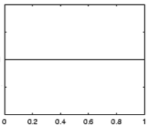
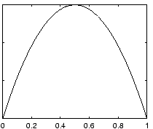
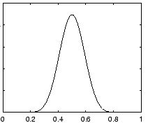
Prior for NB
Uniform prior
Dirichlet prior
λ= 0
increasing
Notes:
- as lambda gets larger we bias more and more towards

Slide 9
Smoothing
training data
for each label, pretend like we’ve seen each feature value occur in λ additional examples
This is also called smoothing because it is seen as smoothing (or interpolating) between the MLE and some other distribution (prior)

Slide 10
Joint vs. Conditional Models
Naïve Bayes models the joint distribution (i.e. the data generating distribution):
However, for classification, why not directly model the conditional distribution?

Slide 11
Can we use a linear model?
Linear model
probability
+∞
1
We like linear models!
Can we transform the probability into a function that ranges over all values?
-∞
0

Slide 12
Odds ratio
Rather than probability, we can predict the ratio: (positive/negative)
These are the odds that it is 1 (true)…
Does this help us?

Slide 13
Odds ratio
Linear model
odds ratio
+∞
+∞
Not there yet…
The ranges are still different
Where are the dividing lines between class 1 and class 0?
We need to transform odds ratio to -∞ to +∞
-∞
0

Slide 14
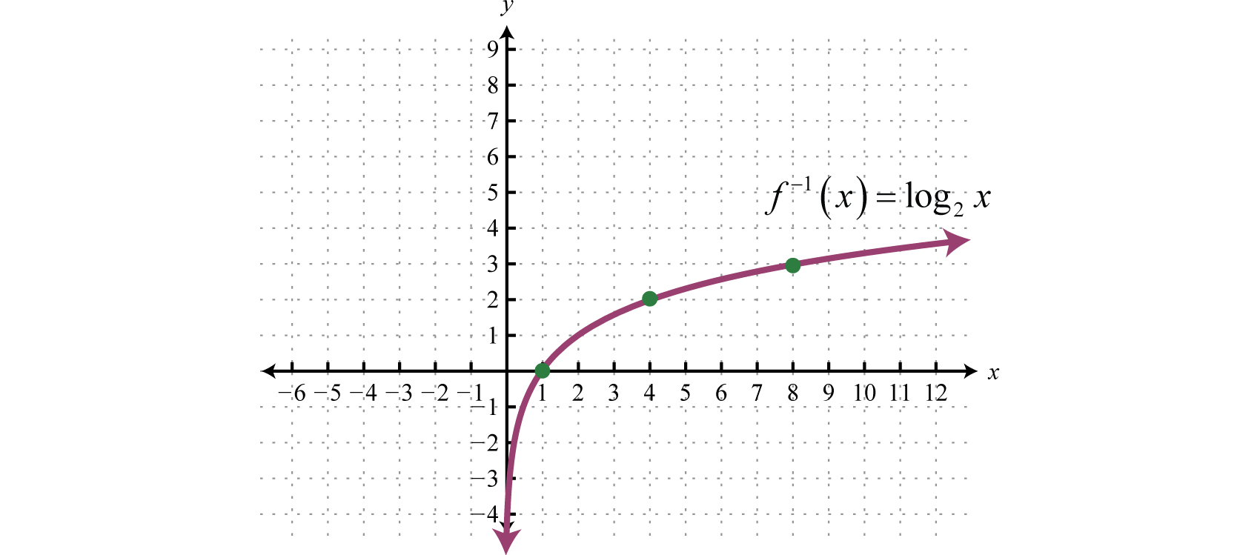
0 1 2 3 4 5 6 7 8 9 ….

Slide 15
Log odds (logit function)
=
Linear regression
odds ratio
+∞
+∞
How do we get the probability of an example?
-∞
-∞

Slide 16
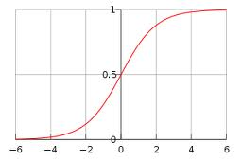
Log odds (logit function)
…

Slide 17
Logistic Regression Classification
If the sum > 0 then p(1)/p(0) > 1, so positive
if the sum < 0 then p(1)/p(0) < 1, so negative
Still a linear classifier
decision boundary is a line

Slide 18
Training logistic regression models
How should we learn the parameters for logistic regression (i.e. the w’s and b)?
parameters

Slide 19
MLE logistic regression
Find the parameters that maximize the likelihood (or log-likelihood) of the data:
assume labels 1, -1

Slide 20
MLE Logistic Regression
We want to maximize, i.e.

Slide 21
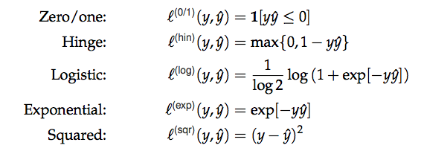
MLE logistic regression
Surrogate loss functions:

Slide 22
3 Ways to Consider Logistic Regression
linear classifier
conditional model
logistic
linear model minimizing logistic loss

Slide 23
Dealing with Overfitting: Regularization/Prior
If we minimize this loss function as-is, we are likely to overfit
How do we deal with that?
or
What are some of the regularizers we know?

Slide 24
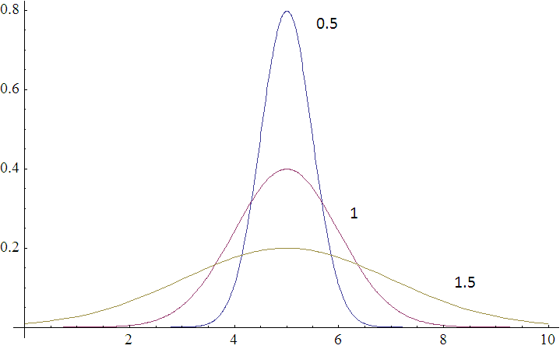
Regularization/prior
L2 regularization:
Gaussian prior:
p(w,b) ~

Slide 25
Regularization/prior
L2 regularization:
Gaussian prior:

Slide 26
Regularization/prior
L2 regularization:
Gaussian prior:
Notes:
Yes!
As the variance gets higher, the prior is weaker (more distributed probabilities). Higher variance = lower lambda.
As the variance gets lower, the prior is stronger (more peaked distribution). Lower variance = higher lambda.

Slide 27
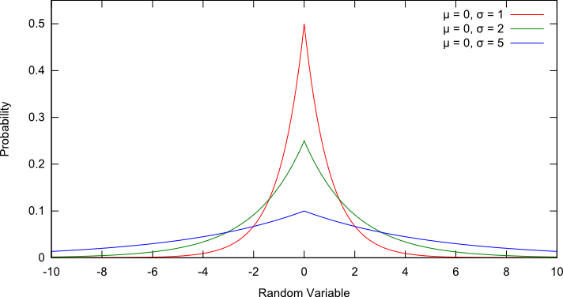
Regularization/prior
L1 regularization:
Laplacian prior:
p(w,b) ~

Slide 28
Regularization/prior
L1 regularization:
Laplacian prior:

Slide 29
L1 vs. L2
L1 = Laplacian prior
L2 = Gaussian prior

Slide 30
Probabilistic models summarized
Two classification models:
Naïve Bayes (models joint distribution)
Logistic Regression (models conditional distribution)
In practice this tends to work better if all you want to do is classify
Priors/smoothing/regularization
Important for both models
In theory: allow us to impart some prior knowledge
In practice: avoids overfitting and often tune on development data

