Slide 1
Decision Trees
Slides adapted from David Kauchak

Slide 2
Decision Trees
One of the most common ML algs.
Supervised Learning
Mostly used for classification
Modifications exist for regression
Input: vector of attributes, labeled with a class
Basic version considers categorical inputs
Extensions for real-valued inputs

Slide 3
What is a Decision Tree?
An inductive learning task
Use particular facts to make more generalized conclusions
A predictive model based on a branching series of Boolean tests
These smaller Boolean tests are less complex than a one-stage classifier
Let’s look at a sample decision tree…

Slide 4
Predicting Commute Time
If we leave at 10 AM and there are no cars stalled on the road, what will our commute time be?
Leave At
10 AM
Representation is a tree
Leaf nodes are classes
Internal nodes are attributes
Edges are labeled with attribute values
9 AM
8 AM
Stall?
Accident?
No
Yes
Long
No
Yes
Short
Long
Medium
Long

Slide 5
To ride or not to ride, that is the question…
Terrain | Unicycle-type | Weather | Go-For-Ride?
Trail | Normal | Rainy | NO
Road | Normal | Sunny | YES
Trail | Mountain | Sunny | YES
Road | Mountain | Rainy | YES
Trail | Normal | Snowy | NO
Road | Normal | Rainy | YES
Road | Mountain | Snowy | YES
Trail | Normal | Sunny | NO
Road | Normal | Snowy | NO
Trail | Mountain | Snowy | YES
Build a decision tree

Slide 6
Recursive approach
Base case: If all data belong to the same class, create a leaf node with that label
Otherwise:
calculate the “score” for each feature if we used it to split the data
pick the feature with the highest score, partition the data based on that data value and call recursively

Slide 7
Partitioning the data
Terrain
Terrain | Unicycle-type | Weather | Go-For-Ride?
Trail | Normal | Rainy | NO
Road | Normal | Sunny | YES
Trail | Mountain | Sunny | YES
Road | Mountain | Rainy | YES
Trail | Normal | Snowy | NO
Road | Normal | Rainy | YES
Road | Mountain | Snowy | YES
Trail | Normal | Sunny | NO
Road | Normal | Snowy | NO
Trail | Mountain | Snowy | YES
Road
Trail
?

Slide 8
Partitioning the data
Terrain
Terrain | Unicycle-type | Weather | Go-For-Ride?
Trail | Normal | Rainy | NO
Road | Normal | Sunny | YES
Trail | Mountain | Sunny | YES
Road | Mountain | Rainy | YES
Trail | Normal | Snowy | NO
Road | Normal | Rainy | YES
Road | Mountain | Snowy | YES
Trail | Normal | Sunny | NO
Road | Normal | Snowy | NO
Trail | Mountain | Snowy | YES
Road
Trail
?

Slide 9
Partitioning the data
Terrain
Terrain | Unicycle-type | Weather | Go-For-Ride?
Trail | Normal | Rainy | NO
Road | Normal | Sunny | YES
Trail | Mountain | Sunny | YES
Road | Mountain | Rainy | YES
Trail | Normal | Snowy | NO
Road | Normal | Rainy | YES
Road | Mountain | Snowy | YES
Trail | Normal | Sunny | NO
Road | Normal | Snowy | NO
Trail | Mountain | Snowy | YES
Road
Trail
YES: 4
NO: 1

Slide 10
Partitioning the data
Terrain
Terrain | Unicycle-type | Weather | Go-For-Ride?
Trail | Normal | Rainy | NO
Road | Normal | Sunny | YES
Trail | Mountain | Sunny | YES
Road | Mountain | Rainy | YES
Trail | Normal | Snowy | NO
Road | Normal | Rainy | YES
Road | Mountain | Snowy | YES
Trail | Normal | Sunny | NO
Road | Normal | Snowy | NO
Trail | Mountain | Snowy | YES
Road
Trail
YES: 4
NO: 1
?

Slide 11
Partitioning the data
Terrain
Terrain | Unicycle-type | Weather | Go-For-Ride?
Trail | Normal | Rainy | NO
Road | Normal | Sunny | YES
Trail | Mountain | Sunny | YES
Road | Mountain | Rainy | YES
Trail | Normal | Snowy | NO
Road | Normal | Rainy | YES
Road | Mountain | Snowy | YES
Trail | Normal | Sunny | NO
Road | Normal | Snowy | NO
Trail | Mountain | Snowy | YES
Road
Trail
YES: 4
NO: 1
YES: 2
NO: 3

Slide 12
Partitioning the data
Terrain
Terrain | Unicycle-type | Weather | Go-For-Ride?
Trail | Normal | Rainy | NO
Road | Normal | Sunny | YES
Trail | Mountain | Sunny | YES
Road | Mountain | Rainy | YES
Trail | Normal | Snowy | NO
Road | Normal | Rainy | YES
Road | Mountain | Snowy | YES
Trail | Normal | Sunny | NO
Road | Normal | Snowy | NO
Trail | Mountain | Snowy | YES
Road
Trail
YES: 4
NO: 1
YES: 2
NO: 3
Unicycle
Mountain
Normal
?
?

Slide 13
Partitioning the data
Terrain
Terrain | Unicycle-type | Weather | Go-For-Ride?
Trail | Normal | Rainy | NO
Road | Normal | Sunny | YES
Trail | Mountain | Sunny | YES
Road | Mountain | Rainy | YES
Trail | Normal | Snowy | NO
Road | Normal | Rainy | YES
Road | Mountain | Snowy | YES
Trail | Normal | Sunny | NO
Road | Normal | Snowy | NO
Trail | Mountain | Snowy | YES
Road
Trail
YES: 4
NO: 1
YES: 2
NO: 3
Unicycle
Mountain
Normal
YES: 4
NO: 0
YES: 2
NO: 4

Slide 14
Partitioning the data
Terrain
Terrain | Unicycle-type | Weather | Go-For-Ride?
Trail | Normal | Rainy | NO
Road | Normal | Sunny | YES
Trail | Mountain | Sunny | YES
Road | Mountain | Rainy | YES
Trail | Normal | Snowy | NO
Road | Normal | Rainy | YES
Road | Mountain | Snowy | YES
Trail | Normal | Sunny | NO
Road | Normal | Snowy | NO
Trail | Mountain | Snowy | YES
Road
Trail
YES: 4
NO: 1
YES: 2
NO: 3
Unicycle
Mountain
Normal
YES: 4
NO: 0
YES: 2
NO: 4
Weather
Rainy
Snowy
Sunny
YES: 2
NO: 1
YES: 2
NO: 2
YES: 2
NO: 1

Slide 15
Partitioning the data
Terrain
Unicycle
Weather
Road
Trail
Mountain
Normal
Rainy
Snowy
Sunny
YES: 4
NO: 1
YES: 2
NO: 3
YES: 4
NO: 0
YES: 2
NO: 4
YES: 2
NO: 1
YES: 2
NO: 2
YES: 2
NO: 1
calculate the “score” for each feature if we used it to split the data
What score should we use?
If we just stopped here, which tree would be best? How could we make these into decision trees?

Slide 16
Decision trees
Terrain
Unicycle
Weather
Road
Trail
Mountain
Normal
Rainy
Snowy
Sunny
YES: 4
NO: 1
YES: 2
NO: 3
YES: 4
NO: 0
YES: 2
NO: 4
YES: 2
NO: 1
YES: 2
NO: 2
YES: 2
NO: 1
How could we make these into decision trees?

Slide 17
Decision trees
Terrain
Unicycle
Weather
Road
Trail
Mountain
Normal
Rainy
Snowy
Sunny
YES: 4
NO: 1
YES: 2
NO: 3
YES: 4
NO: 0
YES: 2
NO: 4
YES: 2
NO: 1
YES: 2
NO: 2
YES: 2
NO: 1

Slide 18
Decision trees
Terrain
Unicycle
Weather
Road
Trail
Mountain
Normal
Rainy
Snowy
Sunny
YES: 4
NO: 1
YES: 2
NO: 3
YES: 4
NO: 0
YES: 2
NO: 4
YES: 2
NO: 1
YES: 2
NO: 2
YES: 2
NO: 1
Training error: the average error over the training set
For classification, the most common “error” is the number of mistakes
Training error for each of these?

Slide 19
Decision trees
Terrain
Unicycle
Weather
Road
Trail
Mountain
Normal
Rainy
Snowy
Sunny
YES: 4
NO: 1
YES: 2
NO: 3
YES: 4
NO: 0
YES: 2
NO: 4
YES: 2
NO: 1
YES: 2
NO: 2
YES: 2
NO: 1
3/10
2/10
4/10
Training error: the average error over the training set

Slide 20
Training error vs. accuracy
Terrain
Unicycle
Weather
Road
Trail
Mountain
Normal
Rainy
Snowy
Sunny
YES: 4
NO: 1
YES: 2
NO: 3
YES: 4
NO: 0
YES: 2
NO: 4
YES: 2
NO: 1
YES: 2
NO: 2
YES: 2
NO: 1
Training
error:
3/10
2/10
4/10
Training
accuracy:
7/10
8/10
6/10
training error = 1-accuracy (and vice versa)
Training error: the average error over the training set
Training accuracy: the average percent correct over the training set

Slide 21
Recurse
Terrain | Unicycle-type | Weather | Go-For-Ride?
Trail | Normal | Rainy | NO
Road | Normal | Sunny | YES
Trail | Mountain | Sunny | YES
Road | Mountain | Rainy | YES
Trail | Normal | Snowy | NO
Road | Normal | Rainy | YES
Road | Mountain | Snowy | YES
Trail | Normal | Sunny | NO
Road | Normal | Snowy | NO
Trail | Mountain | Snowy | YES
Unicycle
Mountain
Normal
YES: 4
NO: 0
YES: 2
NO: 4

Slide 22
Recurse
Unicycle
Mountain
Normal
YES: 4
NO: 0
YES: 2
NO: 4
Terrain | Unicycle-type | Weather | Go-For-Ride?
Trail | Mountain | Sunny | YES
Road | Mountain | Rainy | YES
Road | Mountain | Snowy | YES
Trail | Mountain | Snowy | YES
Terrain | Unicycle-type | Weather | Go-For-Ride?
Trail | Normal | Rainy | NO
Road | Normal | Sunny | YES
Trail | Normal | Snowy | NO
Road | Normal | Rainy | YES
Trail | Normal | Sunny | NO
Road | Normal | Snowy | NO

Slide 23
Recurse
Unicycle
Mountain
Normal
YES: 4
NO: 0
Terrain | Unicycle-type | Weather | Go-For-Ride?
Trail | Mountain | Sunny | YES
Road | Mountain | Rainy | YES
Road | Mountain | Snowy | YES
Trail | Mountain | Snowy | YES
What should we do?

Slide 24
Recurse
Unicycle
Mountain
Normal
YES: 4
NO: 0
Terrain | Unicycle-type | Weather | Go-For-Ride?
Trail | Mountain | Sunny | YES
Road | Mountain | Rainy | YES
Road | Mountain | Snowy | YES
Trail | Mountain | Snowy | YES
No need to examine other features since all examples have the same label.

Slide 25
Recurse
Unicycle
Mountain
Normal
YES: 4
NO: 0
YES: 2
NO: 4
Terrain | Unicycle-type | Weather | Go-For-Ride?
Trail | Normal | Rainy | NO
Road | Normal | Sunny | YES
Trail | Normal | Snowy | NO
Road | Normal | Rainy | YES
Trail | Normal | Sunny | NO
Road | Normal | Snowy | NO

Slide 26
Recurse
Unicycle
Mountain
Normal
YES: 4
NO: 0
YES: 2
NO: 4
Still two features left we can split on
Terrain | Unicycle-type | Weather | Go-For-Ride?
Trail | Normal | Rainy | NO
Road | Normal | Sunny | YES
Trail | Normal | Snowy | NO
Road | Normal | Rainy | YES
Trail | Normal | Sunny | NO
Road | Normal | Snowy | NO

Slide 27
Recurse
Terrain
Unicycle
Road
Trail
Mountain
Normal
YES: 4
NO: 0
YES: 2
NO: 4
Terrain | Unicycle-type | Weather | Go-For-Ride?
Trail | Normal | Rainy | NO
Road | Normal | Sunny | YES
Trail | Normal | Snowy | NO
Road | Normal | Rainy | YES
Trail | Normal | Sunny | NO
Road | Normal | Snowy | NO

Slide 28
Recurse
Terrain
Unicycle
Road
Trail
Mountain
Normal
YES: 2
NO: 1
YES: 0
NO: 3
YES: 4
NO: 0
YES: 2
NO: 4
Terrain | Unicycle-type | Weather | Go-For-Ride?
Trail | Normal | Rainy | NO
Road | Normal | Sunny | YES
Trail | Normal | Snowy | NO
Road | Normal | Rainy | YES
Trail | Normal | Sunny | NO
Road | Normal | Snowy | NO

Slide 29
Recurse
Terrain
Unicycle
Road
Trail
Mountain
Normal
YES: 2
NO: 1
YES: 0
NO: 3
YES: 4
NO: 0
YES: 2
NO: 4
Terrain | Unicycle-type | Weather | Go-For-Ride?
Trail | Normal | Rainy | NO
Road | Normal | Sunny | YES
Trail | Normal | Snowy | NO
Road | Normal | Rainy | YES
Trail | Normal | Sunny | NO
Road | Normal | Snowy | NO
Weather
Rainy
Snowy
Sunny
YES: 1
NO: 1
YES: 0
NO: 2
YES: 1
NO: 1

Slide 30
Recurse
Terrain
Unicycle
Road
Trail
Mountain
Normal
YES: 2
NO: 1
YES: 0
NO: 3
YES: 4
NO: 0
YES: 2
NO: 4
1/6
Terrain | Unicycle-type | Weather | Go-For-Ride?
Trail | Normal | Rainy | NO
Road | Normal | Sunny | YES
Trail | Normal | Snowy | NO
Road | Normal | Rainy | YES
Trail | Normal | Sunny | NO
Road | Normal | Snowy | NO
Weather
Rainy
Snowy
Sunny
YES: 1
NO: 1
YES: 0
NO: 2
YES: 1
NO: 1
2/6
Which should we pick?

Slide 31
Recurse
Unicycle
Mountain
Normal
YES: 4
NO: 0
Terrain
Road
Trail
YES: 2
NO: 1
YES: 0
NO: 3
Terrain | Unicycle-type | Weather | Go-For-Ride?
Road | Normal | Sunny | YES
Road | Normal | Rainy | YES
Road | Normal | Snowy | NO

Slide 32
Recurse
Unicycle
Mountain
Normal
YES: 4
NO: 0
Terrain
Road
Trail
Weather
YES: 0
NO: 3
Rainy
Snowy
Sunny
YES: 1
NO: 1
YES: 0
NO: 1
YES: 1
NO: 0

Slide 33
Recurse
Unicycle
Terrain | Unicycle-type | Weather | Go-For-Ride?
Trail | Normal | Rainy | NO
Road | Normal | Sunny | YES
Trail | Mountain | Sunny | YES
Road | Mountain | Rainy | YES
Trail | Normal | Snowy | NO
Road | Normal | Rainy | YES
Road | Mountain | Snowy | YES
Trail | Normal | Sunny | NO
Road | Normal | Snowy | NO
Trail | Mountain | Snowy | YES
Mountain
Normal
YES: 4
NO: 0
Terrain
Road
Trail
Weather
YES: 0
NO: 3
Rainy
Snowy
Sunny
YES: 1
NO: 0
YES: 0
NO: 1
YES: 1
NO: 0
Are we always guaranteed to get a training error of 0?
Training error?

Slide 34
Problematic data
Terrain | Unicycle-type | Weather | Go-For-Ride?
Trail | Normal | Rainy | NO
Road | Normal | Sunny | YES
Trail | Mountain | Sunny | YES
Road | Mountain | Snowy | NO
Trail | Normal | Snowy | NO
Road | Normal | Rainy | YES
Road | Mountain | Snowy | YES
Trail | Normal | Sunny | NO
Road | Normal | Snowy | NO
Trail | Mountain | Snowy | YES
When can this happen?
Notes:
Error/noise in the data
Missing discriminating preference, e.g. maybe we also need to know whether the person has a good jacket or not.

Slide 35
Recursive approach
Base case: If all data belong to the same class, create a leaf node with that label OR all the data has the same feature values
Do we always want to go all the way to the bottom?

Slide 36
What would the tree look like for…
Terrain | Unicycle-type | Weather | Go-For-Ride?
Trail | Mountain | Rainy | YES
Trail | Mountain | Sunny | YES
Road | Mountain | Snowy | YES
Road | Mountain | Sunny | YES
Trail | Normal | Snowy | NO
Trail | Normal | Rainy | NO
Road | Normal | Snowy | YES
Road | Normal | Sunny | NO
Trail | Normal | Sunny | NO

Slide 37
What would the tree look like for…
Unicycle
Terrain | Unicycle-type | Weather | Go-For-Ride?
Trail | Mountain | Rainy | YES
Trail | Mountain | Sunny | YES
Road | Mountain | Snowy | YES
Road | Mountain | Sunny | YES
Trail | Normal | Snowy | NO
Trail | Normal | Rainy | NO
Road | Normal | Snowy | YES
Road | Normal | Sunny | NO
Trail | Normal | Sunny | NO
Mountain
Normal
YES
Terrain
Road
Trail
Weather
NO
Rainy
Snowy
Sunny
NO
YES
NO
Is that what you would do?
Notes:
- an aside, how did we decide to pick the label for normal->road->rainy? There were no examples in the training data set.

Slide 38
What would the tree look like for…
Unicycle
Terrain | Unicycle-type | Weather | Go-For-Ride?
Trail | Mountain | Rainy | YES
Trail | Mountain | Sunny | YES
Road | Mountain | Snowy | YES
Road | Mountain | Sunny | YES
Trail | Normal | Snowy | NO
Trail | Normal | Rainy | NO
Road | Normal | Snowy | YES
Road | Normal | Sunny | NO
Trail | Normal | Sunny | NO
Mountain
Normal
YES
Terrain
Road
Trail
Weather
NO
Rainy
Snowy
Sunny
NO
YES
NO
Maybe…
Unicycle
Mountain
Normal
YES
NO

Slide 39
What would the tree look like for…
Unicycle
Terrain | Unicycle-type | Weather | Go-For-Ride?
Trail | Mountain | Rainy | YES
Trail | Mountain | Sunny | YES
Road | Mountain | Snowy | YES
Road | Mountain | Sunny | YES
Trail | Normal | Snowy | NO
Trail | Normal | Rainy | NO
Road | Normal | Snowy | YES
Road | Normal | Sunny | NO
Trail | Normal | Sunny | NO
Mountain
Normal
YES
Terrain
Road
Trail
Weather
NO
Rainy
Snowy
Sunny
NO
YES
NO
An aside, how did we decide to pick the label for normal->road->rainy?
Notes:
- an aside, how did we decide to pick the label for normal->road->rainy? There were no examples in the training data set.

Slide 40
What would the tree look like for…
Terrain | Unicycle-type | Weather | Jacket | ML grade | Go-For-Ride?
Trail | Mountain | Rainy | Heavy | D | YES
Trail | Mountain | Sunny | Light | C- | YES
Road | Mountain | Snowy | Light | B | YES
Road | Mountain | Sunny | Heavy | A | YES
… | Mountain | … | … | … | YES
Trail | Normal | Snowy | Light | D+ | NO
Trail | Normal | Rainy | Heavy | B- | NO
Road | Normal | Snowy | Heavy | C+ | YES
Road | Normal | Sunny | Light | A- | NO
Trail | Normal | Sunny | Heavy | B+ | NO
Trail | Normal | Snowy | Light | F | NO
… | Normal | … | … | … | NO
Trail | Normal | Rainy | Light | C | YES

Slide 41
Overfitting
Terrain | Unicycle-type | Weather | Go-For-Ride?
Trail | Mountain | Rainy | YES
Trail | Mountain | Sunny | YES
Road | Mountain | Snowy | YES
Road | Mountain | Sunny | YES
Trail | Normal | Snowy | NO
Trail | Normal | Rainy | NO
Road | Normal | Snowy | YES
Road | Normal | Sunny | NO
Trail | Normal | Sunny | NO
Unicycle
Mountain
Normal
YES
NO
Overfitting is when a machine learning algorithm performs much better on the training data compared to new (unseen) data

Slide 42
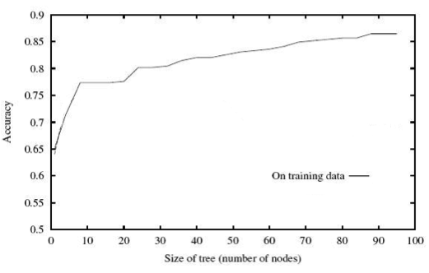
Overfitting
Our decision tree learning procedure always decreases training error
Is that what we want?

Slide 43
Test set error!
Machine learning is about predicting the future based on the past.
-- Hal Daume III
past
future
predict
learn
Training
Data
model/
predictor
Testing
Data
model/
predictor

Slide 44
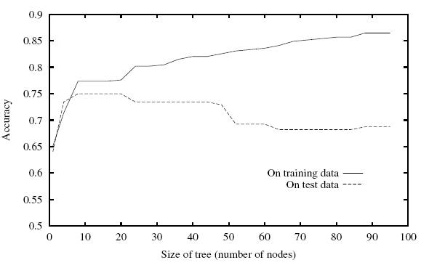
Overfitting
Even though the training error is decreasing, the testing error can go up!

Slide 45
Overfitting
Unicycle
Terrain | Unicycle-type | Weather | Go-For-Ride?
Trail | Mountain | Rainy | YES
Trail | Mountain | Sunny | YES
Road | Mountain | Snowy | YES
Road | Mountain | Sunny | YES
Trail | Normal | Snowy | NO
Trail | Normal | Rainy | NO
Road | Normal | Snowy | YES
Road | Normal | Sunny | NO
Trail | Normal | Sunny | NO
Mountain
Normal
YES
Terrain
Road
Trail
Weather
NO
Rainy
Snowy
Sunny
NO
YES
NO
How do we prevent overfitting?

Slide 46
Preventing overfitting
Base case:
If all data belong to the same class, create a leaf node with that label
OR all the data has the same feature values
OR We’ve reached a particular depth in the tree
?
One idea: stop building the tree early

Slide 47
Preventing overfitting
Base case:
If all data belong to the same class, create a leaf node with that label
OR all the data has the same feature values
OR We’ve reached a particular depth in the tree
We only have a certain number/fraction of examples remaining
We’ve reached a particular training error
Use development data (more on this later)
…

Slide 48
Preventing overfitting: pruning
Unicycle
Pruning: after the tree is built, go back and “prune” the tree, i.e. remove some lower parts of the tree
Similar to stopping early, but done after the entire tree is built
Mountain
Normal
YES
Terrain
Road
Trail
Weather
NO
Rainy
Snowy
Sunny
NO
YES
NO

Slide 49
Preventing overfitting: pruning
Unicycle
Mountain
Normal
YES
Terrain
Road
Trail
Weather
NO
Rainy
Snowy
Sunny
NO
YES
NO
Build the full tree

Slide 50
Preventing overfitting: pruning
Unicycle
Mountain
Normal
YES
Terrain
Unicycle
Road
Trail
Mountain
Normal
Weather
NO
YES
NO
Rainy
Snowy
Sunny
NO
YES
NO
Build the full tree
Prune back leaves that are too specific

Slide 51
Preventing overfitting: pruning
Unicycle
Mountain
Normal
YES
Terrain
Unicycle
Road
Trail
Mountain
Normal
Weather
NO
YES
NO
Rainy
Snowy
Sunny
NO
YES
NO
Pruning criterion?
Notes:
- many of the same things we used to “pre-prune”, i.e. stop building early

Slide 52
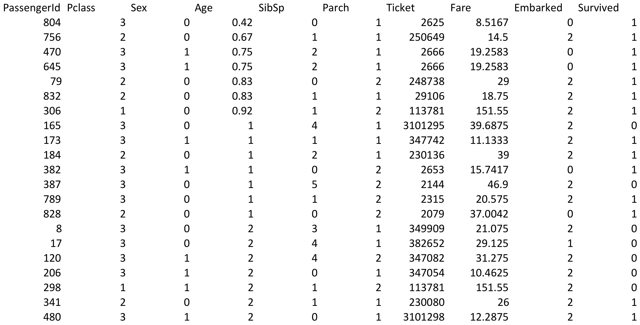
Handling non-binary attributes
What do we do with features that have multiple values? Real-values?

Slide 53
Features with multiple values
Rainy?
Rainy
not Rainy
Weather
NO
Snowy?
Rainy
Snowy
Sunny
Snowy
Sunny
NO
YES
NO
YES
NO
Treat as an n-ary split
Treat as multiple binary splits

Slide 54
Real-valued features
Use any comparison test (>, <, ≤, ≥) to split the data into two parts
Select a range filter, i.e. min < value < max
Fare < $20
Fare
Yes
No
0-10
>50
10-20
20-50

Slide 55
Other splitting criterion
Otherwise:
calculate the “score” for each feature if we used it to split the data
pick the feature with the highest score, partition the data based on that data value and call recursively
We used training error for the score. Any other ideas?

Slide 56
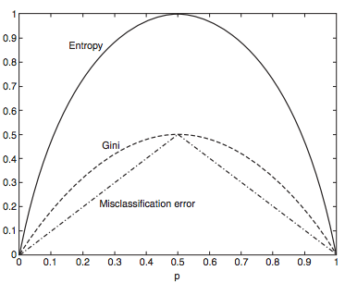
Other splitting criterion
- Entropy: how much uncertainty there is in the distribution over labels after the split
- Gini: sum of the square of the label proportions after split
- Training error = misclassification error
Notes:
All tend to perform roughly the same, so we often won’t worry too much about this

Slide 57
Decision Tree Algorithm
DT_train(data):
Base cases:
If all data belong to the same class, pick that label
If all the data have the same feature values, pick majority label
If we’re out of features to examine, pick majority label
If the we don’t have any data left, pick majority label of parent
If some other stopping criteria exists to avoid overfitting, pick majority label
Otherwise (i.e. if none of the base cases apply):
calculate the “score” for each feature if we used it to split the data
pick the feature with the highest score, partition the data based on that data, e.g. data_left and data_right
Recurse, i.e. DT_train(data_left) and DT_train(data_right)
Make tree with feature as the splitting criterion with the decision trees returned from the recursive calls as the children

Slide 58
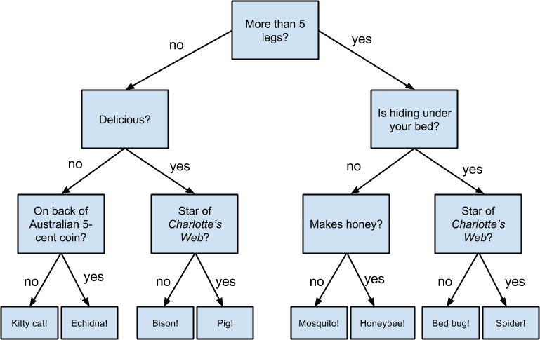
Decision trees
Good? Bad?

Slide 59
Decision trees: the good
Very intuitive and easy to interpret
Fast to run and fairly easy to implement
Historically, perform fairly well
Especially with a few more tricks…
No prior assumptions about the data

Slide 60
Decision trees: the bad
Can be problematic (slow, bad performance) with large numbers of features
Can’t learn some data sets with very simple underlying concepts
E.g., some types of linearly separable data
Why?
Greedy algorithm is non-optimal
Does not consider the relationship between attributes
Pruning/tuning can be tricky to get right

Slide 61
Recap
Decision trees are inductive learners
The trees are easy to understand
Hypothesis are human-readable
Many variants
Discrete (most common) and real attributes
Classification & regression
Tree construction (ID3, C4.5, etc.)
Split criteria (gain, gain ratio, Gini)

