Slide 1
Evaluation
Slides adapted from David Kauchak

Slide 2
Typical ML Workflow
Remove noisy features
Pick “good” features
Normalize feature values
center data
scale data (either variance or absolute)
Normalize example length (maybe)
Train your model
Test & Evaluate your model
Last Tuesday’s class
Last class
Today’s class

Slide 3
What about testing?
training data
(labeled examples)
pre-process data
Terrain | Unicycle-type | Weather | Go-For-Ride?
Trail | Normal | Rainy | NO
Road | Normal | Sunny | YES
Trail | Mountain | Sunny | YES
Road | Mountain | Rainy | YES
Trail | Normal | Snowy | NO
Road | Normal | Rainy | YES
Road | Mountain | Snowy | YES
Trail | Normal | Sunny | NO
Road | Normal | Snowy | NO
Trail | Mountain | Snowy | YES
Terrain | Unicycle-type | Weather | Go-For-Ride?
Trail | Normal | Rainy | NO
Road | Normal | Sunny | YES
Trail | Mountain | Sunny | YES
Road | Mountain | Rainy | YES
Trail | Normal | Snowy | NO
Road | Normal | Rainy | YES
Road | Mountain | Snowy | YES
Trail | Normal | Sunny | NO
Road | Normal | Snowy | NO
Trail | Mountain | Snowy | YES
learn
model/
classifier
“better” training data

Slide 4
What about testing?
test data
classify
Terrain | Unicycle-type | Weather | Go-For-Ride?
Trail | Normal | Rainy | NO
Road | Normal | Sunny | YES
Trail | Mountain | Sunny | YES
Road | Mountain | Rainy | YES
Trail | Normal | Snowy | NO
Road | Normal | Rainy | YES
Road | Mountain | Snowy | YES
Trail | Normal | Sunny | NO
Road | Normal | Snowy | NO
Trail | Mountain | Snowy | YES
model/
classifier
prediction

Slide 5
What about testing?
test data
pre-process data
classify
Terrain | Unicycle-type | Weather | Go-For-Ride?
Trail | Normal | Rainy | NO
Road | Normal | Sunny | YES
Trail | Mountain | Sunny | YES
Road | Mountain | Rainy | YES
Trail | Normal | Snowy | NO
Road | Normal | Rainy | YES
Road | Mountain | Snowy | YES
Trail | Normal | Sunny | NO
Road | Normal | Snowy | NO
Trail | Mountain | Snowy | YES
Terrain | Unicycle-type | Weather | Go-For-Ride?
Trail | Normal | Rainy | NO
Road | Normal | Sunny | YES
Trail | Mountain | Sunny | YES
Road | Mountain | Rainy | YES
Trail | Normal | Snowy | NO
Road | Normal | Rainy | YES
Road | Mountain | Snowy | YES
Trail | Normal | Sunny | NO
Road | Normal | Snowy | NO
Trail | Mountain | Snowy | YES
model/
classifier
prediction
Whatever you do on training, you have to do the EXACT same on testing!

Slide 6
Normalizing test data
Center: adjust the values so that the mean of that feature is 0: subtract the mean from all values
Rescale/adjust feature values to avoid magnitude bias:
Variance scaling: divide each value by the std dev
Absolute scaling: divide each value by the largest value
What values do we use when normalizing testing data?
Reuse the same ones from training normalization!

Slide 7
Normalizing test data
training data
(labeled examples)
Terrain | Unicycle-type | Weather | Go-For-Ride?
Trail | Normal | Rainy | NO
Road | Normal | Sunny | YES
Trail | Mountain | Sunny | YES
Road | Mountain | Rainy | YES
Trail | Normal | Snowy | NO
Road | Normal | Rainy | YES
Road | Mountain | Snowy | YES
Trail | Normal | Sunny | NO
Road | Normal | Snowy | NO
Trail | Mountain | Snowy | YES
Terrain | Unicycle-type | Weather | Go-For-Ride?
Trail | Normal | Rainy | NO
Road | Normal | Sunny | YES
Trail | Mountain | Sunny | YES
Road | Mountain | Rainy | YES
Trail | Normal | Snowy | NO
Road | Normal | Rainy | YES
Road | Mountain | Snowy | YES
Trail | Normal | Sunny | NO
Road | Normal | Snowy | NO
Trail | Mountain | Snowy | YES
learn
model/
classifier
mean, std dev, max,…
test data
pre-process data
classify
Terrain | Unicycle-type | Weather | Go-For-Ride?
Trail | Normal | Rainy | NO
Road | Normal | Sunny | YES
Trail | Mountain | Sunny | YES
Road | Mountain | Rainy | YES
Trail | Normal | Snowy | NO
Road | Normal | Rainy | YES
Road | Mountain | Snowy | YES
Trail | Normal | Sunny | NO
Road | Normal | Snowy | NO
Trail | Mountain | Snowy | YES
Terrain | Unicycle-type | Weather | Go-For-Ride?
Trail | Normal | Rainy | NO
Road | Normal | Sunny | YES
Trail | Mountain | Sunny | YES
Road | Mountain | Rainy | YES
Trail | Normal | Snowy | NO
Road | Normal | Rainy | YES
Road | Mountain | Snowy | YES
Trail | Normal | Sunny | NO
Road | Normal | Snowy | NO
Trail | Mountain | Snowy | YES
model/
classifier
prediction

Slide 8
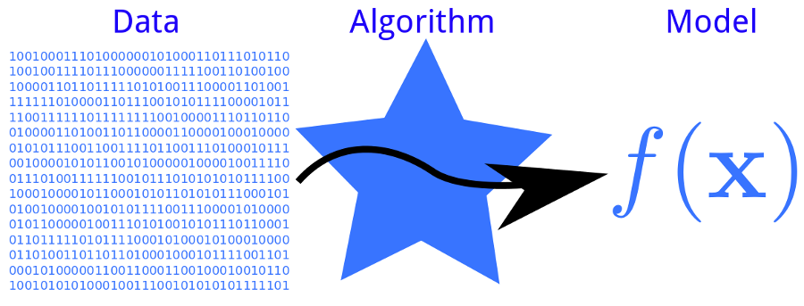
Basic ML Workflow
Remove noisy features
Pick “good” features
Normalize feature values
center data
scale data (either variance or absolute)
Normalize example length
Training
Testing
Evaluation

Slide 9
Supervised evaluation
Data
Label
Training data
0
0
1
Labeled data
1
0
1
Testing data
0

Slide 10
Supervised evaluation
Data
Label
Training data
0
0
model
1
Labeled data
train a
classifier
1
0
1
Testing data
0

Slide 11
Supervised evaluation
Data
Label
1
0
Pretend like we don’t know the labels

Slide 12
Supervised evaluation
Data
Label
1
1
model
1
0
Pretend like we don’t know the labels
Classify

Slide 13
Supervised evaluation
Data
Label
1
1
model
1
0
Pretend like we don’t know the labels
Classify
Compare predicted labels to actual labels

Slide 14
Comparing algorithms
1
model 1
1
Data
Label
1
Is model 2 better than model 1?
0
1
model 2
0

Slide 15
Idea 1
Predicted
Label
Evaluation
1
1
score 1
model 1
1
0
model 2 better if score 2 > score 1
Predicted
Label
1
1
model 2
score 2
0
0
When would we want to do this type of comparison?
Notes:
comparing different learning algorithms
comparing different hyperparameters
comparing different pre-processing techniques
figuring out who has the best algorithm
…

Slide 16
Is model 2 better?
Model 1: 85% accuracy
Model 2: 80% accuracy
Comparing scores on one data set isn’t enough!
Don’t want to know which system is better on particular data
Want to know which is better in general
Want confidence difference is real
not due to random chance
Model 1: 85.5% accuracy
Model 2: 85.0% accuracy
Model 1: 0% accuracy
Model 2: 100% accuracy

Slide 17
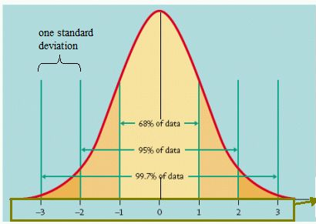
Variance
Recall that variance (or standard deviation) helped us predict how likely certain events are:
How do we know how variable a model’s accuracy is?

Slide 18
Variance
Recall that variance (or standard deviation) helped us predict how likely certain events are:
We need multiple accuracy scores!

Slide 19
Repeated experimentation
Data
Label
Training data
0
0
1
Rather than just splitting once, split multiple times
Labeled data
1
0
1
Testing data
0

Slide 20
Repeated experimentation
Data
Label
Data
Label
Data
Label
0
0
0
0
0
0
1
1
1
Training data
…
1
1
1
0
0
0
1
1
1
= train
= test

Slide 21
n-fold cross validation
break into n
equal-size parts
repeat for all parts/splits: train on n-1 parts optimize on the other
Training data
…
…
…
…
split 1
split 2
split 3

Slide 22
n-fold cross validation
evaluate
More robust for both evaluation and optimizing parameters
Multiplies the computational overhead by n
have to train n models instead of one
score 1
…
score 2
split 1
…
score 3
split 2
…
…
…
split 3

Slide 23
n-fold cross validation
What choice for n?
5 and 10 are common choice of n
1/n of training data is “wasted”
Not used for training
Maybe large n is good…
Leave-one-out cross validation
n-fold cross validation where n = number of examples
very expensive if training is slow
Useful in domains with limited training data

Slide 24
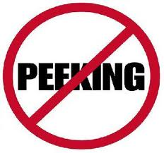
Data
Training
Data
All Training
Data
Validation
Data
Labeled
Data
Test
Data
cross-validation with t-test
(data with labels)
Notes:
No… the problem is that we only have one test set and we can’t resample, etc. because then we’ll have looked at the test data!

Slide 25
Experimentation
Never look at your test data!
During development
Compare different models/hyperparameters on validation data
use cross-validation to get more consistent results
For final evaluation, retrain with all training data
Can use bootstrap resampling combined with a t-test (see CIML)

Slide 26
Summary
Is model A generally better than model B?
The results of a single (or small) experiment can be misleading
Conduct multiple experiments & use statistical tests
Evaluation is common in machine learning
comparing different learning algorithms
comparing different hyperparameters
comparing different pre-processing techniques
figuring out who has the best algorithm

