Slide 1


「Course」
RISC-V Computer System Integration
「 Lecture 4」Creating RISC-V Project with Chipyard
Hoang Trong Thuc
2022/11
1

Slide 2
Today’s lecture purpose:
Learn the organization of chipyard framework.
Learn how to customize SoC architecture on chipyard framework.
Learn how to deploy a customize SoC into FPGA.
Today’s lecture description:
Describe the organization of chipyard framework.
Describe the procedure of customization SoC by using chipyard framework.
Describe the procedure of deploy a customize SoC into FPGA.
2

Slide 3
Outline
Chipyard organization
SoC Generation
FPGA Prototyping
Practice: customize your own core
3

Slide 4
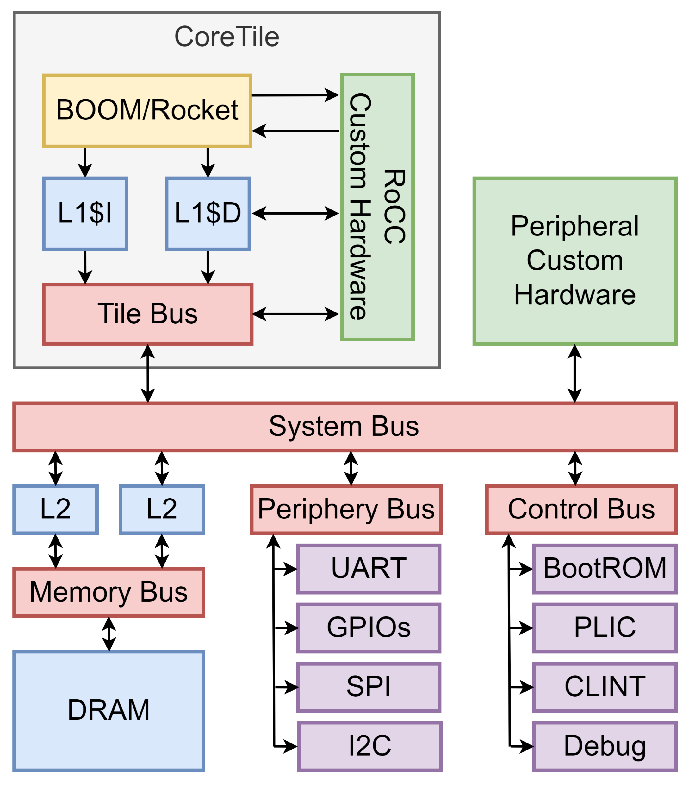
2. SoC Generation (1/11) SoC Architecture
In Chipyard framework, a SoC includes 5 components:
RISC-V Core (or Tile).
Memory system.
Bus system.
Custom hardware.
Peripherals.
13

Slide 5
Today’s lecture highlight:
Chipyard framework is deploy in three level: DigitalTop, ChipTop, ChipHarness.
DigitalTop define SoC architecture. ChipTop connects SoC with IOCell. ChipHarness connects IOCell with physical device.
To customize a SoC on chipyard framework, we begin defining SoC architecture. Then assigning address map, then perform IOBinders, HarnessBinders, define expected clock frequently. Finally, we generate the bitstream of our design system.
Next week lecture:
「 Lecture 5」 Computer System on Arty-A7
38

Slide 6
THANK YOU
2022/11
39

