Slide 1


「Course」
EDHOC on a Rocket RV64 SoC
「 Lesson 1 」 EDHOC SoC on Arty A7-100T
Khai-Duy Nguyen
2026/12
1

Slide 2
Today’s lecture purpose:
Turn the EDHOC hardware requirement into a Chipyard SoC: 64-bit Rocket, 8 KiB caches, 64 KiB on-chip RAM, GPIO / UART / JTAG / SPI.
Set up your PC and boards from a fresh clone, then map the SoC onto two Arty A7-100T boards: SD card, radio, UART and JTAG on the four PMOD ports.
Build the bitstream, close timing at 75 MHz, program both boards and check every peripheral with a test program.
Repository: github.com/Khaiduy/chipyard-edhoc (private: ask the author for access) · paths are relative to its root
2

Slide 3
Outline
Start Here
Requirements → Hardware
SoC Configuration
FPGA Pins & Harness
Build & Timing Closure
Programming & Bring-up
Practice
3

Slide 4
Outline
Start Here
Requirements → Hardware
SoC Configuration
FPGA Pins & Harness
Build & Timing Closure
Programming & Bring-up
Practice
4

Slide 5
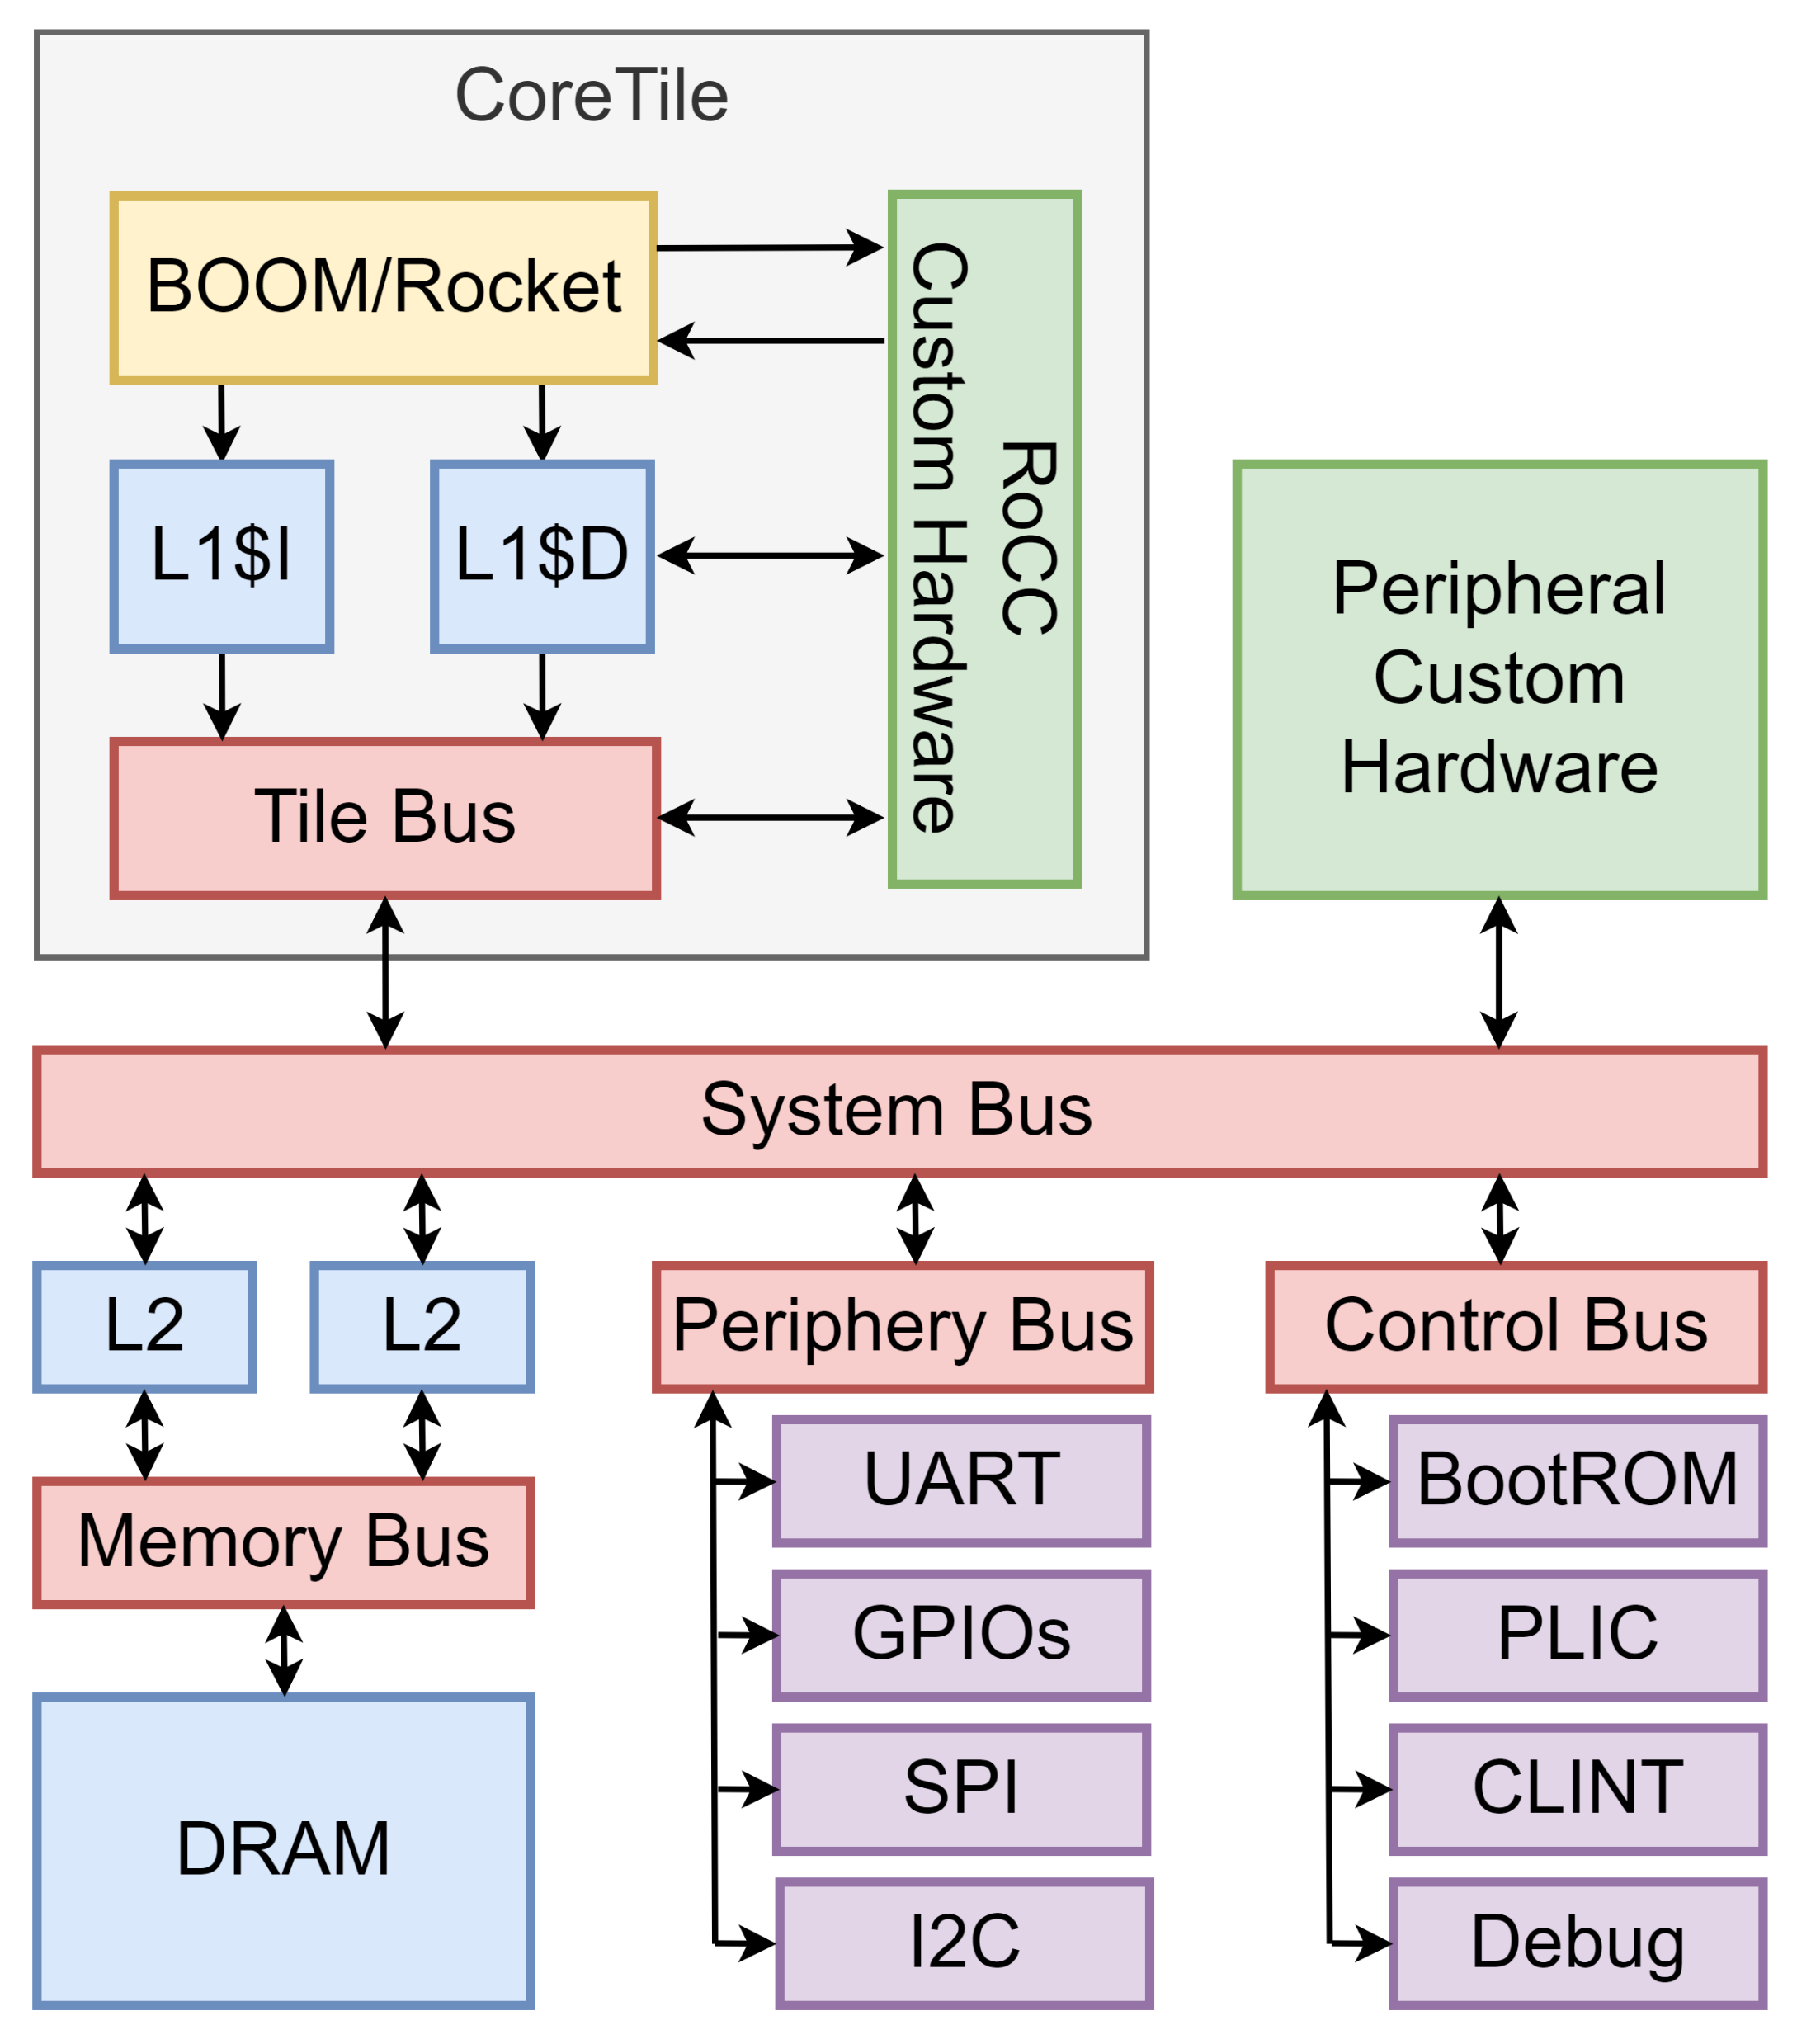
1. Start Here (1/8) The learning path
Clone
Prepare
hardware
Run a
handshake
Understand
the bytes
Transfer
a file
Measure
Diagnose
failures
L1
L1, L2
L3, L4
L3, L4
L5
L3–L5
L2–L5
At the end of the course you can, with only these slides and the repository:
configure your own two boards (cables, consoles, wiring);
run one classical (RFC 9528) and one post-quantum (AuthKEM) handshake and explain the important output lines;
send a file from one SD card to the other and prove it arrived intact;
find the cause of a deliberately broken build or link, and restore it.
Lesson map: 1 hardware SoC · 2 software and first runs · 3 EDHOC · 4 post-quantum EDHOC · 5 file transfer, performance, diagnosis.
5

Slide 6
1. Start Here (2/8) Equipment
Item | Qty | Notes
Digilent Arty A7-100T | 2 | one board per party (initiator A, responder B)
micro-USB cable | 2 | power, FPGA programming and the console of each Arty
FTDI C232HM-DDHSL-0 USB–JTAG cable (3.3 V) | 2 | core debug on PMOD JD; leave its red VCC wire unconnected
microSD PMOD adapter (PmodSD) + microSD card | 2 | PMOD JA; any SDHC / SDXC card — it gets erased
MRF24J40MA 802.15.4 module on a PMOD adapter | 2 | PMOD JC; adapter: [part no.]
SD card reader (optional) | 1 | copy your own files; without one, sd_prep does it over JTAG
3 jumper wires (optional) | – | wired UART1 link on PMOD JB (GND, TX↔RX crossed); 3× faster than the radio
Wiring of every PMOD, pin by pin: section 4 (2/8).
6

Slide 7
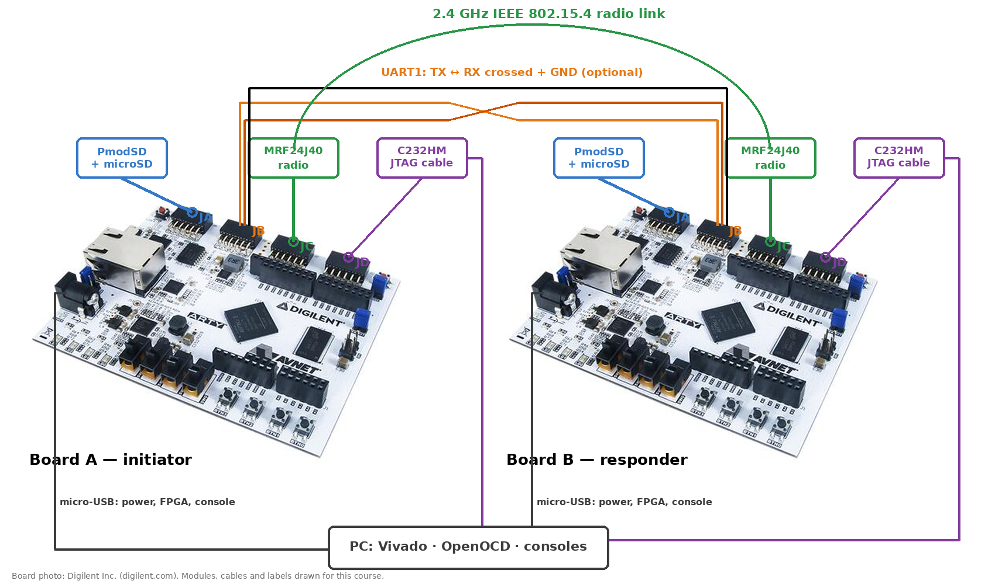
1. Start Here (3/8) How everything is connected
Same wiring on both boards; the 3 UART wires on JB are optional (TRANSPORT=uart). Pin by pin: section 4 (2/8). Arty A7-35 shown; the A7-100T looks the same.
7

Slide 8
1. Start Here (4/8) Software
Software | Tested version | Needed for
Ubuntu (x86-64) | 24.04 LTS | host PC
Vivado ML Standard (free) or Vivado Lab | 2024.2 | building (route A) and programming the FPGAs
Chipyard and its conda environment | 1.11.0 + this fork | route A only
riscv64-unknown-elf-gcc, rv64imac / lp64 multilib | 15.1.0 | all firmware
OpenOCD with RISC-V and FTDI support | 0.12.0+dev | loading firmware over JTAG
Python 3 | 3.11 | host tests, timing tables, reference model
pip: pyfatfs pycryptodome cryptography kyber-py | – | FAT32 host test, AuthKEM reference model
dosfstools (mkfs.vfat, fsck.fat) | 4.2 | FAT32 host test, mksd.sh
USB access without sudo: install Vivado's cable drivers (Digilent) and OpenOCD's 60-openocd.rules (C232HM), and be in the dialout / plugdev groups for the consoles.
Other versions may work; these are the ones every result in the course came from.
8

Slide 9
1. Start Here (5/8) Get the code — two routes
Run this — on your PC
git clone git@github.com:Khaiduy/chipyard-edhoc.git chipyard
cd chipyard
git checkout edhoc-course-v1 # the revision these slides describe
Route | Your goal | Setup | Then
A — full hardware build | learn how the SoC is generated and placed on the FPGA | ./build-setup.sh riscv-tools; source env.sh; ./scripts/init-fpga.sh; ./patches/apply.sh | Lesson 1 from section 2
B — firmware only | run and study the protocols on boards that already hold the EDHOC bitstream | cd fpga/sw/export; toolchain + OpenOCD (Lesson 2, section 1) | Lesson 1, section 6, then Lesson 2
The repository is private: ask the author to add your GitHub account, then clone with your own SSH key.
No prebuilt bitstream ships with the course: route B needs a bitstream built from the same revision (route A), e.g. by your lab, written to the boards' flash or kept as a .bit.
The firmware tree fpga/sw/export/ is self-contained (all code vendored) and needs only the toolchain, OpenOCD and Python — not Chipyard.
9

Slide 10
1. Start Here (6/8) Readiness check
Run this — from the repository root
vivado -version | head -1 # Vivado v2024.2 ...
riscv64-unknown-elf-gcc --version | head -1 # ... 15.1.0
openocd --version 2>&1 | head -1 # Open On-Chip Debugger 0.12.0 ...
cd fpga/sw/export && ./common/board/list_boards.sh
Example output — our lab (your serials differ)
C232HM JTAG FTA6GPSN (C232HM-DDHSL-0)
Arty console 210319B4A439 /dev/ttyUSB4
C232HM JTAG FTA6JVAK (C232HM-DDHSL-0)
Arty console 210319B269F6 /dev/ttyUSB1
Expect two Arty lines, each with a tty, and two C232HM lines.
If | Check first
an Arty is missing | USB cable, board power switch, Vivado cable drivers
an Arty has no tty | dialout / plugdev group (log out and in), Vivado holding the port
a C232HM is missing | USB plug, OpenOCD udev rules (0403:6014)
10

Slide 11
1. Start Here (7/8) How to read the practical slides
Run this — from fpga/sw/export/tests
make gpio_test
Example output — board A
GPIO TEST: PASS (0 failures)
Simplified — common/src/sd_card.c
while (busy) ... /* shortened: not runnable */
Run this boxes are complete commands, in order, with the directory they start from. Example output boxes are real console text. Simplified boxes shorten source code with “...” — read them, do not paste them.
Every lab follows the same steps: objective → starting state → commands → expected output → what it proves → if it fails.
Serial numbers, tty names and times in examples come from our lab; yours differ. Lesson 2 shows how to set up your own.
11

Slide 12
1. Start Here (8/8) Words used in this course
Term | Meaning | Term | Meaning
EDHOC | Ephemeral Diffie-Hellman Over COSE (RFC 9528) | AEAD | encryption + integrity tag (AES-CCM, AES-GCM, ChaCha20/Poly1305)
initiator / responder | board A / board B: who sends message_1 / who answers | KEM | key encapsulation: (ct, ss) = Encaps(pk); ss = Decaps(sk, ct)
suite | set of algorithms (curve or KEM, hash, AEAD) | ML-KEM | the NIST post-quantum KEM (FIPS 203)
method | how each side proves itself: signature or static DH | AuthKEM | post-quantum EDHOC, method 5 (IETF draft)
CBOR / COSE | compact binary encoding / its security formats | PRK_out | the shared secret EDHOC ends with
CRED / ID_CRED / kid | a public-key credential / a short reference to it / key id | TH_n | transcript hash: everything sent so far
PMOD | Digilent 12-pin expansion socket | PERF / STACK | console lines with timing / stack use
Every later lesson uses these words without repeating them; come back here when one is unclear.
12

Slide 13
Outline
Start Here
Requirements → Hardware
SoC Configuration
FPGA Pins & Harness
Build & Timing Closure
Programming & Bring-up
Practice
13

Slide 14
2. Requirements → Hardware (1/4) What the design asks for, and what we chose
Item | Asked for | Built | Why
Core | Rocket, 64-bit | Rocket RV64IMAC (small core)
L1 caches | 8 KiB I$ + 8 KiB D$ | 8 KiB I$ + 8 KiB D$
RAM | 32 KiB minimum | 64 KiB on-chip scratchpad | code + stack, next slide
Peripherals | GPIO, UART, JTAG, SPI | 8 GPIO, 2 UART, 3 SPI, JTAG debug
Clock | 100 MHz | 75 MHz | timing result, (3/4)
FPGA | Artix-7 100T | Arty A7-100T (xc7a100tcsg324-1)
Two items differ from what was asked; the next two slides show why, and how to check it yourself.
Board-to-board traffic goes over an MRF24J40 802.15.4 radio; files come from a microSD card.
14

Slide 15
2. Requirements → Hardware (2/4) Why 64 KiB of RAM
Largest build of each cipher suite (EDHOC suites 0–25, post-quantum TBD1–3), in bytes.
Everything fits 64 KiB = 65,536 B; largest: suite 25 = 60,457 B, TBD3 = 61,445 B.
Smallest build (suite 4, method 3) needs ≈ 32.4 KB with its stack: only method 3 of suites 0 / 1 / 4 fits 32 KiB, and barely.
Check any build yourself: Lesson 2, “Will my build fit?”.
The requirement says “minimum 32 KiB”, so 64 KiB is within it.
15

Slide 16
2. Requirements → Hardware (3/4) Why 75 MHz instead of 100 MHz
Target clock | Worst slack (WNS) | Failing endpoints | Result
100 MHz | −3.191 ns | 4,372 of 24,321 | Fmax ≈ 1 / 13.19 ns = 75.8 MHz
75 MHz | 0.000 ns (met) | 0 of 24,148 | Used
The critical path is inside the Rocket core, not in our peripherals:
fetch queue → RVC expander → decoder → hazard check → EX operand register
13 LUT levels, 83 % of the delay is routing
Result of this implementation (Vivado 2024.2, this config and flow, speed grade -1): 100 MHz failed timing, 75 MHz closes. A different flow, constraints or core configuration can change that — re-check after any change.
The clock is set in one place, WithTinyArty100TTweaks(75) (section 3); the check is report/timing.txt (section 5).
16

Slide 17
2. Requirements → Hardware (4/4) The two-board system
Board A — Initiator
Arty A7-100T
Board B — Responder
Arty A7-100T
Rocket RV64 · 75 MHz
64 KiB scratchpad · 8 KiB I$/D$
2.4 GHz IEEE 802.15.4 radio
EDHOC handshake + encrypted file
Rocket RV64 · 75 MHz
64 KiB scratchpad · 8 KiB I$/D$
JA
microSD
JB
UART1
JC
MRF24J40
JD
JTAG
JA
microSD
JB
UART1
JC
MRF24J40
JD
JTAG
PC: OpenOCD + C232HM
USB-UART console
PC: OpenOCD + C232HM
USB-UART console
Same bitstream on both boards; the firmware decides the role.
SD card on JA holds SEND.BIN (board A) and RECV.BIN (board B).
PHOTO
both boards wired: JA SD, JC radio, JD JTAG cable
17

Slide 18
Outline
Start Here
Requirements → Hardware
SoC Configuration
FPGA Pins & Harness
Build & Timing Closure
Programming & Bring-up
Practice
18

Slide 19
3. SoC Configuration (1/7) One config class builds the SoC
The bitstream is built from EdhocRocket6475MHzArty100TConfig in fpga/src/main/scala/arty100t/Configs.scala:
class EdhocRocket6475MHzArty100TConfig extends Config(
new WithArtyJCRadio ++ // board-to-board link: MRF24J40 on PMOD JC (SPI1)
new WithTinyArty100TTweaks(75) ++ // Arty shell, peripherals, all bus clocks = 75 MHz
new chipyard.config.WithBroadcastManager ++ // coherence without an L2 cache
new chipyard.EdhocRocket64Config // the SoC itself (next slide)
)
Chipyard configs are a chain of fragments joined with ++; a fragment on the left overrides the ones on its right.
Read it bottom-up: the SoC → how memory coherence works → the board shell and clock → the radio pin variant.
Same pattern as the Chipyard lecture (04: MyRocketConfig on Arty 35T), on the 100T board.
19

Slide 20
3. SoC Configuration (2/7) EdhocRocket64Config: the SoC
generators/chipyard/src/main/scala/config/EdhocConfigs.scala
class EdhocRocket64Config extends Config(
new freechips.rocketchip.subsystem.WithL1ICacheSets(128) ++ // 8 KiB I-cache
new freechips.rocketchip.subsystem.WithL1DCacheSets(128) ++ // 8 KiB D-cache
new chipyard.harness.WithDontTouchChipTopPorts(false) ++
new testchipip.soc.WithMbusScratchpad(base = 0x80000000L,
size = BigInt(64 << 10)) ++ // 64 KiB on-chip SRAM
new freechips.rocketchip.subsystem.WithNoMemPort ++ // no DDR / off-chip memory
new freechips.rocketchip.subsystem.WithNSmallCores(1) ++ // one small Rocket, RV64
new freechips.rocketchip.subsystem.WithoutTLMonitors ++
new chipyard.config.AbstractConfig)
Fragment | Effect
WithNSmallCores(1) | 1 Rocket tile, RV64IMAC, no FPU
WithL1I/DCacheSets(128) | 128 sets → 8 KiB caches
WithMbusScratchpad | 64 KiB SRAM at 0x8000_0000 (BRAM)
WithNoMemPort | no DDR: all code + data on chip
WithoutTLMonitors | smaller, faster (no protocol checkers)
Everything the firmware uses — code, data, stack — lives in the 64 KiB scratchpad. There is no external RAM on this SoC.
The Arty’s 256 MB DDR3 is left unused: the requirement asks for on-chip RAM, and the whole firmware fits on chip.
20

Slide 21
3. SoC Configuration (3/7) Cache size and fragment order
128 sets
×
1 way
×
64 B / line
=
8 KiB per cache
WithNSmallCores(1) creates the tile with small default caches; WithL1ICacheSets / WithL1DCacheSets rewrite those tile parameters.
A rewrite only sees tiles that already exist, so the cache fragments must stay to the left of WithNSmallCores in the chain.
Wrong order builds without error but gives the default cache size — check the generated .dts / .json or the utilization report after a change.
Small core = RV64IMAC: integer, multiply/divide, atomics, compressed; no floating point (the firmware is integer-only).
21

Slide 22
3. SoC Configuration (4/7) Memory map
Address | Size | Device | Used for
0x0000_0000 | 4 KiB | Debug module | JTAG debugging / program loading
0x0001_0000 | 8 KiB | Boot ROM (sdboot) | copies the firmware from the SD card at reset
0x0200_0000 | 64 KiB | CLINT | timer, software interrupts
0x0C00_0000 | 64 MiB | PLIC | external interrupts (unused by the firmware)
0x6400_0000 | 4 KiB | UART0 | USB-UART console, 57600 baud
0x6400_1000 | 4 KiB | SPI0 | microSD card (PMOD JA)
0x6400_2000 | 4 KiB | GPIO, 8 pins | 4 LEDs, RGB LED, radio ~RST / INT
0x6400_3000 | 4 KiB | UART1 | PMOD JB (optional wired link)
0x6400_5000 | 4 KiB | SPI2 | spare
0x6400_6000 | 4 KiB | SPI1 | MRF24J40 radio (PMOD JC)
0x8000_0000 | 64 KiB | Scratchpad SRAM | code, data and stack
The firmware’s common/include/platform.h uses the same addresses.
22

Slide 23
3. SoC Configuration (5/7) Peripherals and their addresses
fpga/src/main/scala/arty100t/Configs.scala
class WithDefaultPeripherals extends Config((site, here, up) => {
case PeripheryUARTKey => List(
UARTParams(address = BigInt(0x64000000L)), // UART0 - USB UART
UARTParams(address = BigInt(0x64003000L))) // UART1 - PMOD JB (with the radio)
case PeripherySPIKey => List(
SPIParams(rAddress = BigInt(0x64001000L)), // SPI0 - SD card
SPIParams(rAddress = BigInt(0x64006000L)), // SPI1 - radio
SPIParams(rAddress = BigInt(0x64005000L))) // SPI2
case PeripheryGPIOKey => List(GPIOParams(address = BigInt(0x64002000L), width = 8))
})
The UART, SPI and GPIO blocks are SiFive’s open-source peripherals (sifive-blocks), the same as in the Chipyard lecture (04).
Each list entry is one controller instance; the list index is the port number used by the overlays in section 3 (SPI0 → JA, SPI1 → JC).
Addresses are free to choose inside the peripheral bus window; keep them in step with the firmware headers.
23

Slide 24
3. SoC Configuration (6/7) One clock for the whole SoC
fpga/src/main/scala/arty100t/Configs.scala
class WithTinyArty100TTweaks(freqMHz: Double = 50) extends Config(
new chipyard.harness.WithHarnessBinderClockFreqMHz(freqMHz) ++
new chipyard.config.WithMemoryBusFrequency(freqMHz) ++
new chipyard.config.WithFrontBusFrequency(freqMHz) ++
new chipyard.config.WithSystemBusFrequency(freqMHz) ++
new chipyard.config.WithPeripheryBusFrequency(freqMHz) ++
new chipyard.config.WithControlBusFrequency(freqMHz) ++
new chipyard.config.WithOffchipBusFrequency(freqMHz) ++
new chipyard.clocking.WithPassthroughClockGenerator ++
new WithArty100TUARTHarnessBinder ++ new WithArty100TSPISDCardHarnessBinder ++
new WithArty100TJTAGHarnessBinder ++ new WithArty100TGPIOHarnessBinder ++
...
new WithDefaultPeripherals ++ new WithSystemModifications ++ ...)
(75) sets all seven bus clocks at once.
Chipyard 1.11 added front / control / off-chip bus clocks that default to 500 MHz; every bus in the clock group must ask for the same frequency.
The board’s 100 MHz oscillator (pin E3) feeds a PLL that makes 75 MHz.
Firmware must know the clock too: PERF_CPU_HZ / F_CPU = 75000000 (UART divider, SPI dividers, timing reports).
24

Slide 25
3. SoC Configuration (7/7) Boot ROM rebuilt for RV64
fpga/src/main/scala/arty100t/Configs.scala
class WithSystemModifications extends Config((site, here, up) => {
case BootROMLocated(x) => up(BootROMLocated(x), site).map{ p =>
val freqMHz = (site(SystemBusKey).dtsFrequency.get / (1000 * 1000)).toLong
val make = s"make -C fpga/src/main/resources/arty35t/sdboot " +
s"XLEN=${site(XLen)} PBUS_CLK=${freqMHz}"
require (make.! == 0, "Failed to build bootrom")
p.copy(hang = 0x10000, size = 0x2000,
contentFileName = s"./fpga/src/main/resources/arty35t/sdboot/build/sdboot.bin")
}
...
Every bitstream build recompiles the boot ROM for the core width (XLEN=64) and the bus clock (PBUS_CLK=75).
At reset the boot ROM copies the firmware from the SD card (LBA 2048) into the scratchpad and jumps to 0x8000_0000.
During development we skip it: firmware is loaded over JTAG in seconds (section 5).
25

Slide 26
Outline
Start Here
Requirements → Hardware
SoC Configuration
FPGA Pins & Harness
Build & Timing Closure
Programming & Bring-up
Practice
26

Slide 27
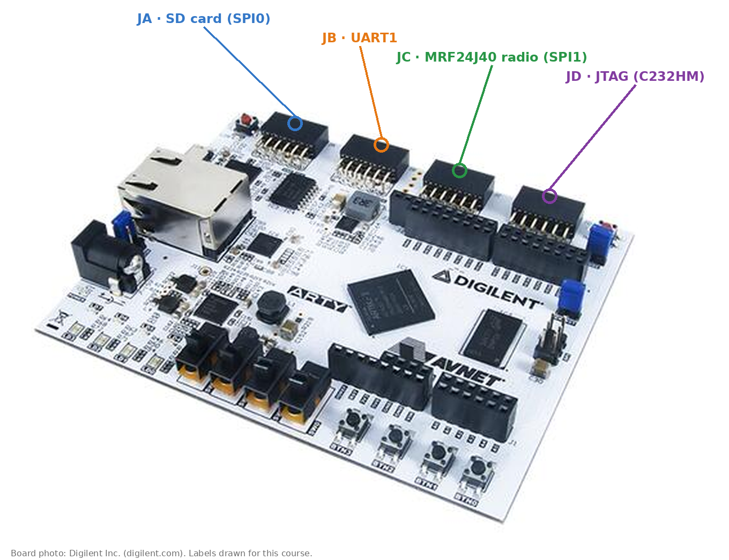
4. FPGA Pins & Harness (1/8) PMOD map
PMOD | Module | Controller | Pins (PMOD pin: FPGA pin)
JA | microSD (PmodSD) | SPI0 @0x6400_1000 | 1 CS: G13 · 2 MOSI: B11 · 3 MISO: A11 · 4 SCK: D12
JB | UART1 | UART1 @0x6400_3000 | 1 RX: E15 · 2 TX: E16
JC | MRF24J40 radio | SPI1 @0x6400_6000 + GPIO 5 / 7 | 1 CS: U12 · 2 MOSI: V12 · 3 MISO: V10 · 4 SCK: V11 · 7 INT: U14 · 8 ~RST: V14
JD | JTAG (C232HM cable) | Debug module | 1 TDI: D4 · 2 TMS: D3 · 3 TCK: F4 · 4 TDO: F3
Same wiring on both boards.
JC used to carry UART1; it moved to JB to free JC for the radio.
The USB-UART console (UART0) uses the on-board FTDI chip, no PMOD.
27

Slide 28
4. FPGA Pins & Harness (2/8) Wiring: pin numbers, direction, power
1
2
3
4
5 GND
6 3.3V
Every PMOD is a 2 × 6 socket: top row 1–6, bottom row 7–12. Pins 5 / 11 are GND, 6 / 12 are 3.3 V. Pin 1 is marked on the board's silkscreen.
7
8
9
10
11 GND
12 3.3V
PMOD | FPGA → module (outputs) | module → FPGA (inputs) | Power
JA SD | 1 CS, 2 MOSI, 4 SCK | 3 MISO | 5 GND, 6 3.3 V
JB UART1 | 2 TX | 1 RX | 5 GND; to the other board: TX → RX, RX ← TX, GND
JC radio | 1 CS, 2 MOSI, 4 SCK, 8 ~RST | 3 MISO, 7 INT | 5 / 11 GND, 6 / 12 3.3 V
JD JTAG | 4 TDO | 1 TDI, 2 TMS, 3 TCK | 5 GND (black wire); red VCC unconnected
Same wiring on both boards. The SD and radio modules take 3.3 V from the PMOD; the C232HM only shares ground.
Check before power-on: every module's GND on pin 5 (and 11), no 5 V anywhere.
28

Slide 29
4. FPGA Pins & Harness (3/8) From SoC port to FPGA pin
DigitalTop
SoC: UART, SPI,
GPIO, JTAG ports
IOBinder
port → IO cell
(ChipTop)
HarnessBinder
IO cell → shell port
(Arty100TWithoutDDRHarness)
Shell overlay
shell port → package
pin + IO standard (XDC)
File (fpga/src/main/scala/arty100t/) | What we changed
Configs.scala | EDHOC configs, peripherals, clock tweak, radio switch
IOBinders.scala | SPI / GPIO punch-through ports (WithArtySPIIOPunchthrough)
HarnessBinders.scala | UART, SPI-SD, JTAG (PMOD JD), GPIO binders
CustomShell.scala | shell with 3 SPI overlays, 2 UARTs, JTAG, GPIO
CustomOverlay.scala | package pins of every overlay (next slides)
Same three levels as in the Chipyard lecture (04): DigitalTop → ChipTop → ChipHarness.
29

Slide 30
4. FPGA Pins & Harness (4/8) SD card on PMOD JA (SPI0)
CustomOverlay.scala — SDIOArtyPlacedOverlay
case 0 => Seq(("D12", IOPin(io.spi_clk)), // SPI0 - PMOD JA (SD card)
("B11", IOPin(io.spi_cs)),
("A11", IOPin(io.spi_dat(0))),
("D13", IOPin(io.spi_dat(1))),
("B18", IOPin(io.spi_dat(2))),
("G13", IOPin(io.spi_dat(3))))
The SDIO overlay uses SD-card pin names: the pin called spi_cs carries MOSI, and CS goes out on dat(3).
Pull-ups on CS, MOSI and MISO.
Same pins as upstream Chipyard’s Arty 100T SD slot.
Card init at ~150 kHz, data at ~2.3 MHz (SPI mode).
Overlay pin | Carries | PMOD pin | PmodSD
G13 spi_dat(3) | chip select | JA1 | CS
B11 spi_cs | MOSI (command) | JA2 | MOSI
A11 spi_dat(0) | MISO (data 0) | JA3 | MISO
D12 spi_clk | clock | JA4 | SCK
PHOTO
PmodSD with microSD card on JA
30

Slide 31
4. FPGA Pins & Harness (5/8) MRF24J40 radio on PMOD JC (SPI1 + GPIO)
CustomOverlay.scala — SPI1 with the radio
case 1 if shell.p(ArtyJCRadioKey) =>
Seq(("V11", IOPin(io.spi_clk)), // JC4 SCK
("V12", IOPin(io.spi_cs)), // JC2 MOSI
("V10", IOPin(io.spi_dat(0))), // JC3 MISO
("F6", IOPin(io.spi_dat(1))), // unused (freed RGB LED pin)
("G4", IOPin(io.spi_dat(2))), // unused (freed RGB LED pin)
("U12", IOPin(io.spi_dat(3)))) // JC1 CS
WithArtyJCRadio sets ArtyJCRadioKey = true; the overlays then pick the radio pinout.
MRF24J40MA: IEEE 802.15.4, 2.4 GHz, 250 kbit/s; SPI at 4.7 MHz.
GPIO 5 drives the radio’s reset, GPIO 7 reads its interrupt line (polled).
Two RGB-LED pins are given up for this.
CustomOverlay.scala — GPIO
val gpioLocations = List("H5", "J5", "T9", "T10", // 4 LEDs
"E1", // RGB LED
if (radio) "V14" else "F6", // JC8 ~RST
"G6",
if (radio) "U14" else "G4") // JC7 INT
PHOTO
MRF24J40MA module on PMOD JC
31

Slide 32
4. FPGA Pins & Harness (6/8) UART0 console and UART1 on PMOD JB
CustomOverlay.scala — UARTArtyPlacedOverlay
// UART0: USB UART (A9=RX, D10=TX)
// UART1: PMOD C (U12=RX, V12=TX), or PMOD B (E15=RX, E16=TX) with the radio
val packagePinsWithPackageIOs = shellInput.index match {
case 0 => Seq(("A9", IOPin(io.rxd)), // USB UART RX
("D10", IOPin(io.txd))) // USB UART TX
case 1 if shell.p(ArtyJCRadioKey) => Seq(
("E15", IOPin(io.rxd)), // PMOD B JB1 - RX
("E16", IOPin(io.txd))) // PMOD B JB2 - TX
case 1 => Seq(("U12", IOPin(io.rxd)), // PMOD C JC1 - RX
("V12", IOPin(io.txd))) // PMOD C JC2 - TX
}
UART0 = console through the board’s USB port, 57600 baud, 8N1.
UART1 = optional wired link between the boards (TRANSPORT=uart).
With the radio, UART1 moves from JC to JB.
Each board shows up as two ttyUSB devices; the console is interface 1 of the Digilent FTDI. Find it by serial number, because ttyUSB numbers change when Vivado or OpenOCD opens a port (section 5).
32

Slide 33
4. FPGA Pins & Harness (7/8) JTAG on PMOD JD with a C232HM cable
C232HM wire | FTDI pin | Signal | PMOD JD | FPGA pin
Orange | ADBUS0 | TCK | JD3 | F4
Yellow | ADBUS1 | TDI | JD1 | D4
Green | ADBUS2 | TDO | JD4 | F3
Brown | ADBUS3 | TMS | JD2 | D3
Black | GND | GND | JD5 (GND) | –
The core’s debug module is wired to PMOD JD, not to the board’s USB JTAG (that one programs the FPGA).
One C232HM per board; scripts pick the cable by its FTDI serial (common/board/boards.env).
JTAG clock 1 MHz (adapter speed 1000).
fpga/sw/export/common/board/c232hm.cfg
source [find interface/ftdi/c232hm.cfg]
transport select jtag
adapter speed 1000
# RISC-V debug DTM: 5-bit IR
jtag newtap riscv tap -irlen 5 -ignore-version
target create riscv.cpu riscv -chain-position riscv.tap
PHOTO
C232HM cable on PMOD JD
33

Slide 34
4. FPGA Pins & Harness (8/8) Makefile entry
fpga/Makefile
ifeq ($(SUB_PROJECT),arty100t)
SBT_PROJECT ?= fpga_platforms
MODEL ?= Arty100TWithoutDDRHarness # was Arty100THarness
VLOG_MODEL ?= Arty100TWithoutDDRHarness
MODEL_PACKAGE ?= chipyard.fpga.arty100t
CONFIG ?= SmallRocket32Arty100TConfig # default; override on the command line
CONFIG_PACKAGE ?= chipyard.fpga.arty100t
GENERATOR_PACKAGE ?= chipyard
...
SUB_PROJECT ?= arty100t is now the default sub-project (upstream: vcu118).
Arty100TWithoutDDRHarness: our harness without the DDR3 controller (the SoC has no memory port).
The EDHOC config is chosen at build time: CONFIG=EdhocRocket6475MHzArty100TConfig (next section).
34

Slide 35
Outline
Start Here
Requirements → Hardware
SoC Configuration
FPGA Pins & Harness
Build & Timing Closure
Programming & Bring-up
Practice
35

Slide 36
5. Build & Timing Closure (1/5) Build the bitstream
Run this — about 1 h on a recent PC
cd chipyard # repository root, route A set up (section 1)
source env.sh
cd fpga
make SUB_PROJECT=arty100t CONFIG=EdhocRocket6475MHzArty100TConfig bitstream
echo $? # 0 = done; 2 = timing failed (a .bit is still written)
Output folder: fpga/generated-src/chipyard.fpga.arty100t.Arty100TWithoutDDRHarness.EdhocRocket6475MHzArty100TConfig/obj/
Arty100TWithoutDDRHarness.bit — the bitstream
report/timing.txt, report/utilization.txt — check these after every build
post_opt.dcp, post_route.dcp — checkpoints for timing closure
Careful: if timing fails, make stops with exit code 2 but still writes the .bit file. Always read timing.txt before using a new bitstream.
36

Slide 37
5. Build & Timing Closure (2/5) Resources used
Resource | Used | Available (XC7A100T) | Use
Slice LUTs | 14,672 | 63,400 | 23.1 %
Flip-flops | 6,716 | 126,800 | 5.3 %
Block RAM (36 Kb) | 34 + 10 half | 135 | 28.9 %
DSP slices | 10 | 240 | 4.2 %
16 of the 34 block RAMs are the 64 KiB scratchpad (16 × 4 KiB).
The rest: caches, boot ROM, peripheral FIFOs.
Plenty of room left: in this build, timing, not area, was the constraint.
From report/utilization.txt (report_utilization -hierarchical):
| Instance | Module | Total LUTs | FFs | RAMB36 | RAMB18 | DSP |
| Arty100TWithoutDDRHarness | (top) | 14672 | 6716 | 34 | 10 | 10 |
| chiptop0 | ChipTop | 14666 | 6630 | 34 | 10 | 10 |
| system | DigitalTop | 14663 | 6624 | 34 | 10 | 10 |
| bank | ScratchpadBank | 67 | 109 | 16 | 0 | 0 |
37

Slide 38
5. Build & Timing Closure (3/5) Reading the timing report
report/timing.txt — Design Timing Summary, 75 MHz build:
WNS(ns) TNS(ns) TNS Failing Endpoints TNS Total Endpoints WHS(ns) THS(ns) THS Failing Endpoints
0.000 0.000 0 24148 0.000 0.000 0
Clock WNS(ns) TNS(ns) TNS Failing TNS Total WHS(ns)
clk_out1_harnessSysPLL 0.000 0.000 0 23458 0.000
JTCK 41.206 0.000 0 548 0.140
Same report for the 100 MHz attempt (EdhocRocket64100MHzArty100TConfig):
WNS(ns) TNS(ns) TNS Failing Endpoints TNS Total Endpoints WHS(ns)
-3.191 -5498.651 4372 24321 0.018
WNS (worst negative slack) ≥ 0 and 0 failing endpoints for setup (TNS) and hold (THS) = timing met.
clk_out1_harnessSysPLL is the 75 MHz system clock; JTCK is the JTAG clock from PMOD JD (10 MHz constraint, easily met).
38

Slide 39
5. Build & Timing Closure (4/5) When timing fails: the closure recipe
75 MHz is close to the limit (≈ 75.8 MHz). Any pin change moves placement and can flip the result: our radio-pin build first came out at −0.166 ns.
Recipe used to close it, starting from the post_opt.dcp checkpoint in Vivado:
open_checkpoint obj/post_opt.dcp
place_design -directive Explore
phys_opt_design -directive AlternateFlowWithRetiming
route_design -directive AggressiveExplore
phys_opt_design -directive Explore ;# -0.062 ns
route_design -directive AggressiveExplore -tns_cleanup ;# -0.162
phys_opt_design -directive Explore ;# +0.015 met
report_timing_summary -file timing.txt
write_bitstream Arty100TWithoutDDRHarness.bit
Hold met too (+0.027 ns).
Over-constraining placement (extra clock uncertainty) made it worse.
Vivado 2024.2 phys_opt_design sometimes crashes after routing (exit 139): run each attempt as its own process from a checkpoint.
39

Slide 40
5. Build & Timing Closure (5/5) How to accept a new bitstream
Step | Look at | Accept when
1. Build | exit status of make | 0 (2 = timing failed, even though a .bit exists)
2. Timing | Design Timing Summary in report/timing.txt | WNS ≥ 0 and WHS ≥ 0, 0 failing endpoints (TNS and THS)
3. Area | report/utilization.txt | ScratchpadBank uses 16 RAMB36 (64 KiB)
4. Program | program_two.tcl (section 6) | PROGRAMMED <serial> for both boards
5. Bring-up | jtag, gpio, spi, uart tests (section 6) | each ends in PASS; jtag_test shows MXL = 2, ACIMX
6. Keep it | copy the .bit with config name and date | —
Run this — step 2
cd fpga/generated-src/chipyard.fpga.arty100t.Arty100TWithoutDDRHarness.EdhocRocket6475MHzArty100TConfig/obj
grep -A6 "Design Timing Summary" report/timing.txt
Do not skip step 2 because the board seems to work: a design that misses timing can fail only now and then, in ways that look like software bugs.
40

Slide 41
Outline
Start Here
Requirements → Hardware
SoC Configuration
FPGA Pins & Harness
Build & Timing Closure
Programming & Bring-up
Practice
41

Slide 42
6. Programming & Bring-up (1/5) Program both FPGAs
Run this — SERIALS are our boards: use your two Arty serials (list_boards.sh)
cd fpga/sw/export
BIT=../../generated-src/chipyard.fpga.arty100t.Arty100TWithoutDDRHarness.\
EdhocRocket6475MHzArty100TConfig/obj/Arty100TWithoutDDRHarness.bit \
SERIALS="210319B269F6 210319B4A439" \
vivado -mode batch -source common/board/program_two.tcl
PROGRAMMED 210319B269F6
PROGRAMMED 210319B4A439
SERIALS = the Digilent USB serial of each Arty, as printed by common/board/list_boards.sh. The script uses a running Vivado GUI’s hardware server if there is one.
At power-up the FPGA loads whatever its QSPI flash holds (on our boards an older design). Symptom: OpenOCD reports “dtmcontrol is 0” → program again.
For a board that starts the EDHOC SoC by itself, write the bitstream to the QSPI flash (Vivado → Add Configuration Memory Device).
42

Slide 43
6. Programming & Bring-up (2/5) Load firmware over JTAG
Run this
cd fpga/sw/export/tests
make gpio_test # build a test program
BOARD=initiator \
../common/board/run_one.sh build/gpio_test.elf 5 # load, run, print console
# both boards at once (responder first):
../common/board/load_both.sh A.elf B.elf
run_one.sh: halt the core, write the ELF into the scratchpad, start at 0x8000_0000, show the console.
Cable and console of each board come from boards.env; Lesson 2 shows how to fill it in with your serials.
The console tty is found by the board's serial, so moving ttyUSB numbers do not matter (57600 baud).
Run this — what run_one.sh does (simplified)
openocd -c "adapter serial $SERIAL" -f c232hm.cfg \
-c "halt" -c "load_image $ELF" \
-c "resume 0x80000000" -c "shutdown"
Run this — which tty is which board?
../common/board/list_boards.sh # serial and tty of every board and cable
43

Slide 44
6. Programming & Bring-up (3/5) Bring-up: GPIO and JTAG
tests/build/gpio_test.elf
=== GPIO test (0x64002000, 8 pins) ===
output_en : got=ff want=ff PASS
all low : got=0 want=0 PASS
all high : got=ff want=ff PASS
walking ones (watch the LEDs):
walk: PASS
xor set : got=ff want=ff PASS
pattern AA : got=aa want=aa PASS
pattern 55 : got=55 want=55 PASS
GPIO TEST: PASS (0 failures)
tests/build/jtag_test.elf
=== JTAG / debug module test ===
Loaded and resumed over JTAG: PASS (this output is the proof)
mhartid : 0
mvendorid : 0
marchid : 1
mimpid : 20181004
misa low32 : 801105 (MXL=2 -> RV64)
extensions : ACIMX
JTAG TEST: PASS (0 failures)
Real output from board A. The GPIO walk lights the four LEDs one after another.
misa confirms the hardware: MXL = 2 → 64-bit; extensions A, C, I, M (X = non-standard extensions present); marchid 1 = Rocket.
44

Slide 45
6. Programming & Bring-up (4/5) Bring-up: SPI (SD card) and UART
tests/build/spi_test.elf
=== SPI test (SPI0 @ 0x64001000, SD slot) ===
sckdiv : got=c want=c PASS
sckmode : got=0 want=0 PASS
csdef : got=1 want=1 PASS
SD CMD0 : R1=1 PASS (card in idle state)
SPI TEST: PASS (0 failures)
tests/build/uart_test.elf
=== UART test ===
UART0 @ 0x64000000 (console), UART1 @ 0x64003000 (PMOD JB)
UART0 console TX: PASS (you are reading it)
UART0 div : got=2a want=2a PASS
UART1 div : got=2a want=2a PASS
UART1 txen : got=1 want=1 PASS
UART1 rxen : got=1 want=1 PASS
UART1 loop : SKIP (no echo; jumper JB1-JB2 to test)
UART TEST: PASS (0 failures)
SD CMD0 → R1 = 0x01 proves clock, chip select and both data lines work against a real card.
Lesson from bring-up: right after power-up the card answers the first CMD0 with one junk byte (e.g. 0x3f). The test and the firmware send CMD0 again; the second answer is always clean.
UART1 loopback needs a jumper JB1–JB2; without it the step is skipped, not failed.
45

Slide 46
6. Programming & Bring-up (5/5) Booting from the SD card
Run this
sudo fpga/sw/export/tools/mksd.sh /dev/sdX # once: partitions + FAT32
sudo fpga/sw/export/common/board/sd_boot.sh build/app.bin sdX1 # firmware -> LBA 2048
Card area | Content
LBA 0 | MBR partition table
LBA 2048 … (partition 1, raw, 32 MiB) | firmware image read by the boot ROM
LBA 67584 … (partition 2, FAT32) | files: SEND.BIN / RECV.BIN (Lesson 5)
PHOTO
microSD card in the PMOD JA slot
At reset the boot ROM copies 126 sectors (63 KiB) from LBA 2048 into the scratchpad and jumps there.
Known issue: the boot ROM still sends CMD0 only once, so the first boot after power-up can fail; press reset once more. The fix needs a new bitstream.
No card reader? tests/sd_prep formats the card from the board over JTAG.
46

Slide 47
Outline
Start Here
Requirements → Hardware
SoC Configuration
FPGA Pins & Harness
Build & Timing Closure
Programming & Bring-up
Practice
47

Slide 48
7. Practice (1/3) Exercises
Exercise 1:
Add EdhocRocket128K75MHzArty100TConfig: the same SoC with a 128 KiB scratchpad.
Build it. How many block RAMs does the scratchpad use now? Does 75 MHz still close?
Exercise 2:
Program both boards with the EDHOC bitstream and run gpio_test, spi_test, jtag_test and uart_test on each.
Put a jumper on JB1–JB2 and make the UART1 loopback PASS.
Exercise 3:
Move UART1 back to PMOD JC (build without WithArtyJCRadio). Which pins change in the generated XDC file?
48

Slide 49
7. Practice (2/3) What to put in the report
Exercise 1: your config class, the utilization table (block RAM count) and the Design Timing Summary lines (WNS, failing endpoints).
Exercise 2: the console output of all four tests on both boards, and a photo of your wiring with the PMOD ports labelled.
Exercise 3: the pin lines of the generated XDC before and after.
For every step: the command you ran and how long it took on your PC.
49

Slide 50
7. Practice (3/3) Answer notes
Exercise | What should change | What should stay the same | Why
1. 128 KiB | ScratchpadBank: 16 → 32 RAMB36; size = BigInt(128 << 10) in a copy of EdhocRocket64Config | the core, caches and pins | one RAMB36 holds 4 KiB. Timing may or may not still close: read timing.txt. The firmware still uses 64 KiB until memory.lds changes
2. Tests | UART1 loop: SKIP → PASS with the jumper | every other line PASS | SKIP means “not run”; the jumper lets UART1 hear itself
3. UART1 → JC | UART1 rxd / txd: E15 / E16 → U12 / V12; GPIO 5 / 7 back to F6 / G4 | JA, JD and UART0 pins | WithArtyJCRadio switches these overlays
Negative case to recognise: a bitstream with WNS < 0 may load and even pass a test — reject it anyway (section 5, (5/5)).
50

Slide 51
Today’s lecture highlight:
EdhocRocket6475MHzArty100TConfig = small RV64 Rocket, 8 KiB caches, 64 KiB scratchpad, no DDR, GPIO / 2 UART / 3 SPI / JTAG.
64 KiB because the largest EDHOC build needs 61.4 KB with its stack; 75 MHz because this implementation failed timing at 100 MHz and closes at 75 MHz.
Pins: JA SD card, JB UART1, JC MRF24J40 radio, JD JTAG — set in the shell overlays, selected by config keys.
Accept a bitstream only after its timing report: a failing build still writes a .bit file.
Program both boards, load over JTAG, prove each peripheral with a test program.
Next lesson:
「 Lesson 2 」 Software environment and tests
51

Slide 52
THANK YOU
2026/12
52

