Slide 1
Predicting Car Price Assignment 2
Building and Running the application
Github :KhaingMonKyaw/car_price_prediction at assignment2
Submitted by st127409

Slide 2
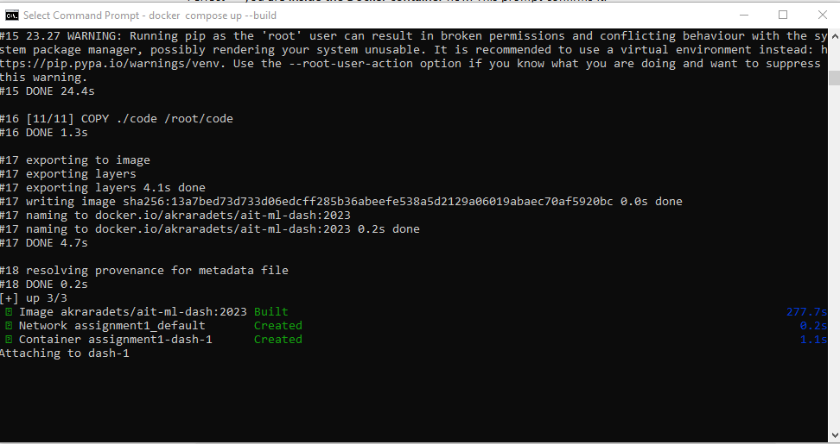
docker compose up --build

Slide 3
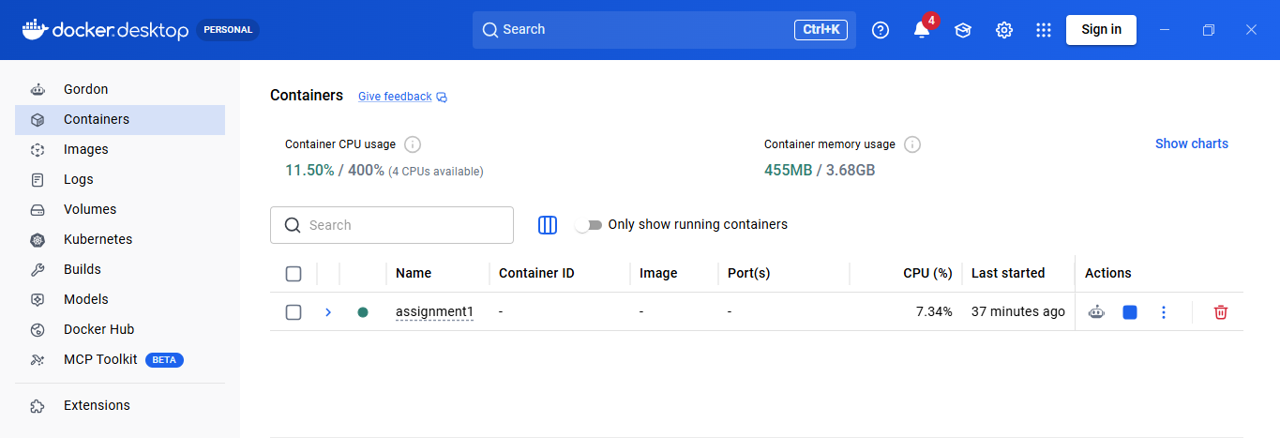

Slide 4
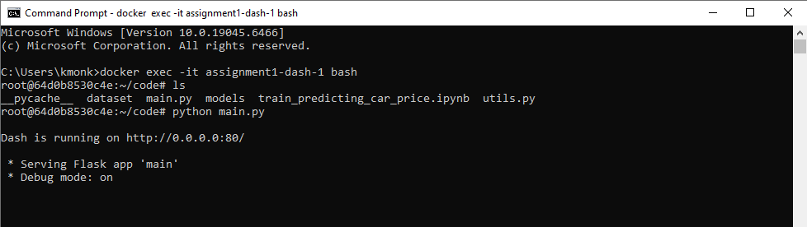
docker exec –it assignment1-dash-1 bash
Python main.py

Slide 5
