Slide 1
REAL ESTATE STOCK ANALYSIS
Group 4 project-1 presentation
April-13-2022

Slide 2
OUR TEAM
Introducing Contributors / Team Members
Arthur Lovett, Email (arthur@arthurlovett.com)
Olga Koryachek, Email (olgakoryachek@live.com)
Maureen Kaaria, Email (maureenkaaria@gmail.com)
Khaing Thwe, Email ( Khaingzt88@gmail.com)

Slide 3
TABLE OF CONTENT
4. DEVELOP & IMPLEMENT
1. OUR TEAM
PROJECT
5. ANALYSIS
2. PROJECT DESCRIPTION
6. Conclusions / Next Step
3. PROJECT OUTLINE

Slide 4
PROJECT TITLE: REAL ESTATE STOCK ANALYSIS
PROJECT DESCRIPTION
Real Estate stocks analysis from 01/01/2021 to 04/13/2022 & forecasting trends for the next 10 years.

Slide 5
PROJECT DESCRIPTION
STOCKLIST vs S&P 500(SPY)
CBRE (CBRE Group Inc)
AVB (AvalonBay Communities Inc)
SPY (S & P 500 ETF TRUST)
AMT (American Towe Corp)
ESS (Essex Property Trust Inc)

Slide 6
PROJECT DESCRIPTION
This project analyzes HISTORICAL PERFORMANCE USING the pricing information of REAL ESTATE stocks from 2021-01-01 to 2022-04-13.
Project picks top 3 best performing stocks from past performance analysis and compares the analysis to SPY(S&P 500 ) within the same timeframe to come up with best performing stock.
Project forecasts future performance of the top three real estate stocks USING MONTE CARLO SIMULATION.
Program is deployed via a CLI Web Application.

Slide 7
PROJECT OVERVIEW TEAM COLLABORATION
Tasks
Assign Tasks to each team member.
Project Objectives
Develop & Implementation Plan
Use Polygon API information, and coding information.
Resources
Problem & Solution
Schedule Zoom Meeting to discuss outcomes.

Slide 8
PROJECT OUTLINE
Project Methods, Techniques, Tools
Resources:
Use Polygon API to pull stock information.
Request the fetching code from Binoy Das.
Importing necessary libraries and dependencies.
Data fetching from polygon.io
Data cleaning/slicing:
Determine the fund with the most investment potential based on key risk-management metrics.
Calculate The daily returns.
Quantitative Analysis
Cumulative Returns.
Standard Deviations (Annualized Standard Deviations, Rolling Standard Deviations).
Sharpe ratios (Average Annual Return Sharpe Ratio, Annualized Sharpe Ration).
S&P 500 vs ( CBRE, ESS, AVB) variance, covariance
Betas.
Monte Carlo Simulation ( Forecast 10 years)
Visualizations/Panel Composition
Other helpful interactive visualizations
The program will be accessed via a CLI Web Application (Voila)

Slide 9
DEVELOP & IMPLEMENT
Data cleaning/slicing:
Data fetching/API integration
Calculate The daily returns.
Quantitative Analysis
Cumulative Returns.
Standard Deviations (Annualized Standard Deviations, Rolling Standard Deviations).
Sharpe ratios (Average Annual Return Sharpe Ratio, Annualized Sharpe Ration).
S&P 500 vs ( CBRE, ESS, AVB) variance, covariance
Betas.
Monte Carlo Simulation ( Forecast 10 years)
Visualizations/Panel Composition
Other helpful interactive visualizations
The program will be accessed via a CLI Web Application (Voila)

Slide 10
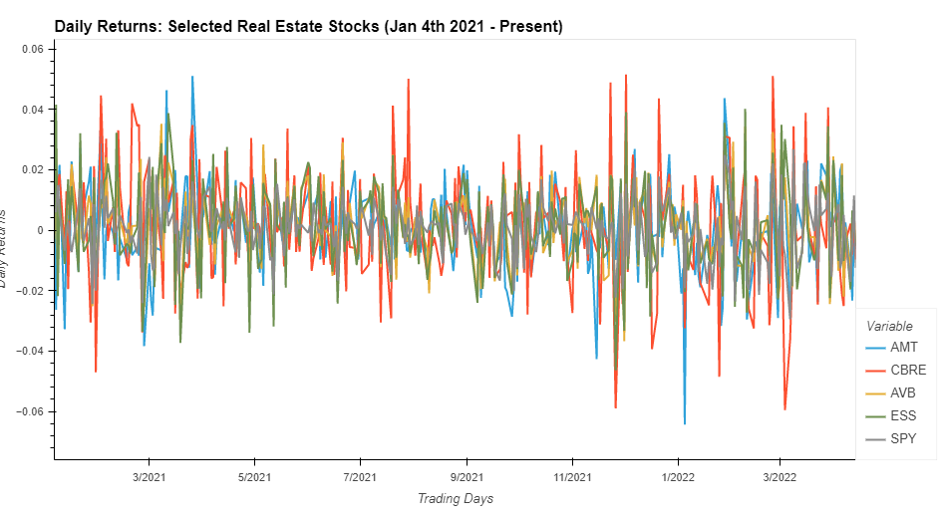
PLOT VISUALIZATION
Daily Returns for 4 stocks and SPY(S&P 500)

Slide 11
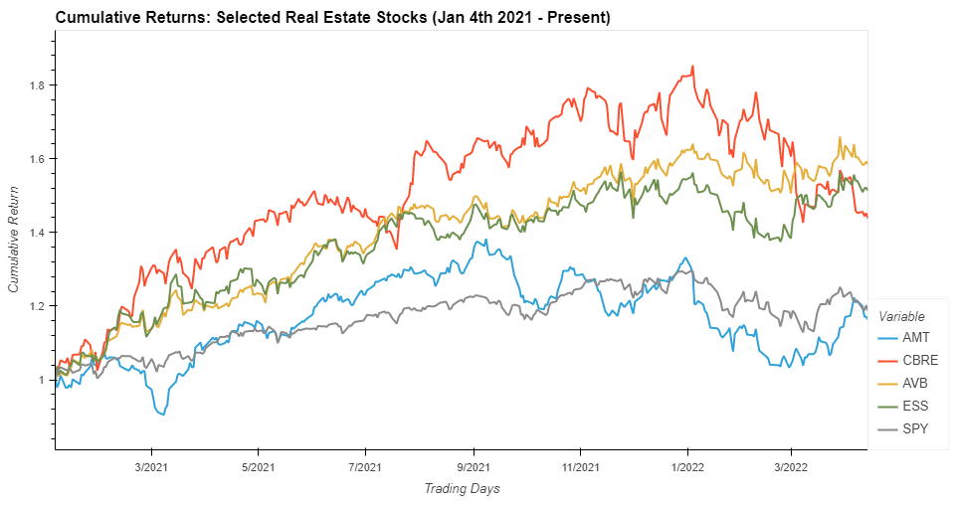
PLOT VISUALIZATION
Cumulative Returns for 4 stocks and SPY(S&P 500)

Slide 12
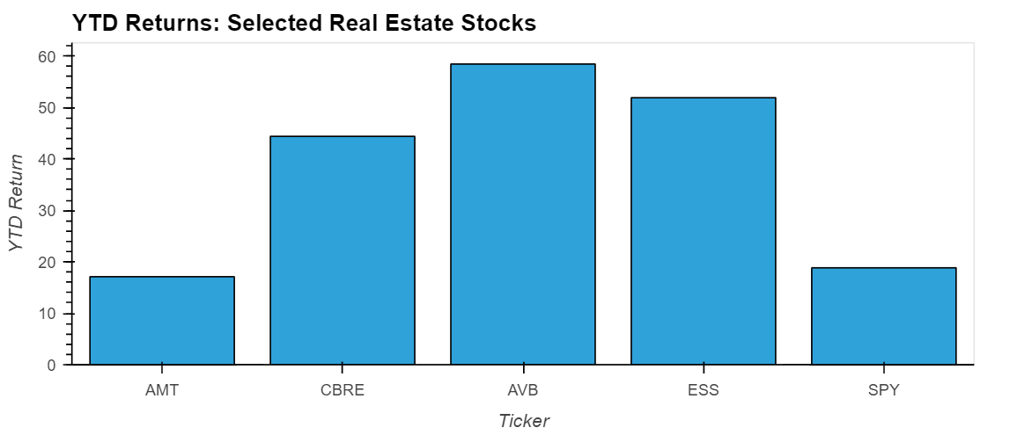
PLOT VISUALIZATION DAILY PRICES OF SPY(S&P 500)
PLOT VISUALIZATION YEAR TO DATE PRICES OF STOCKS & SPY(S&P 500)

Slide 13
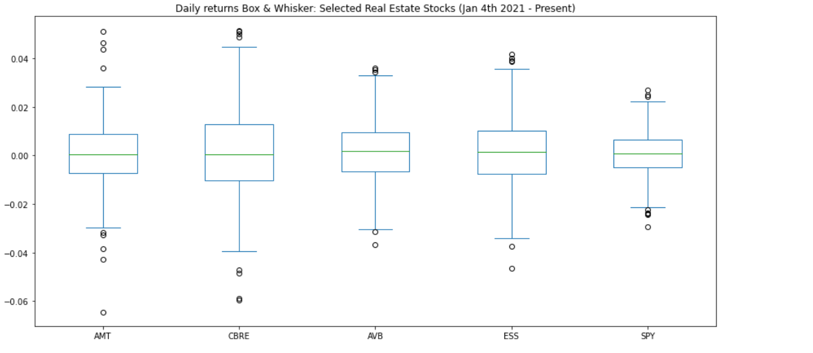
PLOT VISUALIZATION
Real Estate Stocks Box plot

Slide 14
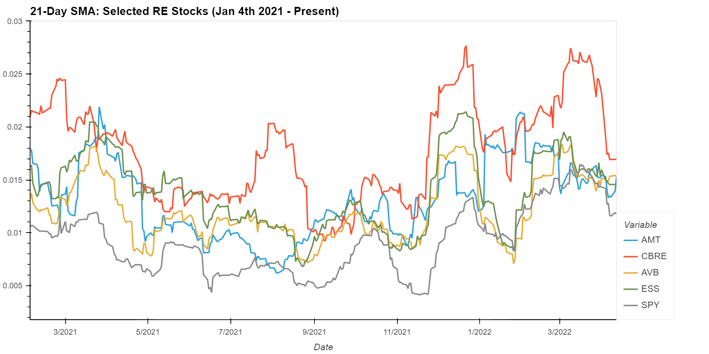
Plot visualization
21-Day Rolling Standard Deviation

Slide 15
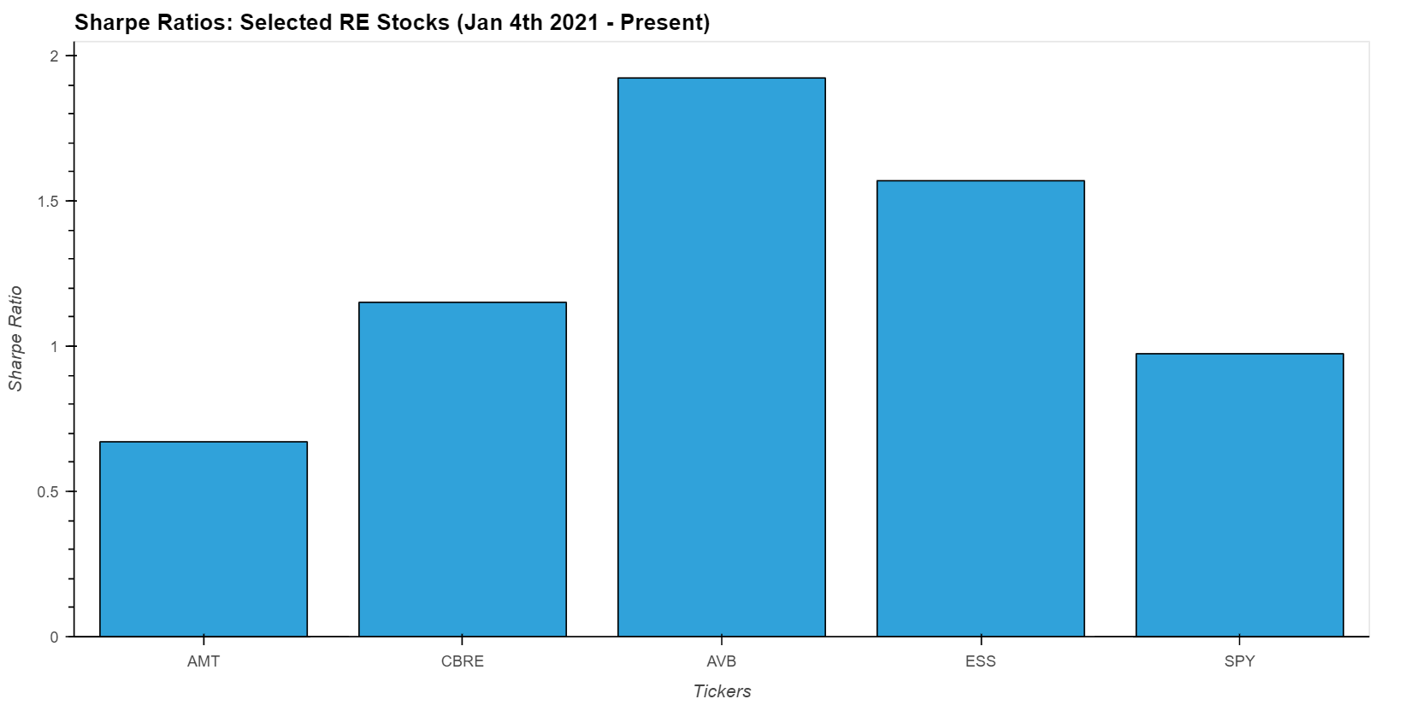
PLOT VISUALIZATION
SHARPE RATIO

Slide 16
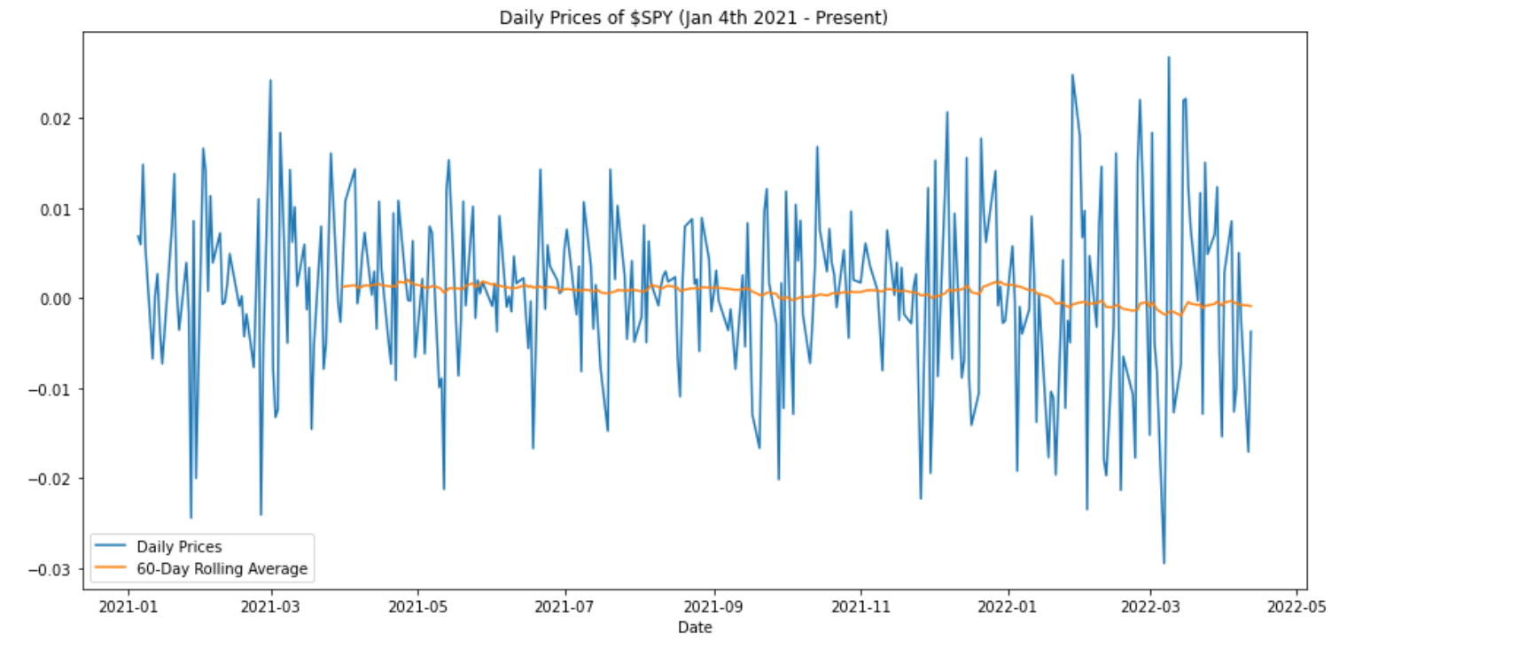
PLOT VISUALIZATION DAILY PRICES OF SPY
Project Analysis

Slide 17
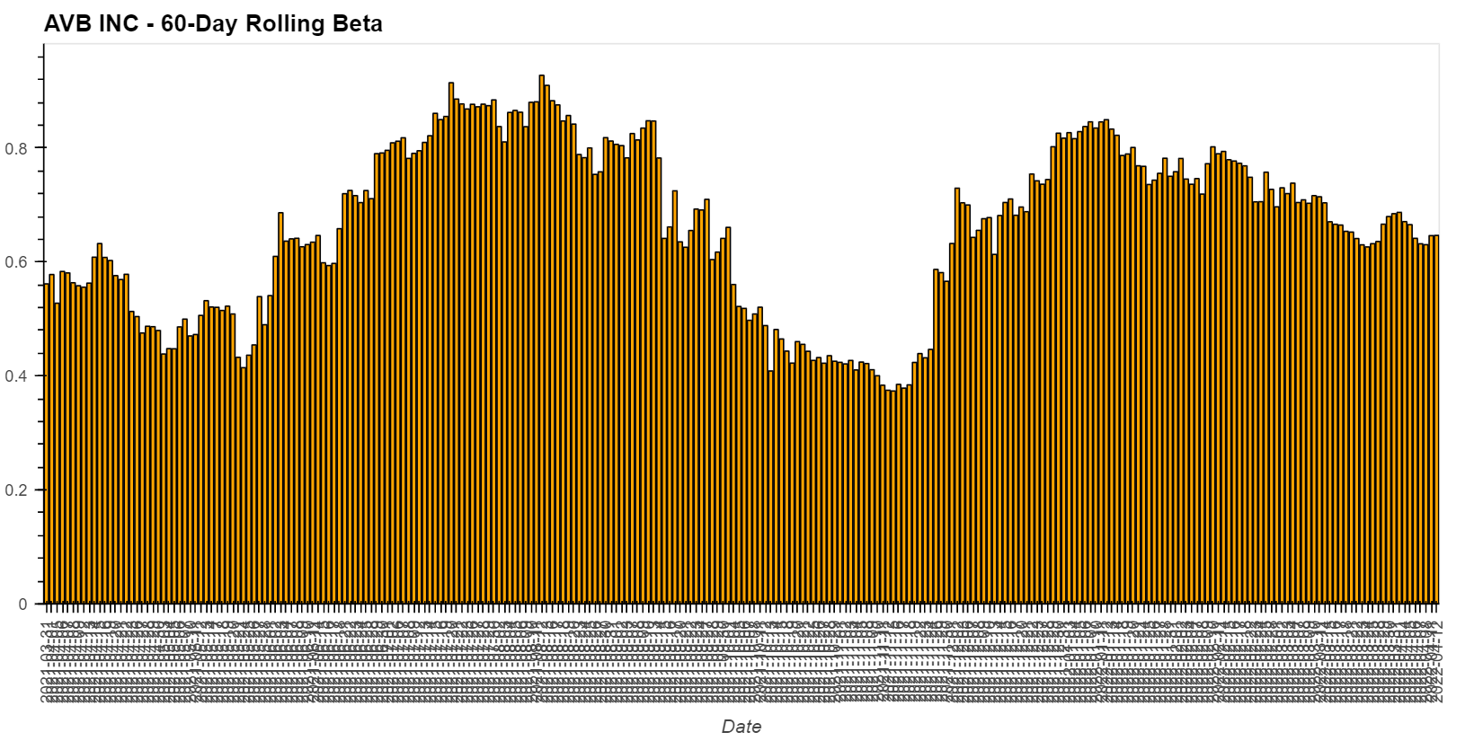
PLOT VISUALIZATION AVB 60-Day Rolling Beta

Slide 18
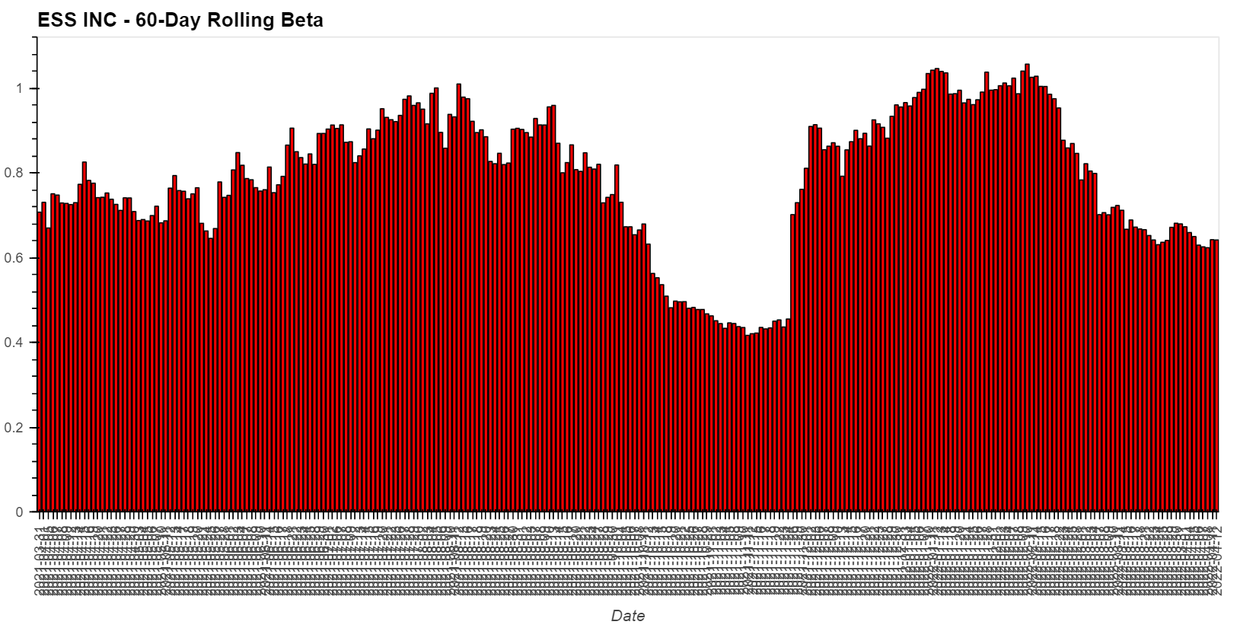
PLOT VISUALIZATION ESS 60-Day Rolling Beta

Slide 19
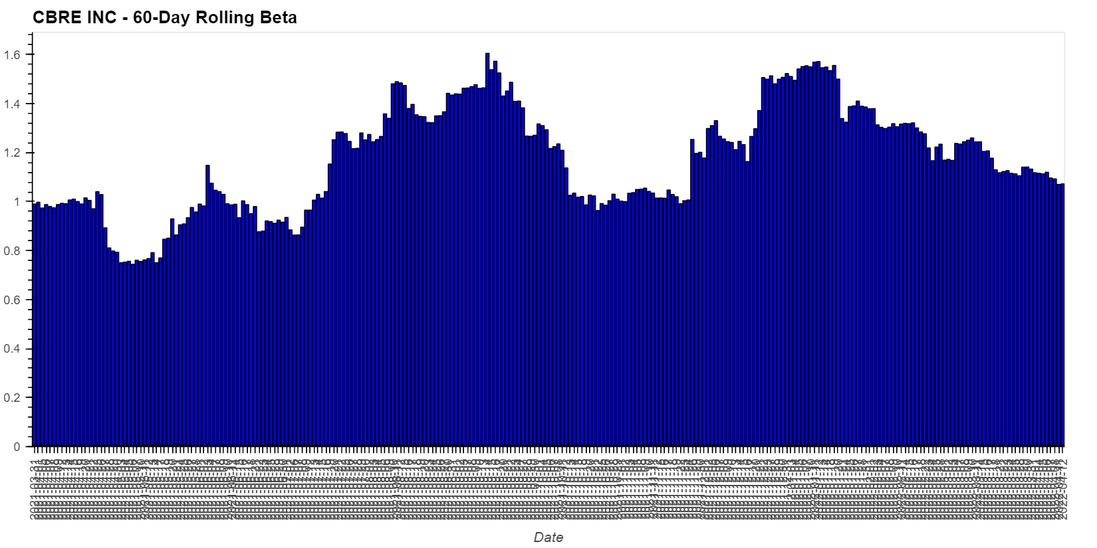
PLOT VISUALIZATION CBRE 60-Day Rolling Beta

Slide 20
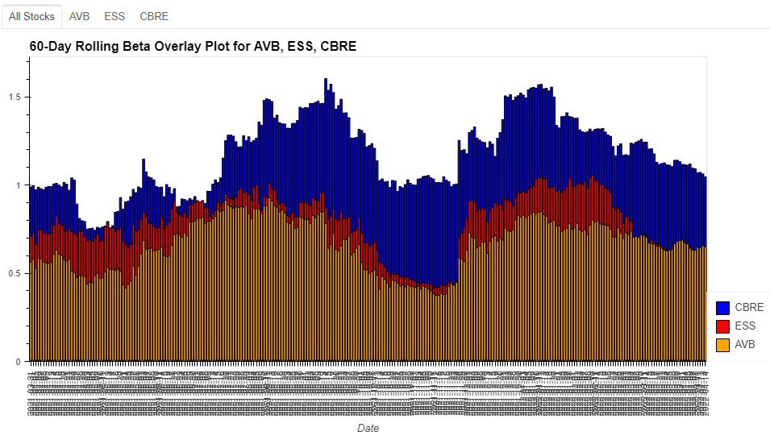
Interactive Dashboard AVB/ ESS/ CBRE 60-Day Rolling Beta Overlay Plot

Slide 21
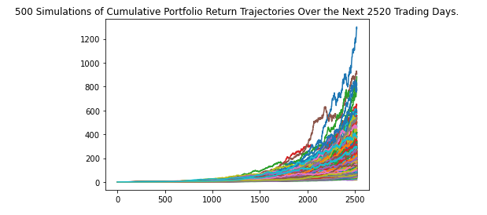
PLOT VISUALIZATION For 10-year Monte Carlo simulation

Slide 22
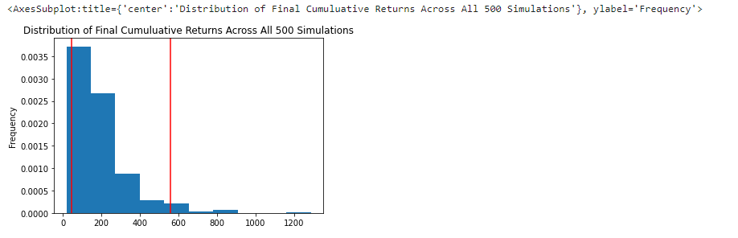
PLOT VISUALIZATION For 10-year Monte Carlo simulation

Slide 23
Project Analysis Conclusions / Next Step
Historical Performance
Based on the analysis and visualization of the Sharpe Ratio, we would recommend CBRE, ESS, and AVB as investment options.
Discuss top 3 portfolios ( Volatility, Risk)
From the historical stock analysis performance at first CBRE seem a good investment option but the volatility and risk are a bit higher and more recently the stock price was decreased compared to 2021.
Future Investment Opportunities
We would recommend AVB as the most suitable stock for future investment opportunities.
Project Next Step
* Washington housing market prediction
* Seattle housing market price compared to King Country housing market price.

Slide 24
Thank You

