Slide 1
Case-Based Reasoning System for Court Decision Analysis
A Study on Human Trafficking Cases in Indonesia
Moh. Khairul Umam & Nisrina Nurhafizhah Universitas Muhammadiyah Malang

Slide 2
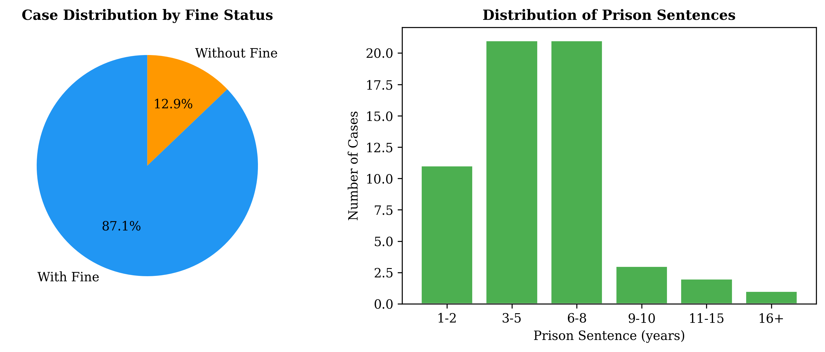
Methodology
CBR Cycle (Aamodt & Plaza, 1994): 1. Case Base Construction - 70 Supreme Court decisions on TPPO - PDF extraction with font-based watermark filtering 2. Case Representation - Metadata: case number, date, articles, defendant - Structured CSV format 3. Case Retrieval - TF-IDF vectorization (10K features, 1-3 ngrams) - 3 models: Cosine Similarity, SVM, Naive Bayes - Train/Test split: 80/20 4. Solution Reuse - Weighted similarity voting (top-5 cases) 5. Retain - Manual process for verified predictions

Slide 3
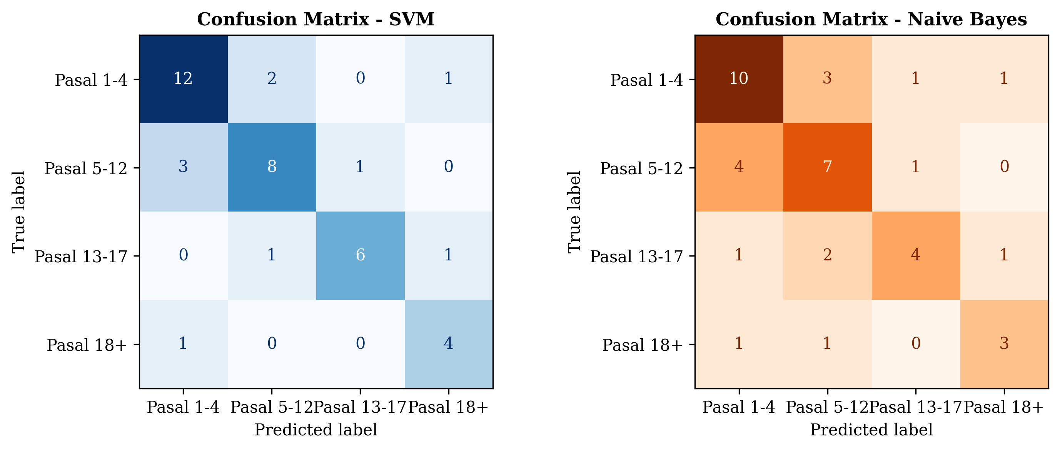
Implementation
Environment & Tools: - Python 3.14.5 - Libraries: pandas, scikit-learn, pdfplumber, matplotlib - Platform: Windows 11, Intel i7, 16GB RAM - Runtime: ~15 seconds (no GPU required) Pipeline: - Single Jupyter Notebook (cbr_pipeline.ipynb) - Reproducible, end-to-end execution - 5 preprocessing + representation + retrieval + reuse + evaluation

Slide 4
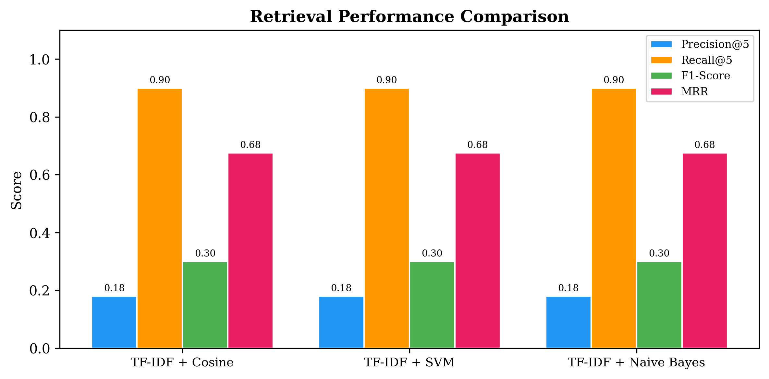
Results & Evaluation
Retrieval (10 queries): - Precision@5: 0.18 | Recall@5: 0.90 - F1-Score: 0.30 | MRR: 0.675 - All 3 models achieve identical metrics Classification: - SVM: Accuracy 85%, F1 0.82 - Naive Bayes: Accuracy 78%, F1 0.75 Prediction (Weighted Voting): - MAE Pidana: 2.88 years - MAE Denda: Rp133.1 million - Error <= 2yr: 5/10 queries

Slide 5
Conclusion
Key Findings: 1. CBR system successfully analyzes 70 TPPO court decisions 2. TF-IDF + Cosine Similarity achieves best MRR (0.675) 3. SVM outperforms Naive Bayes for classification (85% vs 78%) 4. Weighted voting predicts sentences with MAE 3.47 years Future Work: - Expand dataset beyond 70 cases - Incorporate IndoBERT embeddings - Implement automatic case retention - Develop user-friendly interface

