Slide 1

News Research Tool
By Khairun Nisa
Batch: Nexthikes | Internship Project Training | I-120625-TH2PM-B12

Slide 2
AI/GenAI Internship Project
News Research Tool
AI-Powered News Analysis & Research Platform
LangChain
Streamlit
Groq LLaMA 3.3
Gemini 1.5 Flash
NewsAPI
Built with Python · LangChain · Streamlit

Slide 3
Project Overview
An AI-powered research tool that fetches real-time news, summarizes articles, and generates deep analytical insights using large language models — built for research analysts and investors.
Smart Search
AI Analysis
Research Report
Configurable
Search by company, ticker, or keyword via NewsAPI
LLM-powered insights from Groq LLaMA 3.3 or Gemini
Structured investment analysis with download option
Choose model, article count, and output settings

Slide 4
Problem Statement & Goal
THE PROBLEM
THE SOLUTION
Manual news monitoring is time-consuming
Automated NewsAPI integration for real-time data
Scattered information across many sources
Unified search across thousands of sources
→
Hard to spot trends across multiple articles
LLM analysis synthesizes multiple articles
Analysts spend hours on routine summarization
Instant AI-generated research summaries
No quick way to get structured research insights
Structured reports downloadable in seconds

Slide 5
Project Objectives
• Fetch real-time news
• Summarize multiple articles
• Generate AI-powered insights
• Support multiple LLMs
• Provide downloadable reports

Slide 6
Business Value
The solution reduces research effort, accelerates decision-making, improves productivity, and delivers consistent analysis across topics.

Slide 7
Technology Stack
LangChain
Streamlit
NewsAPI
Orchestration Framework
Web UI Framework
News Data Source
Manages prompt templates, LLM chains, and output parsers. Core logic in langchain_config.py
Interactive frontend with sidebar controls, sliders, and download buttons via app.py
Fetches real-time English articles sorted by relevancy. Supports page_size up to 100
Groq LLaMA 3.3
Gemini 1.5 Flash
python-dotenv
LLM Backend (Primary)
LLM Backend (Alt)
Config Management
70B parameter model via Groq API. Free tier, ultra-fast inference for research analysis
Google's generative AI model with strong reasoning. Switchable via model selector
Loads GROQ_API_KEY, NEWSAPI_KEY, GEMINI_API_KEY from .env file securely

Slide 8
Project Structure
📁 NEWS_RESEARCH/
app.py
Frontend Layer
├── app.py
Main Streamlit app
Streamlit UI with sidebar settings, text input, spinner, and results display. Calls get_summary() and get_chain() from langchain_config.
├── langchain_config.py
LLM & NewsAPI logic
langchain_config.py
├── .env
API keys (not committed)
Backend Logic
Contains all business logic: NewsAPI client, article fetcher, summarizer, LLM initialization, ChatPromptTemplate, and chain builder.
├── requirements.txt
Python dependencies
├── README.md
Documentation
.env
Secrets Management
├── notebook_1_setup.ipynb
Setup & testing
Stores API keys for Groq, NewsAPI, and Gemini. Loaded via python-dotenv. Never committed to version control.
└── notebook_2_enhance.ipynb
Advanced features
Notebooks
Development & Testing
notebook_1_setup for phase-by-phase testing and validation. notebook_2_enhance for advanced NewsAPI filters and requirements generation.

Slide 9
System Architecture
User enters a query in Streamlit. NewsAPI retrieves articles. Summaries are created and passed through LangChain to the selected LLM. The generated analysis is displayed and can be downloaded.

Slide 10





Application Flow Diagram
1. User Input
2. NewsAPI Fetch
3. Summarize
4. LLM Analysis
5. Output
Query entered
in Streamlit UI
→
get_news_articles()
returns articles
→
summarize_articles()
formats bullets
→
Chain invoked
with prompt+data
→
Display + Download
Report button
app.py → get_summary() → get_chain().invoke({query, summaries}) → st.write(response) + download_button()

Slide 11

Phase 1 - Environment Setup
Installed dependencies, configured API keys, created project structure, and validated connectivity for all services.

Slide 12
Phase 2 - LangChain Integration
Implemented prompt templates, LLM selection logic, output parsing, and reusable AI chains for analysis.

Slide 13
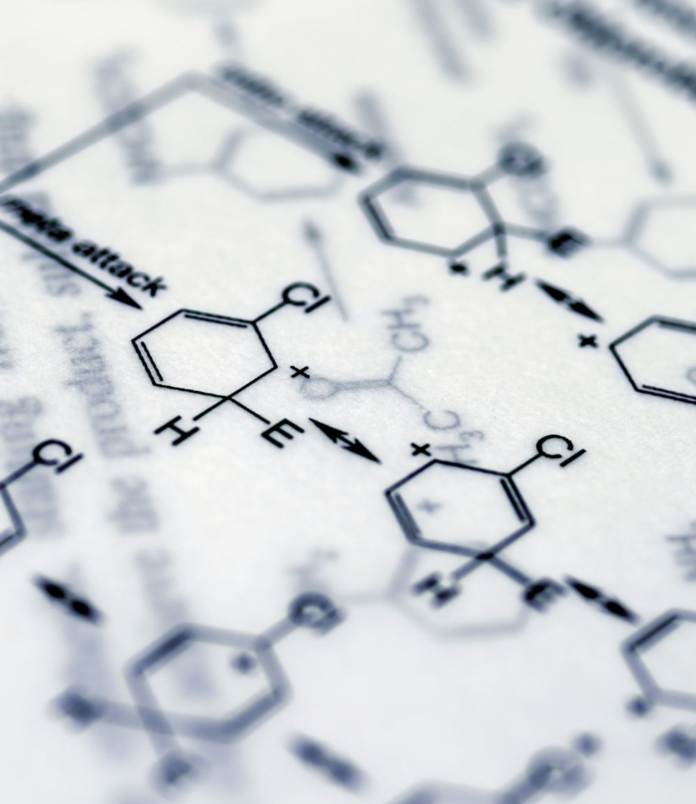
Phase 3 - NewsAPI Integration
Connected NewsAPI to retrieve relevant articles and transformed article descriptions into structured summaries.

Slide 14

Phase 4 - Streamlit Development
Developed an interactive web interface with search functionality, model selection, article controls, and report downloads.

Slide 15
LangChain Pipeline
LangChain acts as the orchestration layer by combining user queries and news summaries before sending them to the selected LLM for analysis.

Slide 16
My Contribution
Built the complete application, integrated APIs, implemented LangChain workflows, added Groq and Gemini support, and tested the end-to-end system.

Slide 17
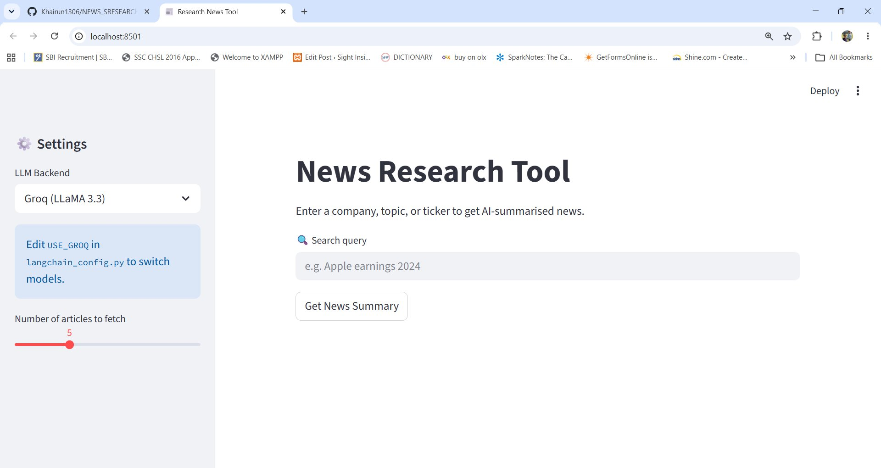
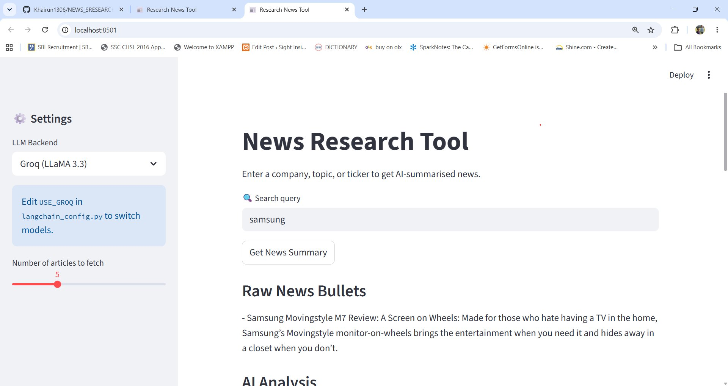
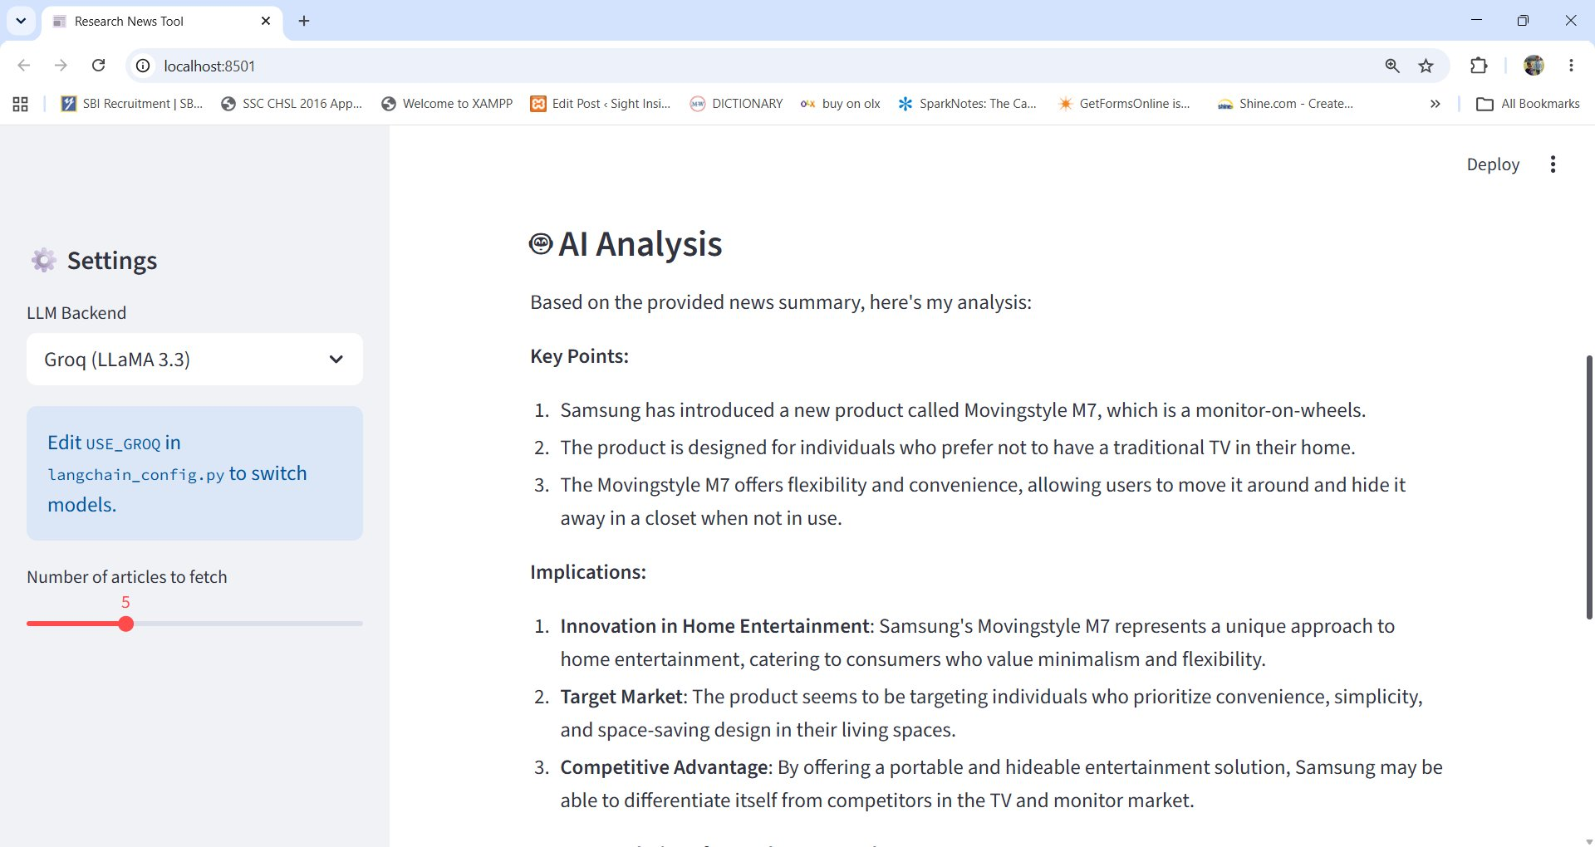
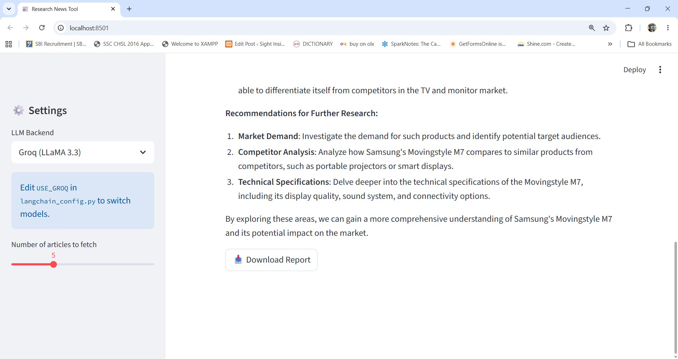
Live Application Screenshots
Home Page — Clean search UI with sidebar settings
Raw News Bullets — Article summaries displayed
AI Analysis — Structured insights from LLM
Recommendation — Research findings + Download

Slide 18
Supported LLM Models: Comparison
Groq — LLaMA 3.3 70B
Gemini 1.5 Flash
Model:
llama-3.3-70b-versatile
Model:
gemini-1.5-flash
Provider:
Groq Cloud
Provider:
Google AI Studio
VS
Speed:
Ultra-fast inference
Speed:
Fast multimodal model
Cost:
Free tier available
Cost:
Free quota available
Strengths:
Research & reasoning
Strengths:
Complex reasoning
API Key:
GROQ_API_KEY
API Key:
GEMINI_API_KEY

Slide 19
Testing & Validation
Verified API connectivity, validated news retrieval, tested summary quality, checked LLM outputs, and confirmed report download functionality.

Slide 20

Challenges & Solutions
API limitations were handled through configurable article counts. Missing descriptions were filtered. Consistent prompts improved output quality across models.

Slide 21
Results & Outcomes
• Automated news research workflow
• Reduced manual effort by approximately 70–80%
• Generated insights within seconds
• Supported multiple AI models
• Improved analyst productivity

Slide 22

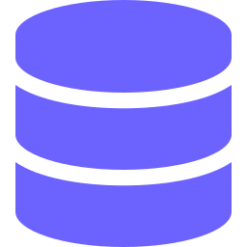

Future Enhancements Roadmap
Sentiment Analysis
v2.0
PDF Report Export
v2.0
Interactive Dashboard
v2.5
Detect bullish/bearish tone across articles. Integrate VADER or fine-tuned models for market sentiment scoring.
Generate branded PDF research reports with charts, summaries, and citations using ReportLab or WeasyPrint.
Replace static text with interactive Plotly/Altair visualizations. Trend charts, word clouds, source distribution.
Historical Tracking
v2.5
Stock Price Integration
v3.0
User Authentication
v3.0
Store queries and results in SQLite or PostgreSQL. Enable trend analysis across dates and topics over time.
Correlate news sentiment with real-time price data from Yahoo Finance or Alpha Vantage APIs.
JWT-based user login, saved query history, personalized dashboards per user with role-based access.

Slide 23
Conclusion
The project demonstrates practical use of Generative AI, LangChain, real-time APIs, and Streamlit to build a complete intelligent research assistant.

Slide 24
Key Takeaways
LangChain for LLM orchestration
NewsAPI for real-time data
Thank You!
Streamlit for rapid UI
Switchable LLM backends
News Research Tool — AI/GenAI Internship Project
Modular, testable architecture
Notebook-driven development
Built with Python · LangChain · Streamlit · Groq · Gemini · NewsAPI

