Slide 1
COURSE NAME : CLOUD INFRASTRUCTURE SERVICES COURSE CODE : 24cs2204,A
TOPICS : Identity and Access Management - Introduction
Access Control – RBAC, ABAC, PBAC
Trust, Reputation & Risk

Slide 2
Identity and Access Management
IAM architecture is the framework that helps securely manage user identities, authentication, and authorization across an organization's IT environment.
Identity and Access Management (IAM) in cloud computing is a security framework of policies, technologies, and processes that ensures authorized users (human or non-human) have the correct access to cloud resources.
Key components include authentication (verifying identity), authorization (granting permissions), and auditing user actions. Major cloud providers—AWS, Azure, and Google Cloud—use IAM to enforce role-based access control (RBAC) and least privilege principles, protecting against data breaches and unauthorized access.

Slide 3
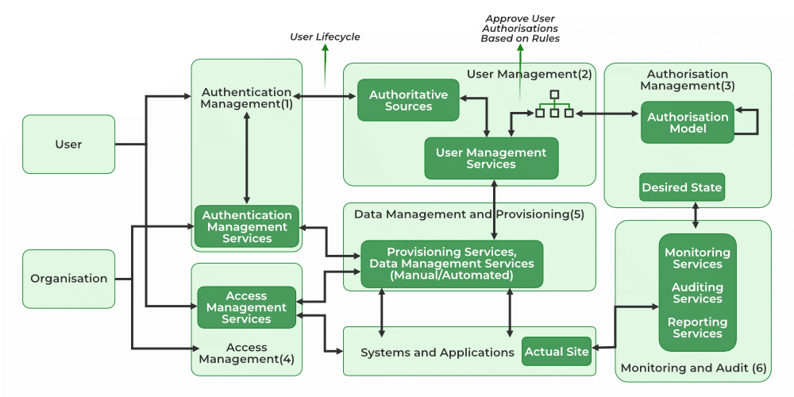

Slide 4
Architecture of Identity Access Management
User Management: It consists of activities for the control and management over the identity life cycles.
Authentication Management: It consists of activities for effectively controlling and managing the processes for determining which user is trying to access the services and whether those services are relevant to him or not.
Authorization Management: It consists of activities for effectively controlling and managing the processes for determining which services are allowed to access according to the policies made by the administrator of the organization.
Access Management: It is used in response to a request made by the user wanting to access the resources with the organization.

Slide 5
Architecture of Identity Access Management
Data Management and Provisioning: The authorization of data and identity are carried towards the IT resource through automated or manual processes.
Monitoring and Auditing: Based on the defined policies the monitoring, auditing, and reporting are done by the users regarding their access to resources within the organization.
Operational Activities of IAM: In this process, we onboard the new users on the organization's system and application and provide them with necessary access to the services and data. Deprovisioning works completely opposite in that we delete or deactivate the identity of the user and de-relinquish all the privileges of the user.
Credential and Attribute Management: Credentials are bound to an individual user and are verified during the authentication process. These processes generally include allotment of username, static or dynamic password, handling the password expiration, encryption management, and access policies of the user.

Slide 6
Architecture of Identity Access Management
Entitlement Management: These are also known as authorization policies in which we address the provisioning and de-provisioning of the privileges provided to the user for accessing the databases, applications, and systems. We provide only the required privileges to the users according to their roles. It can also be used for security purposes.
Identity Federation Management: In this process, we manage the relationships beyond the internal networks of the organization that is among the different organizations. The federations are the associate of the organization that came together for exchanging information about the user's resources to enable collaboration and transactions.
Centralization of Authentication and Authorization: It needs to be developed in order to build custom authentication and authorization features into their application, it also promotes the loose coupling architecture.

Slide 7
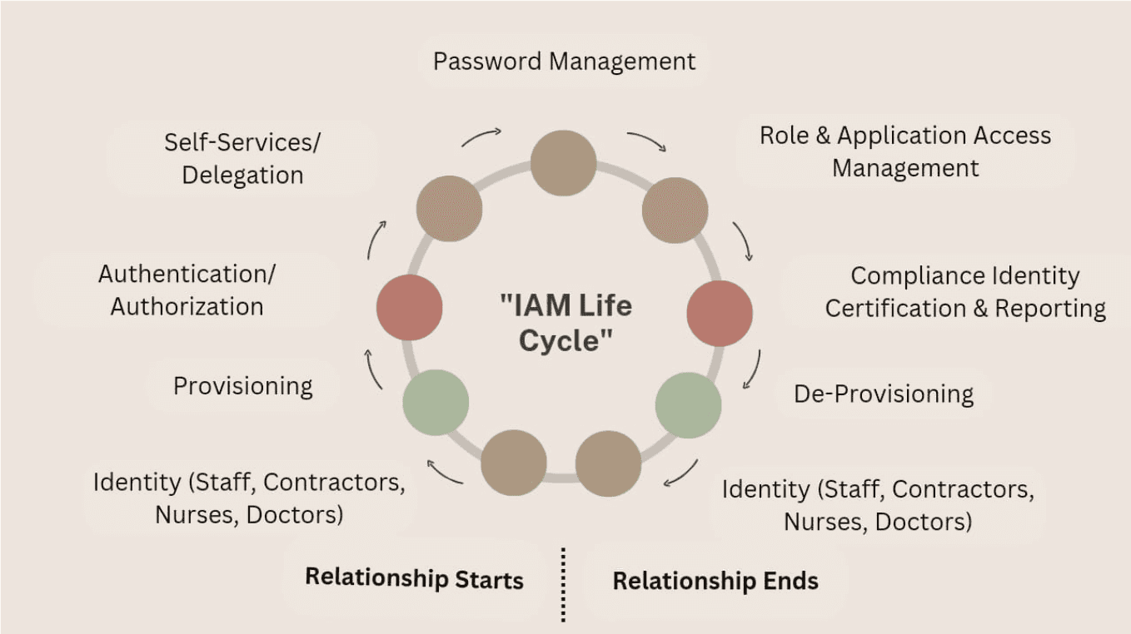

Slide 8
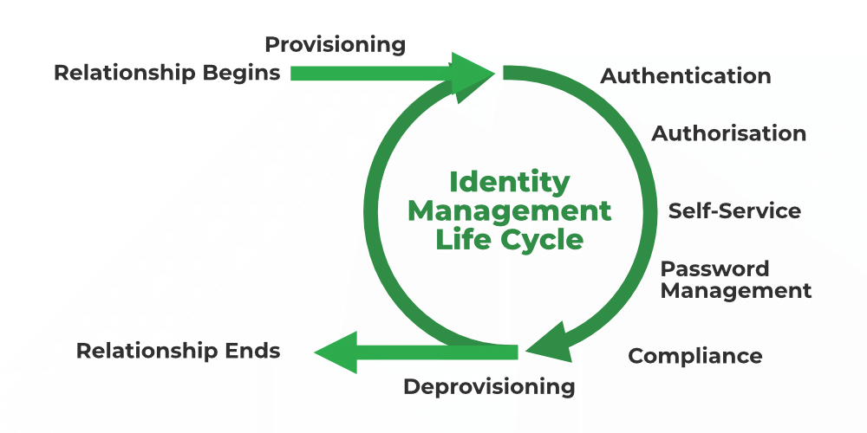

Slide 9
Key Components of IAM Architecture
Identity and Access Management (IAM) in cloud computing helps control who can use cloud resources and what they can do. It has several important parts working together to keep everything safe and organized:
Identity Management
This is like creating a digital ID card for every user, device, or app. Each identity is unique and helps the system know who is trying to access cloud resources. Companies store this information in directories (like a phonebook) and update it when people join, leave, or change roles. Sometimes, with federated identity, one login can work across different apps or organizations so you don’t need multiple passwords.

Slide 10
Key Components of IAM Architecture
Authentication
This step is about proving who you are. The system checks your identity before letting you in. Common methods include:
Single Sign-On (SSO): Log in once and access many apps without logging in again.
Multi-Factor Authentication (MFA): You enter a password plus another verification like a code sent to your phone or fingerprint.
Password-less Authentication: Uses things like biometrics or security keys instead of passwords.
Adaptive Authentication: Changes how strict the check is depending on risk. For example, if you log in from a new device or location.

Slide 11
Key Components of IAM Architecture
Authorization and Permission Controls
After proving who you are, IAM decides what you can do. This is called authorization. You can use Role-Based Access Control (RBAC) and provide permissions based on your job like "manager" and "developer".
Access Policies
These are rules that say who can do what and when. For example, a policy might say "only HR staff can view employee records" or "access is only allowed during work hours". A key idea is least privilege access, which means users only get the minimum permissions they need to do their jobs.

Slide 12
Key Components of IAM Architecture
Monitoring and Auditing
IAM systems keep a close eye on who is accessing what. They log every login, failed attempt, and any changes in permissions. Regular checks (audits) help find and remove unnecessary access. Advanced systems use AI to spot suspicious activities like someone logging in from two different countries within minutes and alert security teams right away.
Integration with Cloud Services
IAM connects smoothly with cloud platforms and apps you use every day. It allows you to use one identity to access many cloud services, whether your company uses one cloud or many (multi-cloud). This integration also supports federated identity, so you don’t have to remember many passwords for different services.

Slide 13
Core Components of AWS IAM
IAM Users
IAM Users represent individual people or applications requiring long-term access to AWS.
Have permanent credentials (passwords and access keys)
Used for console, CLI, or API access
Best managed through groups, not individually
IAM Groups
IAM Groups are collections of users that simplify permission management.
Permissions are assigned once at the group level
Users inherit permissions automatically
Reduces administrative errors and improves scalability

Slide 14
Core Components of AWS IAM
IAM Roles
IAM Roles provide temporary permissions to trusted entities without using long-term credentials.
No passwords or access keys
Uses temporary, auto-rotated credentials
Ideal for AWS services and cross-account access
Most secure method for application permissions

Slide 15
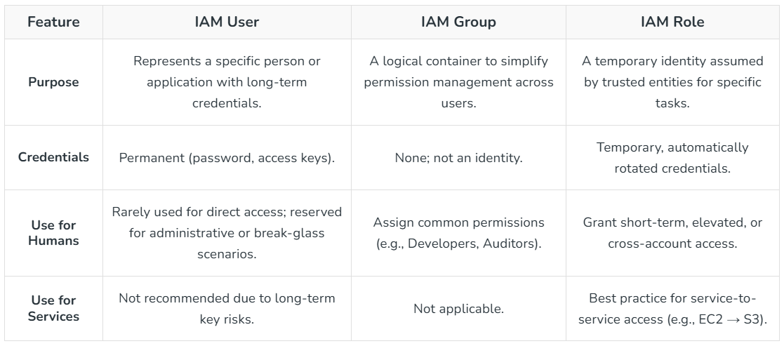

Slide 16
Types of Permissions in IAM
Allow Permissions
An explicit "allow" permission grants the user, group, or role access to a resource. For Example, an IAM user with the "s3:ListBucket" permission can list the content of anS3 Bucket.
Deny Permissions
A "deny" permission explicitly prevents access to a resource. This can be set for security reasons, such as denying access to sensitive resources for certain users.
Implicit Deny
By Default, if no policy is attached to a user, group, or role, access to a resource is denied. IAM denies access if no explicit allow rule is present.

Slide 17
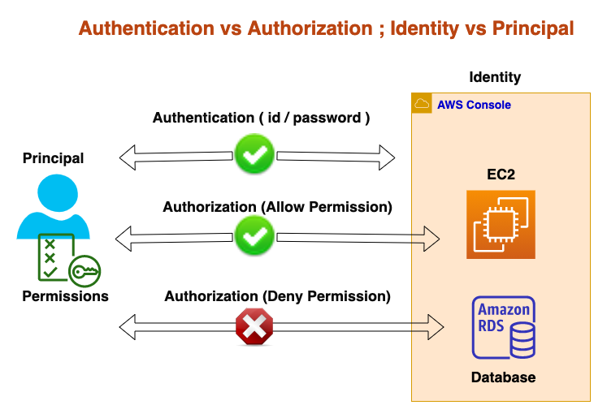

Slide 18
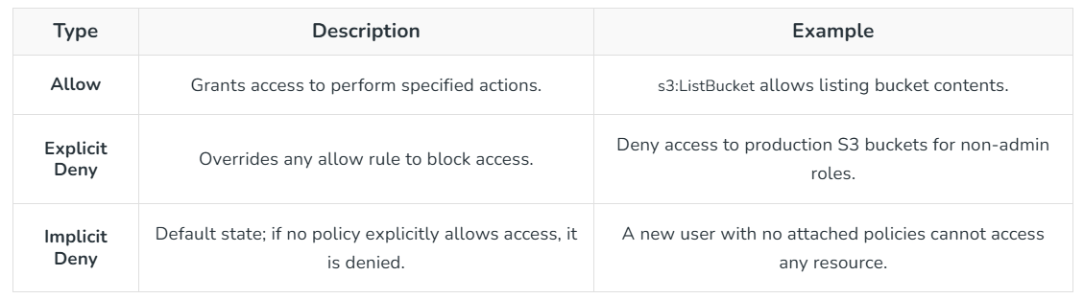

Slide 19
Authenticate the Request
IAM verifies the identity using authentication mechanisms like:
Username and password
Access keys
Multi-Factor Authentication (MFA) Only authenticated identities can proceed further.
Authorize Using Policies (Can Access)
After authentication, IAM checks policies attached to the user, group, or role. These policies define:
Allowed or denied actions (e.g., s3:GetObject)
Specific resources (e.g., a particular S3 bucket)
Conditions (time, IP address, MFA usage)

Slide 20
ACCESS CONTROL – RBAC
Role-based access control (RBAC) authorizes users based on predefined roles. Permissions are assigned to roles, and users are assigned to those roles. This structure makes it straightforward to control what users can access and what actions they can take.
Role-based access control (RBAC) is a security approach that authorizes and restricts system access to users based on their role(s) within an organization.
Key components of RBAC include the roles themselves, the specific permissions tied to those roles, and the processes for assigning and managing them.

Slide 21
ACCESS CONTROL – RBAC
For example: an HR manager logs into a system that stores personnel records. The platform checks the user’s profile, sees the “HR manager” role, and grants access to those files.
RBAC is appealing for its simplicity. It is easy to deploy, quick to audit, and manageable at scale when roles and responsibilities are well-defined. However, it can become rigid in dynamic environments. As roles evolve or the user base grows, RBAC can lead to “role explosion,” where tracking and maintaining roles and permissions becomes unwieldy.
RBAC works best for organizations with stable role definitions and predictable access needs, where simplicity and clarity outweigh flexibility.

Slide 22
different levels OF RBAC
Role-based access control (RBAC) is an authorization approach that relies on predefined permissions tied to user roles. Once roles and their privileges are set up, access is granted automatically—no need for constant manual updates.
RBAC also offers different levels of flexibility:
Traditional RBAC: Users can accumulate roles over time, gradually expanding their permissions.
Constrained RBAC: Puts limits on how many roles a user can have at once to prevent over-permissioning.
Hierarchical RBAC: Aligns access with organizational rank: executives get broader access, while junior employees have more limited permissions.

Slide 23
Benefits of RBAC
Security : RBAC uses the principle of least privilege to lower the risk of a data breach. It also limits damage should a breach occur.
Ease of Use : RBAC connects employees to the data and systems they need and reduces administrative overhead for IT.
Compliance Readiness : Administrators can more easily prove that data and sensitive information have been handled according to privacy, security, and confidentiality standards.
However, implementing RBAC requires collaboration across departments. Determining how to categorize roles and manage access for those roles requires a clear understanding of both the business and the technical infrastructure that supports it.

Slide 24
RBAC is best suited for:
Organizations with clearly defined roles and responsibilities.
Small to medium teams where simplicity and speed of implementation are key.
Environments that prioritize predictability and straightforward compliance audits over granular, context-driven controls.

Slide 25
ACCESS CONTROL – ABAC
Attribute-based access control (ABAC) governs authorization through dynamic rules that go beyond simple roles. Decisions are based on attributes—logical “if-then” statements that evaluate the user, the asset, the action, and the environment, often in real time.
Attribute-based access control (ABAC) expands beyond roles by using a combination of user, resource, and environmental attributes to determine access. These attributes might include a user’s department or title, the sensitivity of the data, the time of day, or even the IP address used to make the request.
For example, a company might create a policy that allows access to a set of legal documents only for users in the legal department and only during business hours. Attempts outside those parameters would be denied and could even trigger alerts.

Slide 26
ACCESS CONTROL – ABAC
ABAC is ideal for organizations with diverse, dynamic, and context-dependent access needs, especially when security and compliance demand nuanced authorization rules.
The strength of ABAC lies in its flexibility and fine-grained control. It adapts well to complex, dynamic environments where access decisions depend on multiple factors. However, ABAC requires thoughtful planning and strong governance. Without a clear structure for defining and managing attributes, it can quickly become complex and difficult to maintain.
Example of ABAC: A financial services app could allow employees to view client records from their office network but require additional authentication if they attempt access from an unknown device or during non-business hours.

Slide 27
ACCESS CONTROL – ABAC
ABAC considers three primary categories of attributes:
User and action attributes: Include not only the user’s role but also more granular details like location, IP address, device, or session length. The specific actions a user is trying to take—such as editing, downloading, or deleting—are also evaluated.
Asset attributes: Define characteristics of the resource in question. This might include file type, sensitivity level, creation date, or even embedded metadata.
Environmental context: Factors like time of day, operational necessity, or threat level are compared against a “business-as-usual” baseline to determine if the request should be authorized.

Slide 28
ABAC is best suited for:
Large or complex organizations where static roles can’t address nuanced access needs.
Highly regulated industries like healthcare, finance, or government that require strict, adaptive controls.
Dynamic environments where user context and risk factors change frequently, and security policies must adapt in real time.

Slide 29
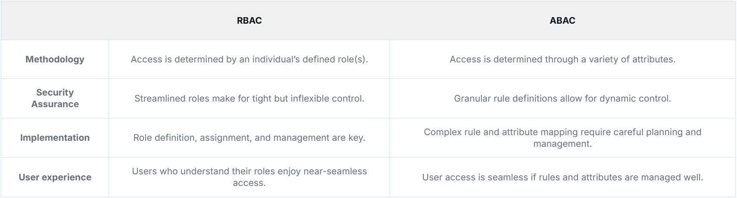

Slide 30
Policy-Based Access Control (PBAC)
PBAC is a dynamic access control model that leverages policies to manage identities, respective access, dynamic ownership, and more.
These policies, formulated using a combination of attributes and logic, serve as the connecting thread between various access control models.
PBAC allows your security model to seamlessly adjust to shifting business requirements and dynamic workforce.
By integrating business terms and conditions into access decisions, PBAC offers a unique, effective, and adaptable approach to managing access in today's rapidly evolving business environments.

Slide 31
Policy-Based Access Control (PBAC)
The true power of PBAC lies in its ability to automate IAM and IGA processes while enforcing compliance.
Traditionally, the IT teams battle with Service Level Agreements (SLAs), audit findings, and often time-consuming manual processes to actively manage identities and access across the organization.
While workflow helps offload some of the burdens, the advent of PBAC allows for many of these processes to be automated, reducing the workload and reducing need for access request.

Slide 32
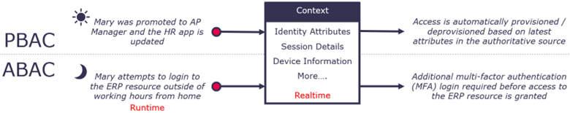
Pbac vs abac

Slide 33
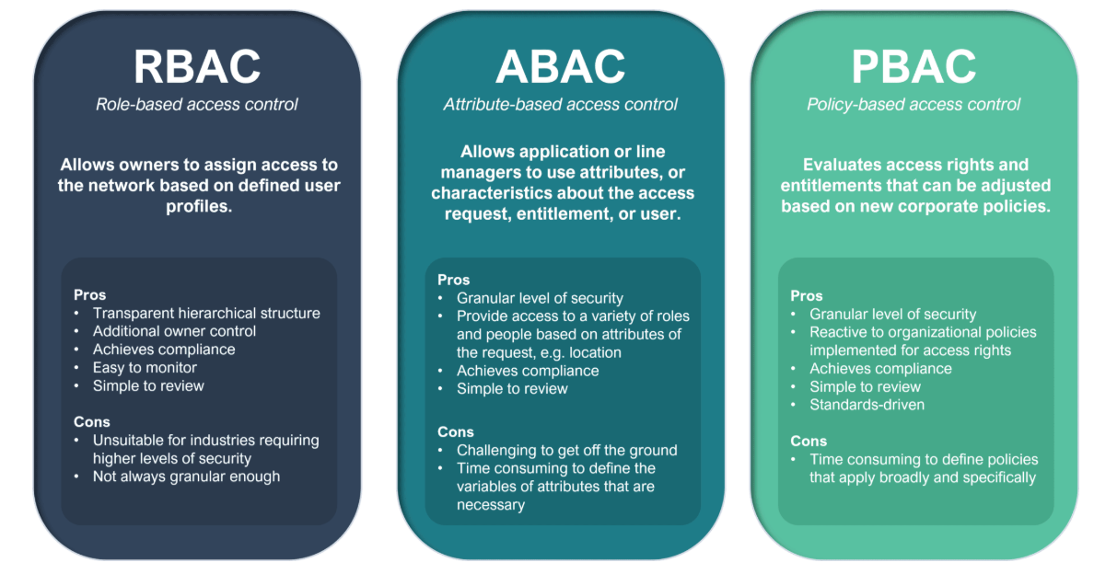

Slide 34
Trust, Reputation & Risk - iam
Identity and Access Management (IAM) is no longer just a security tool; it is the cornerstone of Trust, Reputation, and Risk management in the digital age.
By implementing "never trust, always verify" principles (Zero Trust), IAM ensures that only authorized, verified users and devices can access specific resources, thereby mitigating risks of data breaches, insider threats, and regulatory non-compliance.

Slide 35
Trust, Reputation & Risk - iam
Key Aspects of Trust, Reputation, and Risk in IAM:
Trust (Zero Trust Model): Modern IAM operates on a Zero Trust architecture, which removes implicit trust from the network, requiring continuous authentication and authorization for every access request. This includes verifying user identity, device health, and context (e.g., location).
Reputation Management: A security incident can severely damage an organization's reputation and break customer trust. Robust IAM strengthens security, reducing the likelihood of breaches that lead to public distrust. It also ensures compliance with regulatory requirements (like GDPR or HIPAA), which protects the brand.

Slide 36
Trust, Reputation & Risk - iam
Key Aspects of Trust, Reputation, and Risk in IAM:
Risk Mitigation:
Insider Threats: IAM reduces risks from authorized users by implementing least-privilege access, ensuring users only have the access necessary for their roles.
External Attacks: By using multi-factor authentication (MFA) and granular access controls, IAM prevents unauthorized access from external threats.
Operational Risk: Automated user lifecycle management (provisioning and deprovisioning) prevents "orphaned accounts" and "privilege creep," which are common security gaps.
Components for Success: Effective IAM includes user authentication (confirming who they are), authorization (what they can access), and auditing/monitoring (tracking activity).

Slide 37

THANK YOU
Team – CLOUD INFRASTRUCTURE SERVICES

