Slide 1
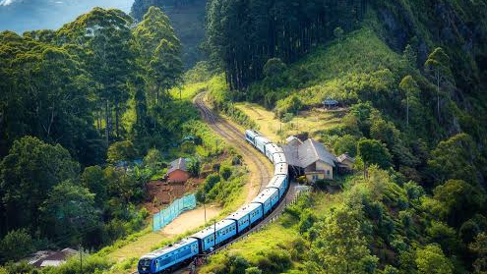
Exploring Vizag, Araku Valley: A 5-Day Adventure

Slide 2


Em bro, veldama vizag tour ki????
Nen raanu ra, work undi "FULL STRESS"
2

Slide 3
For those who are thinking the same
Money returns, time doesn't
-- wise man

Slide 4


12740
Garibrath EXP
KMT
-
VSKP
23:35
07:40
3

Slide 5

Hotel Info to be updated
Write down hotel's name
Address
Google link will be pasted here
Meals
Breakfast Included
4

Slide 6
Day 1 - Vizag City
Time | Location | Description
8:00-9:00(Optional) | Simhachalam Temple | Closures(if any): All days open Cost: Entry free Location: 16Km away from railway station (Have breakfast later on ~1hr)
10:00-11:30 | Kailasagiri | Hours: Opens up by 10 Cost varies with ropeway: ~100/person Location: On the way to RK beach Must try: Ropeway, Toy Train Ride
12:00-13:00 | Tenneti Park/Beach | Relax, Spend some time Cost: Free
13:30-15:00 | RK beach | Cost: Free. Have Lunch Try water Activities
5

Slide 7
Day 1 - Vizag City
Time | Location | Description
15:30-16:00 | Thotlakonda Buddhist Monk site | Cost: Entry free
16:40-17:30 | Beemili Beach | Cost: Entry Free
18:00-19:00 | INS Kursura/Submarine | Cost: 40/Person
19:20-20:30 | TU 142 Aircraft Museum | Cost: 70/Person Last Location of the day Rest to roar tomorrow

Slide 8
Day 2 - Vizag City
Time | Location | Description
6:00-7:30 | Random Beach road | Cost: Entry free Experience the beach Anum/Anums Family exempted
9:00-9:15 | War memorial | Cost: Entry Free
9:20-10:00 | VUDA Park | Cost: Entry 20/Person Return to room, have breakfast
11:00-13:00 | Zoo Park | Cost: 50/Person

Slide 9
Day 2 - Vizag City
Time | Location | Description
13:30-14:15 | Matsyadarshini | Cost: 30/Person
16:00-16:30 | Dolphins nose light house | Cost: 20/Person
17:00-17:30 | Yarada Beach | Cost: Entry Free
18:00-20:00/21:00 | RK beach | Famous for street food at this time Relax, Last location of the day Or can cover if anything missed on day-1, Sleep early to getup at 5:00AM next morning

Slide 10
08551
Kirandul Express
VSKP
-
ARK
06:45
10:55
3

Slide 11
Hotel Info to be updated
Thinking of this - https://tourism.ap.gov.in/home
MAYURI, HARITHA HILL
Address
Google link will be pasted here
Meals
Breakfast Included

Slide 12
Day 3 - Araku Valley
Location | Description
Chaparai Waterfalls
Rana Jellada Waterfalls
Padmapuram Gardens | Take toy train ride
Tribal Museum
Coffee Museum

Slide 13
Day 4 - Lambasingi
Location | Description
Lambasingi
Explore local/Rest

Slide 14
Day 3 - Moving away from Araku
Location | Description
Shooting spot
Sunkarimetta Baptist Church
Ananthagiri Coffee plantations
Galikonda Viewpoint
Ananthagiri Waterfalls

Slide 15
Day 3 - Moving away from Araku
Location | Description
Katika waterfalls
Borra caves

Slide 16

Bye bye Mountains

