Slide 1
Rampathoti Khajababu
Final Project

Slide 2

KEY LOGGER
Keyloggers are a particularly insidious type of spyware that can record and steal consecutive keystrokes (and much more) that the user enters on a device.
The term keylogger, or “keystroke logger,” is self-explanatory: Software that logs what you type on your keyboard.
However, keyloggers can also enable cybercriminals to eavesdrop on you, watch you on your system camera, or listen over your smartphone’s microphone.

Slide 3



AGENDA
Introduction
Problem Statement
Project Overview
End Users
Solution and Value Proposition
The "Wow" Factor in Our Solution
Modelling
Results
3/21/2024 Annual Review

Slide 4

PROBLEM STATEMENT
Keylogger Threats
Keyloggers pose a serious security risk by secretly recording a user's keyboard input, potentially exposing sensitive information like passwords and financial data.
Lack of User Awareness
Many users are unaware of keylogger threats or lack the knowledge to effectively safeguard their devices and online activities.
Inadequate Security Measures
Existing security solutions may not provide comprehensive protection against sophisticated keylogger attacks, leaving users vulnerable.

Slide 5

PROJECT OVERVIEW
Objective:
Develop a comprehensive understanding of keyloggers,
their types, how they work, and effective security measures to prevent keylogging attacks.
Scope:
Includes an analysis of hardware and software keyloggers, legal and ethical implications, security measures, and best practices.

Slide 6

WHO ARE THE END USERS?
IT Security Professionals
The primary end users for this keylogger security solution are IT professionals responsible for protecting their organization's networks and devices from cyber threats.
Business Executives
Business leaders and decision- makers who need to safeguard sensitive company data and ensure the overall security of their digital infrastructure will also benefit from this solution.
Remote Employees
With the rise of remote work, this keylogger security tool can help protect employees accessing company systems and data from their personal devices outside the office network.

Slide 7

YOUR SOLUTION AND ITS VALUE PROPOSITION
Solution:
Implement a multi-layered security strategy that includes anti-keylogging software, regular system scans, software updates ,and user education.
Value Proposition:
Enhanced Security: Reduces the risk of data breaches and
identity theft.
User Awareness: Educates users about keylogging threats and
protection methods.
Compliance: Helps businesses and organizations comply with
data protection regulations.

Slide 8
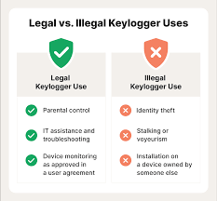

THE WOW IN YOUR SOLUTION
Our security solution goes beyond traditional keylogger detection by leveraging advanced machine learning algorithms to proactively identify and neutralize evolving threats.
This cutting-edge technology provides unparalleled protection, delivering a seamless user experience without compromising security.
3/21/2024 Annual Review
8

Slide 9
MODELLING
Start:
The program begins its execution.
Intercept Keystrokes:
The keylogger intercepts keystrokes entered by the user.
Log Keystrokes:
The intercepted keystrokes are logged.
Store Keystrokes:
The logged keystrokes are stored, usually in a local file or memory.
Optional:
Transmit Keystrokes:
Optionally, the logged keystrokes may be transmitted to a remote
server for storage or further analysis.
End:
The program finishes its execution.
9

Slide 10
MODELLING
Flow Diagram:
Initialization:
Set up the main GUI window.
Initialize global variables for key logging.
Event Capture:
Start capturing key events when the "Start" button is pressed.
Log key press and release events.
Data Logging:
Continuously update text and JSON log files with captured key events.
Stop Logging:
Stop capturing key events when the "Stop" button is pressed.
Update the GUI status to indicate the keylogger is stopped.
10

Slide 11
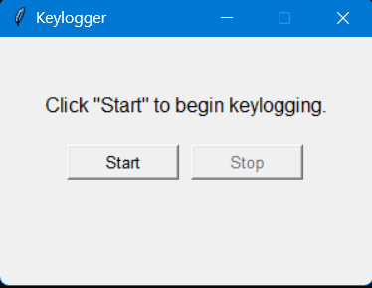
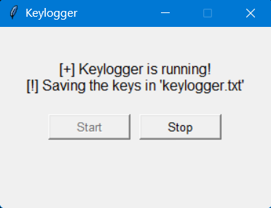
RESULTS
The result of a keylogger program typically involves capturing and logging keystrokes entered by a user on a keyboard.
These logged keystrokes can then be used for various purposes, depending on the intent of the keylogger user.
The covert nature of keyloggers allows them to capture sensitive information, including passwords, personal messages, and financial details, without the user's knowledge or consent.
This poses serious risks to individuals, organizations, and society at large, including identity theft, financial fraud, and unauthorized access to confidential data
Khajababu Ramapthoti
11

