Slide 1
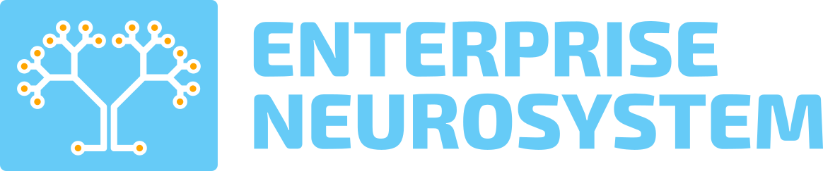
INTERNET OF NATURE • PLANETARY AI • EQUAL ACCESS FOR ALL
A Global AI Architecture for Environmental Intelligence • Enterprise Neurosystem

Slide 2

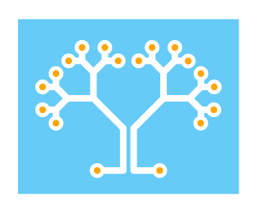
The Enterprise Neurosystem Vision
A single global AI neurology, with equal access for all nations.
Analyzes natural systems on a global scale to understand environmental impacts on the plant and animal species of the world – the Internet of Nature.
Integrates existing projects – satellite networks, and atmospheric, oceanic, seismic and agricultural sensors, for deeper AI cross-correlation.
Enables access for developing nations to current AI models, historical data, and sharing of indigenous knowledge of local habitats and species.
Acts as an early warning architecture, and an AI recommendation engine for course-correction.

Slide 3
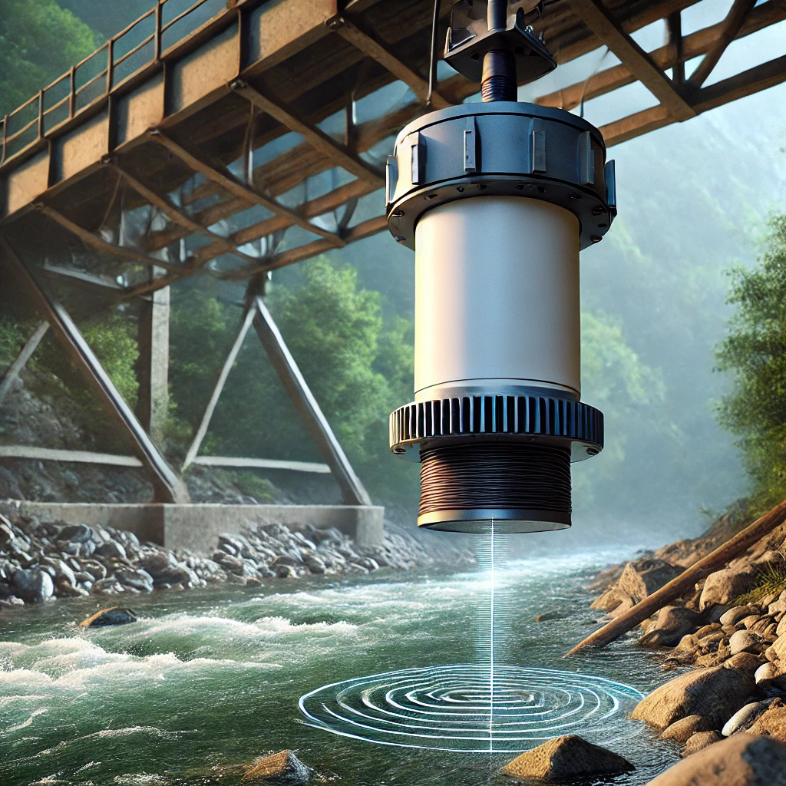
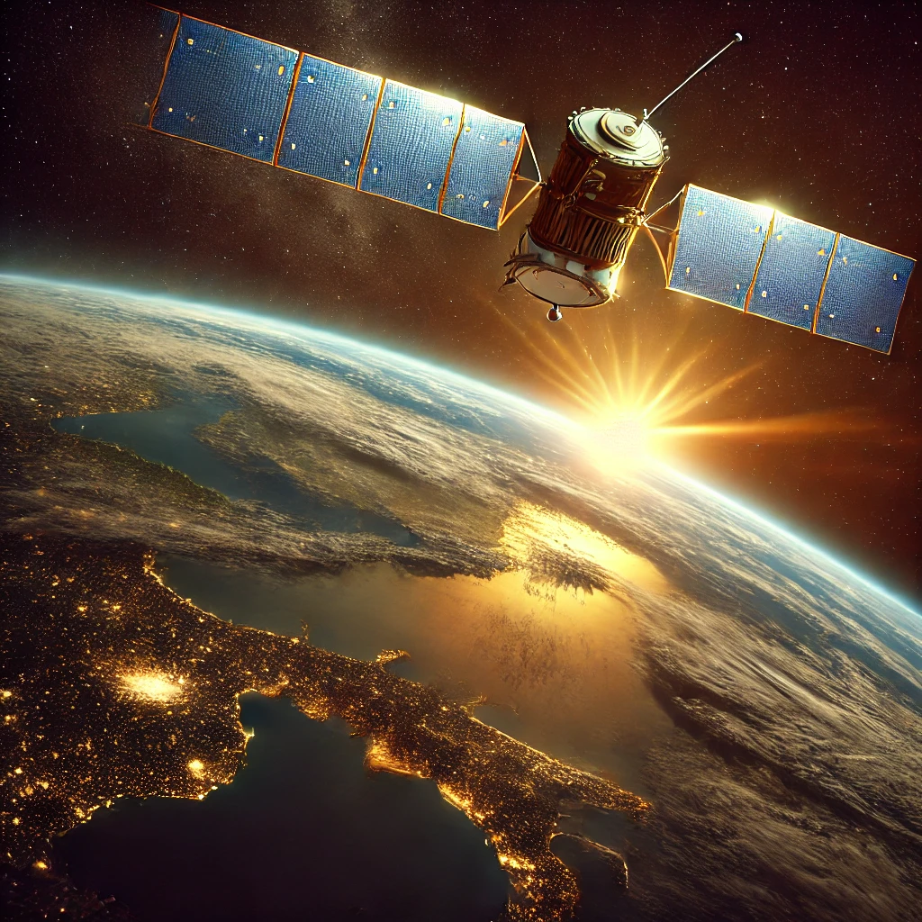

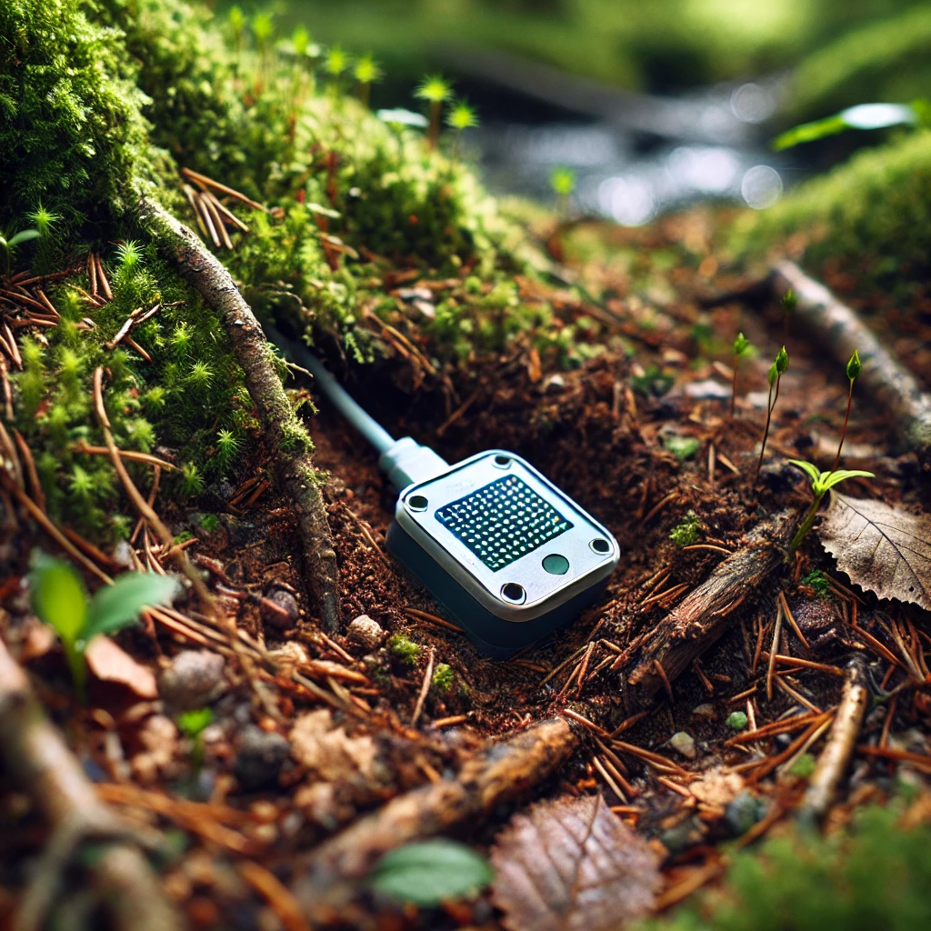
Satellites and other atmospheric and oceanic observation methods are already in place, in addition to mobile and satellite communications networks.
Sensors will be placed among key species, forests, crops and natural resources. They will monitor waterways, soil, atmospheric pollution, and other areas of human impact.
The sensors pass this data onto the primary network, then to AI instances in each country for real time pattern analysis. AI then takes the real time data and cross-correlates it with historical data by area.
Deeper early warning patterns begin to emerge - population density levels for multiple species, deforestation, soil moisture levels, agricultural monitoring, flood and drought conditions, atmospheric pollution, wildfire risks, irrigation levels and so on.
With all this data, highly accurate AI early warning predictions and new course correction recommendations become possible.
AI

Slide 4
A single AI network - with global-scale data and pattern identification - will provide the first complete picture of our planetary environment, based on a single unified global AI architecture, enabled by satellites, sensors and mobile networks.
Given all the available data sources and cross-correlation, this AI network will provide the most accurate early warning capability possible, and provide course correction recommendations for species preservation, agriculture resilience, and water resource optimization.
This provides parity for developing nations, as they gain access to the same shared AI resources as all other countries. This also eliminates bias, as currently only a small group of wealthy nations have the access to large data sets and deep environmental analysis.
An ancillary benefit - over time, species communications will be analyzed for patterns (acoustics, behavioral, etc.) and a Rosetta Stone for animal and insect communications will emerge across thousands of species.

Slide 5
Leading to a single AI observation, analysis and early warning platform.

Slide 6
Projects – Uganda, UNFCCC, USDA

Slide 7
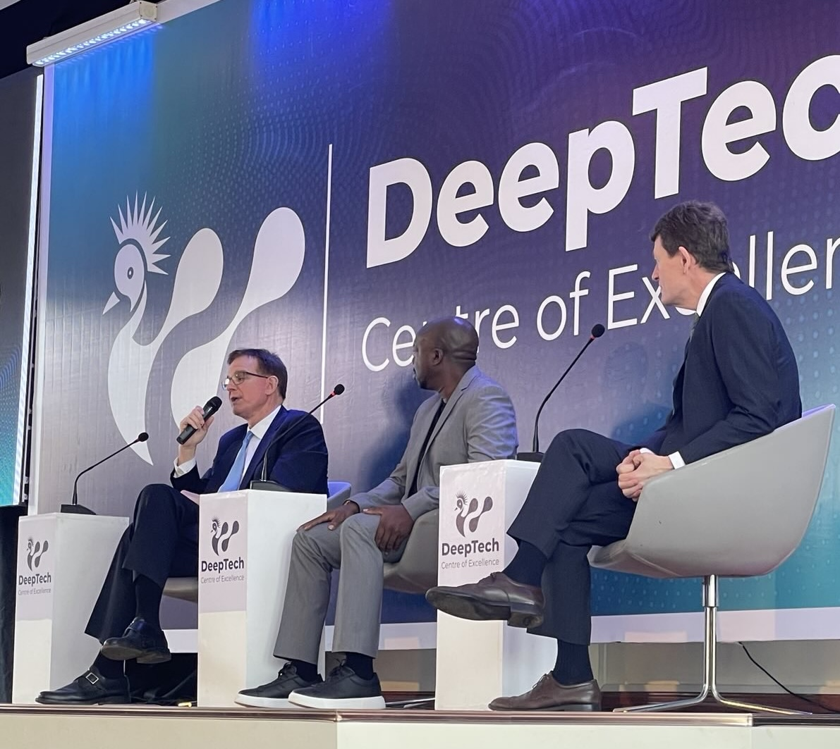
Uganda Project
Uganda Ministry of Science, Technology and Innovation – Economic Development
Uganda’s Chief Scientist contacted the Enterprise Neurosystem, following a UNFCCC panel discussion at COP 29.
The STI was formed by the Presidency to drive a stronger economic foundation via advanced technology. They now have an electric bus factory and lithium battery production coming online, with materials largely sourced in-country with 100 percent renewable energy.
Consists of four economic enablement projects – an AI LLM Foundation Model, Cloud data centers, a climate change early warning system, and advanced IT Training.
The development of a national network of environmental sensors, in partnership with the Enterprise Neurosystem and JPL/Caltech, has been approved for funding by the Minister of STI.

Slide 8
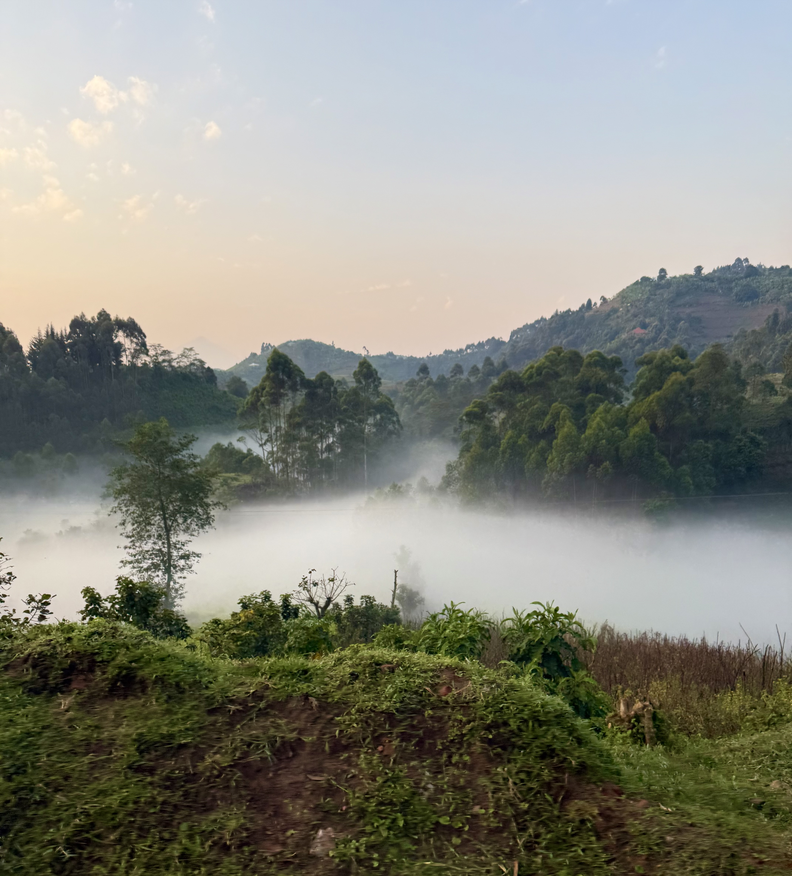
Uganda Project
Uganda Ministry of Science, Technology and Innovation – National AI Sensor Network Project
The Enterprise Neurosystem team recently visited Uganda for government meetings with the STI Ministry.
They arranged a tour of the Bwindi Impenetrable Forest, and a visit to the mountain gorillas.
It became evident this area would be an ideal site for a sensor monitoring project.
The Bwindi region will be proposed as a first site for a national AI sensor network to monitor their environment and resources, via advanced sensor development and deployment.
JPL/Caltech and the Enterprise Neurosystem will codevelop these capabilities with Ugandan universities and scientists.

Slide 9
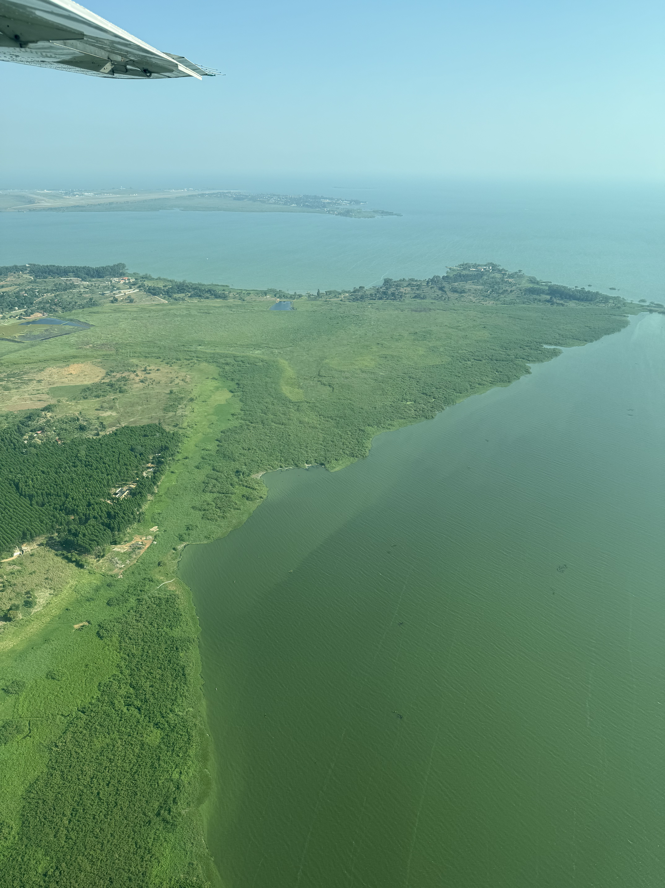
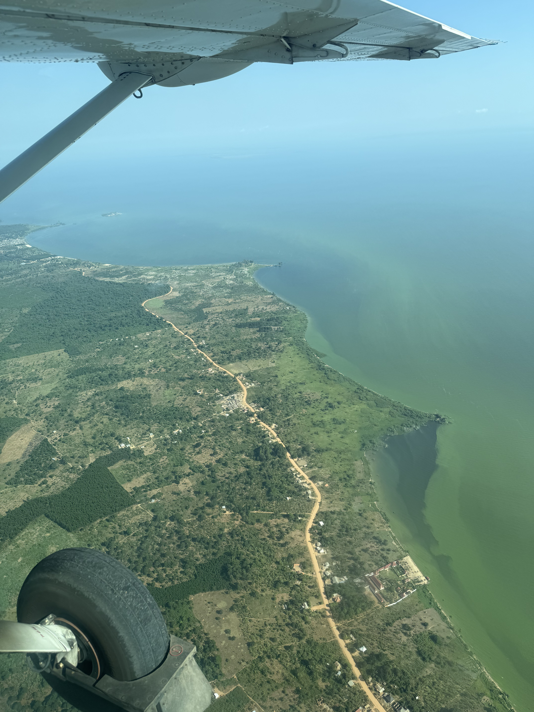
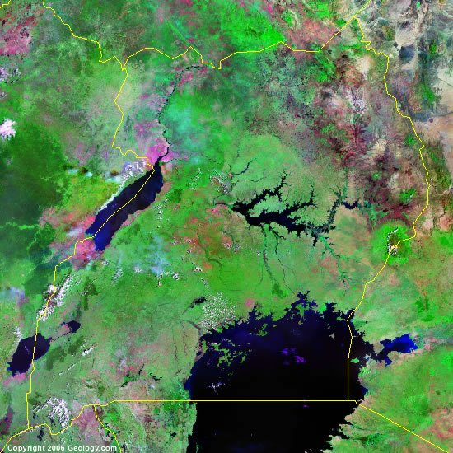
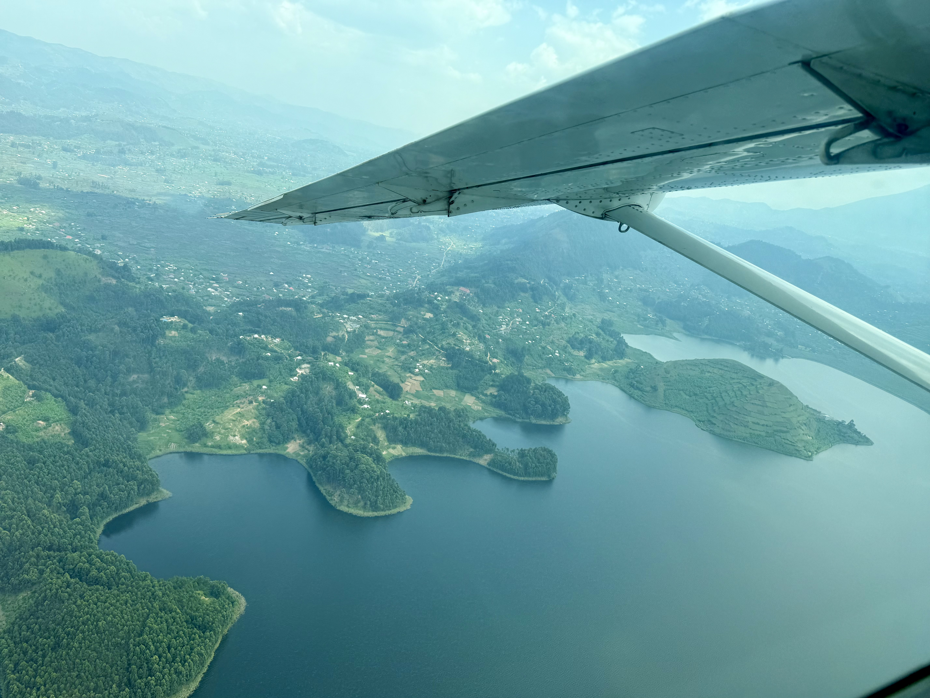
Uganda Projects
Lake Victoria
Millions of Africans rely on Lake Victoria for fresh water, agriculture production, and power.
Heart of the Nile River, which supports agriculture across Egypt and Sudan.
Sewage, climate change and agricultural runoff has led to algal blooms leading to “dead zones” for marine life.
AI analysis can provide the deeper causes and conditions, and in time, recommendations for course correction.

Slide 10
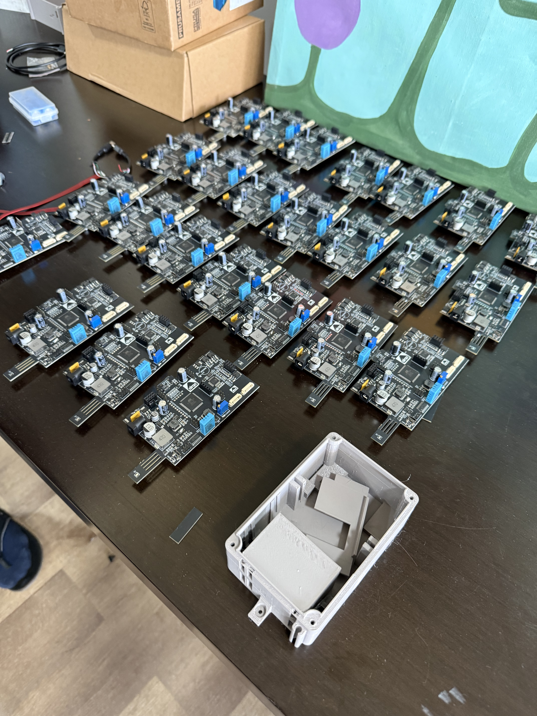
Uganda Project
Uganda Ministry of Science, Technology and Innovation – Robotic Sensor Project
Uganda’s Space and Aeronautics Ministry has proposed a project to create a robotic sensor with AI capabilities to monitor Lake Victoria.
The Enterprise Neurosystem has been engaged to develop this project. A full stack architecture has been designed to provide the AI infrastructure, and the sensor design and implementation will now be established.
JPL/Caltech is now supporting this effort in a formal partnership with the Enterprise Neurosystem, to help design the sensors and network technology, and create a knowledge transfer to Uganda. As a result, Makerere University will also partner on environmental sensor and AI model designs.
The economic benefits are immediate - water and agriculture security, and wide scale species preservation. And as Uganda now has deep manufacturing capabilities, they will manufacture the advanced sensors required for a global environmental analysis network.

Slide 11
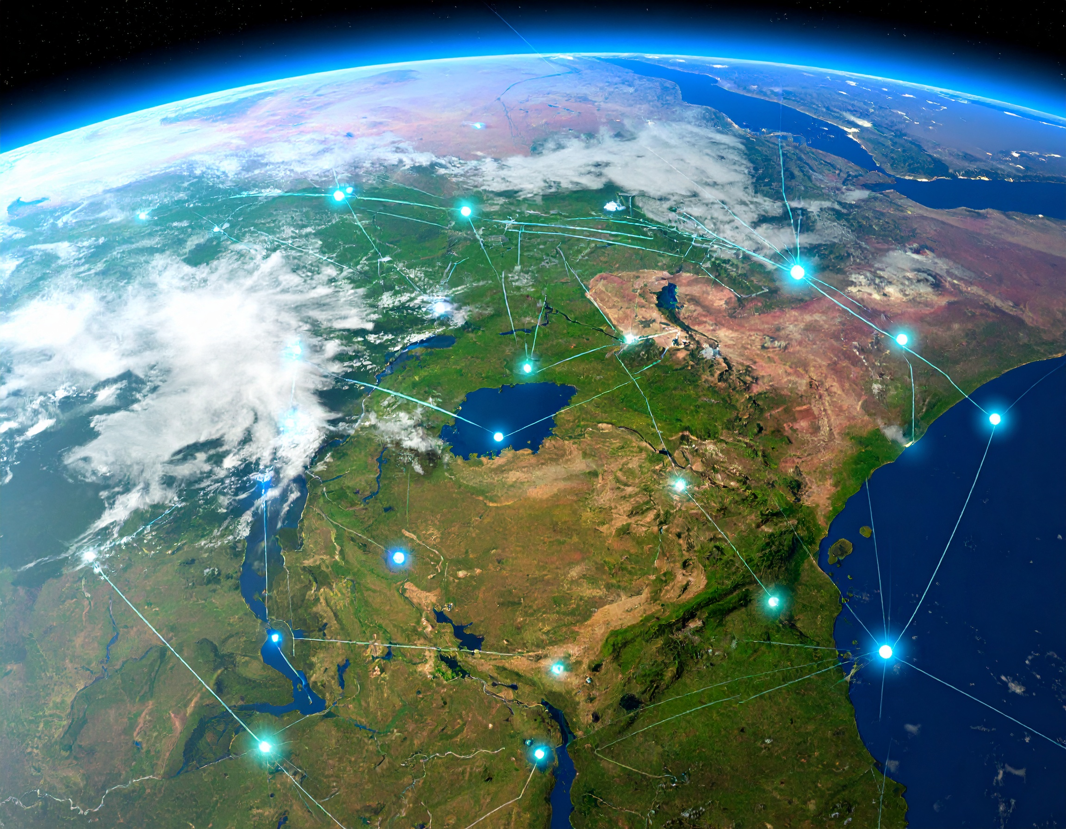
Uganda Project Objective
The National Network Effect
Lake Victoria and Bwindi will be networked together – providing a unified frame of analysis.
In time, agricultural regions, forests and wetlands across the country will be added to the network.
Thousands of different ecosystems and impacts can then be analyzed and charted in real time.
The 24/7 capabilities of AI can provide ongoing analysis around the clock – the more data, the better.
This network effect will be managed by Uganda. The data remains in Uganda. And can be shared for scientific and business value on Ugandan terms.

Slide 12
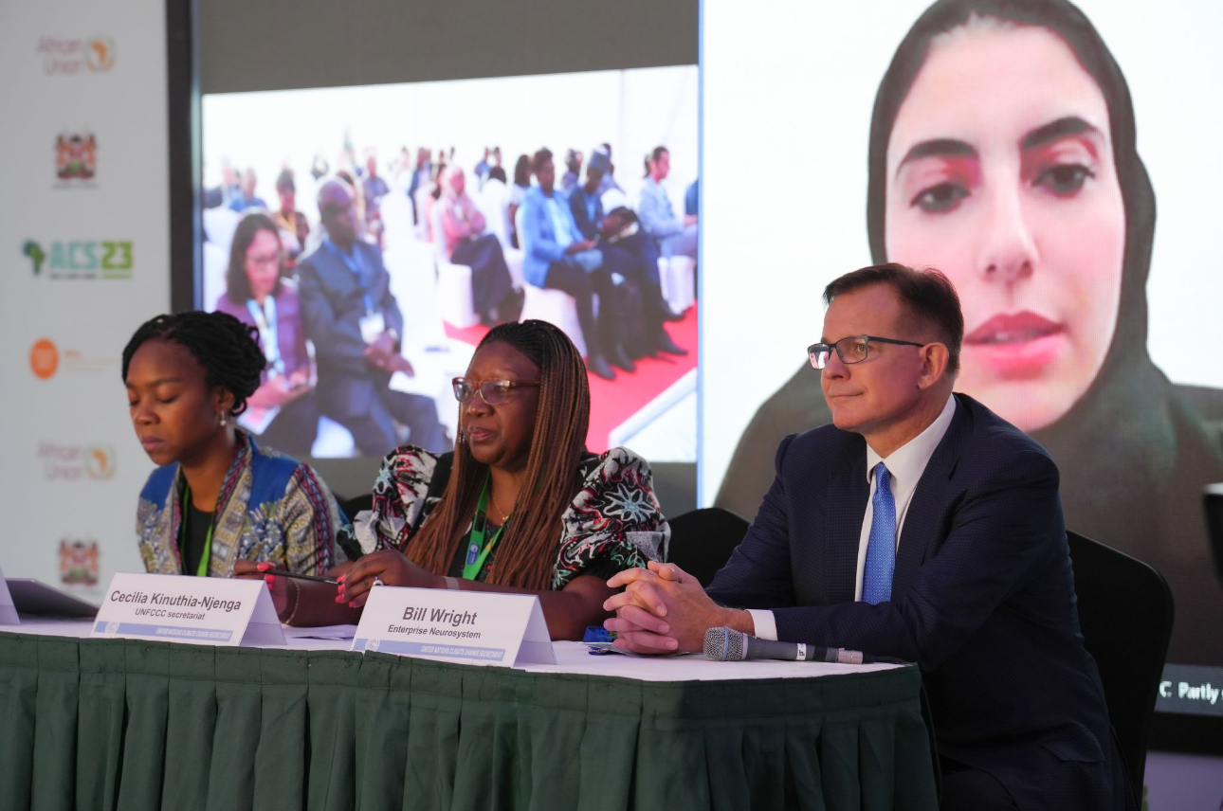
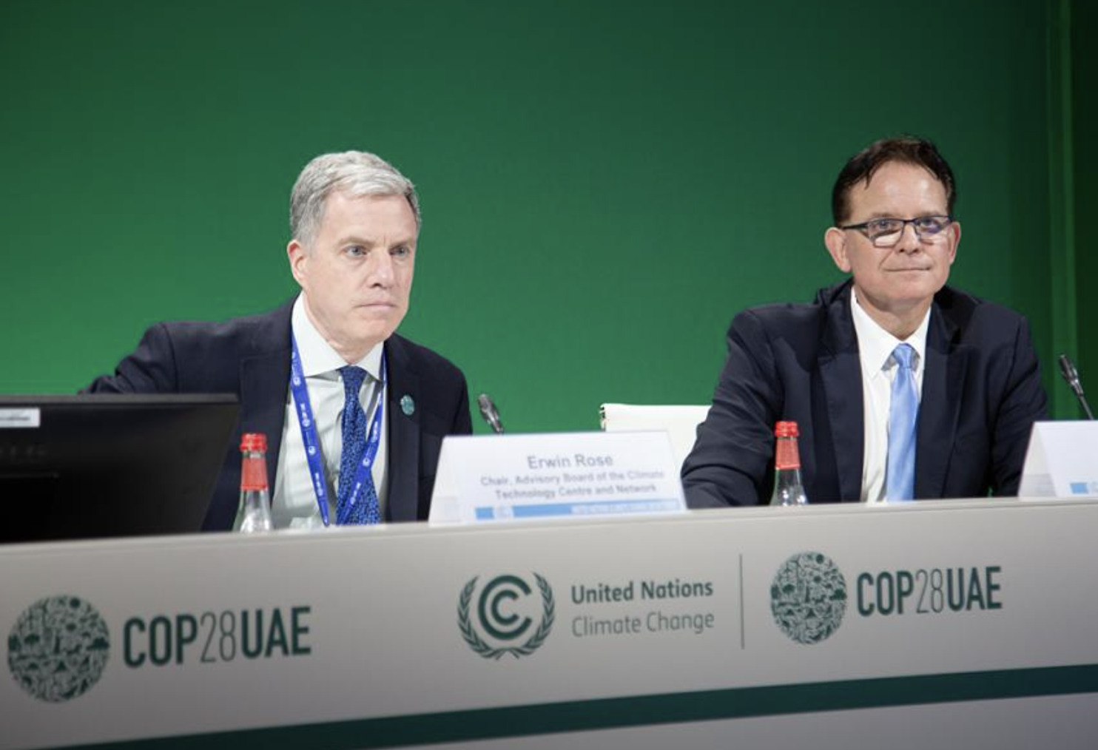
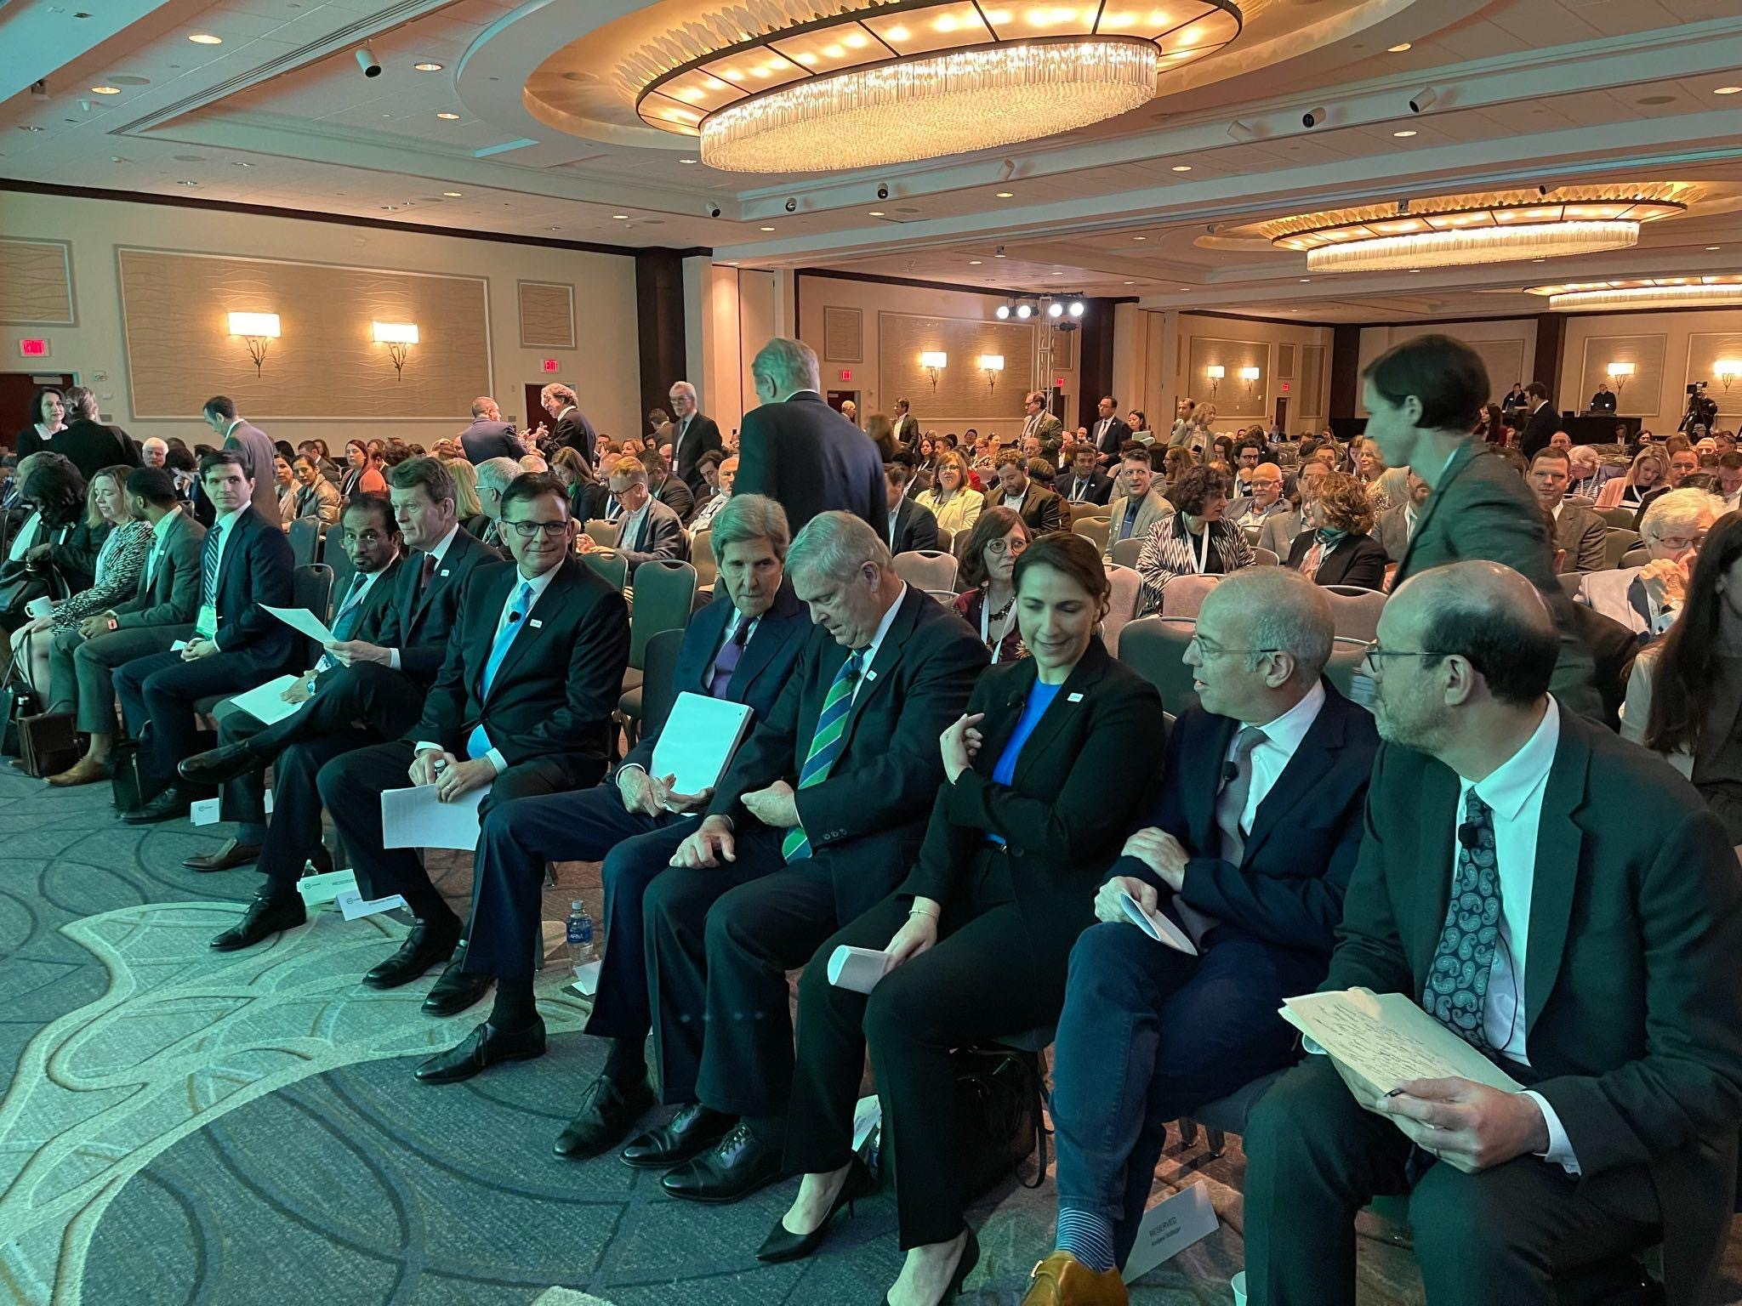
United Nations and USDA Engagement
Active support of UNFCCC and UN University programs.
Built and sponsored the UNFCCC TEC and CTCN AI Grand Challenges.
Participate in the United Nations & ITU Early Warning 4 All (EW4All) Initiative.
Partnered with the UAE and USDA on the AI Grand Challenge competition for innovations in smart agriculture.
Co-creation of new enablement initiatives at COP 28 and 29 (AI Grand Challenge, etc.). Delivered keynote talks on AI technology at Africa Climate Week and Asia Pacific Climate Week.
AI presentations delivered at the UNFCCC TEC / CTCN joint meetings in Korea and Germany.

Slide 13
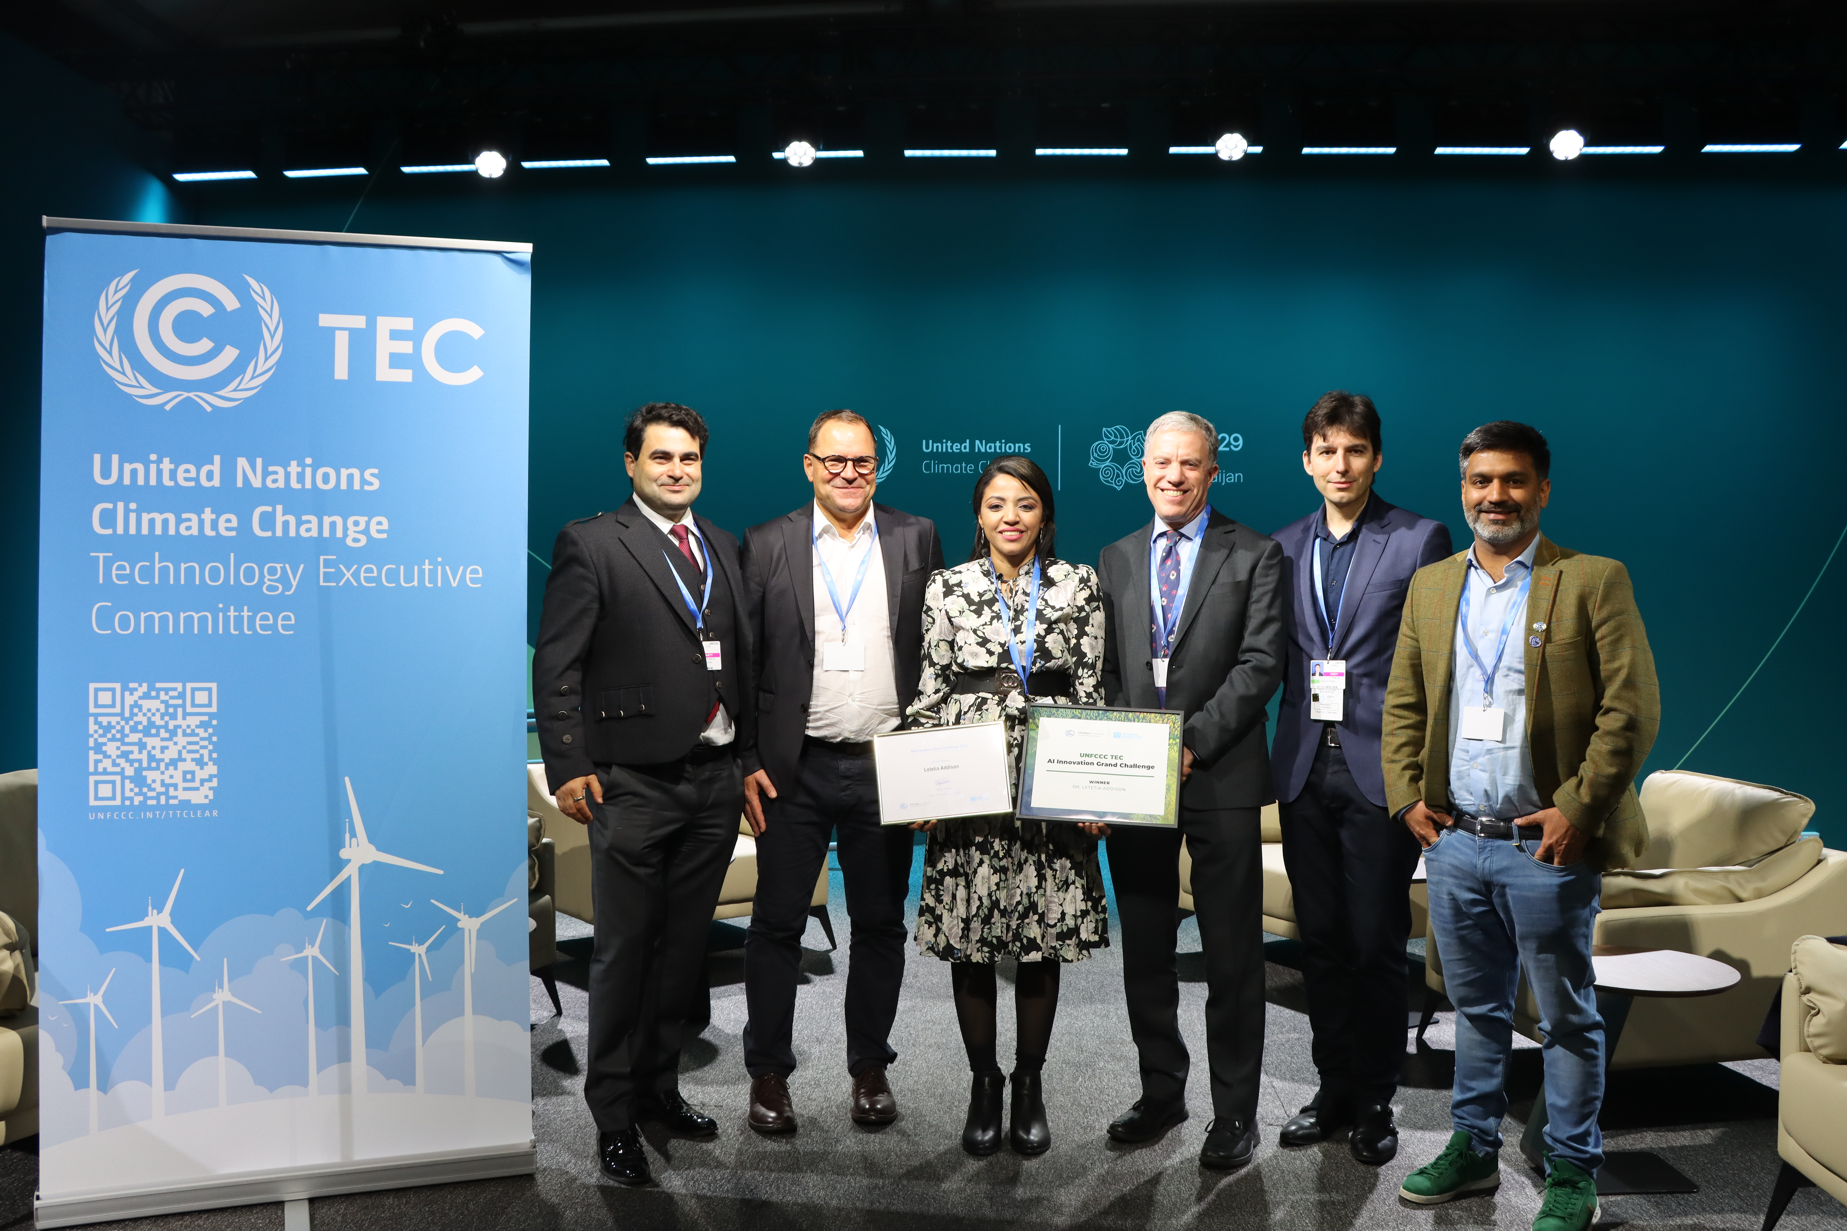
UNFCCC AI Innovation Grand Challenge
The Enterprise Neurosystem works with the UNFCCC TEC on various AI initiatives in support of developing nations, and hosted the UNFCCC AI Innovation Grand Challenge in 2024.
Winner: Dr. Letetia Addison, University of West Indies, Trinidad and Tobago for her AI4SIDS platform proposal.
AI innovators in developing nations were identified, promoted and supported.
Open-source AI applications will be made available free of charge to developing nations.

Slide 14
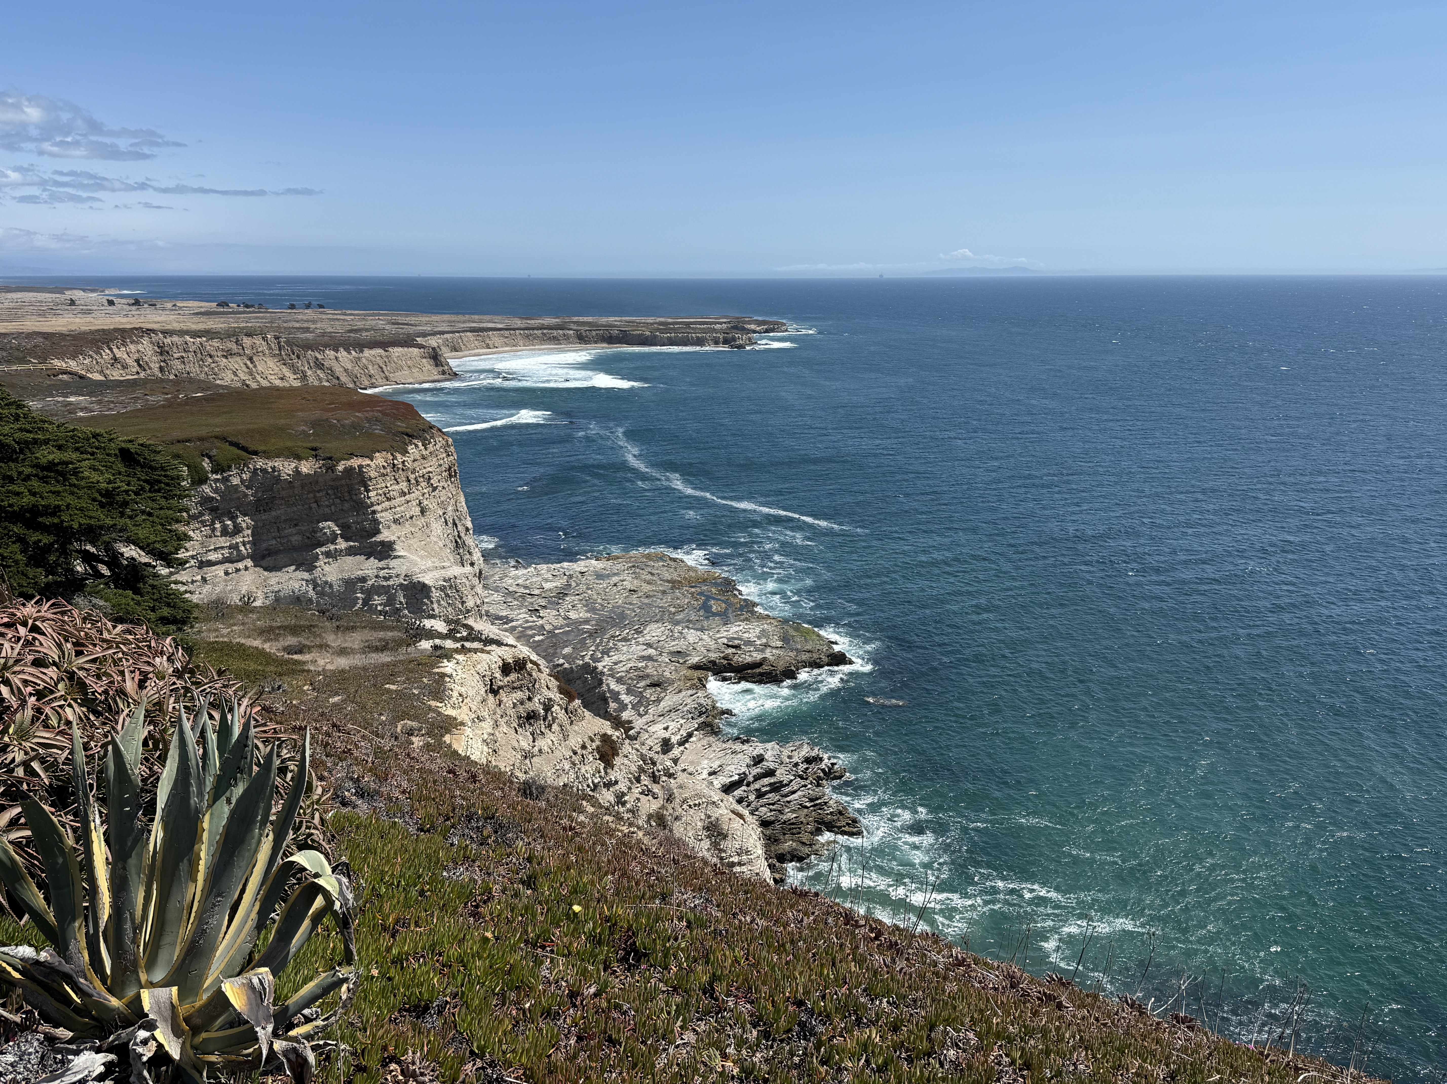
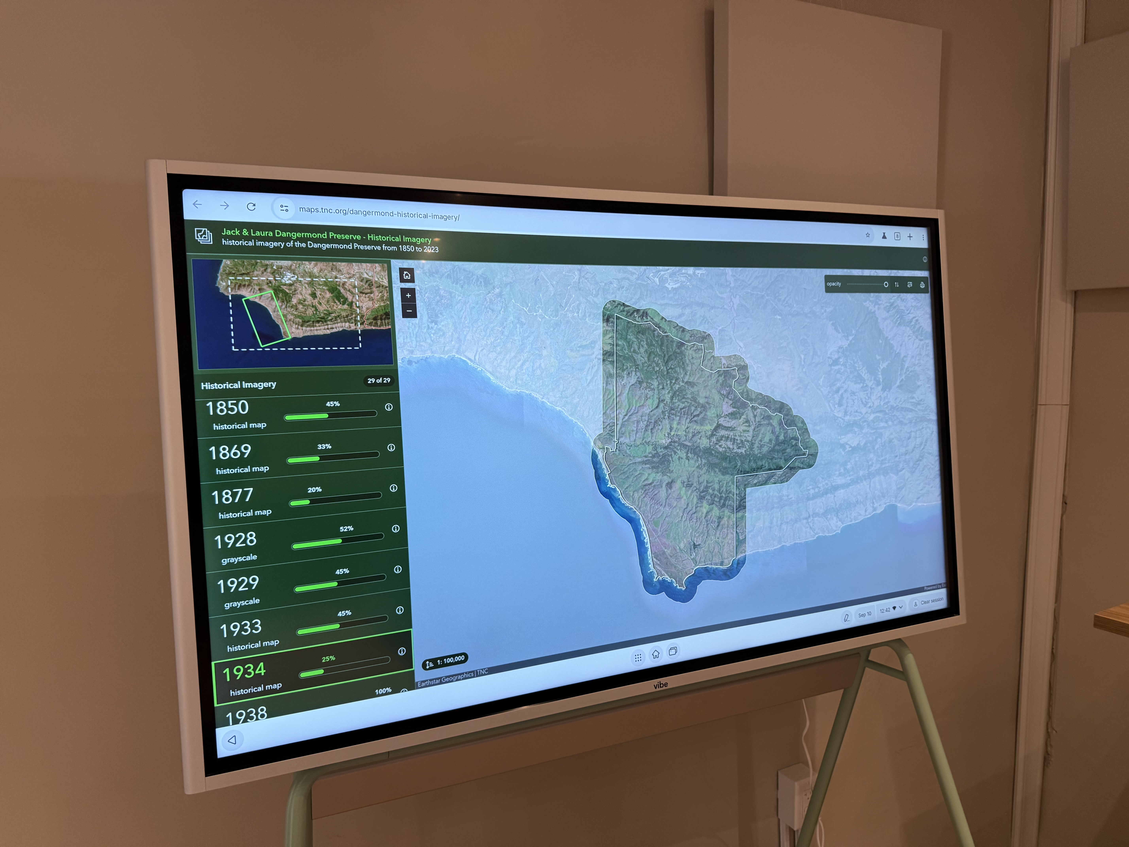
CalTech / JPL and The Nature Conservancy
The JPL and Enterprise Neurosystem engagement began at a United Nations University event in Bonn, Germany.
Meetings were then held at JPL/CalTech and NCEAS to discuss the Enterprise Neurosystem concept and architecture.
The Dangermond Preserve will be the first deployment of the EN architecture in the US.
Will incorporate integrated satellite data, atmospherics, ground sensor and multi-species analysis – a global data fabric and API integration framework, imbued with AI cross-correlation.
Can be used for Earth analysis and planetary exploration.
David Schimel (Nobel Peace Prize – pictured on left, with Ravi Sinha) is the JPL executive sponsor for this project.

Slide 15
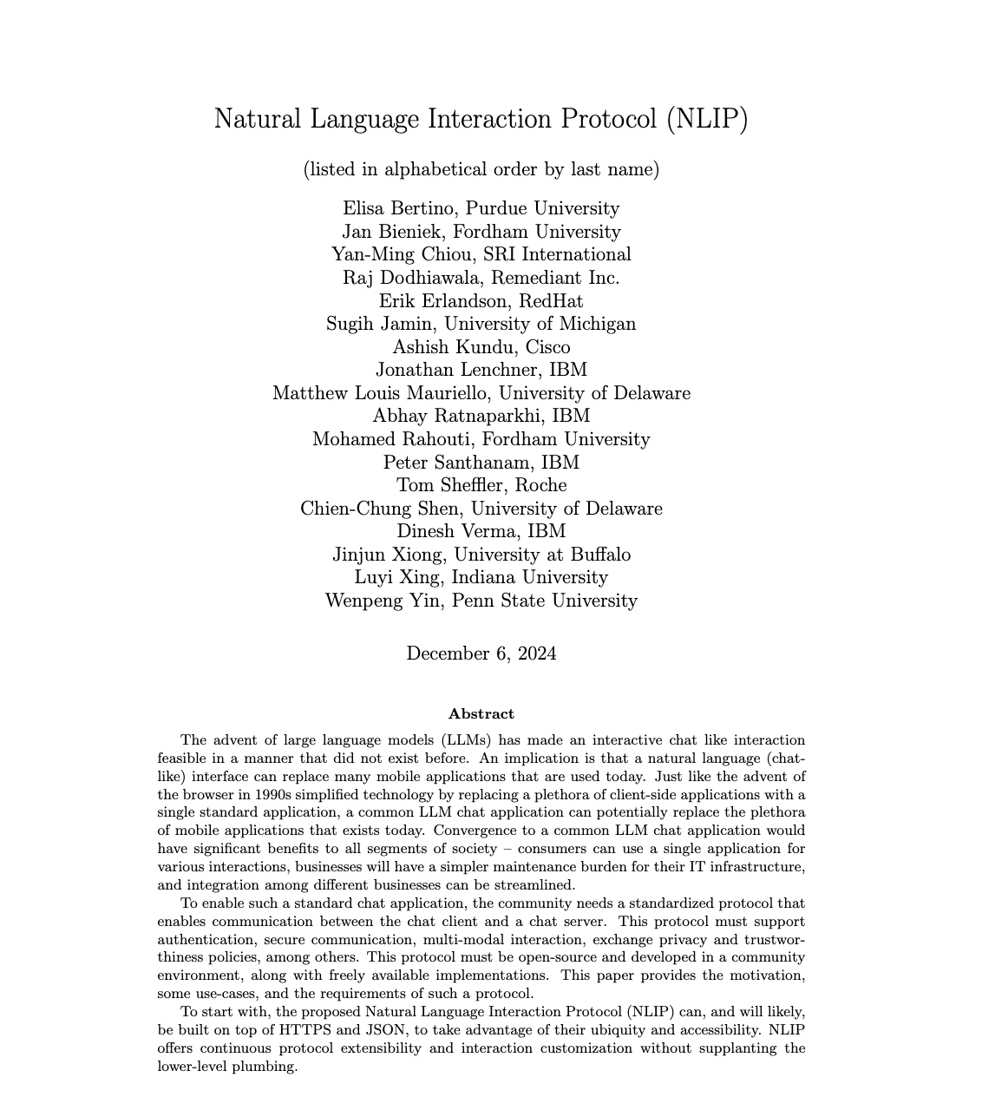
Natural Language Interaction Protocol (NLIP)
Dr. Dinesh Verma (IBM Research and Enterprise Neurosystem CTO) proposed a universal chatbot for all consumer mobile applications.
He realized this approach - and in turn, the EN architecture - requires a GenAI-to-GenAI communications protocol as a global standard.
He then initiated an Enterprise Neurosystem community project – NLIP.
Recently adopted by the ECMA as a global standard and working group.
Backers now include Cisco, Hewlett Packard, Hitachi, IBM, Microsoft, Red Hat and multiple academic institutions.

Slide 16

Uganda Projects
Crane National AI Model
The Atomic Language Model (ALM) was developed with the Uganda Crane AI team and the Enterprise Neurosystem.
Larger LLMs present issues in terms of power consumption and raw compute requirements. The climate impact and business model make this approach unsustainable.
The Atomic Model is 50KB in size, and based on Ugandan (Bantu) languages. It can be used on standard non-GPU chipsets and small IoT devices – sensors, Raspberry Pi, 2G phones, etc.
Based on mathematical principles popularized by the UOR Foundation, to drive greater efficiencies in AI.

Slide 17
Join Us. Change the Planet.
The Enterprise Neurosystem is looking for philanthropic partners, volunteer scientists, AI engineers & network architects.
SUPPORT THE MISSION
VOLUNTEER YOUR EXPERTISE
JOIN THE NETWORK
Bill Wright
Chair, Enterprise Neurosystem • +1-415-710-5207

