Slide 1
Global Development & Economic Performance
Interactive Power BI Analysis Across 229 Countries and 7 Regions
Prepared by: Atef Khalaf | Junior Business Intelligence Analyst

Slide 2
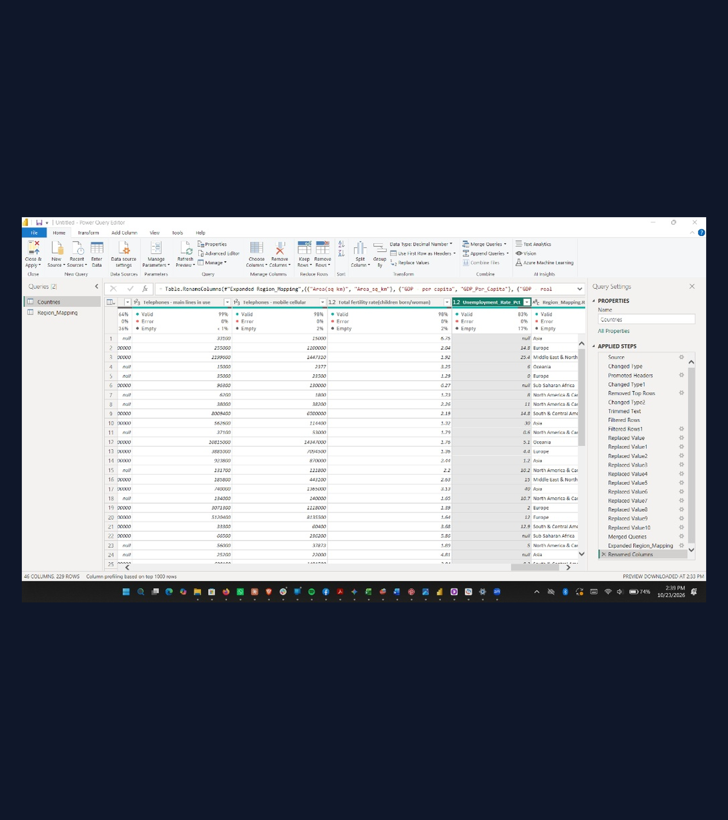
PART 1: DATA PREPARATION
Power Query Pipeline Cleaned 229 Countries
Six Structural Fixes Applied
Schema & Delimiter: Parsed semicolon CSV and removed Row 2 schema text.
Filtered Aggregates: Excluded #European Union and 33 uninhabited islands.
Region Enrichment: Standardized 11 names and merged 7 global regions.
Source: Country Data Comparison.csv | Power Query Editor

Slide 3

PARTS 2 & 3: DATA MODEL & DAX
14 DAX Measures Power Dynamic KPIs
Model & Measure Architecture
Geographic Hierarchy: Configured Region -> Country for Azure Maps.
Four Classifications: Built GDP, Population, Development, and Growth tiers.
Dynamic Ranking: Used RANKX, TOPN, DIVIDE, and CALCULATE for KPIs.
Source: Power BI Data Model | _Measures Table

Slide 4
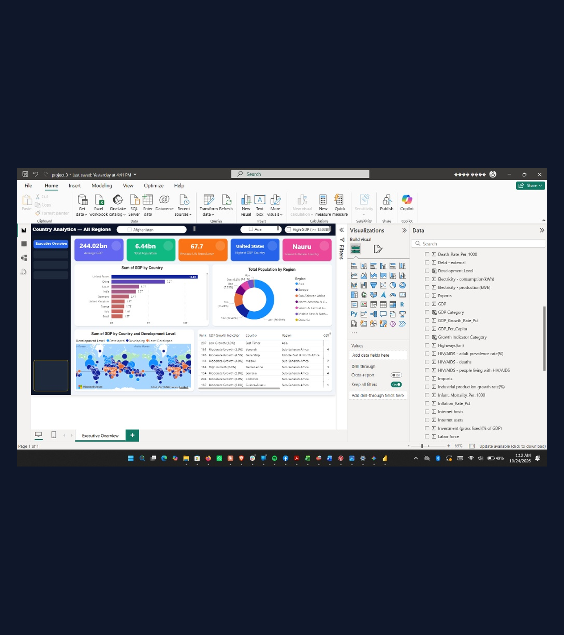
PAGE 1: EXECUTIVE OVERVIEW
Top 20 Economies Drive 80% of Global GDP
Executive Dashboard Findings
Global Scale: $55.64T total GDP across 6.45B global population.
Top Performers: US ($11.75T), China ($7.26T), and Japan ($3.75T) lead.
Asia Dominance: Asia accounts for 56.6% of population and $19.62T GDP.
Source: Power BI Dashboard — Page 1 (Executive Overview)

Slide 5
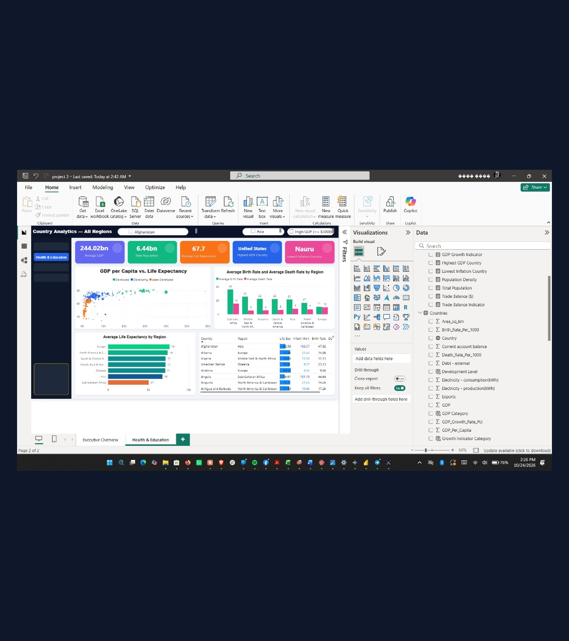
PAGE 2: HEALTH & DEMOGRAPHICS
Income Strongly Lifts Life Expectancy
Health & Demographic Insights
Income Link (r = +0.60): Europe reaches 76.5 years vs. 50.5 in Sub-Saharan Africa.
Demographic Gap: Sub-Saharan Africa averages 35.8 births per 1,000.
Infant Survival: Infant mortality correlates at r = -0.89 with longevity.
Source: Power BI Dashboard — Page 2 (Health & Education)

Slide 6
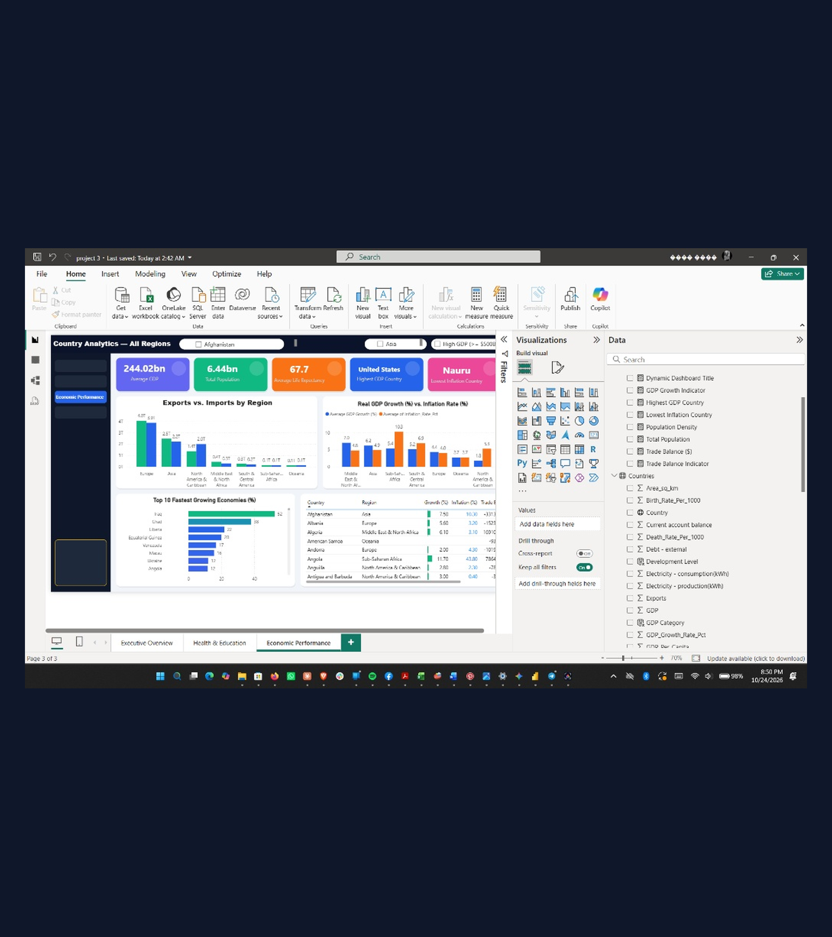
PAGE 3: ECONOMIC PERFORMANCE
Inflation Erodes Growth as Exporters Lead
Trade & Macroeconomic Trends
Fastest Growth: MENA (7.04%) and Asia (6.23%) lead real GDP expansion.
Inflation Drag: Zimbabwe's 133% inflation drives -8.2% GDP contraction.
Trade Balances: Germany (+$176.6B) leads surpluses; US (-$681B) in deficit.
Source: Power BI Dashboard — Page 3 (Economic Performance)

Slide 7
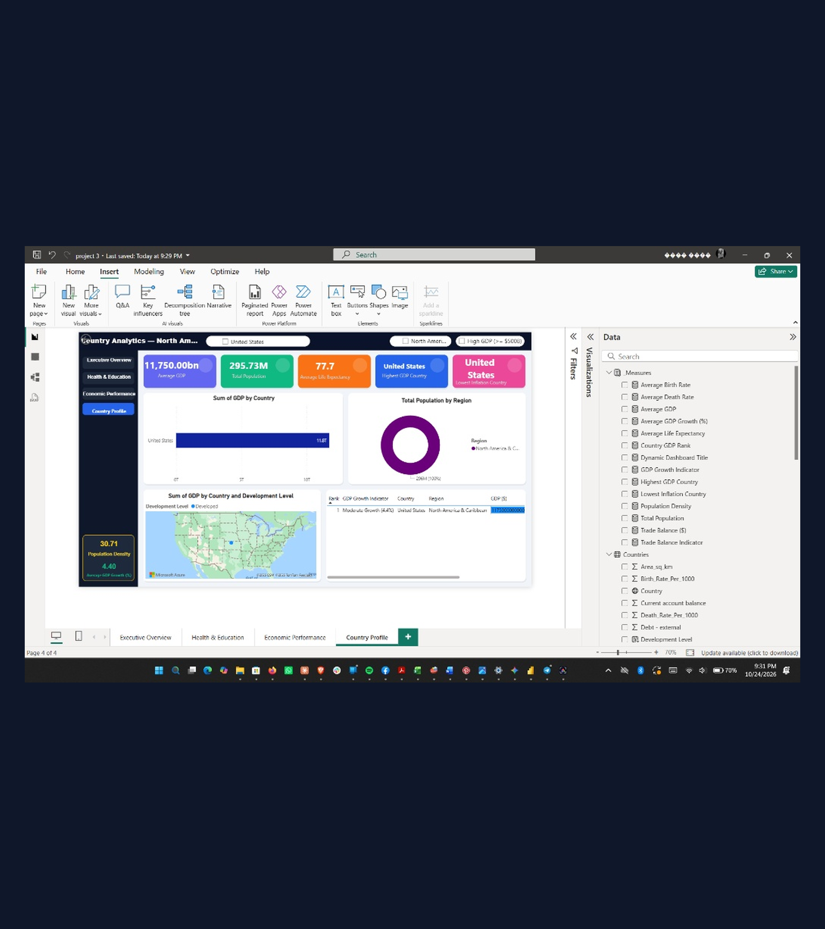
PAGE 4: INTERACTIVE DRILL-THROUGH
Drill-Through Profiles Isolate Country KPIs
United States Drill-Through Case
Economic Output: #1 ranked globally at $11.75T GDP and $40,100 per capita.
Demographics: 295.73M population with 77.7 years life expectancy.
Steady Expansion: 4.40% real GDP growth and 30.71 people per sq km.
Source: Power BI Dashboard — Page 4 (Country Profile)

Slide 8
PART 6: RECOMMENDATIONS
Three Strategic Priorities Guide Policy Action
1. Primary Healthcare
Target Infant Survival: Direct grants to maternal care in Sub-Saharan Africa.
Combat Infectious Disease: Expand HIV/AIDS treatment to lift workforce longevity.
2. Monetary Stability
Curb High Inflation: Tie aid to inflation targeting in >15% inflation states.
Restructure Public Debt: Reduce external debt burdens to restore investor trust.
3. Export Infrastructure
Reinvest Surpluses: Channel MENA and Asian trade gains into power grids.
Digital Connectivity: Expand broadband and rail to diversify export bases.
Source: Executive Policy Synthesis | Country Data Comparison Analysis

Slide 9
Data-Driven Insights Empower Sustainable Growth.
Prepared by: Atef Khalaf | Thank You & Questions

