Slide 1
Bus Bunching Control System
Real-Time Bus Tracking, Route Diversion, and Anti-Bunching Dashboard
Under the Guidance of Dr. Anand S. Krishna
• Deepti V Ligammanavar
• Gowda H L K
• Khalandar S
• Roushni Zynab

Slide 2
Problem Statement
Bus bunching causes multiple buses to arrive together, leading to uneven service and long waiting times for passengers. Manual tracking makes it hard to monitor buses in real time and respond quickly. Current systems also lack proper rerouting to handle traffic or disruptions.
2

Slide 3
Objectives
Four core goals guide this system's design
01
02
Live Map Tracking
Bunching Detection
Render bus positions in real time on a Leaflet/OpenStreetMap interface.
Identify proximity violations and trigger alerts to prevent clustering.
03
04
Multi-Route Diversion
Admin Dashboard
Present multiple alternative paths to the same destination during disruptions.
Enable live operator controls — divert, stop, resume, and route selection.
3

Slide 4
Existing System vs. Proposed System
Existing System
Proposed System
• Passive GPS tracking with no live decision support
• No visual route diversion or alternative path display
• Weak bunching detection and alert mechanisms
• Manual, delayed response to route disruptions
• Real-time WebSocket updates via FastAPI backend
• React + Leaflet map with live bus positions and route lines
• Admin-driven diversion with multiple alternative routes
• Automated proximity alerts and live activity logging
4

Slide 5
System Modules
🖥
🖵
Backend Simulation
Frontend Dashboard
Generates live bus location and speed data for the Tumkur–Bangalore route.
React UI with map, bus list, alerts, and admin control panel.
⇄
⚑
WebSocket Communication
Route Generation & Diversion
Persistent low-latency channel for pushing live updates to the frontend.
Computes and renders alternative paths when a bus is diverted by admin.
5

Slide 6
System Architecture and Workflow
Backend
Simulation
Frontend
Dashboard
Admin
Decision
Generates bus GPS
and speed data
Renders map, bus
list, and alerts
Divert, stop,
resume, select route
WebSocket
Stream
Bunching
Detection
Live Map
Update
Pushes live ticks
to the frontend
Flags proximity
violations
Diversion + status
reflected instantly
6

Slide 7
Input and Output
System Inputs
System Outputs
• Bus GPS coordinates and speed from backend simulation
• Route geometry: waypoints, stops, and destination points
• Admin commands: divert, stop, resume, select route
• Live simulation ticks streamed over WebSocket
• Live bus markers and route polylines on interactive map
• Alternative diversion paths highlighted in distinct colors
• Proximity alerts and real-time bus status indicators
• Activity log and dashboard state updates
7

Slide 8
Mathematical Formulae — Anti-Bunching Logic
Understanding the core formulas and their application is crucial for effective bus bunching prevention.
Core Formulas
Example Calculation
Target Headway = Total Route Distance / Number of Buses
Bunching Threshold = Target Headway × 0.30
Recovery Threshold = Target Headway × 0.60
Holding Threshold = Target Headway × 0.40
For a 20 km route with 3 buses:
Target Headway = 20 / 3 = 6.67 km
Bunching Threshold = 6.67 × 0.30 = 2.00 km
Recovery Threshold = 6.67 × 0.60 = 4.00 km
Holding Threshold = 6.67 × 0.40 = 2.67 km
These thresholds guide real-time decisions to prevent bunching along the route.
8

Slide 9
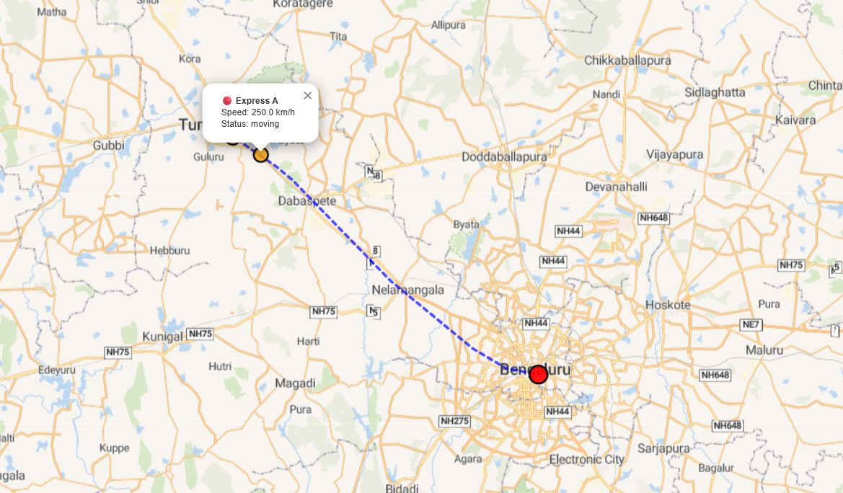
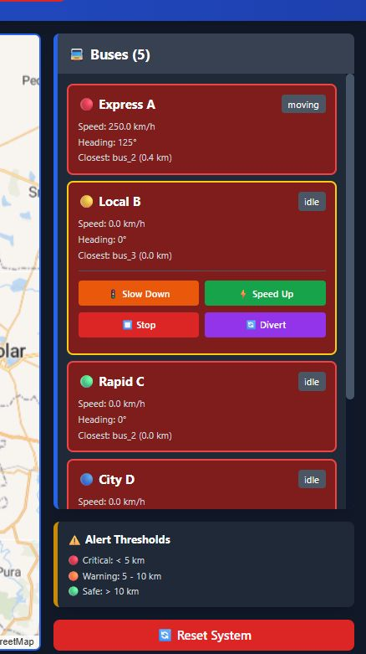
Output Dashboard
Dashboard Features
• Live map with bus markers, route line, and stop labels
• Connection status indicator (connected / disconnected)
• AI Control ON/OFF toggle with live θ / speed-gain tuning sliders
• Bunching alert banner when buses cluster together
• Live decision feed — hold / no-action / speed-ease / speed-boost
• Live metric tiles and rolling CV chart with control-toggle markers
• Driver console — full-screen hold/go instructions per bus
• Passenger view — live stop ETAs and holding/easing status
Sample output – 01 (live map)
Sample output – 02 (bus list)
9

Slide 10
Future Work
01
02
ML-Based Bunching Prediction
Real GPS Hardware Integration
Train models to forecast bunching events before they occur using historical and live data.
Replace simulation with physical GPS devices installed on Tumkur–Bangalore buses.
03
04
Passenger-Facing Mobile App
Multi-Route & City Scaling
Extend the system with a public app showing live arrivals and service alerts.
Generalize the platform to support multiple routes and expand to city-wide deployment.
05
Alert & Monitoring
Detects bunching events and logs all system activity in real time.
10

Slide 11
Conclusion
Developed an integrated real-time tracking and anti-bunching dashboard for the Tumkur–Bangalore corridor, combining live WebSocket telemetry, proximity-based bunching detection, and admin-driven multi-route diversion in a single operator interface.
11

Slide 12
References
1. Eaton, J. et al., Ant Colony Optimization for Simulated Dynamic Multi-Objective Railway Junction Rescheduling, 2017.
2. Sun, L. et al., Hybrid Cooperative Co-evolution Algorithm for Uncertain Vehicle Scheduling, 2018.
3. Deng, W. et al., An Improved Ant Colony Optimization Algorithm Based on Hybrid Strategies for Scheduling Problem, 2019.
4. Zhang, Q. et al., An Improved Multi-Objective Quantum-Behaved Particle Swarm Optimization for Railway Freight Transportation Routing Design, 2019.
5. Wu, L. et al., Brainstorming-Based Ant Colony Optimization for Vehicle Routing With Soft Time Windows, 2019.
6. Liu, W., Route Optimization for Last-Mile Distribution of Rural E-Commerce Logistics Based on ACO, 2020.
7. Song, Q. et al., Dynamic Path Planning for Unmanned Vehicles Based on Fuzzy Logic and Improved Ant Colony Optimization, 2020.
8. Wang, Z. et al., Modeling and Planning Multimodal Transport Paths for Risk and Energy Efficiency, 2020.
9. Liu, D. et al., Two-Echelon Vehicle-Routing Problem: Optimization of Autonomous Delivery Vehicle-Assisted E-Grocery Distribution, 2020.
12

Slide 13
References (continued)
10. Zeng, X. et al., Traveling Salesman Problems With Replenishment Arcs and Improved Ant Colony Algorithms, 2021.
11. Ling, H. et al., An Adaptive Parameter Controlled Ant Colony Optimization Approach for Peer-to-Peer Vehicle and Cargo Matching, 2021.
12. Lodewijks, G. et al., Reducing CO₂ Emissions of an Airport Baggage Handling Transport System Using a Particle Swarm Optimization Algorithm, 2021.
13. Li, J. et al., A Multiobjective Ant Colony System Considering Travel and Pollution Costs for Vehicle Routing in Epidemics, 2022.
14. Govindaraju, S. et al., Intelligent Transportation System's Machine Learning-Based Traffic Prediction, 2024.
15. Afolayan, B. I. et al., Emerging Trends in Machine Learning Assisted Optimization Techniques Across Intelligent Transportation Systems, 2024.
16. Xu, P. et al., Ship Formation and Route Optimization Design Based on Improved PSO and D-P Algorithm, 2024.
17. Hassan, M. et al., Application of Machine Learning in Intelligent Transport Systems: A Comprehensive Review and Bibliometric Analysis, 2025.
18. Ngo, T. & Van, T., Damage Detection in Bridges by Hybrid Particle Swarm Optimization–Simulated Annealing (PSO-SA) Approach, 2026.
13

