Slide 1
CS6068
Parallel Computing - Fall 2014
Lecture Week 6 – Oct 13
Topics:
Unit 6 Udacity Continues
Review Breadth-First Graph Traversals
Depth-first and P-complete problems
Processing Linked Lists in Parallel
Trading Work for Steps
Bloom Filters and Cuckoo Hashing
Notes:
This is in line with Udacity Lesson 6.

Slide 2
Parallel Graph Traversal
WWW, Facebook, Tor
Application: Visit every node once
Breadth-First Traversal:
Visit nodes level-by-level, synchronously
Depth-First Traversal:
Visit nodes at periphery first.
Understand Variety of Graphs : Small Depth, Large Depth, Small-world

Slide 3
Design of BFS
Goal: Compute hop distance of every node from source node.
1st try:
Thread per Edge Method
Work Complexity
Step Complexity
Control Iterations
Race Conditions
Finishing Conditions
Notes:
Kernel needs to be run Depth of the graph (m)
Work Complexity: Depth of the graph * number of edges (n*m) for sequential n+m It’s more work efficient to use CSR

Slide 4
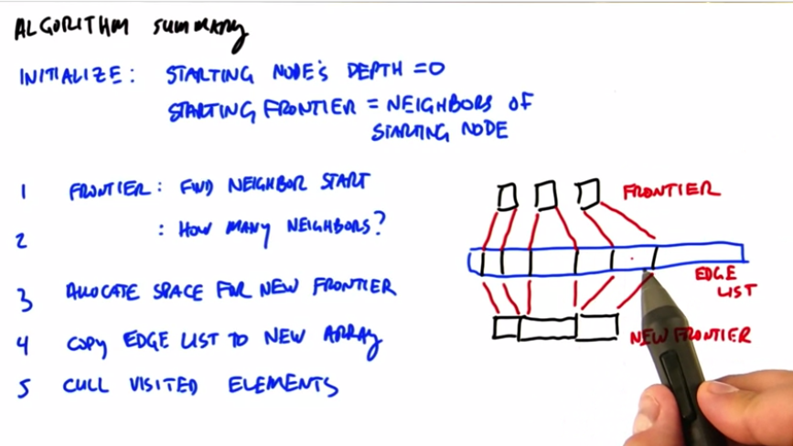
Notes:
For sequential search, we only have to look at the frontier of the edges (we don’t care about the previous edges)
Graph can be presented as CSR matrix: “C: Compacted Adjacency Matrix,” “R: Array of Pointers = R[i+1]-R[i] gives number of neighbors on node i,” and “
Compact operation to pick the vector using row pointers and compact again with predicate (has it been seen?) to remove ones that had been seen from the list

Slide 5

Parallel BFS Strategies
1. Expand current frontier (level-synchronous approach, suited for low diameter graphs)
5
8
1
O(D) parallel steps
Adjacencies of all vertices
in current frontier are
visited in parallel
0
7
3
4
6
9
source
vertex
2
2. Stitch multiple concurrent traversals (Ullman-Yannakakis approach, suited for high-diameter graphs)
5
8
1
path-limited searches from “super vertices”
APSP between “super vertices”
source
vertex
0
7
3
4
6
9
2

Slide 6
Depth-first Traversal def depthFirst (v): if marked[v]: return else: marked[v]=true for each w in Neighbor(v): depthFirst(w)
Depth-first traversal is used in many apps
-Topological sort of DAGs
-Detecting cycles in graphs
-Strongly-connected components
Depth-first ordering is labeling of vertices that are consistent with the ordering of a depth-first traversal.
The problem of computing depth-first ordering is P-complete.

Slide 7
Parallel Complexity Theory
What problems are inherently sequential?
Recall the sequential complextiy classes:
P, NP, NP-complete 1MQ: P = NP ?
A class to describe parallel problems: NC
- solvable in polylog time on poly number of processors
Now we can ask what are the hardest polytime sequential problems? Call this P-complete
Examples:
Circuit Value Problem
Conway’s Game of Life
Lexicographically First Depth First Ordering

Slide 8
Processing a Linked List
Design Strategy: Recursive Pointer Jumping
The idea is to do pointer indirection in parallel and turn a single linked list into 2 shorter (half the length) linked lists in one operation, then recurse.
Here is the basic code:
def pointer_jump_rec (list-of-ptrs):
chum-ptrs = range(len(list-of-ptrs))
for i in range(len(chum-ptrs)):
chumptr[i] = list-of-ptrs[list-of-ptrs[i]]
if eql(chum-ptrs, list-of-ptrs):
return chum-ptrs
else:
return pointer_jump_rec(chum-ptrs)
Notes:
Pointer jumping has log n step complexity
It has n log n work complexity
Sequential has n work complexity

Slide 9
An Example of using Pointer Jumping
0-> 2->1-> 5-> 6 4-> 7-> 3
we have two linked lists that can be stored as one python list of index pointers
ptrs=[2, 5, 1, 3, 7, 6, 6, 3].
If we apply pointer jumping each node index will
eventually point to the head of the list it is a member
of.
>>> pointer_jump_rec ([2, 5, 1, 3, 7, 6, 6, 3])
[6, 6, 6, 3, 3, 6, 6, 3]
Work and Step complexity of Pointer-Jumping??

Slide 10
List Ranking Problem:
Determine the hop distance of each node to its head node.
Can we apply Pointer-Jumping paradigm to solve List-Ranking Problem?

Slide 11
We can update the rank of node with each call to
pointer-jump:
def jump_rank (ptrs, oldranks):
newranks= range(len(oldranks))
for i in range(len(ranks)):
newranks[i] = oldranks[i] + oldranks[ptrs[i]]
chum-ptrs = range(len(ptrs))
for i in range(len(ptrs)):
chum-ptrs[i] = ptrs[ptrs[i]]
if eql(chumptrs,ptrs):
return newranks
else:
return jump_rank(chum-ptrs,newranks)
Why does this work? What are initial ranks?
What is the invariant property of (chum-ptrs,newranks)
Notes:
Sum of the all the nodes is the value of the rank (invariant)

Slide 12
Trading-off Work for Steps
List ranking is a classic example that shows that we can trade-off increasing work for reduction in step complexity.
Let’s apply this principle to sorting. Suppose we permit unlimited work. How much can we reduce the step complexity of sorting??
Notes:
Hillis/Steele

Slide 13
Counting Sort
def countingSort(list):
scatter = range(len(list))
result = range(len(list))
for i in range(len(list)): #do for loop in parallel
scatter[i] = len(compact(lessthan(list[i]), list))
result[scatter[i]] = list[i]
return result
What is the work and step complexity of countingSort??
Notes:
Compact step complexity = scan step complexity = log n
Work complexity is n^2
W S
Seq nlogn nlogn
Bitonic nlog^2n log^2n
countSort n^2 logn

Slide 14
Parallel Hashing
Hashing Problem: Fast lookup in table using keys.
Applications: Implementing Disjoint Sets, Graph lookups
Static Case: Perfect Hashing
Dynamic: Insertions and deletions, bucket contention and collisions
Load Factors – if your hashing n items to m buckets what is optimal load factor?
Separate Chaining
Open Addressing
Problems with Chaining and Open Addressing in
parallel.
Notes:
Optimal load is n/m in n items to m buckets
Separate chaining adds a linked list to a bucket; this is bad for parallel because it creates divergence, and it’s sequential
Open addressing is to allocate a collided bucket to an empty address below it

Slide 15
Bloom Filters for Set Membership
Problem: Fast test of inclusion – is given element
already in a given set.
Bloom Filter BF Solution:
Select k-hash functions map to locations in BF table – large table of bits – initially all 0
Insert item into set by setting k-bits in BF using k-hashes
Testing for set inclusion checks k-bits
Small probability of false positives.

Slide 16
Cuckoo Hashing – avoid problems with chaining
Select k>1 hash functions
To insert item - Map item to any of the k locations
If there are k-collisions we bump one from nest.
Reinsert the bumped element.
When can this fail? Under what conditions?
Is it likely to fail? How large do we choose n?
Notes:
We will add a key to a bucket, if it collides, then we will kick out the value in the bucket and insert the new key to the bucket.

Slide 17
