Slide 1
CS6068
Parallel Computing - Fall 2014
Lecture Week 5 - Sept 29
Topics:
Unit 6 Udacity
Challenging Parallel Design Patterns
Layout Design, Occupancy
Sieves, N-body problems
Breadth-First Graph Traversals

Slide 2
Lecture 5 Plan
Review: Major Optimization Techniques and Main Tradeoffs: latency, bandwidth, occupancy, the number of threads, and the transaction size per thread
Today: Apply Techniques to Common Parallel Patterns that Transcend Single Application Domain
1) Sieve of Eratothenes
2) N-body: Impact on Dense and Sparse Matrices
3) Graph Traversals – BFS

Slide 3
Review Programmer Focus:
Complex system memories: DRAM and caches
Theoretical Peak global memory bandwidth
versus Kernel Memory Utilization
Tiling for coalesced reads and utilization of shared memory
Average latency, and Little’s Law
Synchthreads barriers and block density
Occupancy – latency hiding, maximize the number of active blocks per SM
Divergence and regularity

Slide 4
Sieve of Eratosthenes:
Sequential Algorithm
Sieve of Eratosthenes
2
2
3
3
4
4
5
5
6
6
7
7
8
8
9
9
10
10
11
12
12
13
14
14
15
15
16
16
17
18
18
19
20
20
21
21
22
22
23
24
24
25
25
26
26
27
27
28
28
29
30
30
31
32
32
33
33
34
34
35
35
36
36
37
38
38
39
39
40
40
41
42
42
43
44
44
45
45
46
46
47
48
48
49
49
50
50
51
51
52
52
53
54
54
55
55
56
56
57
57
58
58
59
60
60
61

Slide 5
Sieve of E - Python code
def findSmallest(primes, p): #helper function
for i in range(p, len(primes)): #finds smallest prime after p
if primes[i] == 1: return i
def sieve(n): #return num primes less than n
primes = numpy.ones((n+1,), dtype=numpy.int)
primes[0]=primes[1]=0
k=2
while (k*k <= n):
mult= k*k
while mult <= n:
primes[mult] = 0
mult = mult + k
k = findSmallest(primes,k+1)
return sum(primes)

Slide 6
>>>import time, numpy
for x in range(15,27):
st=time.clock(); s=sieve(2**x); fin=time.clock()
print x, s, fin-st
x sum time
15 3512 0.04
16 6542 0.1
17 12251 0.17
18 23000 0.35
19 43390 0.71
20 82025 1.44
21 155611 2.94
22 295947 5.89
23 564163 11.93
24 1077871 24.67
25 2063689 48.73
26 3957809 100.04

Slide 7

Complexity of Sieve of Eratosthenes
Work and Step Complexity: W(n)= O(n log log n)
D(n) = O(#p < √n) = O(√n/log n)
Proof sketch:
Allocate array O(n)
Sieving with each prime p takes work = n/p
To find next smallest prime p takes work O(p) < n/p
Prime Number Theorem says if a random integer is selected in range(n), the probability that the selected integer is prime is ~ 1 / log n
xth smallest prime is ~ x log x. So total work is bounded by O(n) times sum of the reciprocals of first √n/logn primes.
From calculus:

Slide 8
Designing an Optimized
Parallel Solution for Sieve
Important Issues to consider:
What should a thread do? Focus on divisor or quotient?
Is tiling possible? Where should a thread start? What are dependencies?
Can thread blocks make use of coalesced DRAM memory access and shared memory?
Is compaction possible?

Slide 9
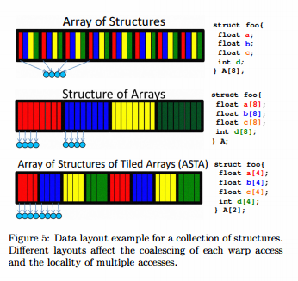
Data Layout Optimization in GPU Computing

Slide 10
Dense N-Body: Computing an NxN matrix of Force vectors
N objects – each with own parameters, 3D-location, mass, charge, etc.
Goal: Compute N^2 Source/Dest Forces
Without Tiling: we have N^2 global memory access
Consider PxP tiles: N^2/P^2 tiles overall
- impact of using P^2 threads per tile (all must share)
- impact of using P threads per tile (one thread per row, only share dest parameters)

Slide 11
If we use P threads on PxP tiles
Q: what is average latency in # global versus shared memory fetches
Privatization principle: avoid write conflicts
Impact of Partition on
Bandwidth,
Shared Memory, and Load balan

Slide 12
Sizing Tiles
How Big Should We Make a Tile
If we choose a larger P, does that mean more or less total main memory bandwidth?
If choose larger P, does that mean easier or harder to make use of shared memory?
3. If choose larger P, does that mean we wait longer or shorter to synchronize?
4. If choose larger P, does that mean we can more easily hide latency better?

Slide 13
Sizing Tiles:
Need to make sure that:
P large enough to get speedups
small enough so we can fit into the shared/register memory limits and
Use at least as many thread blocks as 8 x #SMs.
Definition: Occupancy =
Active Warps(threads) /
Maximum Active Warps (threads)

Slide 14
Occupancy Examples
Remember: resources are allocated for the entire block and are potential occupancy limiters:
Register usage, Shared memory usage, Block size
Fermi Streaming Multiprocessor SM assumed to run 48 active warps of 32 threads = total of 1536 threads
Example 1: SM has 48K shared memory
Kernel uses 32 bytes of shared memory per thread
48K/32 = 1536 threads
Max Occupancy limit = 1
Example 2: SMP has 16K shared memory
Kernel uses 32 bytes of shared memory per thread
Max 16K/32 = 512 threads per block
Max occupancy limit =.3333

Slide 15
Dealing with Sparse Matrices
Recall Sparse Matrix dense vector product problem.
Consider impact of mapping options:
Thread per Row vs Thread per Element
Load imbalance
Hybrid Approach?
We can Divide the problem between Thread per Row and Thread per Element.

Slide 16
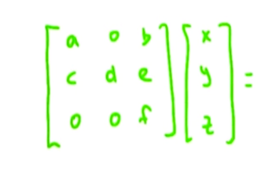
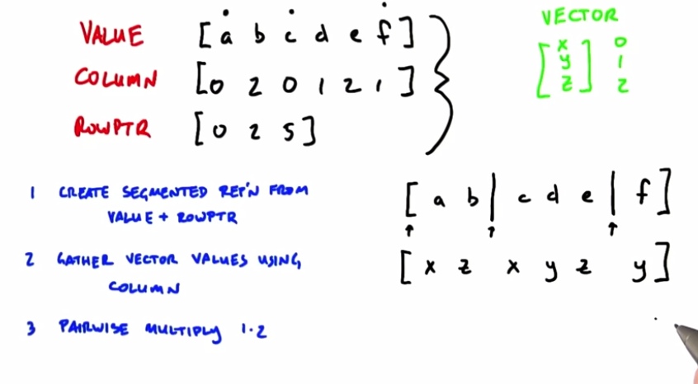

Slide 17
Parallel Graph Traversal
WWW, Facebook, Tor
Application: Visit every node once
Breadth-First Traversal:
Visit nodes level-by-level, synchronously
Variety of Graphs : Small Depth, Large Depth,
Small-world Depth

Slide 18
Design of BFS
Goal: Compute hop distance of every node from source node.
1st try:
Thread per Edge Method
Work Complexity
Step Complexity
Control Iterations
Race Conditions
Finishing Conditions

Slide 19

Parallel BFS Strategies
1. Expand current frontier (level-synchronous approach, suited for low diameter graphs)
5
8
1
O(D) parallel steps
Adjacencies of all vertices
in current frontier are
visited in parallel
0
7
3
4
6
9
source
vertex
2
2. Stitch multiple concurrent traversals (Ullman-Yannakakis approach, suited for high-diameter graphs)
5
8
1
path-limited searches from “super vertices”
APSP between “super vertices”
source
vertex
0
7
3
4
6
9
2

Slide 20
