Slide 1
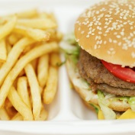


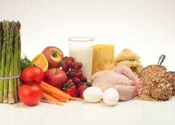
Data: -Training
-Testing
Training
Algorithm
Predict
Result
Testing

