Slide 1
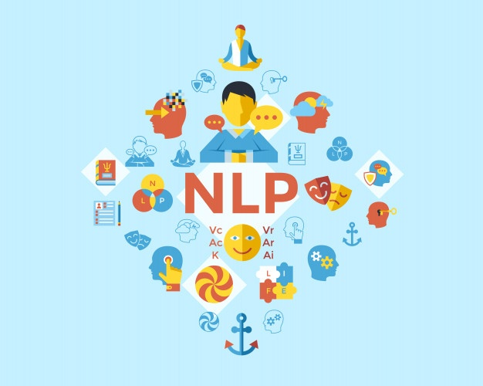
CSE431 Group Paper Presentation
Khaled Ahmmed Anik
ID: 18301083
Zisanur Rahman
ID: 18301025

Slide 2
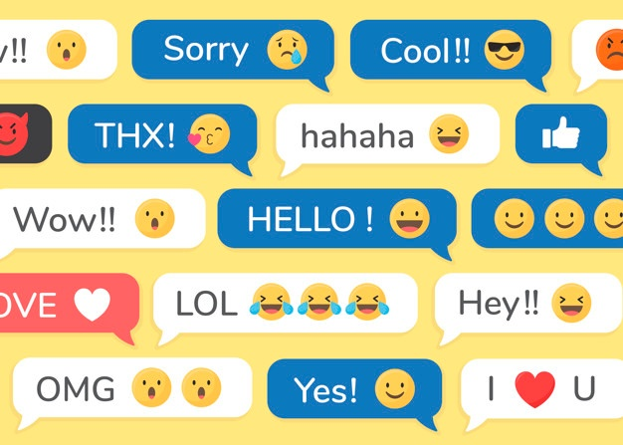

Assessing Emoji Use in Modern Text Processing Tools

Slide 3

ABSTRACT & INTRODUCTION
This study assess systems and tools to operate on text containing emojis by considering test sets of tweets with emojis, based on performing a series of experiments investigating the ability of prominent NLP and text processing tools those consider tokenization, part-of-speech tagging, dependency parsing, as well as sentiment analysis

Slide 4

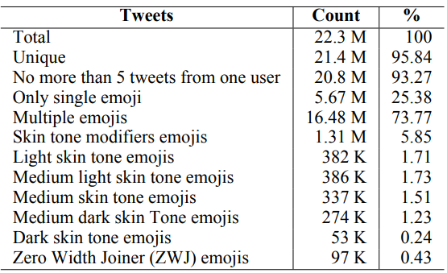
Related work
Dataset
Emoji Prediction Model for Tweets Felbo et al. (2017)
Parts of Speech Tagger & Dependency Parser Proisl (2018)
Extraction of Keywords from a Tweet using NLP Tools Weerasooriya et al. (2016)
Understanding the Use of Emojis from a Grammatical Perspective Cohn et al. (2019)
Tweets containing at least a single emoji
Tools
Gensim
NLTK
PyNLPI
Stanza
TextBlob
AllenNLP
NLTK-TT
SpaCy
SpaCyMoji
http://emoji.nlproc.org/

Slide 5
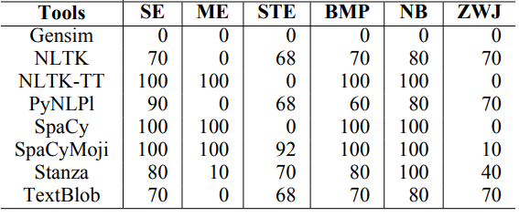
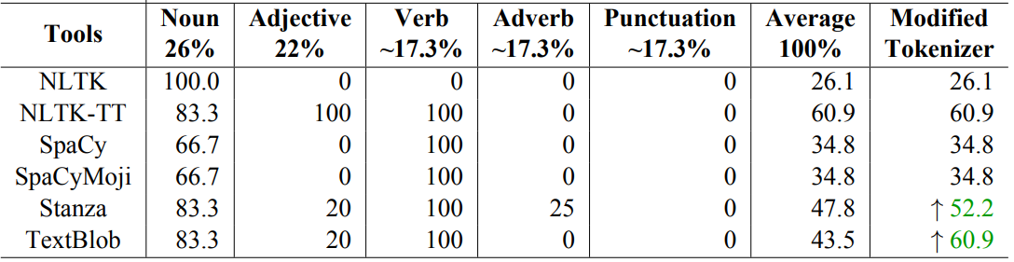
Tasks
Tokenization
Part-of-Speech Tagging
Tokenization accuracy (%) of tools for different test set subsets. SE: single emoji, ME: multiple, STE: skin tone emojis, BMP: Basic Multilingual Plane, NB: Non-BMP, ZWJ: zero width joiner emojis.
The percentage of success of tools at labeling emojis with different parts-of-speech. The last column reports the average percentage of success when a modified tokenizer is used.

Slide 6
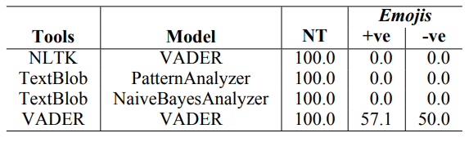
Tasks
Dependency Parsing
Sentiment Analysis
change in the syntactic structure of a sentence
given the insertion of emoji
task of predicting the sentiment polarity of a text harboring emojis.
Accuracy (in %) of different tools at predicting sentiment scores of neutral text alone (NT) or neutral text along with positive (+ve) or negative (-ve) emojis

Slide 7
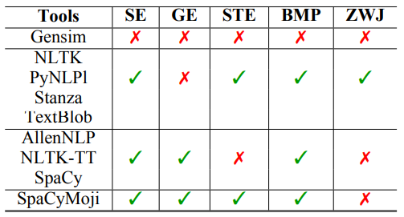
Conclusion
A collection of tools has been tested on three separate tasks over a variety of difficult test sets capturing certain phenomena and encodings. Despite the fact that several tools are only partially capable of working with emojis, one of them showed to be entirely capable of dealing with the whole range of issues we examined.
An overview of popular text processing NLP tools and their emoji support. SE: single emoji, GE: groups of emojis, STE: skin tone emojis, BMP: Basic Multilingual Plane, ZWJ: zero width joiner emojis

