Slide 1
Generative adversarial network (GAN)
By Eng: Khaled Mohammed Abdelgaber
Tele: +201150882331
E-mail: Khaled.edu.engineer@gmail.com
References: Deep Learning for Vision Systems by Mohamed Elgendy

Slide 2
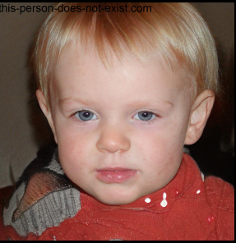
intro
https://this-person-does-not-exist.com/en
Generative Adversarial Networks (GANs) are a new type of neural architectures introduced by Ian Goodfellow and other researchers at the University of Montreal, including Yoshua Bengio, in June 2014, in their paper “Generative Adversarial Nets” in 2014.
GANs have been called “the most interesting idea in the last 10 years in ML” by Yann LeCun, Facebook’s AI research director.
The excitement is well justified. The most notable features of GANs are their capacity to create hyper-realistic images, videos, music, and text.

Slide 3
Generative models
Generative Models. They are neural network models that are able to imagine and produce new content that hasn’t been created before.
They can imagine new worlds, new people, and new reality in a seemingly magical way.
We train generative models by providing a training dataset in a specific domain and their job is to create images that have new objects from the same domain that look so close to the real data.
the introduction of generative networks, researchers were able to make computers generate content of the same or higher quality compared to their human counterparts.
By allowing computers to learn to mimic any distribution of data, they can be taught to create worlds that are similar to our own in any domain: images, music, speech, prose. They are robot artists in a sense, and their output is impressive.

Slide 4
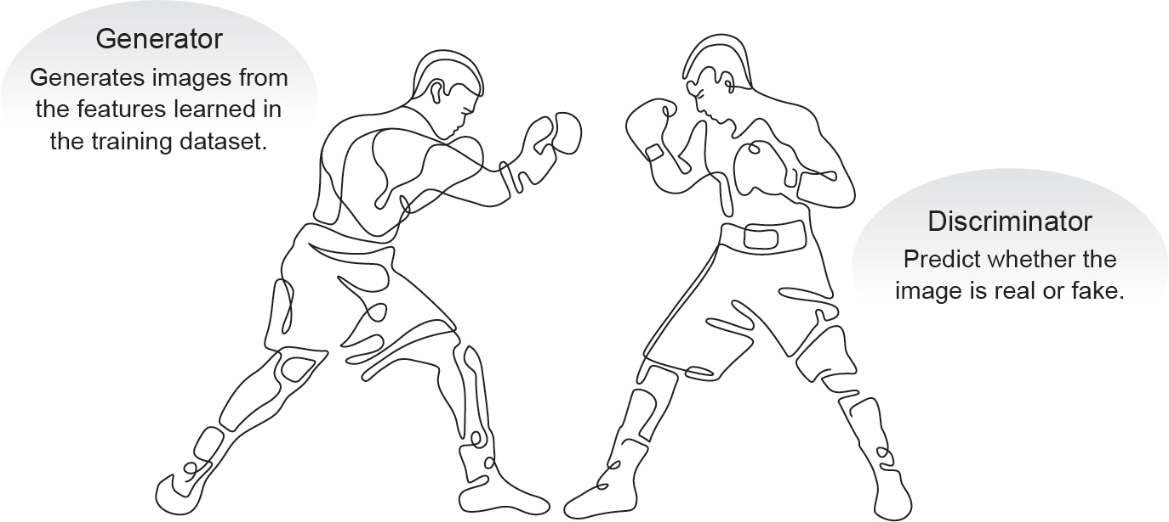
GANs Architecture
GANs are based on the idea of adversarial training.
They basically consist of two neural networks which compete against each other.
This competitiveness helps them to mimic any distribution of data. I like to think of the GAN architecture as two boxers fighting.
In their conquest to win the game, both are learning each others’ moves and techniques.
They both start the game with less knowledge about their opponent.
As the game goes, they learn and become better and better.

Slide 5
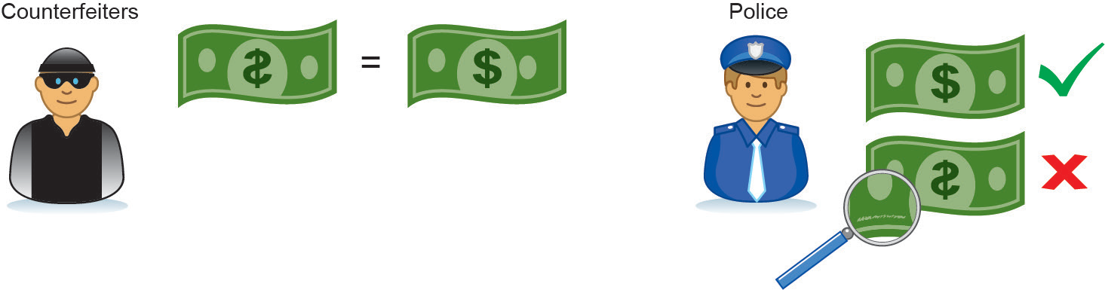
Cont.
Another analogy to help drive the idea home: think of GANs as the opposition of a counterfeiter and a cop in a game of cat and mouse, where the counterfeiter is learning to pass false notes, and the cop is learning to detect them.
Both are dynamic. Meaning, as the counterfeiter is learning to perfect creating false notes, the cop is in training and getting better too and each side comes to learn the other’s methods in a constant escalation.

Slide 6
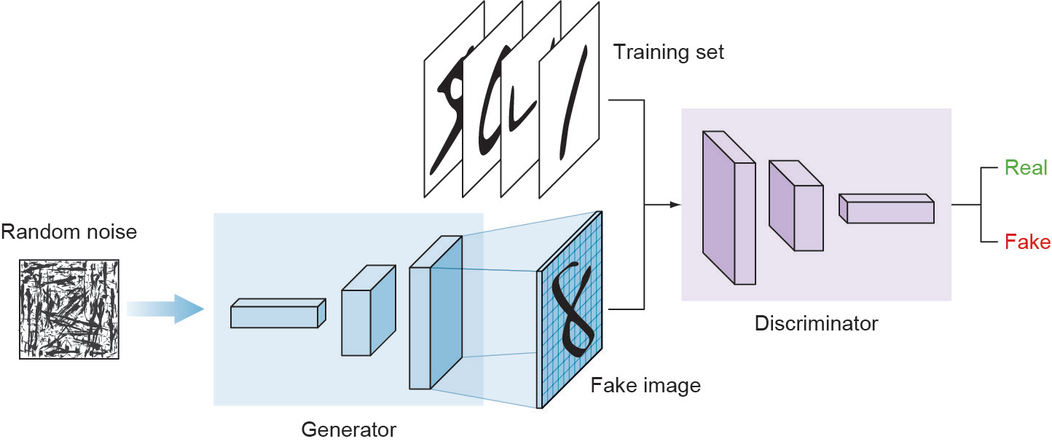
Cont.
The GAN architecture is composed of two main networks:
The Generator tries to convert random noise into observations that look as if they have been sampled from the original dataset.
The Discriminator tries to predict whether an observation comes from the original dataset or is one of the generator’s forgeries.
As you can see in the architecture diagram (Figure),
the steps a GAN takes are as follows:
The generator takes in random numbers and returns
an image.
This generated image is fed into the discriminator
alongside a stream of images taken from the actual,
ground-truth dataset.
The discriminator takes in both real and fake images and returns probabilities, a number between 0 and 1, with 1 representing a prediction of authenticity and 0 representing fake.

Slide 7
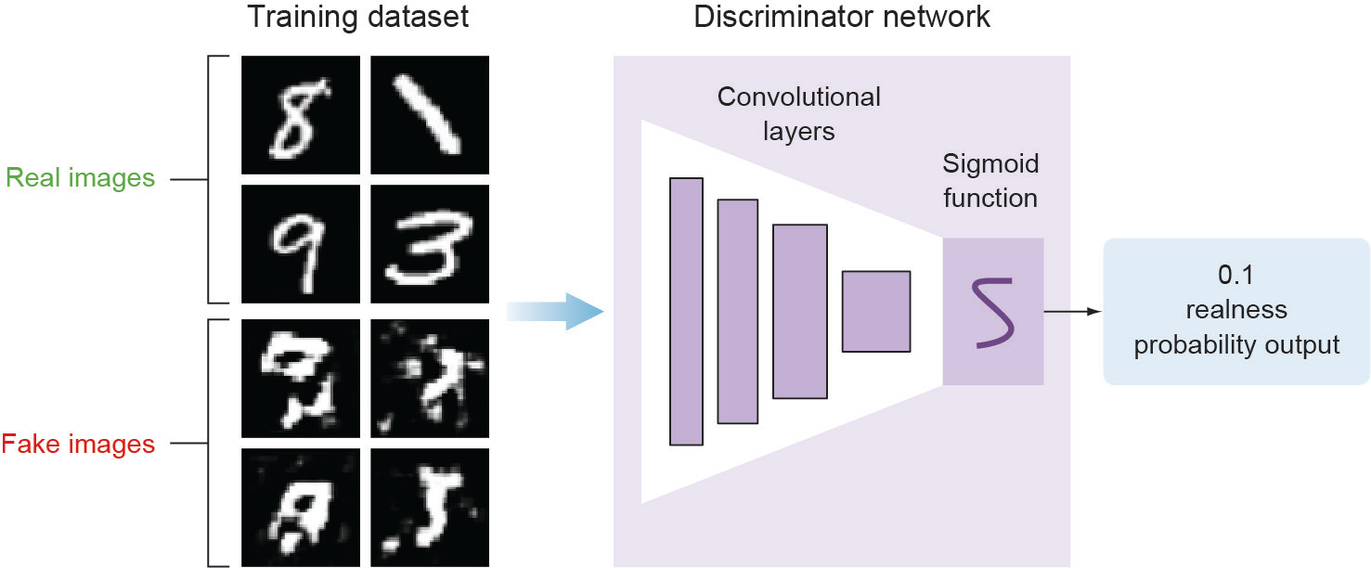
The Discriminator Model:
the goal of the discriminator is to predict if an image is real or fake.
This is a typical supervised classification problem, so we can use the traditional classifier network that we learned. The network consists of stacked convolutional layers, followed by a dense output layer with sigmoid activation function.
We use the sigmoid activation function because this is a binary classification problem and the goal of the network is to output prediction probability values that range between 0 and 1.
Where 0 means that the image generated by the generator is fake and 1 means that it is 100% real.

Slide 8
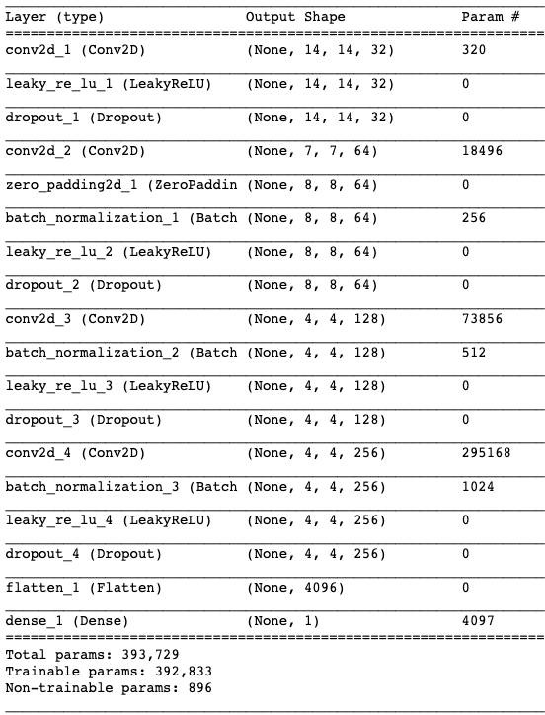
Cont.
The discriminator is a normal and well understood classification model.
As you can see in Figure , training the discriminator is pretty straight forward.
As a supervised classification problem,
we feed the discriminator with labelled images: fake (or generated) and real images.
The real images come from the training dataset and the fake images are the output of the generator model.

Slide 9
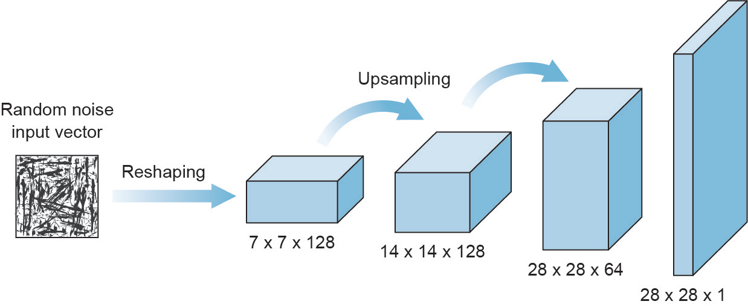
The Generator Model
The generator takes in some random data and try to mimic the training dataset to generate fake images.
Its goal is to trick the discriminator by trying to generate images that are perfect replicas from the training dataset.
As it gets trained it gets better and better after each iteration.
On the other hand, the discriminator is being trained at the same time so the generator has to keep improving as the discriminator learns its tricks.
As you might have noticed from Figure , the generator model looks like an inverted ConvNet. The generator takes a vector input with some random noise data, reshapes it to cube volume that has a width, height and depth. This volume is meant to be treated as a feature map that will be fed to several convolutional layers that will create the final image.

Slide 10
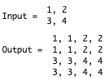
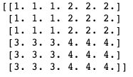
UPSAMPLING TO SCALE FEATURE MAPS
Just like traditional convolutional neural networks use pooling layers to downsample input images.
In order to scale the feature maps, we use upsampling layers that scales the image dimensions by repeating each row and column of its input pixels.
What this line of code does is that it repeats every row and column of the image matrix two times because the size of the scaling factor is set to (2, 2).
When we build the generator model, we keep adding upsampling layers until the size of the feature maps is similar to the training dataset.

Slide 11
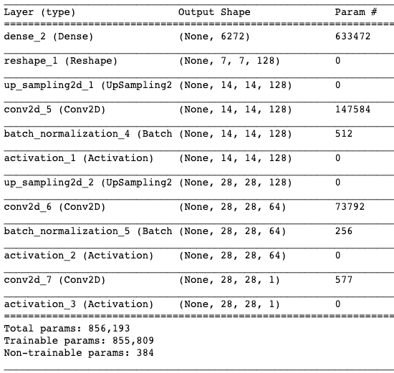
Cont.
we don’t use any components that you are not already familiar with.
The only new component is the Upsampling layer to double its input dimensions by repeating pixels.
Similar to the discriminator, we stack convolutional layers on top of each other and add other optimization layers like BatchNormalization.
The key difference in the generator model is that it starts with the flattened vector then images are upsampled until they have similar dimensions to the training dataset.
All these layers have their hyperparameters that we tune when we are training the network. For your own implementation, you can tune these hyperparameters and add or remove layers as you see fit.

Slide 12
Training the GAN
Now that we’ve learned the discriminator (D) and generator (G) models separately, let’s put them together to train an end-to-end generative adversarial network.
The discriminator is being trained to become a better classifier to maximize the probability of assigning the correct label to both training examples (real) and images generated (fake) by the generator (i.e. the policeman becomes better at differentiating between fakes and real dollar signs).
The generator on the other hand is being trained to become a better forger to maximize its chances to fool the discriminator.
Both networks are getting better at what they do.

Slide 13
process of training GAN models
The process of training GAN models involves two training processes:
Train the discriminator:
this is a straightforward supervised training process.
Where the network is given labeled images coming from the generator (fake) and the training data (real) and it learns to classify between real and fake images with a sigmoid prediction output.
Nothing new here.
Train the generator:
this process is a little tricky.
The generator model cannot be trained alone like the discriminator.
It needs the discriminator model to tell it whether it did a good job faking images or not.
So we create a combined network to train the generator that is composed of both G and D models.
Think of the two training processes as two parallel lanes. One lane training the discriminator alone, and the other lane is the combined model that trains the generator.

Slide 14
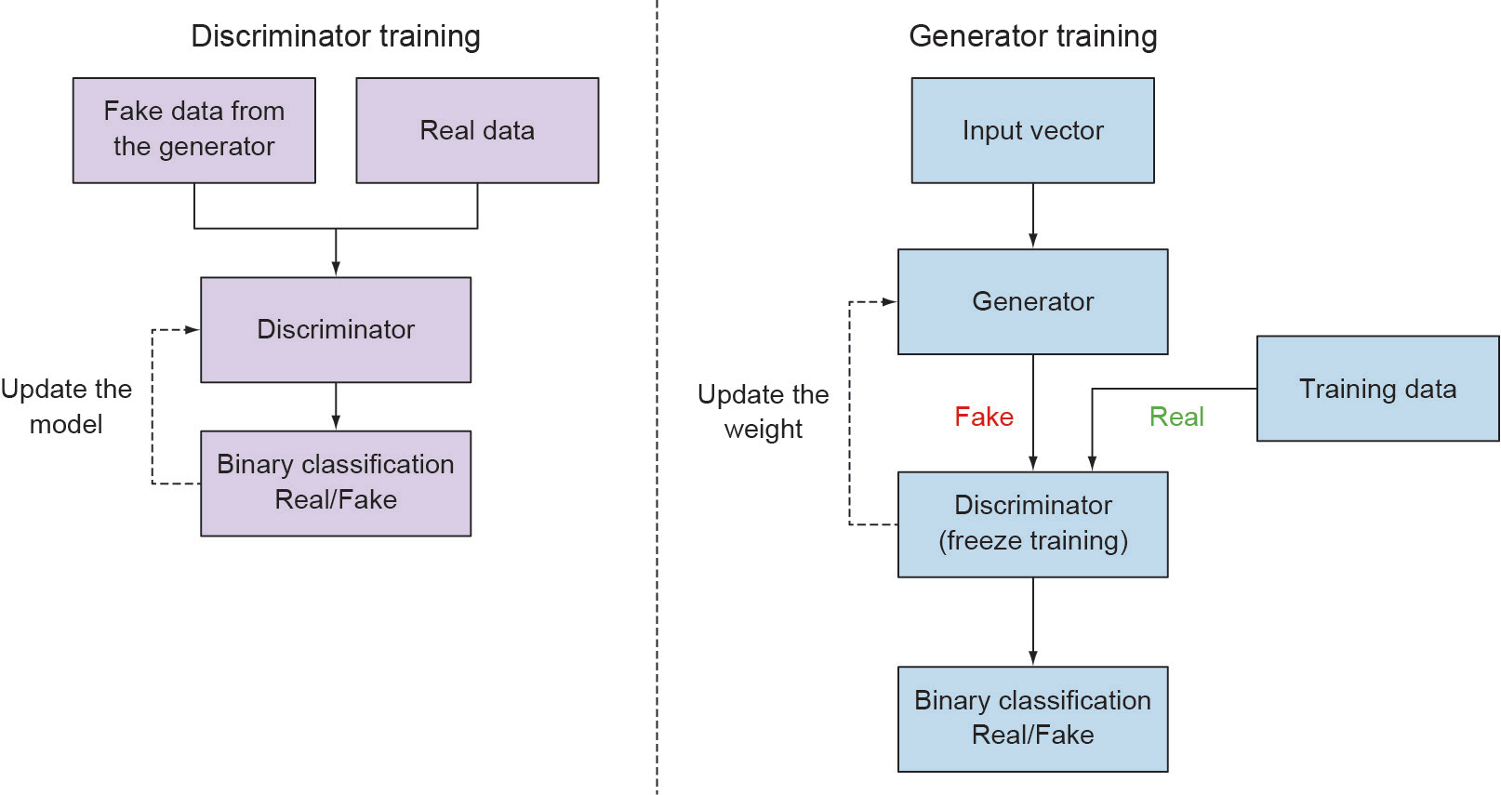
Training process diagram

Slide 15
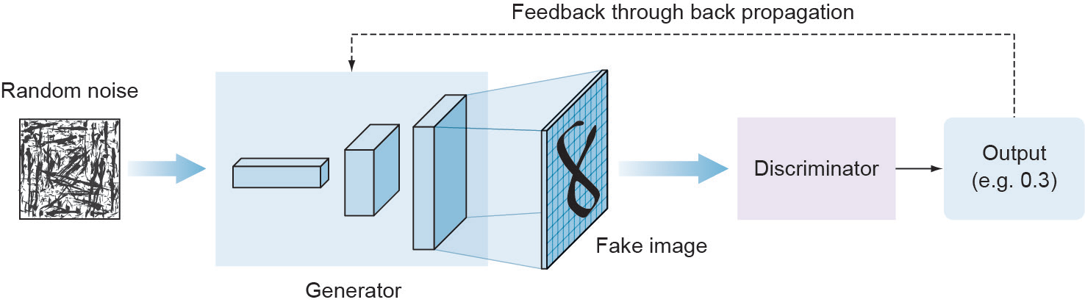
TRAIN THE GENERATOR (COMBINED MODEL)
Here is the one tricky part in training GANs, training the generator. While the discriminator can be trained in isolation from the generator model, the generator needs the discriminator to be trained. For this, we build a combined model that contains both the generator and the discriminator as you can see in Figure 8.12.

Slide 16
Cont.
When we want to train the generator, we freeze the weights of the discriminator model because the generator and discriminator have different loss functions pulling in different directions.
If we don’t freeze the discriminator weights, it will be pulled in the same direction the generator is learning so it will be more likely to predict generated images as real, which is not the desired outcome.
Freezing the weights of the discriminator model doesn’t affect the existing discriminator model that we compiled earlier when we were training the discriminator.
Think of it as that we have two discriminator models which is not the case, but just easier to imagine.
Once when training the discriminator. In which, the error is backpropagated to the discriminator model to update its weights, and
the second time when we build the combined model. In which, we freeze the weights of the discriminator model and the error is backpropagated to the generator model to update its weights.

Slide 17
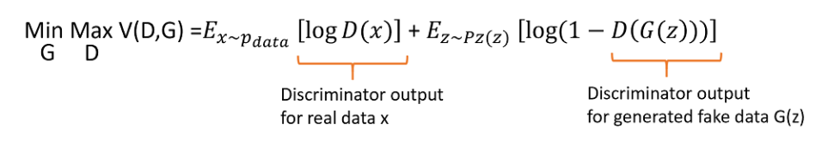
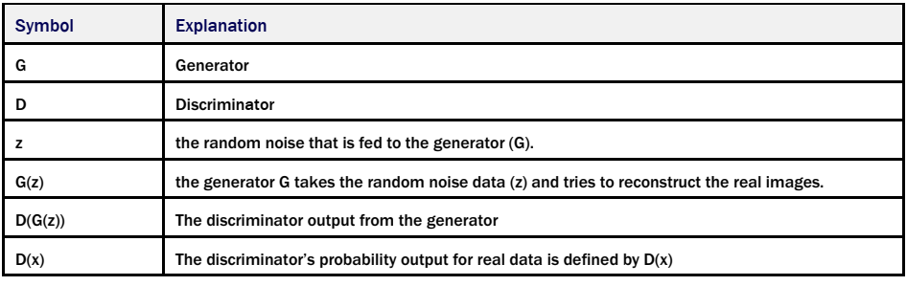
Minimax objective function.
We train D to maximize the probability of assigning the correct label to both training examples and samples from G. We simultaneously train G to minimize log(1-D(G(z))). In other words, D and G play the following two-player minimax game with value function V (D,G)

Slide 18
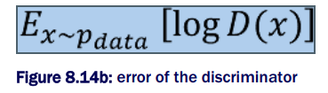

Cont.
The discriminator takes its input from two sources:
Data from the generator G(z) - this is the fake data (z). The discriminator output from the generator is denoted as D(G(z))
The real input from the real training data (x) - The discriminator output from the real data is denoted as log D(x).
One for the discriminator alone represented by the function below which aims to maximize the minimax function by making the predictions as close as possible to 1:
And another one for the combined model to train the generator represented by the function below which aims to minimize the minimax function by making the predictions as close as possible to 0:

Slide 19
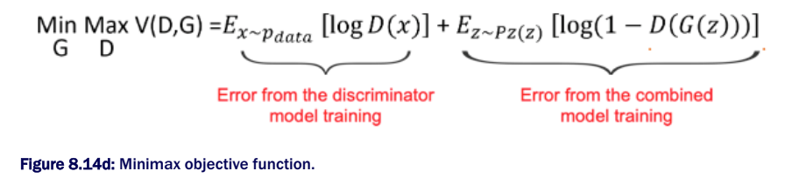
Cont.
The goal of the minmax objective function V(D, G) is to maximize D(x) from the true data distribution and minimize D(G(z)) that is from the fake data distribution.
To achieve this, we use the log-likelihood of D(x) and 1-D(z) in the objective function.
The log just makes sure that the closer it is to an incorrect value, the more it is penalized.

Slide 20
INTUITION OF MINIMAX IN GANS
Early in the training process, the Discriminator will reject generates fake data from Generator with high confidence because the fake images will be very different from the real training data since the Generator hasn’t learned yet.
As we train Discriminator to maximize the probability of assigning the correct labels to both real examples and fake images from Generator.
We simultaneously train Generator to minimize the Discriminator classification error for the generated fake data.
The discriminator wants to maximize objective such that D(x) is close to 1 for real data and D(G(z)) is close to 0 for fake data.
Whereas, the generator wants to minimize objective such that D(G(z)) is close to 1 so that the discriminator is fooled into thinking generated G(z) is real.
We stop the training when the fake data generated by the Generator is recognized as the real data.

Slide 21
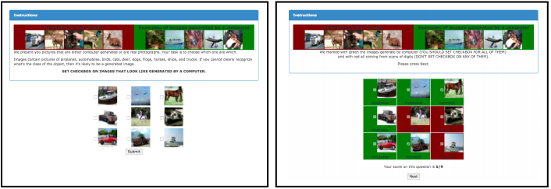
Evaluate GAN models
GAN models must be evaluated using the quality of the generated synthetic images and manually inspecting the generated images.
One technique that Ian Goodfellow et al. used in their paper “Improved Techniques for Training GANs” to evaluate their GAN performance is by having human annotators manually judge the visual quality of the synthesized samples. They created a web interface (Figure ) and hired annotators on Amazon Mechanical Turk (MTurk) to distinguish between generated data and real data.

Slide 22
Cont.
One downside of using human annotators is that the metric varies depending on the setup of the task and the motivation of the annotators. They also found that results change drastically when they give annotators feedback about their mistakes: By learning from such feedback, annotators are better able to point out the flaws in generated images, giving a more pessimistic quality assessment. The left image in previous Figure presents a screen from the annotation process, while the right column shows feedback to annotators about their mistakes.

Slide 23
non-manual ways to evaluate GAN
Two commonly used evaluation metrics for image quality and diversity are: the Inception Score and the Fréchet Inception Distance (FID).
Inception score:
The Inception Score is based on a heuristic that realistic samples should be able to be classified when passed through a pre-trained network, such as Inception on ImageNet, hence the name Inception Score. The idea is really simple. The heuristic relies on two values:
.High predictability of the generated image: we apply a pre-trained inception classifier model to every generated image and get its softmax prediction. If the generated image is so good, then it should give us high predictability score.
Diverse the generated samples: meaning that there should not be any dominating classes over the distribution of the generated images.
A large number of generated images are classified using the model. Specifically, the probability of the image belonging to each class is predicted.
The probabilities are then summarized in the score to both capture how much each image looks like a known class and how diverse the set of images are across the known classes.
If both these traits are satisfied, there should be a large Inception Score. A higher inception score indicates better-quality generated images.

Slide 24
Cont.
Fréchet Inception Distance (FID):
The score was proposed as an improvement over the existing Inception Score.
Like the inception score, the FID score uses the inception model to capture specific features of an input image.
These activations are calculated for a collection of real and generated images.
The activations for each real and generated image are summarized as a multivariate Gaussian and the distance between these two distributions is then calculated using the Frechet distance, also called the Wasserstein-2 distance.
An important note is that FID needs a decent sample size to give good results (suggested size = 50k samples ).
If you use too few samples, you will end up over-estimating your actual FID and the estimates will have a large variance.
A lower FID score indicates more realistic images that match the statistical properties of real images.

Slide 25
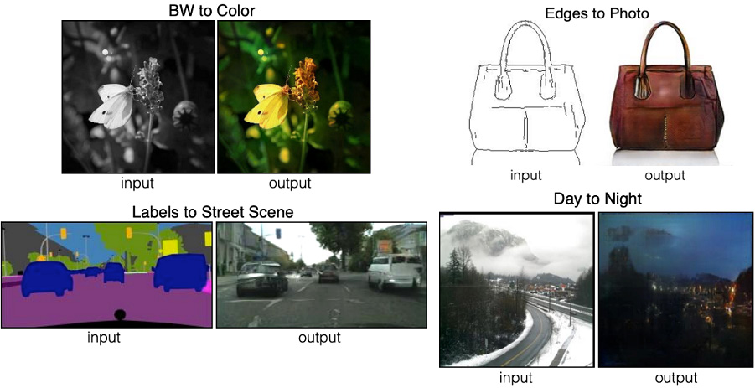
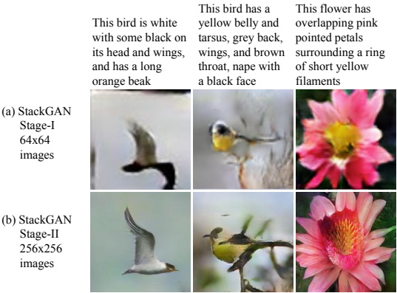
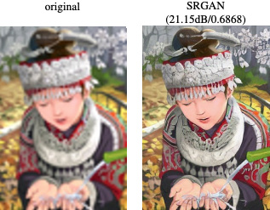
Popular GANs Applications
Text-to-Photo Synthesis
Image-to-image translation (Pix2Pix GAN)
Image Super-Resolution GAN (SRGAN)

Slide 26
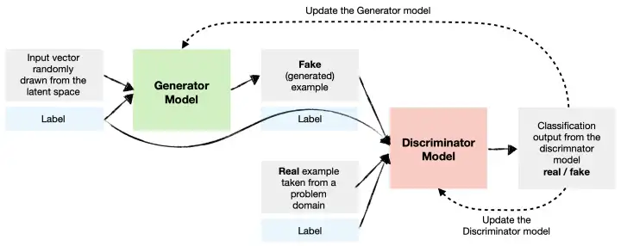
Conditional GANs (CGANs)
type of GANs that allow the user to control the generated data by adding an additional input to the generator network.
This input specifies the desired characteristics of the generated data, such as the color or shape of an image.
CGANs can be thought of as a combination of a GAN and a conditional generative model, where the generator and discriminator are trained to take into account both the input data and the condition.
This allows CGANs to generate data that is more in line with the user’s expectations.

Slide 27
Wasserstein GANs (WGANs)
are a relatively new type of GANs that address some of the stability issues that are commonly encountered when training GANs.
WGANs use the Wasserstein distance metric to evaluate the quality of the generated data, which has been shown to provide improved stability during training compared to other metrics.
The Wasserstein distance metric measures the earth mover’s distance between the generated data and the training data, which provides a robust measure of the quality of the generated data.
WGANs have been shown to be particularly effective for generating high-quality images.

