Slide 1
NLP
Natural language processing

Slide 2
What is Natural Language Processing (NLP)
Natural language processing (NLP) is the discipline of building machines that can manipulate human language — or data that resembles human language — in the way that it is written, spoken, and organized.
NLP can be divided into two overlapping subfields:
natural language understanding (NLU), which focuses on semantic analysis or determining the intended meaning of text, and
natural language generation (NLG), which focuses on text generation by a machine.

Slide 3
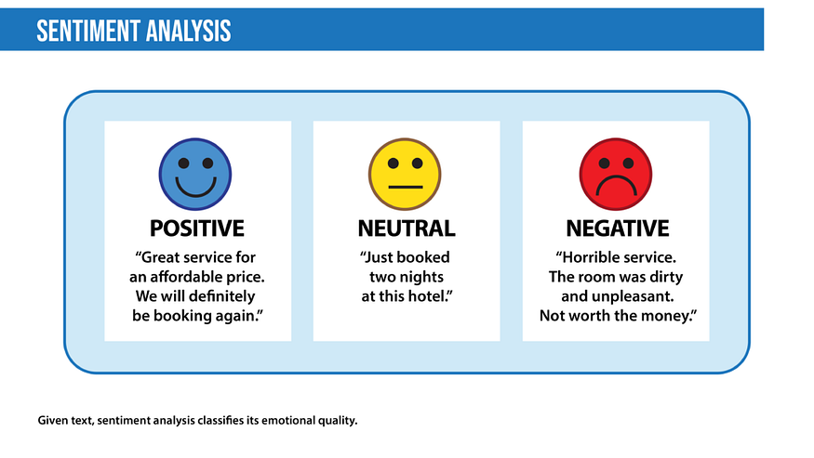
Nlp applications
Sentiment analysis is the process of classifying the emotional intent of text.
Machine translation automates translation between different languages. The input to such a model is text in a specified source language, and the output is the text in a specified target language.

Slide 4
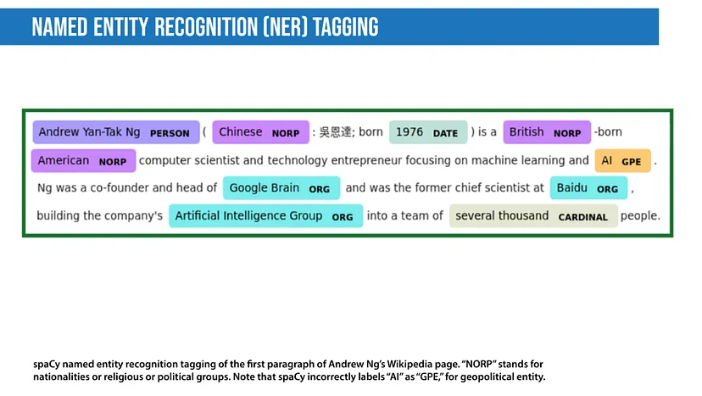
Cont.
Named entity recognition aims to extract entities in a piece of text into predefined categories such as personal names, organizations, locations, and quantities.

Slide 5
Cont.
Spam detection is a prevalent binary classification problem in NLP, where the purpose is to classify emails as either spam or not.
Grammatical error correction models encode grammatical rules to correct the grammar within text.
Topic modeling is an unsupervised text mining task that takes a corpus of documents and discovers abstract topics within that corpus. The input to a topic model is a collection of documents, and the output is a list of topics that defines words for each topic as well as assignment proportions of each topic in a document.
Text generation more formally known as natural language generation (NLG), produces text that’s similar to human-written text.

Slide 6
Cont.
Autocomplete predicts what word comes next, and autocomplete systems of varying complexity are used in chat applications like WhatsApp.
Chatbots automate one side of a conversation while a human conversant generally supplies the other side.
Summarization is the task of shortening text to highlight the most relevant information.

Slide 7
How Does Natural Language Processing (NLP) Work?

Slide 8
Data preprocessing
Before a model processes text for a specific task, the text often needs to be preprocessed to improve model performance or to turn words and characters into a format the model can understand.
Stemming and lemmatization:
Stemming is an informal process of converting words to their base forms using heuristic rules.
For example, “university,” “universities,” and “university’s” might all be mapped to the base univers. (One limitation in this approach is that “universe” may also be mapped to univers, even though universe and university don’t have a close semantic relationship.)
Lemmatization is a more formal way to find roots by analyzing a word’s morphology using vocabulary from a dictionary.
Stemming and lemmatization are provided by libraries like spaCy and NLTK.

Slide 9
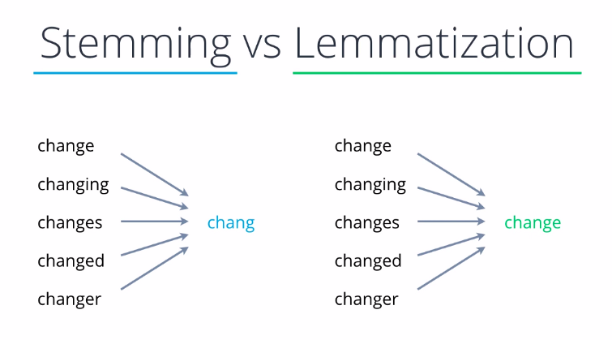

Slide 10
Cont.
why we need them?
simplifies the text data, making it easier to analyze and process.
Improving Search and Information Retrieval:
Challenge: When searching for documents or information, different word forms might cause relevant documents to be missed.
Solution: By applying stemming or lemmatization, search engines can match documents with different forms of the search terms, improving recall. For instance, a search for "running" would also return documents containing "run" or "ran."
Stemming and lemmatization reduce the number of unique words (tokens) by combining different forms of the same word. This helps in creating more generalizable and effective models.
Normalization of Text:
By normalizing words to their root forms, stemming and lemmatization ensure that the analysis focuses on the underlying concepts rather than superficial differences in word forms.
Improving Computational Efficiency:
Reducing the text data's complexity through stemming or lemmatization can decrease the amount of data to be processed, speeding up tasks like indexing, clustering, and classification.
Facilitating Better Text Matching:
Tasks like document clustering, duplicate detection, and similarity matching can be hampered by different word forms.
Stemming and lemmatization help in better aligning similar documents or texts by ensuring that similar words are treated as identical.

Slide 11
Cont.
Sentence segmentation:
breaks a large piece of text into linguistically meaningful sentence units.
This is obvious in languages like English, where the end of a sentence is marked by a period, but it is still not trivial.
A period can be used to mark an abbreviation as well as to terminate a sentence, and in this case, the period should be part of the abbreviation token itself.
The process becomes even more complex in languages, such as ancient Chinese, that don’t have a delimiter that marks the end of a sentence.
How?
Punctuation Marks
The most common way to segment text into sentences is by looking for punctuation marks like periods (.), exclamation points (!), and question marks (?). These marks typically indicate the end of a sentence.
Capitalization
After identifying a punctuation mark, the next sentence usually begins with a capital letter. This can help confirm that a sentence boundary exists.
Abbreviations and Numbers
Special cases like abbreviations (e.g., "Dr.", "Mr.") and numbers (e.g., "3.14") require more sophisticated rules, as they can include periods that do not indicate the end of a sentence.
Quotation Marks and Parentheses
Sentences within quotation marks or parentheses need to be treated carefully to avoid splitting sentences incorrectly.

Slide 12
Cont.
Stop word removal
aims to remove the most commonly occurring words that don’t add much information to the text. For example, “the,” “a,” “an,” and so on.
Tokenization
splits text into individual words and word fragments.
The result generally consists of a word index and tokenized text in which words may be represented as numerical tokens for use in various deep learning methods.
A method that instructs language models to ignore unimportant tokens can improve efficiency.

Slide 13
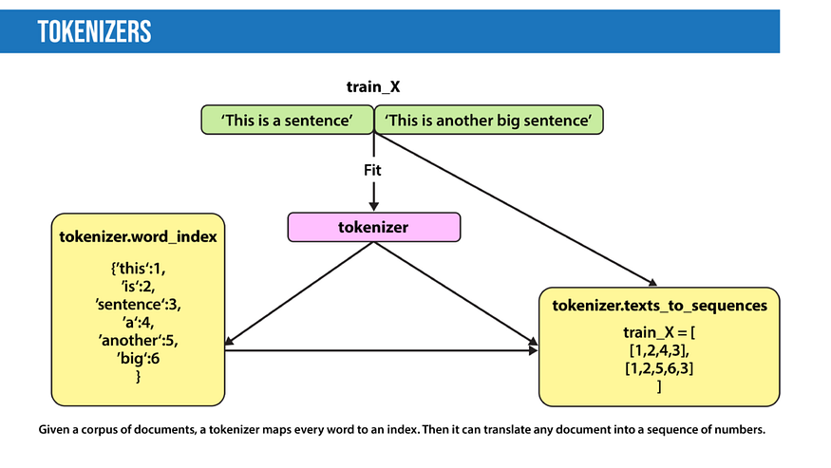
Cont.

Slide 14
Feature extraction

Slide 15
Feature extraction:
Most conventional machine-learning techniques work on the features — generally numbers that describe a document in relation to the corpus that contains
More recent techniques include Word2Vec, GLoVE, and learning the features during the training process of a neural network.

Slide 16
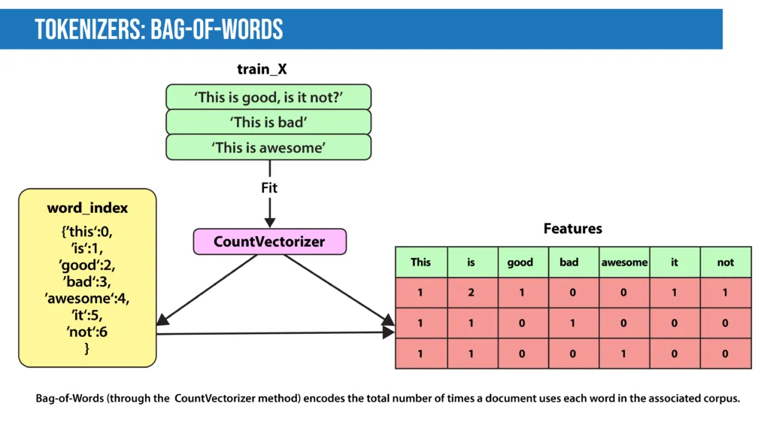
Bag-of-Words
Bag-of-Words counts the number of times each word or n-gram (combination of n words) appears in a document. For example, below, the Bag-of-Words model creates a numerical representation of the dataset based on how many of each word in the word_index occur in the document.

Slide 17
TF-IDF
In Bag-of-Words, we count the occurrence of each word or n-gram in a document.
In contrast, with TF-IDF, we weight each word by its importance.
To evaluate a word’s significance, we consider two things:
Term Frequency: How important is the word in the document?
TF(word in a document)= Number of occurrences of that word in document / Number of words in document
Inverse Document Frequency: How important is the term in the whole corpus?
IDF(word in a corpus)=log(number of documents in the corpus / number of documents that include the word)

Slide 18
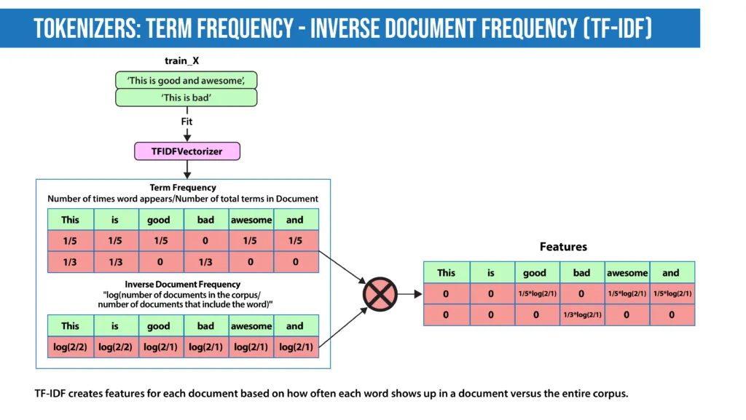
Cont.
A word is important if it occurs many times in a document.
But that creates a problem. Words like “a” and “the” appear often. And as such, their TF score will always be high.
We resolve this issue by using Inverse Document Frequency, which is high if the word is rare and low if the word is common across the corpus.
The TF-IDF score of a term is the product of TF and IDF.

Slide 19
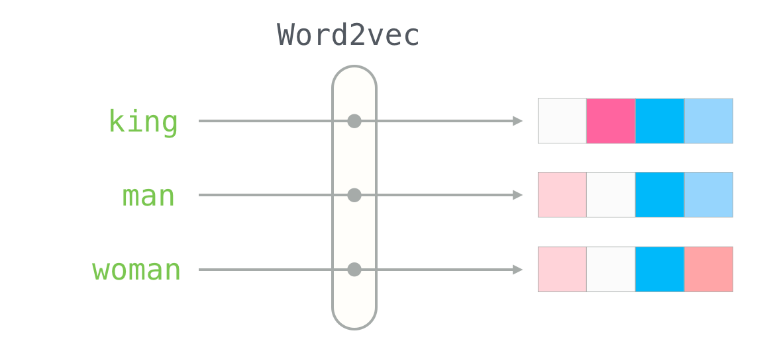
Word2Vec
introduced in 2013, uses a vanilla neural network to learn high-dimensional word embeddings from raw text.
It comes in two variations:
Skip-Gram,
in which we try to predict surrounding words given a target word, and
Continuous Bag-of-Words (CBOW),
which tries to predict the target word from surrounding words.
After discarding the final layer after training, these models take a word as input and output a word embedding that can be used as an input to many NLP tasks.
Embeddings from Word2Vec capture context.
If particular words appear in similar contexts, their embeddings will be similar.

Slide 20
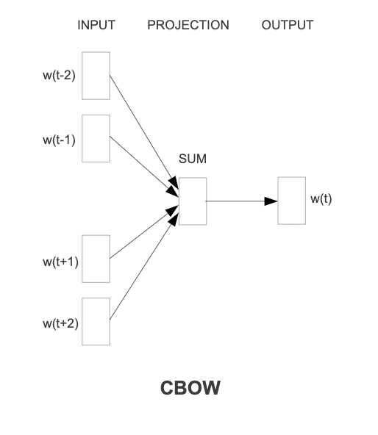
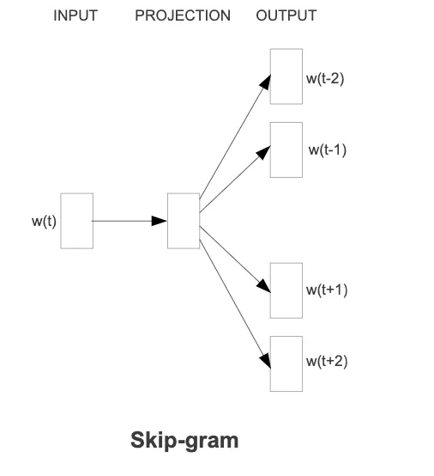
Cont.

Slide 21
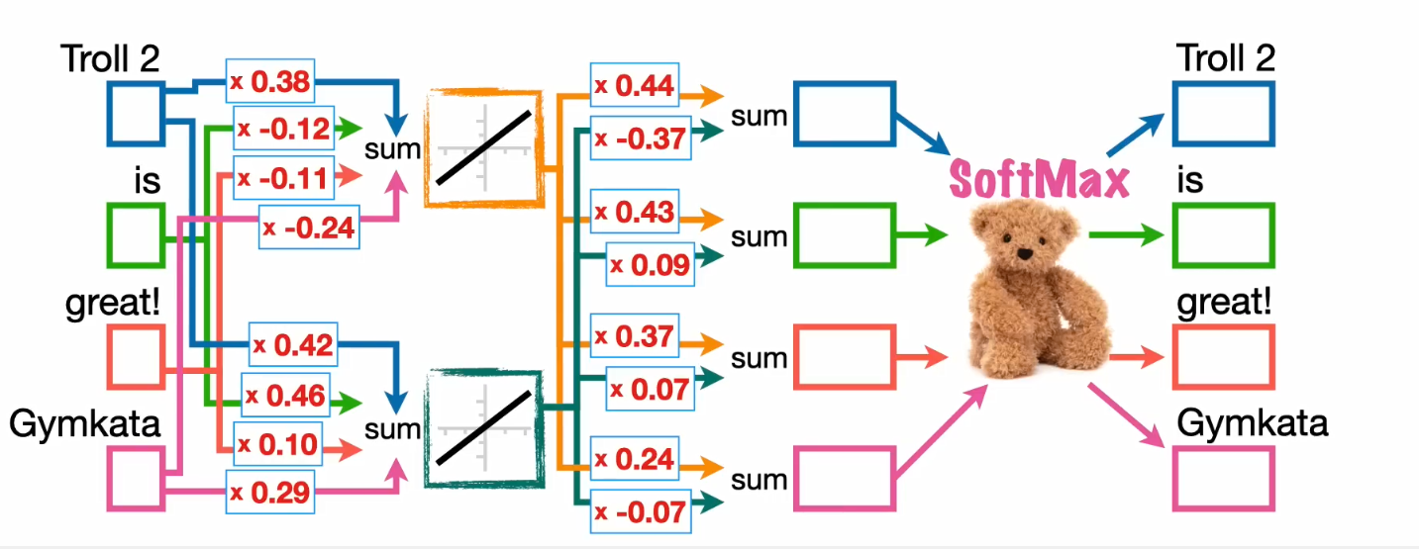

Slide 22
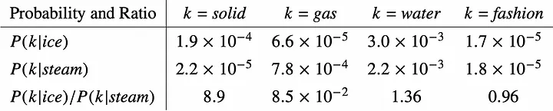
GLoVE [Global Vectors for Word Representation]
GLoVE is similar to Word2Vec as it also learns word embeddings, but it does so by using matrix factorization techniques rather than neural learning.
The GLoVE model builds a matrix based on the global word-to-word co-occurrence counts.
it leverages word-word co-occurrence for learning word embeddings.
The concept of a word-word co-occurrence matrix is key to Glove. It is a matrix that captures the occurrences of each word in the context of every other word in the corpus.
Each cell in the matrix represents the count of occurrences of one word in the context of another word.

Slide 23
Cont.
By comparing the ratio P(k | ice) / P(k | steam), we can determine the association of word k with either ice or steam. If the ratio is much greater than 1, it indicates a stronger association with ice. Conversely, if it is closer to 0, it suggests a stronger association with steam. A ratio closer to 1 implies no clear association with either ice or steam.

Slide 24
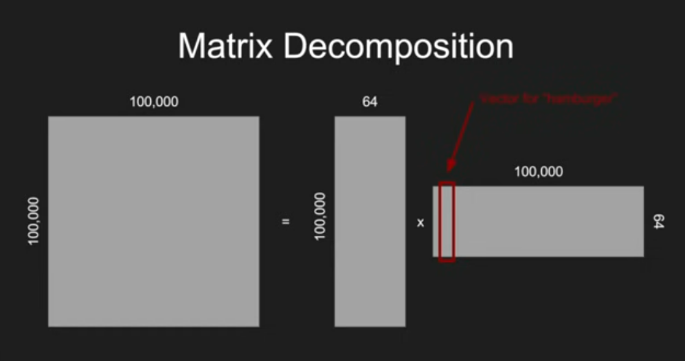
Cont.
Co-occurrence Matrix (X): This is a large matrix where each entry 𝑋𝑖𝑗 represents the frequency with which word 𝑖 co-occurs with word 𝑗 in a given corpus within a certain context window.
For example, if "cat" and "dog" appear frequently together in sentences, then 𝑋 𝑐𝑎𝑡,𝑑𝑜𝑔 will have a high value.
Matrix Factorization Overview
The goal of matrix factorization is to decompose the co-occurrence matrix X into two smaller matrices, W and C, where:
W is the matrix containing the word vectors for target words.
C is the matrix containing the word vectors for context words.

Slide 25
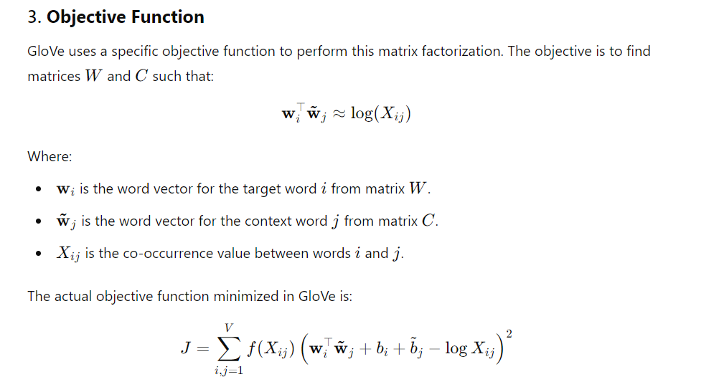
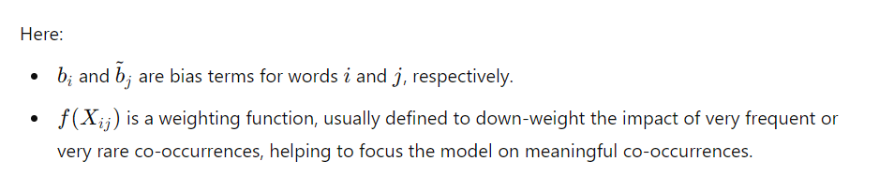
Cont.

