Slide 1


Assignment #3 Active up conversion mixer
Presented by: Khaled Ahmed Swilam

Slide 2
Agenda
The Need of Mixers in Transceivers
Mixer Specifications
Mixer Topologies
The Architecture used
Design Methodology
Technical Flow
Results

Slide 3
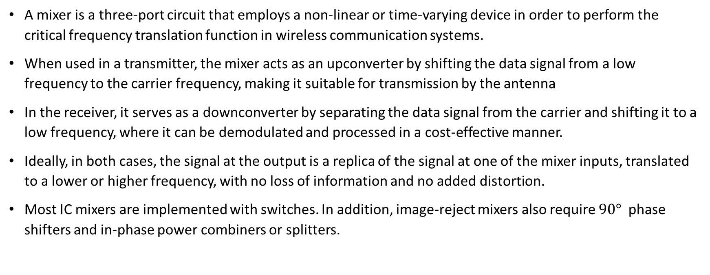
What is the mixer?!
A mixer is a three-port circuit that employs a non-linear or time-varying device in order to perform the critical frequency translation function in wireless communication systems.
When used in a transmitter, the mixer acts as an upconverter by shifting the data signal from a low frequency to the carrier frequency, making it suitable for transmission by the antenna
In the receiver, it serves as a downconverter by separating the data signal from the carrier and shifting it to a low frequency, where it can be demodulated and processed in a cost-effective manner.
Ideally, in both cases, the signal at the output is a replica of the signal at one of the mixer inputs, translated to a lower or higher frequency, with no loss of information and no added distortion.
Most IC mixers are implemented with switches. In addition, image-reject mixers also require $90°$ phase shifters and in-phase power combiners or splitters.

Slide 4
Mixer specifications
The conversion gain represents the small signal transfer function from the RF input to the IF output in a downconverter, or from the IF input to the RF output in an upconverter. It is normally defined as a power gain, Note that Resistive mixers implemented with diodes and FETs exhibit conversion loss, whereas active mixers implemented with transistors can exhibit conversion gain.
The linearity of the down conversion mixer is defined in much the same way as that of a LNA or receiver, using the 1dB compression point P1dB and the third-order intercept point at the input, IIP3.
In up conversion mixers, the signal levels are usually higher than in a downconverter and the linearity is often specified as in a PA, in terms of the input and output 1dB compression point.
In general, passive resistive mixers implemented with diodes or with FETs in balanced topologies, exhibit the best linearity. Unfortunately, they require larger LO signals and suffer from high conversion loss and high noise figure.

Slide 5
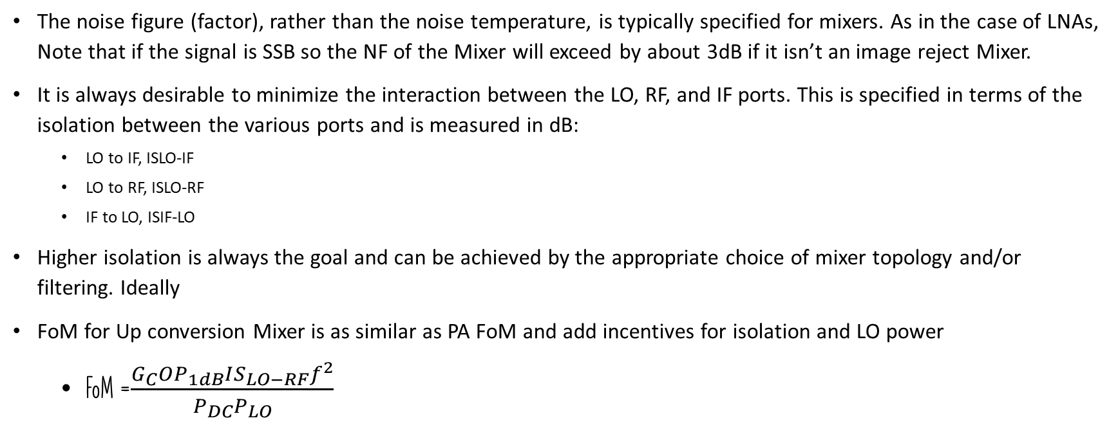
Mixer specifications cont.
The noise figure (factor), rather than the noise temperature, is typically specified for mixers. As in the case of LNAs, Note that if the signal is SSB so the NF of the Mixer will exceed by about 3dB if it isn’t an image reject Mixer.
It is always desirable to minimize the interaction between the LO, RF, and IF ports. This is specified in terms of the isolation between the various ports and is measured in dB:
LO to IF, ISLO-IF
LO to RF, ISLO-RF
IF to LO, ISIF-LO
Higher isolation is always the goal and can be achieved by the appropriate choice of mixer topology and/or filtering. Ideally
FoM for Up conversion Mixer is as similar as PA FoM and add incentives for isolation and LO power
FoM =$\frac{G_{C}OP_{1dB}IS_{LO−RF}f^{2}}{P_{DC}P_{LO}}$

Slide 6
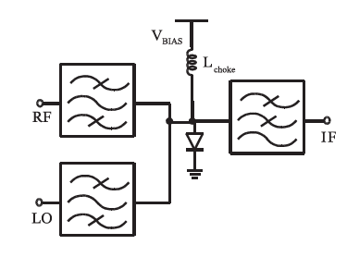
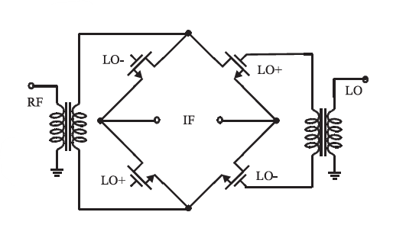
Mixer topologies
As we have seen earlier, mixers can be classified as:
passive, if they are realized with diodes or FETs operated as resistors
a single-diode passive mixer, still used today, especially at frequencies above 100GHz. Filters or duplexers and an inductive choke are employed to provide isolation between the port signals and between the port signals and the power supply.
In 0-bias mixers, the LO signal must be large enough to self-bias the diode, However their provide a very high linearity.
Fig1. Single Diode Mixer
Fig2. Double Balanced Resistive FET Mixer

Slide 7
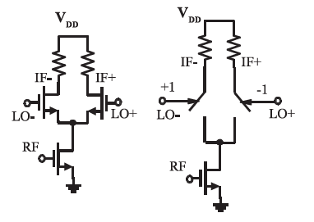
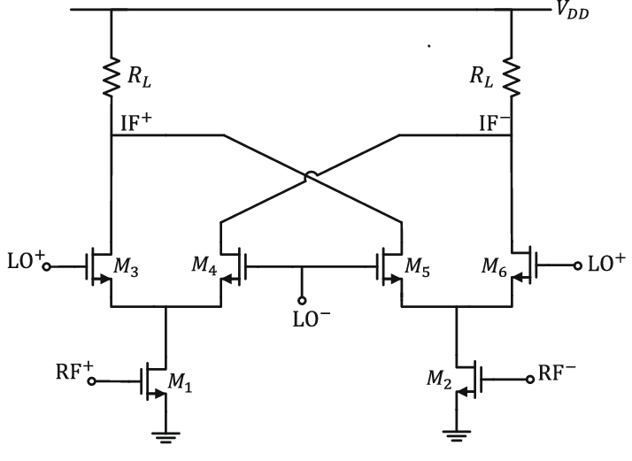
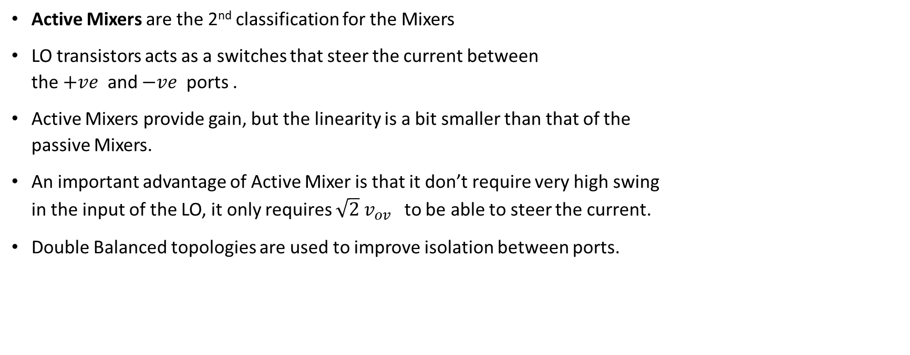
Mixer topologies cont.
Active Mixers are the 2nd classification for the Mixers
LO transistors acts as a switches that steer the current between the $+ve$ and $−ve$ ports .
Active Mixers provide gain, but the linearity is a bit smaller than that of the passive Mixers.
An important advantage of Active Mixer is that it don’t require very high swing in the input of the LO, it only requires $\sqrt{2} v_{ov}$ to be able to steer the current.
Double Balanced topologies are used to improve isolation between ports.
Fig3. Active imp. And the conceptual cct.
Fig4. Double Balanced Active Mixer

Slide 8
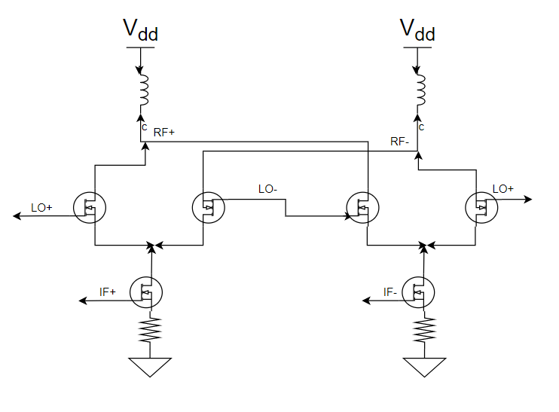
The architecture used
Double Balanced Gilbert Cell was implemented to achieve the required Specs.
As we implement Up converter so the o/p frequency is high so we used inductor load instead of resistive load to not reduce the available swing.
Resistive degeneration is used in order to Improve the Mixer’s linearity
The degeneration Improves the linearity by taking some swing from the input port, and also reduces the variations in the MOSFET’s small signal parameters so the relation between i/p and o/p voltages become more linear.
Resistive degeneration is used instead of inductive degeneration as the input frequency is low as it’s an up conversion Mixer.
Fig5. Chosen Architecture.

Slide 9
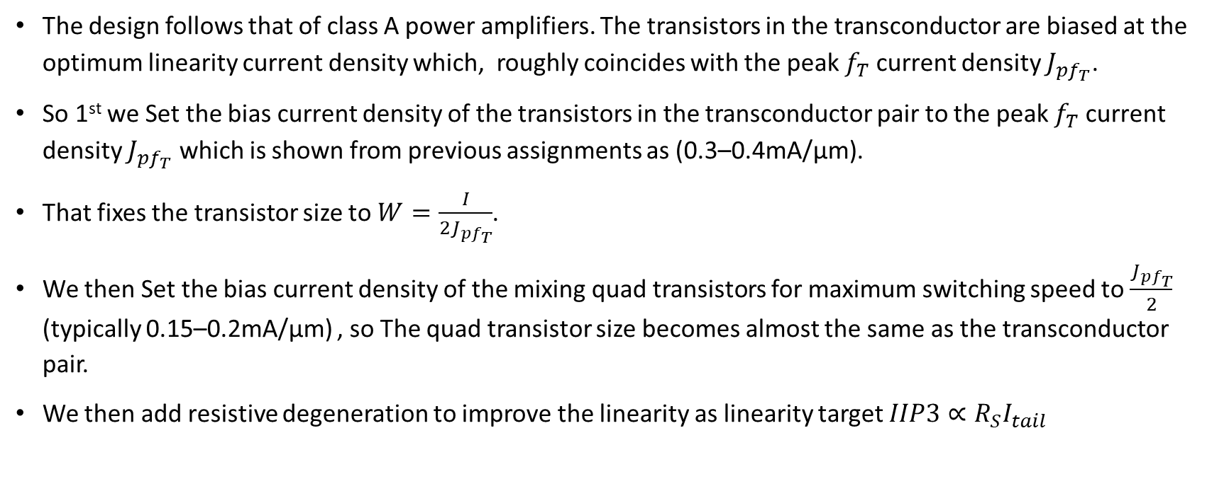
Design methodology
The design follows that of class A power amplifiers. The transistors in the transconductor are biased at the optimum linearity current density which, roughly coincides with the peak $f_{T}$ current density $J_{pf_{T}}$.
So 1st we Set the bias current density of the transistors in the transconductor pair to the peak $f_{T}$ current density $J_{pf_{T}}$ which is shown from previous assignments as (0.3–0.4mA/μm).
That fixes the transistor size to $W=\frac{I}{2J_{pf_{T}}}$.
We then Set the bias current density of the mixing quad transistors for maximum switching speed to $\frac{J_{pf_{T}}}{2}$ (typically 0.15–0.2mA/μm) , so The quad transistor size becomes almost the same as the transconductor pair.
We then add resistive degeneration to improve the linearity as linearity target $IIP3∝R_{S}I_{tail}$

Slide 10
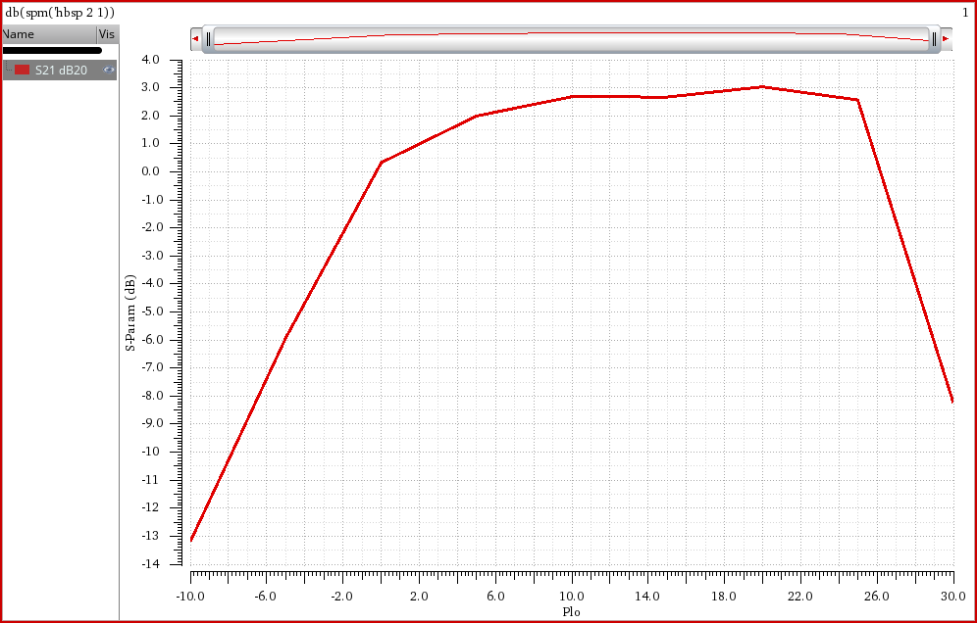
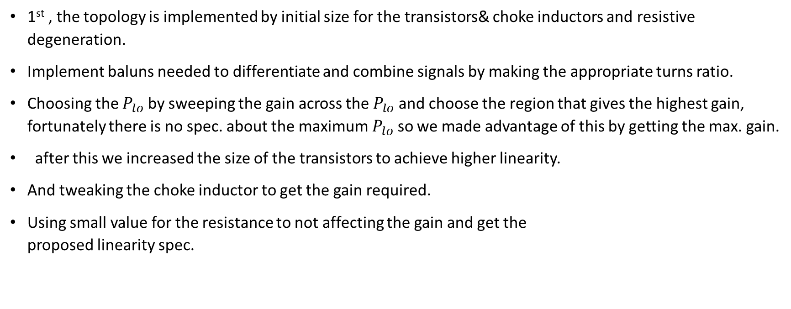

Technical flow
1st , the topology is implemented by initial size for the transistors& choke inductors and resistive degeneration.
Implement baluns needed to differentiate and combine signals by making the appropriate turns ratio.
Choosing the $P_{lo}$ by sweeping the gain across the $P_{lo}$ and choose the region that gives the highest gain, fortunately there is no spec. about the maximum $P_{lo}$ so we made advantage of this by getting the max. gain.
after this we increased the size of the transistors to achieve higher linearity.
And tweaking the choke inductor to get the gain required.
Using small value for the resistance to not affecting the gain and get the proposed linearity spec.
Fig6. S21 Vs $P_{lo}$.

Slide 11
results

Slide 12
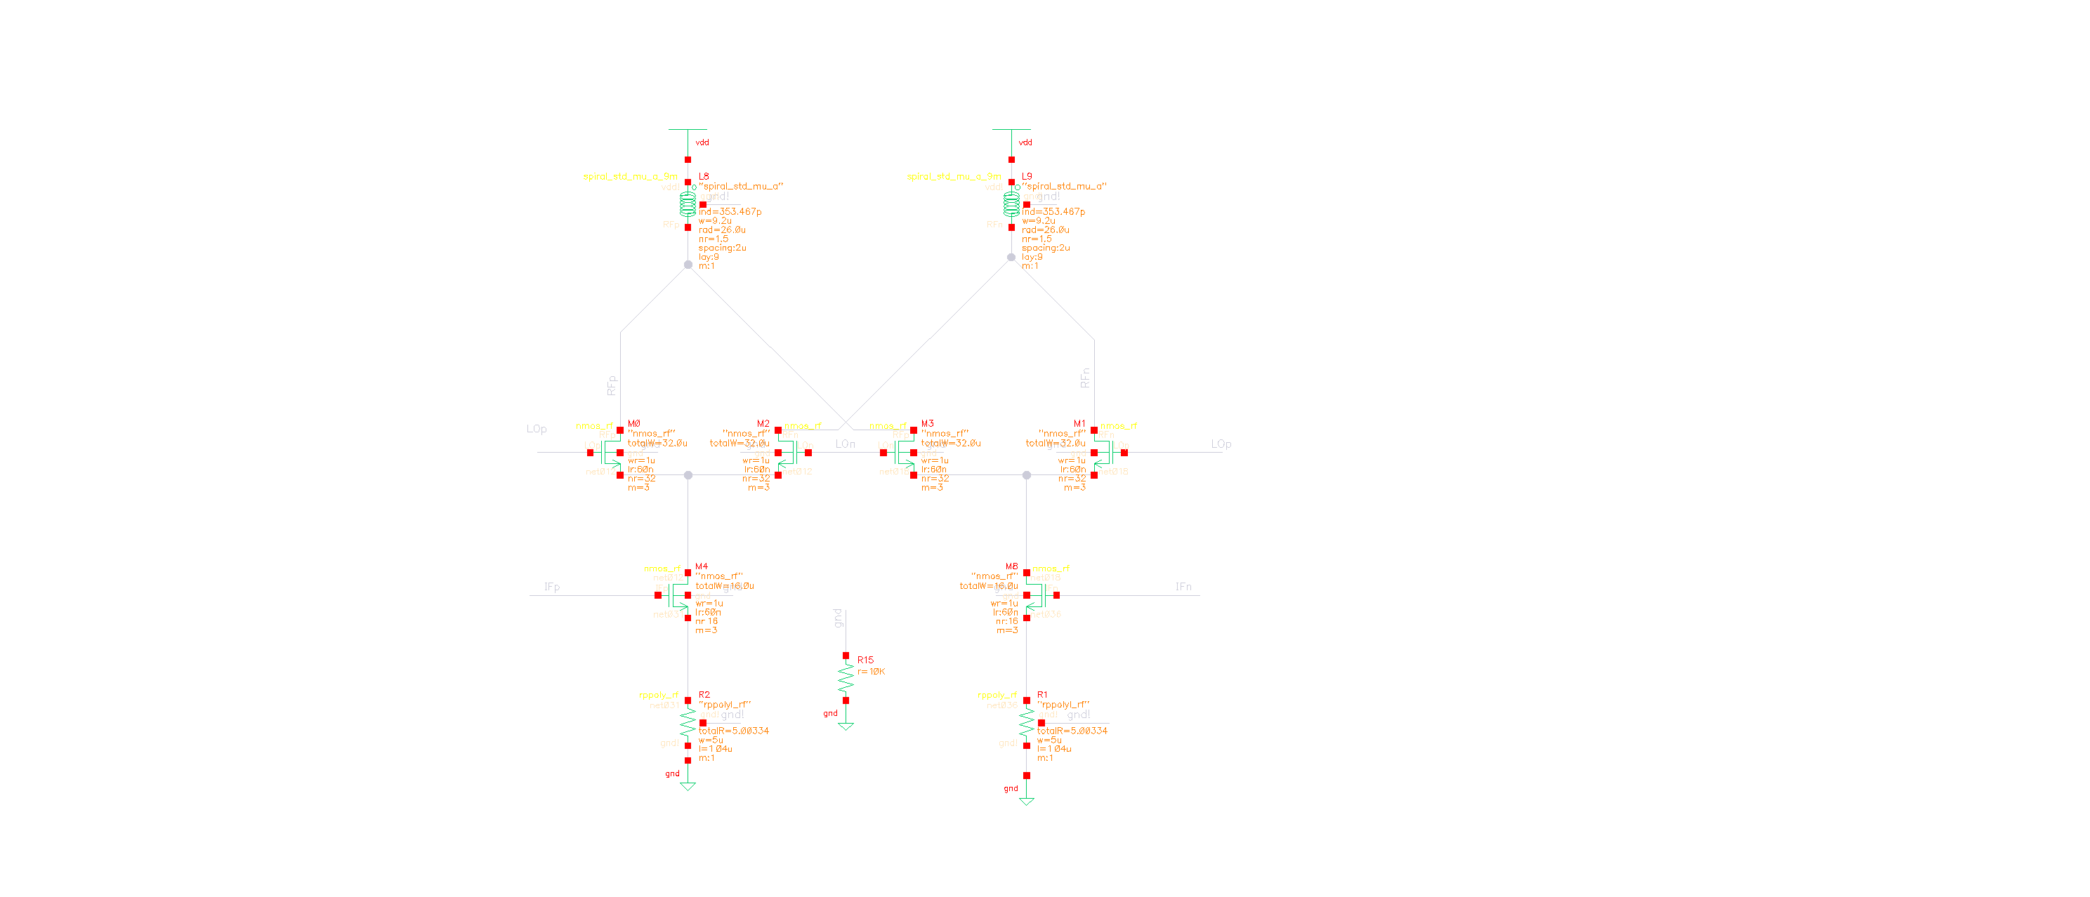
Test bench
Fig7. Schematics.

Slide 13
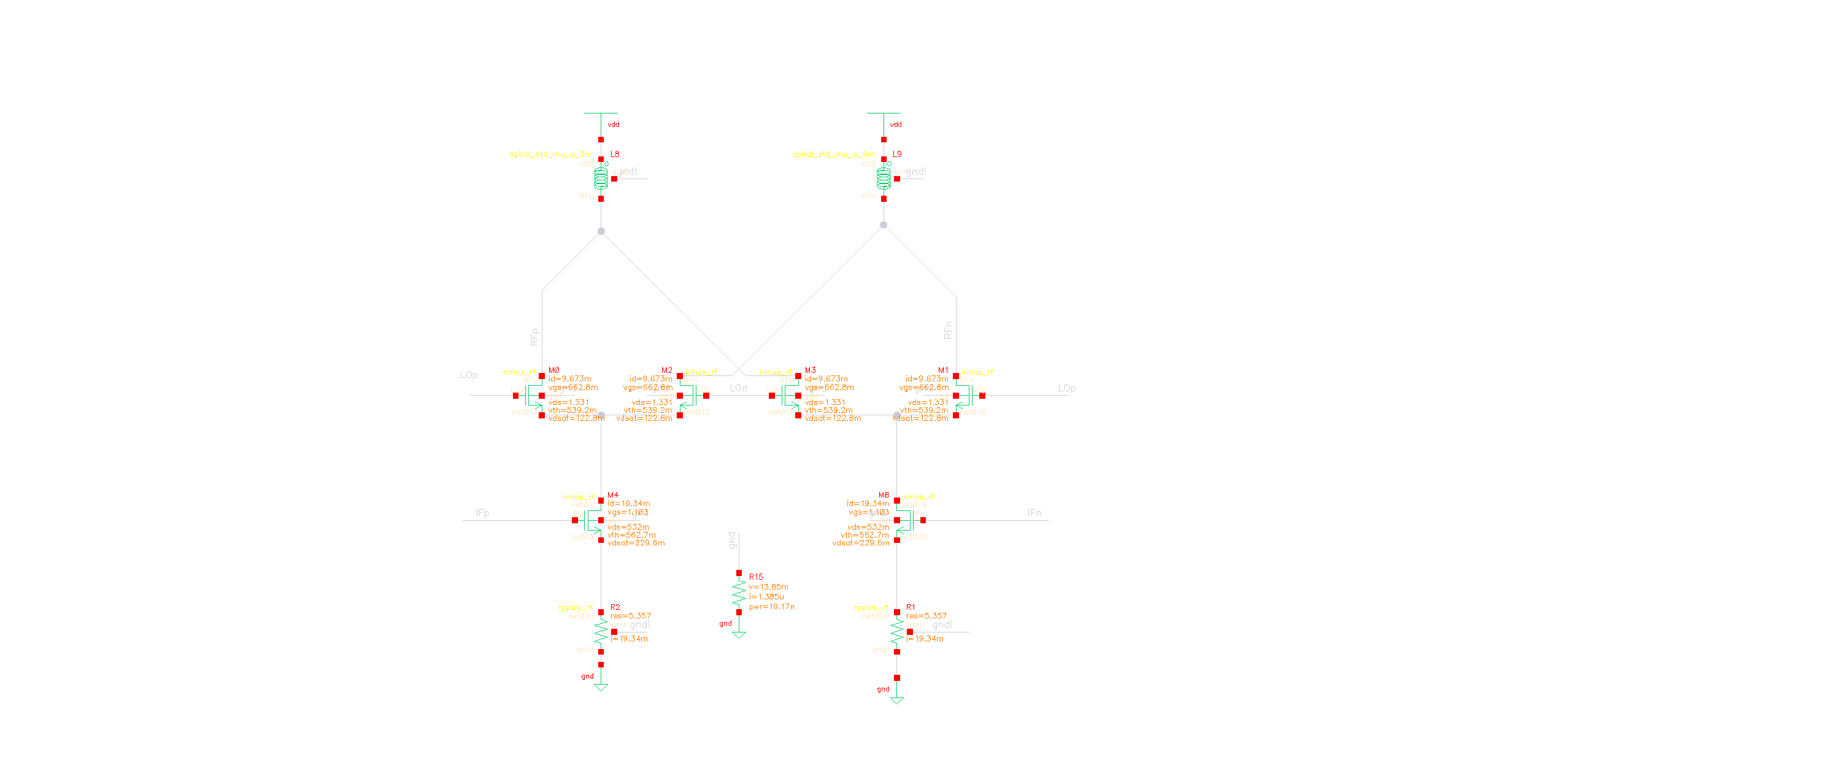
Operating point
Fig8. Op. Point.

Slide 14
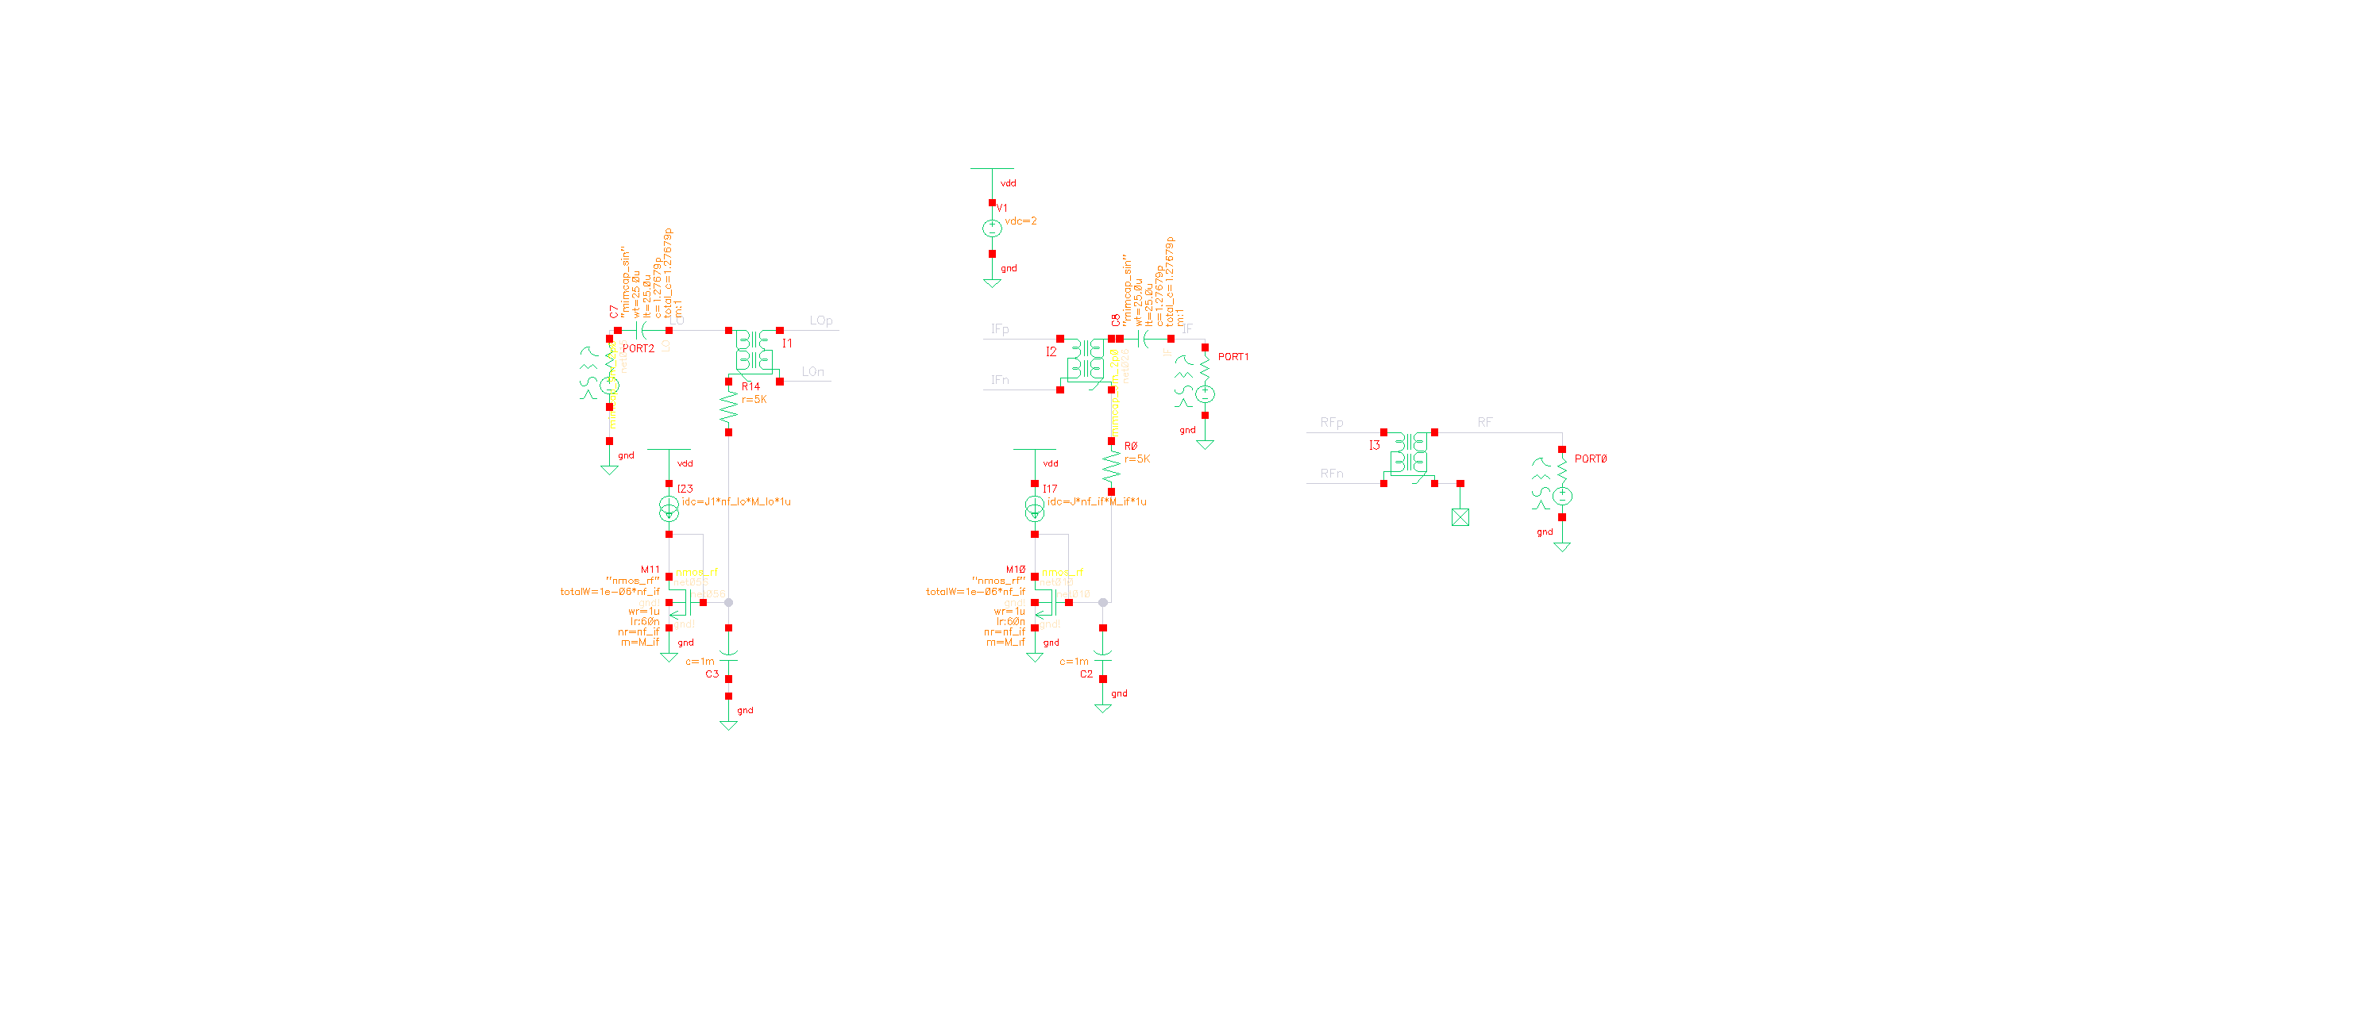
Biasing circuit
Fig9. Biasing cct.

Slide 15
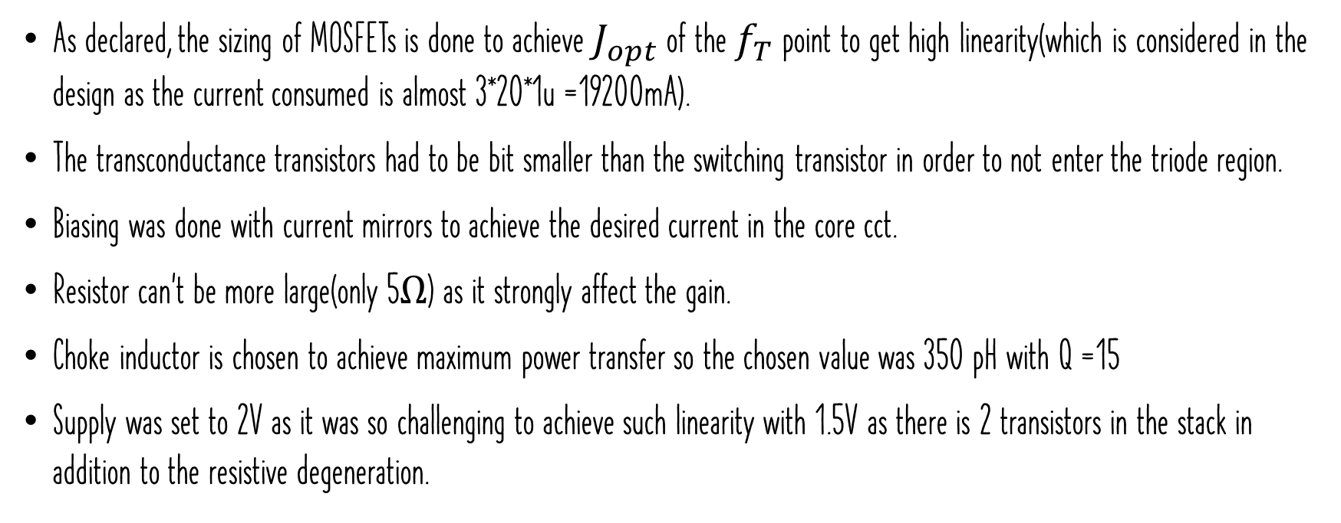
Comments on schematics & op. point
As declared, the sizing of MOSFETs is done to achieve $J_{opt}$ of the $f_{T}$ point to get high linearity(which is considered in the design as the current consumed is almost 3*20*1u =19200mA).
The transconductance transistors had to be bit smaller than the switching transistor in order to not enter the triode region.
Biasing was done with current mirrors to achieve the desired current in the core cct.
Resistor can’t be more large(only 5$Ω$) as it strongly affect the gain.
Choke inductor is chosen to achieve maximum power transfer so the chosen value was 350 pH with Q =15
Supply was set to 2V as it was so challenging to achieve such linearity with 1.5V as there is 2 transistors in the stack in addition to the resistive degeneration.

Slide 16
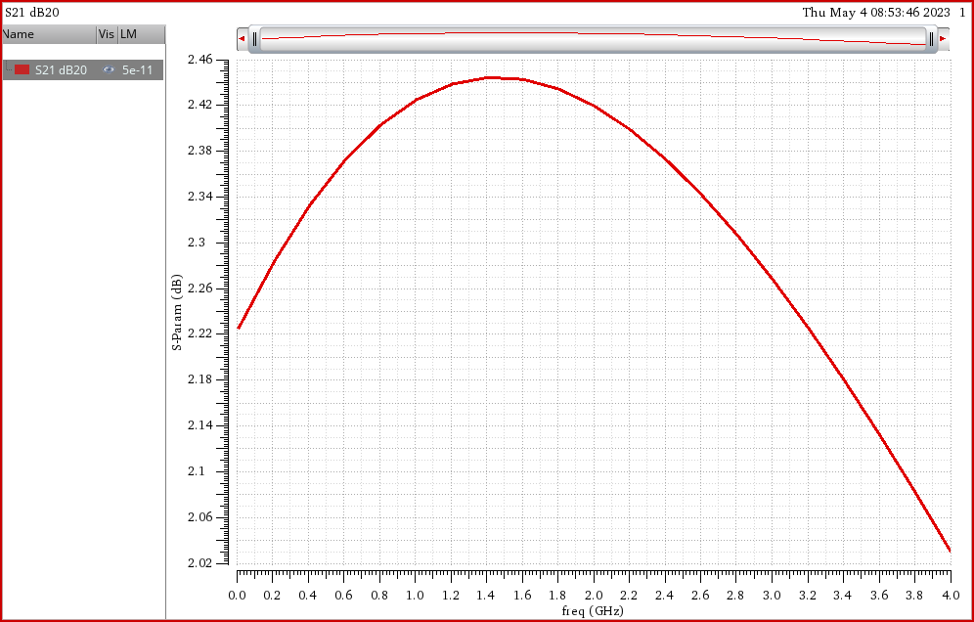
S21 vs IF
Fig10. shows that the gain spec. is achieved across all the frequency range.
Also the gain flatness is very good as it is almost 0.5dB across all the range.
Fig10. S21 Vs IF freq.

Slide 17
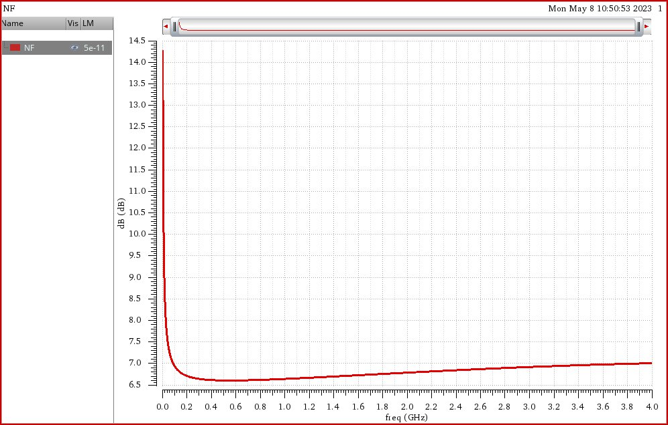
NF vs IF
Fig11. shows that the NF spec. is achieved across all the frequency range.
Note that the NF is high in the 1st 100MHz, this is expected due to the flicker noise, However, all over the range we have a good margin on the spec. of the NF.
Fig11. NF Vs IF freq.

Slide 18
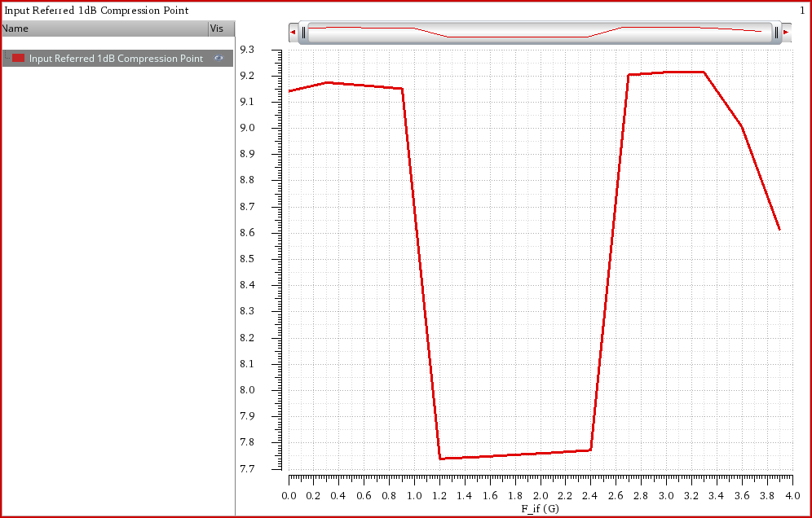
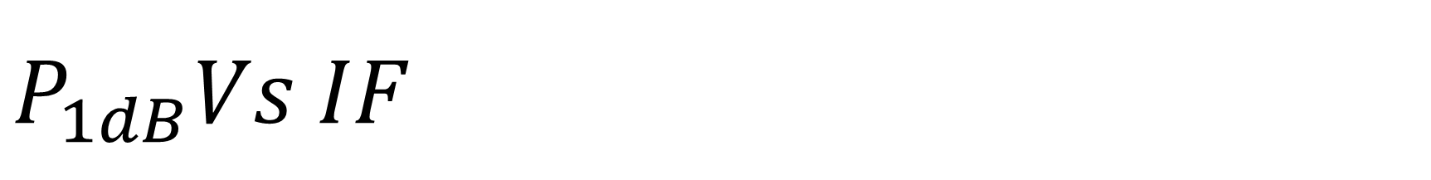
$P_{1dB}Vs IF$
Fig12. shows that the P1dB spec. is achieved across all the frequency range.
Values of the current & size of the MOSFETs and the degeneration affects the P1dB spec., which finally achieved across all the range
Setup of the simulation is done by inserting 1 tone in the IF port and use it in the hb analysis as well as the LO tone, then sweeping the i/p Power from -50dBm to 20dBm.
Fig12. P1dB Vs IF freq.

Slide 19
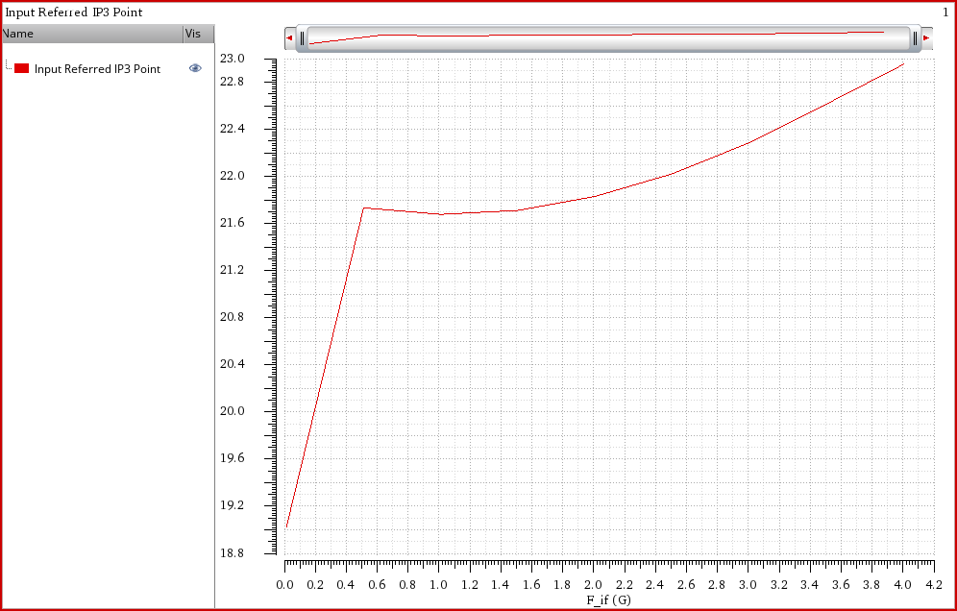
iip3 vs IF
Fig13. shows that the IIP3 spec. is achieved across all the frequency range.
Note that IIP3 and P1dB are strongly related as the relation between them is almost 10dB as previously theoretically proved.
Setup of the simulation is done by inserting 2 tones in the IF port with i/p Power of -30 dBm(which is much below the IP1dB) and with delta in frequency by 5MHz use it in the hb analysis as well as the LO tone.
Fig13.IIP3 Vs IF freq.

Slide 20
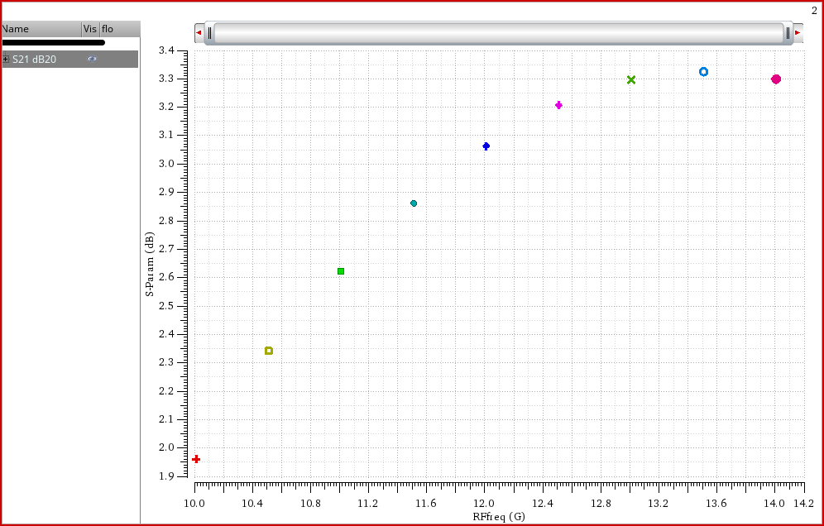
S21 vs RF
Also the gain spec is achieved across all the RF frequency range at IF=10MHz, RFfreq sweeped across this range and LOfreq was set to RFfreq – F_if then get these results which is good across all the range.
Also the flatness if good as it’s about 1.5 dB .
Fig14. S21 Vs RF freq.

Slide 21
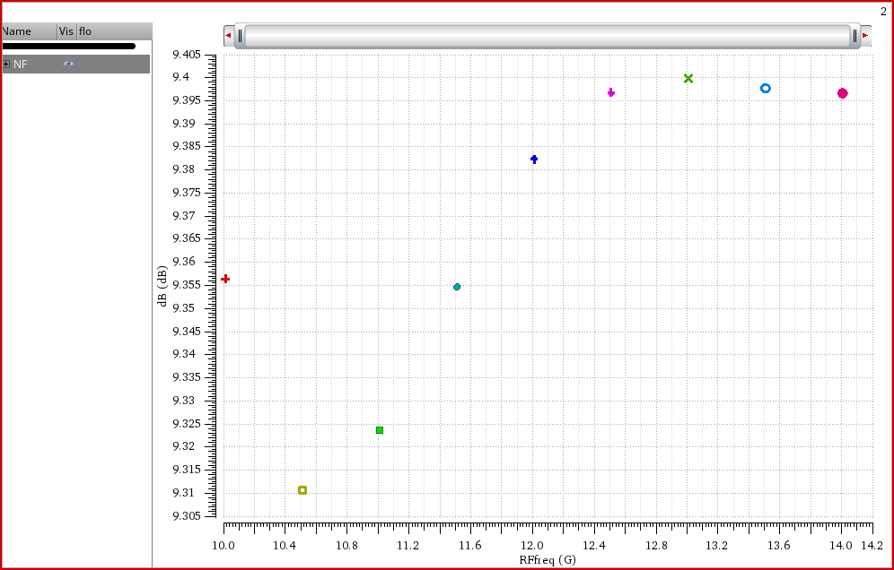
NF vs RF
Fig15. shows that the spec. of the NF is also achieved across all RF range at IFfreq=10MHz.
Fig15. NF Vs RF freq.

Slide 22
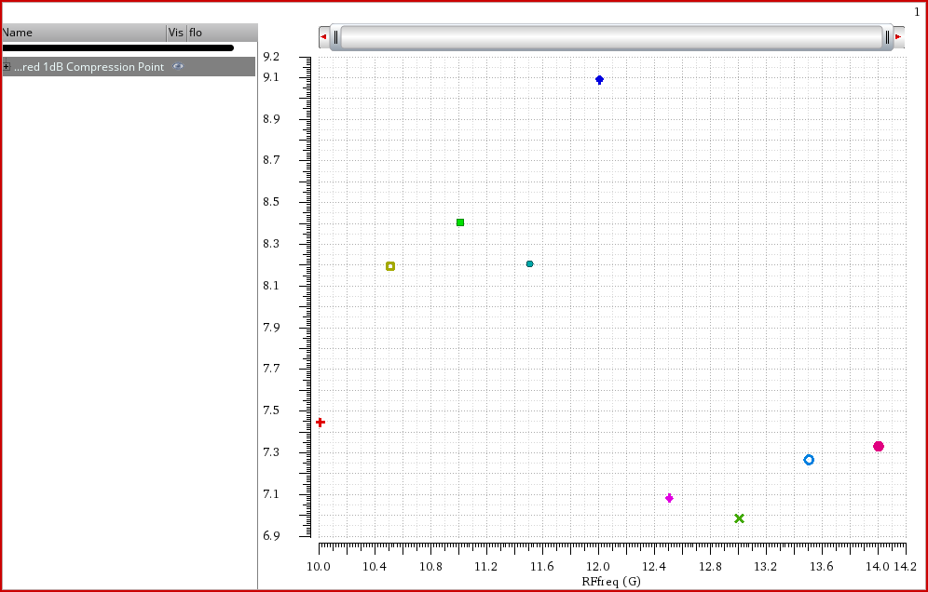
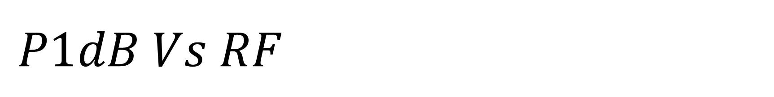
$P1dB Vs RF$
P1dB spec. is achieved across the most of the range, However there is some regions that P1dB was below 7dB, but overall the achievement is good across the range.
Fig16. P1dB Vs RF freq.

Slide 23
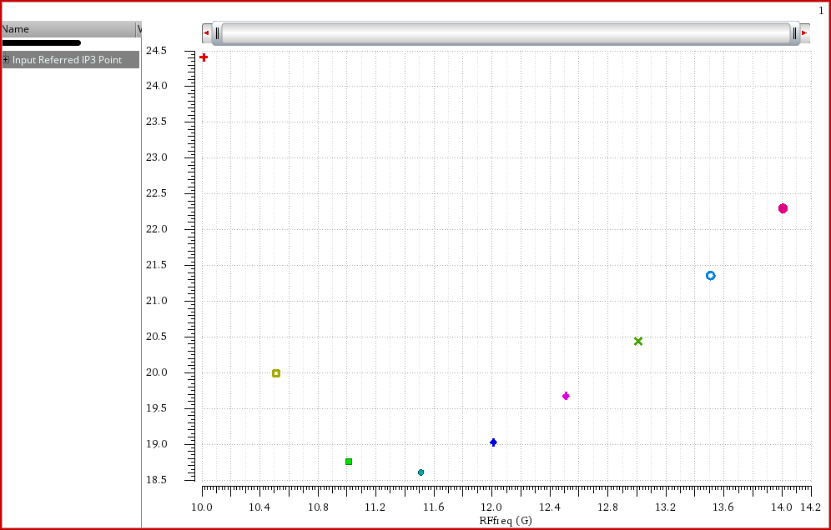
IIP3 vs RF
IIP3 is so good across the whole range of RF
The difference between IIP3 & P1dB is almost 10 dB as there are related to each other.
Fig17. IIP3 Vs RF freq.

Slide 24
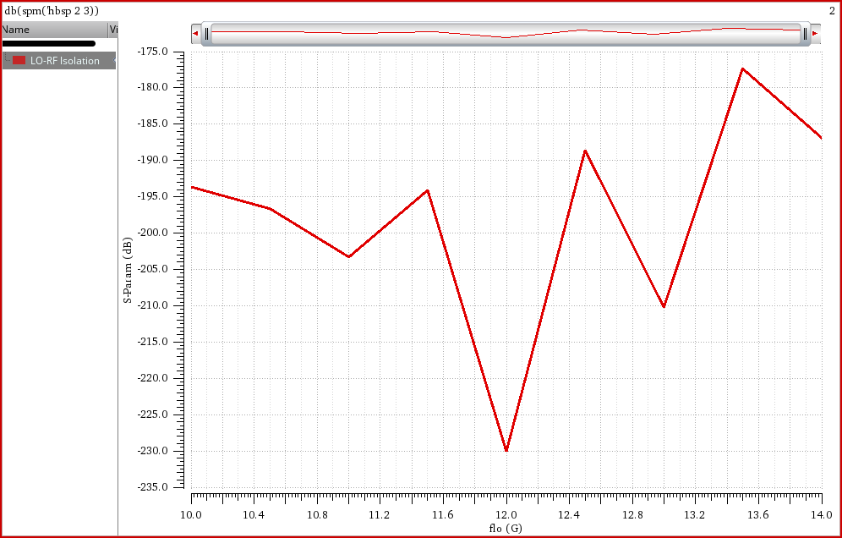
LO-RF isolation
The isolation between LO and RF is so good even by variation of 1% between the LO MOSFETs which is good, eventually it’s a good advantage of the gilbert cell architecture.
However, this good isolation will degrade after the layout.
Fig18. LO-RF Isolation.

Slide 25
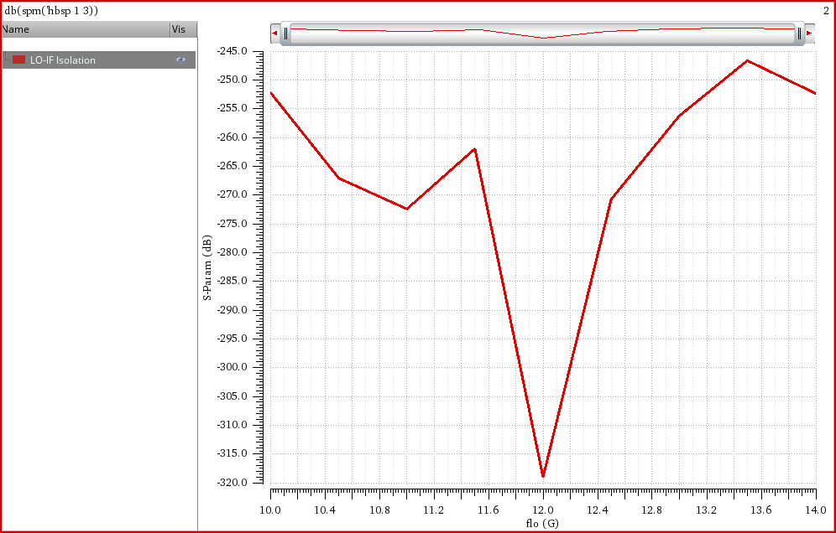
LO-RF isolation
The isolation between LO and IF is so good even by variation of 1% between the LO MOSFETs which is good, eventually it’s a good advantage of the gilbert cell architecture.
However, this good isolation will degrade after the layout.
Fig19. LO-IF Isolation.

Slide 26
Summary of the results
 | Spec. | Achieved | Unit
S21 Vs IF | 2 | 2 | dB
NF Vs IF | 15 | 14.5 | dB
P1dB Vs IF | 7 | 7.7 | dBm
IIP3 Vs IF | 17 | 18.8 | dBm
S21 Vs RF | 2 | 2 | dB
NF Vs RF | 15 | 9.4 | dB
P1dB Vs RF | 7 | 7 | dBm
IIP3 Vs RF | 17 | 18.5 | dBm
LO-RF isolation | 30 | 230 | dB
LO-IF isolation | 40 | 320 | dB

