Slide 1


project #2 power amplifier
Presented by: Khaled Ahmed Swilam

Slide 2
Agenda
What is A Power Amplifier?!
Power Amplifier Specifications
Power Amplifier Classes
Class A Power Amplifier Design Methodology
Technical Flow
Results

Slide 3
What is a power amplifier?!
Power amplifiers are key components in the transmission path of wireless communication systems and in automotive radar.
They typically deliver the power required for transmitting information to the antenna with high efficiency and, usually, high linearity, over bandwidths of 10% to 20% relative to the center frequency of the amplifier.
CMOS PAs have advantages in system-on-chip applications where a relatively small transmit power is needed.
In discrete PAs with higher transmit power, e.g. for cellular base station applications, other technologies such as LDMOS (laterally diffused drain MOSFET) or compound semiconductor technologies have prevailed.
There are many classes in PAs which have the trade off between the linearity and efficiency.

Slide 4
power amplifier specifications
To establish a performance figure of merit, several key parameters must be taken into account.
These include output power Pout, power gain G, carrier frequency f, linearity (in terms of OP1dB), and power-added-efficiency (PAE).
Unfortunately, linearity strongly depends on the operating class of the amplifier, making it difficult to compare amplifiers of different classes. Moreover, the most recent developments increasingly focus on highly non-linear, saturated output power switching PA topologies because of their high efficiency.
To remain independent of the design approach and the specifications of different applications, the linearity is often not included in the PA figure of merit ($FoM_{PA}$)=$P_{out}.G.PAE.f^{2}$ , where PAE= $\frac{{P_{out}−P}_{in}}{P_{DC}}$

Slide 5
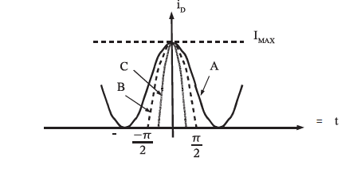
power amplifier classes
PAs can be classified in:
PAs in which the transistor operates as a voltage-controlled current source
PAs in which the transistor acts as a switch
The PA classes are defined based on the shape of the voltage and current waveforms and on the angle of current conduction.
In the 1st group, we have:
Class A PAs with 100% current conduction, that is the device is always “on” and the conduction angle is 2$π$
Class B PAs with a conduction angle of $π$, that is the transistor only conducts for half of the period of the input voltage waveform
Class AB PAs where the angle of conduction can be anywhere between π and 2π, and
Class C PAs with a conduction angle smaller than π.
Fig.1. Conduction angle definition

Slide 6
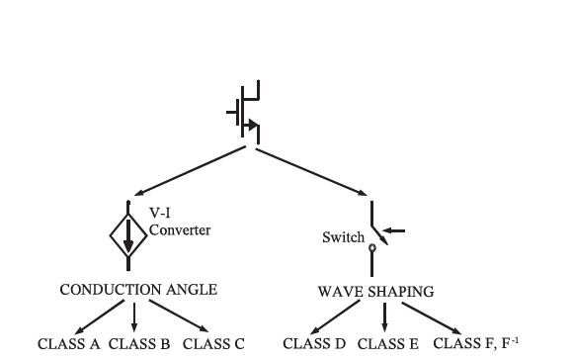
power amplifier classes cont.
The switching PA group includes :
class D,
class E,
class F, and
inverse F ($F^{−1}$)
Fig.2. PA Family tree

Slide 7
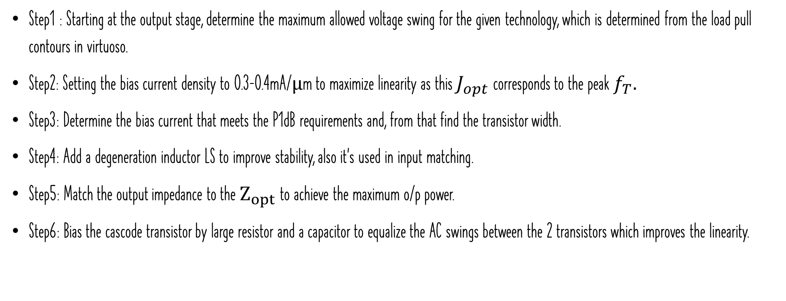
class a power amplifier design methodology
Step1 : Starting at the output stage, determine the maximum allowed voltage swing for the given technology, which is determined from the load pull contours in virtuoso.
Step2: Setting the bias current density to 0.3–0.4mA/μm to maximize linearity as this $J_{opt}$ corresponds to the peak $f_{T}.$
Step3: Determine the bias current that meets the P1dB requirements and, from that find the transistor width.
Step4: Add a degeneration inductor LS to improve stability, also it’s used in input matching.
Step5: Match the output impedance to the $Z_{opt}$to achieve the maximum o/p power.
Step6: Bias the cascode transistor by large resistor and a capacitor to equalize the AC swings between the 2 transistors which improves the linearity.

Slide 8
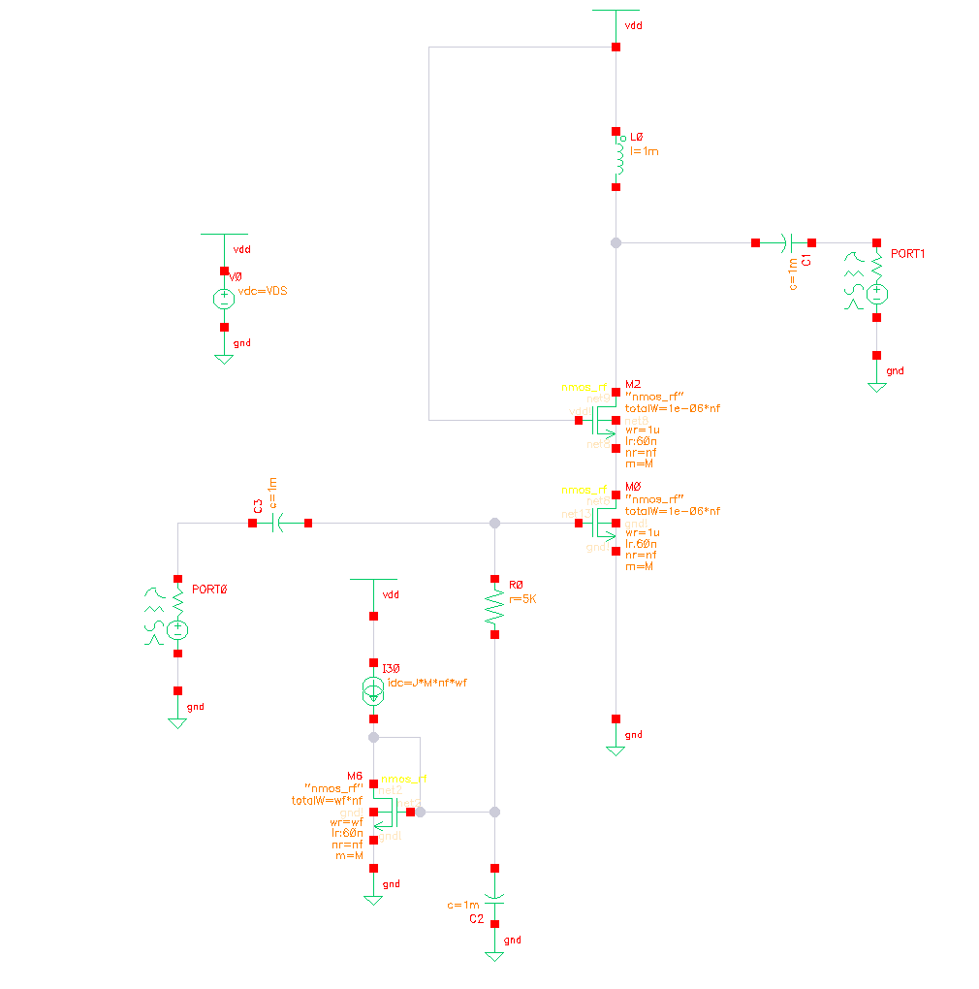
technical flow
The following figure show the testbench used to go on the design of the PA.
Fig.3. Test Bench

Slide 9
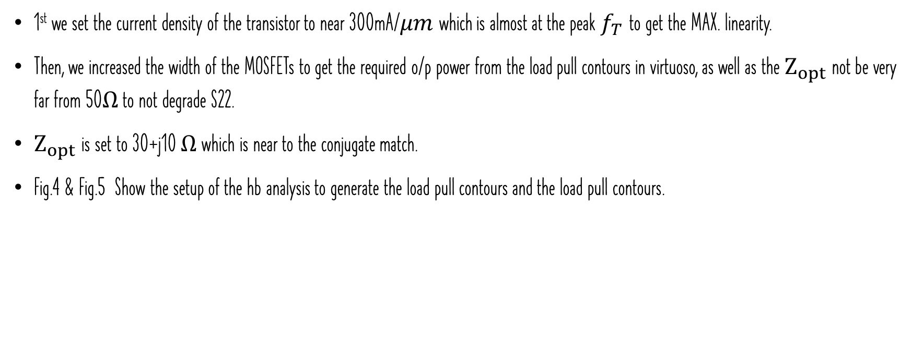
technical flow cont.
1st we set the current density of the transistor to near 300mA/$μm$which is almost at the peak $f_{T}$ to get the MAX. linearity.
Then, we increased the width of the MOSFETs to get the required o/p power from the load pull contours in virtuoso, as well as the $Z_{opt}$not be very far from 50$Ω$ to not degrade S22.
$Z_{opt}$is set to 30+j10 $Ω$ which is near to the conjugate match.
Fig.4 & Fig.5 Show the setup of the hb analysis to generate the load pull contours and the load pull contours.

Slide 10
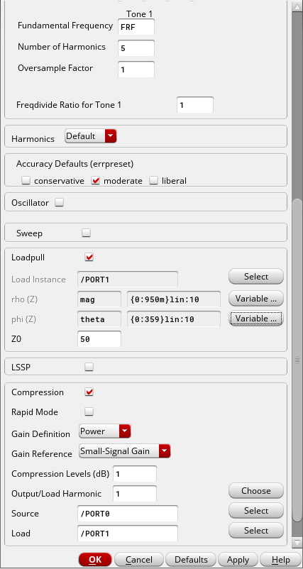
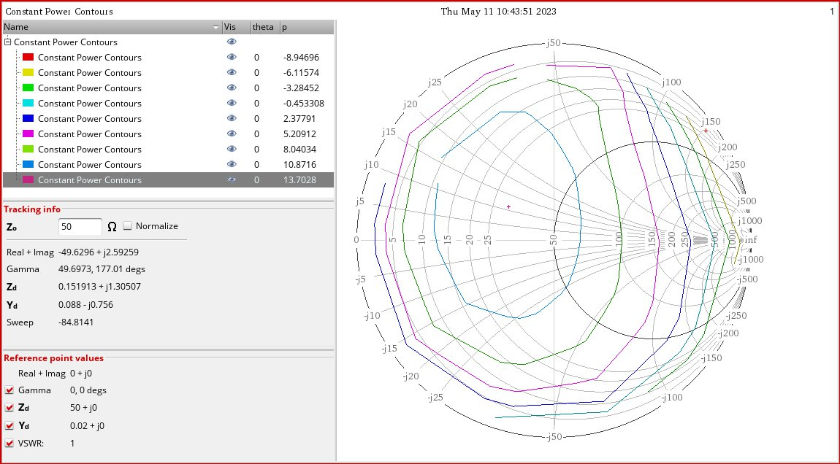
Technical flow cont.
Fig.4. PA Load Pull Contours
Fig.5. hb analysis

Slide 11
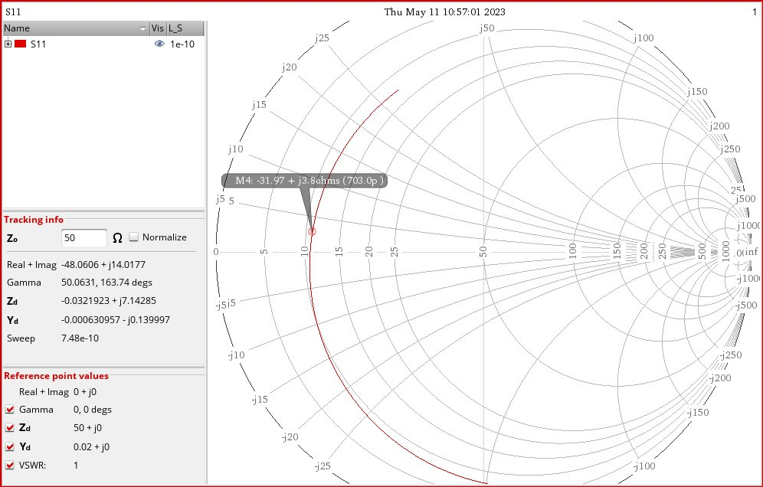
technical flow cont.
After that, we begin to design the input matching cct. , by assuming the coupling cap. Equals to 5pF, and by using series inductor And a degeneration one to help in stability as well as input matching.
By sweeping the value of the gate inductor, we choose the value of 700pH
Fig.6. choosing the value of the gate inductor

Slide 12
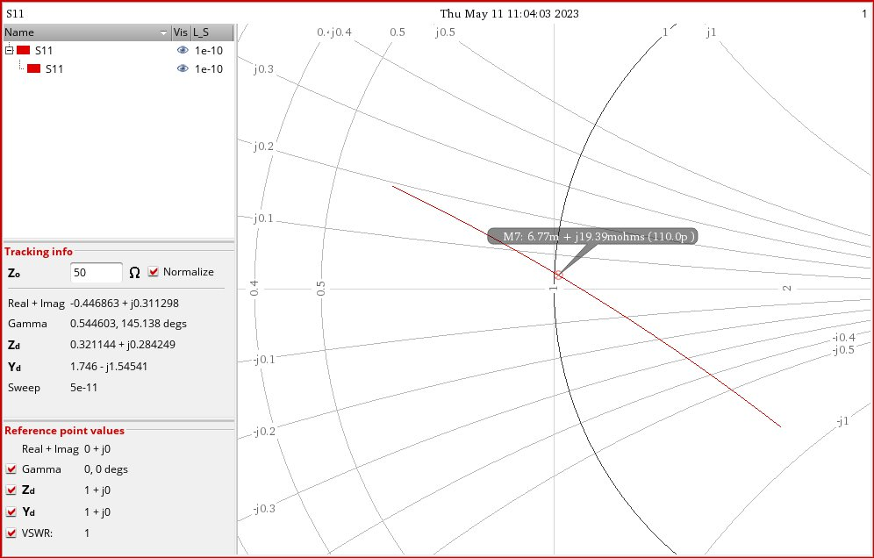
technical flow cont.
After that, we swept the degeneration inductor to achieve conjugate matching in the input.
We chose the value of 110pH, However this value will be increased to achieve stability requirements.
Fig.7. choosing the value of the degeneration inductor

Slide 13
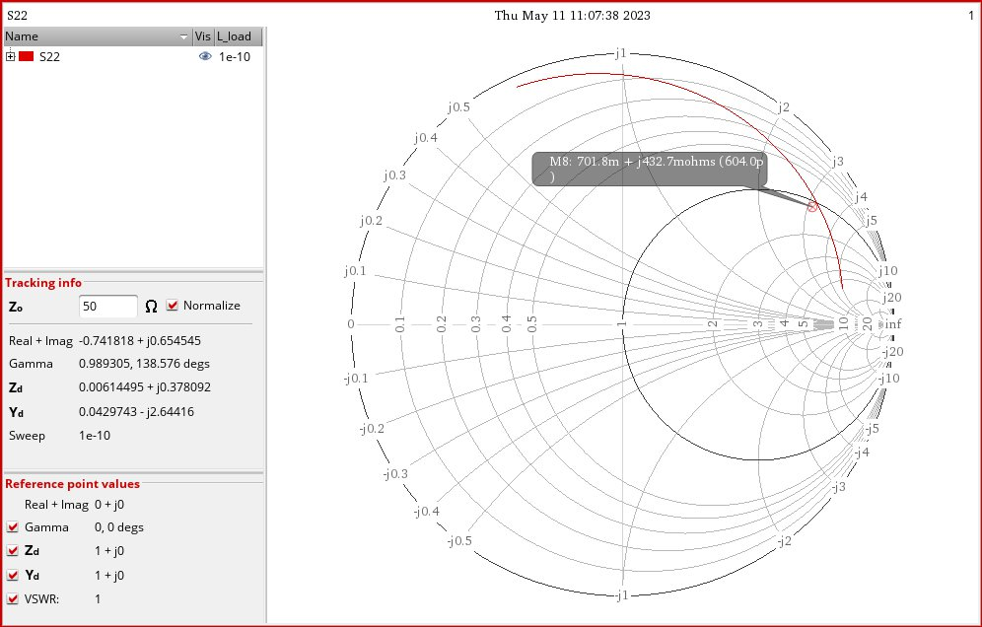

technical flow cont.
After finishing the i/p matching, we go to o/p matching
For sure we will match for p1dB not conjugate matching
So, the impedance of the o/p port is set to the $Z_{opt}$then we began to match
We swept the value of the load inductor to intersect the circle of unity.
The chosen value is 605pH.
Fig.8. choosing the value of the load inductor

Slide 14
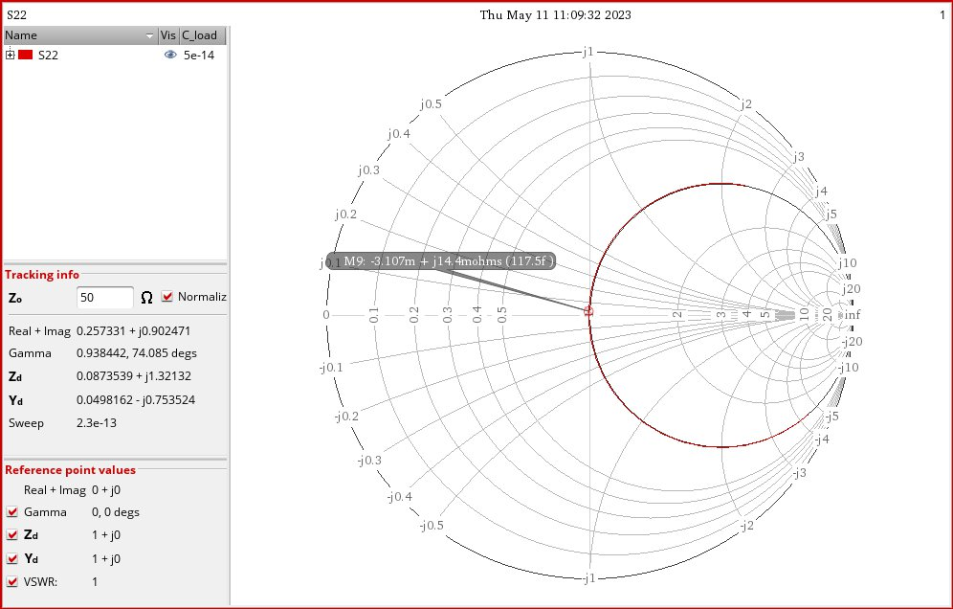
technical flow cont.
After that we swept the load cap. To go to the origin.
The chosen value is around 120fF.
Note that, these values specifically load inductor & load capacitance will be changed to achieve good S22 as well as good linearity.
Also as the real inductors from the kit used the optimum values will change so it will need some tweaking.
Fig.9. choosing the value of the load Cap.

Slide 15
results

Slide 16
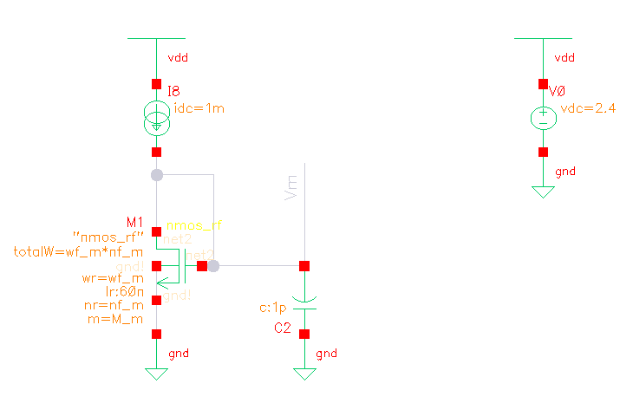
Biasing circuit
2.4V supply is used
Current mirror is used to bias the input transistors.
Fig.10. The Biasing cct.

Slide 17
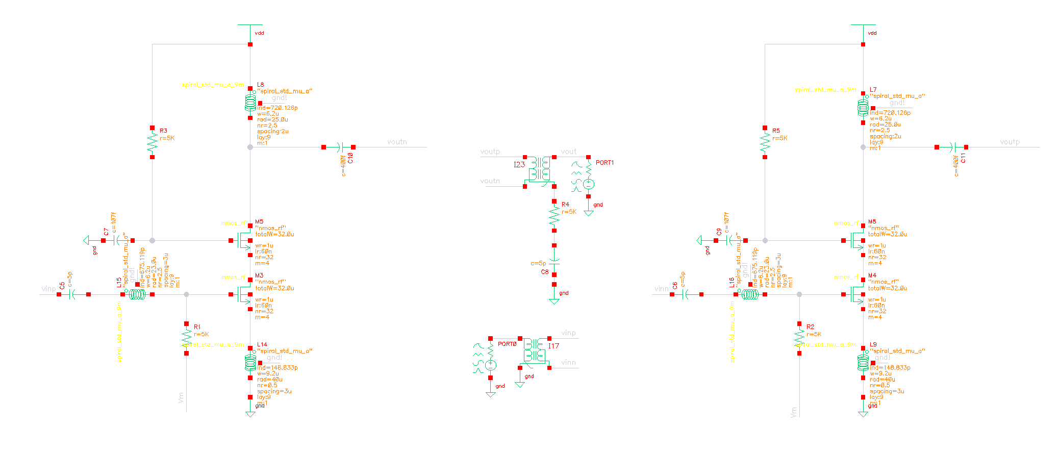
Schematic
Fig.11. Schematic.

Slide 18
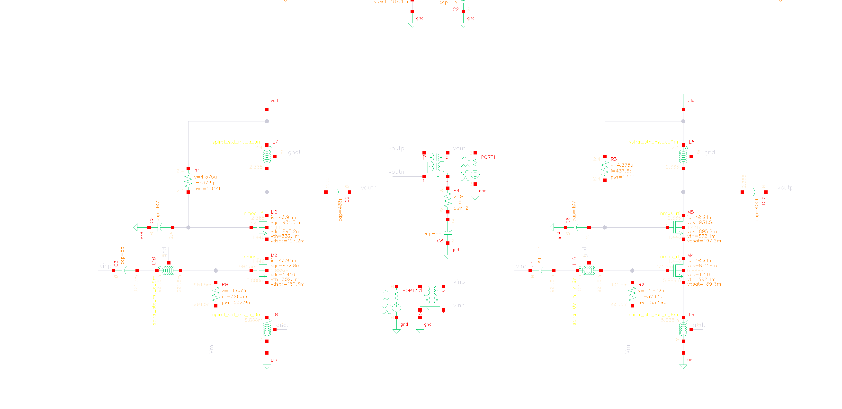
DC Operating point
Fig.12. DC Operating Point.

Slide 19
Components parameters
 | size
MOSFETs | 4*32*1u
Choke inductor | 720pH / Q=15(from the kit)
Degeneration inductor | 150pH/ Q=18 (from the kit)
Input inductor | 675pH / Q=15 (from the kit)
Input Cap. | 5pF
Load Cap. | 400fF
Cascode Cap. | 107fF

Slide 20
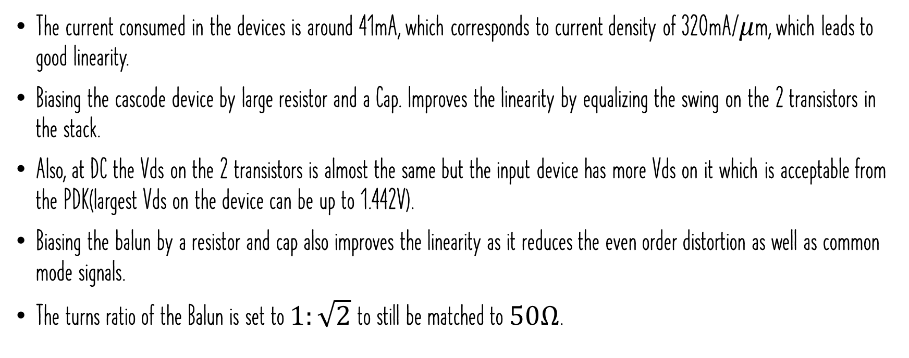
Comments on schematics & DC operating point
The current consumed in the devices is around 41mA, which corresponds to current density of 320mA/$μ$m, which leads to good linearity.
Biasing the cascode device by large resistor and a Cap. Improves the linearity by equalizing the swing on the 2 transistors in the stack.
Also, at DC the Vds on the 2 transistors is almost the same but the input device has more Vds on it which is acceptable from the PDK(largest Vds on the device can be up to 1.442V).
Biasing the balun by a resistor and cap also improves the linearity as it reduces the even order distortion as well as common mode signals.
The turns ratio of the Balun is set to $1:\sqrt{2}$ to still be matched to $50Ω$.

Slide 21
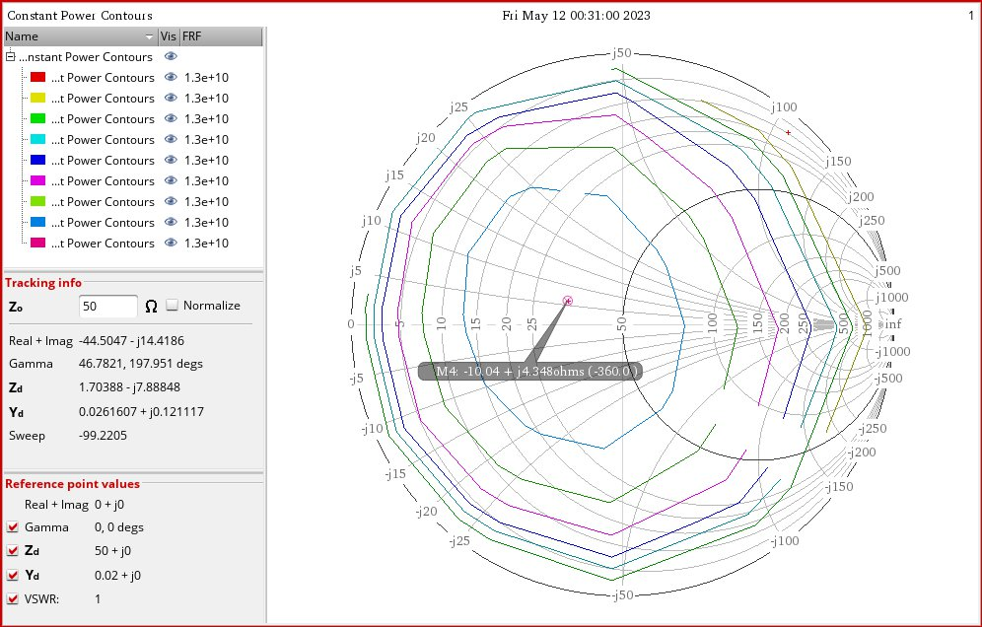
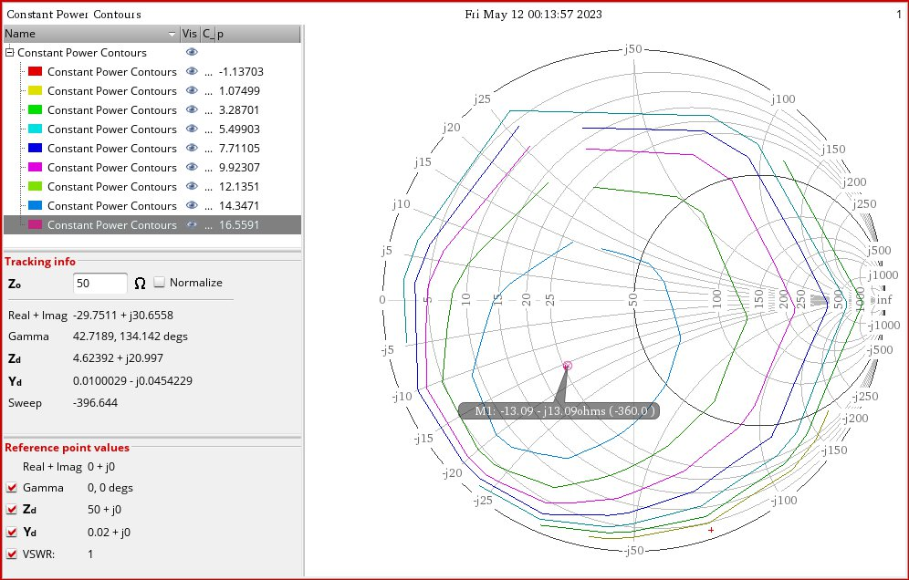
Load pull contours @13GHz
Fig.13. Load pull contours without Matching network.
Fig.14. Load pull contours with Matching network.

Slide 22
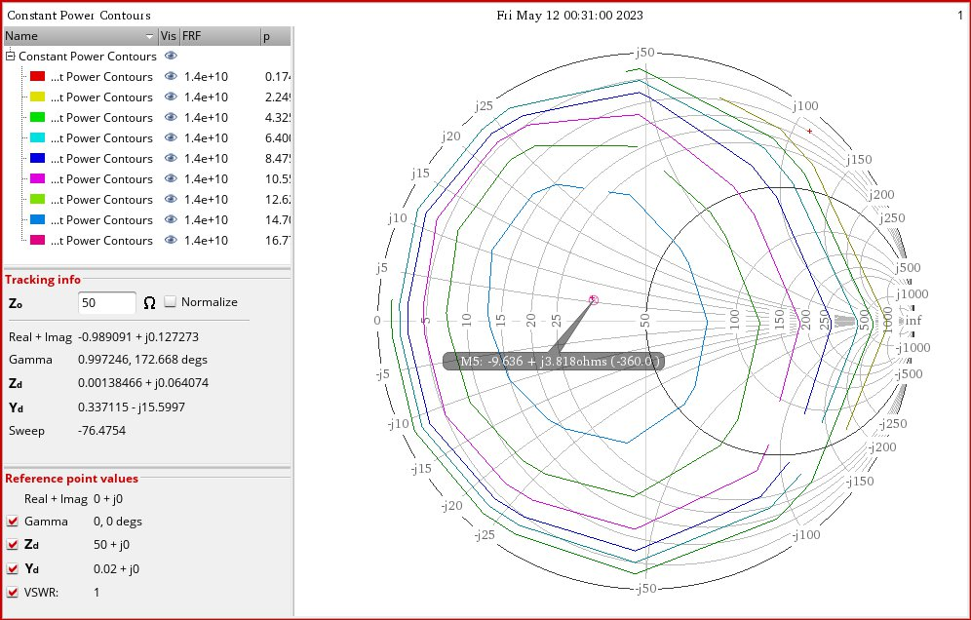
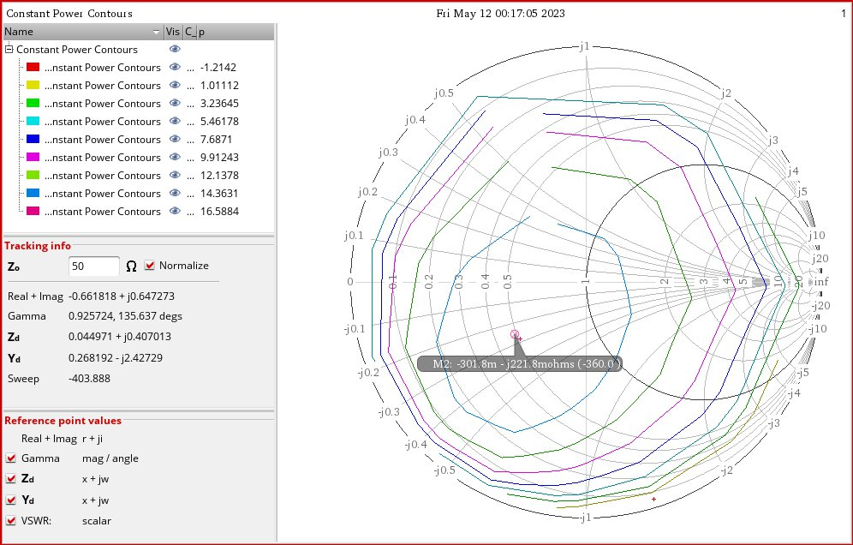
Load pull contours @14GHz
Fig.15. Load pull contours without Matching network.
Fig.16. Load pull contours with Matching network.

Slide 23
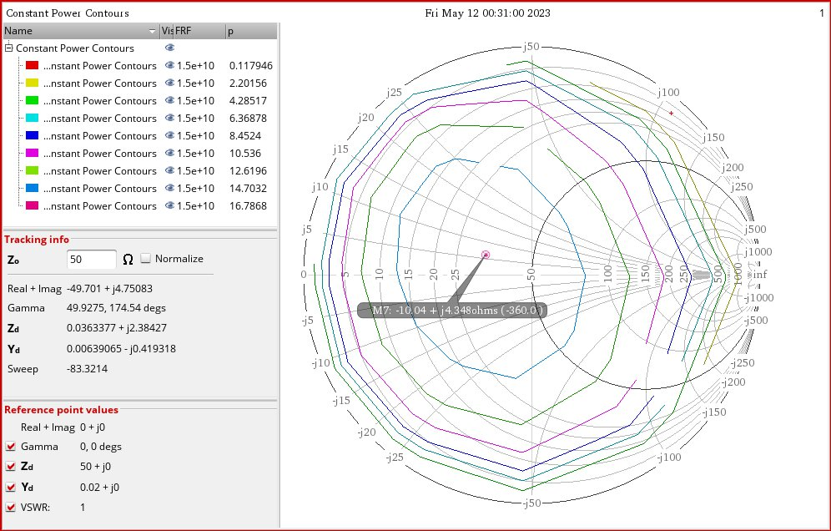
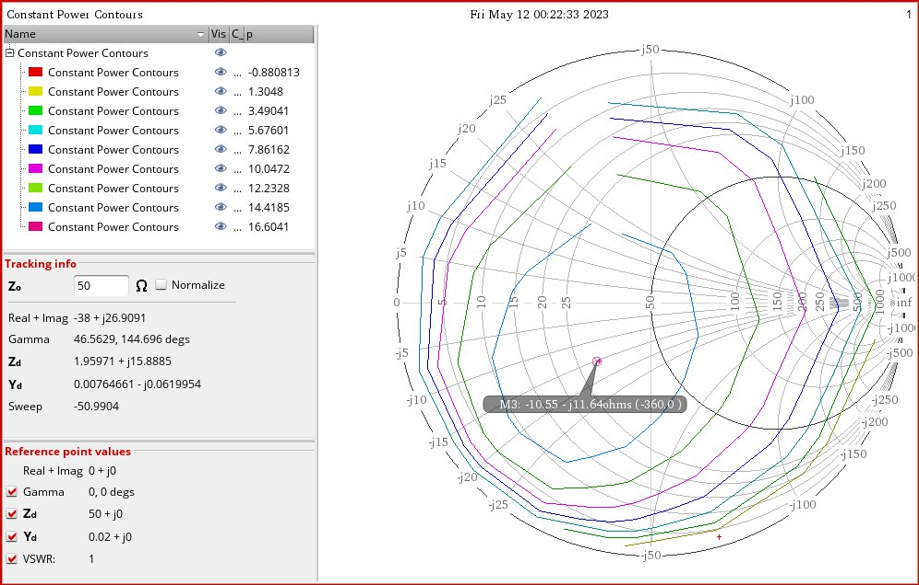
Load pull contours @15GHz
Fig.17. Load pull contours without Matching network.
Fig.18. Load pull contours with Matching network.

Slide 24
Comments in load pull contours
Note that the load pull contours is almost constant at different frequencies.
The maximum power available after output matching is less than the maximum power available without output matching, and this makes sense as the losses at the output affects the maximum power available from the amplifier.
Some techniques here are applied to increase the P1dB even above the maximum value available, as biasing the balun with large resistor and a cap. As this decrease the even order distortion and common mode signals, also biasing the gate of the cascode by large resistor and a cap. Increases the linearity of the amplifier as it equalizes the swing among the 2 MOSFETs in the stack, by these techniques we are able to get high P1dB even higher than the available with basic biasing.

Slide 25
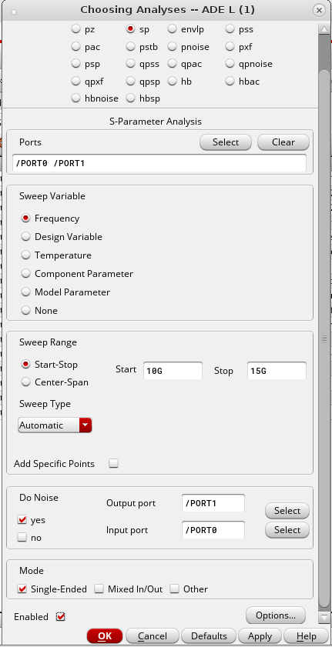
S-parameter Analysis
Single stage testbench to calculate:
S11
S22
Gain
NF
K stability factor
Fig.19. SP analysis setup.

Slide 26
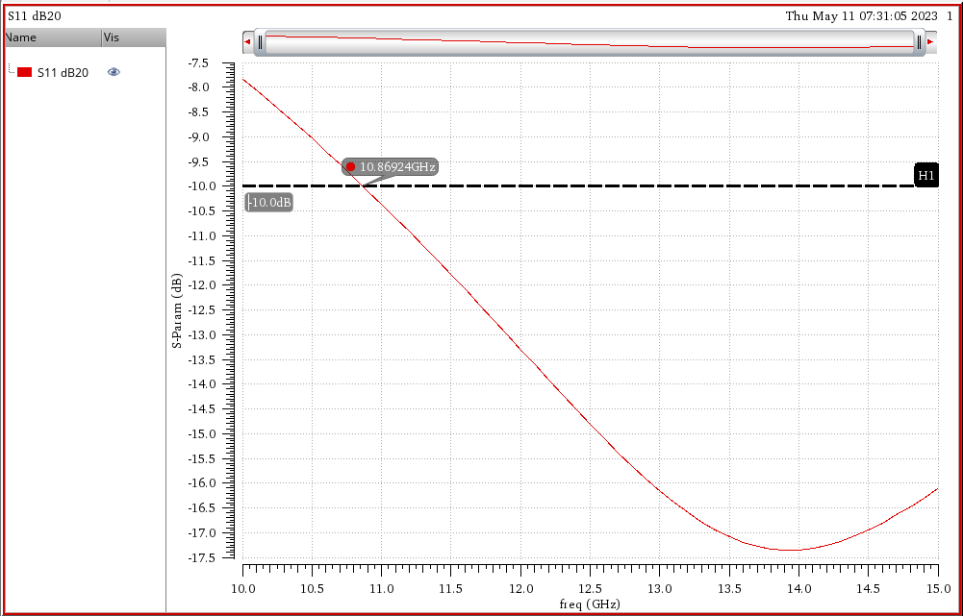
S11
Good input matching, S11 is below -10dB in the required band.
Also the performance around the band is very good as the i/p matching is below 10dB from around 10.5GHz.
Fig.20. S11.

Slide 27
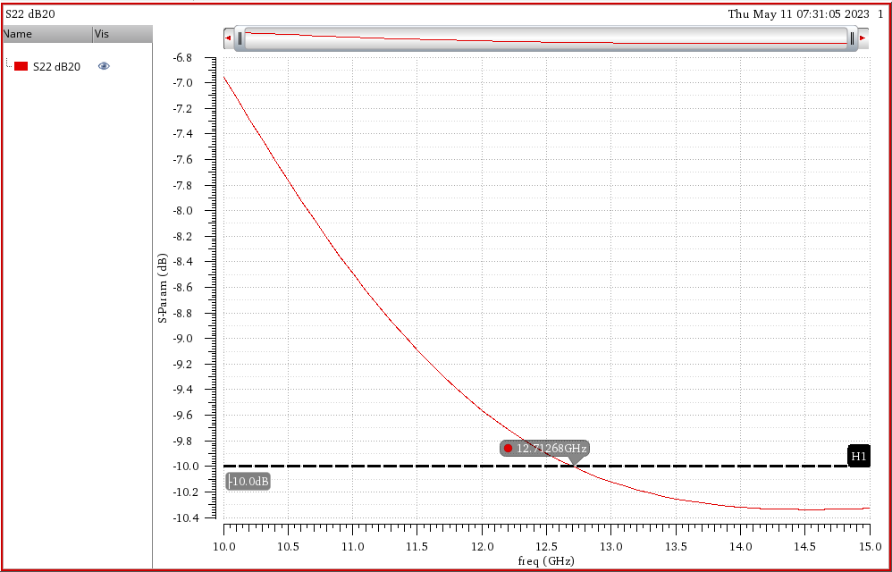
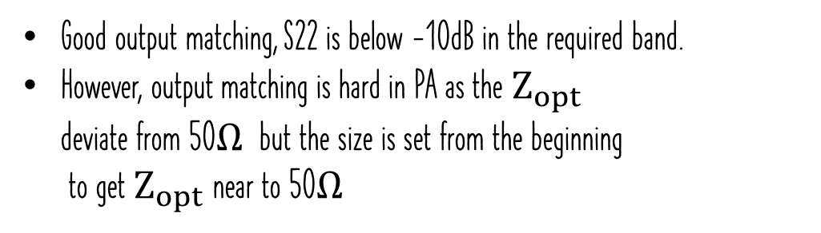
S22
Good output matching, S22 is below -10dB in the required band.
However, output matching is hard in PA as the $Z_{opt}$ deviate from 50$Ω$ but the size is set from the beginning to get $Z_{opt}$near to 50$Ω$
Fig.21. S22.

Slide 28
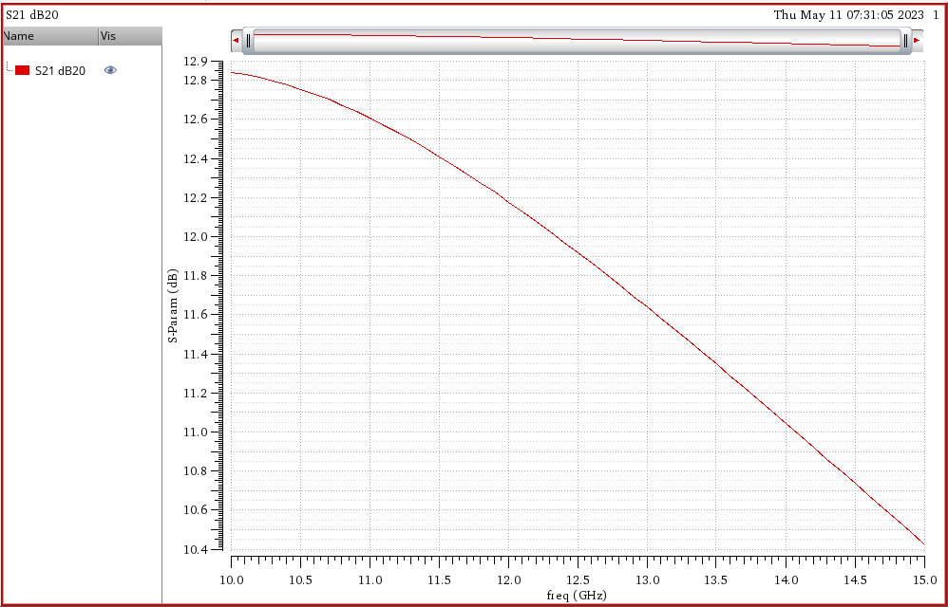
S21
S21 is achieving the gain requirement(10dB) all over the band.
Acceptable gain flatness in the required band (around 1dB).
Note that this high gain improves the PAE, makes it near to the basic efficiency.
Fig.22. S21.

Slide 29
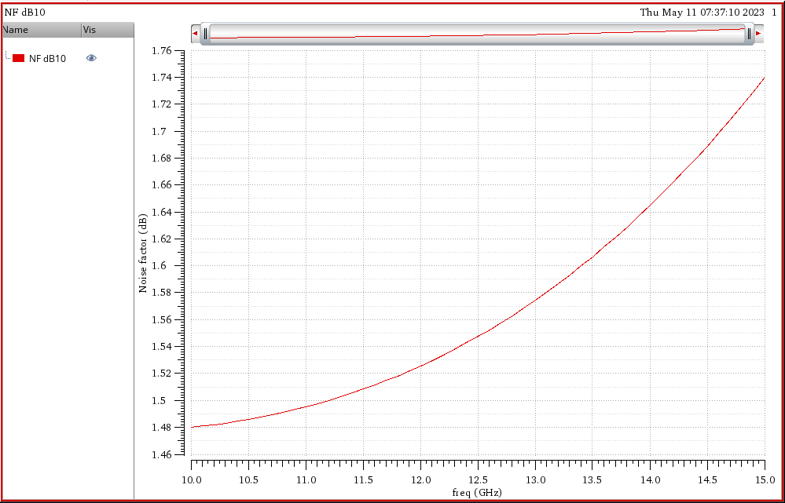
NF
The NF of the power amplifier is very good, although it isn’t as important as linearity, as the signal is already high so the SNR is very good and won’t be affected easily by the noise of the amplifier.
However, the NF is so good as the current consumed in the PA is high.
Fig.23. NF.

Slide 30
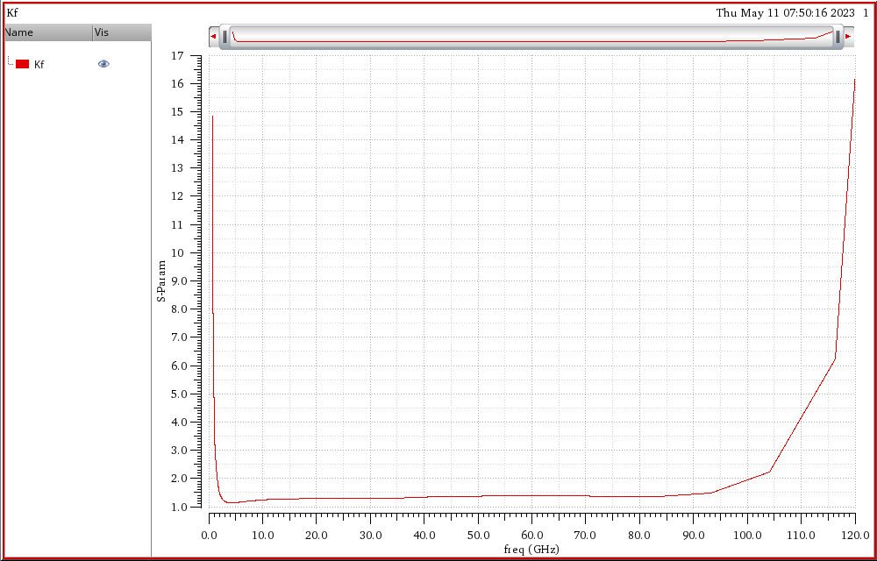
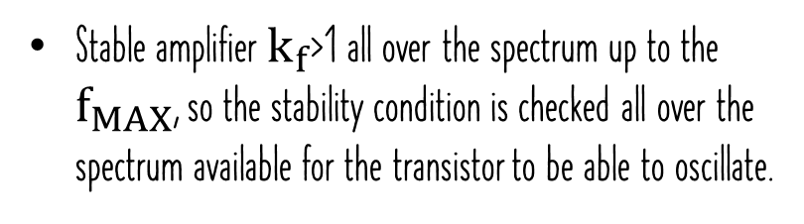

Kf
Stable amplifier $k_{f}$>1 all over the spectrum up to the $f_{MAX}$, so the stability condition is checked all over the spectrum available for the transistor to be able to oscillate.
Fig.24. $K_{f}$.

Slide 31
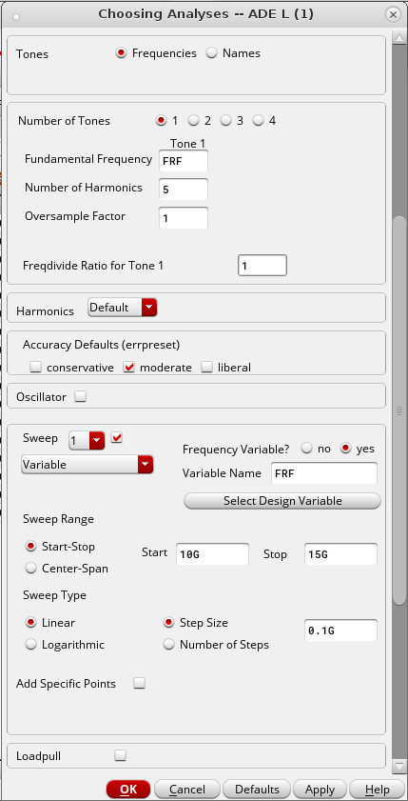
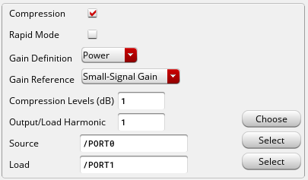
OP1dB setup
HB analysis is used to calculate OP1dB:
Input port tone frequency = FRF , Of power=-30dBm
Fig.25. hb analysis setup.

Slide 32
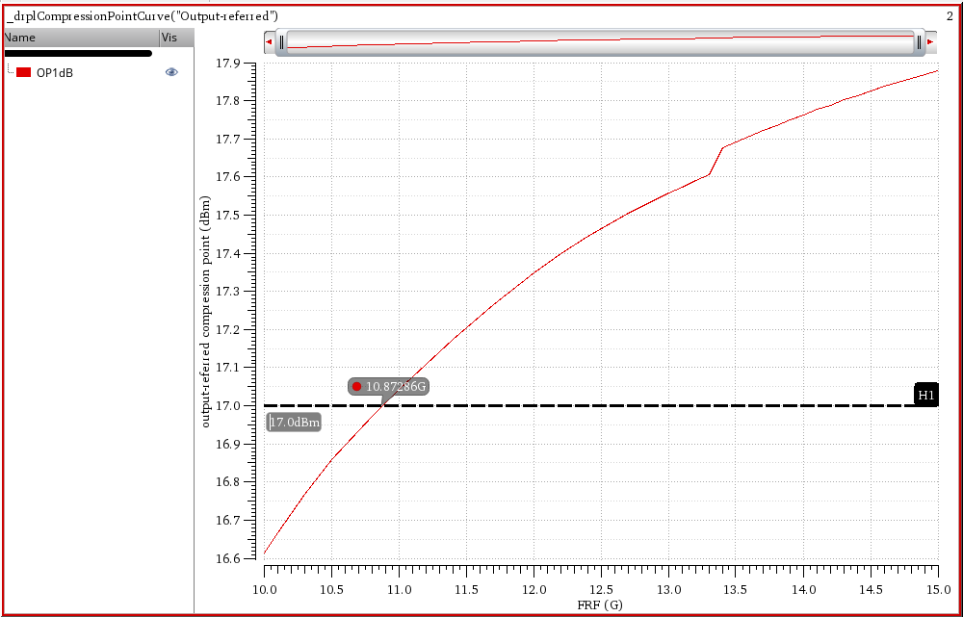
OP1dB
Very good OP1dB that achieving 17dBm across the whole range, also it’s achieving 17dBm around the required band, as 17dBm is achieved from around 11GHz
Fig.26. OP1dB.

Slide 33
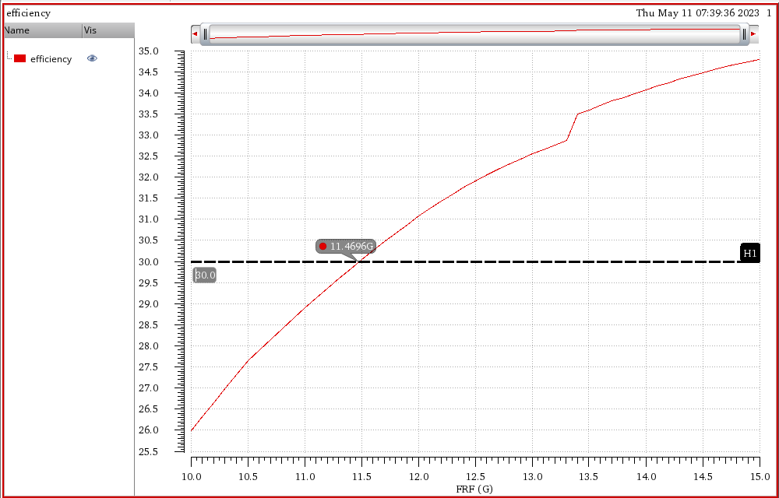
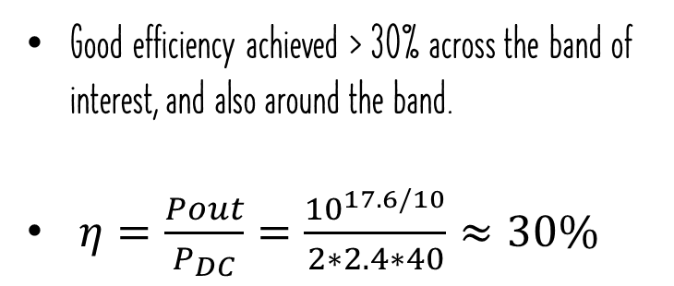
Efficiency at P1dB
Good efficiency achieved > 30% across the band of interest, and also around the band.
$η=\frac{Pout}{P_{DC}}=\frac{{10}^{17.6/10}}{2∗2.4∗40}≈30\%$
Fig.27. Efficiency.

Slide 34
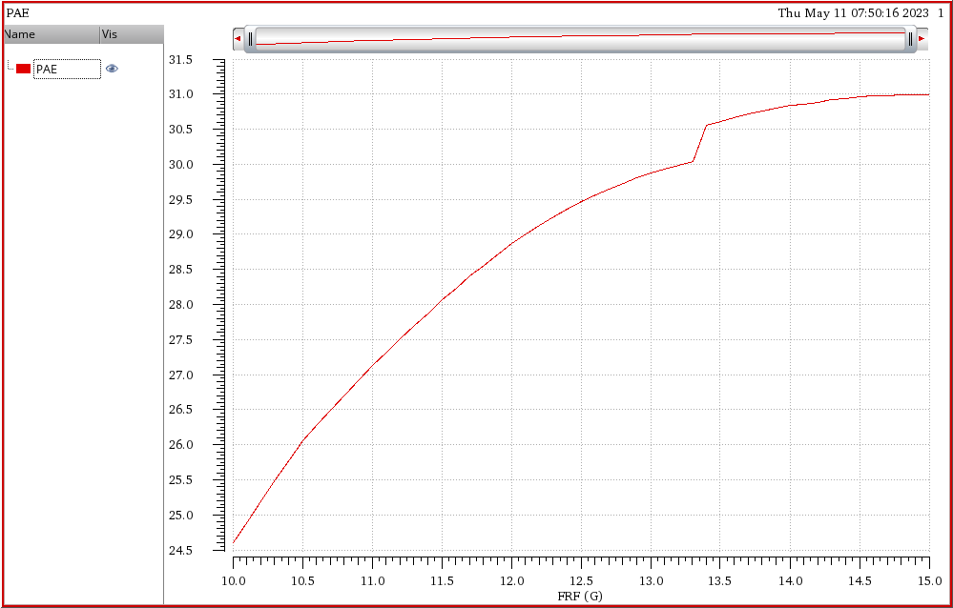
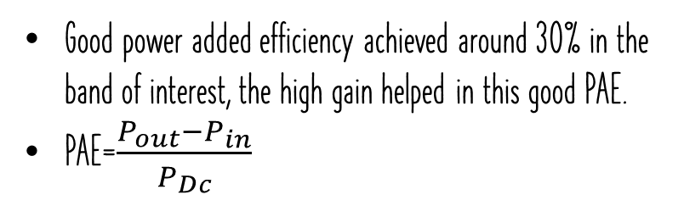
PAE at p1db
Good power added efficiency achieved around 30% in the band of interest, the high gain helped in this good PAE.
PAE=$\frac{P_{out}−P_{in}}{P_{Dc}}$
Fig.28. PAE.

Slide 35
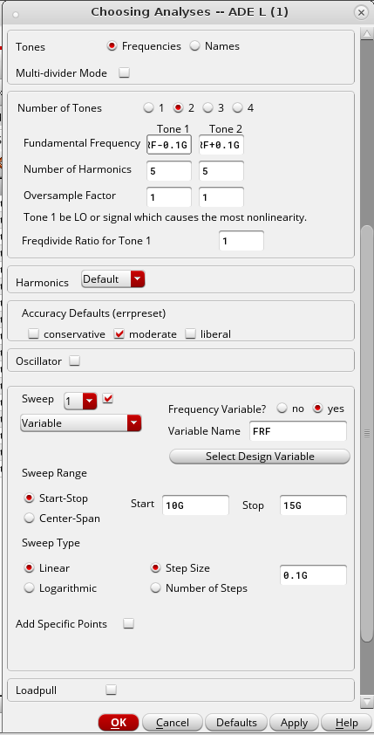
OIP3 vs RF frequency
HB analysis is used to calculate OIP3:
Input port 2 tone frequencies:
1st tone: FRF-delta
2nd tone: FRF+delta
Where delta=0.1GHz
Each tone of power=-30dBm
Fig.29. hb analysis setup.

Slide 36
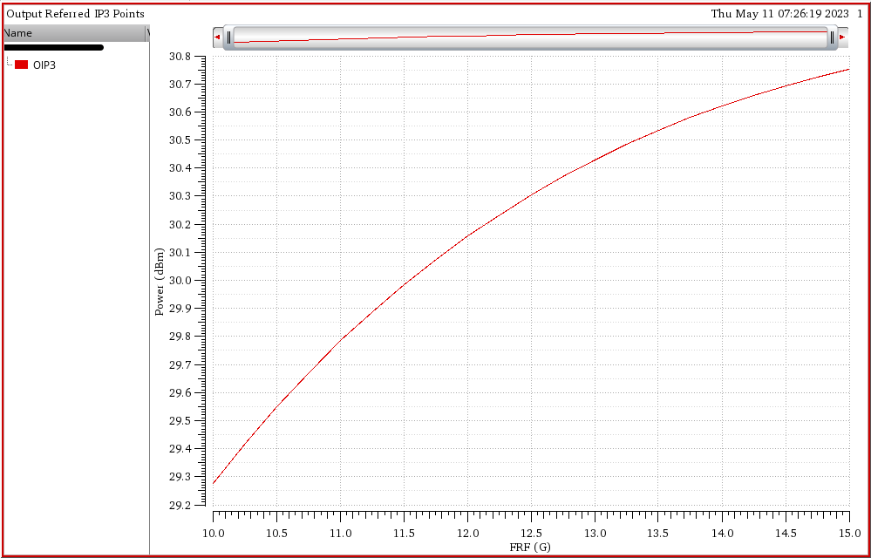
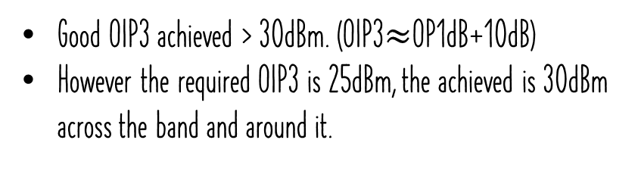
OIP3 vs RF frequency
Good OIP3 achieved > 30dBm. (OIP3$≈$OP1dB+10dB)
However the required OIP3 is 25dBm, the achieved is 30dBm across the band and around it.
Fig.30. OIP3.

Slide 37
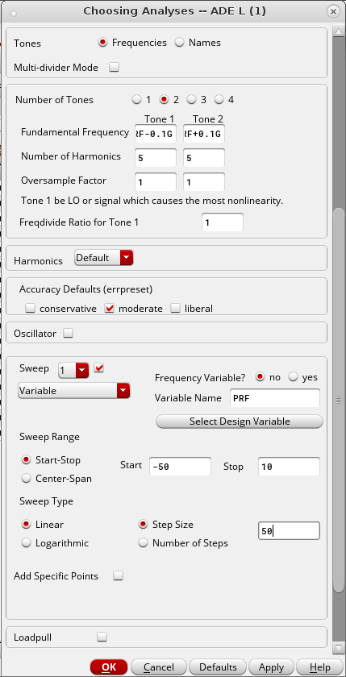
OIP3 vs p_{OUT}
HB analysis is used to calculate OIP3:
Input port 2 tone frequencies:
1st tone: fRF-delta
2nd tone: fRF+delta
Where delta=0.1GHz
Sweep input power from -50 to 10dBm
Fig.31. hb analysis setup.

Slide 38
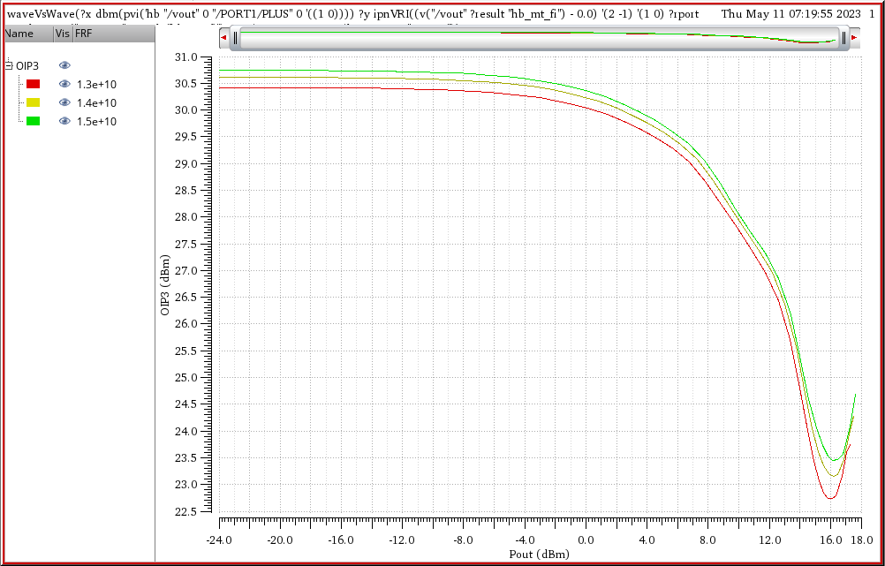
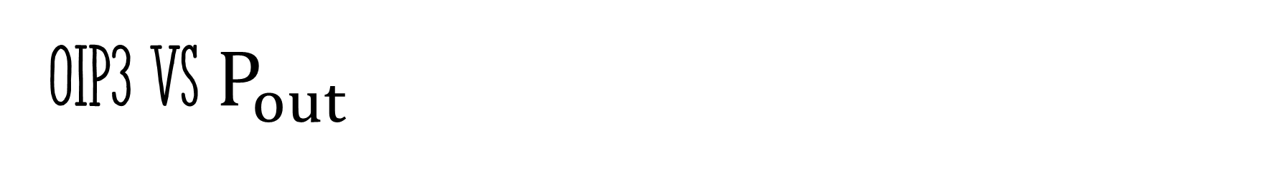
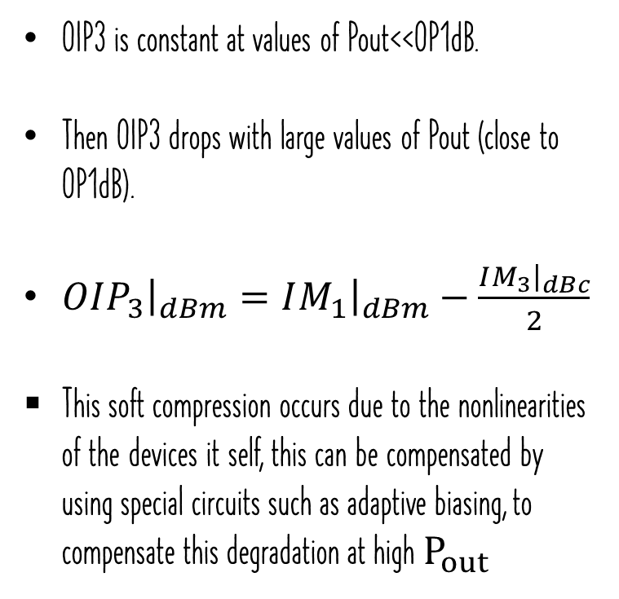
OIP3 vs $P_{out}$
OIP3 is constant at values of Pout<<OP1dB.
Then OIP3 drops with large values of Pout (close to OP1dB).
$OIP_{3}{\left.​\right|}_{dBm}=IM_{1}{\left.​\right|}_{dBm}−\frac{IM_{3}{\left.​\right|}_{dBc}}{2}$
This soft compression occurs due to the nonlinearities of the devices it self, this can be compensated by using special circuits such as adaptive biasing, to compensate this degradation at high $P_{out}$
Fig.32. OIP3 Vs Pout.

Slide 39
Summary of the results
 | Spec. | Achieved | Unit
S21 Vs RF | 10 | 10.5 | dB
NF Vs RF | -- | 1.7 | dB
OP1dB Vs Rf | 17 | 17.5 | dBm
OIP3 Vs RF | 25 | 30 | dBm
S11 Vs RF | -10 | -16 | dB
S22 Vs RF | -10 | -10 | dB
OIP3 Vs Pout | --- | 23 | dBm

Slide 40
Thanks!

