Slide 1

Advanced Database
Rawan H. Mourad
Mariam O. eldesoky
Khaled E. Hussein

Slide 2

Agenda
Data Warehouse
Data Cubes
Power BI

Slide 3

Introduction
Advanced Database is a Data Warehouse that , with the integration of SQL Server Analysis Service and Power BI, provides some powerful insights for four main aspects of a fictitious bicycle manufacturer AdventureWorks Cycles.

Slide 4
Data Warehouse
Fact Tables

Slide 5
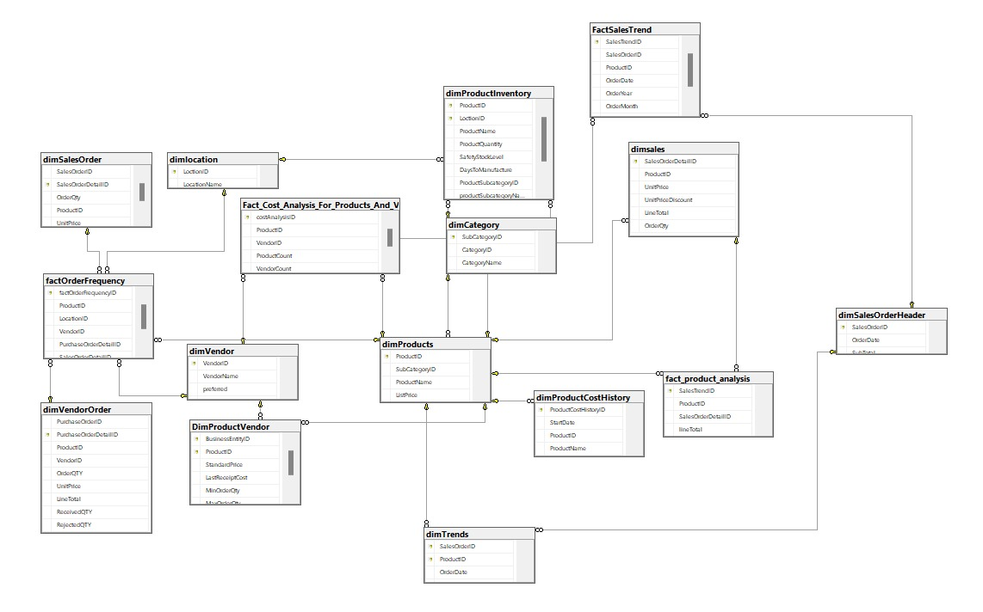
Data Warehouse Diagram

Slide 6
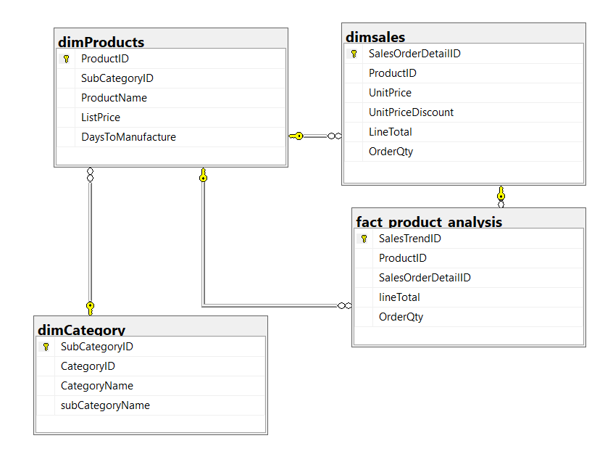
1) Product analysis
Description:
Determine the top-selling products and product categories.
Dimensions:
DimCategory
DimProduct
DimSales

Slide 7
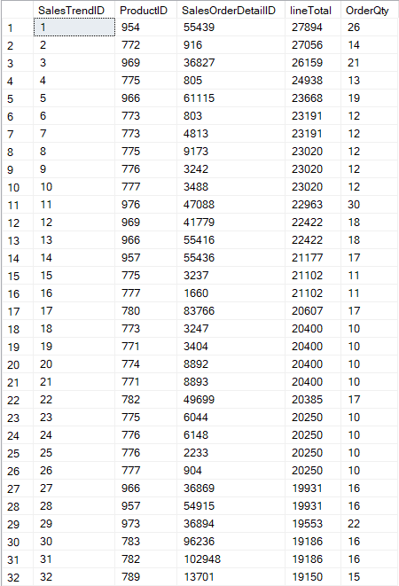
The output “factProductAnalysis” table

Slide 8
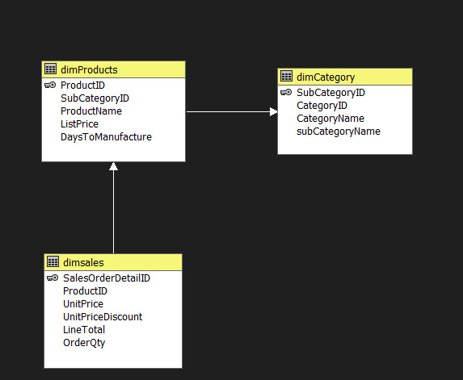
Cube of product analysis

Slide 9
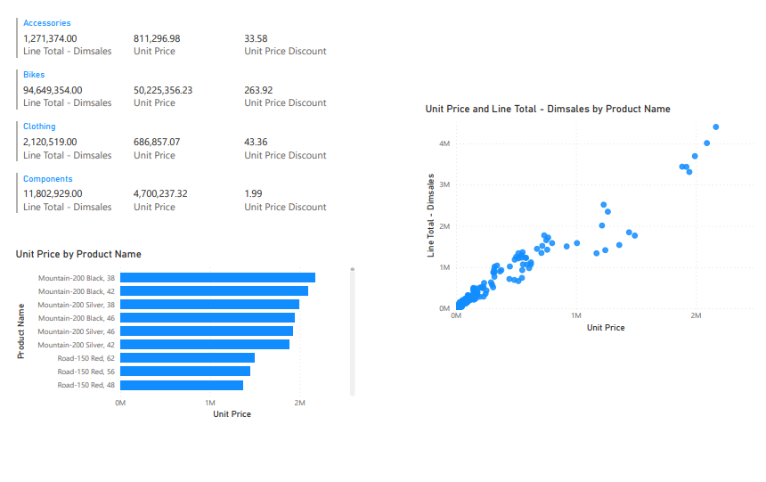
Power BI of product analysis

Slide 10
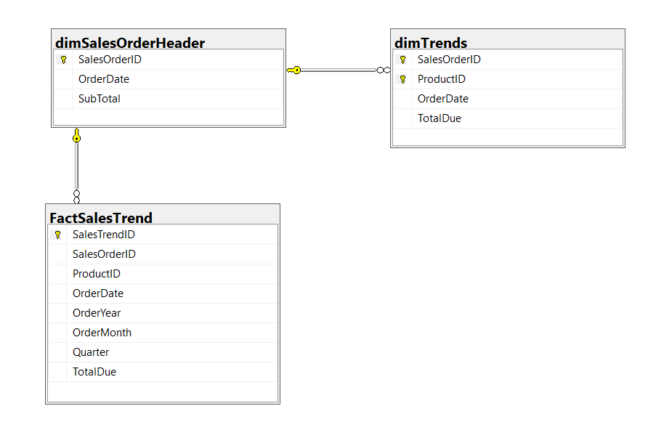
2) Sales Trends
Description:
Examine monthly and quarterly sales trends.
Dimensions:
DimSalesOrderHeader
DimTrends

Slide 11
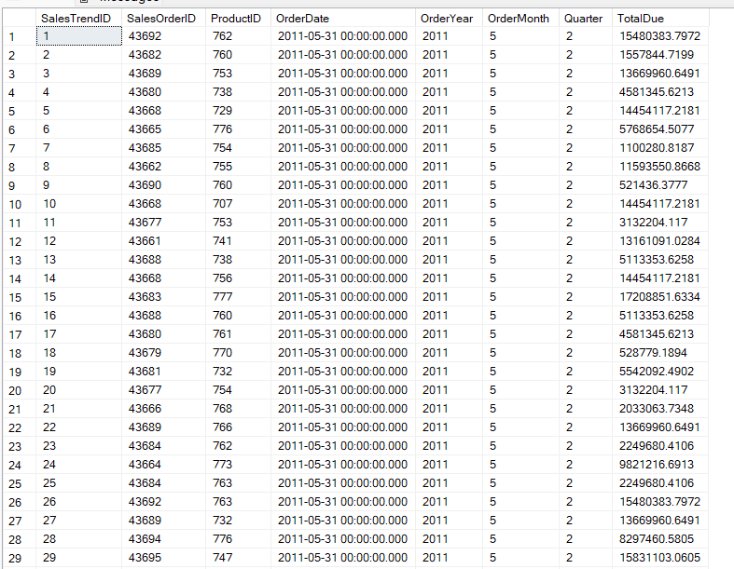
The output of “FactSalesTrend”

Slide 12
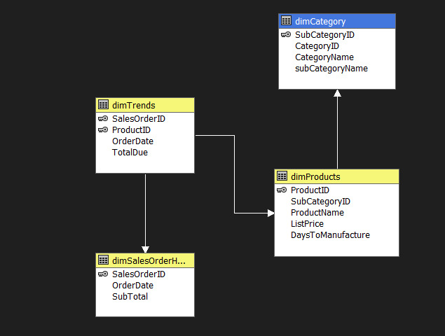
Cube of sales trend

Slide 13
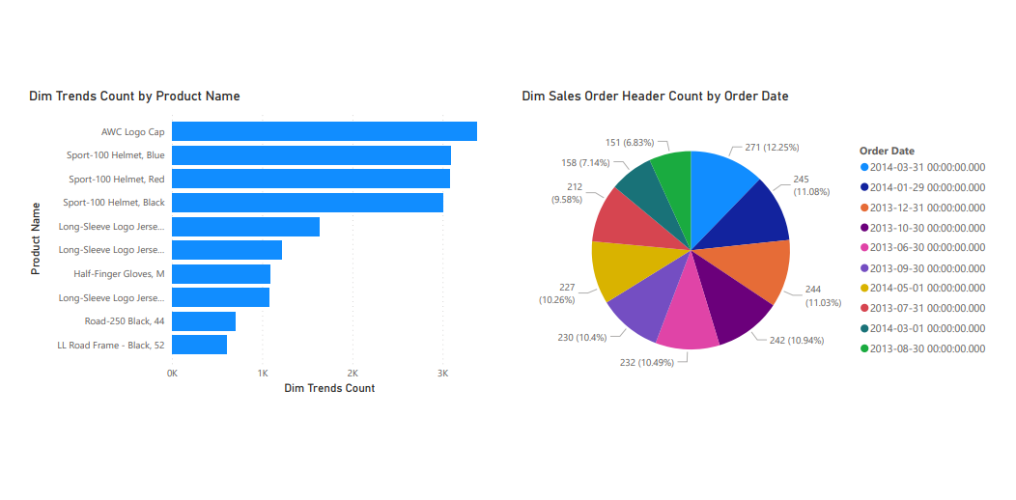
Power BI of sales trend

Slide 14
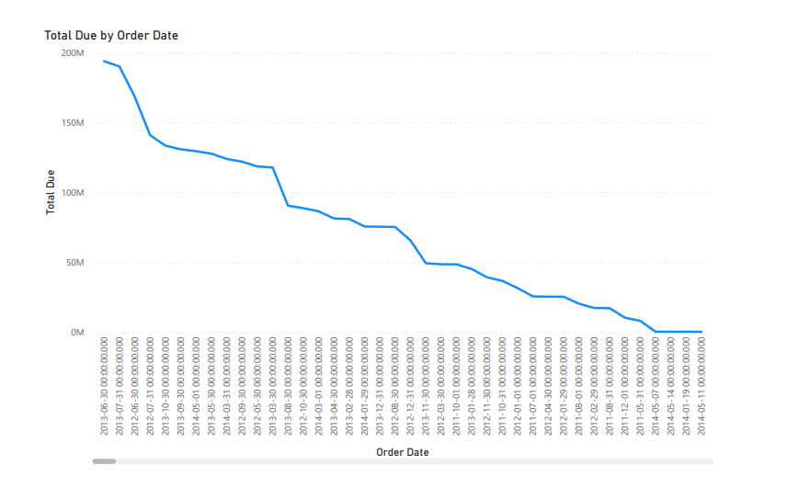
Power BI of sales trend

Slide 15
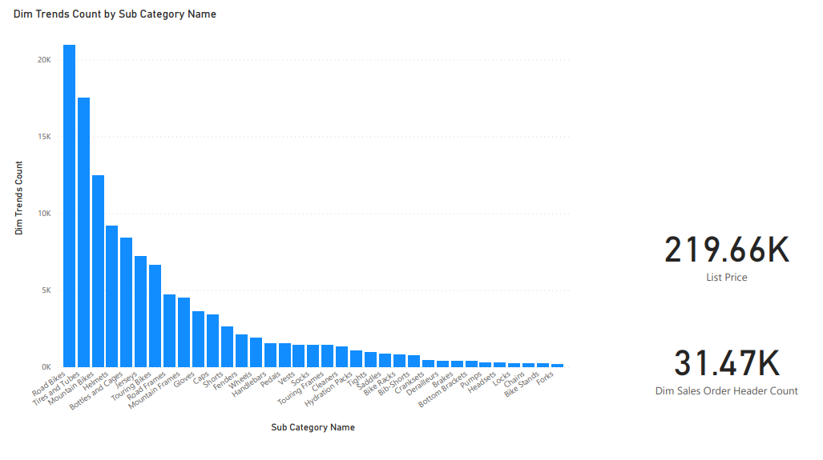
Power BI of sales trend

Slide 16
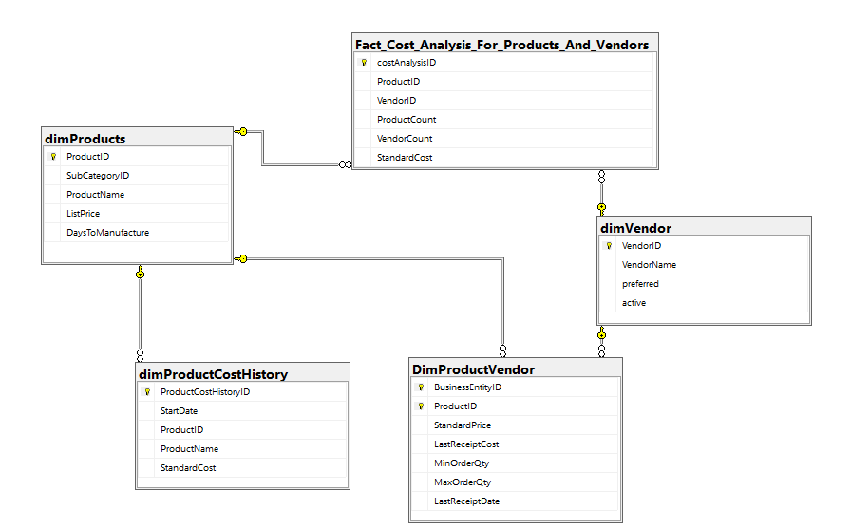
3) Cost analysis and negotiation
descriptions:
Analyze costs associated with different vendors and products. Negotiate favorable terms with vendors to optimize procurement costs.
Dimensions:
DimProductVendor
DimProductHistory
DimProduct
DimVendor

Slide 17
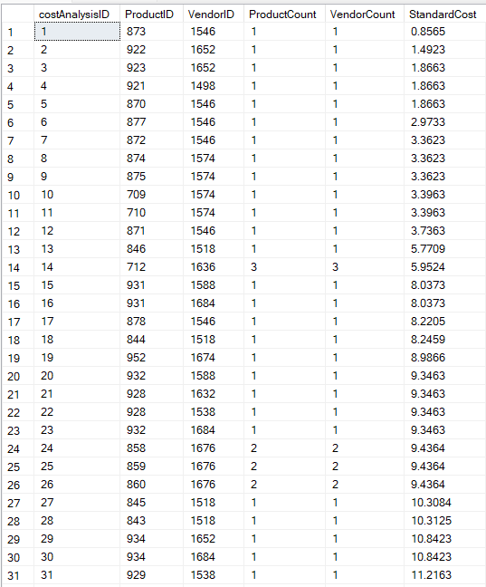
The output of “FactCostAnlysis”

Slide 18
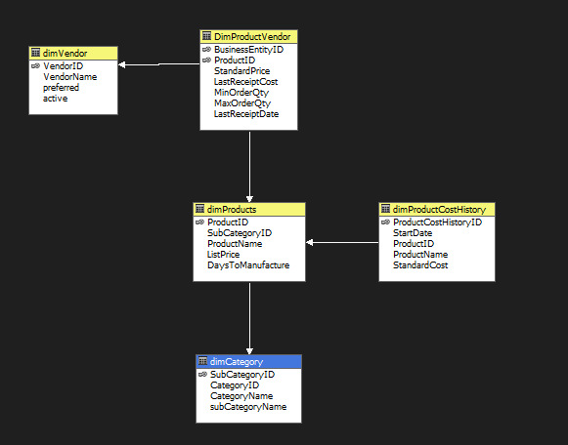
Cube of cost analysis for product and vendor

Slide 19
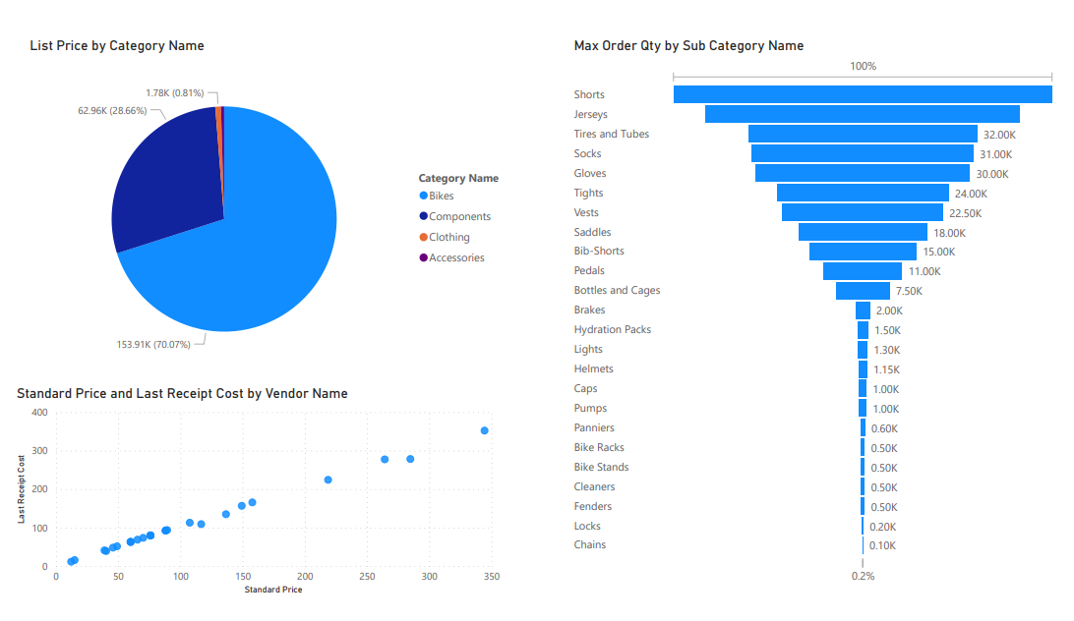
Power BI of cost analysis

Slide 20
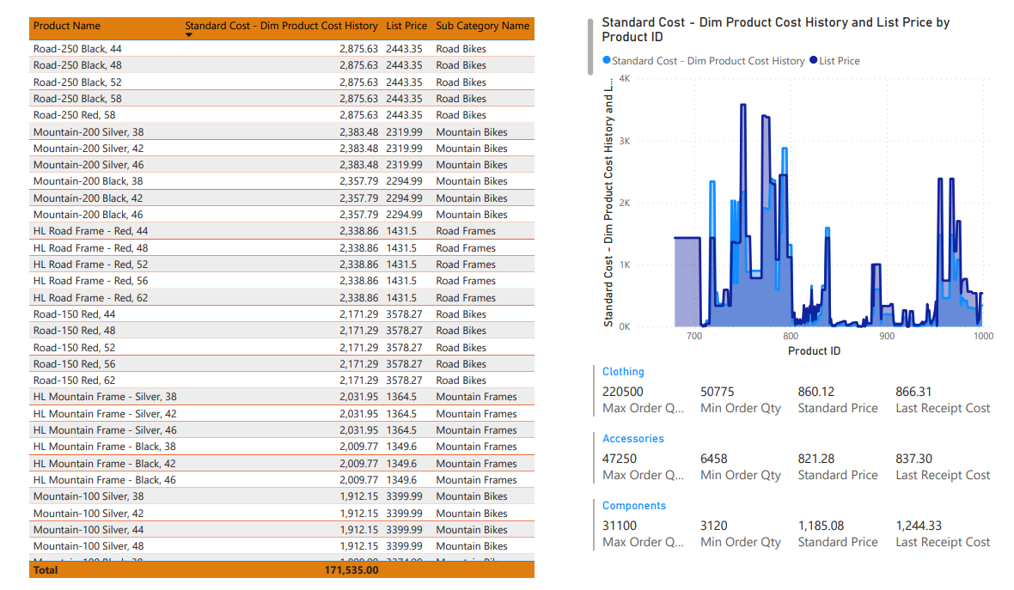
Power BI of cost analysis

Slide 21
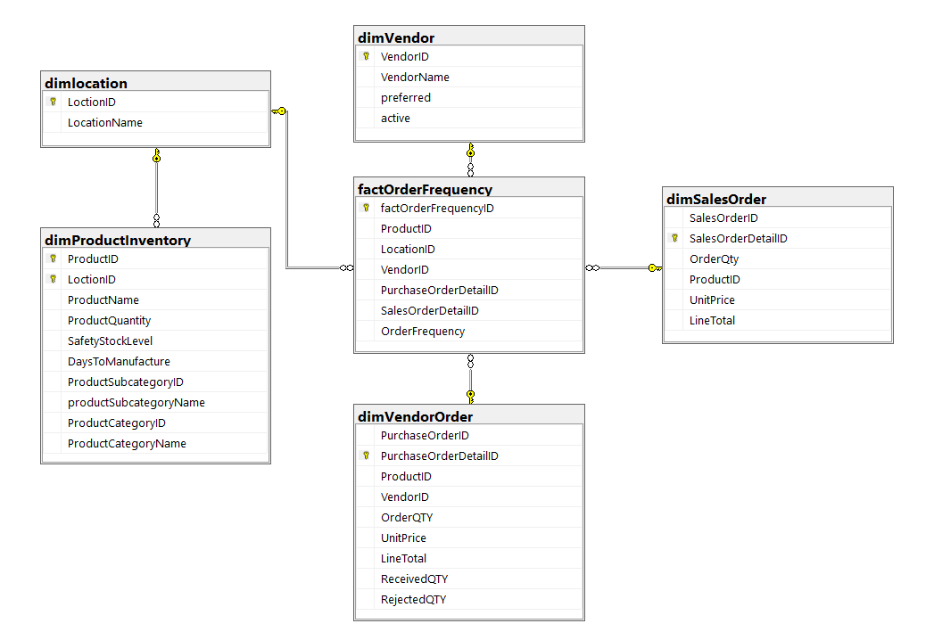
3) Order Frequency
description:
Determine the order frequency for various products and suppliers. Identify opportunities to optimize order quantities and frequencies
Dimensions:
DimLocation
DimProductInventory
DimVendor
DimVendorOrder
DimSalesOrder

Slide 22
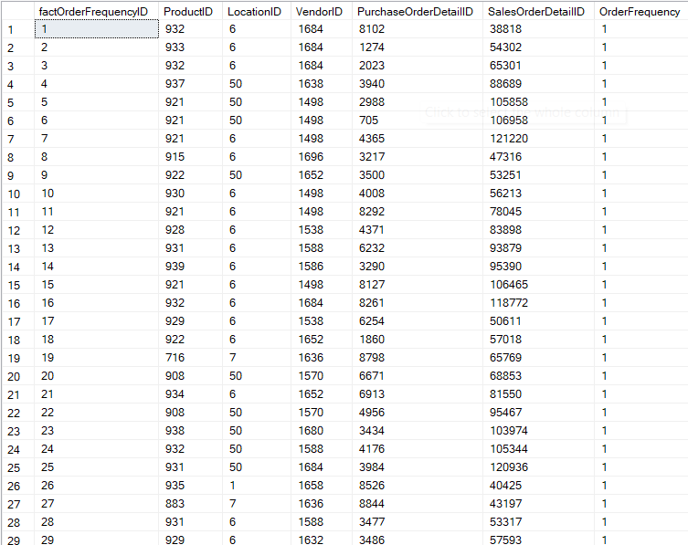
The output of “FactOrderFrequency”

Slide 23
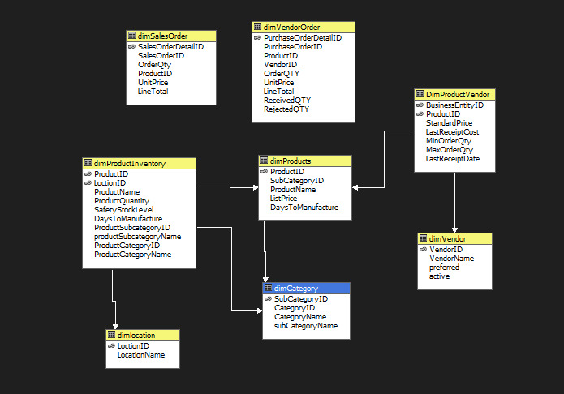
Cube of Order Frequency

Slide 24
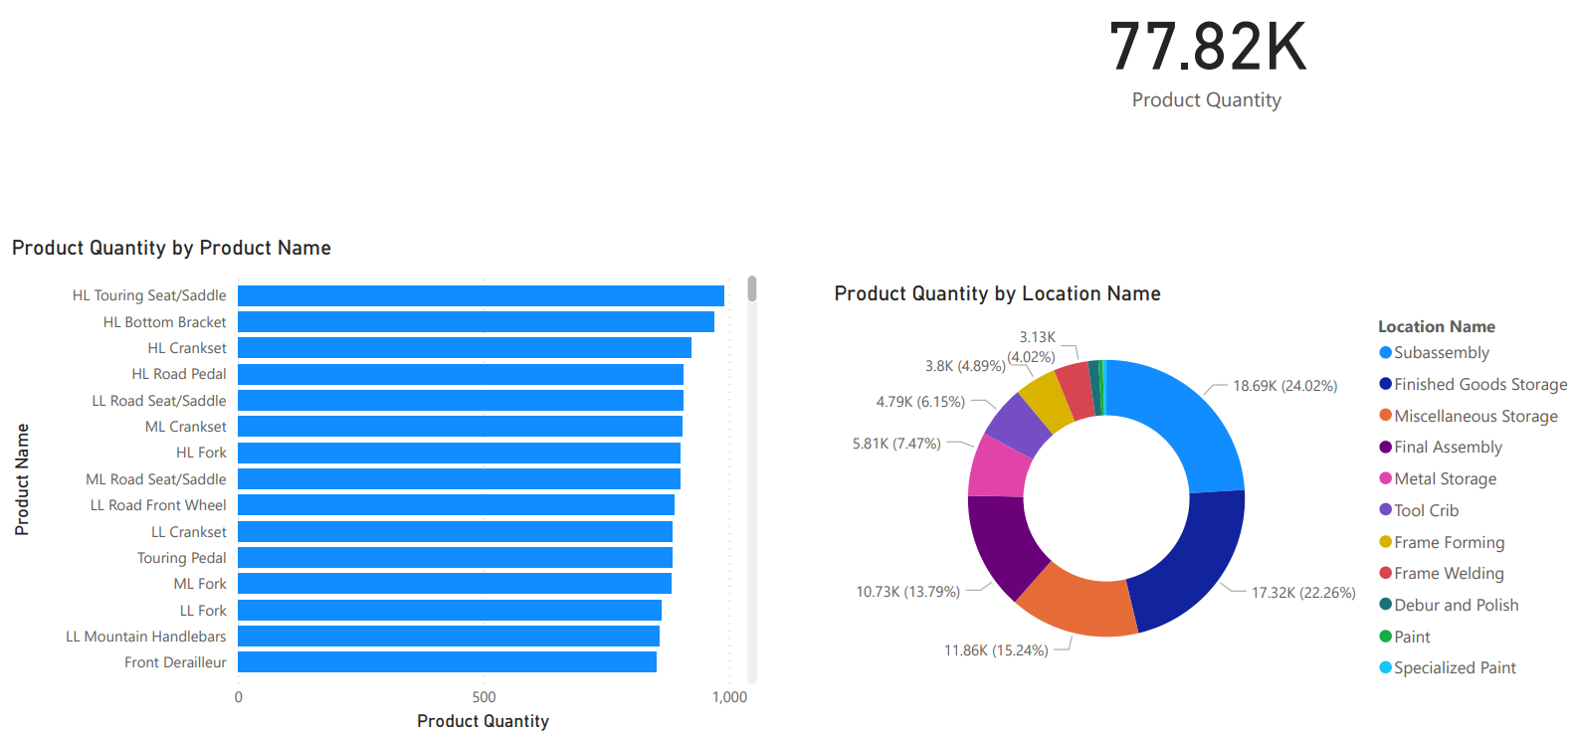
Power BI of Order Frequency

Slide 25




Thank you

