Slide 1
Graduation Project DEPI
TITLE : Space Missions Analysis From 1957 to Feb,2024
Track : Data Analysis (Power BI Engineer)
Name : Khaled Ramadan Ali

Slide 2
Content
Introduction
Problem Definition & Questions
Collecting Data
Data Cleaning
Normalization and data modeling
Create measures (KPIs)
Data visualization (Dashboards)
Contact

Slide 3
Introduction
Who am I ?
My name is Khaled Ramadan, a fourth-year student in Space Technology, specializing in space navigation and satellites. I am also an intermediate-level Data Analyst with skills in Power BI, Python, Excel, and SQL. I am passionate about leveraging data for insights and decision-making.

Slide 4
Analysis Steps
Problem Definition
rich dataset from (nextspaceflight.com) that includes all the space missions since the beginning of Space Race between the USA and the Soviet Union in 1957! It has data on the mission status (success/failure), the cost of the mission, the number of launches per country, and much more. There's so much we can learn from this dataset about the dominant organisations and the trends over time . Needed to analyze this data to make it clear and calculates KPIs.

Slide 5
Questions
Top countries by number of missions and cost of missions
Top companies by number of missions and cost
Top rocket used by number of and cost of missions
% of missions status by countries and companies and dates
% rocket status by countries and companies
Years and months have high missions which launching
Which hour of the day has high missions launching

Slide 6
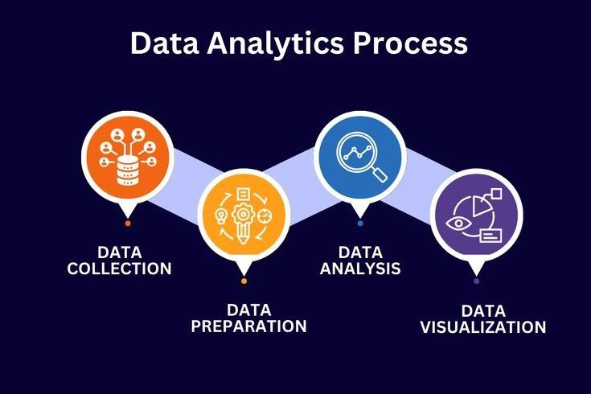
Analysis Steps
Data Collection
Initially, I began by collecting the data, using Kaggle as a source for additional datasets. I found that this data would help me better understand the space race among countries, space agencies, and the companies participating in this competition.

Slide 7
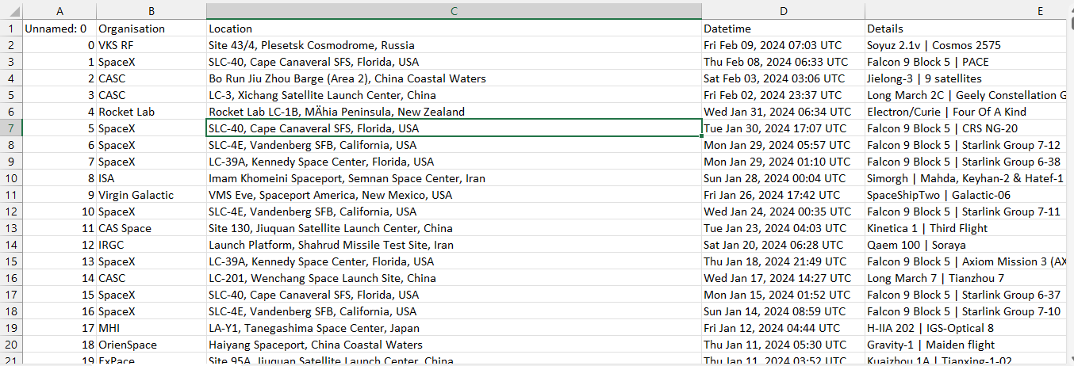
Analysis Steps
Data Cleaning
when I downloaded the data the data not been cleaning start to clean the data on (power Query) inside power BI. The features in this editor helped me to clean data with the good way to help me in analysis

Slide 8
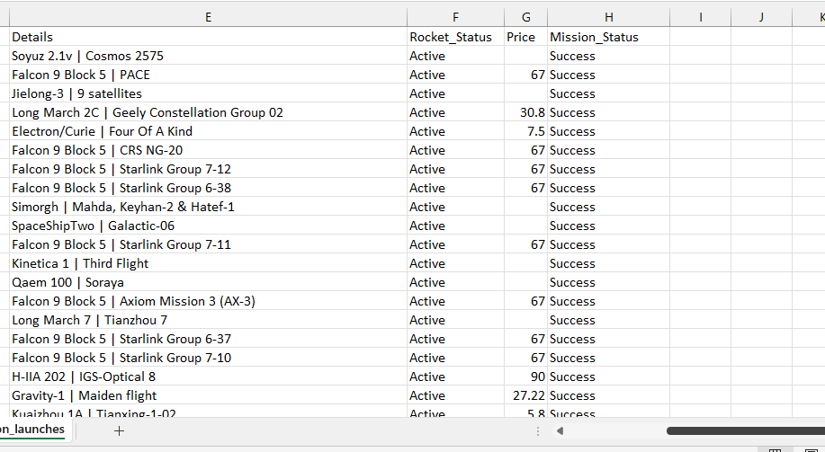
Data Cleaning before cleaning

Slide 9
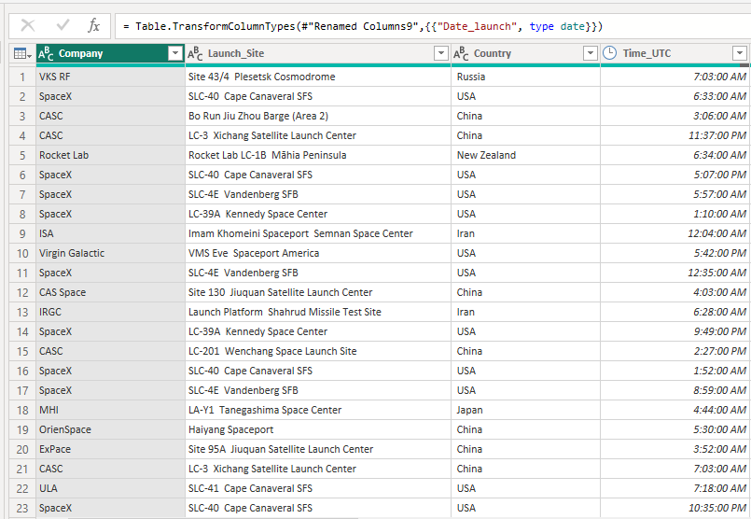
Data Cleaning After cleaning

Slide 10
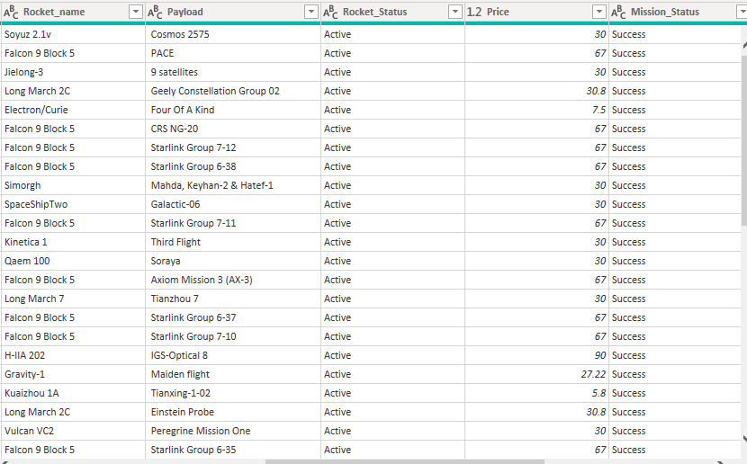
Data Cleaning After cleaning

Slide 11
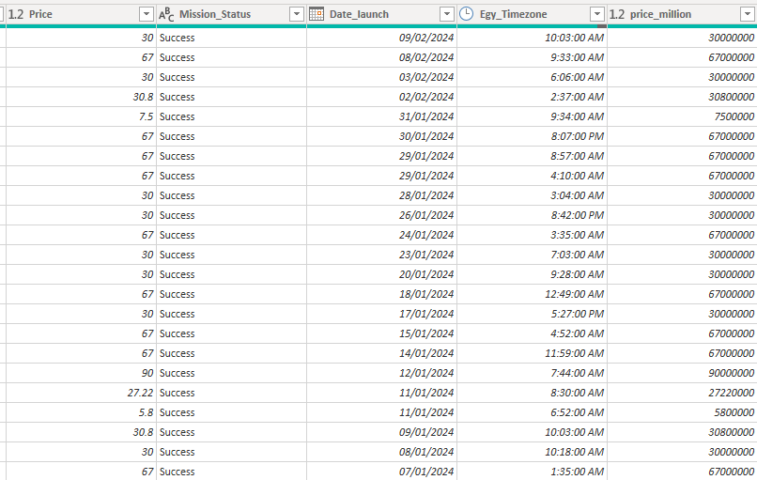
Data Cleaning After cleaning

Slide 12
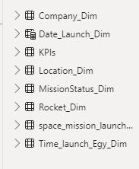
Analysis Steps
Normalization and Data Modeling
After cleaning the data, I proceeded to normalize it and created a star schema model. Using the main cleaned dataset, I developed dimension tables to organize the information effectively and establish relationships, optimizing the data structure for analysis. The model contain the “space_mission_launchs” as fact table and 6 dimensions tables and another table “KPIs” for measures using DAX equations.

Slide 13
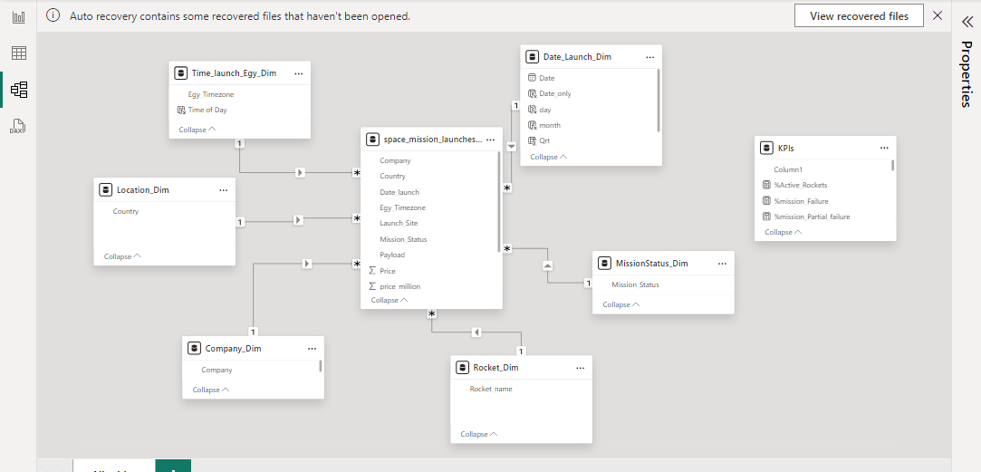
Normalization and Data Modeling

Slide 14
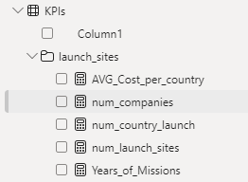
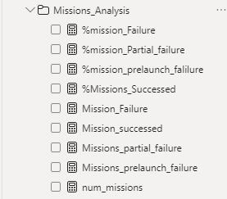
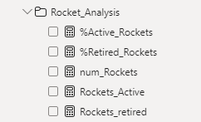
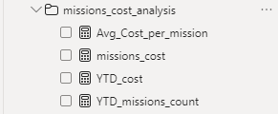
Analysis Steps
Measures
After cleaning and modeling the data this time for creating measures to discover the data from mathematical view. The KPIs table contain four folders inside it on for

Slide 15
Analysis Steps
Data Visualization
To visualize the insights from the dataset, I developed a series of dashboards ”7 Dashboards ” that highlight key performance indicators and trends specific to the project's scope. The visualizations include interactive charts, graphs, and metrics that provide an in-depth look at the data, such as the performance of different categories, trends over time, and comparisons between various dimensions. These dashboards are designed to make the data accessible and actionable for stakeholders, enabling them to explore and understand the information intuitively

Slide 16
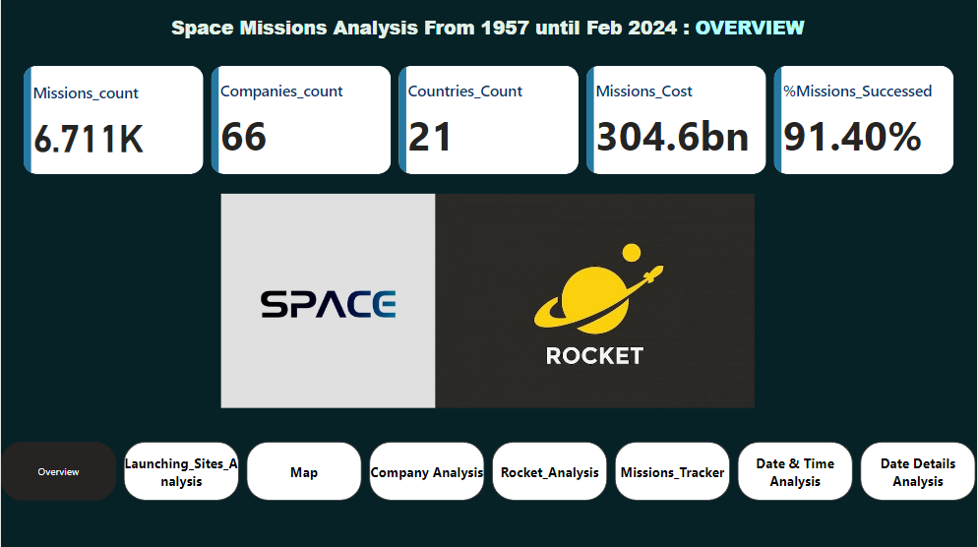
Data Visualization
Overview

Slide 17
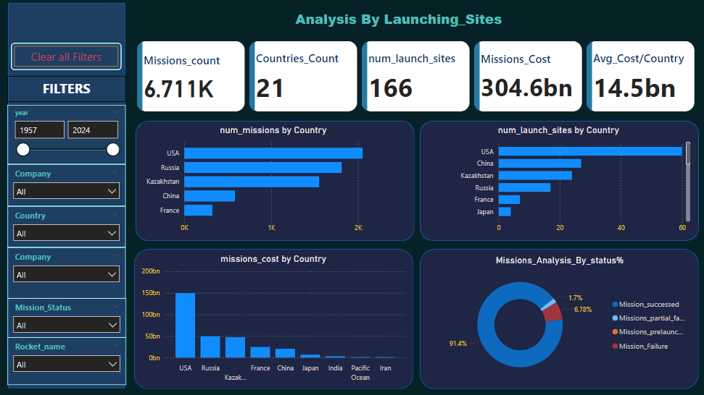
Data Visualization
Launching Sites Analysis

Slide 18
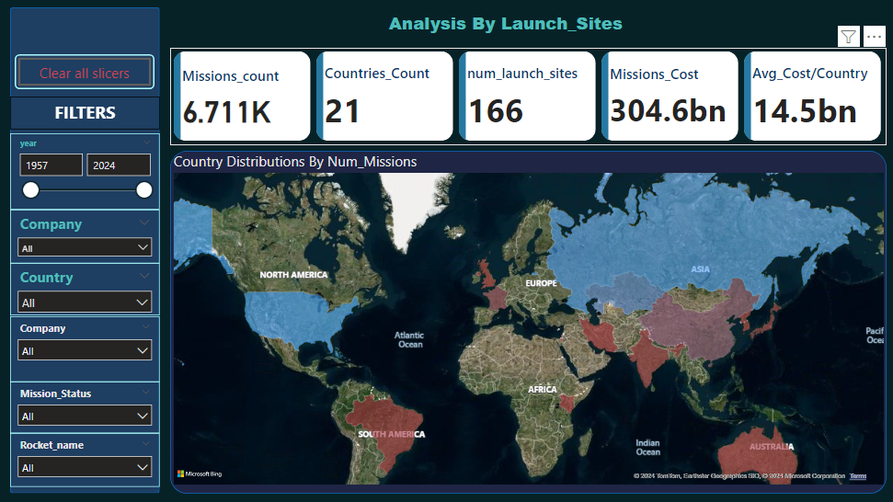
Data Visualization
Map

Slide 19
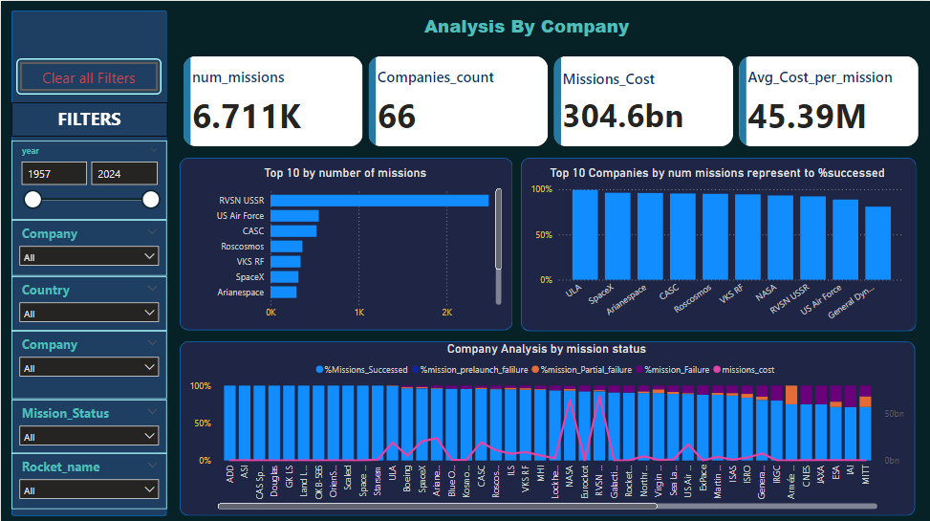
Data Visualization
Company Analysis

Slide 20
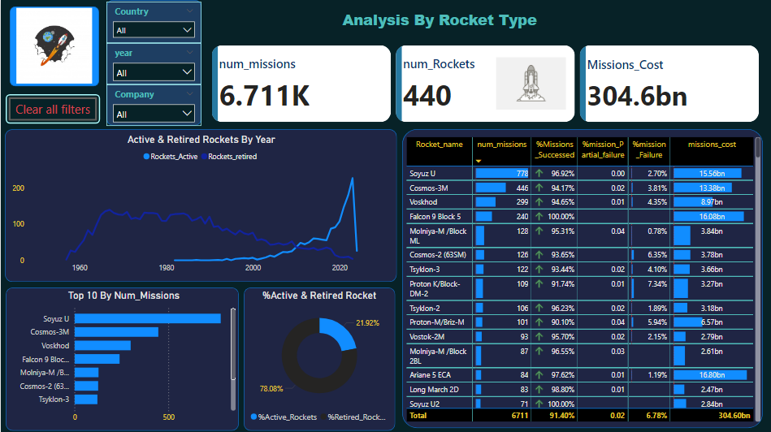
Data Visualization
Rocket Analysis

Slide 21
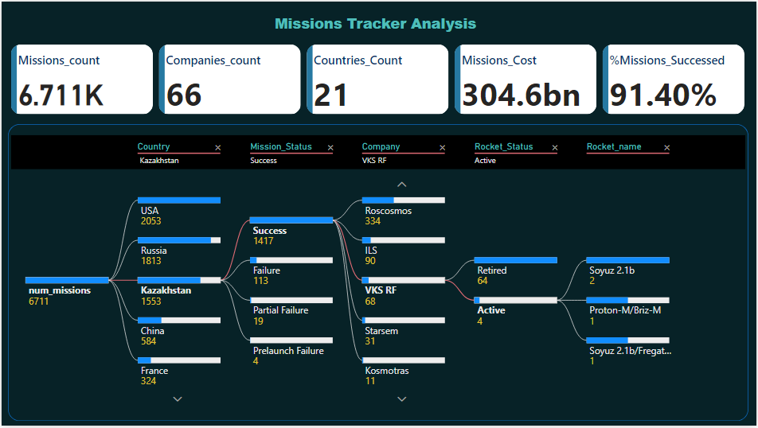
Data Visualization
Mission tracker Analysis

Slide 22
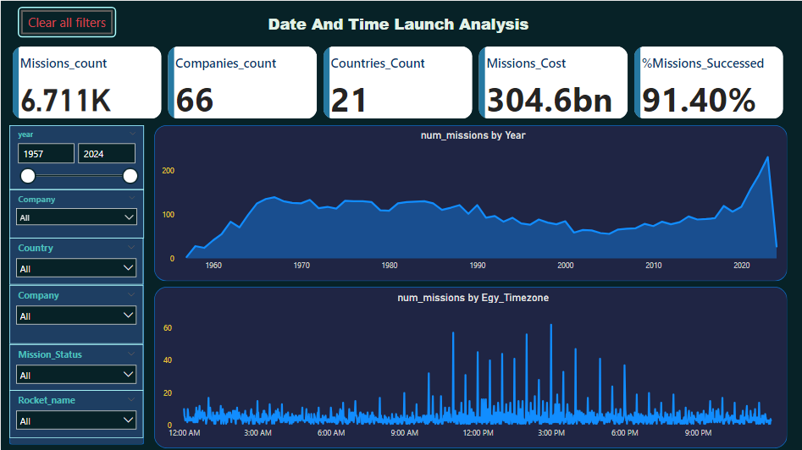
Data Visualization
DATE & TIME Analysis

Slide 23
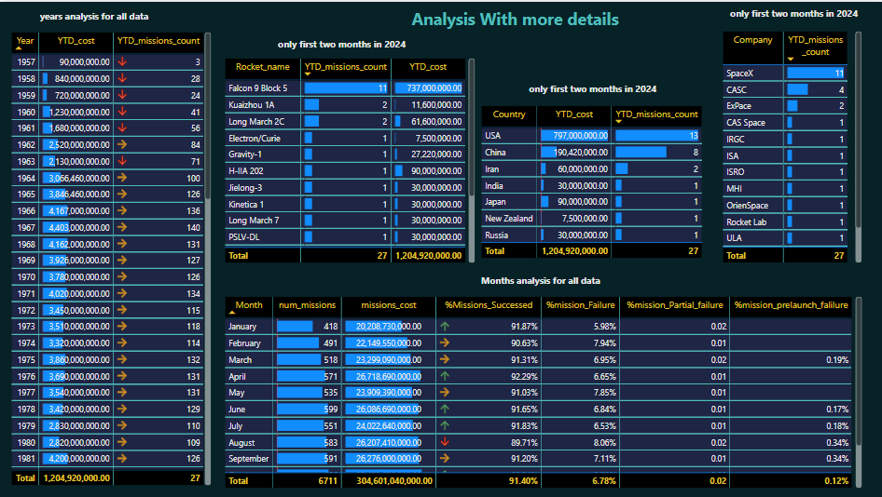
Data Visualization
Date Analysis Details

Slide 24
Contact
Linkedin : https://www.linkedin.com/in/khaled-ramadan-143610232/
Github repo for mor details : https://github.com/Khaled22ramadan/Internship_Graduation_project_-Space-Missions-Analysis-From-1957-to-Feb-2024-

