Slide 1
Library Management System < A Python-based console application >

Slide 2
Presented By: 1- Khaled Ramadan 2- Esraa Ahmed Under Supervision of: NEURONETIX

Slide 3
Outlines
1. Introduction
2. Features of the System
3. System Architecture
4. Core Components
5. Reporting Functionality
6. Challenges & Solutions
7. Future Improvements
8. Conclusion

Slide 4
Introduction

Slide 5
Introduction
Project Objective: To develop a Library Management System that automates key library operations such as managing books, members, and tracking borrowed books with due dates and late fees.
Purpose:
To simplify library management by replacing manual processes with an automated solution.
To enable better tracking of book availability and overdue books.
To provide useful reports such as overdue books, popular books, and borrowing history.

Slide 6
Features of the System

Slide 7
Features of the System
1. Book Management:
Add new books to the library.
Update book details (title, author, genre).
Remove books from the system.
Display available and unavailable books.
2. Member Management:
Register new members.
Update member details.
Remove members from the system.
3. Borrowing & Returning:
Borrow books with automatic due date assignment (default: 14 days).
Return books and reset availability.
Track overdue books and calculate late fees.
4. Reporting:
List all borrowed books along with their due dates.
Identify and display overdue books.
Track and display the most popular books based on borrow count.

Slide 8
System Architecture

Slide 9
System Architecture
1. User Interaction
2. Core Components:
Book Class
Member Class
Library Class
3. Data Handling:
books.txt: Stores details of all books.
members.txt: Stores details of all registered members.
4. Main Functionality Flow

Slide 10
Core Components

Slide 11
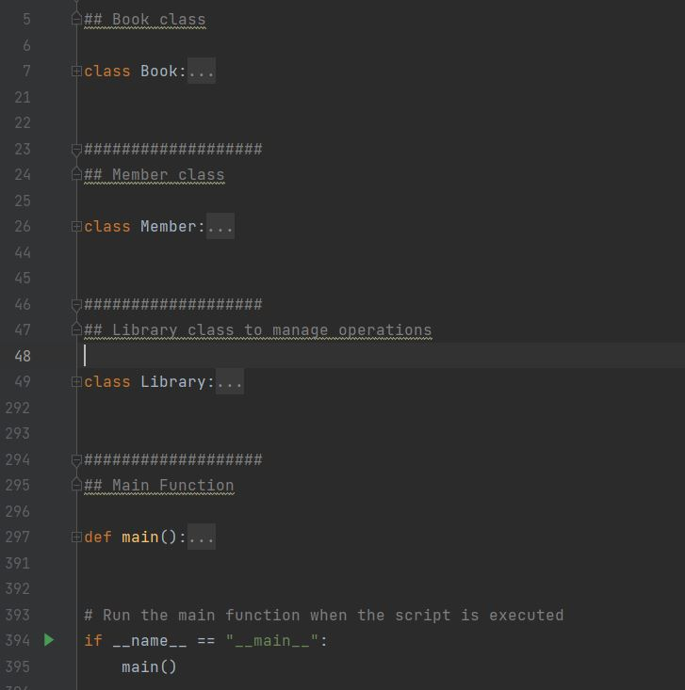
Core Components of the System
Class Design:
Book Class:
Attributes: book_id, title, author, genre, availability, due_date
Methods: __str__()
Member Class:
Attributes: member_id, name, borrowed_books
Methods: borrow_book(), return_book()
Library Class:
Attributes: books, members
Methods: add_book(), borrow_book(), return_book(),
list_overdue_books(), etc.

Slide 12
Key Features Demonstration

Slide 13
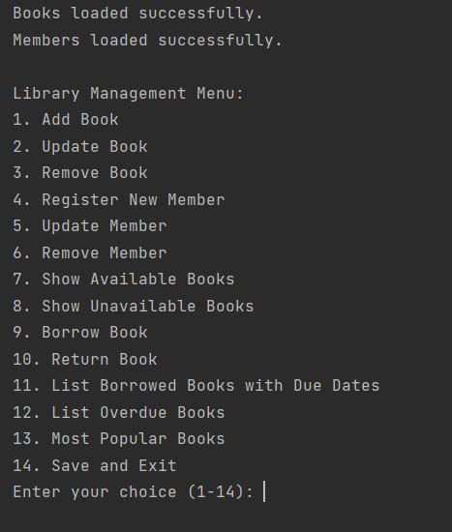
Key Features Demonstration

Slide 14
Reporting Functionality

Slide 15
Reporting Functionality
1. List Borrowed Books with Due Dates:
Displays all books currently borrowed by members.
Shows the book title, member name, and due date.
2. List Overdue Books:
Identifies books that have exceeded their due dates.
Displays the book title, borrower’s name, and how many days they are overdue.
3. Most Popular Books:
Tracks and lists the most frequently borrowed books.
Displays the book title, author, and the number of times borrowed.

Slide 16
Challenges & Solutions

Slide 17
Challenges & Solutions
1. Challenge: Handling Due Dates and Late Fees:Problem: Calculating due dates for borrowed books and managing late fees for overdue books.Solution: Used Python's datetime module to manage due dates and calculate overdue periods for books.
2. Challenge: Data Persistence:Problem: Ensuring that the system saves data (books, members) even after the program is closed.Solution: Implemented file-based storage using books.txt and members.txt to read/write data.
3. Challenge: Error Handling:Problem: Managing errors when a book or member does not exist, or when borrowing/returning fails.Solution: Added custom error messages and checks for invalid input, ensuring robust handling of exceptions.

Slide 18
Future Improvement

Slide 19
Future Improvement
1. Add a Graphical User Interface (GUI):
Move from a console-based system to a GUI using frameworks like Tkinter or PyQt for a more user-friendly experience.
2. Database Integration:
Replace file-based storage with a database system (e.g., SQLite or MySQL) for more efficient data management, better scalability, and more complex querying options.
3. Notifications for Overdue Books:
Implement a notification system (e.g., email reminders) to alert users when their books are overdue.
4. Advanced Search Options:
Add more detailed search functionality, allowing users to filter books by author, genre, availability, or due date.

Slide 20
Conclusion

Slide 21
Conclusion
Summary:
The Library Management System simplifies library operations by managing books, members, and borrowing processes.
Key features include book management, member registration, due date tracking, and reporting (borrowed books, overdue books, popular books).
What Was Learned:
Improved skills in Python programming, file handling, and object-oriented design.
Gained experience with data management and handling real-world constraints like due dates and late fees.
Future Enhancements:
Plan to add a GUI, improve reporting, and integrate a database for better performance and scalability.

Slide 22
Thank You!

