Slide 1
Introduction
CHAPTER 5 / SOFTWARE IMPLEMENTATION
Intelligent Decision Support System
with Predictive Analytics
for Small Businesses
Basira is a web platform that turns small-business records into dashboards, forecasts and AI-supported explanations for everyday decisions.
Khaled Waled Abdulakder (20236110155)
Supervisor: Dr. Hilal Al-Bayatti
01
Notes:
This presentation covers the implementation in Chapter 5 only. Basira combines operational data management with descriptive analytics, local forecasts and external language-model support. Introduce the implemented prototype and its purpose. Presenter and supervisor details come from the report cover.
Source: C:\Users\khale\OneDrive\المستندات\ASU\Modules\Graduation Project 2\Basira_Graduation_Report_Chapters_1_to_5.pdf
Chapter 5, 5.1 and opening of 5.2, pp. 38–39.

Slide 2
Technology and architecture
One Next.js application serves the interface and the business API.
Layer | Implementation
Interface | React, Next.js and Tailwind CSS
Server | TypeScript, Node.js and Route Handlers
Database | PostgreSQL 18 through Prisma ORM
External services | Google sign-in and NVIDIA AI
Local setup
Windows 11
Intel Core i7-12700H
16 GB RAM
1 TB SSD
The server validates requests and checks ownership before database access.
02
Notes:
The browser communicates with the Next.js server through HTTP(S). Server services apply domain rules and use the generated Prisma client with the PostgreSQL driver. Only the server contacts the database and NVIDIA. NVIDIA hosts inference, so the application does not need a local model-serving GPU. Hardware values describe the observed development machine, not benchmarked minimum requirements.
Source: C:\Users\khale\OneDrive\المستندات\ASU\Modules\Graduation Project 2\Basira_Graduation_Report_Chapters_1_to_5.pdf
Chapter 5, 5.1.1–5.2.2, pp. 38–41.

Slide 3
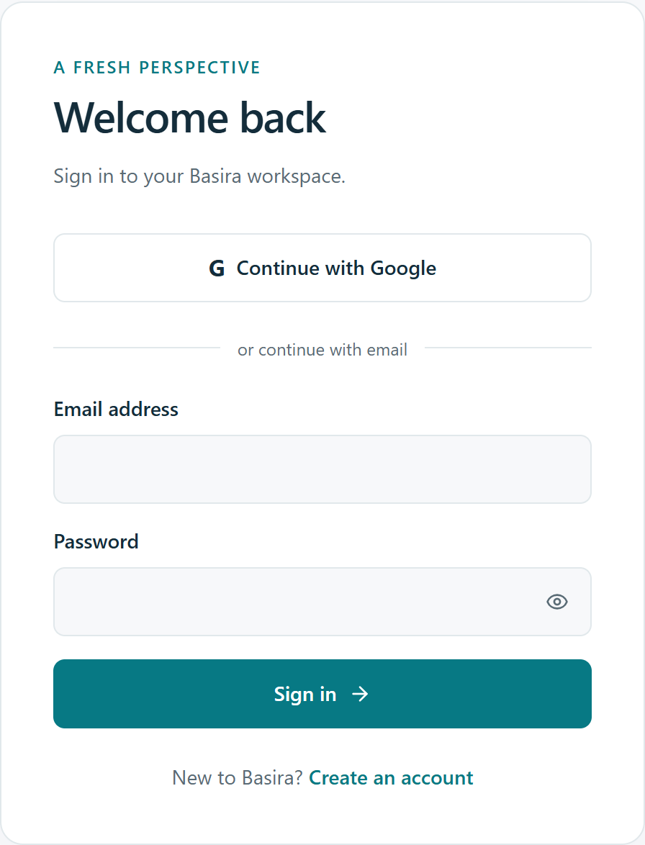
Access and business management
Secure sign-in
Email/password accounts and optional Google OAuth.
Separate business workspaces
Owners manage multiple businesses. Currency and timezone lock after financial data is saved.
Limited administrator access
Administrators manage account status and basic metadata. Private business records remain owner-only.
03
Notes:
The login screenshot is the original project interface shown in Figure 5.2. Passwords use salted scrypt hashes. Server checks reload current account status. Profile isolation applies to every business operation, including administrator requests. Currency/timezone locks preserve the meaning of historical values and are not cleared by deleting records. Google sign-in depends on configured OAuth credentials.
Source: C:\Users\khale\OneDrive\المستندات\ASU\Modules\Graduation Project 2\Basira_Graduation_Report_Chapters_1_to_5.pdf
Chapter 5, 5.2.4–5.2.5 and 5.2.16, pp. 43–44 and 56.

Slide 4
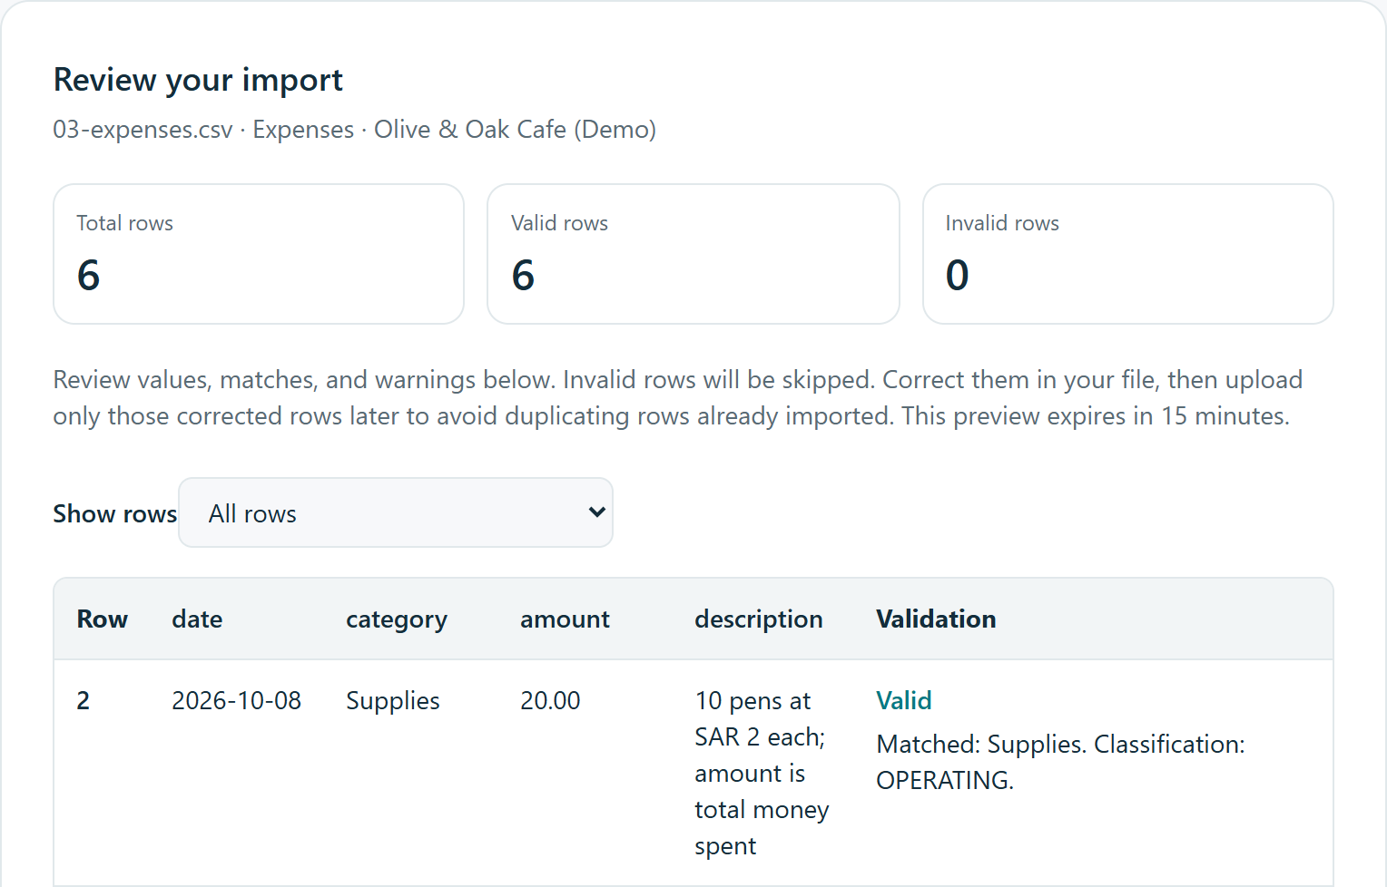
Data entry and file imports
Operational records
Products and services, sales, expenses, daily visits and customer feedback.
Review before saving
CSV and Excel templates support row validation, warnings and explicit confirmation.
Up to 1,000 rows per file
Maximum file size: 2 MiB
Synthetic demonstration data
04
Notes:
The screenshot is the upper section of the import preview in Figure 5.5, using synthetic data. Sales import names must match a unique active catalogue item. Expense categories must already exist. Daily visit totals include repeats and cannot be duplicated silently. Import confirmation revalidates current data and writes the accepted subset with history in one transaction. The original file is not retained.
Source: C:\Users\khale\OneDrive\المستندات\ASU\Modules\Graduation Project 2\Basira_Graduation_Report_Chapters_1_to_5.pdf
Chapter 5, 5.2.6–5.2.9, pp. 44–47.

Slide 5
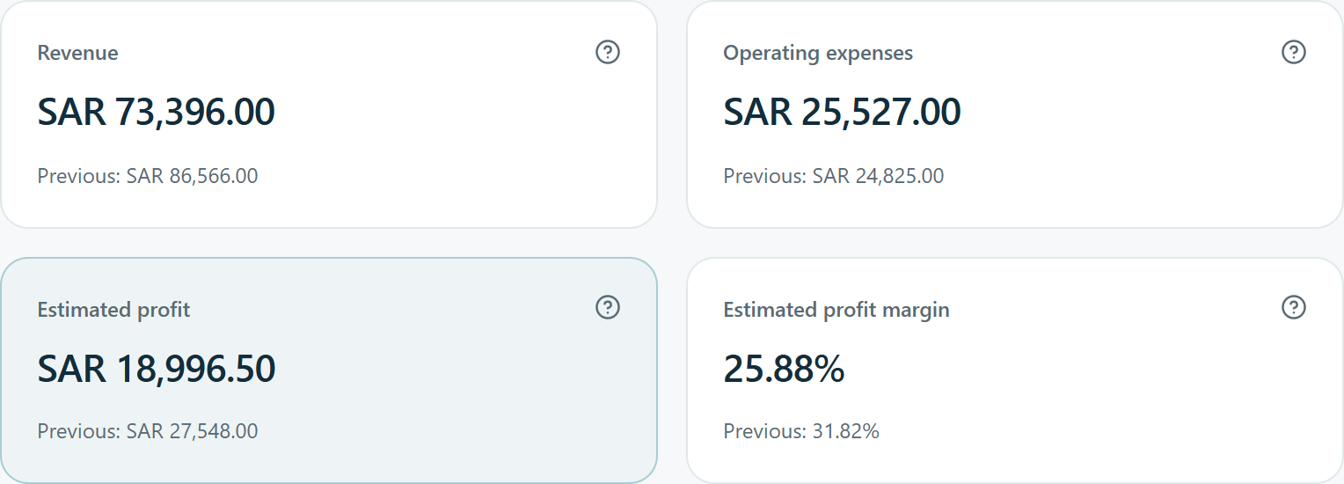
Dashboard and financial metrics
Revenue, spending, estimated profit, visits and sales trends.
Date filters compare equal reporting periods.
Demo cafe, 18 July–15 October 2026
Estimated profit
Revenue − known cost of goods sold − operating expenses
Inventory purchases are excluded from this deduction. Missing costs reduce reliability.
05
Notes:
The screenshot preserves the top four KPI cards of Figure 5.6 and uses synthetic demonstration records. Profit subtracts known historical cost of goods sold (COGS) and Operating expenses. Inventory purchases must not be deducted again, and Other spending appears separately. Unknown costs can overstate estimated profit. The full dashboard shows cost-data coverage, equal-period comparisons, customer coverage and trend charts. Visits represent visits, not unique customers.
Source: C:\Users\khale\OneDrive\المستندات\ASU\Modules\Graduation Project 2\Basira_Graduation_Report_Chapters_1_to_5.pdf
Chapter 5, 5.2.10, pp. 48–49.

Slide 6
Predictive analytics
Local Holt trend forecasting estimates revenue or total spending.
Forecast horizon | Minimum recorded history | Displayed result
Next 7 days | 14 dates | 7 daily estimates
Next 30 days | 60 dates | 30 daily estimates
Next 3 months | 180 dates | 3 full calendar-month totals
Historical holdouts and a simple baseline help assess forecast error.
Owners confirm gaps before treating them as zero. The model has no seasonal component.
06
Notes:
Forecasting runs locally and does not call an AI language model. Holt smoothing tracks level and trend. Parameters use training data only, with chronological holdouts of 7, 30 or 90 observations. Basira reports MAE and nonzero-only MAPE, with a naive last-value baseline. MAPE is an error measure, not an accuracy percentage. Training excludes today. Monthly outputs cover three full future calendar months. Saved runs retain their original history and parameters. These estimates do not include seasonality or prediction intervals.
Source: C:\Users\khale\OneDrive\المستندات\ASU\Modules\Graduation Project 2\Basira_Graduation_Report_Chapters_1_to_5.pdf
Chapter 5, 5.2.11, pp. 50–51, Table 5.6.

Slide 7
AI assistant and feedback analysis
Business assistant
Customer feedback
Explains the selected period using calculated metrics and recent conversation context.
Classifies sentiment, identifies a main topic and summarizes each comment.
Nemotron 3.5 Lightning
Hosted by NVIDIA
Google Gemma 4 31B IT
Hosted by NVIDIA
The owner requests analysis. The server validates every response.
AI cannot execute database commands or change records.
AI interpretations require review and depend on provider availability.
07
Notes:
The supplied report names Gemma as the original shared model. The user subsequently approved switching business chat to NVIDIA Nemotron 3.5 Lightning after Gemma timeouts. The current application records that change in docs/ASSISTANT_MODEL_SWITCH.md and src/lib/ai/models.ts. Feedback and optional report summaries still use Gemma. This slide reflects the approved current implementation. The assistant receives bounded aggregates and up to three recent completed exchanges, not raw transactions or account secrets. Feedback analysis sends individual comments only after an explicit action. Strict JSON validation controls response structure, not factual truth.
Source: C:\Users\khale\OneDrive\المستندات\ASU\Modules\Graduation Project 2\Basira_Graduation_Report_Chapters_1_to_5.pdf
Chapter 5, 5.2.12–5.2.13, pp. 52–53, with the user-approved assistant model update.

Slide 8
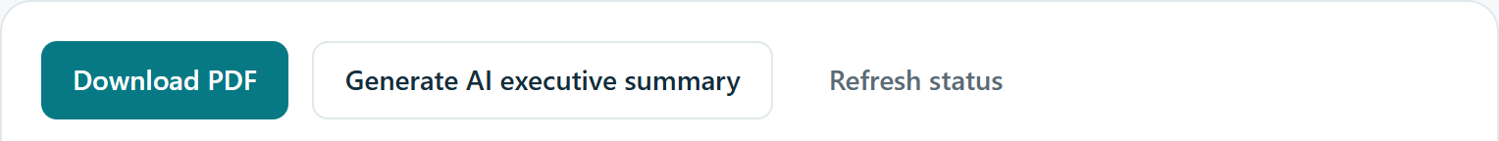
Alerts and business reports
Five configurable alert rules
Saved report snapshots
Sales decline, expense increase, low estimated margin, negative feedback and forecast decline.
Weekly, monthly or custom reports preserve calculated figures and support PDF download.
Rules check data coverage before triggering and retain the supporting evidence.
Reports work without AI. Owners can request an optional executive summary.
Reports run on demand. Scheduled email delivery is outside the implementation.
08
Notes:
Local rule calculations generate in-app alerts and preserve their trigger evidence. Insufficient data is a distinct state. Marking an alert read or dismissed does not resolve the business condition. Report figures remain immutable after later edits. PDF rendering and the deterministic summary work without AI. The image shows actual export controls from the report interface, cropped to the actions. No automatic email or background schedule is implemented.
Source: C:\Users\khale\OneDrive\المستندات\ASU\Modules\Graduation Project 2\Basira_Graduation_Report_Chapters_1_to_5.pdf
Chapter 5, 5.2.14–5.2.15, pp. 54–55.

Slide 9
Security and deployment status
Access protection
Server-side authentication and ownership checks protect every business operation.
Data integrity
Zod validation, database constraints, transactions and record versions reject invalid or stale changes.
Local prototype
Separate development and test databases are configured. Hosting preparation is complete, but public deployment remains pending.
09
Notes:
Secrets remain server-side. State-changing routes check origin and request sizes. Safe error messages avoid exposing raw provider errors, credentials or stack traces. Version checks and business-row locks coordinate concurrent changes. Deployment preparation includes CI/Vercel configuration, environment validation and migration instructions. The report does not claim a connected public host, hosted performance or continuous operation. The prototype includes responsive screens, light/dark themes and keyboard-friendly controls.
Source: C:\Users\khale\OneDrive\المستندات\ASU\Modules\Graduation Project 2\Basira_Graduation_Report_Chapters_1_to_5.pdf
Chapter 5, 5.2.17–5.2.18, pp. 56–57.

Slide 10
Thank you
Questions?
Khaled Waled Abdulakder
10
Notes:
Invite questions about the Chapter 5 implementation, application modules and technical decisions.

