Slide 1
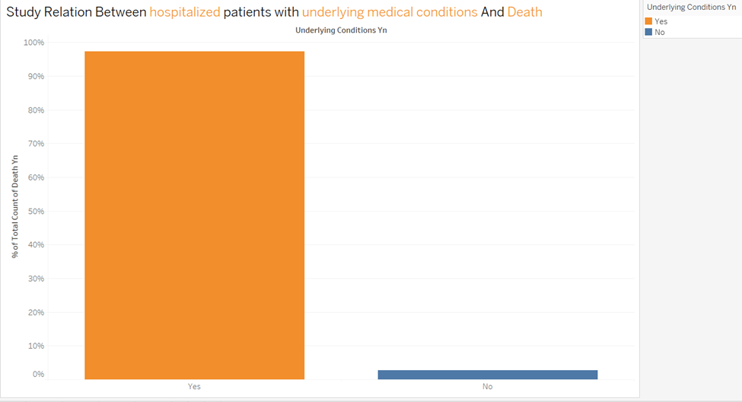
Hospitalization and Mortality Risk with Underlying Conditions
Question:
Are hospitalized patients with underlying medical conditions and/or risk behaviors more likely to die from COVID-19?
Finding:
Yes, hospitalized patients with underlying conditions and/or risk behaviors are more likely to die from COVID-19
Implications:
Prioritize medical care and resources for high-risk individuals. Focus on preventive measures and early treatment for those with known risk factors.

Slide 2
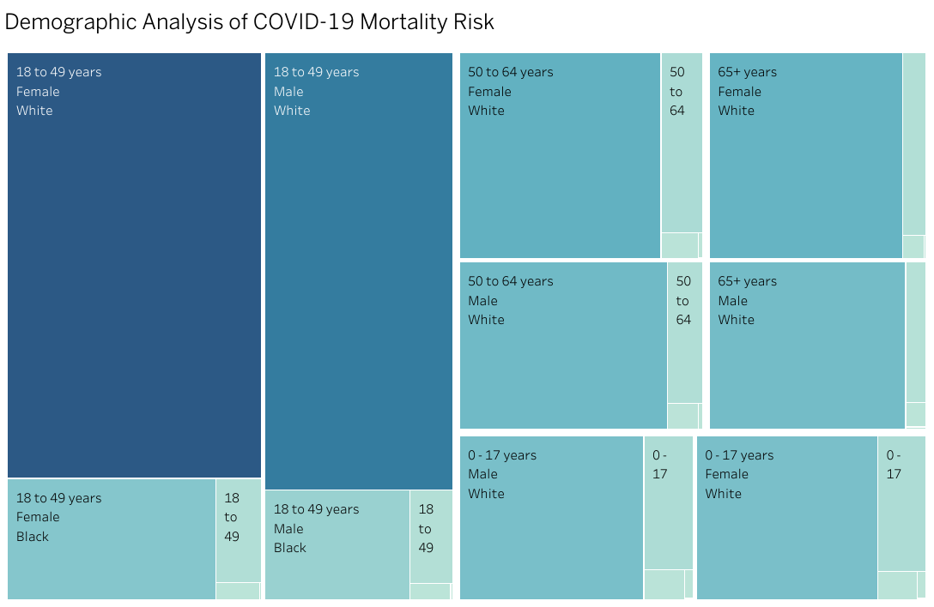
Demographic Risk of COVID-19 Death
Question:
Who are the people most at risk of death due to COVID-19? Who is the least at risk?
Finding:
Most at risk: White females aged 18-49 years. Least at risk: Native Hawaiian males aged 65 years and above.
Implications:
Targeted healthcare interventions for high-risk groups. Tailored public health messaging.

Slide 3
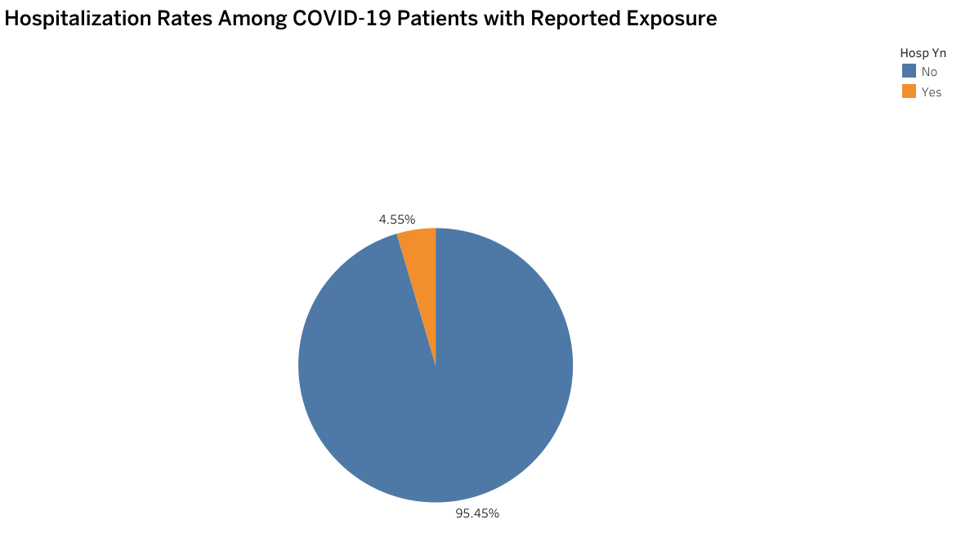
Hospitalization Rates Related to Travel or Congregation Exposure
Question:
What percent of patients who reported exposure to travel or congregation within 14 days prior to illness onset end up hospitalized?
Finding:
4.55% of hospitalized patients reported exposure to travel or congregation, with significant missing data likely affecting the figure.
Implications:
Improve data collection for accurate risk assessment.

Slide 4
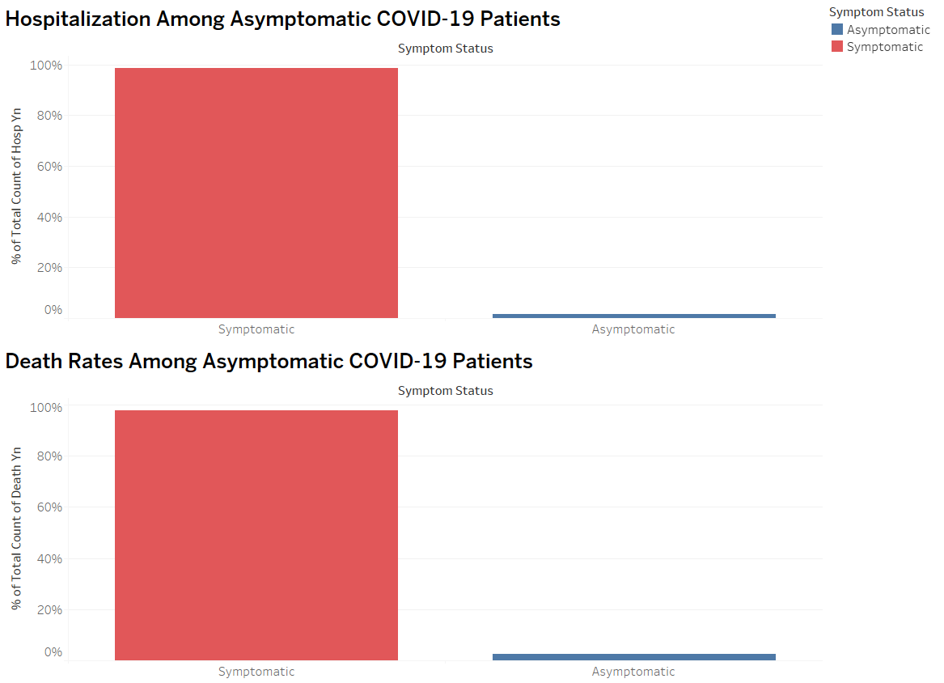
Hospitalization and Mortality Rates of Asymptomatic COVID-19 Patients
Question:
Are asymptomatic COVID patients less likely to be hospitalized? Are they less likely to die from their illness?
Finding:
Yes, asymptomatic COVID patients are less likely to be hospitalized and less likely to die.
Implications:
Hospitals can allocate resources more efficiently by focusing on symptomatic cases.

Slide 5
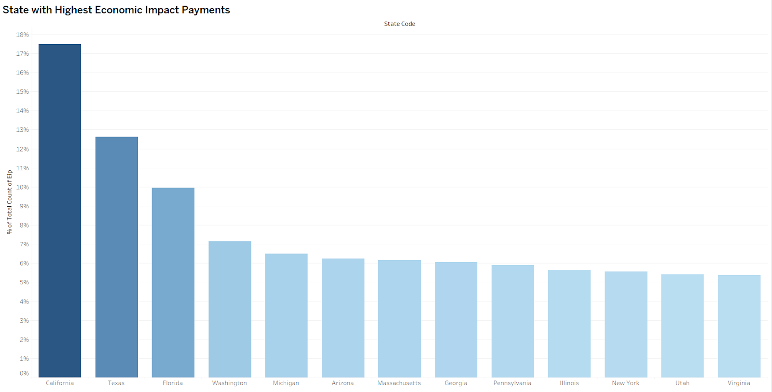
State with Highest Economic Impact Payments
Question:
Which state is associated with the highest percentage of Economic Impact (stimulus) payments among survey respondents?
Finding:
California has the highest economic impact payments.
Implications:
Identify states requiring more economic support and target relief efforts accordingly.

Slide 6
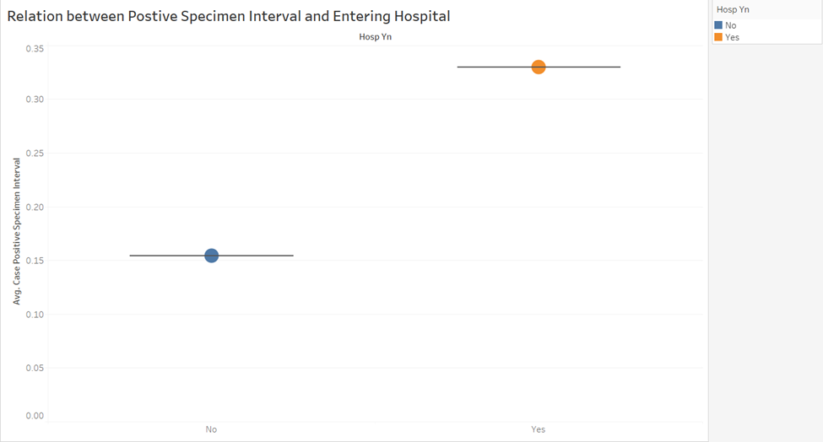
Relationship Between Time from Positive Test to Case Onset and Hospitalization
Question:
Is there a relationship between the time from positive specimen collection to case onset and the likelihood of hospitalization?
Finding:
There's a correlation between longer time from positive specimen collection to case onset and higher likelihood of hospitalization.
Implications:
Expedite testing processes to promptly identify and isolate positive cases.

Slide 7
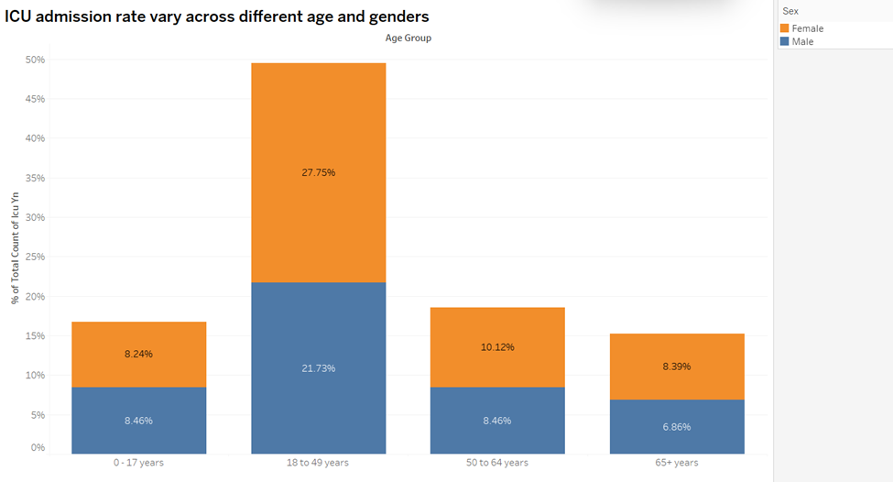
ICU Admission Rates by Age and Gender
Question:
How does the ICU admission rate vary across different age groups and genders?
Finding:
ICU admission rates are higher among females aged 18-49 years.
Implications:
Allocate resources to meet the intensive care needs of vulnerable populations, particularly females aged 18-49 years.

Slide 8
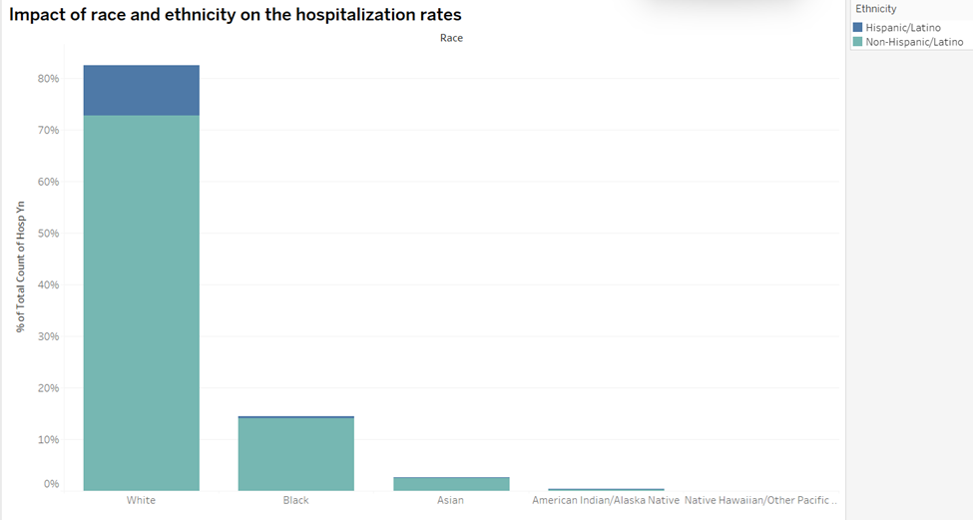
Impact of Race and Ethnicity on Hospitalization Rates
Question:
What is the impact of race and ethnicity on the hospitalization rates of COVID-19 patients?
Finding:
White Non-Hispanic/Latino individuals have a higher percentage of hospitalization rates among COVID-19 patients.
Implications:
Develop tailored interventions to address disparities in hospitalization risks among different racial and ethnic groups.

Slide 9
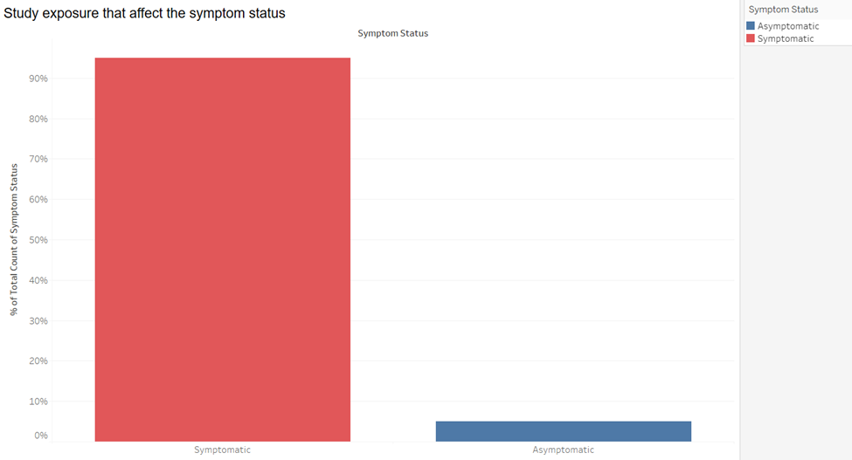
Effect of Exposure on Symptom Development
Question:
How does exposure affect the symptom status of COVID-19 patients?
Finding:
More than 90% of COVID-19 patients who report exposure develop symptoms.
Implications:
Inform public health guidelines and risk assessments for various exposure scenarios.

Slide 10
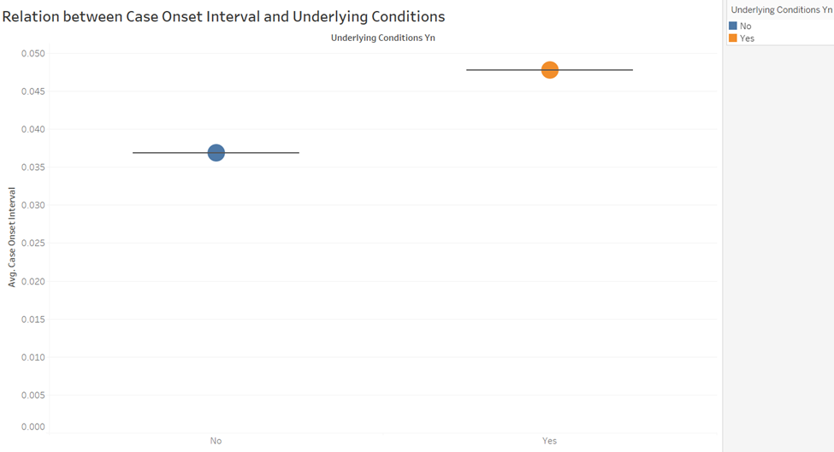
Influence of Underlying Medical Conditions on Hospitalization Timing
Question:
Does the presence of underlying medical conditions influence the interval between case onset and hospitalization?
Finding:
Patients with underlying medical conditions (e.g., diabetes) have a longer interval between symptom onset and hospitalization.
Implications:
Insights into how pre-existing health issues affect the progression of COVID-19 and the timing of medical intervention.

