Slide 1
CiCd

Slide 2
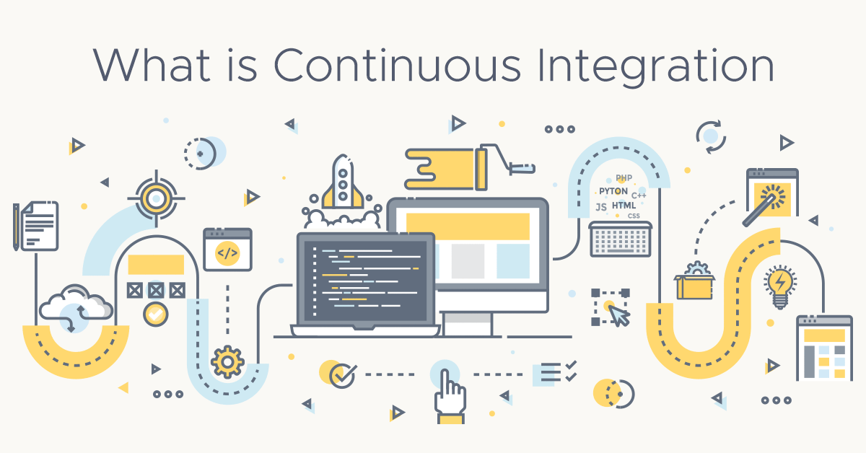
What is continuous integration? Build your team's agility with faster feedback. Because you only move as fast as your tests. Continuous integration (CI) is the practice of automating the integration of code changes from multiple contributors into a single software project. It’s a primary DevOps best practice, allowing developers to frequently merge code changes into a central repository where builds and tests then run. Automated tools are used to assert the new code’s correctness before integration. A source code version control system is the crux of the CI process. The version control system is also supplemented with other checks like automated code quality tests, syntax style review tools, and more.

Slide 3
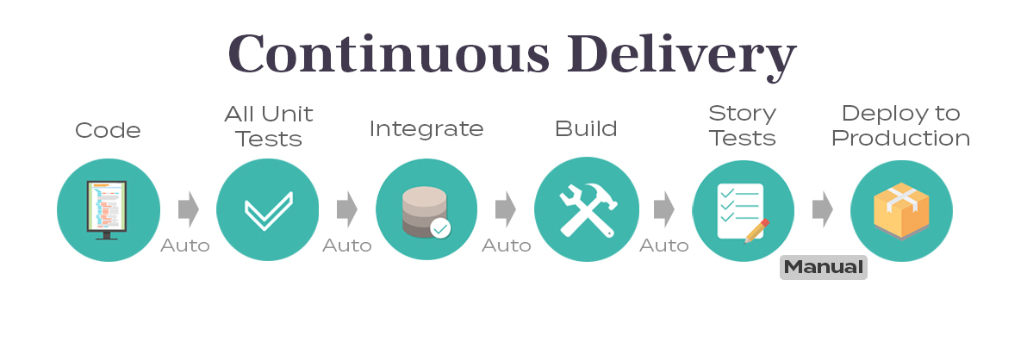
Continuous delivery Following the automation of builds and unit and integration testing in CI, continuous delivery automates the release of that validated code to a repository. So, in order to have an effective continuous delivery process, it’s important that CI is already built into your development pipeline. The goal of continuous delivery is to have a codebase that is always ready for deployment to a production environment. In continuous delivery, every stage—from the merger of code changes to the delivery of production-ready builds—involves test automation and code release automation. At the end of that process, the operations team is able to deploy an app to production quickly and easily.

Slide 4
Benefits of continuous integration-continuous deployment (CI-CD)
Smaller code changes are simpler (more atomic) and have fewer unintended consequences.
Fault isolation is simpler and quicker.
Mean time to resolution (MTTR) is shorter because of the smaller code changes and quicker fault isolation.
Testability improves due to smaller, specific changes. These smaller changes allow more accurate positive and negative tests.
Elapsed time to detect and correct production escapes is shorter with a faster rate of release.
The backlog of non-critical defects is lower because defects are often fixed before other feature pressures arise.
The product improves rapidly through fast feature introduction and fast turn-around on feature changes.
Upgrades introduce smaller units of change and are less disruptive
CI-CD product feature velocity is high. The high velocity improves the time spent investigating and patching defects.

Slide 5
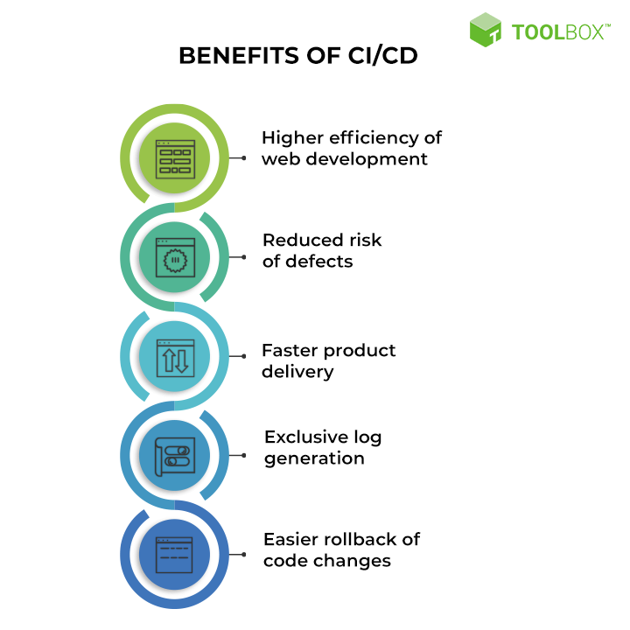
Continue
Feature toggles and blue-green deploys enable seamless, targeted introduction of new production features.
You can introduce critical changes during non-critical (regional) hours. This non-critical hour change introduction limits the potential impact of a deployment problem.
Release cycles are shorter with targeted releases and this blocks fewer features that aren’t ready for release.
End-user involvement and feedback during continuous development leads to usability improvements. You can add new requirements based on customer’s needs on a daily basis.

Slide 6
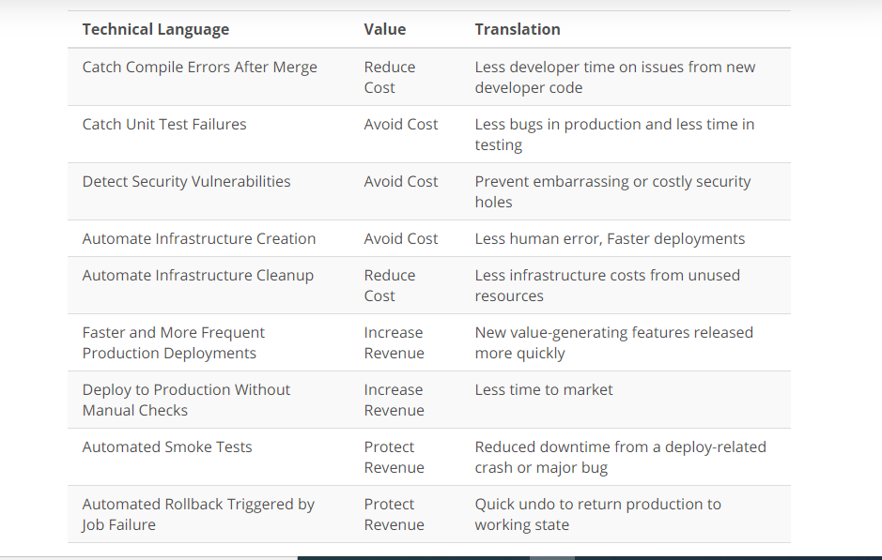
Why Is Translation Important? If the decision-makers in your company can't understand why something is important or adds value, they might not approve it. This usually isn't because they're ignorant or trying to be difficult, this is often because they don't understand how the technical changes translate into benefits for the company. Using language they understand will make everyone's lives better and easier!

