Slide 1
Docker

Slide 2
Agenda
Virtualization VS Containerization
Virtualization and VMS
Containerization
What is Docker?
Image vs Container
Docker Architecture
Dockerfile
Volumes
Docker Compose
Demo

Slide 3
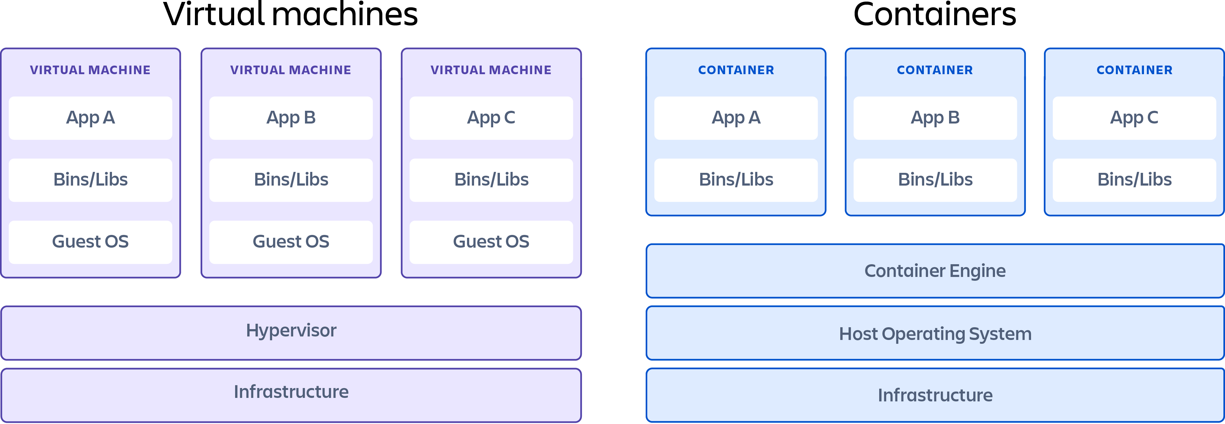
Virtualization VS Containerization

Slide 4
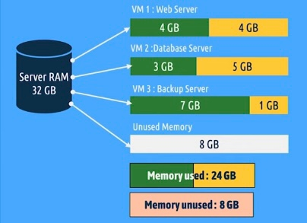
Virtualization and VMS

Slide 5
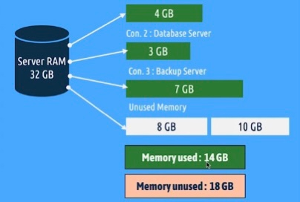
Containerization

Slide 6
Advantages and disadvantages
Portability
Lightweight
Native Performance
Start up in milliseconds
Multible Containers
Simple and fast deployment

Slide 7

What Is The Problem?
A new developer is joining a company
Backend: PhP, laravel, PostgressSql
Frontend: JavaScript, Angular 4
Deploy your app

Slide 8
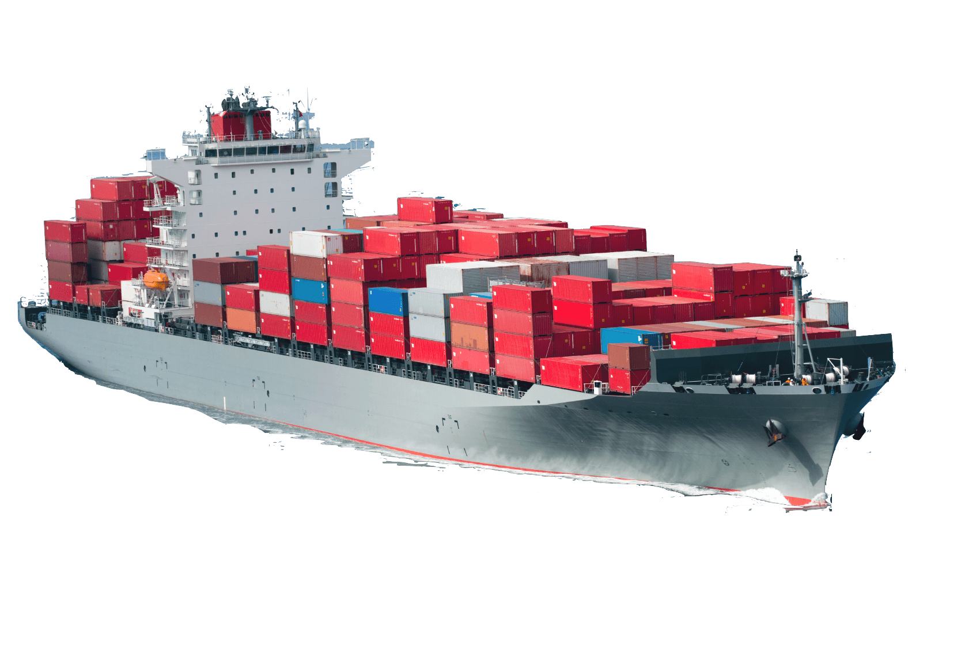
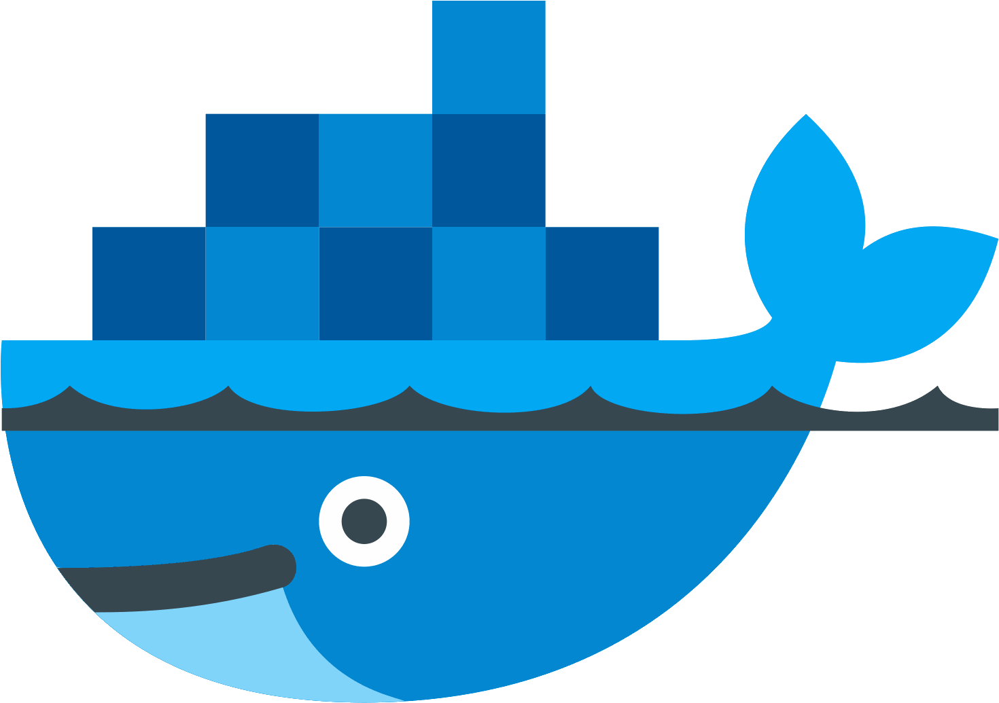
What is Docker?

Slide 9
What is Docker?
Docker is an open source platform that enables developers to build, deploy, run, update and manage containers—standardized, executable components that combine application source code with the operating system (OS) libraries and dependencies required to run that code in any environment.

Slide 10
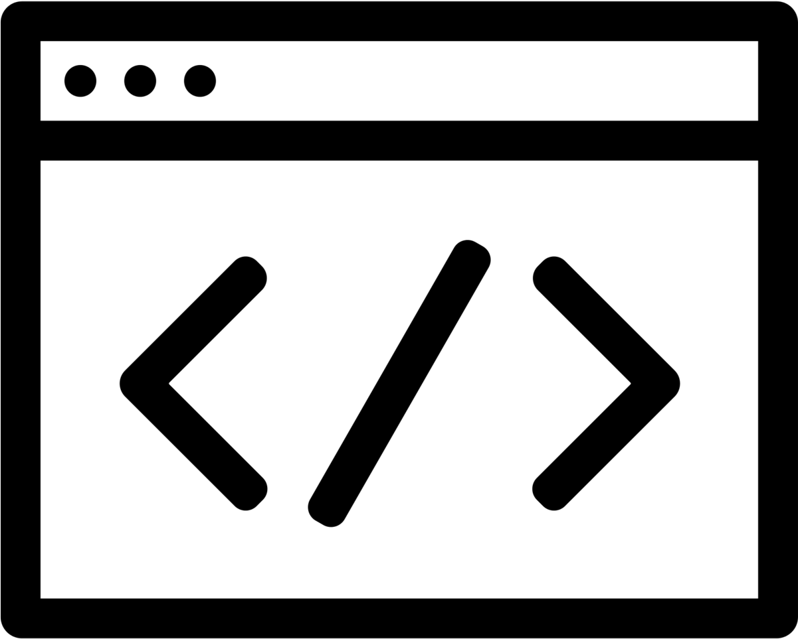


Image vs Container
Docker images contain executable application source code as well as all the tools, libraries, and dependencies that the application code needs to run as a container.
Docker Images are read-only templates containing instructions for creating
a container.
Docker containers are the live, running instances of Docker images.

Slide 11

Image vs Container
Docker image templates can exist in isolation but containers can't exist without images.
Docker images can’t be paused or started but a Docker container is a run time instance that can be started or paused.

Slide 12
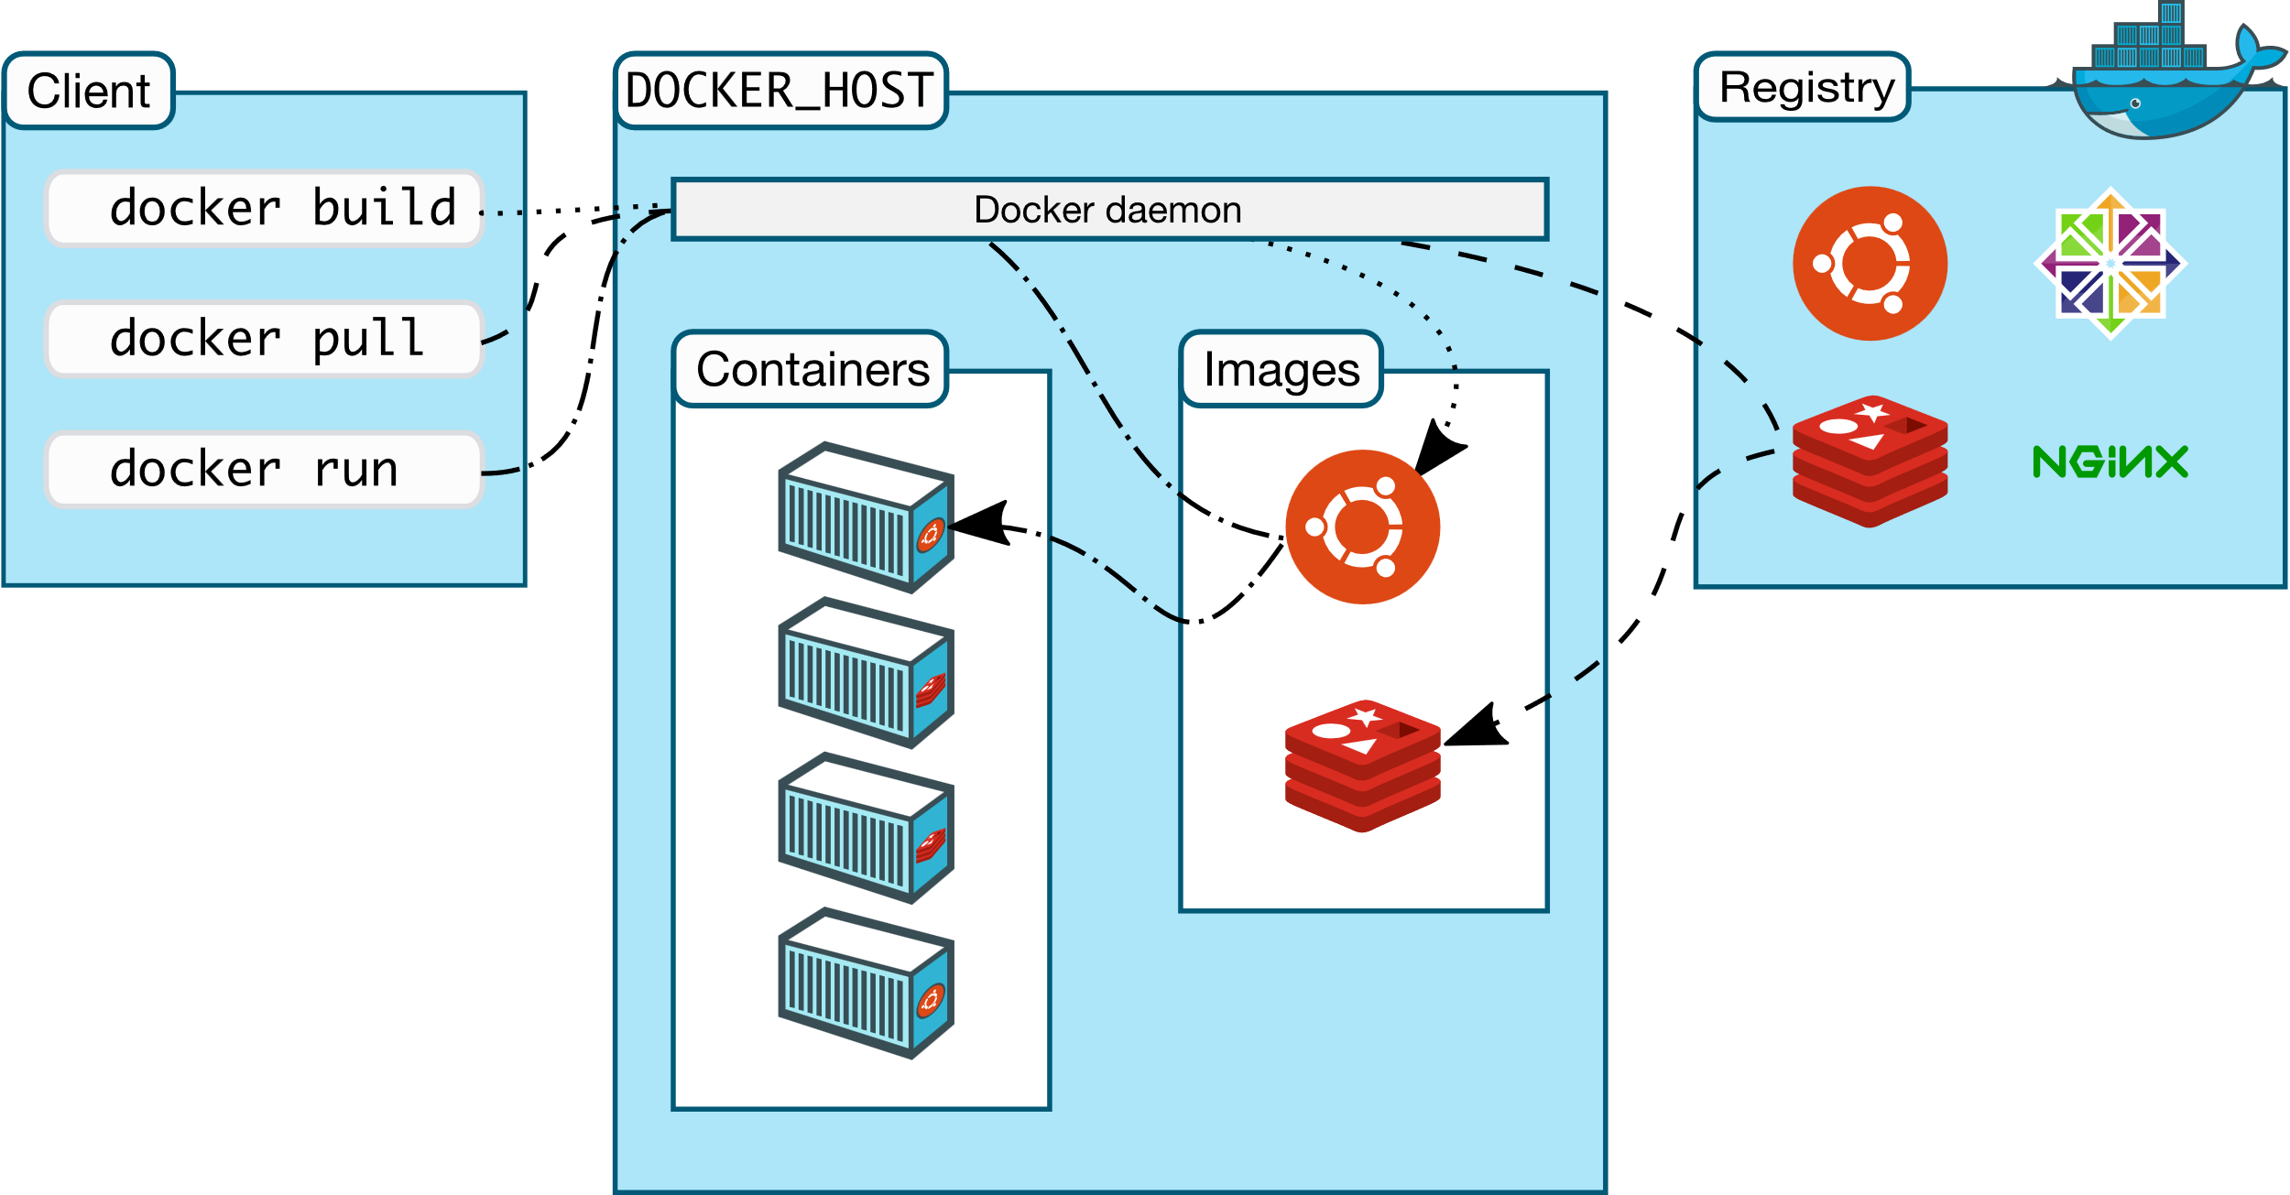
Docker Architecture
Notes:
Docker hub is the public repository of Docker images that calls itself the “world’s largest library and community for container images.” .

Slide 13
Dockerfile
A Dockerfile is a text document that contains all the commands a user could call on the command line to assemble an image.
You can build a Docker image using a Dockerfile. The command “docker build .”
Named “Dockerfile” with no extensions

Slide 14
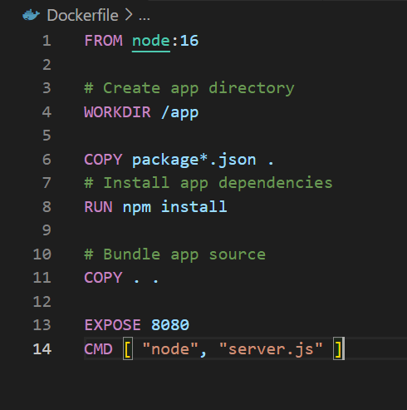
Dockerfile
FROM
WORKDIR
COPY / ADD
RUN
EXPOSE
CMD
ENV

Slide 15
Dockerfile
FROM
Initializes a new build stage and sets the Base Image for subsequent instructions.
A valid Dockerfile must start with a FROM instruction.
Syntax: FROM <image_name>:<version>
FROM node
FROM node:16
FROM node:19-alpine3.16
From local PC or Docker Hub

Slide 16
Dockerfile
WORKDIR
Sets the working directory for the following instructions.
Will be created, if it doesn’t exist
Syntax: WORKDIR /<folder_name>
WORKDIR /app
Will be created in the root folder

Slide 17
Dockerfile
COPY / ADD
Copy all the source file into the image
Syntax: COPY <source> <destination>
COPY . .
The dot means the current directory
ADD : Can decompress any compressed files
: Can use URL as a source

Slide 18
Dockerfile
RUN
Run commands in build-time of the image.
Syntax: RUN <command>
RUN npm install
Will installs all the dependencies listed in the packages.json during build-time

Slide 19
Dockerfile
CMD
Run commands in run-time of creating new container.
Syntax: CMD <command>
CMD node server.js
Will start the server when new container is created
Only one CMD instruction is allowed in Dockerfile.

Slide 20

Dockerfile
EXPOSE
Informs Docker that the container listens on the specified network ports at runtime.
Syntax: EXPOSE <port>/<protocol>
Default protocol is tcp

Slide 21
Dockerfile
ENV
Environment variables can also be used in certain instructions as variables to be interpreted by the Dockerfile
Syntax: ENV <name>=<value>
ENV path=/app
WORKDIR $path
WORKDIR $path = WORKDIR /app

Slide 22
Dockerfile
Caching
Each instruction in this Dockerfile translates (roughly) to a layer in your final image.
Whenever a layer changes, that layer will need to be re-built.
If a layer changes, all other layers that come after it are also affected.

Slide 23
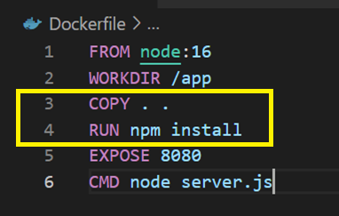
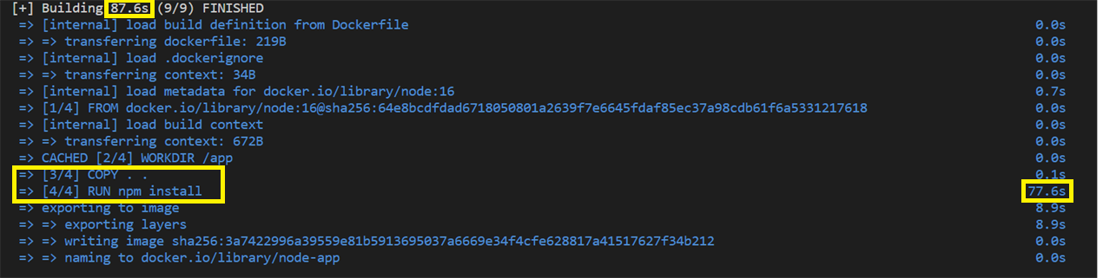
Dockerfile
Caching

Slide 24
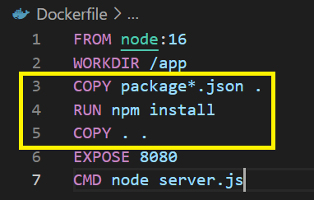
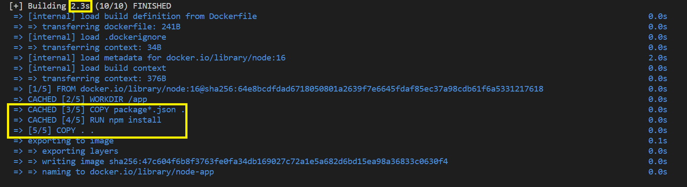
Dockerfile
Caching

Slide 25
Dockerfile
USER -> Addgroup and adduser
Syntax: RUN ADDGROUP <group_name> && ADDUSER –S –G <group_name> <user_name>
: USER <user_name>
RUN ADDGROUP appG && ADDUSER –S –G appG appU
USER appU
Should be after FROM instruction

Slide 26
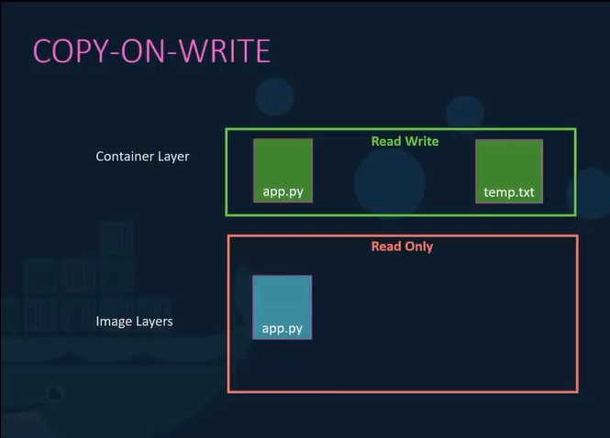
Volumes

Slide 27
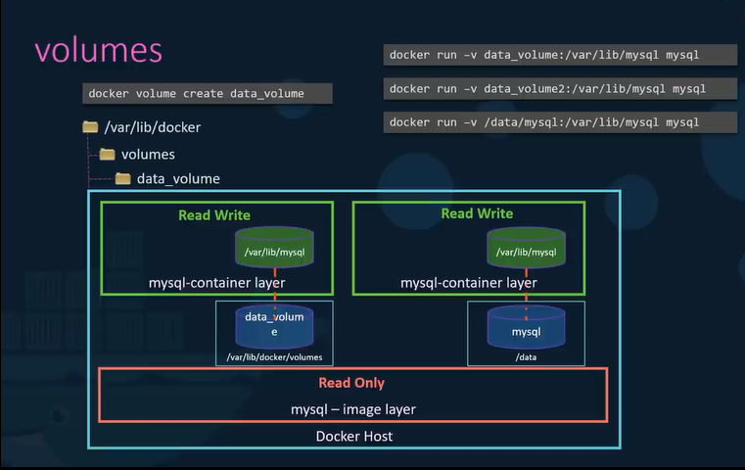
Volumes

Slide 28
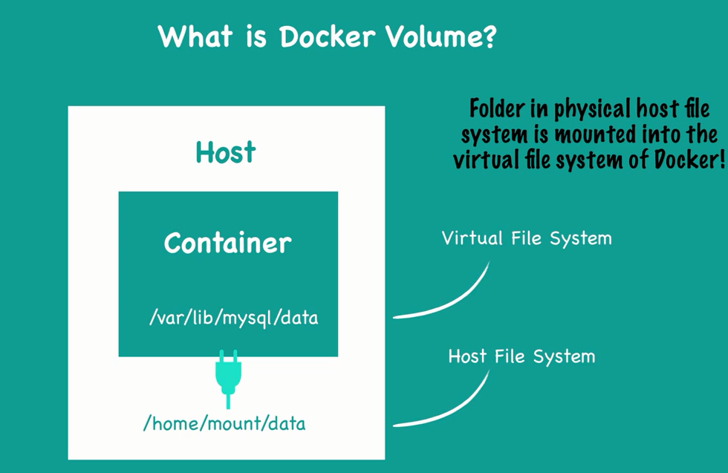
Volumes
Volumes are the preferred mechanism for persisting data generated by and used by Docker containers. volumes are completely managed by Docker.

Slide 29
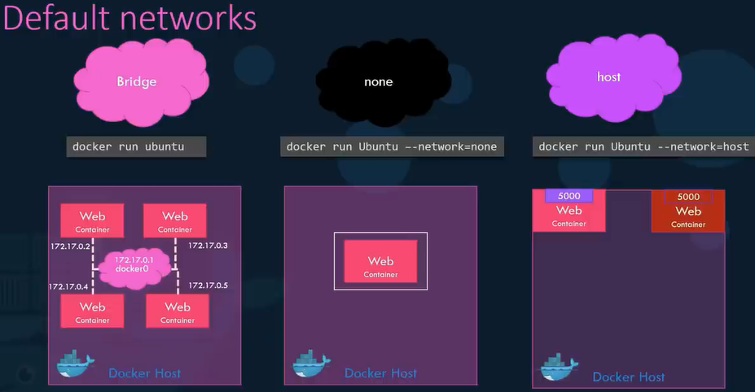
Container Networking

Slide 30
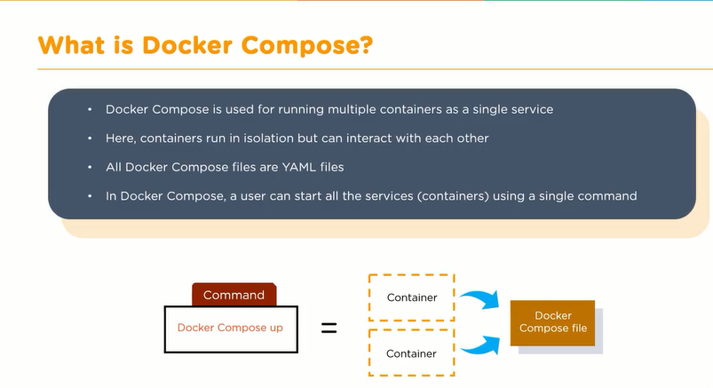
Docker Compose

Slide 31
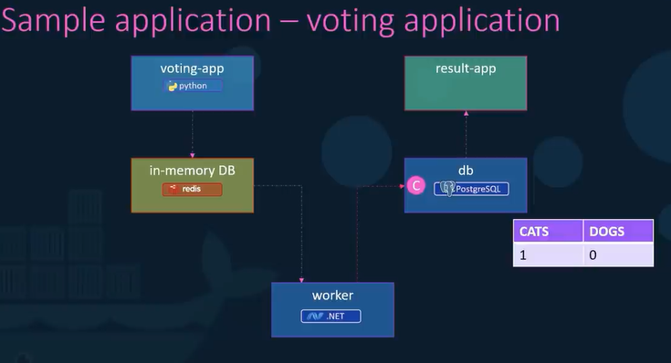
Docker Compose

Slide 32
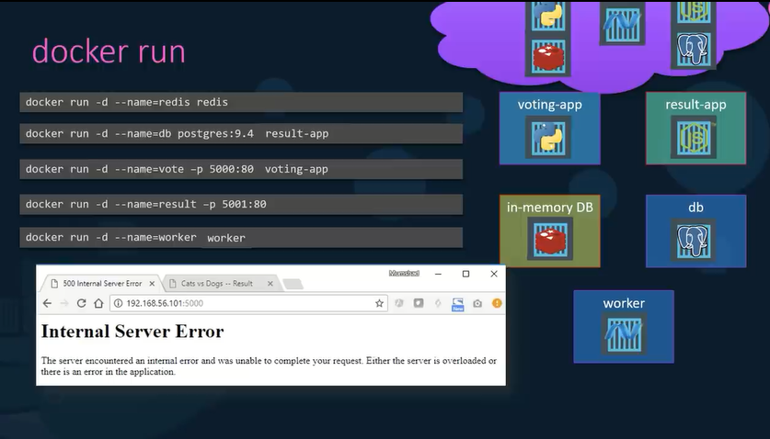
Docker Compose

Slide 33
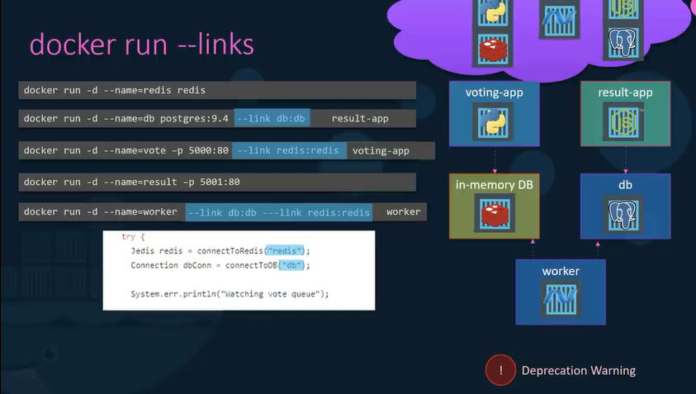
Docker Compose

Slide 34
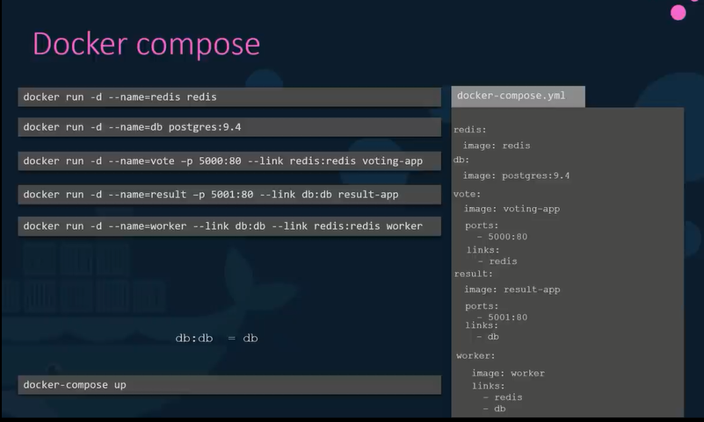
Docker Compose

Slide 35
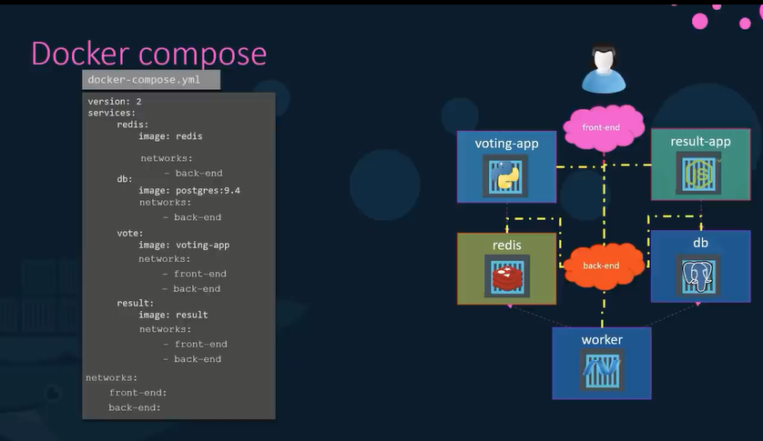
Docker Compose

Slide 36
Demo

Slide 37
Thank You

