Slide 1
AI EMPLOYMENT & LABOR VULNERABILITY
How Artificial Intelligence Is Reshaping
Jobs, Salaries & Career Risk (2020–2026)
An end-to-end analytics & machine-learning study across 8 industries, 9 countries, and 10 job roles
Directed by: Dr. Amal Mahmoud

Slide 2




Meet Our Expert Team
The people behind the data, the models, and the story
Esraa Fathy
Mahmoud Ahmed
Khaled Elserry
Sondos Mostafa
Visualization Specialist
Project Manager
Data Engineer
Data Analyst
Designs the dashboards that turn AI-employment data into clear executive insight.
Plans and manages the project from data discovery through to final delivery.
Builds the ETL pipelines and data warehouse behind the analysis.
Analyzes workforce data and extracts the insights driving recommendations.
02

Slide 3
WHAT'S INSIDE
Project Roadmap
01
The Dataset
15,000 records, 43 indicators — salaries, adoption, automation, skills
02
Executive & Employee Dashboards
Interactive BI views of AI adoption and workforce impact
03
Industry & Geography
Where AI is moving fastest, and where jobs are most exposed
04
Predictive Model
A machine-learning pipeline forecasting labor vulnerability
05
Business Insights & Recommendations
What leaders should do next
03

Slide 4
DATA & APPROACH
Dataset & Methodology
15,000
43
8
9
10
Employment records
Indicators tracked
Industries
Countries
Job roles
Pipeline: from raw data to a leakage-safe predictive model
1
Smart data discovery & cleaning
2
Exploratory analysis across salary, adoption & risk
3
Feature engineering — 26 model-ready inputs (23 numeric, 3 categorical)
4
Leakage-safe train / test split (12,000 / 3,000 records)
5
9 regression models benchmarked, best pipeline tuned & validated
04

Slide 5
HOW IT WAS BUILT
Tools & Tech Stack
Excel
SQL
Power BI & Tableau
Python (ML)
Data cleaning, standardization & native PivotTable/PivotChart dashboards
A 7-table star-schema data warehouse for structured analysis
Executive-ready dashboards with interactive filters & KPIs
A leakage-safe pipeline predicting labor vulnerability
Duplicate & inconsistent value fixing
1 fact table + 6 dimension tables
3 published report pages
9 regression models benchmarked
Formula-driven "_update" correction columns
29 reusable views
Cross-filtering by year, country, industry
Extra Trees, R² = 0.957
3 interactive Pivot dashboards
75+ analytical queries
Bookmark-based navigation
5-fold cross-validation
05

Slide 6
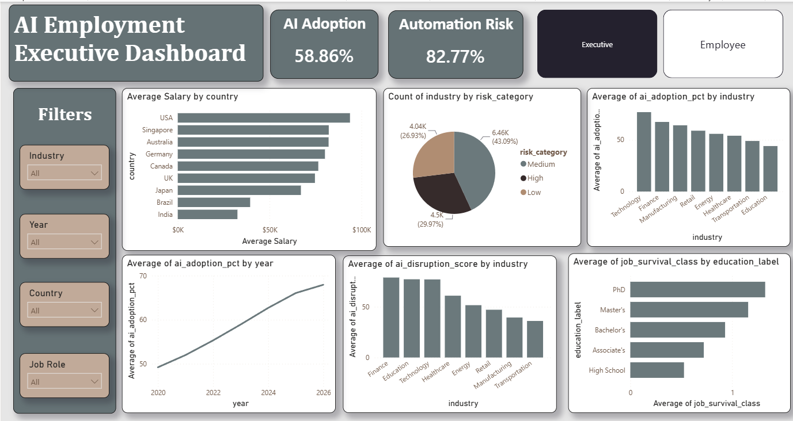
STEP 01 · EXCEL
Cleaning the Data & First Dashboards
The raw export arrived dirty — Excel was used to standardize it and build the first native Pivot dashboards
Cleaning Highlights
Standardized inconsistent text entries — e.g. “Mohamed” / “MOHAMED” / “Mohamed ” → one clean value
Added formula-driven correction columns (salary, AI-adoption stage, time-saved) alongside the original raw fields
Removed duplicate records and fixed missing values before loading to SQL
Built 3 native Excel Pivot dashboards (Executive & Employee views) as the first look at the data
06

Slide 7
STEP 02 · SQL
A Star-Schema Data Warehouse
A 7-table warehouse structures the cleaned data for fast, reliable analysis
7
29
75+
Dim_Year
Tables
SQL Views
Analytical Queries
Dim_Country
Dim_Risk
Query Themes
Fact_Employment
Executive Insights
Adoption, risk & salary trends at a glance
Student / Career Guidance
Dim_Education
Dim_Job
Safest, highest-paid roles after AI
Behavioral & Fear Analysis
Dim_Industry
Whether fear of AI matches actual risk
07

Slide 8
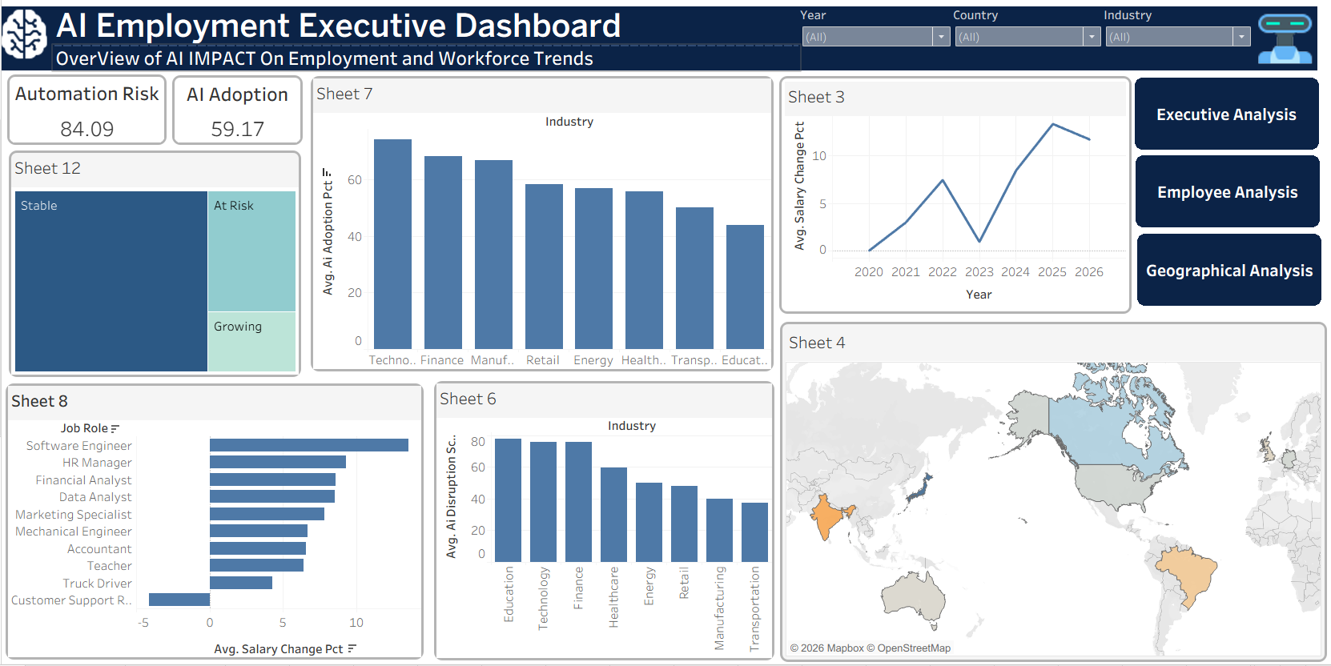
POWER BI · REPORT 01
Executive Dashboard
Real-time view of AI adoption and automation exposure, filterable by industry, country, year and role
59.2%
AI Adoption
84.1%
Automation Risk
+6.7%
Avg. Salary Change
08

Slide 9
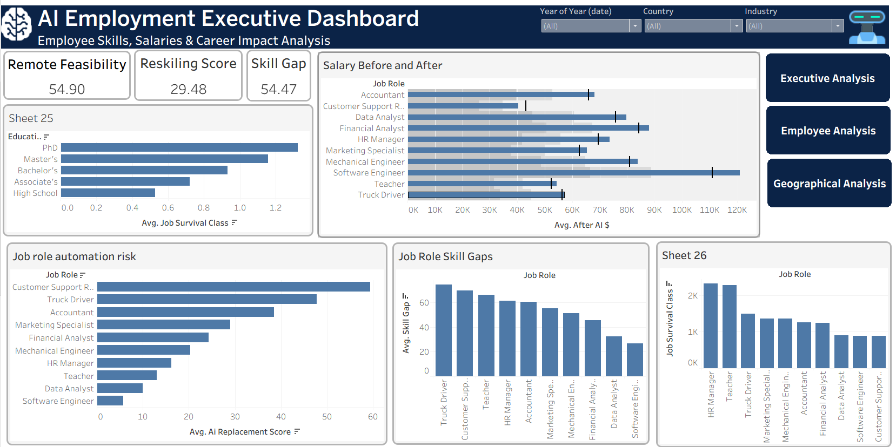
POWER BI · REPORT 02
Employee Skills & Career Impact
Salary before/after AI, reskilling needs and skill gaps by job role and education level
54.9%
Remote Feasibility
29.5
Reskilling Score
54.5
Avg. Skill Gap
09

Slide 10
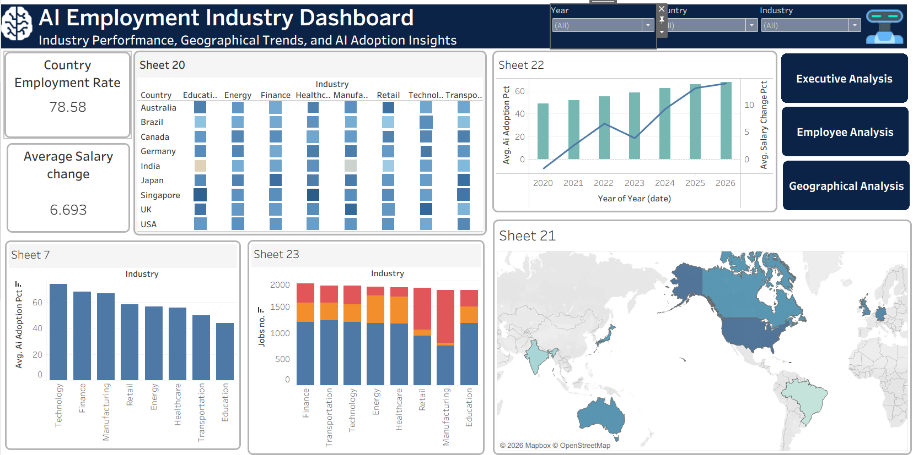
POWER BI · REPORT 03
Industry & Geographic Analysis
AI adoption pace and workforce disruption compared across industries and countries
78.6%
Employment Rate
+6.7%
Avg. Salary Change
9
Countries Tracked
10

Slide 11
SYNTHESIS
What the Dashboards Tell Us
Executive View
Employee View
Industry View
AI adoption has reached ~59% and keeps climbing
Reskilling is becoming essential, not optional
AI adoption grows year-over-year across every region
Technology, Finance & Manufacturing lead adoption
Customer Support & truck driving face the highest replacement risk
Salary growth tracks closely with AI adoption
Education remains the least AI-enabled industry
Software engineers stay highly valued post-AI
Manufacturing shows the heaviest automation pressure
Salaries keep rising even as automation increases
PhD & Master's holders show the strongest job survival
Employment stays globally balanced despite the shift
11

Slide 12
FROM INSIGHT TO PREDICTION
Building a Predictive Model
Goal: predict each job's AI Labor Vulnerability Score from workforce, industry and task-level signals — without leaking the answer into the inputs.
01
02
03
04
Preprocessing
Leakage Control
Benchmarking
Tuning & Validation
ColumnTransformer with imputation, scaling & one-hot encoding for 23 numeric + 3 categorical features
17 reconstruction & target-adjacent columns removed before training
9 regression algorithms trained on identical pipelines — linear, tree & boosting families
5-fold cross-validation + randomized search on the best-performing model
12

Slide 13
WHERE THE RISK CONCENTRATES
Highest-Risk Jobs & Industries
Average AI Labor Vulnerability Score by Job Role
Average AI Labor Vulnerability Score by Industry
13

Slide 14
GLOBAL LENS
Where Countries Stand
Reading the Map
Emerging economies (India, Brazil) show the highest vulnerability despite lower AI adoption — wages haven't kept pace with automation pressure
The U.S. combines high salaries with high exposure — more to lose from disruption
Australia & Singapore sit lowest — higher-value, harder-to-automate role mix
14

Slide 15
WHAT LEADERS SHOULD DO
Recommendations
1
2
3
4
Invest in Reskilling
Automate Repetitive Work First
Reward Advanced Education
Track Vulnerability, Not Just Adoption
Fund continuous learning and AI-literacy programs, prioritizing the highest-vulnerability roles first
Target routine, task-based processes before touching judgment-heavy or client-facing roles
Support degrees and certifications — PhD/Master's holders show the strongest job survival
Use a predictive score (like this model) to flag at-risk teams early, not after layoffs
15

Slide 16
AI is transforming jobs — not replacing all workers
The organizations that invest in reskilling, track vulnerability early, and lead with data will keep the advantage
Thank You
16

