Slide 1


MULTI-REGION WEB APPLICATION
AZURE HUB & SPOKE ARCHITECTURE
Prepared by :
Khaled Gamal
Alaa Amir

Slide 2


Agenda
1
Project Overview
2
Architecture Overview
3
Packet Walk-Through
4
Key Benefits
4
Final Summary

Slide 3
PROJECT OVERVIEW
Purpose of Project:
Multi-region e-commerce platform on Azure
High availability and low latency
Hub & Spoke architecture
Global entry with Azure Front Door
Secure private application and data access

Slide 4
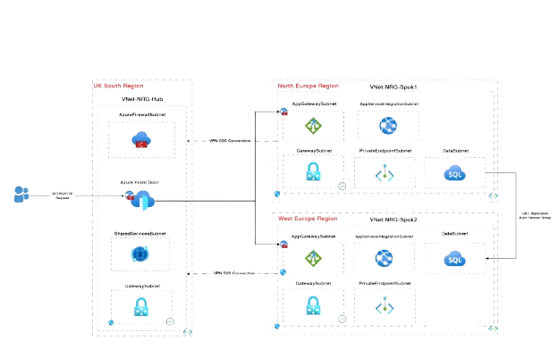
ARCHITECTURE OVERVIEW

Slide 5
PACKET WALK-THROUGH
1
2
User → Azure front Door
front door → primary region & app gw
3
4
App Service (Private Access) & Data Access (Azure SQL)
Geo-Replication & Response Path Back

Slide 6

STEP 1: USER → AZURE FRONT DOOR
User sends HTTPS request
Request reaches Azure Front Door
Front Door performs
Request is routed to nearest healthy region
SSL termination
WAF inspection (OWASP 3.2)
DDoS protection
Health probe check

Slide 7
STEP 2: FRONT DOOR → PRIMARY REGION & APP GW
Traffic enters selected region
Request reaches Application Gateway + WAF v2
WAF
Layer 7 inspection:
Path-based routing
HTTP header validation
Additional WAF rules

Slide 8
STEP 3: APP SERVICE (PRIVATE ACCESS) & DATA ACCESS (AZURE SQL)
App Gateway forwards traffic via Private Endpoint
App Service
App requests data from Azure SQL Database
Connection via
SQL runs
Premium v3
Zone-redundant
Autoscaling enabled
Private Endpoint
Private DNS Zone
General Purpose
Gen5 – 4 vCores
Zone-redundant

Slide 9
STEP 4: GEO-REPLICATION & RESPONSE PATH BACK
SQL data replicated to secondary region
Requirements SQL → App Service
Analysis
App Service → App Gateway
App Gateway → Azure Front Door
Front Door → User
Disaster recovery
Read workloads (best practice)

Slide 10
KEY BENEFITS
01
02
03
Secure packet flow
Low latency
High availability
04
05
Scalable design
Enterprise-ready

Slide 11
FINAL SUMMARY
End-to-end packet flow
Azure best practices
Fully secured path
Private backend access

Slide 12
THANK YOU!

