Slide 1
ELECTRONICS COMPANY WEBSITE: MOUKHANE
Mohammad Al Moukhallalati
Jane Daou
Khaled El Madani

Slide 2
TABLE OF CONTENTS
01
Conceptual Data Model Logical Data Model
02
Website
03
Database Connection

Slide 3
ABOUT OUR COMPANY
What does our shop consists?

Slide 4

9 entities
7 relationships
Customer can :
Buy items from the website
Acquire services with the help of professional staff of the company
Register as a member
Member will have extra features such as:
Competing with other members
The winner will get a reward prize
Register to study courses where our company hires professional teachers

Slide 5
DIVING INTO DETAILS
There exists 2 available courses to register on the website: 1. Microelectronics
2. Soldering
There are several competitions such as:
1. Soldering
2. Trivial Questions (or IQ Tests)
Services include:
1. Guide for projects
2. Soldering

Slide 6
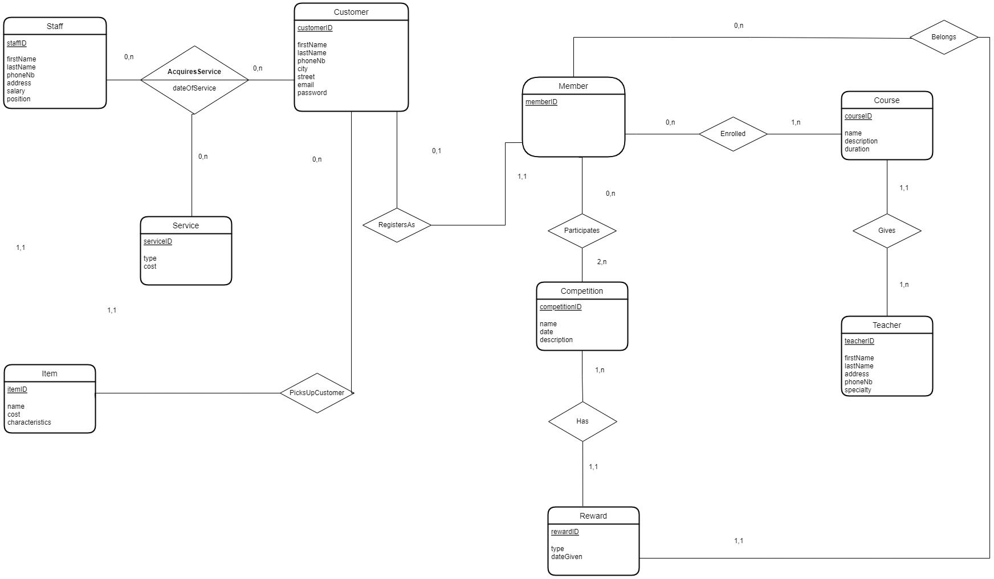
CDM
Notes:
9 entities
7 relationships
Customer can buy items, can acquire services with the help of professional staffs
+ the customer can register as a member; he will have extra features such as competitions and winner will get a reward
+ he can study courses where we hire professional teachers
There exist for now 2 available courses microelectronics and soldering
Competition such as soldering and trivial IQ test knowledge test
Services guide into projects and soldering

Slide 7
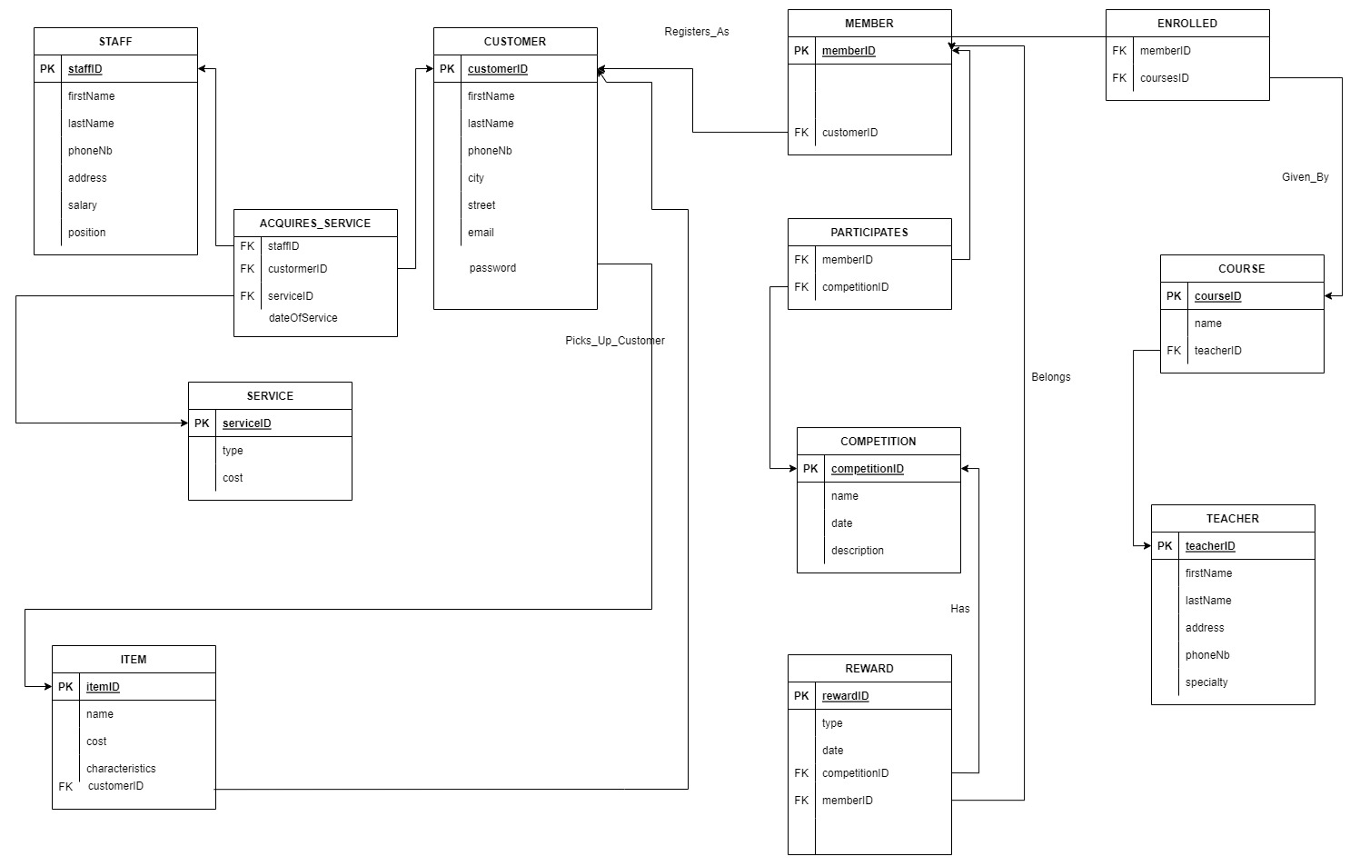
LDM

Slide 8
Languages Used
For the frontend, we used HTML, CSS, and JavaScript
For the backend, we used PHP.

Slide 9
THANKS
Do you have any questions?
youremail@freepik.com
+91 620 421 838
yourcompany.com
MOUKHANE CO.
Please keep this slide for attribution

