Slide 1




FOOTBALL PLAYER MARKET VALUE PREDICTION
AN END-TO-END MACHINE LEARNING PIPELINE BRIDGING RAW HISTORICAL DATA
AND ACTIONABLE SPORTING INTELLIGENCE.
Presented By: Khaled BLEL
Notes:
Hello everyone, Today, I will be presenting my project on developing a regression model to estimate football players' market values. our aim is to create a data-driven approach for improved accuracy, vital for club strategies and negotiations.
We will demonstrate how our model enhances objectivity in player valuations, assisting clubs in making informed transfer decisions.

Slide 2
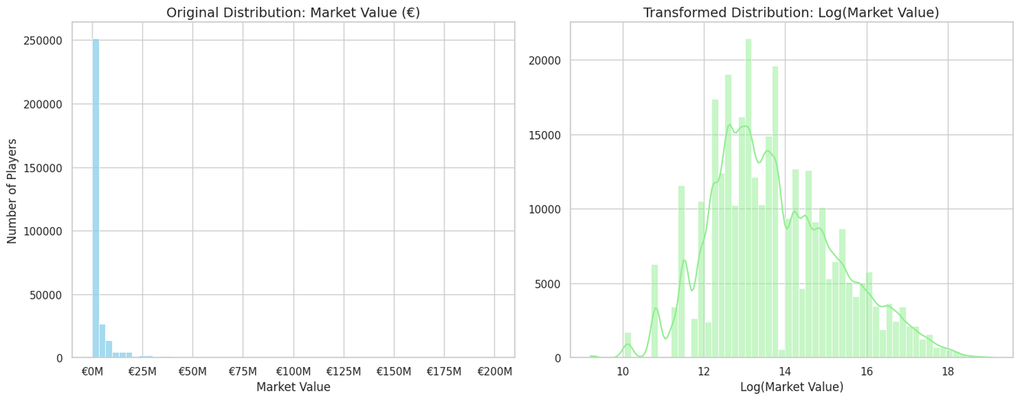

PROBLEM AND OBJECTIVE
Why this problem matters:
Transfer decisions involve high financial risk, and valuation is often subjective.
The football transfer market is inherently highly skewed
Accurate, data-driven valuations are critical for modern club strategy, contract negotiations, and adhering to financial fair play regulations.
Objective
Build a regression model to estimate market value from historical player data.
Evaluation targets
High R2 (explained variance)
Low MAE in EUR (real monetary error)
Notes:
This problem matters because transfer decisions involve high financial risk, and valuation is often subjective.
A key challenge is that football market values are highly right-skewed: most players are in lower value ranges, while a small elite has extremely high values.
So the objective is to build a regression model that handles this skewed distribution and still gives accurate, practical estimates.
Success is measured with two metrics: high R2 for explained variance and low MAE in euros for real-world financial error.

Slide 3
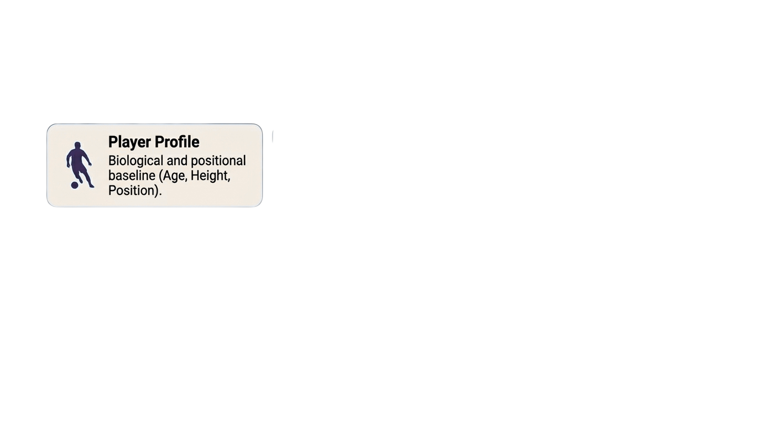
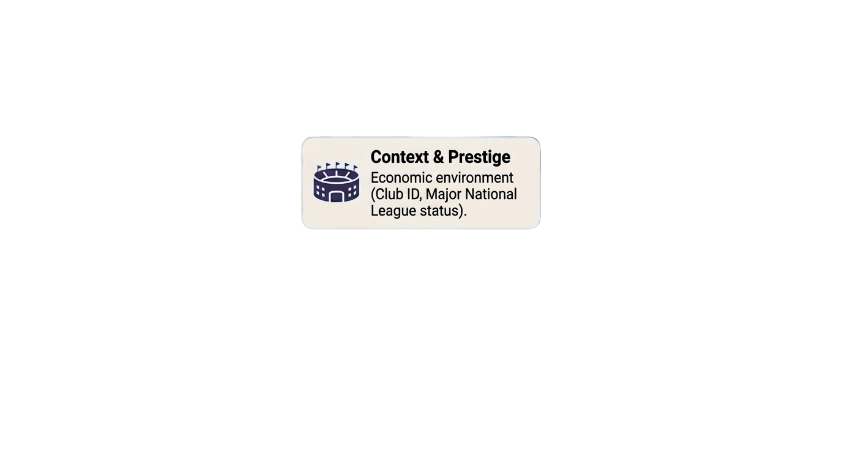
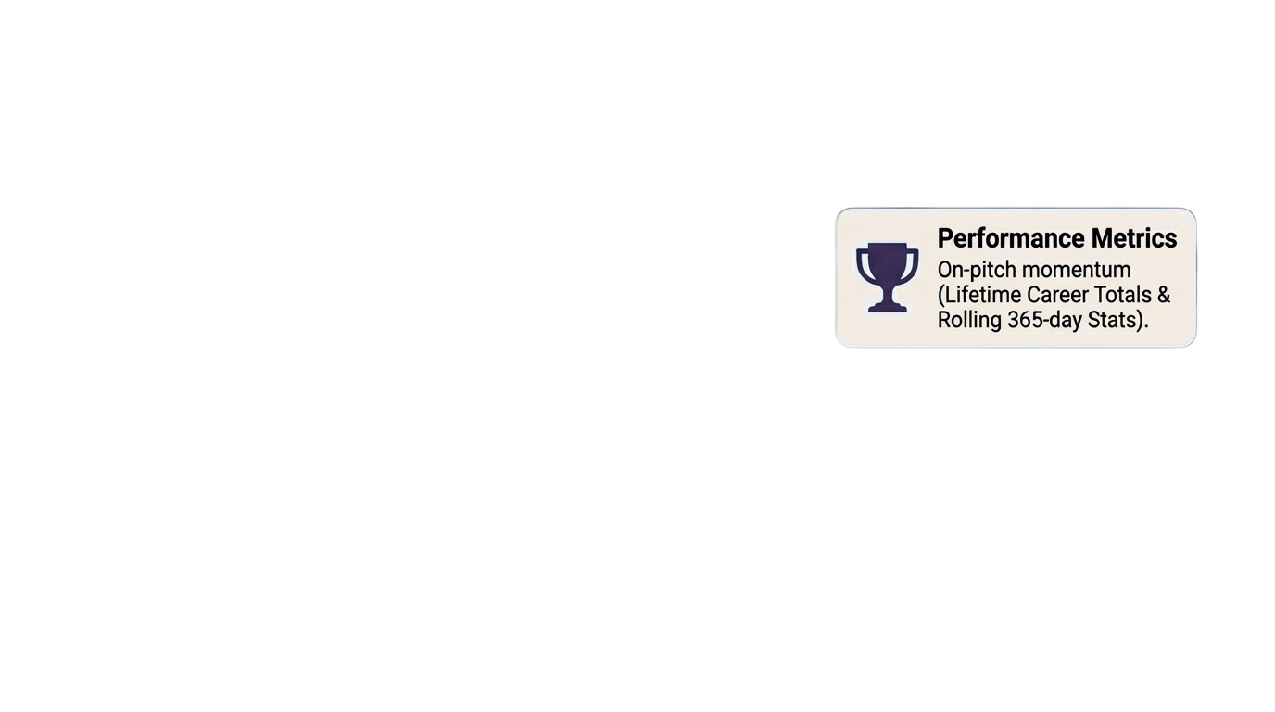

DATA OVERVIEW
Dataset source:
Kaggle - Player Scores
https://www.kaggle.com/datasets/davidcariboo/player-scores
Data Scope:
316,103 rows
Period: 2003 to 2026
Split strategy
Time-based train/test split (about 90/10) to avoid temporal leakage.
Notes:
For data, I used the Player Scores dataset from Kaggle, with more than 316,000 records from 2003 to 2026.
The features include player attributes, club and league information, and both career and recent performance indicators.
To avoid temporal leakage, I used a time-based split, with roughly 90 percent for training and 10 percent for testing.

Slide 4
ML PIPELINE
Preprocessing
Target Encoding (high-cardinality categorical features)
One-Hot Encoding (low-cardinality categorical features)
StandardScaler (numerical features)
Model training and tuning
Ridge, Lasso, Random Forest, XGBoost, LightGBM
Cross-validation and hyperparameter search
Evaluation
R2, RMSE, MAE
Notes:
The pipeline has three main steps.
First, preprocessing: target encoding for high-cardinality categorical variables, one-hot encoding for low-cardinality variables, and scaling for numeric features.
Second, model training and tuning with cross-validation.
Third, evaluation using R2, RMSE, and MAE, then selecting the best model for deployment.

Slide 5
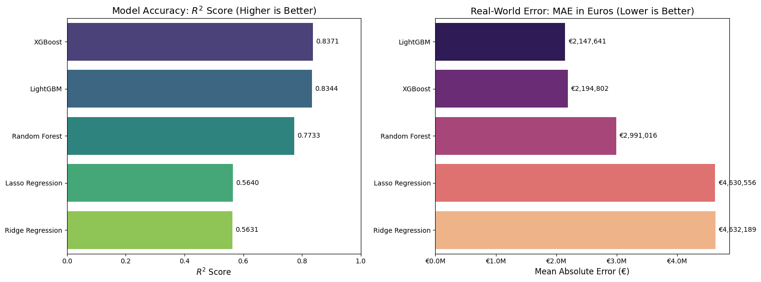
MODEL COMPARISON AND SELECTION
Notes:
I compared five models: Ridge, Lasso, Random Forest, LightGBM, and XGBoost.
XGBoost achieved the best overall R2 at 0.83,
LightGBM was very close, Random Forest was moderate, and linear models were clearly weaker.
Based on this comparison, XGBoost was selected as the champion model.

Slide 6
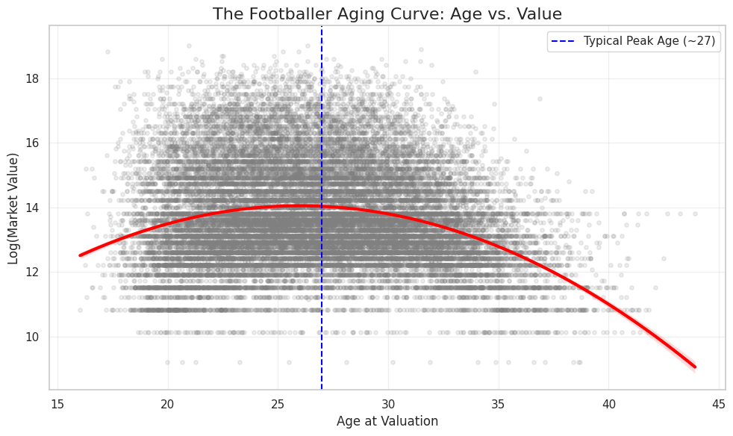
WHY BOOSTING WON?
Linear models severely underperformed because they fail to capture non-linear biological realities.
Player market value follows a strict aging curve (peaking at ~27 years old before declining).
XGBoost naturally captures these complex, non-linear feature interactions while efficiently handling the high complexity of our encoded historical data.

Slide 7
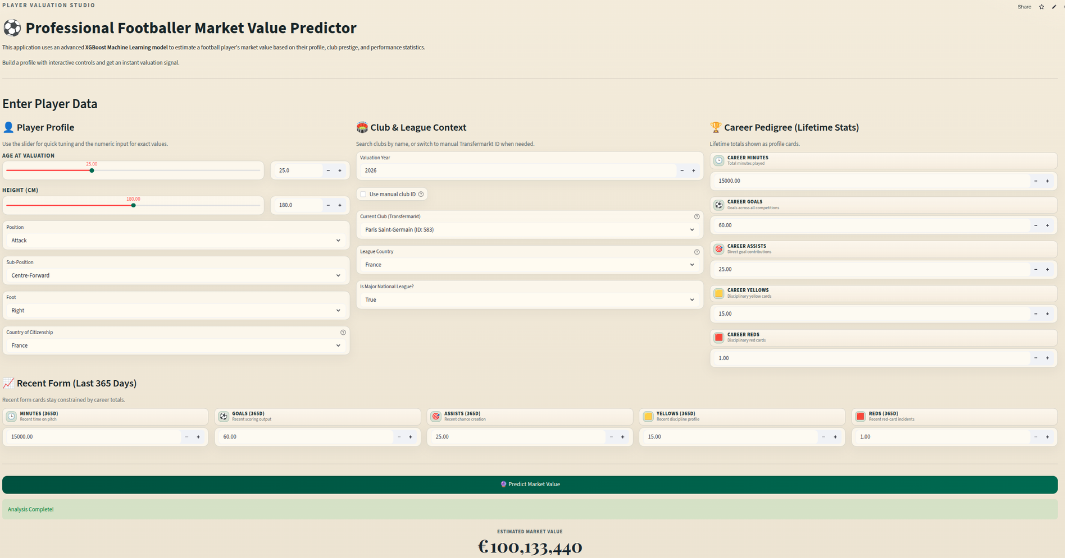
DEPLOYED APPLICATION
Notes:
this is the Application Deployed on a Streamlit Cloud Container
Users can input player profile, club context, and performance stats, then get an instant market value prediction.
This transforms the project from notebook analysis into a practical tool that can be demonstrated and used in real time.

Slide 8
CONCLUSION AND NEXT STEPS
Main takeaways:
XGBoost delivers the best overall predictive performance.
Time-based splitting improves realism for future-value prediction.
Current limitations:
No direct contract, injury, or marketing variables.
Market dynamics can shift quickly.
Next steps:
Add richer transfer-context features
Retrain periodically with new seasons (Automation)
Notes:
To conclude: first, the project confirms that the xgboost models outperforms linear baselines for this task.
Second, time-aware validation is essential for realistic market prediction.
For next steps, I would add richer contextual features like contract details and injuries,

Slide 9
THANK YOU

