Slide 1
Amazon Sales Analysis
Name : Khaled Elsafy
Dataset : Amazon Sales Dataset
1

Slide 2
Project Overview
Turning 100,000 Amazon orders into actionable business insights.
Orders
100,000
Original Columns
20
Years
2020–2024
Sellers
1,999
• Understand sales performance and order patterns.
• Analyze customer behavior and repeat purchases.
• Identify strong and weak products, categories, brands and markets.
• Translate findings into practical business recommendations.
2

Slide 3
Problem Statement
Business Question
What drives order volume and sales performance across customers, products and markets?
• Which products and categories perform best?
• Where are the strongest markets?
• How do customers behave and how often do they repeat?
• Which brands and sellers stand out?
• What patterns can support better business decisions?
3

Slide 4
Objectives
Sales
Measure sales
and order performance.
Customers
Understand purchase frequency and repeat behavior.
Products
Identify best- and worst-performing products.
Markets
Compare countries and states.
Business
Turn analysis into clear actions.
4

Slide 5
Dataset Overview
Amazon Sales Dataset used for the analysis.
Rows
100,000
Original Columns
20
Final Columns
22
Order Value
Avg. 918
Median: 714
• Key fields: OrderID, CustomerID, ProductName, Category, Brand, Quantity, TotalAmount, Country, State and SellerID.
• Numeric fields include Quantity, UnitPrice, Discount, Tax, ShippingCost and TotalAmount.
• OrderDate was converted to datetime and Year was extracted.
5

Slide 6
Data Cleaning
Major data-quality checks and transformations.
Missing Values
0
No null values
Duplicate Rows
0
No duplicates
OrderDate
Converted
Object → datetime
CustomerKey
Created
ID + Name
• CustomerID was not fully reliable as a unique customer identifier because the same ID appeared with different customer names.
• A CustomerKey combining CustomerID and CustomerName was created for customer-level analysis.
• No rows were removed for missing values or duplicates.
6

Slide 7
Analytical Questions
• Which products are ordered the most and the least?
• Which category and brand generate the strongest performance?
• Which countries and states have the most orders?
• How many customers repeat their purchases?
• How are orders distributed across years?
• How do seller order volumes compare?
• Is order value related to quantity or shipping cost?
7

Slide 8
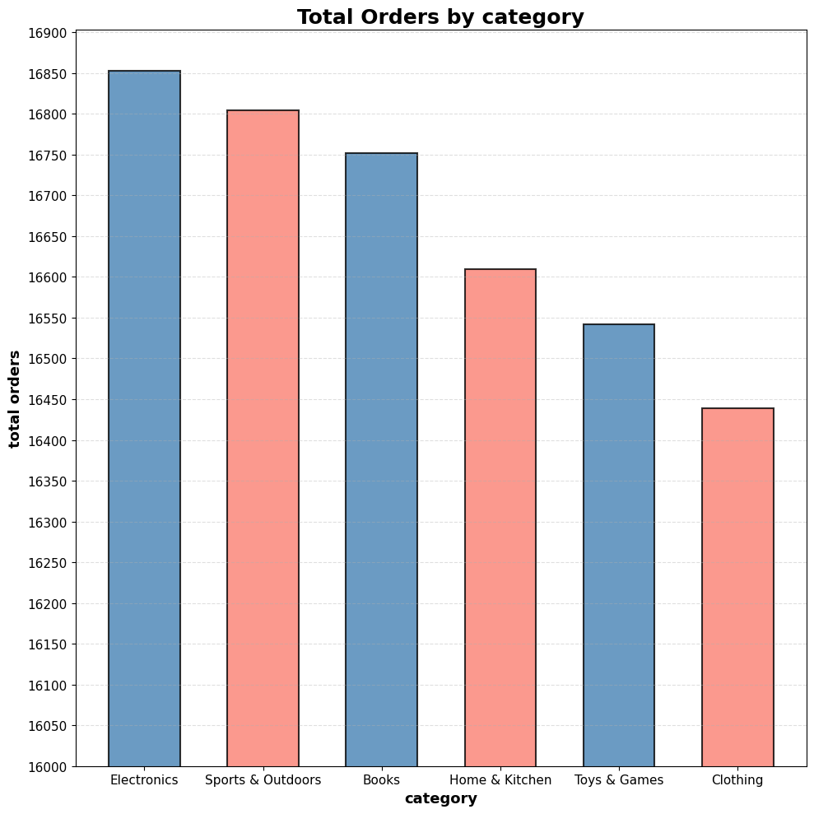
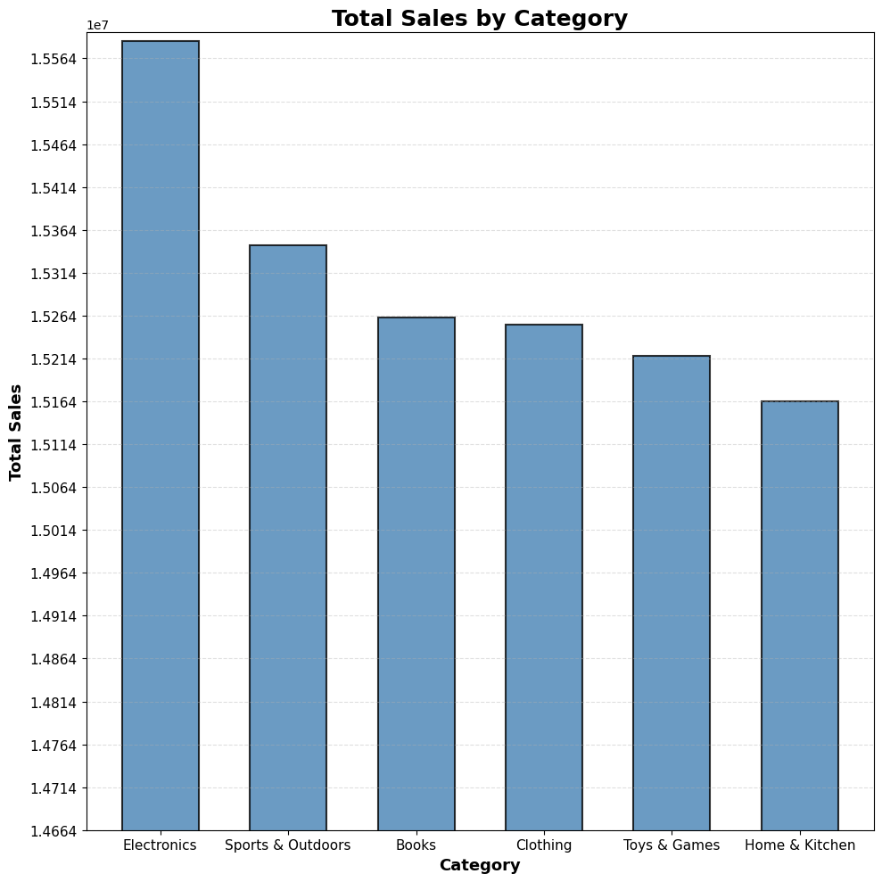
Finding 1 — Product & Category Performance
Insight: LED Desk Lamp is the most ordered product (6,344 units). Electronics leads by order volume (16,853).
8

Slide 9
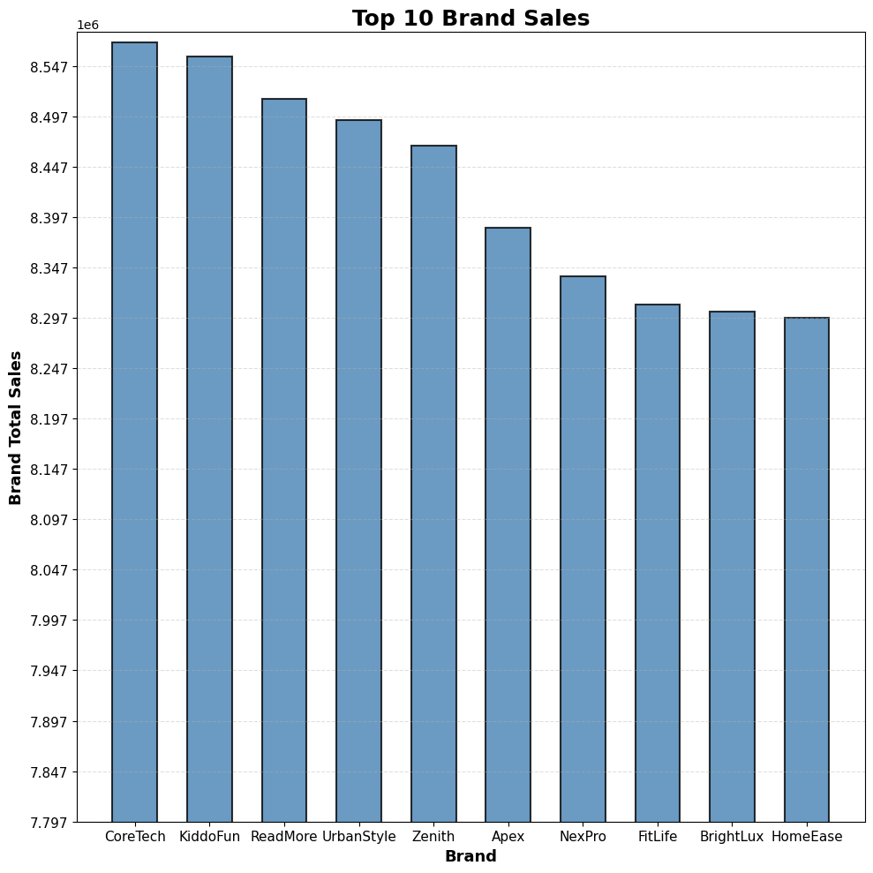
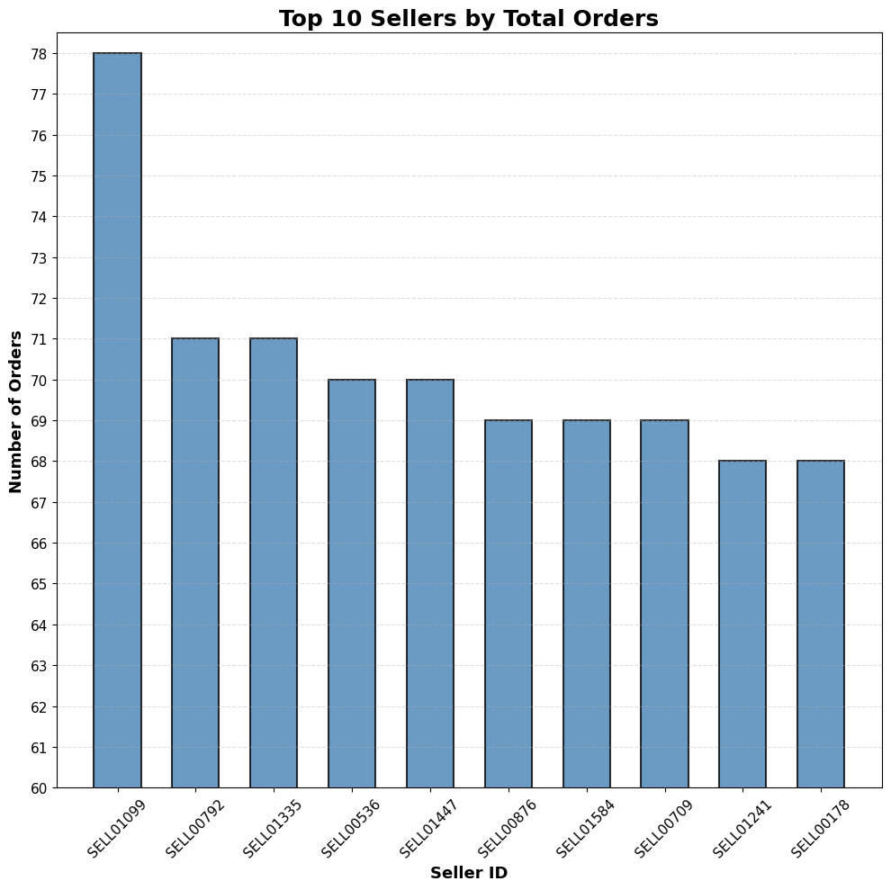
Finding 2 — Brand & Seller Performance
Insight: CoreTech has the highest brand sales (~8.57M). Top sellers handle about 78 orders.
9

Slide 10
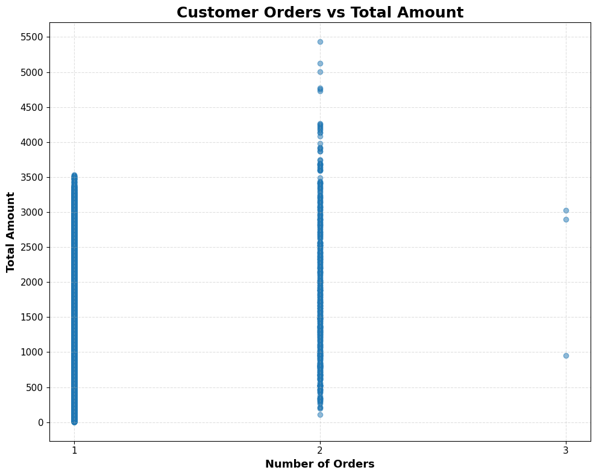
Finding 3 — Customer Behavior
CustomerKey
99,500
Used for customer-level analysis
1 Order
99,003 customers
Most customers
2 Orders
494 customers
Repeat customers
Insight: Most customers made only 1 order, so retention is a clear growth opportunity.
10

Slide 11
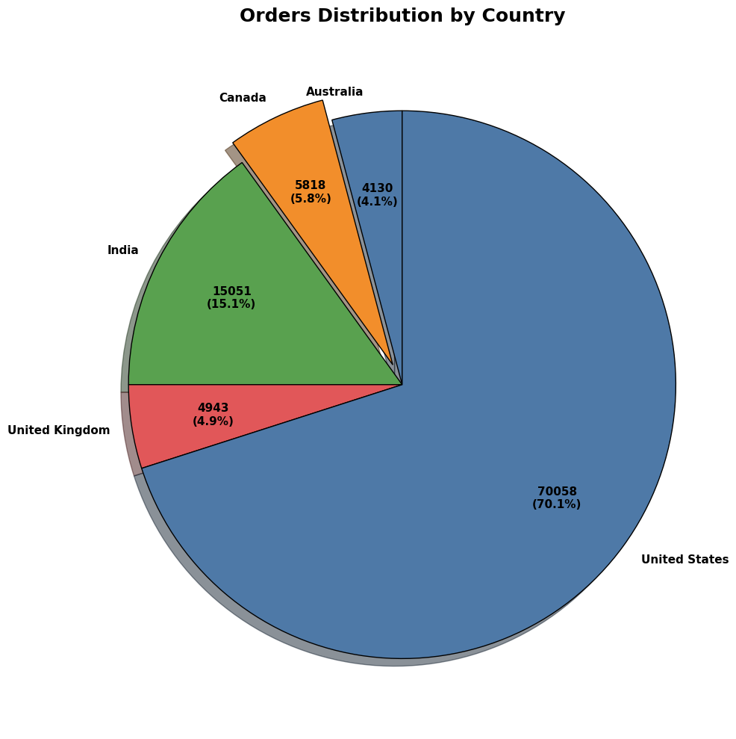
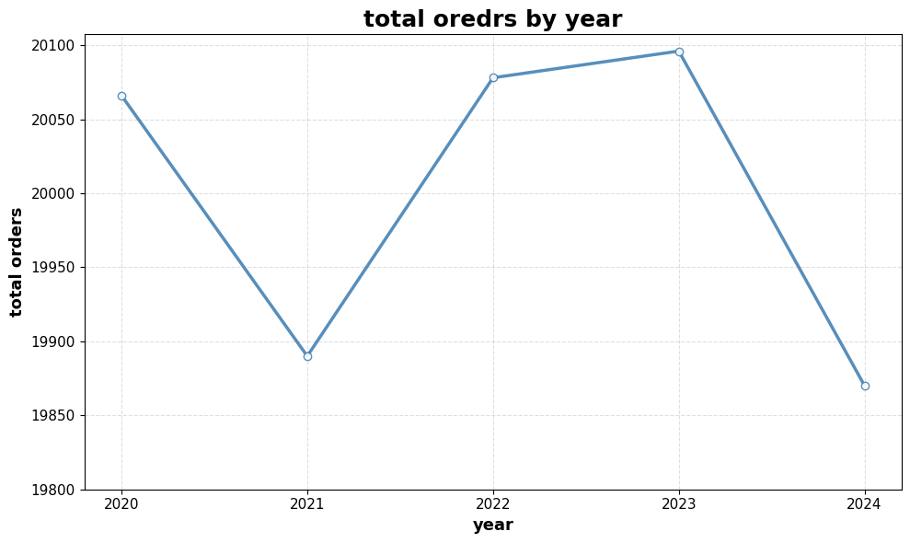
Finding 4 — Geographic & Time Trends
Insight: The US leads with 70,058 orders; Texas leads states with 24,896. 2023 has the highest yearly order volume (20,096).
11

Slide 12
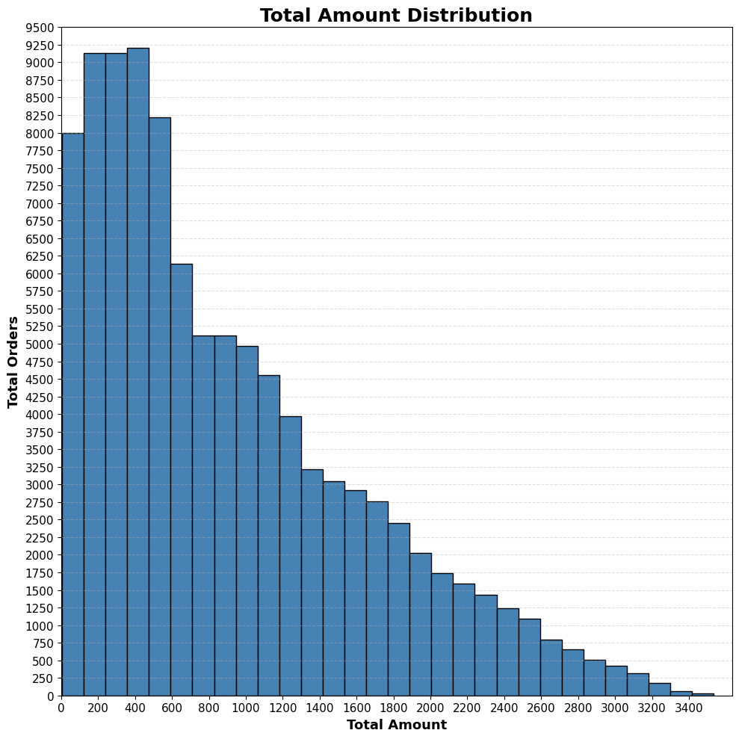
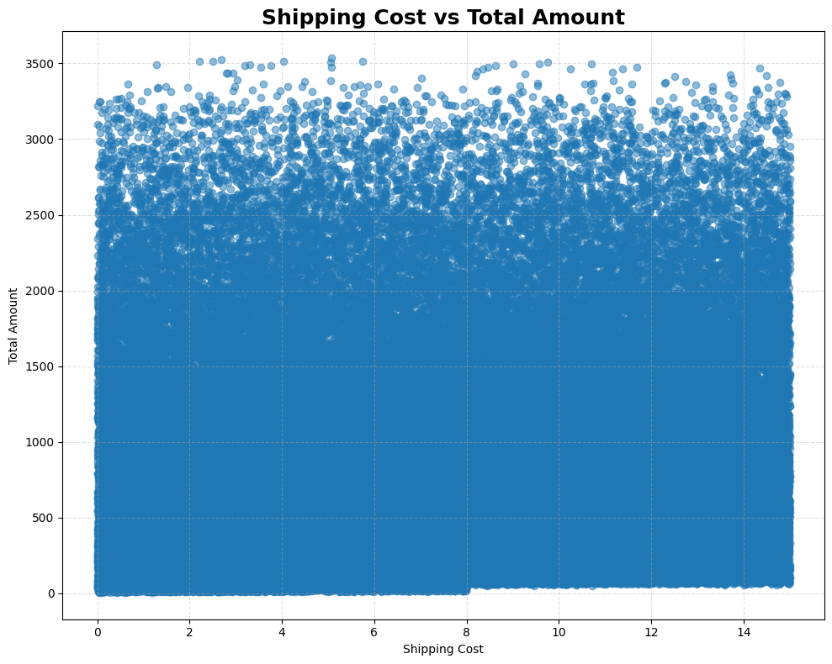
Finding 5 — Order Value & Shipping
Insight: Average order value is ~918 versus a median of ~714; order values are strongly concentrated at the lower end.
12

Slide 13
Key Insights
Best and weakest performers from the analysis.
BEST PERFORMERS
• Best Product: LED Desk Lamp — 6,344 units.
• Best Category: Electronics — 16,853 orders.
• Best Brand: CoreTech — ~8.57M sales.
• Best Market: United States — 70,058 orders.
• Best State: Texas — 24,896 orders.
• Highest Year: 2023 — 20,096 orders.
AREAS TO IMPROVE
• Lowest Product: Children's Book — 5,619 units.
• Lowest Category: Clothing — 16,439 orders.
• Lowest Brand: HomeEase — ~8.30M sales.
• Lowest Market: Australia — 4,130 orders.
• Lowest State: Arizona — 4,941 orders.
• Customer behavior: 99,003 customers made only 1 order.
13

Slide 14
Recommendations
What an owner or seller can do next.
Protect the winners
Prioritize Electronics, CoreTech and high-demand products.
1
1
Grow repeat purchases
Use loyalty offers and targeted follow-ups for one-time customers.
2
2
Focus the strongest market
Keep strong inventory and marketing coverage in the US, especially Texas.
3
3
Improve weak areas
Review Clothing, HomeEase and lower-volume markets for pricing, product mix and promotion.
4
4
Learn from top sellers
Compare top sellers' products and order patterns with lower-performing sellers.
5
5
14

Slide 15
Conclusion
• The analysis shows a large and diverse sales base with clear differences across products, brands and markets.
• Electronics, CoreTech, the US and Texas are the strongest areas.
• Most customers make only one purchase, making retention the clearest growth opportunity.
• The results can guide inventory, marketing and customer-retention decisions.
From data → insights → business action
15

Slide 16
Thank You
Khaled Elsafy
Amazon Sales Analysis
16

