Slide 1
Amazon Sales Analysis
Name : Khaled Elsafy
Dataset : Amazon Sales Dataset
1

Slide 2
Project Overview
Turning 100,000 Amazon orders into actionable business insights.
Orders
100,000
Original Columns
20
Years
2020 – 2024
Sellers
1,999
• Understand sales performance and order patterns.
• Analyze customer behavior and repeat purchases.
• Identify strong and weak products, categories, brands and markets.
• Translate findings into practical business recommendations.
2

Slide 3
Problem Statement
Business Question
What drives order volume and sales performance across customers, products and markets?
• Which products and categories perform best?
• Where are the strongest markets?
• How do customers behave and how often do they repeat?
• Which brands and sellers stand out?
• What patterns can support better business decisions?
3

Slide 4
Objectives
Sales
Measure sales
and order performance.
Customers
Understand purchase frequency and repeat behavior.
Products
Identify best and worst performing products.
Markets
Compare countries and states.
Business
Turn analysis into clear actions.
4

Slide 5
Dataset Overview
Amazon Sales Dataset used for the analysis.
Rows
100,000
Original Columns
20
Final Columns
22
Order Value
Avg. 918
Median: 714
• Key fields: OrderID, CustomerID, ProductName, Category, Brand, Quantity, TotalAmount, Country, State and SellerID.
• Numeric fields include Quantity, UnitPrice, Discount, Tax, ShippingCost and TotalAmount.
• OrderDate was converted to datetime and Year was extracted.
5

Slide 6
Data Cleaning
Major data-quality checks and transformations.
Missing Values
0
No null values
Duplicate Rows
0
No duplicates
OrderDate
Converted
Object → datetime
CustomerKey
Created
ID + Name
• CustomerID was not fully reliable as a unique customer identifier because the same ID appeared with different customer names.
• A CustomerKey combining CustomerID and CustomerName was created for customer-level analysis.
• No rows were removed for missing values or duplicates.
6

Slide 7
Analytical Questions
• Which products are ordered the most and the least?
• Which category and brand generate the strongest performance?
• Which countries and states have the most orders?
• How many customers repeat their purchases?
• How are orders distributed across years?
• How do seller order volumes compare?
• Is order value related to quantity or shipping cost?
7

Slide 8
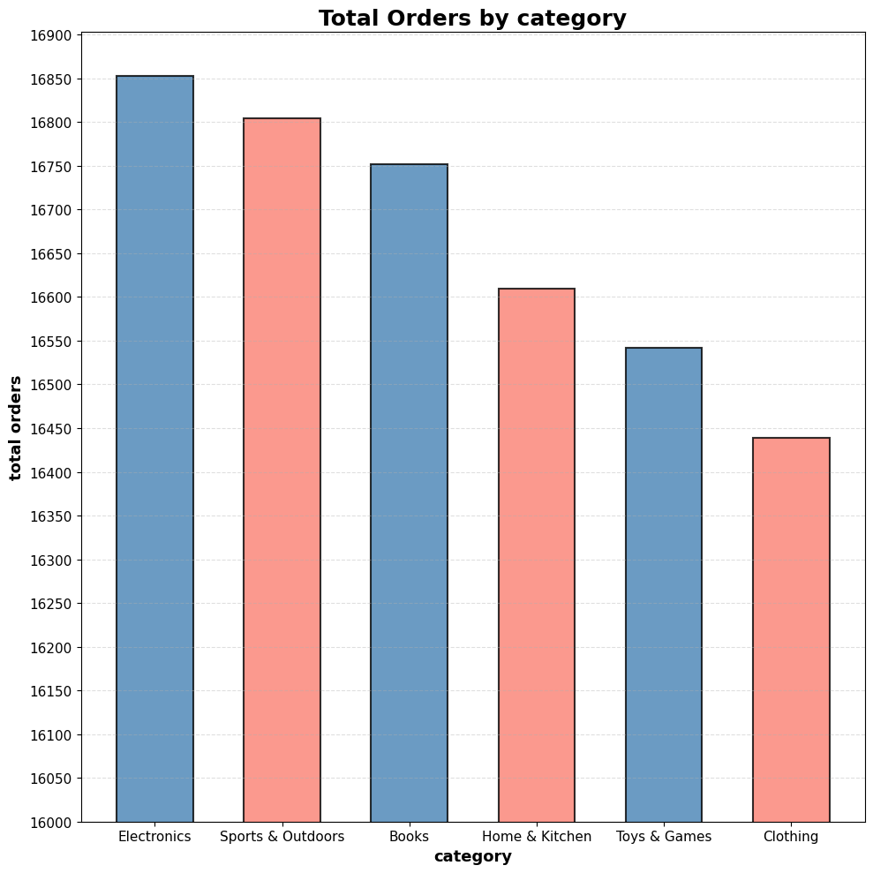
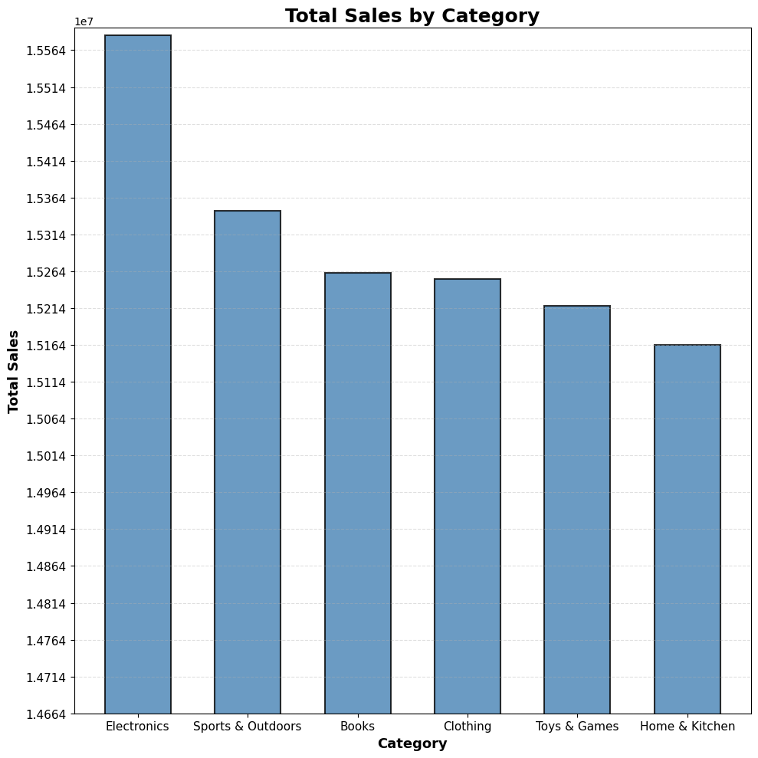
Finding 1 — Product & Category Performance
Insight: LED Desk Lamp is the most ordered product (6,344 units). Electronics leads by order volume (16,853).
8

Slide 9
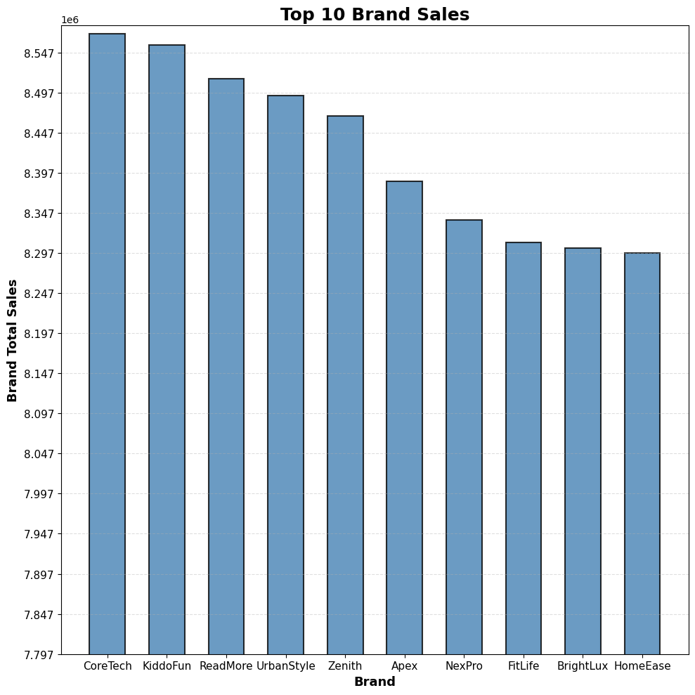

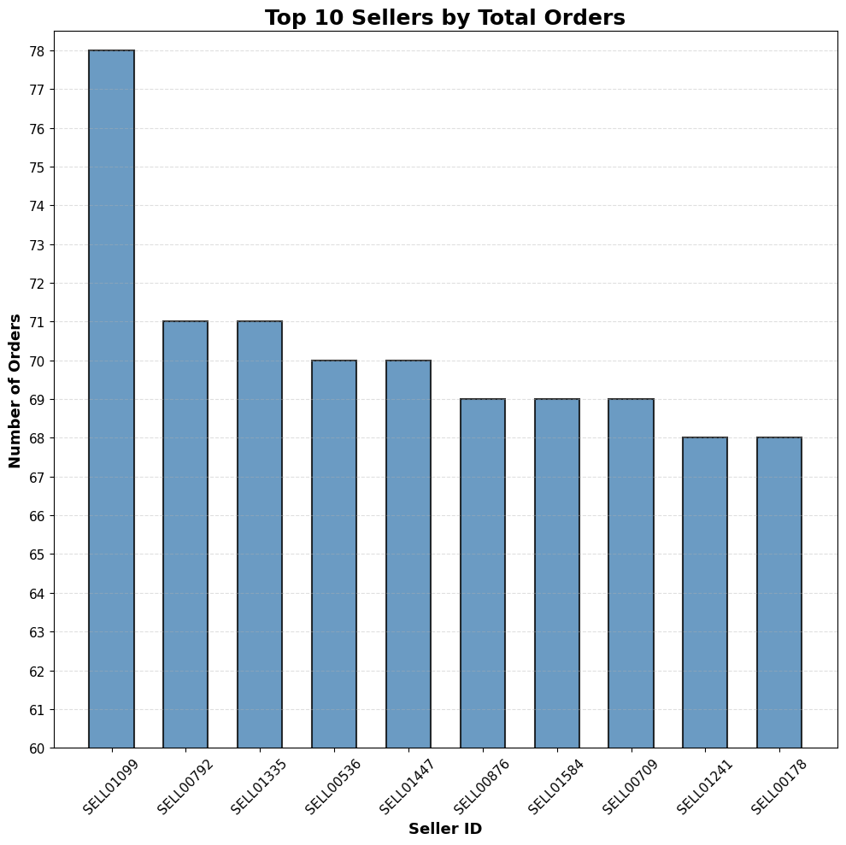
Finding 2 — Brand & Seller Performance
Insight: CoreTech has the highest brand sales (~8.57M). Top sellers handle about 78 orders.
8

Slide 10
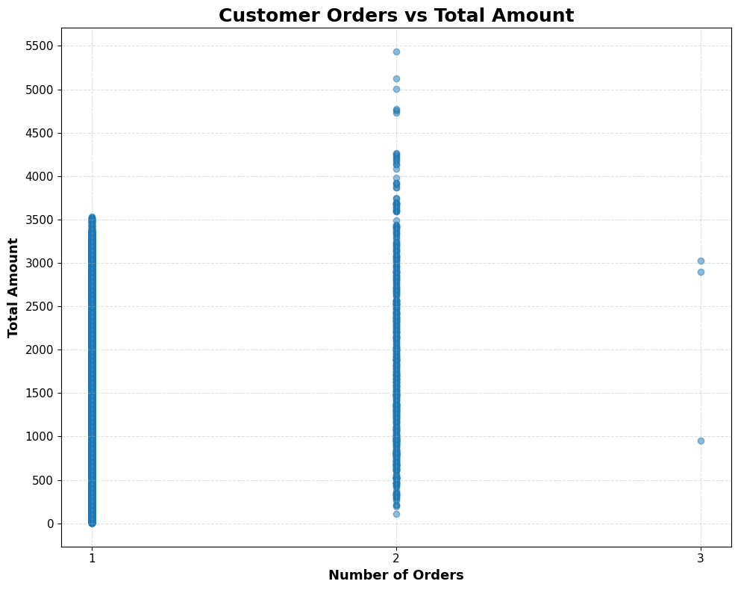
Finding 3 — Customer Behavior
CustomerKey
99,500
Used for customer-level analysis
1 Order
99,003 customers
Most customers
2 Orders
494 customers
Repeat customers
Insight: Most customers made only 1 order, so retention is a clear growth opportunity.
10

Slide 11
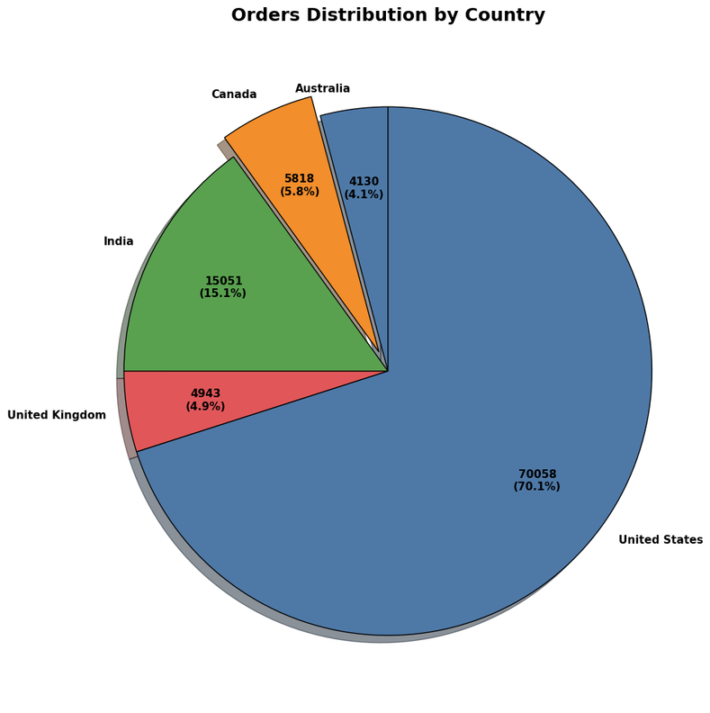
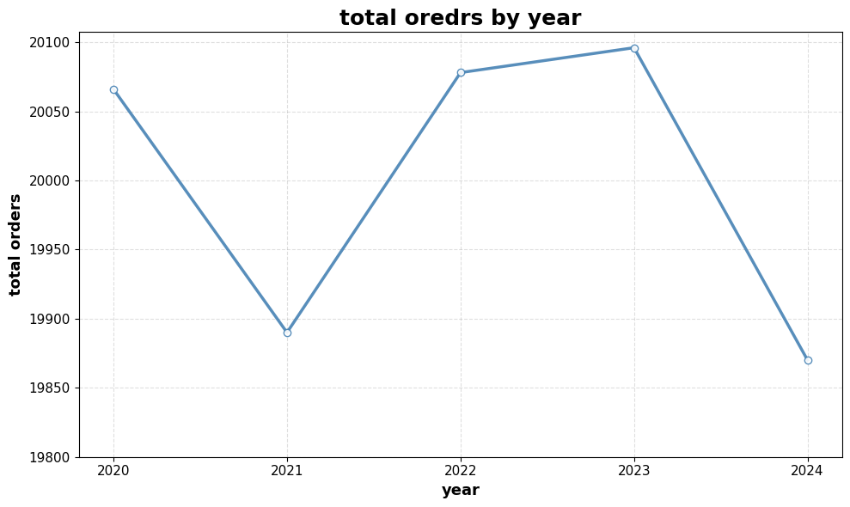
Finding 4 — Geographic & Time Trends
Insight: The US leads with 70,058 orders; Texas leads states with 24,896. 2023 has the highest yearly order volume (20,096).
11

Slide 12
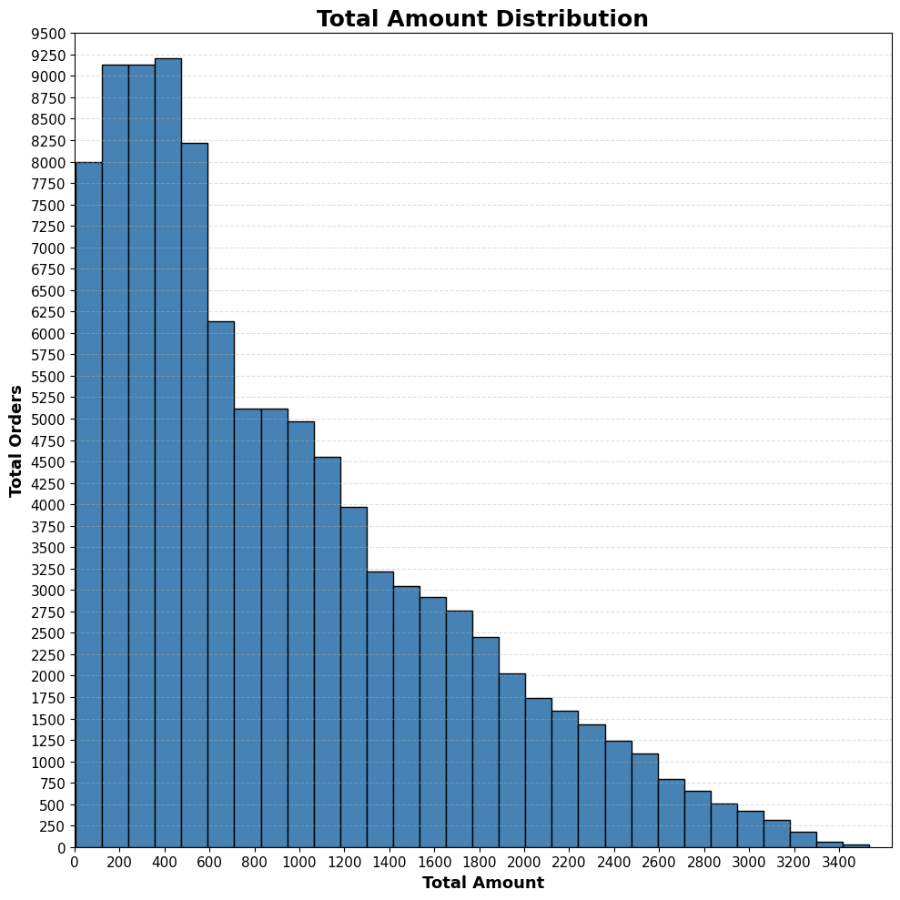
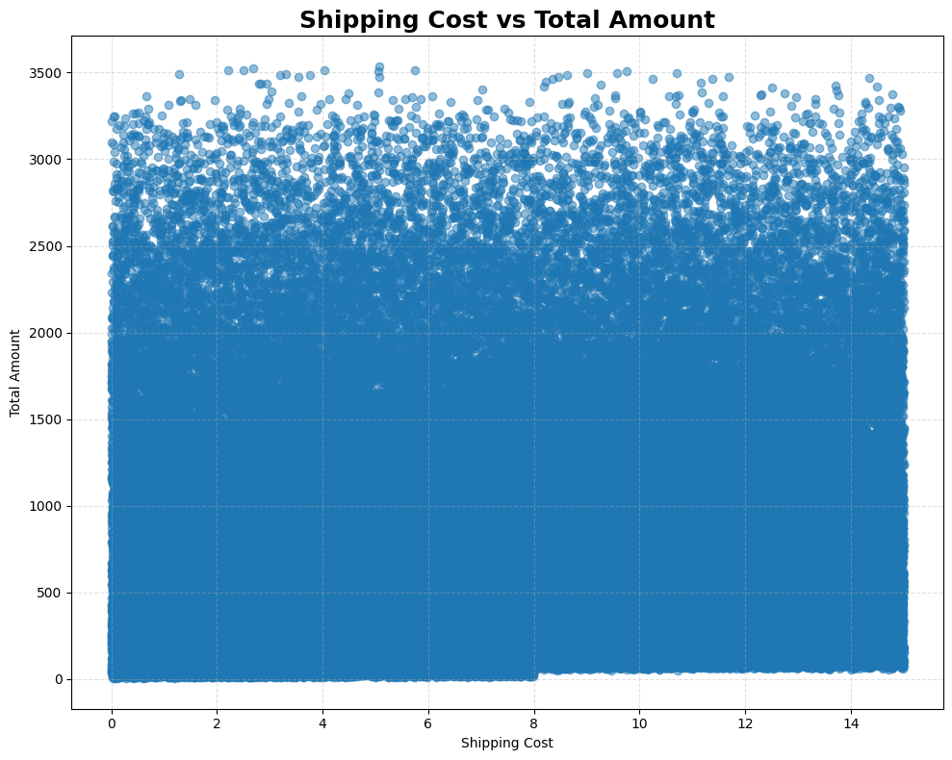
Finding 5 — Order Value & Shipping
Insight: Average order value is ~918 versus a median of ~714; order values are strongly concentrated at the lower end.
12

Slide 13
Key Insights
Best and weakest performers from the analysis.
BEST PERFORMERS
• Best Product: LED Desk Lamp — 6,344 units.
• Best Category: Electronics — 16,853 orders.
• Best Brand: CoreTech — ~8.57M sales.
• Best Market: United States — 70,058 orders.
• Best State: Texas — 24,896 orders.
• Highest Year: 2023 — 20,096 orders.
AREAS TO IMPROVE
• Lowest Product: Children's Book — 5,619 units.
• Lowest Category: Clothing — 16,439 orders.
• Lowest Brand: HomeEase — ~8.30M sales.
• Lowest Market: Australia — 4,130 orders.
• Lowest State: Arizona — 4,941 orders.
• Customer behavior: 99,003 customers made only 1 order.
13

Slide 14
Recommendations
What an owner or seller can do next.
1
Protect the winners
Prioritize Electronics, CoreTech and high-demand products.
2
Grow repeat purchases
Use loyalty offers and targeted follow-ups for one-time customers.
3
Focus the strongest market
Keep strong inventory and marketing coverage in the US, especially Texas.
4
Improve weak areas
Review Clothing, HomeEase and lower-volume markets for pricing, product mix and promotion.
5
5
Learn from top sellers
Compare top sellers' products and order patterns with lower-performing sellers.
14

Slide 15
Conclusion
• The analysis shows a large and diverse sales base with clear differences across products, brands and markets.
• Electronics, CoreTech, the US and Texas are the strongest areas.
• Most customers make only one purchase, making retention the clearest growth opportunity.
• The results can guide inventory, marketing and customer-retention decisions.
From data → insights → business action
15

Slide 16
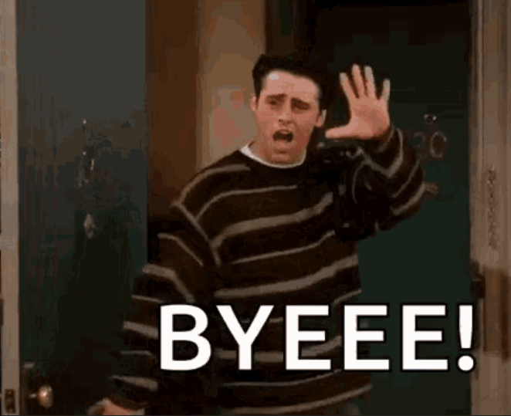
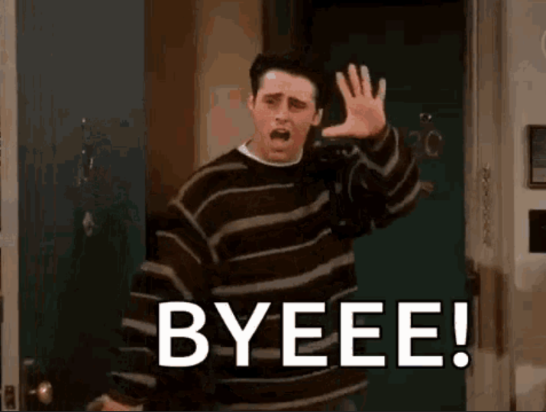
Khaled Elsafy
16

