Slide 1
Chapter 1:
An Overview of Computers and Programming Languages

Slide 2
Objectives
In this chapter, you will:
  Learn about different types of computers
  Explore hardware and software
  Learn about the language of a computer
  Learn about the evolution of programming languages
  Examine high-level programming languages
C++ Programming: From Problem Analysis to Program Design, Sixth Edition

Slide 3
Objectives (cont’d.)
  Discover what a compiler is and what it does
  Examine a C++ program
  Explore how a C++ program is processed
  Learn what an algorithm is and explore problem-solving techniques
  Become aware of structured design and object-oriented design programming methodologies
  Become aware of Standard C++ and ANSI/ISO Standard C++
C++ Programming: From Problem Analysis to Program Design, Sixth Edition

Slide 4
Introduction
Without software, the computer is useless
Software is developed with programming languages
  C++ is a programming language
C++ suited for a wide variety of programming tasks
C++ Programming: From Problem Analysis to Program Design, Sixth Edition

Slide 5
A Brief Overview of the History of Computers
Early calculation devices
  Abacus, Pascaline
  Leibniz device
  Jacquard’s weaving looms
  Babbage machines: difference and analytic engines
  Hollerith machine
C++ Programming: From Problem Analysis to Program Design, Sixth Edition

Slide 6
A Brief Overview of the History of Computers (cont’d.)
Early computer-like machines
  Mark I
  ENIAC
  Von Neumann architecture
  UNIVAC
  Transistors and microprocessors
C++ Programming: From Problem Analysis to Program Design, Sixth Edition

Slide 7
A Brief Overview of the History of Computers (cont’d.)
Categories of computers
  Mainframe computers
  Midsize computers
  Micro computers (personal computers)
C++ Programming: From Problem Analysis to Program Design, Sixth Edition

Slide 8
Elements of a Computer System
Hardware
CPU
Main memory
Secondary storage
Input/Output devices
Software
C++ Programming: From Problem Analysis to Program Design, Sixth Edition

Slide 9
Hardware
CPU
Main memory: RAM
Input/output devices
Secondary storage
C++ Programming: From Problem Analysis to Program Design, Sixth Edition

Slide 10
Central Processing Unit and Main Memory
Central processing unit
  Brain of the computer
  Most expensive piece of hardware
  Carries out arithmetic and logical operations
C++ Programming: From Problem Analysis to Program Design, Sixth Edition

Slide 11
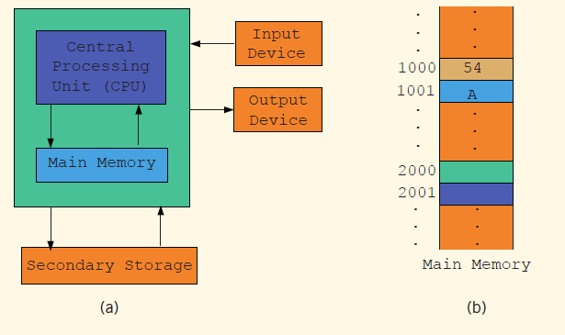
Central Processing Unit and Main Memory (cont’d.)
C++ Programming: From Problem Analysis to Program Design, Sixth Edition

Slide 12
Central Processing Unit and Main Memory (cont'd.)
Random access memory
  Directly connected to the CPU
All programs must be loaded into main memory before they can be executed
All data must be brought into main memory before it can be manipulated
When computer power is turned off, everything in main memory is lost
C++ Programming: From Problem Analysis to Program Design, Sixth Edition

Slide 13
Central Processing Unit and Main Memory (cont’d.)
Main memory is an ordered sequence of memory cells
  Each cell has a unique location in main memory, called the address of the cell
Each cell can contain either a programming instruction or data
C++ Programming: From Problem Analysis to Program Design, Sixth Edition

Slide 14
Secondary Storage
Secondary storage: device that stores information permanently
Examples of secondary storage:
  Hard disks
  Flash drives
  Floppy disks
  Zip disks
  CD-ROMs
  Tapes
C++ Programming: From Problem Analysis to Program Design, Sixth Edition

Slide 15
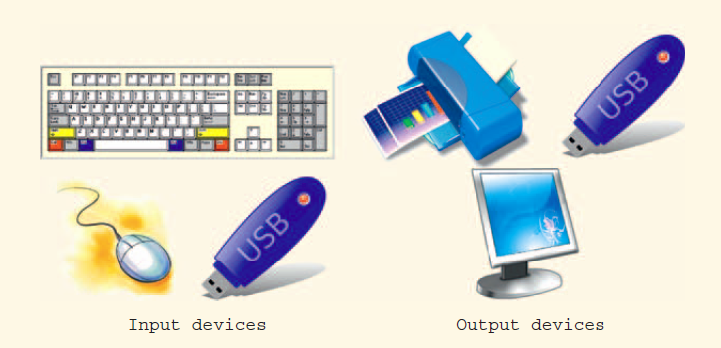

Input/Output Devices
Input devices feed data and programs into computers
  Keyboard
  Mouse
  Secondary storage
Output devices
display results
  Monitor
  Printer
  Secondary storage
C++ Programming: From Problem Analysis to Program Design, Sixth Edition

Slide 16
Software
Software: programs that do specific tasks
System programs control the computer
  Operating system monitors the overall activity of the computer and provides services such as:
    Memory management
    Input/output activities
    Storage management
Application programs perform a specific task
  Word processors
  Spreadsheets
  Games
C++ Programming: From Problem Analysis to Program Design, Sixth Edition

Slide 17
The Language of a Computer
Analog signals: continuous wave forms
Digital signals: sequences of 0s and 1s
Machine language: language of a computer; a sequence of 0s and 1s
Binary digit (bit): the digit 0 or 1
Binary code (binary number): a sequence of 0s
and 1s
C++ Programming: From Problem Analysis to Program Design, Sixth Edition

Slide 18
The Language of a Computer (cont’d.)
Byte:
  A sequence of eight bits
Kilobyte (KB): 2¹⁰ bytes = 1024 bytes
ASCII (American Standard Code for Information Interchange)
  128 characters
  A is encoded as 1000001 (66th character)
  3 is encoded as 0110011
C++ Programming: From Problem Analysis to Program Design, Sixth Edition

Slide 19
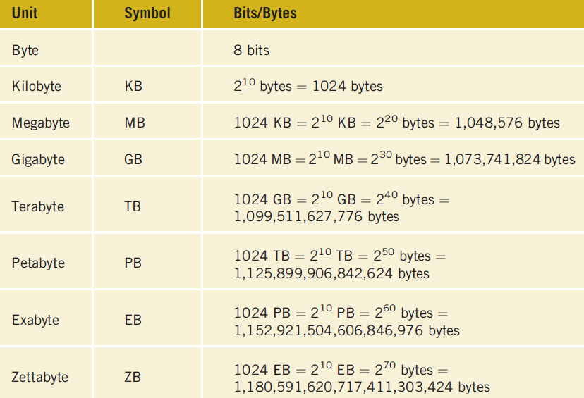
The Language of a Computer (cont’d.)
C++ Programming: From Problem Analysis to Program Design, Sixth Edition

Slide 20
The Language of a Computer (cont’d.)
EBCDIC
  Used by IBM
  256 characters
Unicode
  65536 characters
  Two bytes are needed to store a character
C++ Programming: From Problem Analysis to Program Design, Sixth Edition

Slide 21
The Evolution of Programming Languages
Early computers were programmed in machine language
To calculate wages = rate * hours in machine language:
100100 010001 //Load
100110 010010 //Multiply
100010 010011 //Store
C++ Programming: From Problem Analysis to Program Design, Sixth Edition

Slide 22
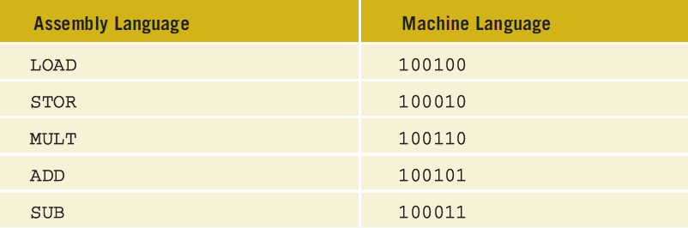
The Evolution of Programming Languages (cont’d.)
Assembly language instructions are mnemonic
Assembler: translates a program written in assembly language into machine language
C++ Programming: From Problem Analysis to Program Design, Sixth Edition

Slide 23
The Evolution of Programming Languages (cont’d.)
Using assembly language instructions, wages = rate • hours can be written as:
  LOAD rate
  MULT hour
  STOR wages
C++ Programming: From Problem Analysis to Program Design, Sixth Edition

Slide 24
The Evolution of Programming Languages (cont’d.)
High-level languages include Basic, FORTRAN, COBOL, Pascal, C, C++, C#, and Java
Compiler: translates a program written in a high-level language into machine language
The equation wages = rate • hours can be written in C++ as:
wages = rate * hours;
C++ Programming: From Problem Analysis to Program Design, Sixth Edition

Slide 25
Processing a C++ Program
#include <iostream>
using namespace std;
int main()
{
cout << "My first C++ program." << endl;
return 0;
}
Sample Run:
My first C++ program.
C++ Programming: From Problem Analysis to Program Design, Sixth Edition

Slide 26
Processing a C++ Program (cont’d.)
To execute a C++ program:
  Use an editor to create a source program in C++
  Preprocessor directives begin with # and are processed by the preprocessor
  Use the compiler to:
    Check that the program obeys the language rules
    Translate into machine language (object program)
C++ Programming: From Problem Analysis to Program Design, Sixth Edition

Slide 27
Processing a C++ Program (cont’d.)
To execute a C++ program (cont'd.):
  Linker:
    Combines object program with other programs provided by the SDK to create executable code
    Library: contains prewritten code you can use
  Loader:
    Loads executable program into main memory
  The last step is to execute the program
Some IDEs do all this with a Build or Rebuild command
C++ Programming: From Problem Analysis to Program Design, Sixth Edition

Slide 28
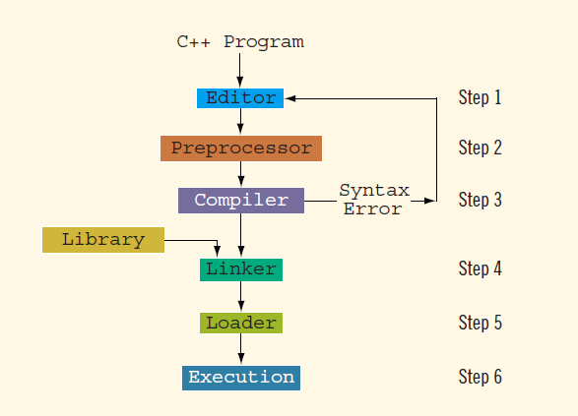
Processing a C++ Program (cont’d.)
C++ Programming: From Problem Analysis to Program Design, Sixth Edition

Slide 29
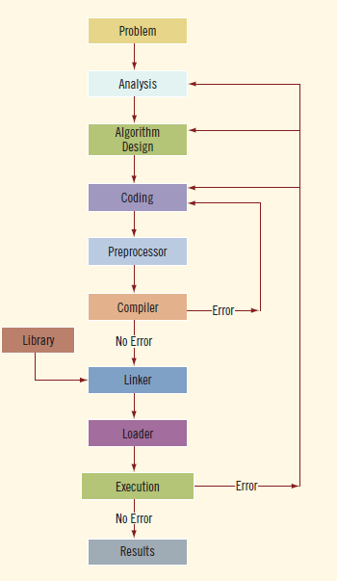
Programming with the Problem Analysis–Coding–Execution Cycle
Algorithm:
  Step-by-step problem-solving process
  Solution achieved in finite amount of time
Programming is a process of problem solving
C++ Programming: From Problem Analysis to Program Design, Sixth Edition

Slide 30
The Problem Analysis–Coding–Execution Cycle (cont’d.)
Step 1: Analyze the problem
  Outline the problem and its requirements
  Design steps (algorithm) to solve the problem
Step 2: Implement the algorithm
  Implement the algorithm in code
  Verify that the algorithm works
Step 3: Maintenance
  Use and modify the program if the problem domain changes
C++ Programming: From Problem Analysis to Program Design, Sixth Edition

Slide 31
The Problem Analysis–Coding–Execution Cycle (cont’d.)
Thoroughly understand the problem and all requirements
  Does program require user interaction?
  Does program manipulate data?
  What is the output?
If the problem is complex, divide it into subproblems
  Analyze and design algorithms for each subproblem
Check the correctness of algorithm
  Can test using sample data
  Some mathematical analysis might be required
C++ Programming: From Problem Analysis to Program Design, Sixth Edition

Slide 32
The Problem Analysis–Coding–Execution Cycle (cont’d.)
Once the algorithm is designed and correctness verified
  Write the equivalent code in high-level language
Enter the program using text editor
C++ Programming: From Problem Analysis to Program Design, Sixth Edition

Slide 33
The Problem Analysis–Coding–Execution Cycle (cont’d.)
Run code through compiler
If compiler generates errors
  Look at code and remove errors
  Run code again through compiler
If there are no syntax errors
  Compiler generates equivalent machine code
Linker links machine code with system resources
C++ Programming: From Problem Analysis to Program Design, Sixth Edition

Slide 34
The Problem Analysis–Coding–Execution Cycle (cont’d.)
Once compiled and linked, loader can place program into main memory for execution
The final step is to execute the program
Compiler guarantees that the program follows the rules of the language
  Does not guarantee that the program will run correctly
C++ Programming: From Problem Analysis to Program Design, Sixth Edition

Slide 35
Example 1-1
Design an algorithm to find the perimeter and area of a rectangle
The perimeter and area of the rectangle are given by the following formulas:
perimeter = 2 * (length + width)
area = length * width
C++ Programming: From Problem Analysis to Program Design, Sixth Edition

Slide 36
Example 1-1 (cont’d.)
Algorithm:
  Get length of the rectangle
  Get width of the rectangle
  Find the perimeter using the following equation:
perimeter = 2 * (length + width)
  Find the area using the following equation:
area = length * width
C++ Programming: From Problem Analysis to Program Design, Sixth Edition

Slide 37
Example 1-5
Calculate each student’s grade
  10 students in a class; each student has taken five tests; each test is worth 100 points
Design algorithms to:
  Calculate the grade for each student and class average
  Find the average test score
  Determine the grade
Data: students’ names; test scores
C++ Programming: From Problem Analysis to Program Design, Sixth Edition

Slide 38
Example 1-5 (cont’d.)
Algorithm to determine the average test score:
  Get the five test scores
  Add the five test scores
    Suppose sum stands for the sum of the test scores
  Suppose average stands for the average test score:
    average = sum / 5;
C++ Programming: From Problem Analysis to Program Design, Sixth Edition

Slide 39
Example 1-5 (cont’d.)
Algorithm to determine the grade:
if average is greater than or equal to 90
grade = A
otherwise
if average is greater than or equal to 80 and less than 90
grade = B
otherwise
if average is greater than or equal to 70 and less than 80
grade = C
otherwise
if average is greater than or equal to 60 and less than 70
grade = D
otherwise
grade = F
C++ Programming: From Problem Analysis to Program Design, Sixth Edition

Slide 40
Example 1-5 (cont’d.)
Main algorithm is as follows:
  totalAverage = 0;
  Repeat the following for each student:
    Get student’s name
    Use the algorithm to find the average test score
    Use the algorithm to find the grade
    Update totalAverage by adding current student’s average test score
  Determine the class average as follows:
    classAverage = totalAverage / 10
C++ Programming: From Problem Analysis to Program Design, Sixth Edition

Slide 41
Programming Methodologies
Two popular approaches to programming design
  Structured
  Object-oriented
C++ Programming: From Problem Analysis to Program Design, Sixth Edition

Slide 42
Structured Programming
Structured design:
  Dividing a problem into smaller subproblems
Structured programming:
  Implementing a structured design
The structured design approach is also called:
  Top-down (or bottom-up) design
  Stepwise refinement
  Modular programming
C++ Programming: From Problem Analysis to Program Design, Sixth Edition

Slide 43
Object-Oriented Programming
Object-oriented design (OOD)
  Identify components called objects
  Determine how objects interact with each other
Specify relevant data and possible operations to be performed on that data
Each object consists of data and operations on that data
C++ Programming: From Problem Analysis to Program Design, Sixth Edition

Slide 44
Object-Oriented Programming (cont’d.)
An object combines data and operations on the data into a single unit
A programming language that implements OOD is called an object-oriented programming (OOP) language
Must learn how to represent data in computer memory, how to manipulate data, and how to implement operations
C++ Programming: From Problem Analysis to Program Design, Sixth Edition

Slide 45
Object-Oriented Programming (cont’d.)
Write algorithms and implement them in a programming language
Use functions to implement algorithms
Learn how to combine data and operations on the data into a single unit called an object
C++ was designed to implement OOD
OOD is used with structured design
C++ Programming: From Problem Analysis to Program Design, Sixth Edition

Slide 46
ANSI/ISO Standard C++
C++ evolved from C
C++ designed by Bjarne Stroustrup at Bell Laboratories in early 1980s
  Many different C++ compilers were available
C++ programs were not always portable from one compiler to another
In mid-1998, ANSI/ISO C++ language standards were approved
C++ Programming: From Problem Analysis to Program Design, Sixth Edition

Slide 47
Summary
Computer: electronic device that can perform arithmetic and logical operations
Computer system has hardware/software
  Central processing unit (CPU): brain
  Primary storage (MM) is volatile; secondary storage (e.g., disk) is permanent
  Operating system monitors overall activity of the computer and provides services
  Various kinds of languages
C++ Programming: From Problem Analysis to Program Design, Sixth Edition

Slide 48
Summary (cont’d.)
Compiler: translates high-level language into machine code
Algorithm: step-by-step problem-solving process; solution in finite amount of time
Problem-solving process has three steps:
  Analyze problem and design an algorithm
  Implement the algorithm in code
  Maintain the program
C++ Programming: From Problem Analysis to Program Design, Sixth Edition

Slide 49
Summary (cont’d.)
Structured design:
  Problem is divided into smaller subproblems
  Each subproblem is solved
  Combine solutions to all subproblems
Object-oriented design (OOD): a program is a collection of interacting objects
  Object: data and operations on those data
C++ Programming: From Problem Analysis to Program Design, Sixth Edition

