Slide 1
Chapter 6:
User-Defined Functions

Slide 2
Objectives
In this chapter, you will:
Learn about standard (predefined) functions
Learn about user-defined functions
Examine value-returning functions
Construct and use a value-returning, user-defined function
Construct and use void functions
Understand value and reference parameters
C++ Programming: From Problem Analysis to Program Design, Sixth Edition

Slide 3
Objectives (cont’d.)
In this chapter, you will (cont’d.):
Learn about the scope of identifiers
Understand local and global identifiers
Learn about static variables
Debug programs using drivers and stubs
Learn about function overloading
Explore functions with default parameters
C++ Programming: From Problem Analysis to Program Design, Sixth Edition

Slide 4
Introduction
Functions are often called modules
They are like miniature programs that can be combined to form larger programs
They allow complicated programs to be divided into manageable pieces
C++ Programming: From Problem Analysis to Program Design, Sixth Edition

Slide 5
Predefined Functions
In C++, a function is similar to that of a function in algebra
  It has a name
  It does some computation
Some of the predefined mathematical functions are:
  sqrt(x)
  pow(x, y)
  floor(x)
C++ Programming: From Problem Analysis to Program Design, Sixth Edition

Slide 6
Predefined Functions (cont'd.)
Predefined functions are organized into separate libraries
  I/O functions are in iostream header
  Math functions are in cmath header
To use predefined functions, you must include the header file using an include statement
See Table 6-1 in the text for some common predefined functions
C++ Programming: From Problem Analysis to Program Design, Sixth Edition

Slide 7
User-Defined Functions
Value-returning functions: have a return type
  Return a value of a specific data type using the return statement
Void functions: do not have a return type
  Do not use a return statement to return a value
C++ Programming: From Problem Analysis to Program Design, Sixth Edition

Slide 8
Value-Returning Functions
To use these functions, you must:
  Include the appropriate header file in your program using the include statement
  Know the following items:
    Name of the function
    Number of parameters, if any
    Data type of each parameter
    Data type of the value returned: called the type of the function
C++ Programming: From Problem Analysis to Program Design, Sixth Edition

Slide 9
Value-Returning Functions (cont’d.)
Can use the value returned by a value-returning function by:
  Saving it for further calculation
  Using it in some calculation
  Printing it
A value-returning function is used in an assignment or in an output statement
C++ Programming: From Problem Analysis to Program Design, Sixth Edition

Slide 10
Value-Returning Functions (cont’d.)
Heading (or function header): first line of the function
  Example: int abs(int number)
Formal parameter: variable declared in the heading
  Example: number
Actual parameter: variable or expression listed in a call to a function
  Example: x = pow(u, v)
C++ Programming: From Problem Analysis to Program Design, Sixth Edition

Slide 11
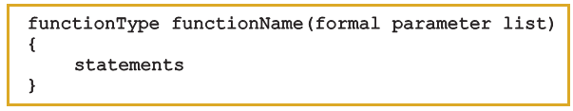
Syntax: Value-Returning Function
Syntax:
functionType is also called the data type or return type
C++ Programming: From Problem Analysis to Program Design, Sixth Edition

Slide 12
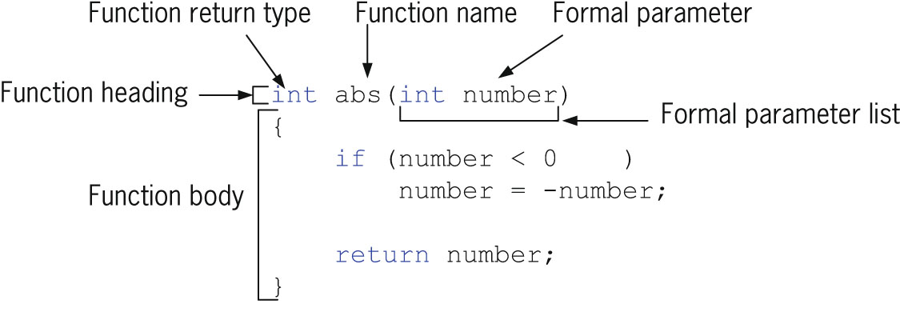

Syntax: Formal Parameter List
C++ Programming: From Problem Analysis to Program Design, Sixth Edition

Slide 13

Function Call
Syntax to call a value-returning function:
C++ Programming: From Problem Analysis to Program Design, Sixth Edition

Slide 14


Syntax: Actual Parameter List
Syntax of the actual parameter list:
Formal parameter list can be empty:
A call to a value-returning function with an empty formal parameter list is:
C++ Programming: From Problem Analysis to Program Design, Sixth Edition

Slide 15
return Statement
Function returns its value via the return statement
  It passes this value outside the function
C++ Programming: From Problem Analysis to Program Design, Sixth Edition

Slide 16

Syntax: return Statement
Syntax:
In C++, return is a reserved word
When a return statement executes
  Function immediately terminates
  Control goes back to the caller
When a return statement executes in the function main, the program terminates
C++ Programming: From Problem Analysis to Program Design, Sixth Edition

Slide 17
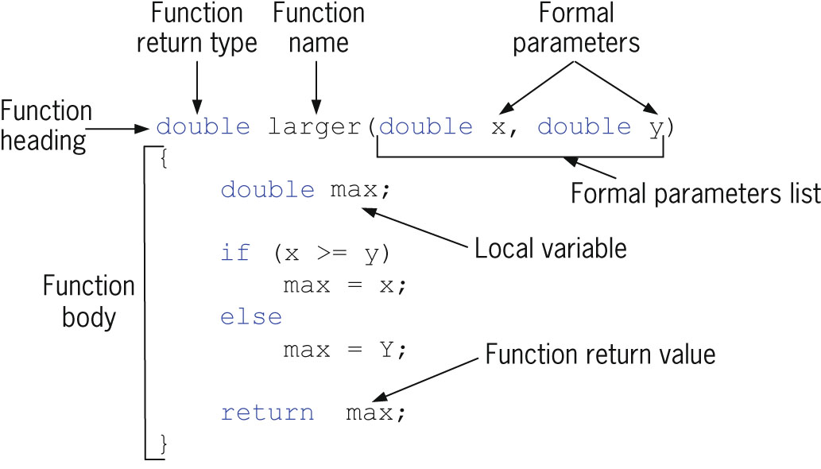
Syntax: return Statement (cont’d.)
C++ Programming: From Problem Analysis to Program Design, Sixth Edition

Slide 18

Function Prototype
Function prototype: function heading without the body of the function
Syntax:
Not necessary to specify the variable name in the parameter list
Data type of each parameter must be specified
C++ Programming: From Problem Analysis to Program Design, Sixth Edition

Slide 19

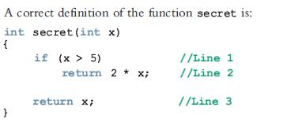
Value-Returning Functions: Some Peculiarities
C++ Programming: From Problem Analysis to Program Design, Sixth Edition

Slide 20
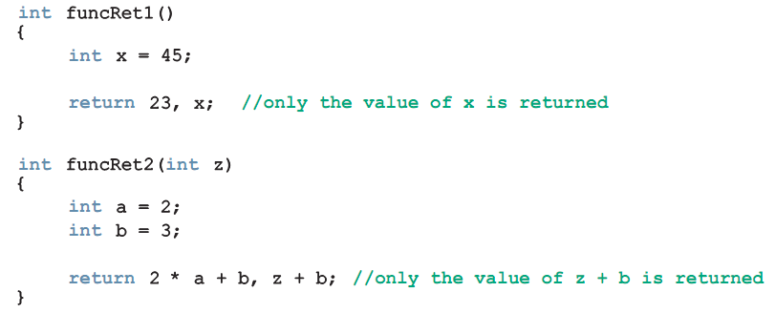
Value-Returning Functions: Some Peculiarities (cont’d.)
C++ Programming: From Problem Analysis to Program Design, Sixth Edition

Slide 21
Flow of Execution
Execution always begins at the first statement in the function main
Other functions are executed only when called
Function prototypes appear before any function definition
  Compiler translates these first
Compiler can then correctly translate a function call
C++ Programming: From Problem Analysis to Program Design, Sixth Edition

Slide 22
Flow of Execution (cont’d.)
Function call transfers control to the first statement in the body of the called function
When the end of a called function is executed, control is passed back to the point immediately following the function call
  Function’s returned value replaces the function call statement
C++ Programming: From Problem Analysis to Program Design, Sixth Edition

Slide 23
Void Functions
User-defined void functions can be placed either before or after the function main
If user-defined void functions are placed after the function main
  The function prototype must be placed before the function main
Void function does not have a return type
  return statement without any value is typically used to exit the function early
C++ Programming: From Problem Analysis to Program Design, Sixth Edition

Slide 24
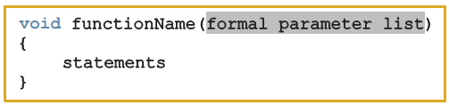
Void Functions (cont’d.)
Formal parameters are optional
A call to a void function is a stand-alone statement
Void function definition syntax:
C++ Programming: From Problem Analysis to Program Design, Sixth Edition

Slide 25

Void Functions (cont’d.)
Formal parameter list syntax:
Function call syntax:
Actual parameter list syntax:
C++ Programming: From Problem Analysis to Program Design, Sixth Edition

Slide 26
Void Functions (cont’d.)
Value parameter: a formal parameter that receives a copy of the content of corresponding actual parameter
Reference parameter: a formal parameter that receives the location (memory address) of the corresponding actual parameter
C++ Programming: From Problem Analysis to Program Design, Sixth Edition

Slide 27
Value Parameters
If a formal parameter is a value parameter:
  The value of the corresponding actual parameter is copied into it
  Formal parameter has its own copy of the data
During program execution
  Formal parameter manipulates the data stored in its own memory space
C++ Programming: From Problem Analysis to Program Design, Sixth Edition

Slide 28
Reference Variables as Parameters
If a formal parameter is a reference parameter
  It receives the memory address of the corresponding actual parameter
During program execution to manipulate data
  Changes to formal parameter will change the corresponding actual parameter
C++ Programming: From Problem Analysis to Program Design, Sixth Edition

Slide 29
Reference Variables as Parameters (cont'd.)
Reference parameters are useful in three situations:
  Returning more than one value
  Changing the actual parameter
  When passing the address would save memory space and time
C++ Programming: From Problem Analysis to Program Design, Sixth Edition

Slide 30
Value and Reference Parameters and Memory Allocation
When a function is called
  Memory for its formal parameters and its local variables is allocated in the function data area
For a value parameter, the actual parameter’s value is copied into the formal parameter’s memory cell
  Changes to the formal parameter do not affect the actual parameter’s value
C++ Programming: From Problem Analysis to Program Design, Sixth Edition

Slide 31
Value and Reference Parameters and Memory Allocation (cont’d.)
For a reference parameter, the actual parameter’s address passes to the formal parameter
  Both formal and actual parameters refer to the same memory location
  During execution, changes made to the formal parameter’s value permanently change the actual parameter’s value
C++ Programming: From Problem Analysis to Program Design, Sixth Edition

Slide 32
Reference Parameters and Value-Returning Functions
Can also use reference parameters in a value-returning function
  Not recommended
By definition, a value-returning function returns a single value via return statement
If a function needs to return more than one value, change it to a void function and use reference parameters to return the values
C++ Programming: From Problem Analysis to Program Design, Sixth Edition

Slide 33
Scope of an Identifier
Scope of an identifier: where in the program the identifier is accessible
Local identifier: identifiers declared within a function (or block)
Global identifier: identifiers declared outside of every function definition
C++ does not allow nested functions
  Definition of one function cannot be included in the body of another function
C++ Programming: From Problem Analysis to Program Design, Sixth Edition

Slide 34
Scope of an Identifier (cont’d.)
Rules when an identifier is accessed:
  Global identifiers are accessible by a function or block if:
    Declared before function definition
    Function name different from identifier
    Parameters to the function have different names
    All local identifiers have different names
C++ Programming: From Problem Analysis to Program Design, Sixth Edition

Slide 35
Scope of an Identifier (cont’d.)
Rules when an identifier is accessed (cont’d.):
  Nested block
    Identifier accessible from declaration to end of block in which it is declared
    Within nested blocks if no identifier with same name exists
  Scope of function name similar to scope of identifier declared outside any block
    i.e., function name scope = global variable scope
C++ Programming: From Problem Analysis to Program Design, Sixth Edition

Slide 36
Scope of an Identifier (cont’d.)
Some compilers initialize global variables to default values
Scope resolution operator in C++ is ::
By using the scope resolution operator
  A global variable declared before the definition of a function (or block) can be accessed by the function (or block)
  Even if the function (or block) has an identifier with the same name as the global variable
C++ Programming: From Problem Analysis to Program Design, Sixth Edition

Slide 37
Scope of an Identifier (cont’d.)
To access a global variable declared after the definition of a function, the function must not contain any identifier with the same name
  Reserved word extern indicates that a global variable has been declared elsewhere
C++ Programming: From Problem Analysis to Program Design, Sixth Edition

Slide 38
Global Variables, Named Constants, and Side Effects
Using global variables causes side effects
A function that uses global variables is not independent
If more than one function uses the same global variable:
  Can be difficult to debug problems with it
  Problems caused in one area of the program may appear to be from another area
Global named constants have no side effects
C++ Programming: From Problem Analysis to Program Design, Sixth Edition

Slide 39
Static and Automatic Variables
Automatic variable: memory is allocated at block entry and deallocated at block exit
  By default, variables declared within a block are automatic variables
Static variable: memory remains allocated as long as the program executes
  Global variables declared outside of any block are static variables
C++ Programming: From Problem Analysis to Program Design, Sixth Edition

Slide 40

Static and Automatic Variables (cont’d.)
Can declare a static variable within a block by using the reserved word static
Syntax:
Static variables declared within a block are local to the block
  Have same scope as any other local identifier in that block
C++ Programming: From Problem Analysis to Program Design, Sixth Edition

Slide 41
Debugging:
Using Drivers and Stubs
Driver program: separate program used to test a function
When results calculated by one function are needed in another function, use a function stub
Function stub: a function that is not fully coded
C++ Programming: From Problem Analysis to Program Design, Sixth Edition

Slide 42
Function Overloading:
An Introduction
In a C++ program, several functions can have the same name
Function overloading: creating several functions with the same name
Function signature: the name and formal parameter list of the function
  Does not include the return type of the function
C++ Programming: From Problem Analysis to Program Design, Sixth Edition

Slide 43
Function Overloading (cont’d.)
Two functions are said to have different formal parameter lists if both functions have either:
  A different number of formal parameters
  If the number of formal parameters is the same, but the data type of the formal parameters differs in at least one position
Overloaded functions must have different function signatures
C++ Programming: From Problem Analysis to Program Design, Sixth Edition

Slide 44
Function Overloading (cont’d.)
The parameter list supplied in a call to an overloaded function determines which function is executed
C++ Programming: From Problem Analysis to Program Design, Sixth Edition

Slide 45
Functions with Default Parameters
In a function call, the number of actual and formal parameters must be the same
  C++ relaxes this condition for functions with default parameters
Can specify the value of a default parameter in the function prototype
If you do not specify the value for a default parameter when calling the function, the default value is used
C++ Programming: From Problem Analysis to Program Design, Sixth Edition

Slide 46
Functions with Default Parameters (cont’d.)
All default parameters must be the rightmost parameters of the function
If a default parameter value is not specified:
  You must omit all of the arguments to its right
Default values can be constants, global variables, or function calls
Cannot assign a constant value as a default value to a reference parameter
C++ Programming: From Problem Analysis to Program Design, Sixth Edition

Slide 47
Summary
Functions (modules) divide a program into manageable tasks
C++ provides standard, predefined functions
Two types of user-defined functions: value-returning functions and void functions
Variables defined in a function heading are called formal parameters
Expressions, variables, or constant values in a function call are called actual parameters
C++ Programming: From Problem Analysis to Program Design, Sixth Edition

Slide 48
Summary (cont’d.)
Function heading and the body of the function are called the definition of the function
A value-returning function returns its value via the return statement
A prototype is the function heading without the body of the function
User-defined functions execute only when they are called
Void functions do not have a data type
C++ Programming: From Problem Analysis to Program Design, Sixth Edition

Slide 49
Summary (cont’d.)
Two types of formal parameters:
  A value parameter receives a copy of its corresponding actual parameter
  A reference parameter receives the memory address of its corresponding actual parameter
Variables declared within a function (or block) are called local variables
Variables declared outside of every function definition (and block) are global variables
C++ Programming: From Problem Analysis to Program Design, Sixth Edition

Slide 50
Summary (cont’d.)
Automatic variable: variable for which memory is allocated on function/block entry and deallocated on function/block exit
Static variable: memory remains allocated throughout the execution of the program
C++ functions can have default parameters
C++ Programming: From Problem Analysis to Program Design, Sixth Edition

