Slide 1
Chapter 8
Arrays and Strings

Slide 2
Objectives
In this chapter, you will:
  Learn about arrays
  Declare and manipulate data into arrays
  Learn about “array index out of bounds”
  Learn about the restrictions on array processing
  Pass an array as a parameter to a function
  Search and sort an array
C++ Programming: From Problem Analysis to Program Design, Sixth Edition

Slide 3
Objectives (cont’d.)
In this chapter, you will (cont’d.):
  Learn about C-strings
  Use string functions to process C-strings
  Input data into—and output data from—a C-string
  Learn about parallel arrays
  Manipulate data in a two-dimensional array
  Learn about multidimensional arrays
C++ Programming: From Problem Analysis to Program Design, Sixth Edition

Slide 4
Introduction
Simple data type: variables of these types can store only one value at a time
Structured data type: a data type in which each data item is a collection of other data items
C++ Programming: From Problem Analysis to Program Design, Sixth Edition

Slide 5

Arrays
Array: a collection of a fixed number of components, all of the same data type
One-dimensional array: components are arranged in a list form
Syntax for declaring a one-dimensional array:
intExp: any constant expression that evaluates to a positive integer
C++ Programming: From Problem Analysis to Program Design, Sixth Edition

Slide 6

Accessing Array Components
General syntax:
indexExp: called the index
  An expression with a nonnegative integer value
Value of the index is the position of the item in the array
[]: array subscripting operator
  Array index always starts at 0
C++ Programming: From Problem Analysis to Program Design, Sixth Edition

Slide 7


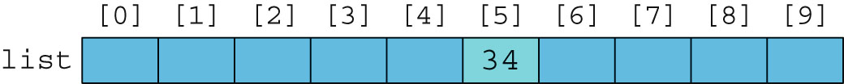
Accessing Array Components (cont’d.)
C++ Programming: From Problem Analysis to Program Design, Sixth Edition

Slide 8

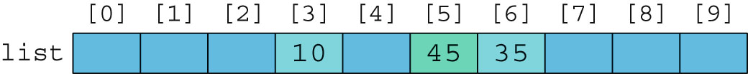
Accessing Array Components (cont’d.)
C++ Programming: From Problem Analysis to Program Design, Sixth Edition

Slide 9
Processing One-Dimensional Arrays
Basic operations on a one-dimensional array:
  Initializing
  Inputting data
  Outputting data stored in an array
  Finding the largest and/or smallest element
Each operation requires ability to step through elements of the array
  Easily accomplished by a loop
C++ Programming: From Problem Analysis to Program Design, Sixth Edition

Slide 10
Processing One-Dimensional Arrays (cont’d.)
Given the declaration:
  int list[100]; //array of size 100
  int i;
Use a for loop to access array elements:
  for (i = 0; i < 100; i++) //Line 1
  cin >> list[i]; //Line 2
C++ Programming: From Problem Analysis to Program Design, Sixth Edition

Slide 11
Array Index Out of Bounds
Index of an array is in bounds if the index is >=0 and <= ARRAY_SIZE-1
  Otherwise, the index is out of bounds
In C++, there is no guard against indices that are out of bounds
C++ Programming: From Problem Analysis to Program Design, Sixth Edition

Slide 12
Array Initialization During Declaration
Arrays can be initialized during declaration
  Values are placed between curly braces
  Size determined by the number of initial values in the braces
Example:
  double sales[] = {12.25, 32.50, 16.90, 23, 45.68};
C++ Programming: From Problem Analysis to Program Design, Sixth Edition

Slide 13
Partial Initialization of Arrays During Declaration
The statement:
  int list[10] = {0};
  Declares an array of 10 components and initializes all of them to zero
The statement:
  int list[10] = {8, 5, 12};
  Declares an array of 10 components and initializes list[0] to 8, list[1] to 5, list[2] to 12
  All other components are initialized to 0
C++ Programming: From Problem Analysis to Program Design, Sixth Edition

Slide 14

Some Restrictions on Array Processing
Aggregate operation: any operation that manipulates the entire array as a single unit
  Not allowed on arrays in C++
Example:
Solution:
C++ Programming: From Problem Analysis to Program Design, Sixth Edition

Slide 15
Arrays as Parameters to Functions
Arrays are passed by reference only
Do not use symbol & when declaring an array as a formal parameter
Size of the array is usually omitted
  If provided, it is ignored by the compiler
Example:
C++ Programming: From Problem Analysis to Program Design, Sixth Edition

Slide 16
Constant Arrays as Formal Parameters
Can prevent a function from changing the actual parameter when passed by reference
  Use const in the declaration of the formal parameter
Example:
C++ Programming: From Problem Analysis to Program Design, Sixth Edition

Slide 17
Base Address of an Array and Array in Computer Memory
Base address of an array: address (memory location) of the first array component
Example:
  If list is a one-dimensional array, its base address is the address of list[0]
When an array is passed as a parameter, the base address of the actual array is passed to the formal parameter
C++ Programming: From Problem Analysis to Program Design, Sixth Edition

Slide 18
Functions Cannot Return a Value of the Type Array
C++ does not allow functions to return a value of type array
C++ Programming: From Problem Analysis to Program Design, Sixth Edition

Slide 19
Integral Data Type and Array Indices
C++ allows any integral type to be used as an array index
  Improves code readability
Example:
C++ Programming: From Problem Analysis to Program Design, Sixth Edition

Slide 20

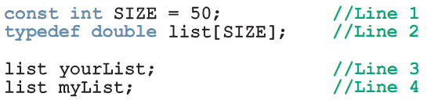
Other Ways to Declare Arrays
Examples:
C++ Programming: From Problem Analysis to Program Design, Sixth Edition

Slide 21
Searching an Array for a Specific Item
Sequential search (or linear search):
  Searching a list for a given item, starting from the first array element
  Compare each element in the array with value being searched for
  Continue the search until item is found or no more data is left in the list
C++ Programming: From Problem Analysis to Program Design, Sixth Edition

Slide 22
Selection Sort
Selection sort: rearrange the list by selecting an element and moving it to its proper position
Steps:
  Find the smallest element in the unsorted portion of the list
  Move it to the top of the unsorted portion by swapping with the element currently there
  Start again with the rest of the list
C++ Programming: From Problem Analysis to Program Design, Sixth Edition

Slide 23
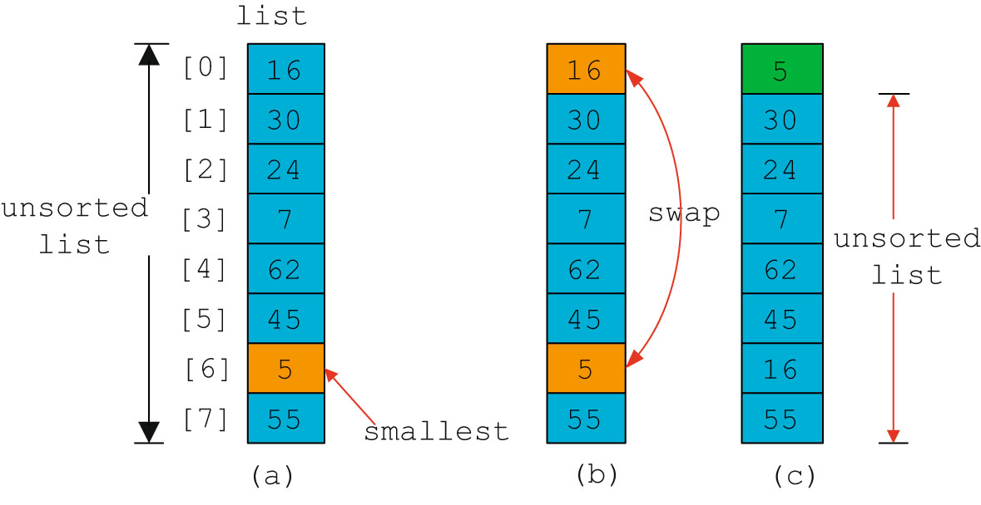
Selection Sort (cont’d.)
C++ Programming: From Problem Analysis to Program Design, Sixth Edition

Slide 24
C-Strings (Character Arrays)
Character array: an array whose components are of type char
C-strings are null-terminated ('\0‘) character arrays
Example:
  'A' is the character A
  "A" is the C-string A
  "A" represents two characters, 'A' and '\0‘
C++ Programming: From Problem Analysis to Program Design, Sixth Edition

Slide 25
C-Strings (Character Arrays) (cont’d.)
Example:
char name[16];
Since C-strings are null terminated and name has 16 components, the largest string it can store has 15 characters
If you store a string whose length is less than the array size, the last components are unused
C++ Programming: From Problem Analysis to Program Design, Sixth Edition

Slide 26
C-Strings (Character Arrays) (cont’d.)
Size of an array can be omitted if the array is initialized during declaration
Example:
char name[] = "John";
  Declares an array of length 5 and stores the C-string "John" in it
Useful string manipulation functions
  strcpy, strcmp, and strlen
C++ Programming: From Problem Analysis to Program Design, Sixth Edition

Slide 27
String Comparison
C-strings are compared character by character using the collating sequence of the system
  Use the function strcmp
If using the ASCII character set:
  "Air" < "Boat"
  "Air" < "An"
  "Bill" < "Billy"
  "Hello" < "hello"
C++ Programming: From Problem Analysis to Program Design, Sixth Edition

Slide 28
Reading and Writing Strings
Most rules for arrays also apply to C-strings (which are character arrays)
Aggregate operations, such as assignment and comparison, are not allowed on arrays
C++ does allow aggregate operations for the input and output of C-strings
C++ Programming: From Problem Analysis to Program Design, Sixth Edition

Slide 29
String Input
Example:
cin >> name;
  Stores the next input C-string into name
To read strings with blanks, use get function:
cin.get(str, m+1);
  Stores the next m characters into str but the newline character is not stored in str
  If input string has fewer than m characters, reading stops at the newline character
C++ Programming: From Problem Analysis to Program Design, Sixth Edition

Slide 30
String Output
Example:
cout << name;
  Outputs the content of name on the screen
  << continues to write the contents of name until it finds the null character
  If name does not contain the null character, then strange output may occur
    << continues to output data from memory adjacent to name until a '\0' is found
C++ Programming: From Problem Analysis to Program Design, Sixth Edition

Slide 31
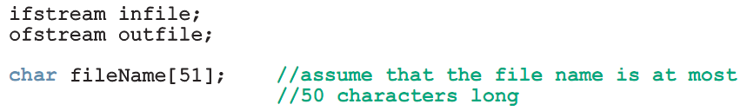
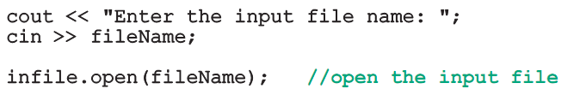
Specifying Input/Output Files at Execution Time
User can specify the name of an input and/or output file at execution time:
C++ Programming: From Problem Analysis to Program Design, Sixth Edition

Slide 32
string Type and Input/Output Files
Argument to the open function must be a null-terminated string (a C-string)
  If using a string variable for the name of an I/O file, the value must first be converted to a C-string before calling open
  Use the c_str function to convert
Syntax:
strVar.c_str()
  Where strVar is a variable of type string
C++ Programming: From Problem Analysis to Program Design, Sixth Edition

Slide 33
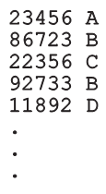
Parallel Arrays
Two (or more) arrays are called parallel if their corresponding components hold related information
Example:
  int studentId[50];
  char courseGrade[50];
C++ Programming: From Problem Analysis to Program Design, Sixth Edition

Slide 34

Two- and Multidimensional Arrays
Two-dimensional array: collection of a fixed number of components (of the same type) arranged in two dimensions
  Sometimes called matrices or tables
Declaration syntax:
  intExp1 and intExp2 are expressions with positive integer values specifying the number of rows and columns in the array
C++ Programming: From Problem Analysis to Program Design, Sixth Edition

Slide 35

Accessing Array Components
Accessing components in a two-dimensional array:
  Where indexExp1 and indexExp2 are expressions with positive integer values, and specify the row and column position
Example:
sales[5][3] = 25.75;
C++ Programming: From Problem Analysis to Program Design, Sixth Edition

Slide 36
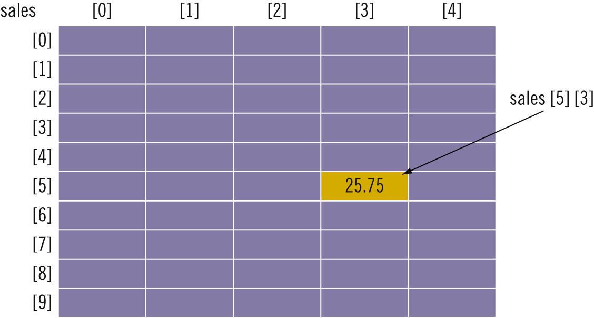
Accessing Array Components (cont’d.)
C++ Programming: From Problem Analysis to Program Design, Sixth Edition

Slide 37
Two-Dimensional Array Initialization During Declaration
Two-dimensional arrays can be initialized when they are declared:
  Elements of each row are enclosed within braces and separated by commas
  All rows are enclosed within braces
  For number arrays, unspecified elements are set to 0
C++ Programming: From Problem Analysis to Program Design, Sixth Edition

Slide 38
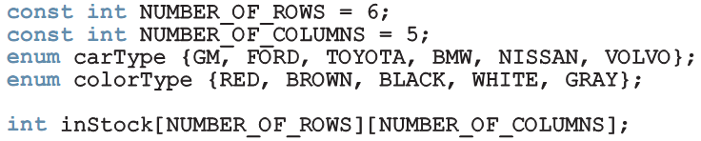

Two-Dimensional Arrays and Enumeration Types
Enumeration types can be used for array indices:
C++ Programming: From Problem Analysis to Program Design, Sixth Edition

Slide 39
Processing Two-Dimensional Arrays
Ways to process a two-dimensional array:
  Process entire array
  Row processing: process a single row at a time
  Column processing: process a single column at a time
Each row and each column of a two-dimensional array is a one-dimensional array
  To process, use algorithms similar to processing one-dimensional arrays
C++ Programming: From Problem Analysis to Program Design, Sixth Edition

Slide 40


Initialization
Examples:
  To initialize row number 4 (fifth row) to 0:
  To initialize the entire matrix to 0:
C++ Programming: From Problem Analysis to Program Design, Sixth Edition

Slide 41
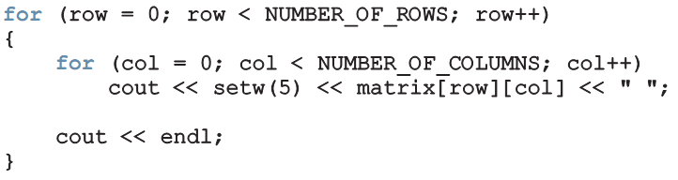
Print
Use a nested loop to output the components of a two dimensional array:
C++ Programming: From Problem Analysis to Program Design, Sixth Edition

Slide 42


Input
Examples:
  To input into row number 4 (fifth row):
  To input data into each component of matrix:
C++ Programming: From Problem Analysis to Program Design, Sixth Edition

Slide 43
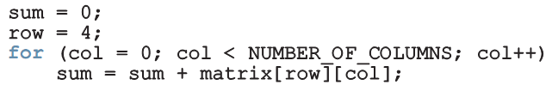
Sum by Row
Example:
  To find the sum of row number 4:
C++ Programming: From Problem Analysis to Program Design, Sixth Edition

Slide 44
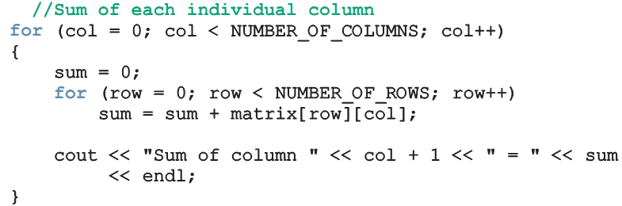
Sum by Column
Example:
  To find the sum of each individual column:
C++ Programming: From Problem Analysis to Program Design, Sixth Edition

Slide 45
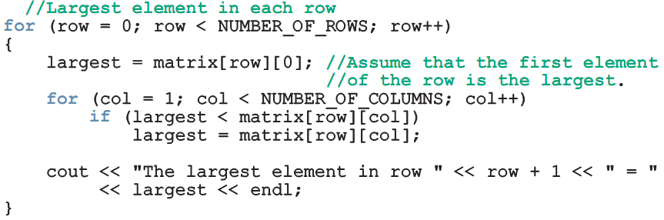
Largest Element in Each Row and Each Column
Example:
  To find the largest element in each row:
C++ Programming: From Problem Analysis to Program Design, Sixth Edition

Slide 46
Passing Two-Dimensional Arrays as Parameters to Functions
Two-dimensional arrays are passed by reference as parameters to a function
  Base address is passed to formal parameter
Two-dimensional arrays are stored in row order
When declaring a two-dimensional array as a formal parameter, can omit size of first dimension, but not the second
C++ Programming: From Problem Analysis to Program Design, Sixth Edition

Slide 47
Arrays of Strings
Strings in C++ can be manipulated using either the data type string or character arrays (C-strings)
On some compilers, the data type string may not be available in Standard C++ (i.e., non-ANSI/ISO Standard C++)
C++ Programming: From Problem Analysis to Program Design, Sixth Edition

Slide 48
Arrays of Strings and the string Type
To declare an array of 100 components of type string:
  string list[100];
Basic operations, such as assignment, comparison, and input/output, can be performed on values of the string type
The data in list can be processed just like any one-dimensional array
C++ Programming: From Problem Analysis to Program Design, Sixth Edition

Slide 49
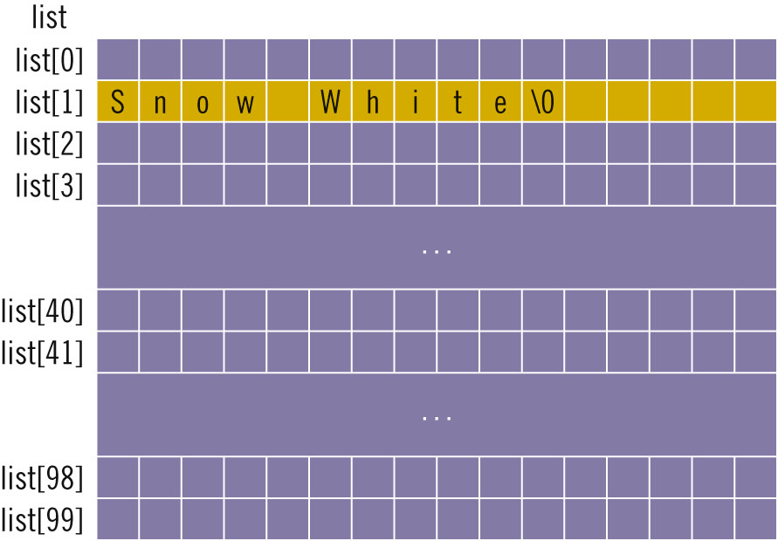
Arrays of Strings and C-Strings (Character Arrays)
C++ Programming: From Problem Analysis to Program Design, Sixth Edition

Slide 50
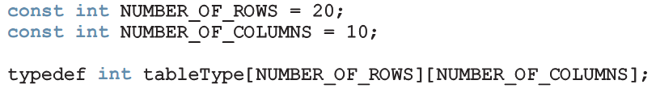

Another Way to Declare a Two-Dimensional Array
Can use typedef to define a two-dimensional array data type:
To declare an array of 20 rows and 10 columns:
C++ Programming: From Problem Analysis to Program Design, Sixth Edition

Slide 51
Multidimensional Arrays
n-dimensional array: collection of a fixed number of elements arranged in n dimensions (n >= 1)
Declaration syntax:
To access a component:
C++ Programming: From Problem Analysis to Program Design, Sixth Edition

Slide 52
Summary
Array: structured data type with a fixed number of components of the same type
  Components are accessed using their relative positions in the array
Elements of a one-dimensional array are arranged in the form of a list
An array index can be any expression that evaluates to a nonnegative integer
  Must always be less than the size of the array
C++ Programming: From Problem Analysis to Program Design, Sixth Edition

Slide 53
Summary (cont’d.)
The base address of an array is the address of the first array component
When passing an array as an actual parameter, use only its name
  Passed by reference only
A function cannot return an array type value
In C++, C-strings are null terminated and are stored in character arrays
C++ Programming: From Problem Analysis to Program Design, Sixth Edition

Slide 54
Summary (cont’d.)
Commonly used C-string manipulation functions include:
  strcpy, strcmp, and strlen
Parallel arrays are used to hold related information
In a two-dimensional array, the elements are arranged in a table form
C++ Programming: From Problem Analysis to Program Design, Sixth Edition

Slide 55
Summary (cont’d.)
To access an element of a two-dimensional array, you need a pair of indices:
  One for row position, one for column position
In row processing, a two-dimensional array is processed one row at a time
In column processing, a two-dimensional array is processed one column at a time
C++ Programming: From Problem Analysis to Program Design, Sixth Edition

