Slide 1
Data Science Project
Predicting the outcome of soccer games

Slide 2
Result Prediction
1. Change GET /soccerGames to /soccerGamesResults
2. Change finalResult to predictedFinalResult in the json file
3 Add in the JSON file originalFinalResult

Slide 3
Goals Prediction
1. Create GET /soccerGamesGoals
2. Create the JSON file contains:
dateMatch, homeTeam, awayTeam
predictedFinalGoals in the format (homegoals – awaygoals) (same string)
originalFinalGoals
Note: I assume that you will keep having the attributes in SoccerGames as in the privous JSON file. Please let me know if you want to change that.

Slide 4
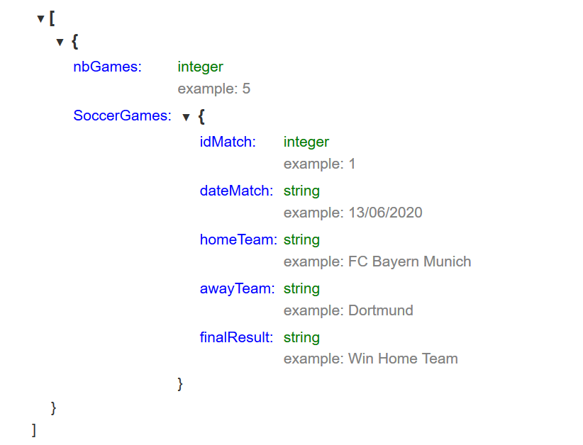
Old Version as a reminder
GET the list of predicted soccer games: GET /soccerGamesResults in a JSON format.

Slide 5
Fetching and Retrain Model Button
GET /retrainClassification (for results)
STRING: okay
GET /retrainRegression (for goals)
STRING: okay

