Slide 1
Data Science Project
Predicting the outcome of soccer games
Sprint Review

Slide 2
This Sprint
Read Raschka book (Python Machine Learning).
Read the report of the previous semester.
Understanding the different algorithms of ML.
Making familiar with the working environment and the existing code.

Slide 3
This Sprint
Adding more statistical tools
Select the best model
Implement the frontend
Implement simple backend

Slide 4
Model
Adding more statistical tools (Accuracy, Loss, Mean Absolute Error, Mean Absolute Percentage Error and Mean Square Error)
Select the best model (model02_H3_M)
Option 2: 21 features
3 Hidden Layers + Dropout
Medium Amount of Neurons: 12 Neurons in each hidden layer
Test set (10%), Training set (80% of the remaining 90%) and Validation set (20% of the remaining 90%).
Loss: 0.968027185310017
Test Accuracy: 0.5411932
Mean Square Error: 1.4485668
Mean Absolute Error: 1.0269886
Mean Absolute Percentage Error: 99905360.0

Slide 5





Web Architecture
Web App
Front-end
HTML
JS
CSS
RESTful API (GET only)
Application code, Web services Python (Flask)
Database
(SQLite)
Trained Model (.h5 file)

Slide 6
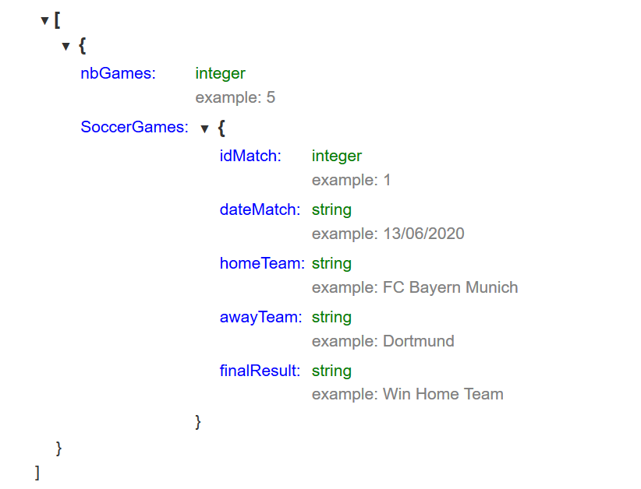
REST API Definition
GET the list of predicted soccer games: GET /soccerGames in a JSON format.

Slide 7
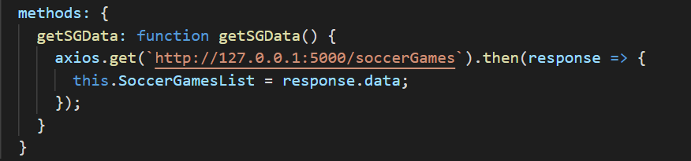
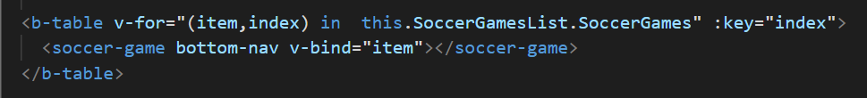
Frontend Implementation
- Get the list of predicted soccer games from the backend:
- Output the list of soccer games:

Slide 8
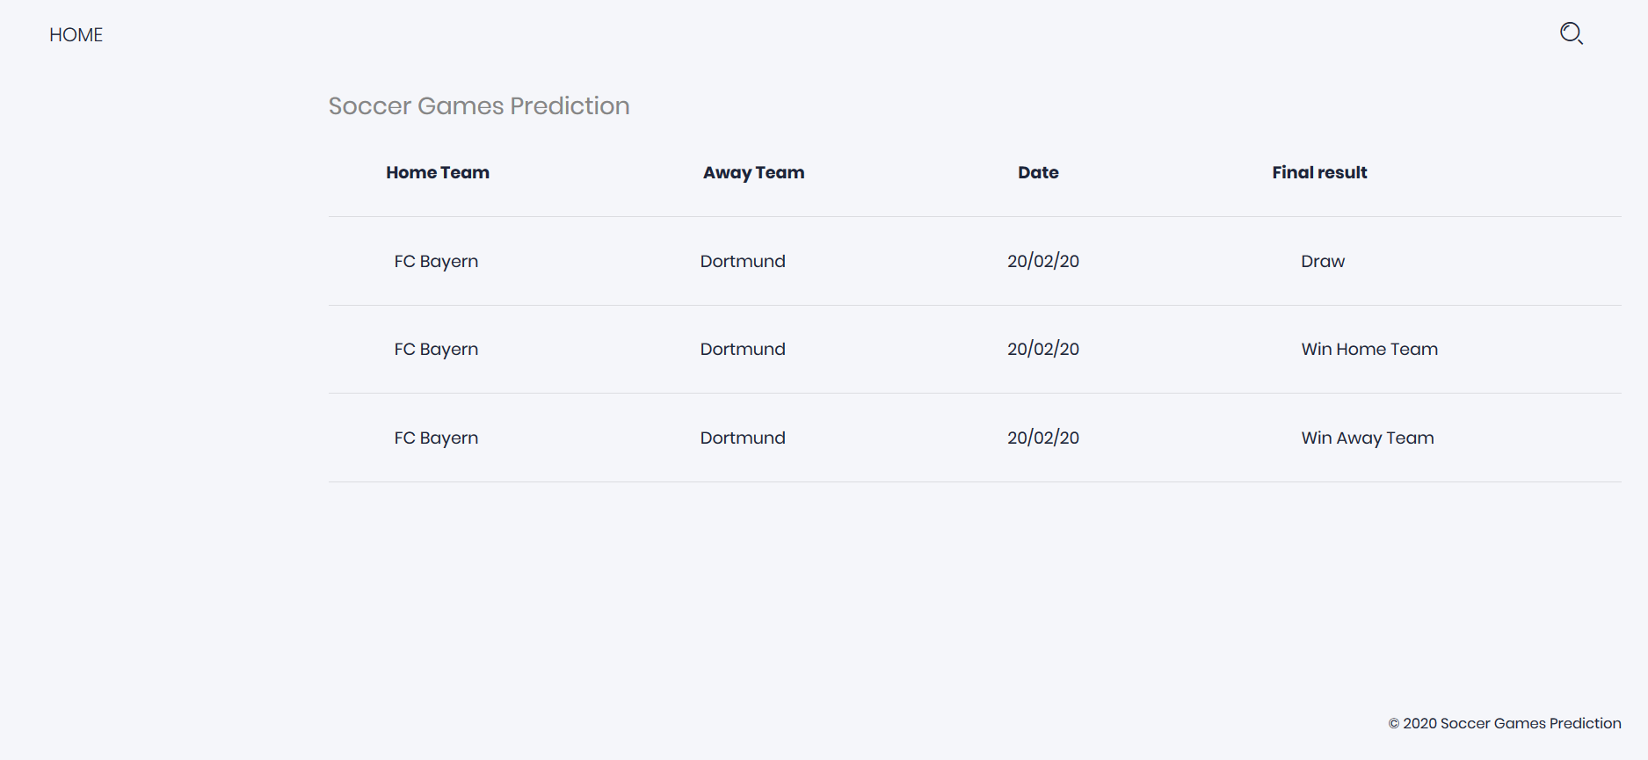
Frontend Web Page

Slide 9
Next Sprint
Implementation of the backend (Model, Static Matches)
Integrate the model in the backend.
Regression: Predict the goals scored by each team
Research and implement models.

