Slide 1
Data Science Project
Predicting the outcome of soccer games

Slide 2
API changes
1. Split GET /soccerGames to
GET /soccerMatchesClassification and
GET /soccerMatchesRegression
Each will get its own page in the frontend
2. Split finalResult in JSON to
predictedResult<string> and
actualResult<string>
Depending on which /soccerMatches[…] will be called, predictedResult will change accordingly
3. Add GET /retrainClassification and GET /retrainRegression
Requires new Buttons “Retrain” on each corresponding page in frontend
OR we just add one button “Retrain” that activates both?
Either way, the button needs to “wait” until backend sends “ok”
4. Add GET /fetchNewMatches
Requires new Button “Fetch new matches” in frontend, that waits until backend sends “ok”
Automatically predicts games prior to adding to database

Slide 3
Possible API calls
GET /soccerGamesClassification
Returns Matchlist as stated on next slide
GET /soccerGamesRegression
Returns Matchlist as stated on next slide
GET /retrainClassification
Returns “ok”
(maybe refresh page and update from /soccerGamesClassification)
GET /retrainRegression
Returns “ok”
(maybe refresh page and update from /soccerGamesRegression)
GET /fetchNewMatches
Returns “ok”

Slide 4
GET /soccerMatches[…] JSON
{
“SoccerMatches”: [
“date”: <string>
“homeTeam”: <string>
“awayTeam”: <string>
“predictedResult”: <string>
Either “[D|H|A]” e.g. “H” for classification
Or “<homegoals>:<awaygoals>” e.g. “3:2” for regression
“actualResult”: <string>
]
}

Slide 5
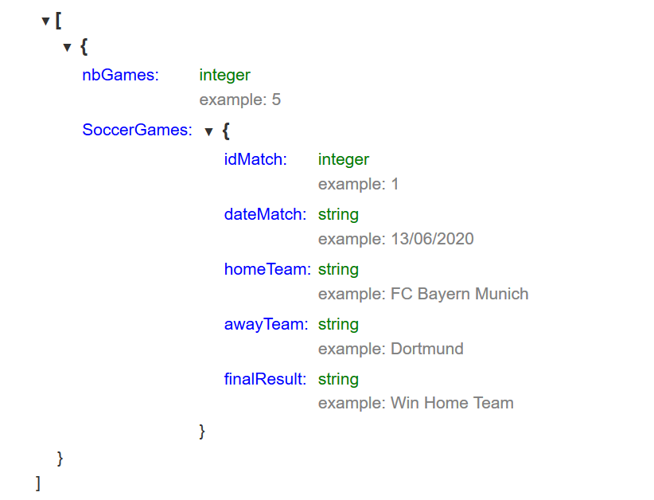
Old Version as a reminder
GET the list of predicted soccer games: GET /soccerGamesResults in a JSON format.

Slide 6
Future ideas
Add error field in frontend, so if one of the API-calls doesn’t work, you get an error displayed instead of just nothing

