Slide 1
Data Science Project
Predicting the outcome of soccer games

Slide 2
Agenda
Data Set
Techniques
Actual State
Outlook
Notes:
All

Slide 3
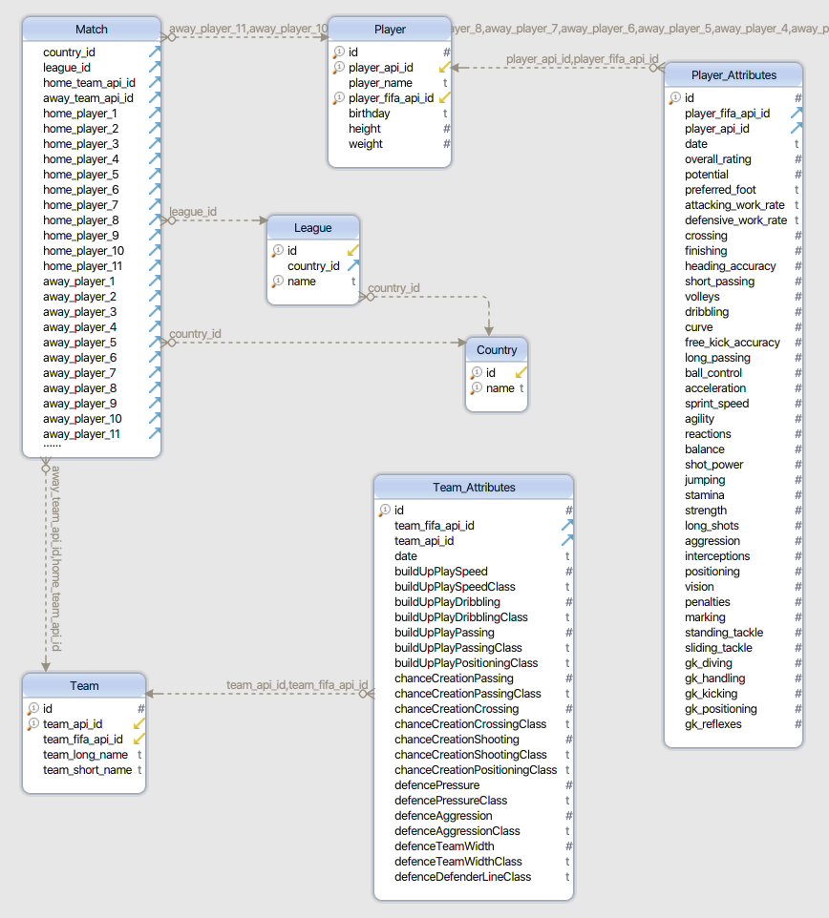
Data Set

Slide 4
Techniques
Python
TensorFlow
Scrum
Git

Slide 5
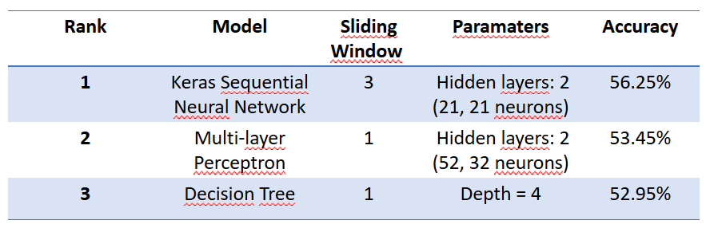
Actual State

Slide 6
Outlook
•Test different parameters (activation functions, optimizers)
•Test different modeling techniques: Logistic Regression
•Test different features

Slide 7
Thank you for your attention!

